Slide 1
Tishk International University
FACULTY OF PHARMACY
Department of Pharmacognosy
Oil and remedies for health beauty and home
A R O M A t h e r a p y
Grade 4- Spring semester
Dr. Omji Porwal

Slide 2
COMMON AROMATHERAPY MISTAKES
There aren’t that many hard and fast rules in the world of DIY aromatherapy.
There are some common-sense guidelines—don’t walk away from the stove when you’re melting beeswax, for example—but by and large, no one’s standing over you like an Olympic ice skating judge who saw every mistake you made on that triple toe-loop.
Even so, when beginning any new venture, mistakes are likely to be made. Familiarizing yourself ahead of time with some of the most common aromatherapy missteps can help you to avoid making them in the first (or at least second) place.

Slide 3
MISTAKE # 1: USING UNDILUTED OILS
Aromatherapy oils are so concentrated that they can irritate the skin, cause photosensitivity reactions, or build up in the body and lead to a sensitization response.
Always dilute essential oils.
If you get undiluted essential oils on your skin, wash them away with soap and water immediately.

Slide 4
MISTAKE #2: USING TOO MUCH ESSENTIAL OIL
Some people want their products to have a strong scent, so they use more essential oils than a recipe calls for.
While this may make the end product more fragrant, it might also irritate the skin or nasal passages.
It’s important to follow recipes exactly.
When you have gained experience and confidence with essential oils and are beginning to make your own recipes, the rule to follow is: Use no more than one drop of essential oil per teaspoon of carrier oil.

Slide 5
MISTAKE #3: USING POROUS MATERIALS FOR MIXING, MEASURING, AND POURING
Porous materials like plastic will absorb fragrance.
Once those aromas are there, they are there to stay, which can muddle the fragrances of future recipes made with the same objects.
If you use plastic stirrers, funnels, droppers, or pipettes, consider them single-use objects.
For mixing, use glass or metal bowls and stirring rods, and use metal funnels or dispose of plastic funnels after a single use.

Slide 6
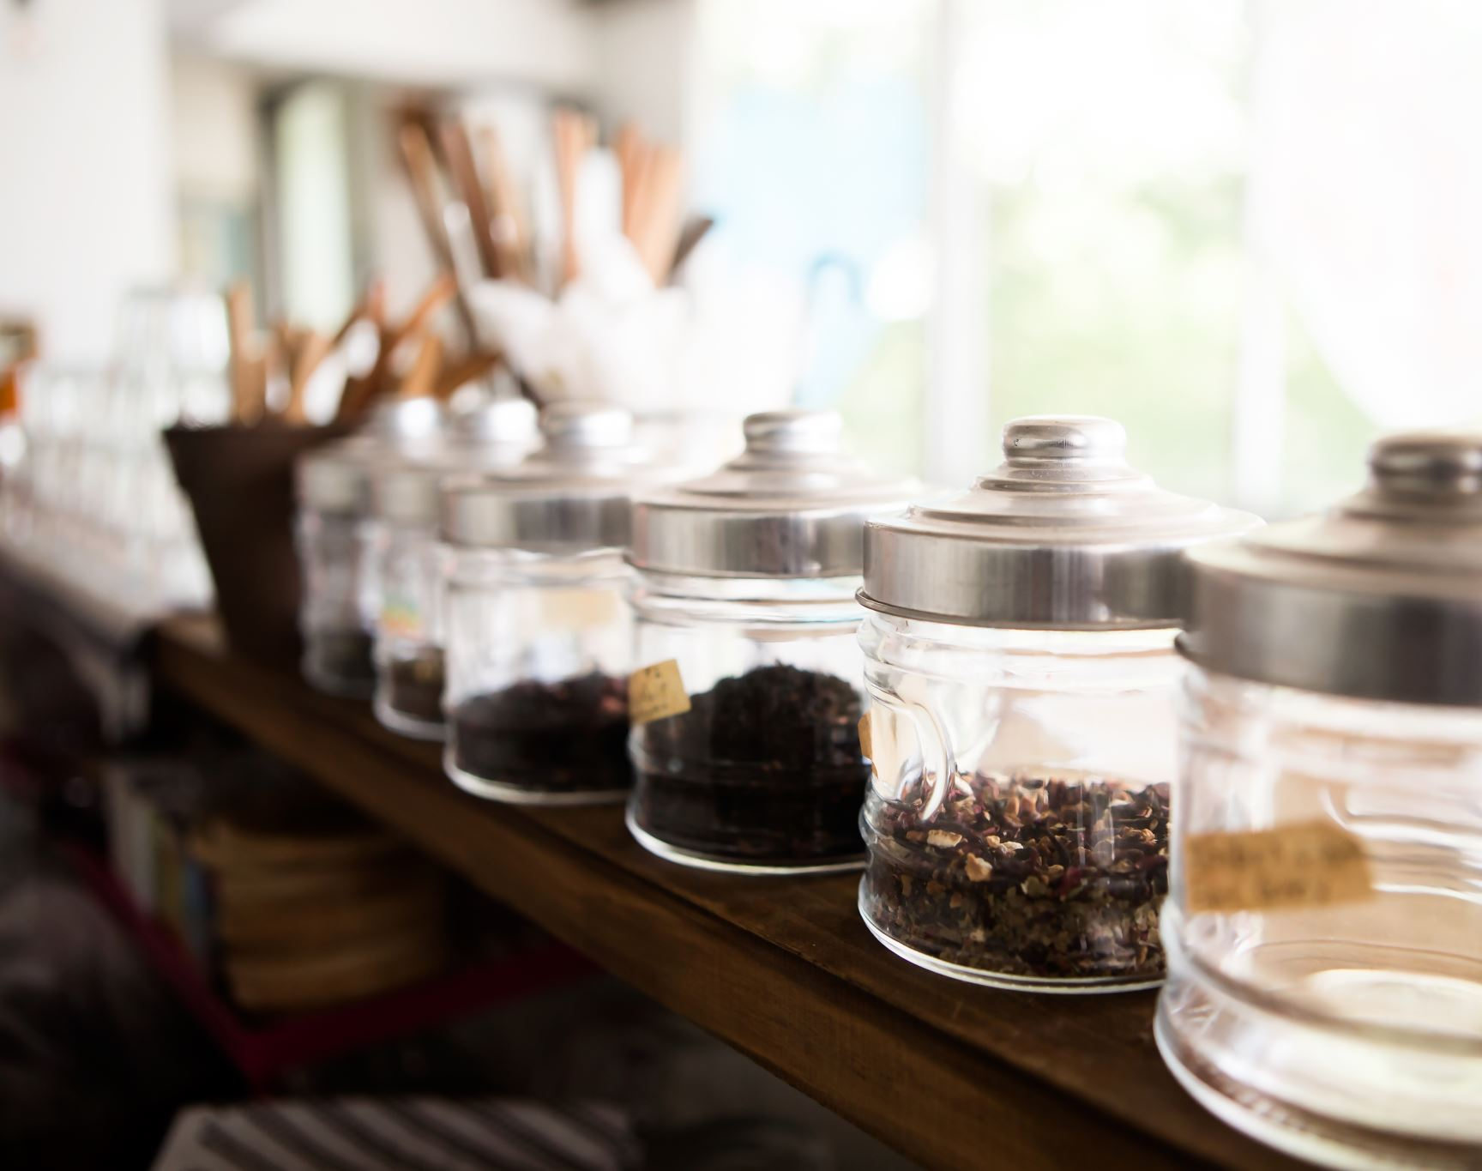
MISTAKE #4: STORING IMPROPERLY
Essential oils are volatile and break down over time. Most manufacturers put them in dark glass jars, which keeps the light out and preserves the oils.
Still, in order to preserve the oils for as long as possible, store the bottles tightly sealed in a cool, dry location away from a heat source or vibration both of which can break down the volatile compounds more quickly.

Slide 7
MISTAKE #5: BUYING TOO MANY OILS
Getting started with essential oils is exciting and fun, so it’s easy to get carried away.
Don’t purchase the biggest starter kit you can find, because it may be difficult to use all of those oils before they go bad.
Instead, buy a few commonly used starter oils such as lavender, peppermint, and lemon, and then add a few more as needed.
Check the oils after about six months and again after a year to ensure they remain fresh, and discard those with an off scent.

Slide 8
YOUR FIRST AROMATHERAPY BLENDS
You don’t have to buy an entire portfolio with hundreds of essential oils and carrier oils.
In fact, with just a few different oils, you can make some fun recipes that use just one or two oils and have powerful properties, smell great, and will whet your appetite for making aromatherapy a regular part of your life.
The three recipes in this chapter are your introduction to using some of the most popular essential oils.
Even if you’re extremely new to aromatherapy, the projects are easy, fun, and an affordable way to enter the wonderful world of aromatherapy.

Slide 9
FIVE OILS AND THREE BLENDS
Swiss Army knives are incredibly popular tools because of their versatility.
With a single tool, you can perform numerous functions.
Consider the five oils and three blends contained in this section as your Swiss Army knife of aromatherapy.
With them, you can create an array of products that work well and smell amazing.
Many manufacturers sell their essential oils in kits, and if you do some research, you’ll discover that these basic kits often contain the same five or six essential oils or blends.
The kits are a great way to save a little bit of money and get started with essential oil blends.
They typically use the same handful of oils or blends because these have powerful healing properties and are the most useful and versatile in aromatherapy work.
Your five go-to oils are listed below with brief descriptions, and one or more of them are included in the three starter projects that follow.

Slide 10
Eucalyptus essential oil works as an expectorant, and it has antibacterial and antiviral qualities.
It is also cooling and soothing.
Because of this, it is incredibly versatile, helping with an array of ailments such as the common cold, muscle aches and pains, and even as an insect repellent.
Lavender essential oil not only smells great with its classic floral scent but also has several properties including stress release and relaxation.
It’s useful to help people sleep, and it has antiseptic properties making it useful for treating illness and infection.
Lemon essential oil has a delicious sunny smell, and it has powerful antibacterial properties.
The citrusy smell can invigorate you and help focus your mind or soothe frayed nerves.

Slide 11
Peppermint essential oil has antispasmodic properties that can soothe an upset stomach.
It is also an antiseptic and anti-inflammatory substance, and the smell is invigorating and helps improve focus and concentration.
Tea tree essential oil is a workhorse around the house.
It stimulates the immune system. It has antimicrobial and antiseptic properties, and it boosts immune function.
It’s also great for fighting several common complaints including dandruff and athlete’s foot.
Now feel free to dive into your first aromatherapy project.
The options on the following pages include a lip balm, a disinfectant, and a candle.

Slide 12
Thanks

