Slide 1
Tishk International University
FACULTY OF PHARMACY
Department of Pharmacognosy
A R O M A t h e r a p y
Oil to know and use them-1
Grade 4- Spring semester
Prof. Dr. Omji Porwal

Slide 2
ESSENTIAL OIL DILUTIONS AND CONVERSIONS
If you aren’t familiar with the metric system, the way essential oils are packaged for sale can be baffling at first.
Even if you can convert ½ ounce into 15 milliliters in your head, how does that relate to drams and drops? And what does an ounce look like anyway? For aromatherapy recipes, crafters use drops, drams, milliliters, ounces, teaspoons, and tablespoons as measurements.
Here’s how they all relate: 20 drops = 1 milliliter (mL) 10 mL = ⅓ ounce 15 mL = ½ ounce 75 drops = 1 teaspoon = 1 dram 3 teaspoons = 1 tablespoon 2 tablespoons = 1 ounce 1 ounce = 30 milliliters = 600 drops In general, a 1 percent dilution means you’ll be using one drop of essential oil per one teaspoon of carrier oil

Slide 5
OILS TO KNOW AND USE
Here are hundreds of essential oils and blends available for your DIY needs, but knowing which one suits your needs can take a little research.
If you’re interested in making your own nontoxic baby lotions, for example, you need to know which oils are safe for infants (lavender and dill, for instance) and, more importantly, which are not (rosemary, eucalyptus).
Just as you wouldn’t treat a headache with a spoon of cough syrup, it makes sense to focus on the oils that fit the specific requirement of your project—whether it’s making an antiseptic salve, a nourishing eye cream, or a disinfectant spray to remove pet odors.

Slide 6
COST KEY
The following pages contain the profiles of the most common, affordable, and useful essential oils available.
For each essential oil, a cost rating is included.
1- $1 to $9 2- $ 10 to $20 3- $ $21 to $35
This rating is based on the price of ½ ounce (15 mL) of essential oil.
There are approximately 300 drops of essential oil in ½ ounce, and most recipes only use a few drops, so ½ ounce should last a while unless you’re crafting blends on a large scale.
Some essential oils may cost as much as $35 for a 15 mL bottle (hops flower, helichrysum, and rose, for example), but there are plenty of great-smelling, equally therapeutic essential oils that work for DIY projects and won’t stress your budget.

Slide 7
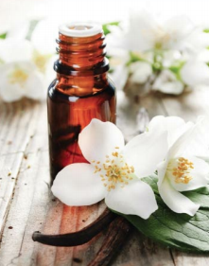
BASIL Ocimum basilicum
SCENT: HERBACEOUS/SPICY

Slide 8
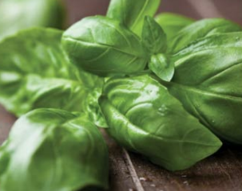
Ocimum basilicum SCENT: HERBACEOUS/SPICY
Native to India, where it is considered sacred, basil is widely used in Ayurvedic medicine.
The herb has also been used in funerary rites since ancient times and is commonly planted on graves in ancient Persia, Malaysia, and Greece.
Egyptians believed the leaves opened the gates of heaven and in ancient India, sprigs of the herb were placed in the hands of the dead to ease their passage to the next world.
The Romans used it to treat wounds, mixing it with honey to make an antiseptic salve.

Slide 9
PROPERTIES
Antibacterial, Antidepressant, Anti-inflammatory, Antiseptic, Antispasmodic
POTENTIAL USES
Abrasions, Acne, Brain fog, Cleaning products, Digestive issues, Gout, Insect bites and stings, Loss of appetite, Menstrual cramps, Muscle aches, Respiratory problems
BLENDS WELL WITH
Citrus: lemon, lemongrass, lime, grapefruit, orange, neroli
Herbal: thyme, parsley Floral: lavender, clary sage, chamomile
CAN BE SUBSTITUTED WITH: Oregano Thyme
PRECAUTIONS
Avoid use while pregnant or breastfeeding.
Avoid use if you suffer from epilepsy.

Slide 10
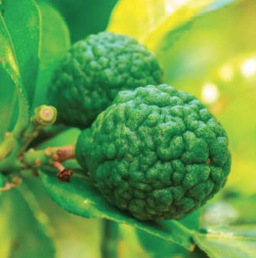
BERGAMOT Citrus bergamia SCENT: CITRUS/FLORAL
Bergamot oil is used both in food preparation and perfumery. It is the oil that gives Earl Grey tea its distinctive taste.
It has also been used to flavor pipe tobacco.
The best bergamot oil is sourced from Italy, although the plant also grows in Africa, southern France, and parts of Turkey, where it is primarily used to flavor marmalade.
It is sometimes adulterated with the essential oil of bergamot mint.

Slide 11
PROPERTIES
Antidepressant, Antifungal, Antiseptic, Deodorant, Digestive tonic, Febrifuge, Immune booster, Insect repellant, Sedative
POTENTIAL USES Acne, Anxiety, Body odor, Colds and flu, Cold sores, Cough, Depression, Digestive problems, Dry Skin, Eczema, Fever, Insomnia, Laryngitis, Mood disorders, Nerve pain, Psoriasis, Scabies, Seborrhea, Skin infection, Skin irritation, Stress and tension, Urinary tract infections, Wound healing
BLENDS WELL WITH Citrus: grapefruit, orange, bergamot Floral: lavender, geranium, palmarosa, ylang ylang Oriental: patchouli Spicy: cinnamon, clove, nutmeg
CAN BE SUBSTITUTED WITH Bitter Orange Grapefruit
PRECAUTIONS
Never use more than 1 drop per 2 teaspoons of carrier oil.
Do not spend time in the sun after using this essential oil.

Slide 12
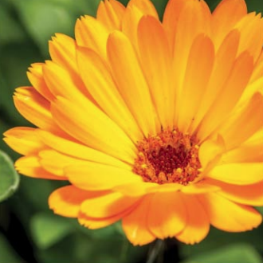
CALENDULA Calendula officinalis
SCENT: FLORAL
Also known as the pot marigold, calendula is one of the few flowers that produces an essential oil and not an absolute.
The flower has a long history of being associated with sacred rituals and was used to adorn Hindi temples and revered by the Egyptians for its regenerative properties.
Calendula ointments have long been used to treat conjunctivitis (pink eye) and as a gentle lotion for diaper rash.

Slide 13
PROPERTIES
Anti-inflammatory, Antispasmodic, Sedative, Skincare, Soporific, Tonic
POTENTIAL USES Acne, Anxiety, Burns, Cold sores, Menstrual issues, Psoriasis, Skin irritation
BLENDS WELL WITH: Citrus: orange, lemon, neroli Floral: lavender, chamomile Woody: cypress, pine, cedarwood
CAN BE SUBSTITUTED WITH Lavender
PRECAUTIONS Avoid use if pregnant or breast feeding

Slide 14
To be continue….. In Part-2

Slide 15
Thanks

