Slide 1
Introduction to the cell lab 3
Tishk international university
Faculty of science
Medical analysis Department
Biology Module: Practical

Slide 2
Introduction to cell
Cells are the basic unit of life, every living thing, from the tiniest bacterium to the largest whale is made of one or more cells. There are mainly two types of organisms, divided on the basis of the cell. The organisms which have only one cell are unicellular (Organisms that exist as single cells), whereas the organisms, which have the numerous cells are known as the multicellular (organisms that are made up of groups of cells working together)

Slide 3
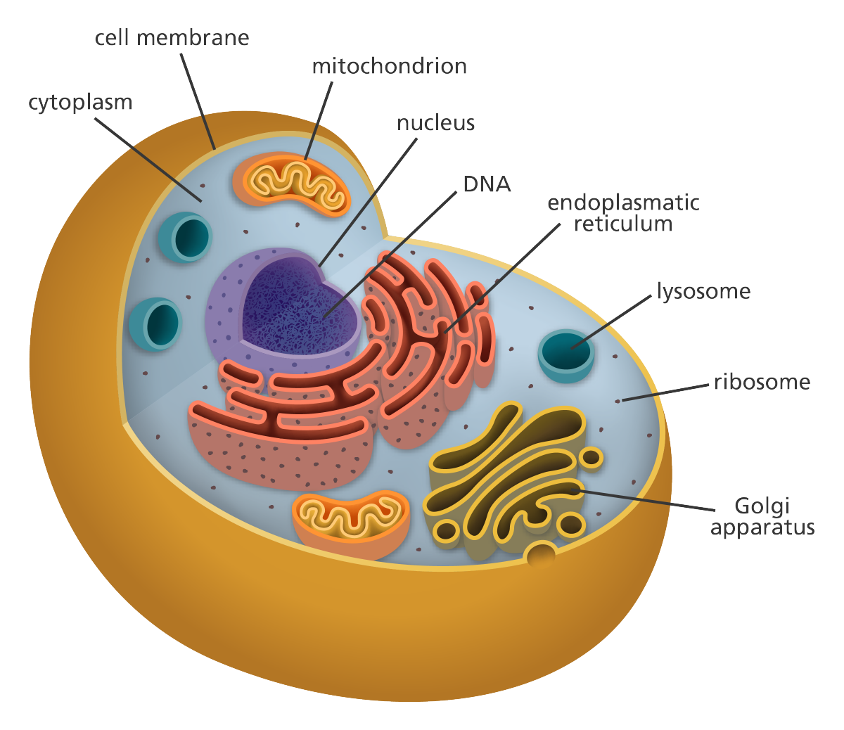
Cell structure and internal organization
Plasma membrane present around all types of the cells.
Generally, the plasma membrane consists of lipids and proteins.
Inside the cells, there is a specific membrane bounded structure which is called Nucleus
Inside the nucleus the chromosomes (DNA+Proteins ) are located

Slide 4
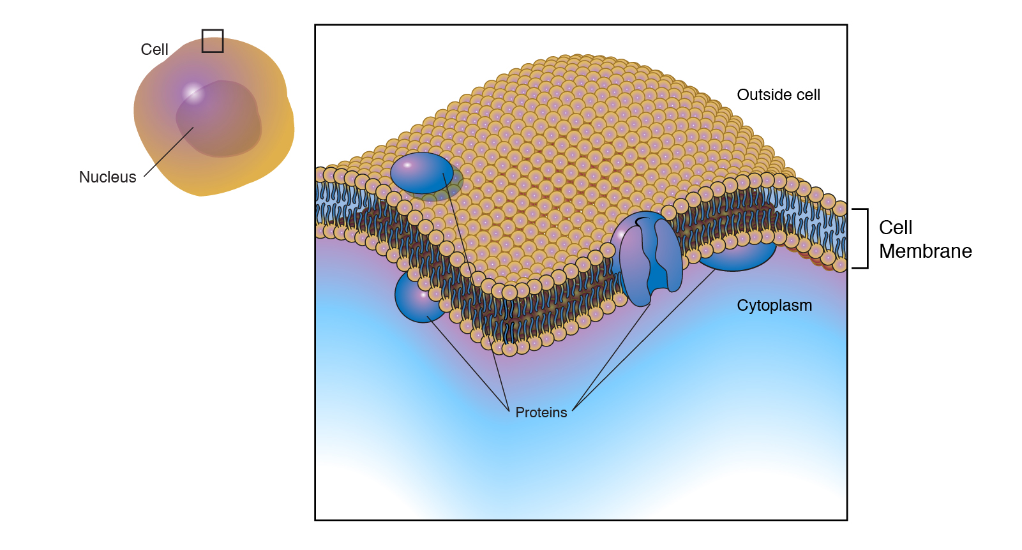

Slide 5
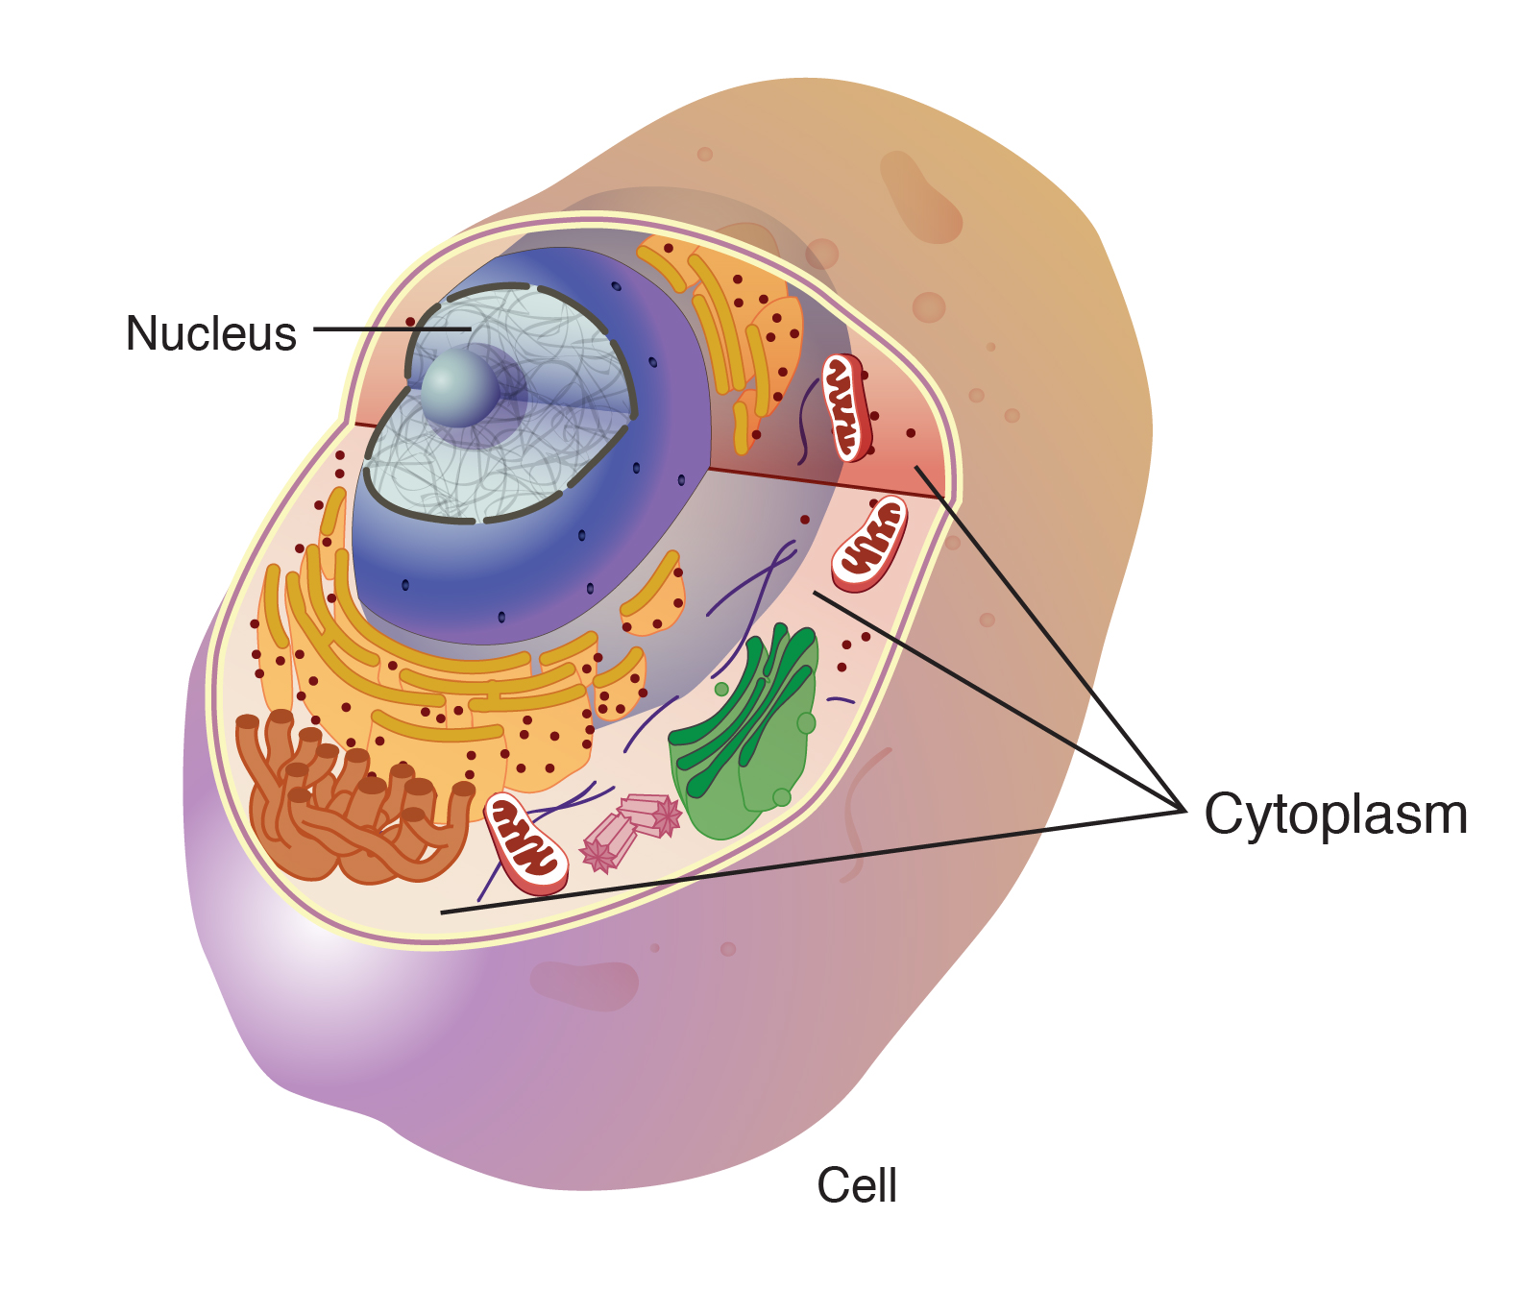
Cytoplasm consists of all of the contents outside of the nucleus and enclosed within the cell membrane of a cell. It is clear in color and has a gel-like appearance.
The main components of the cytoplasm are cytosol (a gel-like substance), the organelles (the cell's internal sub-structures), and various cytoplasmic inclusions(macromolecules and granules)
The cytoplasm is about 80% water and is usually colorless

Slide 6
Cells contain a variety of internal structures called organelles (except prokaryotic cells) they are located in cytoplasm, and each perform a specific function
Organelles including mitochondria, endoplasmic reticulum (rough and smooth), chloroplast, Golgi apparatus…..etc
The nucleus, mitochondria and chloroplasts of the, all are cell surrounded by double membrane.

Slide 7
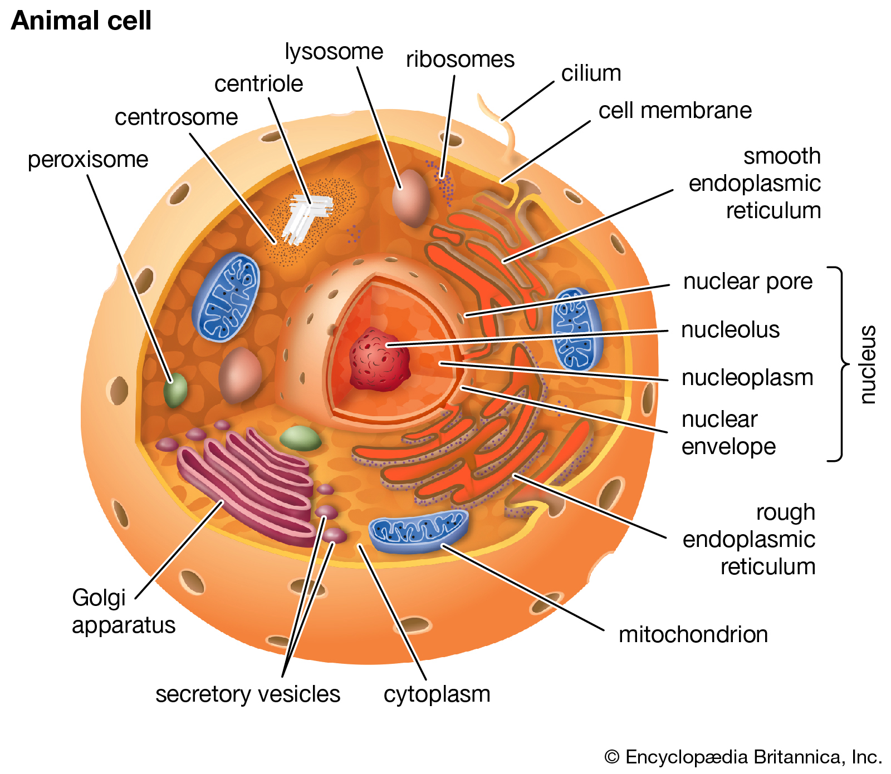
Cell structure and internal organization

Slide 8
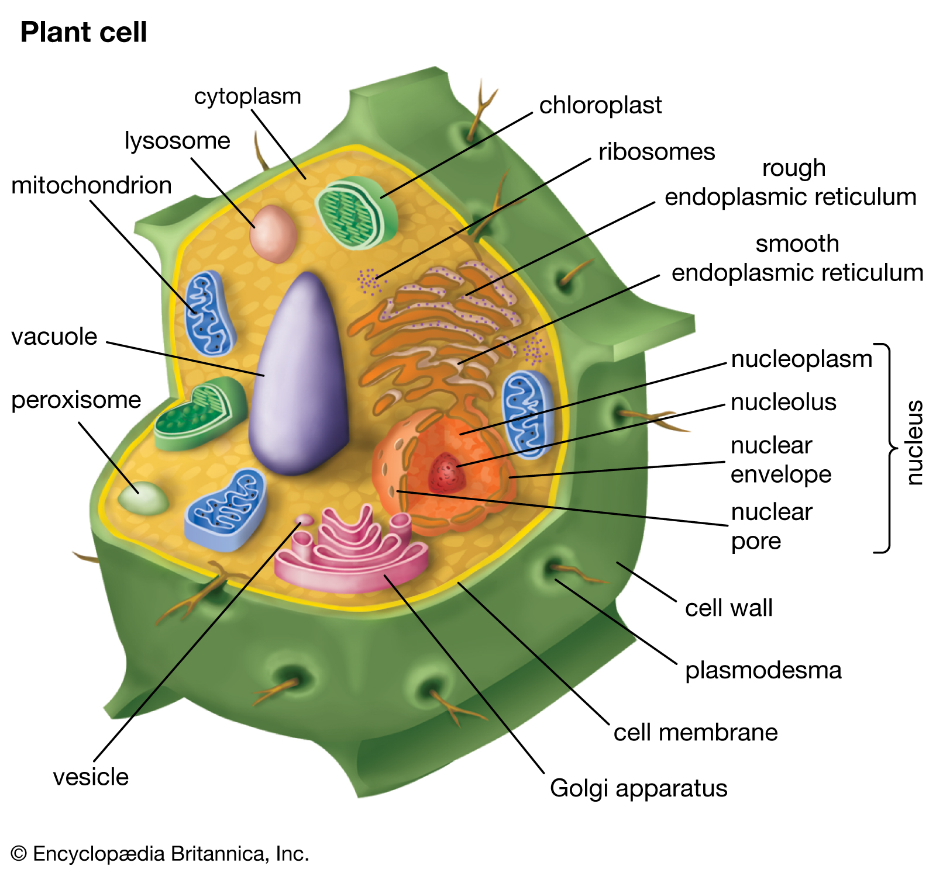
Plant cell

Slide 9
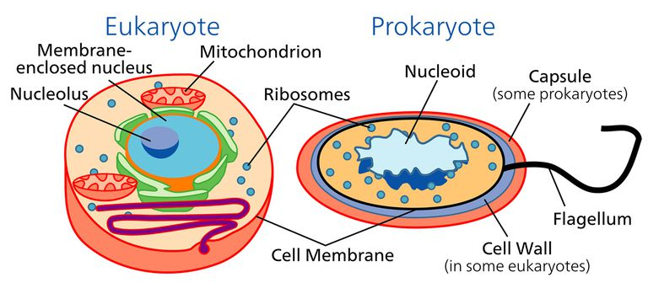
All living things are divided into two major groups these two groups are the Eukaryotes, and the Prokaryotes
Eukaryotic cell
Has true nucleus that is mean DNA surrounded by membrane (nuclear envelope).
Compartmentalization (membrane bounded organelles present).
Example animal cell.
Prokaryotic cells
Prokaryotic cell doesn’t have true nucleus.
DNA concentrates in a region which called nucleoid.
Prokaryotic cell doesn’t have membrane bounded organelles.
Example bacteria.

Slide 11
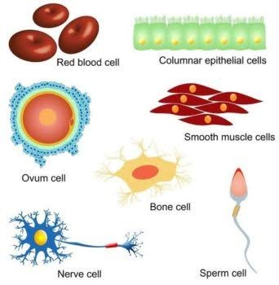
Cell shape
Not all cells are alike. Even cells within the same organism show a number of diversity in size, shape, and internal organization.
Your body contains around 10¹³ to 10¹⁴ cells of around 300 different cell types and they differ in shape and size.
The shape of cells sometimes varies according to their function or location (shapes of cells vary from one tissue to another), cells can have the shapes as oval, spherical, rectangular, and polyhedral, spindle shaped, and star shaped, rod-shaped or totally irregular. Cell membrane as well as cell wall maintains shape of cell.

Slide 12
Rod shape (bacteria)
Spherical shape (bacteria)
Oval shape (yeast)
Rectangular (onion or plant)
Columnar shaped cell (epithelium)
Elongated in shape (skeletal muscle)
Fusiform in shape (smooth muscle)
Thread like in shape (neuron)
Star shape (osteocyte)
Polyhedral shape (hepatocyte)

Slide 13
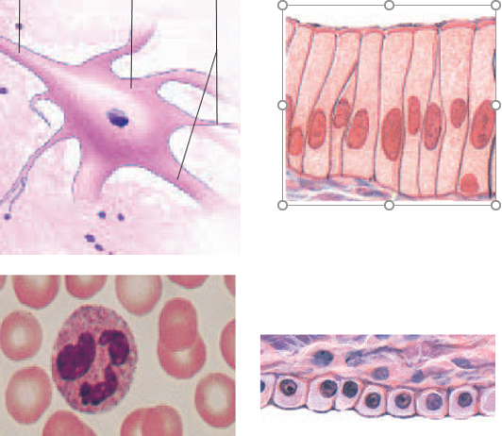
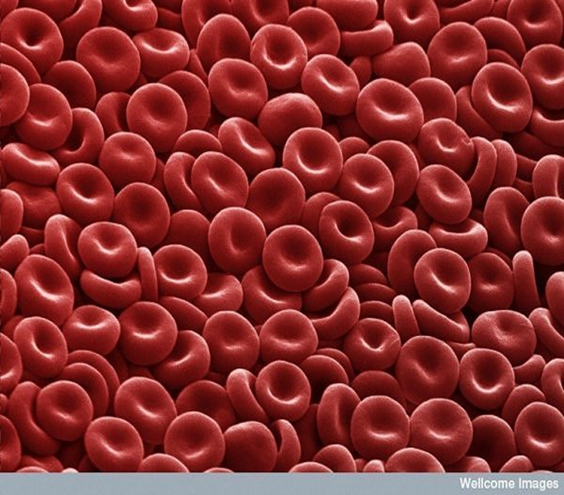

Slide 14
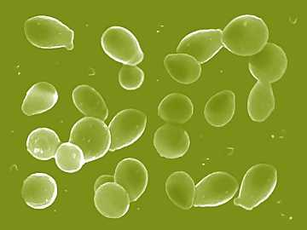
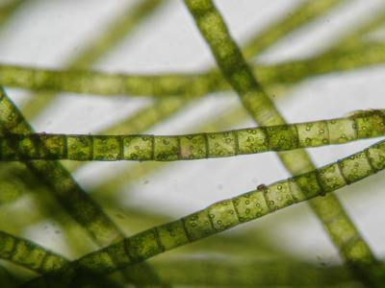
Fungal shape
Notes:
Shape of the cell

Slide 15
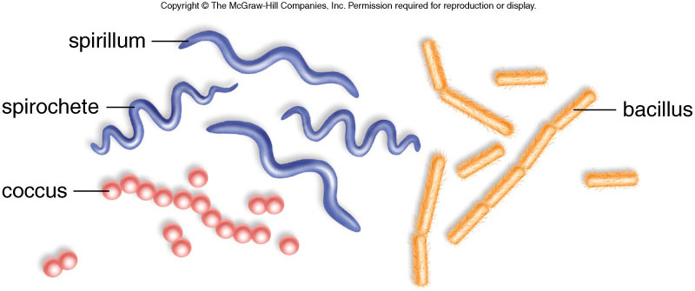
Shapes of Bacterial Cells

Slide 16
Pleomorphism
Is the ability of some cells to alter their shape or size in response to environmental conditions? This property is seen in many bacteria and fungi.

Slide 17
Prepare and Examine animal cell, using light microscope
Swab inside cheek surface again using a disposable inoculating loop/swab and transfer the sample onto the second slide. Put the loop/swab into the disposal jar.
Cover the sample with one drop of methylene blue solution.
Allow to stand for one minute.
Apply a cover slip to this preparation as in Fig. 1.
Dry the slide carefully with filter paper/absorbent paper and label it.
Examine under the microscope following the usual procedure.
Draw and Label the cell …..

Slide 18
