Slide 1
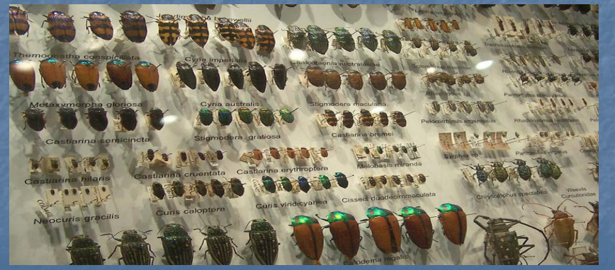
The Classification of organism
Lab4

Slide 2
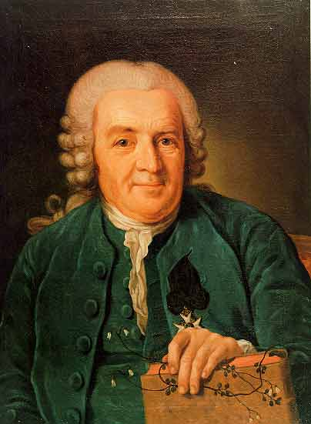
Taxonomy is the part of science that focuses on naming and classifying or grouping of organisms based on their characteristics (similarities and dissimilarities).
All modern classification systems have their roots in the Linnaean classification system.
It was developed by Swedish botanist Carolus Linnaeus in the 1700s. He tried to classify all living things that were known at his time. He grouped together organisms that shared obvious physical traits, such as number of legs or shape of leaves.
For his contribution, Linnaeus is known as the “father of taxonomy.” .
Carolus Linnaeus

Slide 3
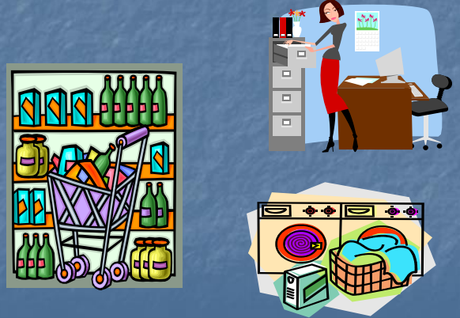
Why Classify?
To study the diversity of life, biologists use a classification system to name organisms and group them in a logical manner.
Classification makes life easier. What are some ways we classify in our daily living?

Slide 4
1-Binomial nomenclature
The of two important Linnaeus contributions to taxonomy are:
Binomial nomenclature is the formal naming system for living things that all scientists use.
The name of each organisms is consisted of two part both are Latin
The first part of the name – the Genus name – identifies the genus to which the species belongs,
The second part return to the species names
Genus is Capitalized; species is not; both are italicized
Examples:
Felis domesticus = cat
Panthera tigris = tiger

Slide 5
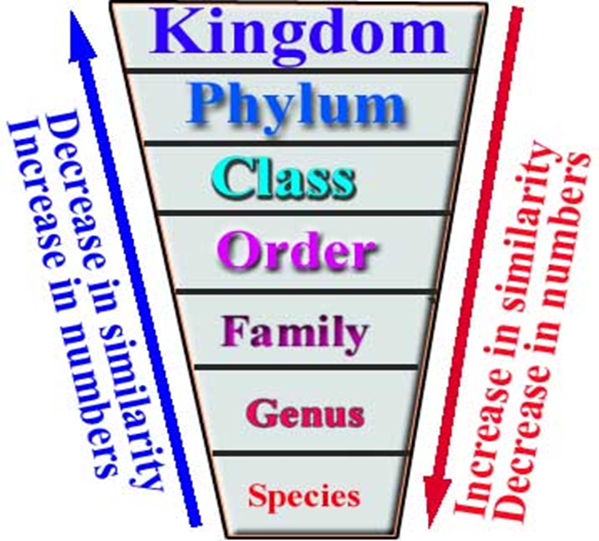
2- Linnaean Classification Hierarchy
The Linnaean system of classification consists of a hierarchy(levels) of groupings of organism, In taxonomic nomenclature, each level is called a taxon (plural: taxa) or taxonomic category.
Linnaeus’ hierarchical system of classification includes seven levels. They are, from largest to smallest, kingdom, phylum, class, order, family, genus, and species.

Slide 6
The kingdom is the largest and most inclusive (includes) of the taxonomic categories.
Linnaeus proposed that there were three broad groups, called kingdoms in which the whole nature could fit, the kingdoms were plants, animals and minerals, he divided each of these kingdoms in to classes, classes were divided in to orders, these were further divided into genera and then species, still we use these system today with some modification
Species is the smallest and least inclusive of the taxonomic categories.
The more taxonomic categories that two organisms share, the more closely related they are considered to be.

Slide 7
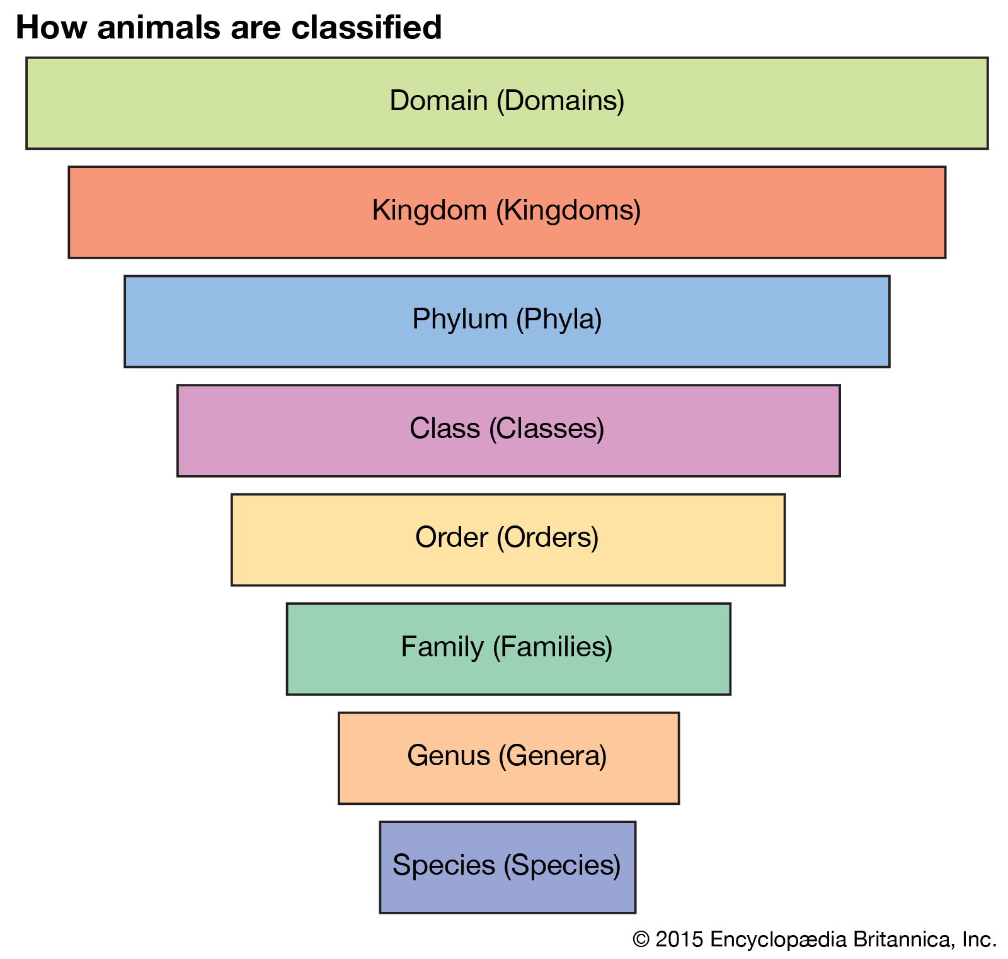
Linnaean Classification Hierarchy

Slide 8
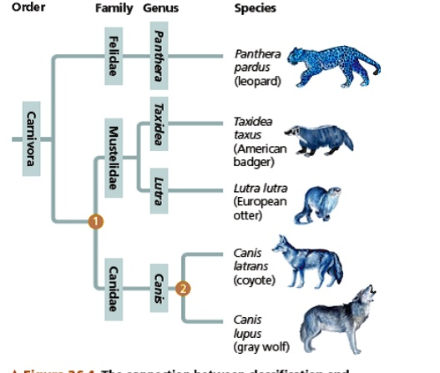
The species is the smallest and most exclusive grouping. It consists of organisms that are similar enough to produce fertile offspring together. Closely related species are grouped together in a genus.

Slide 9
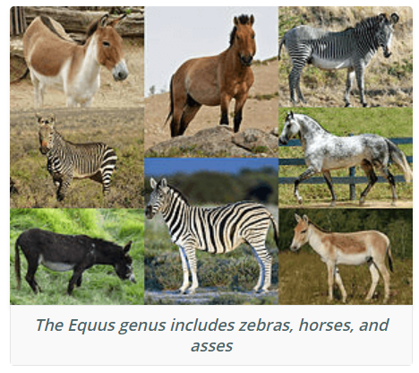
Genus, plural genera biological classification ranking between family and species, consisting of structurally or phylogenetically related species
Among animals, for example, the species of horses and zebras form the genus Equus
Equus quagga (zebra)
Equus caballus (Horse)
Equus asinus ( Donkey )

Slide 10
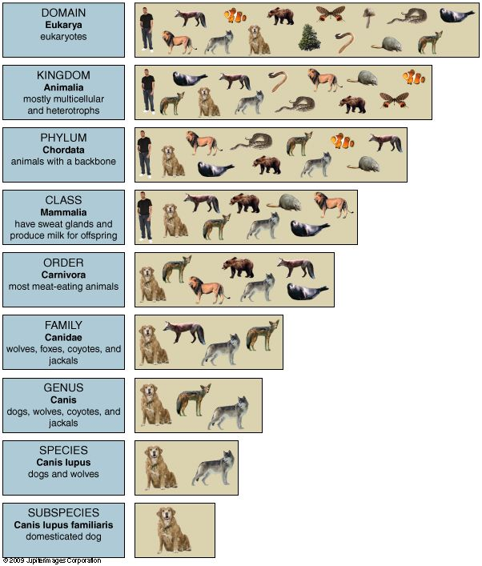
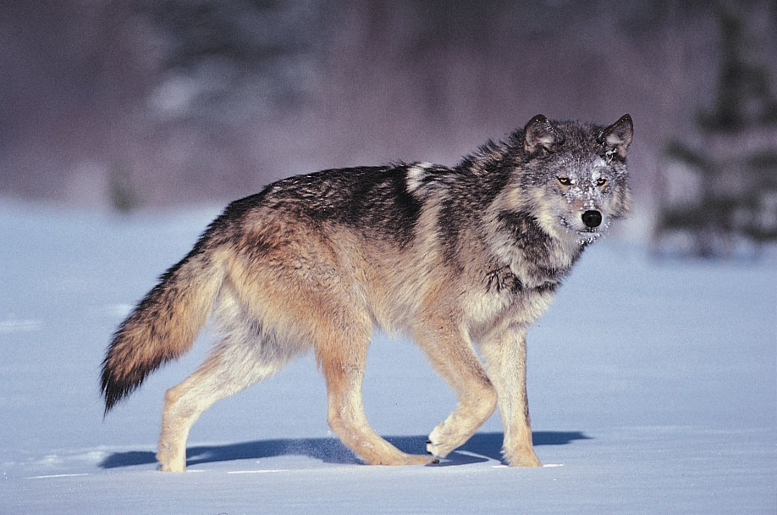
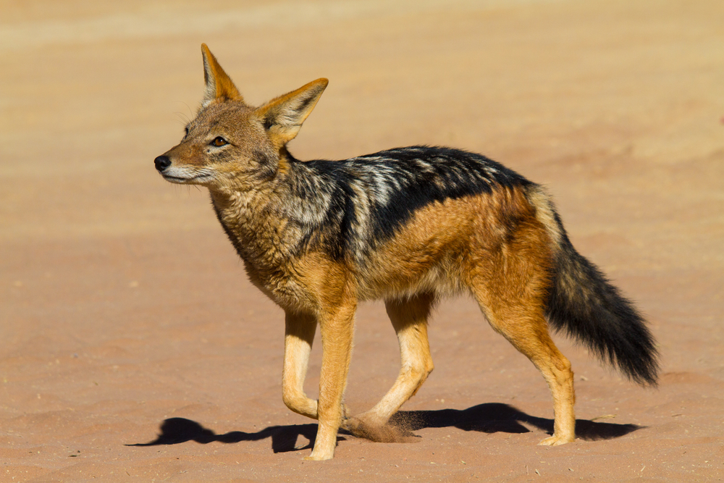

Slide 11
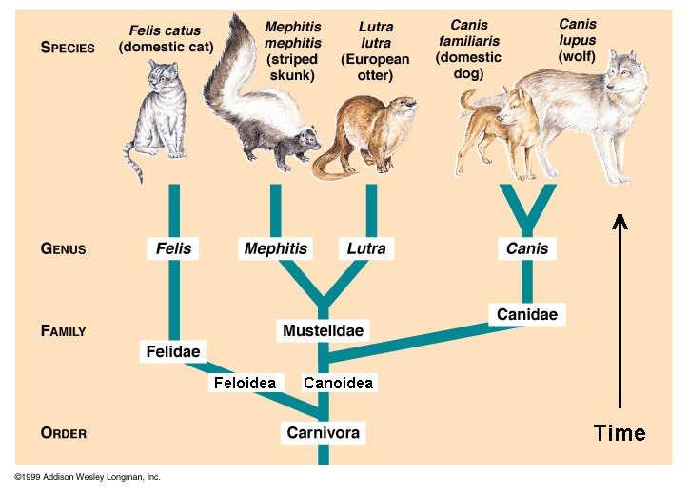
Species is defined as a group of organisms that can interbreed to produce a fertile offspring (They have the same number of chromosomes). Such as Dogs | It comes below the family and above the species in the taxonomic hierarchy. A genus can have many species Organisms of different species of the same genus cannot produce a fertile offspring if interbred together Read more: .
Canis aureus

Slide 12
History of classification of organism in to kingdoms
From Aristotle’s time to the middle of the twentieth century, biologists recognized only two kingdoms: kingdom Plantae (plants) and kingdom Animalia (animals).
Plants were literally organisms that were planted (immobile), whereas animals were animated (moved about).
In the 1880s, a German scientist, Ernst Haeckel, proposed adding a third kingdom: The kingdom Protista (protists) included single-celled microscopic organisms but not multicellular, largely macroscopic ones.

Slide 13
In 1969, R. H. Whittaker expanded the classification system to the five-kingdom system: Monera, Protista, Fungi, Plantae, and Animalia
Basic characteristics of classification
Nature of Cells: prokaryotic or eukaryotic
Cellularity: unicellular or multicellular
Level of organization: cellular, tissue, organ and organ system
Mode of nutrition: autotrophic or heterotrophic

Slide 14
Most Biologists classify organisms in to five kingdoms including :
Kingdome: Monera e.g Bacteria
Kingdome: Protista e.g. Paramecium
Kingdome: Plantae e.g. Trees
Kingdome: Fungi e.g yeasts
Kingdome: Animalia e.g Birds

Slide 15
Today, additional levels of hierarchy is added. The broadest level of life is now Domain: All living things are now fit into one only three domains: Archaea, Bacteria and Eukarya. Within each of these domain there are kingdoms
For example Domain Eukarya includes the kingdoms Animalia, planta, fungi and protests
Many more new taxa has added to the hierarchy of classification such are phyla and family

Slide 16
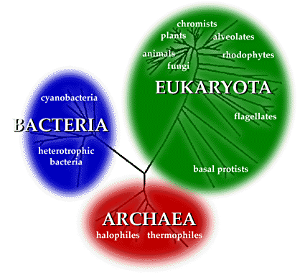
Three Domains: Six Kingdoms
Eukarya
Animal
Plant
Fungi
Protista
All have organisms made of eukaryotic cells
Bacteria
Eubacteria
Peptidoglycan in the cell walls
Prokaryotic single celled organisms
Archea
Archeabacteria
No peptidoglycan in the cell walls
Prokaryotic single celled organisms that live in extreme environments

Slide 17
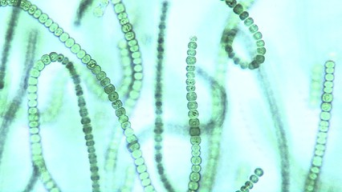
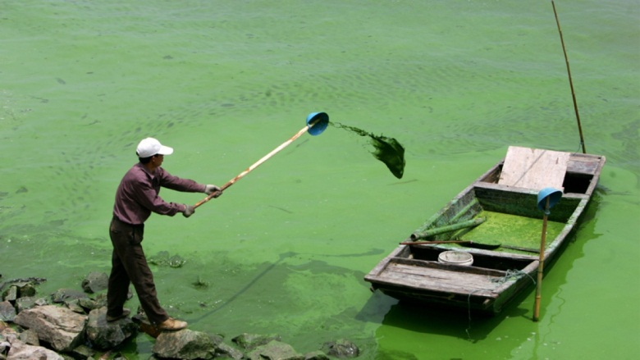
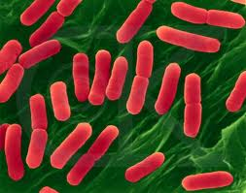
Five Kingdome of classification
1. Kingdom Monera (Procaryotae): Most widespread organisms.
Procaryotes (“Before nucleus”):
Lack nuclear membrane around DNA.
Lack membrane bound organelles (mitochondria, chloroplast, golgi, endoplasmic reticulum).
Unicellular: Single celled organisms. Decomposers
Have a cell wall.
Include: Bacteria, blue green algae

Slide 18
2. Kingdom Protista:
Eucaryotes (True nucleus)
Have nuclear membrane around DNA.
Have membrane bound organelles (mitochondria, chloroplast, golgi, endoplasmic reticulum).
Motley Unicellular or simple multicellular.
Do not show cellular specialization or differentiation into tissues. That means their cells all look the same and for the most part, function the same
Most are larger and more complex than bacteria.
Some make their own food (phothosynthetic), others (heterotrophs) must eat on other organisms.
Include: Protozoa, algae, slime molds.
`````

Slide 19
Protists
Three Types of Protists
Protozoa (Animal like protists)
Algae (Plant like protists)
Slime molds (Fungi like protists)

Slide 20
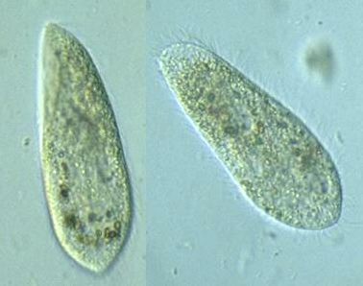
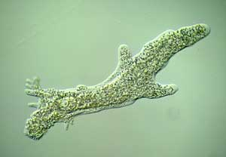
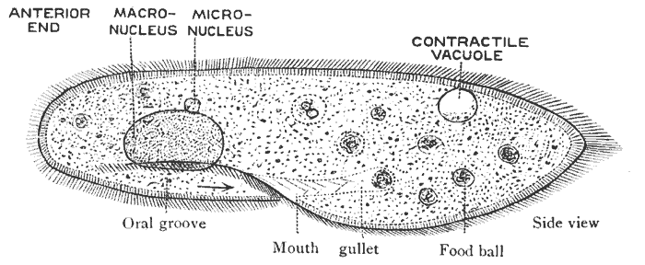
Protists - Protozoa
Protozoans are microscopic protists that have several characteristics that are like animals.

Slide 21
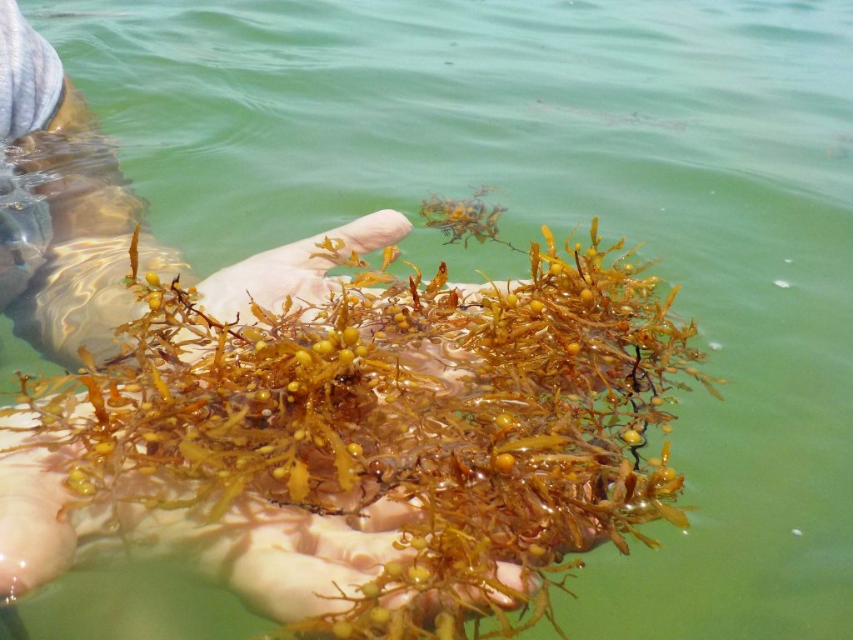
Protists - Algae
Algae are protists that have a few characteristics in common with plants.
Algae make their own food using photosynthesis.
Green Algae and brown algae

Slide 22
3-Kingdom: Fungi
Eukaryotic and Mostly Multicellular
Have membrane bound organelles (mitochondria, chloroplast, golgi, endoplasmic reticulum).
Fungi must obtain their food from other organisms Heterotrophs
Fungi are decomposers

Slide 23
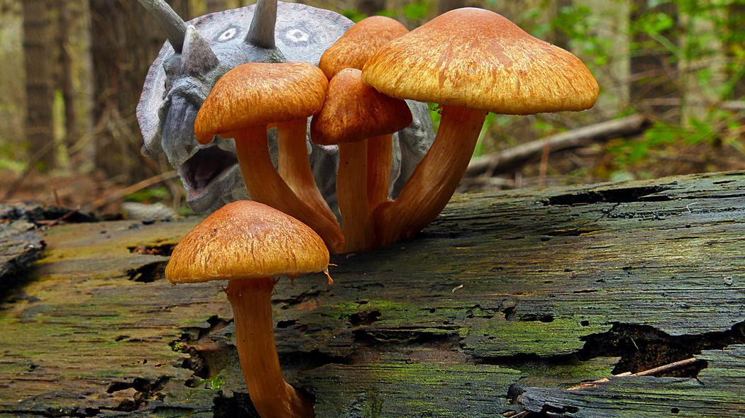

Slide 24
4. Kingdom Plantae:
Complex multicellular organisms.
Cellulose cell walls.
Eukaryotes: Have nuclear membrane around DNA and membrane bound organelles.
Autotrophs: Convert sunlight, water, and carbon dioxide into food through photosynthesis.
Other features:
Waxy cuticle that prevents water loss.
Multicellular sex organs.
Openings in leaves and stems for gas exchange (stomata).
Include: Trees, flowering plants, and mosses.

Slide 25
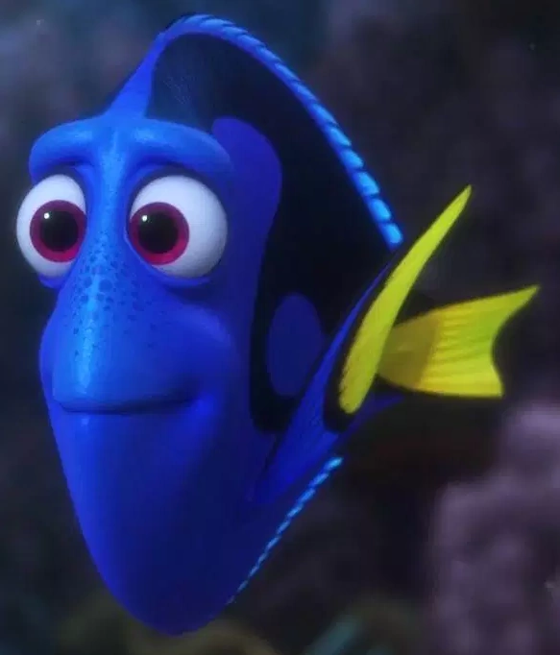
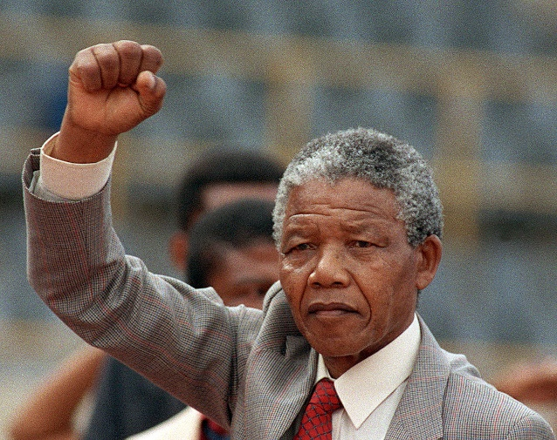
5. Kingdom Animalia:
Complex multicellular organisms.
Lack cell walls.
Eucaryotes: Have nuclear membrane around DNA and membrane bound organelles.
Heterotrophs: Obtain chemical energy from living sources. Eat other organisms for nourishment.
Features of complex animals:
High degree of tissue specialization and body organization.
Locomotion.
Well developed sense organs, nervous system, and muscles.
Include: Sponges, worms, insects, and vertebrates.

Slide 26
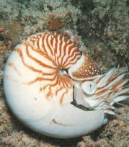
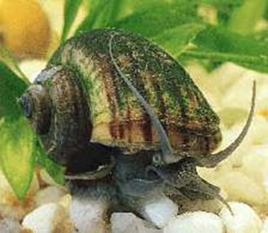
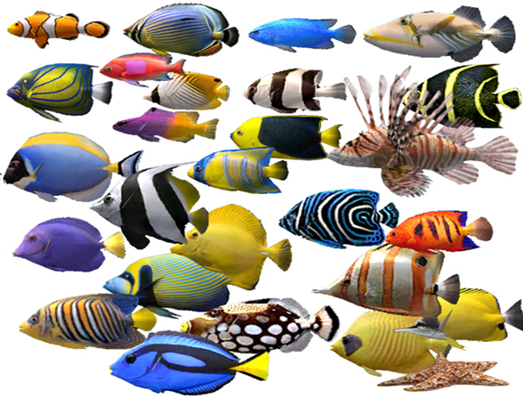

Slide 28
Prepare a wet mount of a biological specimen
Place a drop of water containing from a pond water on a clean microscope slide.
Place the edge of a clean coverslip at an edge of the drop at a 45° angle; then slowly lower the coverslip onto the drop so that no air bubbles are trapped (fig. 3.7). (Your instructor will demonstrate this technique.) The coverslip holds the specimen in place and prevents the lens of an objective from contacting the water and the specimen.
Experiment with various intensities of illumination. To do this, rotate the 4. objective into place and adjust the condenser iris diaphragm to produce the least illumination. Observe the image; note its clarity, contrast, and color.
Repeat step 3 for the 10. and 40. objectives.

Slide 29
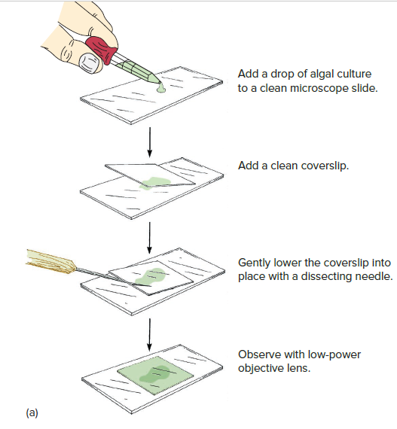

Slide 30
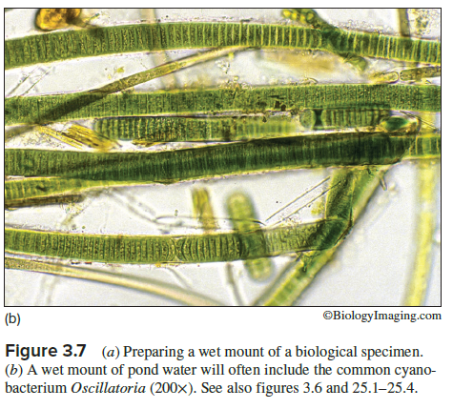

Slide 31
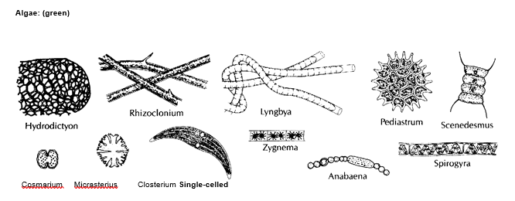

Slide 32
