Slide 1
Cell division
Tishk international university
Faculty of science
Medical analysis Department
Biology Module: Practical
Lab5
Peshraw S. Hamadamin

Slide 2
Cell Division
Cell division is the process by which new cells are formed for growth, repair, and replacement in the body. This process includes division of the nuclear material and division of the cytoplasm
The continuity of life is based on the reproduction of cells, or cell division

Slide 3
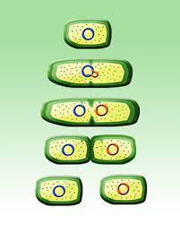
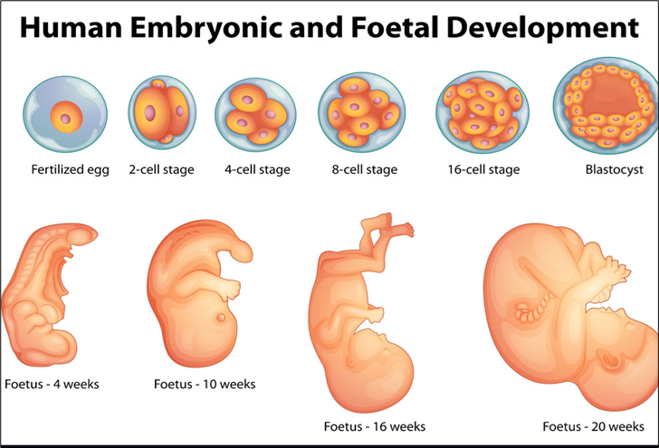
Cell division plays several important roles in life.
The division of one prokaryotic cell reproduces an entire organism. The same is true of a unicellular eukaryote
Cell division also enables multicellular eukaryotes to develop from a single cell, like the fertilized egg that gave rise to the two-celled embryo.

Slide 4
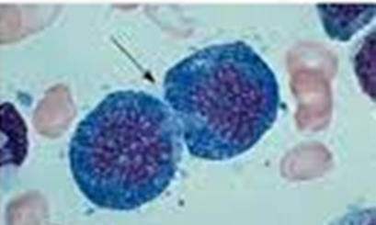
After an organism is fully grown, cell division continues to function in renewal and repair, replacing cells that die from normal wear and tear or accidents. For example, dividing cells in your bone marrow continuously make new blood cells
Function of cell division
Reproduction
Growth and development
Tissue renewal
Q/ What is differences between Cell division and reproduction ?

Slide 5
Depending on division, cell divided into:-
Undifferentiated cell (divided cell): ex…Bone marrow, Skin cell, embryonic cells).
Semi-differentiated cells:
Cells lost their ability to divide but under certain condition return their ability to divide like Liver cell, Lymphatic cells.
Differentiated cells: This type of cell lost their ability for division, and they never divide like Nerve cells.

Slide 6
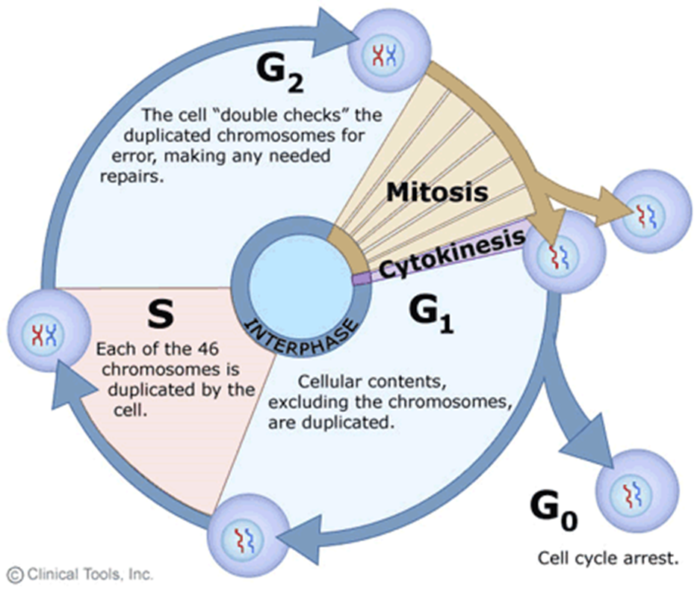
Cell cycle (the life of the cell)
The cell division process is an integral part of the cell cycle: the life of a cell from the time it is first formed from a dividing parent cell until its own division into two daughter cells.
There are two types of cell division Mitosis and meiosis.

Slide 7
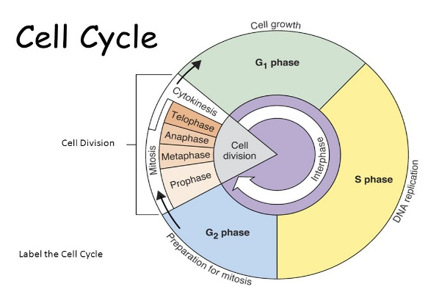
Phases of the Cell Cycle
The cell cycle consists of
Interphase – During interphase, a cell that is about to divide grows and copies its chromosomes in preparation for cell division
The mitotic phase – cell division mitotic (M) phase, which includes both mitosis and cytokinesis, is usually the shortest part of the cell cycle
In fact, the mitotic (M) phase, is usually the shortest part of the cell cycle. Mitotic cell division alternates with a much longer stage called interphase, which often accounts for about 90% of the cycle

Slide 8
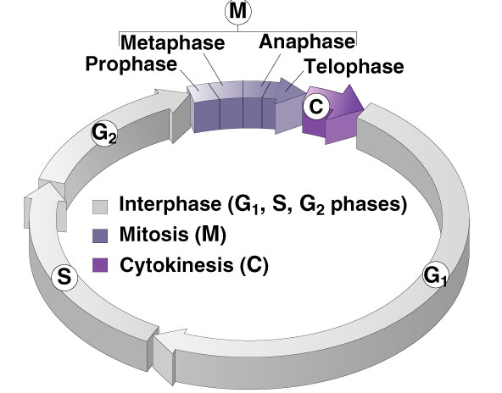
Phases of the Cell Cycle
Interphase, which often accounts for about 90% of the cycle.
During interphase, a cell that is about to divide grows and copies its chromosomes in preparation for cell division. Interphase can be divided into subphases:
G1 - primary gap phase
S – synthesis; DNA replicated
G2 - secondary growth phase

Slide 9
2- Mitotic (M) phase
Mitosis in eukaryotic include
Division of the nucleus (karyokinesis)
Prophase
Metaphase
Anaphase
Telophase
Division of cytoplasm (cytokinesis)

Slide 10
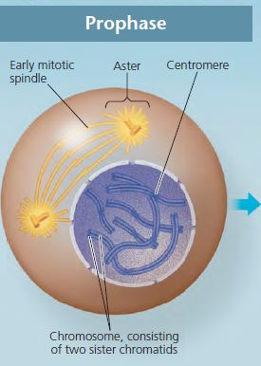
1. Prophase
The chromatin fibers become more tightly coiled, condensing into discrete chromosomes
Each duplicated chromosome appears as two identical sister chromatids joined at their centromeres
Nuclear membrane & nucleoli are broken down
The mitotic spindle (named for its shape) begins to form. It is composed of the centrosomes and the microtubules that extend from them
The centrosomes move away from each other

Slide 11
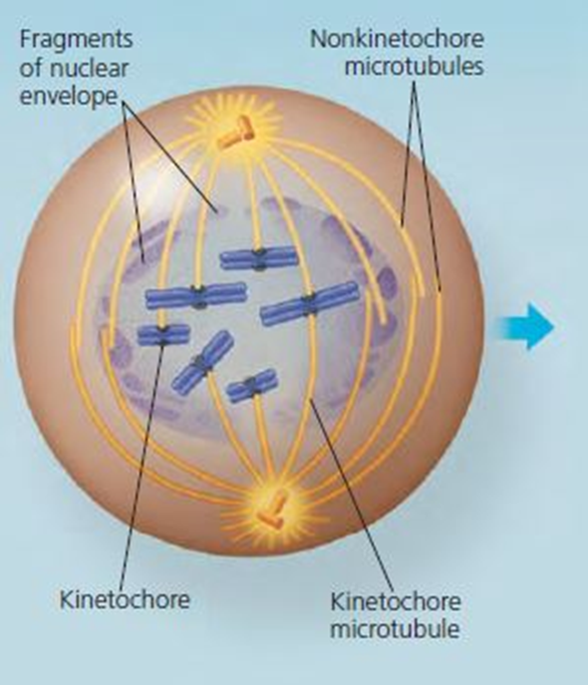
The microtubules extending from each centrosome can now invade the nuclear area.
The chromosomes have become even more condensed.
Some of the microtubules attach to the kinetochores (specialized protein structure at the centromere), becoming “kinetochore microtubules,” which jerk the chromosomes back and forth

Slide 12
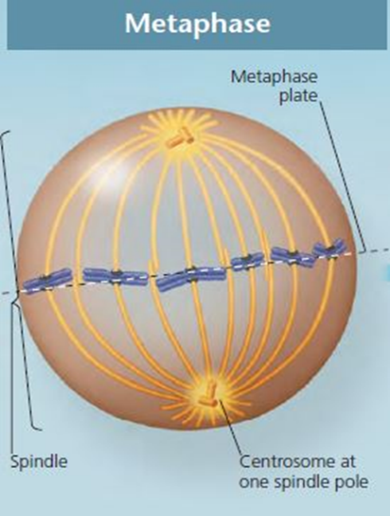
2. Metaphase
The chromosomes lined up at the metaphase plate, an imaginary plane that is equidistant between the spindle’s two poles..
The centrosomes are now at opposite ends of the cell.

Slide 13
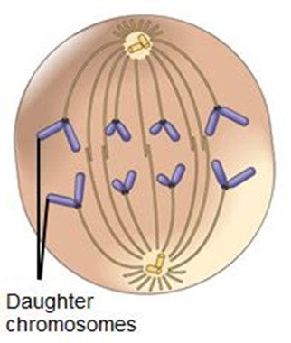
3. Anaphase
Anaphase begins when the two sister chromatids of each pair suddenly part.
The two liberated chromosomes begin moving toward opposite ends of the cell, Each chromatid thus becomes a full- fledged chromosome
The cell elongates, by the end of anaphase, the two ends of the cell have equivalent—and complete—collections of chromosomes
By the end of anaphase, the two ends of the cell have equivalent—and complete— collections of chromosomes

Slide 14
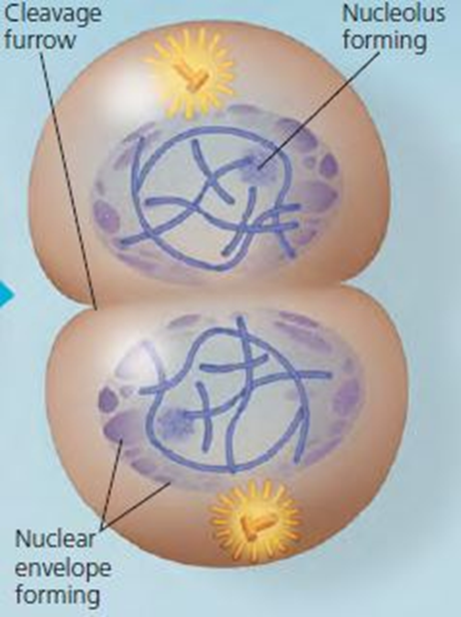
4. Telophase
The chromosomes are at opposite poles
Spindle disassembles
Nuclear envelope forms around each set of sister chromatids
Nucleolus reappears
CYTOKINESIS occurs
Chromosomes are decondensed and are reappear as chromatin

Slide 15
Cytokinesis
Means division of the cytoplasm
Division of cell into two, identical halves called daughter cells
In plant cells, cell plate forms at the equator to divide cell
In animal cells, cleavage furrow forms to split cell

Slide 16
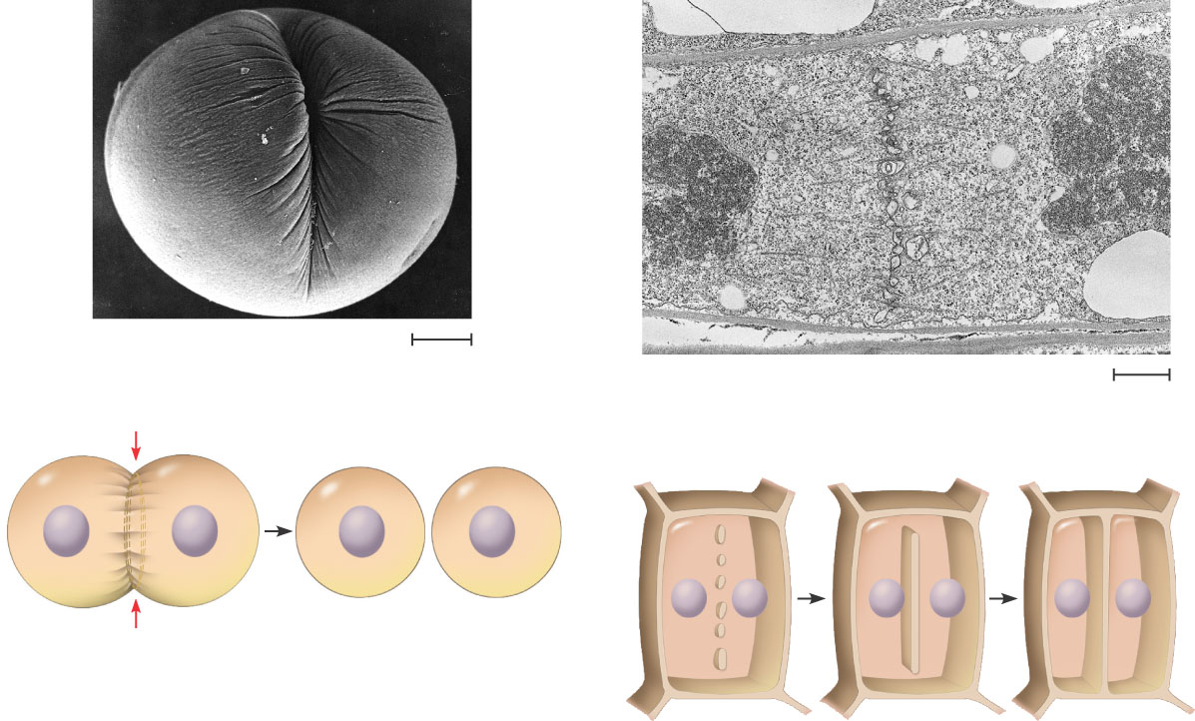
Cytokinesis In Animal And Plant Cells
Cleavage furrow
100 µm
Vesicles forming cell plate
Wall of patent cell
1 µm
Cell plate
New cell wall
Contractile ring of microfilaments
Daughter cells
Daughter cells
(a) Cleavage of an animal cell (SEM)
(b) Cell plate formation in a plant cell (SEM)

Slide 17
