Slide 1
Developmental disturbances of teeth
Dr. Layla Muhammed
ORAL PATHOLOGY / DENT 495-DENT 496
First Semester
Week 1
01 - 04/10/2023

Slide 2
DEVELOPMENTAL ANOMALIES INVOLVING TEETH L 1
-A developmental anomaly is a broad term used to define conditions which are present at conception or occur before the end of pregnancy, a small number also occur after birth.
-Developmental anomalies are also sometimes called birth defects, congenital malformations or congenital anomalies.
-And developmental dental anomalies may occur during various stages of the dental development.

Slide 3
ABNORMALITIES IN THE NUMBER OF TEETH
Anodontia: Congenital lack of teeth. Because development of both deciduous and permanent teeth begins before birth, their failure to develop is congenital.
Hypodontia and oligodontia:
Hypodontia: having less than 6 congenitally missing teeth (partial anodontia).
Oligodontia: having 6 or more congenitally missing teeth.
The permanent dentition is most commonly affected..

Slide 4
The teeth most often missing are the maxillary and mandibular third molars, the maxillary lateral incisors, and the mandibular second premolars.
Teeth are often missing bilaterally.
The mandibular incisor is the tooth most commonly missing in the deciduous dentition.
The best known of the missing teeth syndromes is X-linked ectodermal dysplasia.

Slide 5
Ectodermal derivatives such as hair, sweat glands, nails and teeth are involved. Head hair, eye lashes and brows are sparse, nails are dystrophic and there is marked oligodontia, rarely total anodontia. Diminished sweat glands lead to the inability to regulate body temperature.
When there is anodontia, the alveolar process, without teeth to support, fails to develop and has too little bone to support implants. There are many rare syndromes where hypodontia is a feature,but the only common one is Down's syndrome .

Slide 6
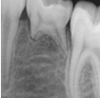
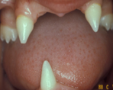
One or more third molars are absent in over 90% of these patients ,while absence of individual teeth scattered about the arch is also common. Anodontia is rare. Palatal clefts may be associated.
A
B
C D
(A) Congenitally missing bicuspid. (B) Oligodontia. (C, D) Ectodermal dysplasia.

Slide 7
Supernumerary teeth:
Extra teeth found in the dental arches, result from either the formation of extra tooth buds in the dental lamina or the cleavage of already existing tooth buds and may occur in either the deciduous or the permanent dentition.
Extra teeth may occur singly or in multiples and unilaterally or bilaterally
The most common supernumerary tooth is called the mesiodens, which is located between the maxillary central incisors at or near the midline. It is usually a small tooth with a conical crown and short roots.

Slide 8
The second most common supernumerary tooth is maxillary fourth molar, which is also called a distomolar because it is located distal to the third molar.
The distomolar can look like a miniature third molar or be of normal third-molar size and shape. It rarely erupts into the oral cavity and is usually discovered on a radiograph.
The maxillary paramolar is a small rudimentary tooth that occurs buccal to the third molar.

Slide 9
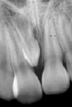
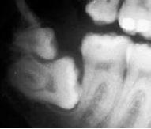
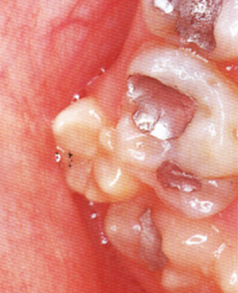
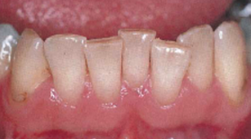
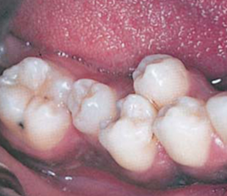
Other supernumerary teeth include mandibular and maxillary premolars and maxillary lateral incisors.
Multiple supernumerary teeth may be a component of a syndrome such as cleidocranial dysplasia
A
B
C
D
E
:(A)Mesiodens.(B)Distomolar.(C)Paramolar.(D)Supernumerary incisor and (E) Premolar.

Slide 10
Natal teeth are those observable in the oral cavity at birth and neonatal teeth are those that erupt during the first 30 days of life, may be primary dentition or supernumerary to the normal teeth.
May appear as shell-shaped crown or solid crown poorly fixed to the alveolus by gingival tissue with little or no root.
Up to 75% of natal and neonatal teeth present as a pair of teeth in the centre of the lower gum .
The risk of tooth dislocation and consequent aspiration, in addition to traumatic injury to the baby’s tongue and/or to the maternal breast, has been described as reasons for its removal.

Slide 11
Local factors affecting eruption of deciduous teeth
Having no predecessors, deciduous teeth usually erupt unobstructed. Occasionally an eruption cyst may overlie a tooth but is unlikely to block eruption.
Local factors affecting eruption of permanent teeth
Loss of space
Abnormal position of the crypt
Overcrowding
Supernumerary and supplemental teeth
Displacement in a dentigerous cyst
Rentention of a deciduous predecessor

Slide 12
ABNORMALITIES IN THE SIZE OF TEETH
Microdontia: One or more teeth in the dentition are smaller than normal.
-True generalized microdontia is seen in the pituitary dwarf resulting generally from a lack of growth hormone produced by the pituitary gland, all the teeth are smaller than normal.
Generalized relative microdontia is normal-size teeth appear small in large jaws.
Microdontia involving a single tooth is more common and the maxillary lateral incisor and the maxillary third molar are the teeth most often affected.

Slide 13
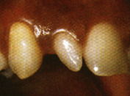
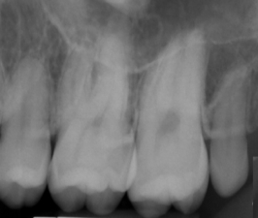
The maxillary lateral incisors often appear peg shaped, with the mesial and distal tooth surfaces converging toward the incisal edge.
This “peg lateral” is thought to be familial.
The maxillary third-molar microdont typically appears small but normally shaped

Slide 14
Macrodontia: One or more teeth in a dentition are larger than normal. True generalized macrodontia is rare and is seen occasionally in cases of pituitary gigantism.
Relative generalized macrodontia is seen in individuals with normal size teeth in small jaws.
Macrodontia affecting a single tooth is uncommon
Localized macrodontia affecting one side of the dental arches may be seen in a condition called facial hemihypertrophy.

Slide 15
DISTURBANCE IN STRUCTURE OF TEETH
1- DISTURBANCE IN STRUCTURE OF ENAMEL
Localized developmental defects in enamel :
When only one or few adjacent teeth exhibit an enamel defect, it is usually considered to be caused by a localized factor rather than a more generalized systemic or genetic factor.
Turner's hypoplasia is manifested as a portion of missing or diminished enamel on a permanent tooth, usually affects only one tooth in the mouth and, it is referred to as a Turner's tooth.

Slide 16
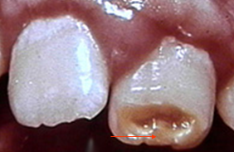
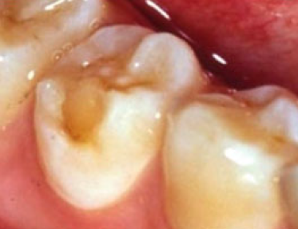
The most common causes are trauma, trauma in the form of a fall, or a blow to a primary tooth, causing intrusion or lateral luxation, are probably the most common causes of localized enamel defects in the succedaneous teeth, chronic periapical infection in a primary predecessor tooth, surgery in the adjacent area or radiation therapy. Injuries to the primary teeth often result in enamel defects in the succedaneous permanent teeth because of the direct impact of the apex of the root of a primary tooth on the crown or follicle of the developing permanent successor.

Slide 17
2. Generalized developmental defects in enamel:
Genetic disorders :Amelogenesis imperfecta is a genetic disorder affecting the enamel of the teeth.
The condition often results from a single gene defect, either as an X–linked, autosomal dominant or autosomal recessive trait.
The types are:

Slide 18
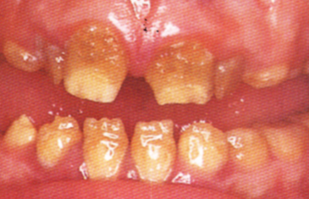
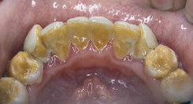
Hypoplastic type: Inadequate formation of enamel matrix, both pitting and smooth types exist. Enamel may be reduced in quantity but is of normal hardness.
2. Hypocalcification type: It is defect in initial mineralization.
A defect not in the quantity but in the quality of enamel.
It is poorly mineralized, soft and wears easily and can be removed by a blunt instrument.

Slide 19
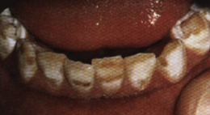
3. Hypomaturation (Hypomineralization) type: A defect in the crystal structure of enamel leads to a mottled enamel with white to brown to yellow colors.
The enamel can be pierced with an explorer tip with firm pressure, and the teeth shows chipping of enamel away from normal dentine surface.

Slide 20
B. Systemic disturbances :
Generalized enamel hypoplasia due to systemic disturbances usually involves teeth which are formed during first year of life like permanent incisors, canines, and first molars.
The other teeth are rarely affected because their formation start 3 years after birth or later.
Systemic ingestion of lead, mercury, some drugs such as anticancer agents and tetracycline and some trace elements including fluoride have been associated with developmental defect of enamel.

Slide 21
Exposure to such substances during amelogenesis may result in the formation of defective enamel depending on the stage of enamel development, the timing of exposure, the length of exposure.
Ingestion of excess fluoride (more than one PPM) during tooth development can result in dental fluorosis
Enamel vary in color from chalky white, yellow, or brown, and in some cases there are white striations or brown spot.

Slide 22
Vitamin A, C, D deficiency, hypocalcemia, hypophosphatemia and hyperparathyroidism have also all be implicated in developmental defect of enamel.
Infectious diseases (include, congenital syphilis, measles, mumps, scarlet fever, otitis media, pneumonia, and exanthematous fevers) occurring during early childhood that may be related to developmental defect of enamel.

Slide 23
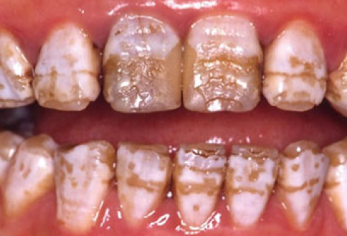
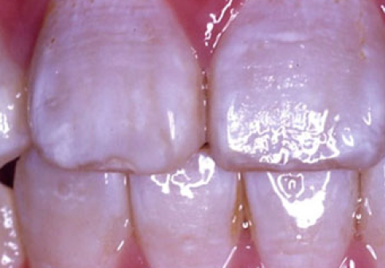
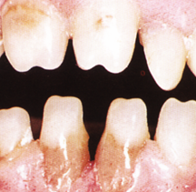
The child in uterus of actively infected mother with Treponema pallidum may suffer from enamel hypoplasia in permanent incisors (tapering of mesial and distal surfaces towards the incisal edge with a screw driver appearance with a central notch at their incisal edge - Hutchinsons incisors) and enamel hypoplasia of first molars (mulberry molar) due to infection of developing tooth germ by Treponema spirochetes.
(A)
B
(C)
(D)
(A) Sever fluorosis (9 ppm of fluoride in the drinking water). (B) Less severe fluorosis. (C)Congenital syphilis with Hutchinsons incisors(D) and mulberry molar.

