Slide 1
Patient Assessment
Dr. Shajwan Salar
Patient assessment course code
Semester one
Week two
18-10-2023

Slide 2
Patient Assessment And Communication
Dr. Shajwan Salar Nanakali
BPharm, MPH (Global Public Health)

Slide 3
Learning Objectives/Outcomes
Patient history and case presentation
Patient assessment and documentation
SOAP note
Vital signs

Slide 4
Patient history and case presentation
Much of the information needed to accurately assess a patient's symptom complex is obtained from the patient's history, acquired by interviewing the patient in a structured method. Because the patient is telling their story, patient histories are referred to as subjective data, whereas laboratory tests, medical imaging test results and the physical examination, are called objective data.
Open-ended questions and close-ended questions
Patient histories can be patient-oriented or provider-oriented.
Patient-oriented histories explore the patient's feelings regarding the physical aspects, personal or social components of the symptoms, and the patient's emotional reactions to the symptoms or disease
Provider-centered patient histories are designed to get specific types of information from the patient to use to make a diagnosis, with less attention paid to personal, social, and emotional aspects

Slide 5
A complete medical history consists of five components:
1. History of present illness (HPJ): The HPI, also known as a chief complaint history, focuses on the present symptoms
and by itself is the history used in most ambulatory situations, involving acute symptoms.
2. Past medical history: includes general health status, infectious diseases and immunizations,
adverse reactions to medications, and hospitalizations.
3. Family history: asks about significant health events in the lives of parents, siblings, and offspring, looking for patterns of disease and common causes of death
4. Personal/social history: includes occupation, marital status, personal habits such as alcohol or smoking, financial status, and current living arrangements.
5. Review of systems: A review of systems uses open-ended and closed-ended questions to probe for other symptoms or conditions, not found during the HPI; past, family, personal, and social histories; or a review of the health record. Ex, General: Weight loss, decreased appetite

Slide 6
PATIENT CASE PRESENTATION DEFINITIONS AND FURTHER EXAMPLES
The patient’s medical history and physical examination findings are provided in the following standardized outline format.
CHIEF COMPLAINT (CC) The chief complaint is a brief statement of the reason why the patient consulted the physician, stated in the patient’s own words. In order to convey the patient’s symptoms accurately, medical terms and diagnoses are generally not used. CC can be obtained by asking the patient how can I help you today? or what can I do for you today?
HPI (history of presenting illness) is a thorough description and expansion of the CC. Specific characteristics should be routinely obtained regarding all the presenting symptoms. This can be obtained using the pneumonic LOQQSAM
PMH (past medical history) The past medical history includes serious illnesses, surgical procedures, and injuries the patient has experienced previously. Minor complaints (e.g., influenza, colds) are usually omitted unless they might have a bearing on the current medical situation. The abbreviation S/P (status post) indicates a past event is commonly used in PMH.
FH (family history) The family history includes the age and health of parents, siblings, and children. For deceased relatives, the age and cause of death are recorded. In particular, heritable diseases are noted (e.g., diabetes mellitus, cardiovascular disease, malignancy, rheumatoid arthritis, obesity).

Slide 7
SH (social history) The social history includes the social characteristics of the patient as well as the environmental factors and behaviors that may contribute to the development of disease. Items that may be listed are the patient’s marital status; number of children; educational background; occupation; physical activity; hobbies; dietary habits; and use of tobacco, alcohol, and illicit drugs.
MEDS (medication history) The medication history should include an accurate record of the patient’s current and sometimes past use of prescription medications, nonprescription products, and dietary supplements. (the names, doses, routes of administration, schedules, and duration of therapy for all medications, including dietary supplements and other alternative therapies. )
ALL (allergies) Allergies to drugs, food, pets, and environmental factors (e.g., grass, dust, pollen) are recorded. An accurate description of the reaction that occurred should also be included. Care should be taken to distinguish adverse drug effects (“upset stomach”) from true allergies (“hives”).

Slide 8
PATIENT SCRIPT TO PRACTICE CHIEF COMPLAINT HISTORY TAKING (LOQQSAM)
WHAT CAN I DO FOR YOU TODAY?
What do you have that is good for a cold and runny nose?
TELL ME MORE ABOUT YOUR COLD.
I've had it for a while and just can't seem to get rid of it.
LOCATION
N/A.
ONSET
Started about 2 weeks ago, seemed to get better, and now it’s back worse
QUALITY
Now the discharge is thick and yellow-brown all the time. When it started it was clear most of the time except when I woke up it was thick and yellow.
QUANTITY
Not bad, just annoying.
SETTING
I caught it from the guys at work.
ASSOCIATED SYMPTOMS
Not sneezing, have a slight Fever; a mild headache centered just below my eyes, mucous tastes and
smells terrible.
MODIFYING FACTORS
Pseudoephedrine hasn't helped much.
Bending over makes the facial discomfort worse.
MEDICATIONS THAT CAUSED IT
I don't take any medicine and I don't know why it got worse.

Slide 9
PATIENT SCRIPT TO PRACTICE CHIEF COMPLAINT HISTORY TAKING (LOQQSAM)
What can I do for you today?
What do you have that is good for heartburn?
Tell me more about your heartburn.
I’ve just got this pain that at times makes my stomach seem like it’s on fire.
LOCATION
Just above my belly button.
ONSET
Started about 1 month ago.
QUALIUTY
Burning pain.
QUANTITY
Not too bad, but is getting worse.
SETTING
Get it about 1 to 2 hours after I eat and lately, it’s been waking me up at night.
ASSOCIATED SYMPTOMS
A lot of belching and gas. I have had loose dark bowel movements the last few days.
MODIFYING FACTORS
Eating makes it better, Rennie tabs have helped a little, and cheese makes it worse

Slide 10
Patient assessment and documentation

Slide 11
Pharmacist documentation of clinical patient encounters is a required professional function.
Pharmacists should be able to develop a problem list by medical record review and to use SOAP notes to document each encounter.
A SOAP note is a written document created by a healthcare professional describing a session with a patient.
Importance of SOAP
Its structure facilitates clinical reasoning and makes medical record easier
It creates a problem-oriented medical record that contributes to a detailed reader-friendly medical history.
Both subjective and objective data are considered.
SOAP format improves communication between health carers and patients

Slide 12
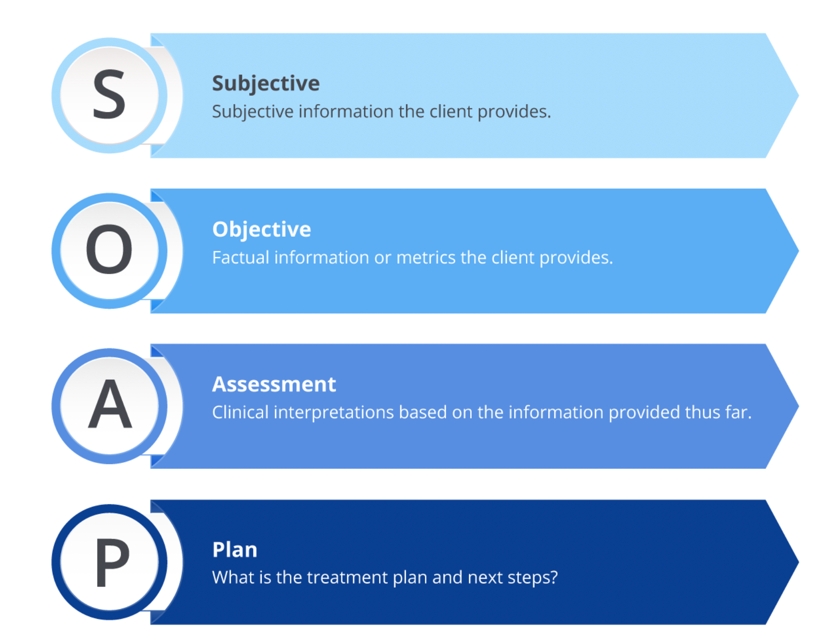

Slide 13
Subjective data S stands for subjective information, which is information obtained during their interview. It also includes information given to you verbally by family, friends, or other health care providers and staff. Subjective information is the patient's and others' perceptions of the illness.
When answers to closed-ended questions rule out complications due to chronic diseases, such as diabetes, all negative answers can be lumped under the term "denies; e.g., "patient denies, visual disturbances, chest pain, shortness of breath (SOB), hypoglycemic symptoms, numbness and tingling in extremities, vaginal discharge, or dysuria.
Any positive responses are further investigated using LOQQSAM and added to the note. "She states she has periodic headaches that are mild, of short duration and are relieved by acetaminophen and are not associated with low blood glucose or neurological symptoms.
Objective Data O stands for objective data, which include laboratory or diagnostic test results, findings on physical examination, vital signs, and what you observe, e.g., labored breathing, splinting, or coughing. in addition to whatever is documented previously or found in the medical record by either yourself or other providers, including subjective information from previous visits, the problem list, etc.
Assessment A stands for assessment. Assessment includes the suspected diagnosis, level of control of chronic diseases, or provisional diagnosis while waiting for final confirmation of the diagnosis. For example, the 80-year-old lady with multiple C-sections might have her assessment read “Severe abdominal pain, nausea, and vomiting suggesting intestinal obstruction” Later once the diagnosis is confirmed, it would change to intestinal obstruction. In the case of a patient seen for a routine follow-up visit for diabetes, the entry might be "Type 2 diabetes nearly at target A1C, without complications.
Plan P stands for plan, which includes a variety of topics. Referrals, follow-up appointments ("Return to clinic in 3 months:'), and further diagnostic tests are all included in the plan. In addition, the plan includes patient education performed and the treatment plan, which includes both drug and nondrug therapies.

Slide 14
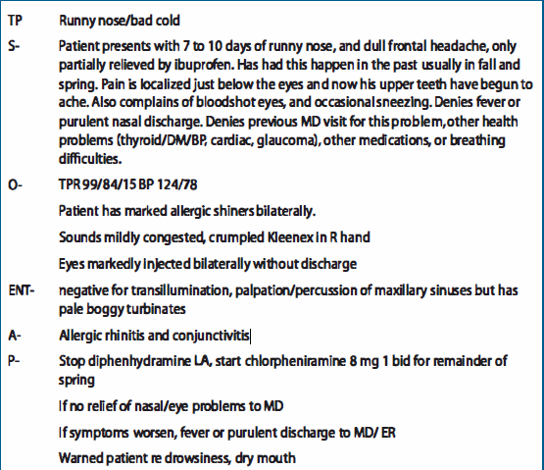
SOAP Example

Slide 15
References
Jones, R. M., & Jones, R. M. (2016). Patient assessment in pharmacy practice. Wolters Kluwer.
Plowden, K. O., & Janice Donaldson Hausauer. (2004). Instructor’s Resource Kit for Jarvis Physical Examination and Health Assessment.
Herrier, R. N., Apgar, D. A., Boyce, R. W., & Foster, S. L. (2015). Patient assessment in pharmacy. Mcgraw Hill Education Medical.

