Slide 1
DISTURBANCE IN STRUCTURE OF DENTINE L2
It may be due to
local causes like trauma (Turner’s tooth)
- general causes like vitamin D deficiency, mineral deficiency or drugs like chemotherapy.
The inherited dentine defects are:
1.Dentinogenesis imperfecta(opalescent dentine):
- Represents a group of hereditary conditions that are characterized by abnormal dentine formation.
- An autosomal dominant condition affecting both deciduous and permanent teeth.
.

Slide 2
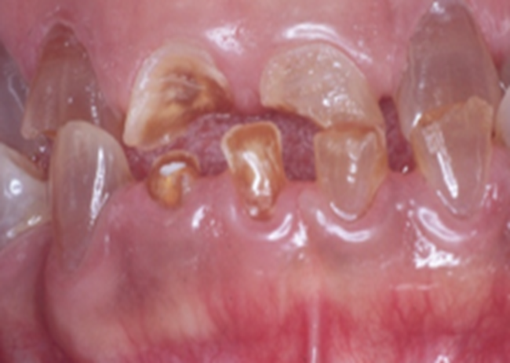
The types are:
*Dentinogenesis imperfecta type I: Individuals have osteogenesis imperfecta.
*Dentinogenesis imperfecta type II: Osteogenesis imperfecta is not a feature.
Affected teeth in dentinogenesis imperfecta type I and II are gray to yellow or brown and have broad crown and constricted cervical area (bell shape).
Enamel is easily broken leading to
exposure of dentine that undergoes
accelerated attrition
.

Slide 3
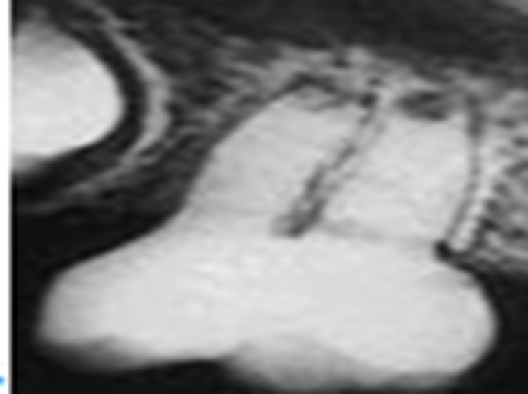
Radiographically, the teeth appear solid, lacking pulp chambers and root canals.
Histological examination shows that the
- Dentine contains a reduced number of tubules, many of which are wide and irregular.
.

Slide 4
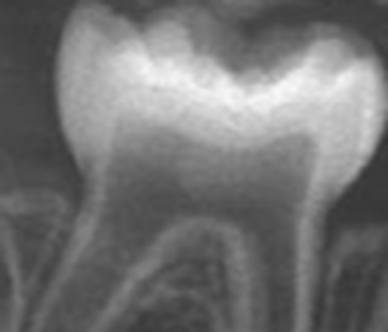
* Dentinogenesis imperfecta type III: Very rare, characterized by
too little dentin resulting in shell teeth
.
Dentinogenesis imperfecta type III

Slide 5
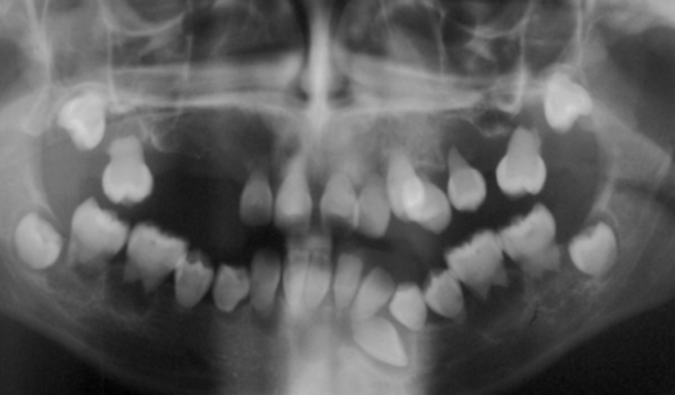
2.Dentinal dysplasia: Genetic disorder of teeth, commonly exhibiting an autosomal dominant inheritance.
- It is characterized by presence of normal enamel but atypical dentine with abnormal pulpal morphology.
*Dentine dysplasia type I (radicular type):
The roots of teeth are shorter than normal may lead to mobility and early exfoliation of the teeth
Total obliteration of the pulps
- perapical lesions are also seen
.
Dentine dysplasia type I

Slide 6
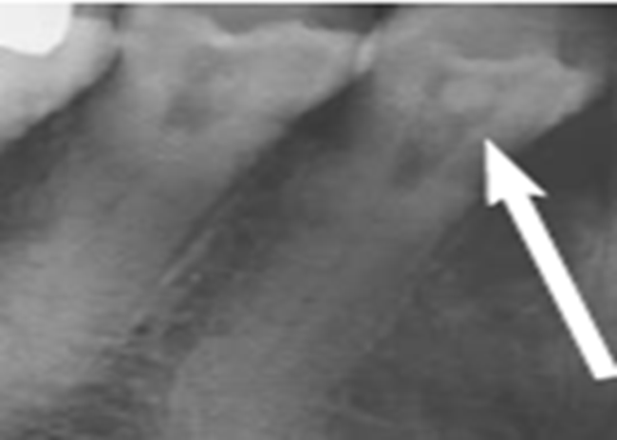
*Dentine dysplasia type II (coronal type):
In the deciduous dentition, coronal dentine dysplasia bears a resemblance to dentinogenesis imperfecta type II.
In permanent dentition is characterized by teeth of nearly normal length but as the pulp ascends to the crown, it flares into a flame shape and multiple pulp stone may be found .
.
dentinogenesis imperfecta type II

Slide 7
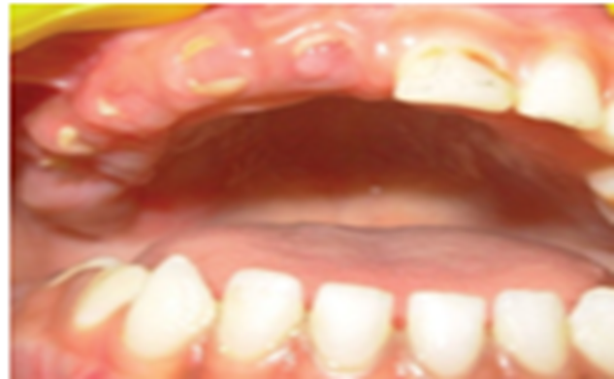
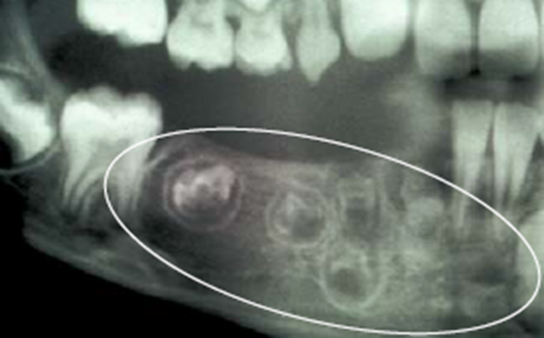
DISTURBANCE IN STRUCTURE OF ENAMEL AND DENTINE
1- Regional odontodysplasia (ghost teeth):
-This is a sporadic (not inherited) developmental defect, relatively rare.
Local ischemic change during odontogenesis may be the cause.
The clinical manifestations of odontodysplasia are localized occurrence within a particular region in either or both dentitions.
.

Slide 8
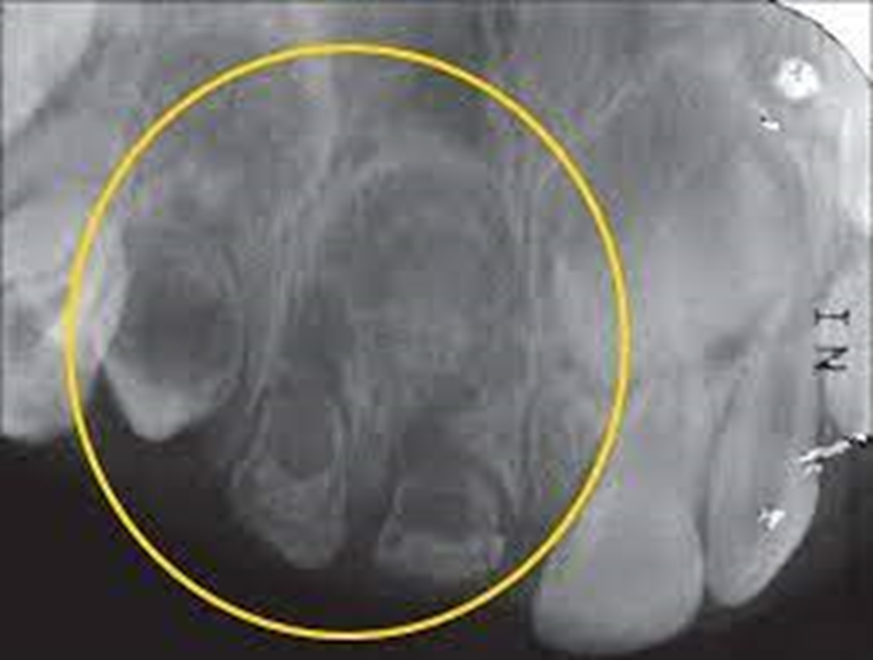
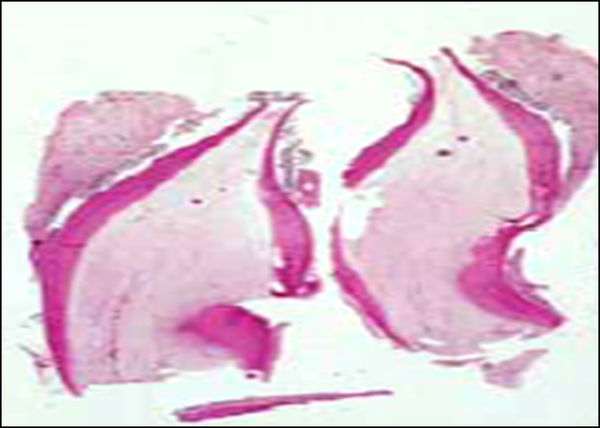
Hypocalcification and hypoplasia of the enamel and dentine are seen, they are thin and with the large pulp produce a ghost likes appearance of teeth.

Slide 9
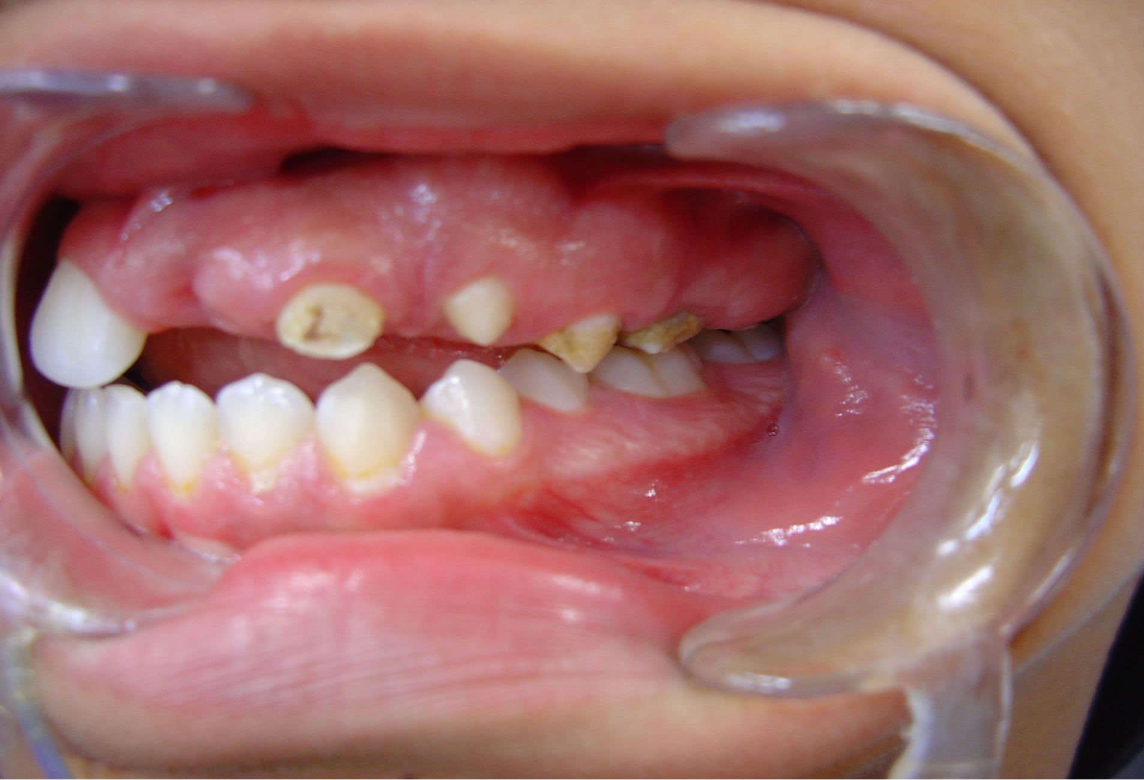
The teeth show irregular contour with surface pits and grooves and yellowish or brownish discoloration
.

Slide 10
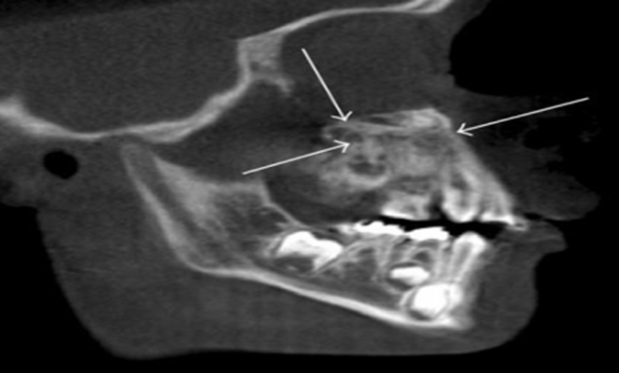
2- Segmental odontomaxillary dysplasia:
- Uncommon, nonhereditary developmental anomaly involving the maxilla, gingiva and dentition of the same arch.
It is a painless, unilateral enlargement of the upper jaw.
The cause is unknown.
The segment of the jaw that is involved is expanded due to enlargement of the bone in addition to its increased density, and hyperplasia of overlying gingiva.
Teeth in the involved jaw are
malformed and may be missing
.

Slide 11
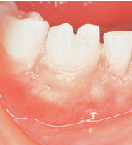
ABNORMALITIES IN THE SHAPE OF TEETH
Gemination: Developmental anomaly that occurs when a single tooth germ attempts to divide and results in the incomplete formation of two teeth.
The cause of this aborted twinning of a single tooth germ is unknown.
Clinically, appears as two crowns joined together by a notched incisal area .

Slide 12
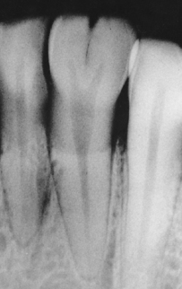
Radiographically
usually one single root and one common pulp canal exist.
The patient has a full complement of teeth.

Slide 13
Fusion: Results from the union of two normally separated adjacent tooth germs.
The cause of fusion is uncertain; heredity, external pressure, and crowding all have been suggested.
Fusion of adjacent teeth can be complete or incomplete, depending on the stage of tooth development at time of contact.
Early contact of developing tooth germs can result in a single large tooth; later contact can result in the union of crowns only or the union of roots only

Slide 14
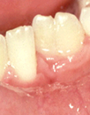
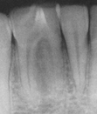

Slide 15
Concrescence: Condition in which two adjacent teeth are united by cementum only.
It is a form of fusion that takes place after tooth formation is complete
The cause of concrescence is thought to be crowding or trauma that results in the close approximation of adjacent tooth roots.
Subsequent cementum deposition acts to fuse the two adjacent roots.
Concrescence may involve erupted, unerupted, or impacted teeth.

Slide 16
Dilaceration:
- Abnormal curve or angle in the root
-This dental anomaly is thought to be caused by trauma to the tooth germ during root development.

Slide 17
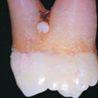
Enamel pearl:
Small, spherical enamel projection located on a root surface
This developmental anomaly is thought to occur as a result of the abnormal displacement of ameloblasts during tooth formation.

Slide 18
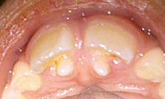
Talon cusp:
- Accessory cusp located in the area of the cingulum of a maxillary or mandibular permanent incisors
It resembles an eagle’s talon.
It often projects lingually and composed of normal enamel and dentin and contains a pulp horn

Slide 19
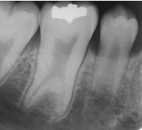
Taurodontism:
Developmental dental anomaly in which the teeth exhibit elongated, large pulp chambers and short roots , caused by developmental failure of the Hertwig epithelial root sheath to invaginate at the proper level.
- The tooth tends to have a stretched appearance without a constriction at the cementoenamel junction.
The roots appear short, with the
furcation located near the apices.

Slide 20
Dens in dente (dens invaginatus):
Developmental anomaly that results when the enamel organ invaginate into the crown of a tooth before mineralization. Radiographically
- A tooth like structure appears within the involved tooth.
An elongated bulb or pear-shaped mass of enamel is seen in dentine surrounding a radiolucent area; hence the name dens in dente, or “tooth within a tooth.”

Slide 21
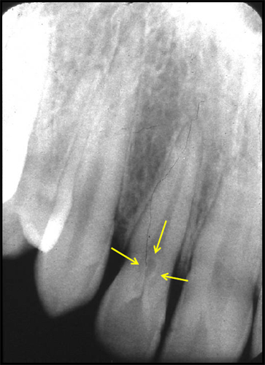
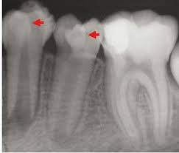

Slide 22
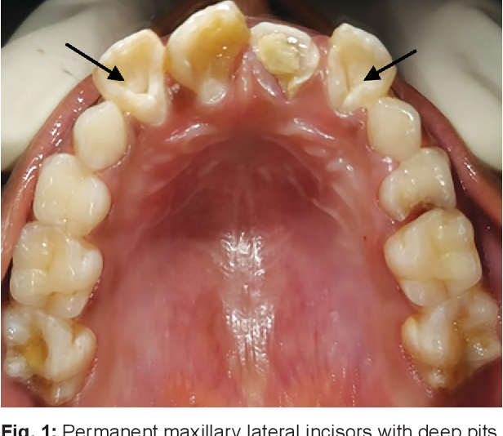
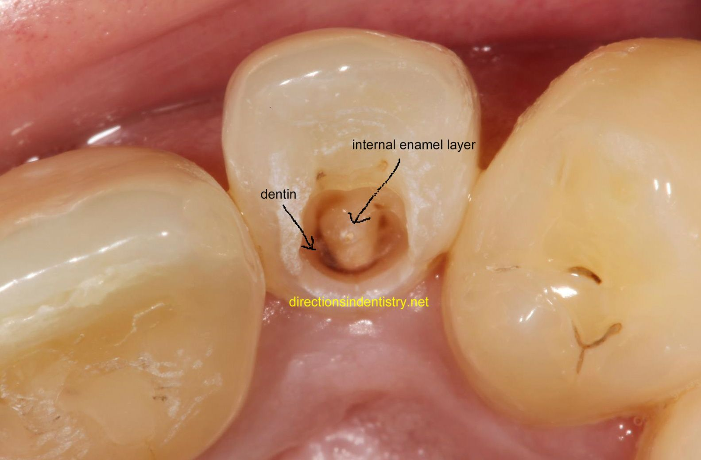
Anterior teeth, particularly the maxillary and mandibular incisors, are more commonly affected

Slide 23
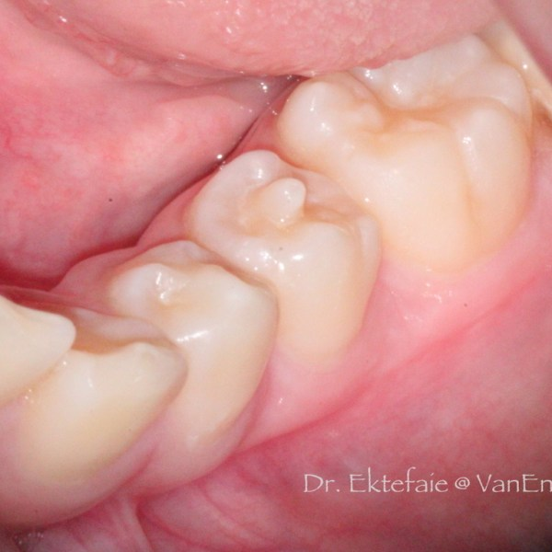
Dens evaginatus:
Accessory enamel cusp found on the occlusal tooth surface .
Dens evaginatus is thought to result from the proliferation and out pouching of enamel epithelium during tooth development. Clinically:
The dens evaginatus appears as a small,rounded nodule mostly on the occlusal surface of a mandibular
premolar between the buccal and lingual
cusps.

Slide 24
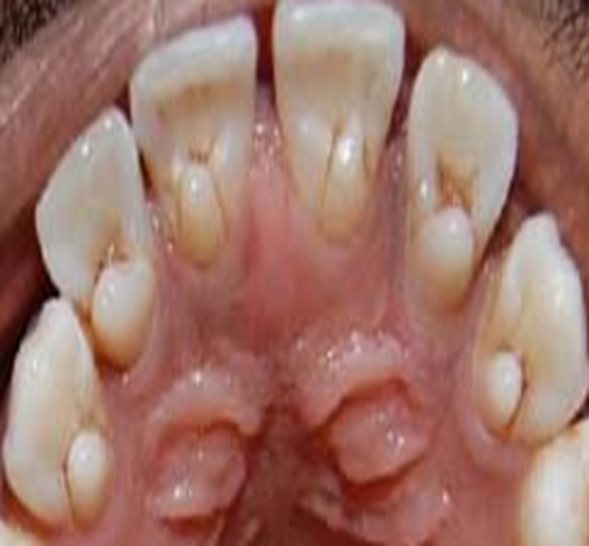
A pulp horn may extend into this extra cusp.
Occlusal wear or fracture of this accessory cusp may result in pulp exposure.
Some references considered talon cusp as dens evaginatus.
Dens evaginatus.

Slide 25
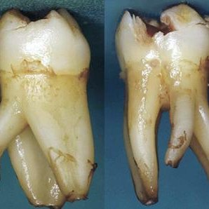
Supernumerary roots: Characterized by the presence of extra roots
Supernumerary roots.
extracted mandibular first molars

Slide 26



