Slide 1
L3
DEVELOPMENTAL ANOMALIES OF ORAL SOFT TISSUES

Slide 2
INTRODUCTION
Malformation or defect resulting from disturbance of growth and development are known as developmental anomalies
Hereditary developmental anomalies: when certain defects are inherited by the offspring from either of his parents, such types of anomalies are always transmitted through genes
Acquired anomalies: develop during intra-uterine life due to some pathological environmental conditions they are not transmitted through genes

Slide 3
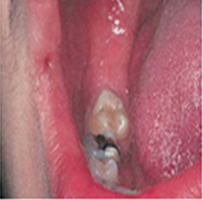
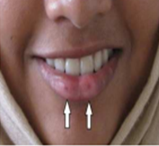
Lip pits and fistulas:
Developmental malformations which appear to be inherited as autosomal dominant trait, either unilateral or bilateral.
Commissural pit are epithelium-lined blind tracts located at the corners of the mouth, may be shallow or deep.
Lip pit occurs near the midline of the
vermilion border, may appear as a depression,
and more commonly seen in lower lip
No treatment is indicated.

Slide 4
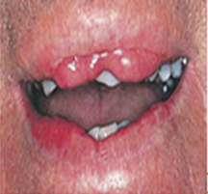
Double lip:
Horizontal fold of redundant mucosal tissue usually located on the inner aspect of the upper lip, although the lower lip can also be occasionally involved
It may be congenital or acquired

Slide 5
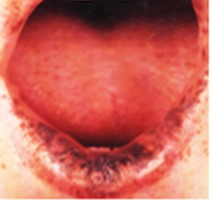
Hereditary intestinal polyposis (Peutz-Jeghers syndrome):
It is an autosomal dominantly inherited disorder characterized by intestinal polyps in association with mucocutaneous melanocytic macules
The affected individuals usually have a positive family history.
The principal causes of morbidity stem from the intestinal location of the polyps and unexplained intestinal bleeding.
Cutaneous pigmentation of the perioral
region crossing the vermilion border, perinasal
areas is seen

Slide 6
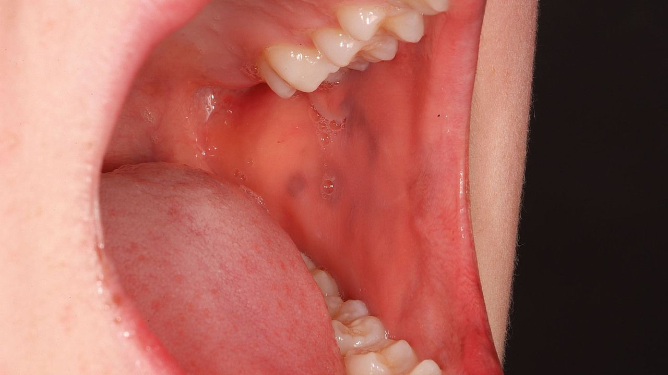
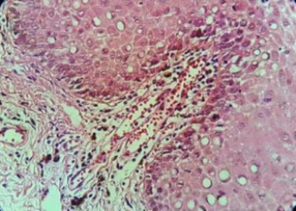
pigmentation may also be present on the fingers and toes, on the dorsal and ventral aspects of the hands and feet.
This pigmentation may fade after puberty.
Mucous membrane pigmentation primarily affects the buccal mucosa mostly.
Histological examination of oral macular lesions exhibited excessive accumulation of melanin granules in basal layer.

Slide 7
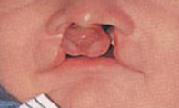
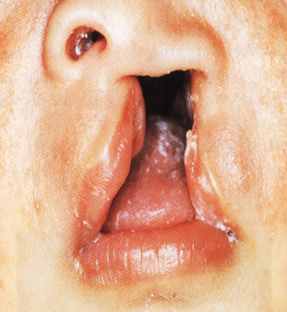
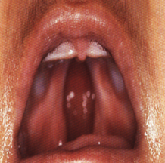
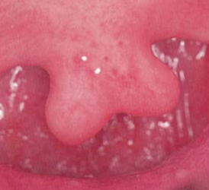
Cleft lip:
Relatively common defect of the lateral upper lip characterized by failure of the tissue processes to fuse during embryonic life.
Midline clefts are rarely occurring.
The cleft may extend through the soft tissue and may involve the maxillary alveolar ridge and may cause cleft palate, or cleft uvula and may involve the nostril on that side
Unilateral or bilateral involvement can be seen.

Slide 8
- Cleft lip can be treated by surgery in the first week after birth, but cleft palate are corrected surgically at the age of 18 months or immediately after that to prevent abnormal speech development.
- The etiology of cleft lip and cleft palate may be hereditary, or due to environmental factors during pregnancy (Nutritional factors, alcohol, toxins, drugs like high dose of steroid therapy, infections, mechanical obstruction by enlarged tongue, relative ischemia to the area during development, and psychological stress in pregnant mother).

Slide 9
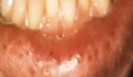
Cheilitis glandularis
-Uncommon developmental anomalies characterized by chronic enlargement of lips, mostly the lower lip causing eversion, attributable to chronic enlargement of labial salivary glands, inflammation, hyperemia, edema, and fibrosis in the area.
- Surface keratosis, erosion, and crusting develop as consequent to longstanding actinic exposure.

Slide 10
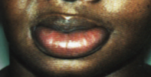
Cheilitis granulomatosa
Non tender firm swelling and enlargement of one or both lips due to granulomatous inflammation,
Mostly the lower lip involved .
The cause is unknown.
A genetic predisposition may exist in Melkersson-Rosenthal syndrome in which facial paralysis and fissured tongue are also present.
Crohn’s disease and sarcoidosis may present in a similar clinical fashion with identical histological findings.

Slide 11
White Sponge Nevus (oral epithelial naevus):
Familial white folded disease appears to follow a hereditary pattern as an autosomal dominant trait.
The oral lesions may be widespread, and may be apparent in infancy or early childhood and often involving the lip, cheeks, palate, and gingiva, floor of the mouth and portions of the tongue.
The mucosa appears thickened and corrugated with a soft or spongy texture

Slide 12
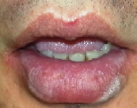
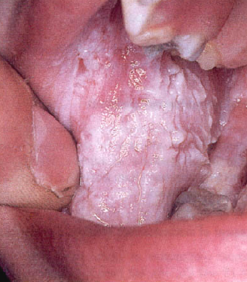
- In occasional cases, the oral lesions were accompanied by similar lesions of other mucosal surfaces, including the vagina, anus, rectum and nasal cavity.

Slide 13
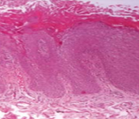
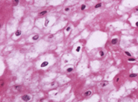
- Epithelium is generally thickened, showing both hyperparakeratosis and acanthosis.
-The cells of the nearly entire spinous layer exhibit intracellular edema.
Only the cell walls and the pyknotic nuclei in the centers of the cells are visible.
The submucosa may show no inflammatory cell infiltration, but this is not consistent. There is no treatment for the condition, and it is not premalignant

Slide 14
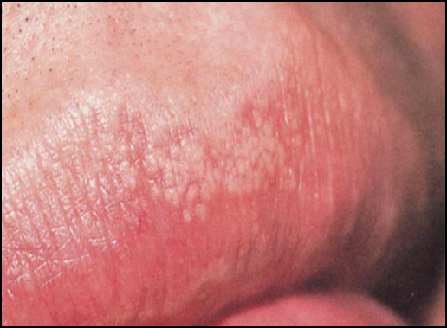
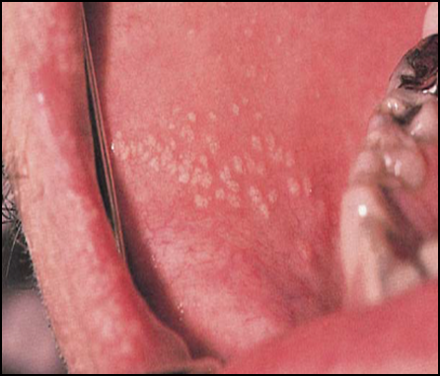
Fordyce’s granules:
characterized by ectopic collections of sebaceous glands at various sites in the oral cavity, appear as small yellowish whitish spots, often projecting slightly above the surface of tissue
Found most frequently in a bilaterally symmetrical pattern on the mucosa of the cheeks opposite the molar teeth in the retromolar region, on the vermilion border or inner surface of the lips, and occasionally on the
tongue, gingiva, and
palate.

Slide 15
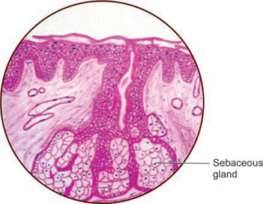
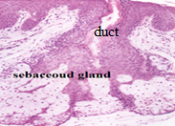
Histologically
- They are similar to normal sebaceous glands found in the skin but not associated with hair

Slide 16
Varix:
- Varices appear as red, blue, or deep purple broad-based elevations in oral mucosa, compressible and blanches upon pressure unless a thrombus has formed within it.
-The buccal mucosa is a common place to find them, however, they are also found in lip mucosa and ventral and lateral mucosa of the tongue and floor of the mouth.
- On ventral tongue they are multiple (lingual varicosity).

Slide 17
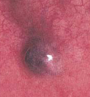
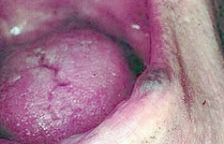
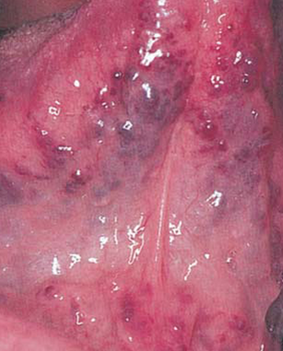
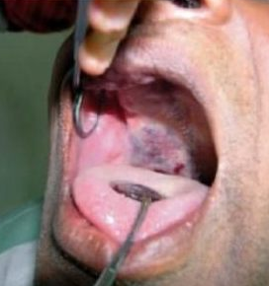
-They are seen more commonly in the elderly.
-The reason for venous distention is unclear but may be related to weakening of the vessel wall secondary to aging.
Varix: (A) Cheek. (B) Lip. (C) Tongue and (D) Palate.

Slide 18
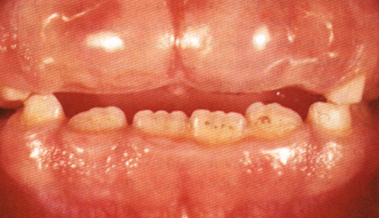
Fibromatosis gingivae:
-This anomalies characterized by diffuse fibrous overgrowth of the gingival tissues, transmitted through a dominant autosomal gene.
-This condition is manifested as a dense, diffuse, smooth, or nodular overgrowth of the gingival tissues
Usually appearing about time of eruption of the permanent incisors.
The tissue is usually not inflamed, but is of normal or even pale color, and it is often so firm and dense that it may prevent the normal eruption of teeth.

Slide 19
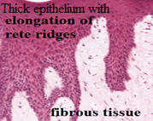
It is not painful and shows no tendency for hemorrhage.
The extent of the tissue overgrowth may be such that the crowns of the teeth are nearly hidden even though they are fully erupted with respect to the alveolar bone.
Histologically
Epithelium may be somewhat thickened with elongated rete pegs
The connective tissue is composed of dense fibrous connective tissue

Slide 20
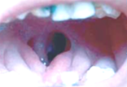
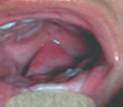
DEVELOPMENTAL ANOMALIES OF TONGUE
Aglossia: Congenital absence of the tongue
Aglossia with a hollow space in the region of tongue
Microglossia: Another congenital anomaly in which only a tiny or rudimentary tongue has developed

Slide 21
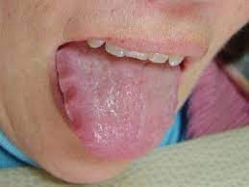
Macroglossia:
-Increase in size tongue due to hypertrophy of tongue musculature.
Macroglossia of either congenital or acquired type may cause displacement of teeth, and the lateral margins of the tongue appears scalloped.
The common causes are acromegaly and cretinism, amyloidosis with diffuse deposition of amyloids in the tongue, cystic lesion in the tongue like epidermoid and dermoid cyst,
and tumors in the tongue like lyphangioma
and hemangioma.

Slide 22
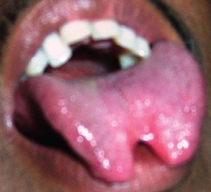
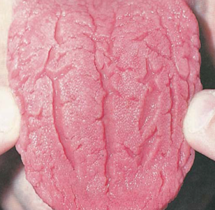
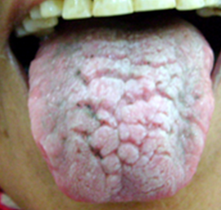
Bifid tongue:
The cleft tongue/bifid tongue is rare congenital anomaly develops due to partial or complete failure of union between the two lateral lingual swellings during emberyogenesis
Fissured tongue:
It is congenital developmental malformation which manifests clinically as numerous small furrows or groves on the dorsal surface of the tongue
-May leads to collection of food debris and microorganisms in the fissures and cause discomfort like
burning sensation and halitosis.

Slide 23
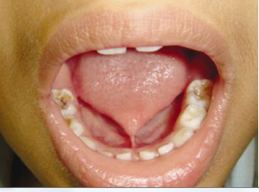
Ankyloglossia:
Occurs as a result of the fusion of the lingual frenum to the floor of the mouth
However, complete fusion rarely occurs; a partial ankyloglossia or "tongue-tie" is a much more common condition.
This leads to speech problems.
The treatment is by surgical removal of the connection between the frenum and the floor.

Slide 24
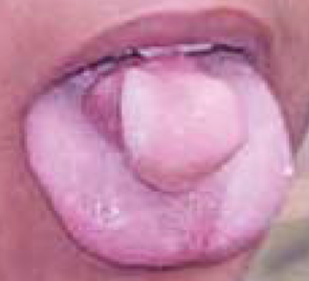
An accessory tongue:A rare congenital anomalies causing difficulty in speech
Lingual thyroid:
Normally thyroid gland descends along a path from foramen cecum in the tongue to the final position, failure of this migration leads to the development of lingual thyroid.
Fine needle aspiration biopsy from the mass revealed normal thyroid tissue with few colloidal changes.

Slide 25
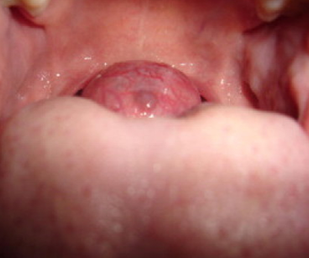
It appears as a nodular smooth exophytic mass in the midline, about 2-3 cm in diameter posterior to foramen caecum
Symptoms vary from difficulty in swallowing (dysphagia), respiratory obstraction(dyspnea), to change in voice(dysphonia).

Slide 26
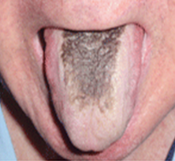
Hairy tongue:
-Characterized by the hypertrophy of the filiform papillae of the tongue.
If papillae become stained with tobacco, they appear black and look like hair on the tongue.
The tongue may appear yellowish-white if foodstuff is trapped within these papillae, gastric troubles are said to have a significant bearing on the development of this condition.
Smoking remains the biggest cause for
the occurrence of the condition.

Slide 27
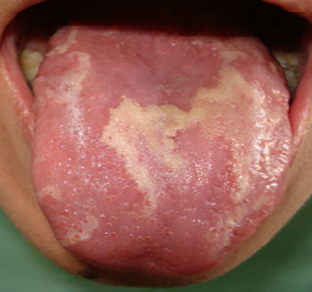
Benign migratory glossitis(geographic tongue):
-This lesions tend to "migrate" from one area of the tongue to another. - Exact cause for the condition remains unknown, although it tends to occur with more intensity in cases of emotional stress.
-Females are twice as affected as males.
- On examination of tongue, multifocal, patchy, sharply demarcated, and irregular areas of surface erosion
with depapillation were noted .

Slide 28
Median rhomboid glossitis:
A structure called "tuberculum impar" is supposed to withdraw when the two halves of tongue come close to each other during development. -- When this does not happen, the structure gets trapped in between the two halves of the tongue, thereby creating an area on it.
It typically presents in the posterior region of the dorsum of the tongue, at the midline, anterior to the lingual “V”.

Slide 29
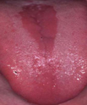
It appears as a rounded or rhomboid painless
area with well-defined margin
- It may present in two distinct clinical forms:
atrophic non-raised macular, or exophytic raised

Slide 30
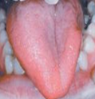
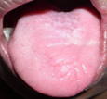
Hemihypertrophy: Side of the tongue appears larger than the other side.
Etiology is idiopathic, possibly related to neural, vascular, lymphatic, endocrine or chromosomal abnormalities
Hemiatrophy: Side of the tongue appears smaller than the other side

Slide 31
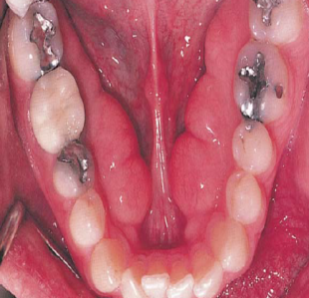
DEVELOPMENTAL ANOMALIES INVOLVING THE JAW BONE
1-Clefts palate:
2-Mandibular tori: Present benign overgrowths of mature, lamellar bone, occurring on the lingual mandibular cortex.
-Typically attached to the mandible opposite the premolar region and superior to the mylohyoid line
They are most commonly bilateral.

Slide 32
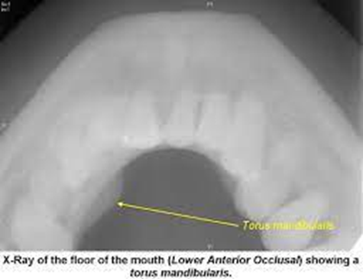
Apparently, genetic factors also influence tori development, as the offspring of parents with mandibular tori have a much higher incidence of development.
Radiographically, tori appear as well-defined areas of radio-opacity overlying the tooth roots, particularly extending from the canine to the molar regions.

Slide 33
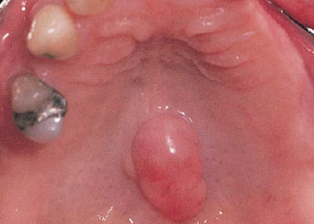
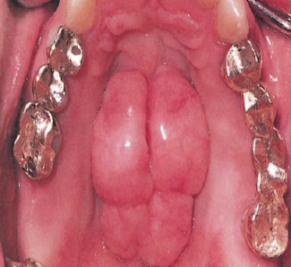
Maxillary torus:
Hard, frequently lobulated, benign overgrowth of mature lamellar bone located in the midline of the hard palate and attached by a broad, bony base
Hereditary factors have been implicated.
On radiographs, it may be visualized as radio-opacity in the midline.

Slide 34
Agnathia: Complete failure of development of the jawbone, involving maxilla or mandible or both of them and may involve part of the jawbone like condyle, ramus or premaxilla.
Micrognathia: Developmental anomalies characterized by abnormal small jaw.
Pseudomicrognathia is a condition where normal sized jaw bone appears to look small when the opposite jaw is larger than normal or when the jaw is positioned more posterior in relation to skull.

Slide 35
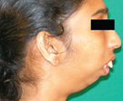
In true micrognathia the jawbone are really smaller than normal, and can be congenital or acquired.
The congenital missing premaxilla often leads to maxillary micrognathia.
Acquired problem is post natal in origin, the causes is ankylosis of the temporomandibular joint as result of trauma/infection leads to mandibular micrognathia with retruded chin

Slide 36
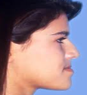
Macrognathia: Developmental anomalies characterized by abnormal large jaw or jaws
Pseudo macrognathia is a condition where normal sized jawbone appears to look large when the opposite jaw is smaller than normal. In true macrognathia the jaw bone are really larger than normal. Mandibular prognathism often occur due to hereditary causes.
Other causes of large jaw are pituitary gigantism, acromegaly, or Paget’s disease.

Slide 37
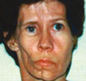
Facial hemiatrophy: Progressive decrease in the size of one side of the face due to atrophy of facial structure.
-The affected side shows atrophy of the skin, subcutaneous tissue, the muscles, bones, cartilages, alveolar bone and soft palate.
Dental abnormalities include incomplete root formation, delayed eruption, severe facial asymmetry resulting in facial deformation and difficulty with mastication.
Eruption of teeth on the affected
side may also be retarded

Slide 38
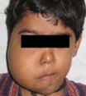
Facial hemihyperatrophy: A rare developmental anomaly characterized by enlargement which is confined to one side, unilateral macroglossia and premature development and eruption as well as increased size of dentition, the permanent teeth on the affected side develop more rapidly and erupt before their counterparts on the uninvolved side.
Coincident to this phenomenon is
premature shedding of the deciduous teeth.

Slide 39
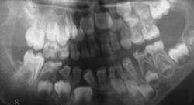
- The bone of the maxilla and mandible is also enlarged, being wider and thicker.

Slide 40
References
ORAL PATHOLOGY, Clinical pathologic correlation.3rd Edition
REGEZI and SCIUBBA.
2. ORAL PATHOLOGY. Fourth Edition, SOAMES and SOUTHAM..
3. Cawson 's Essentials of Oral Pathology and Oral Medicine
7th Edition.

