Slide 1
Nervous System
2nd grade Lab 1 Goran Saleh goran.nori@tiu.edu.iq

Slide 2
Objectives
CNS
PNS
Neuron

Slide 7
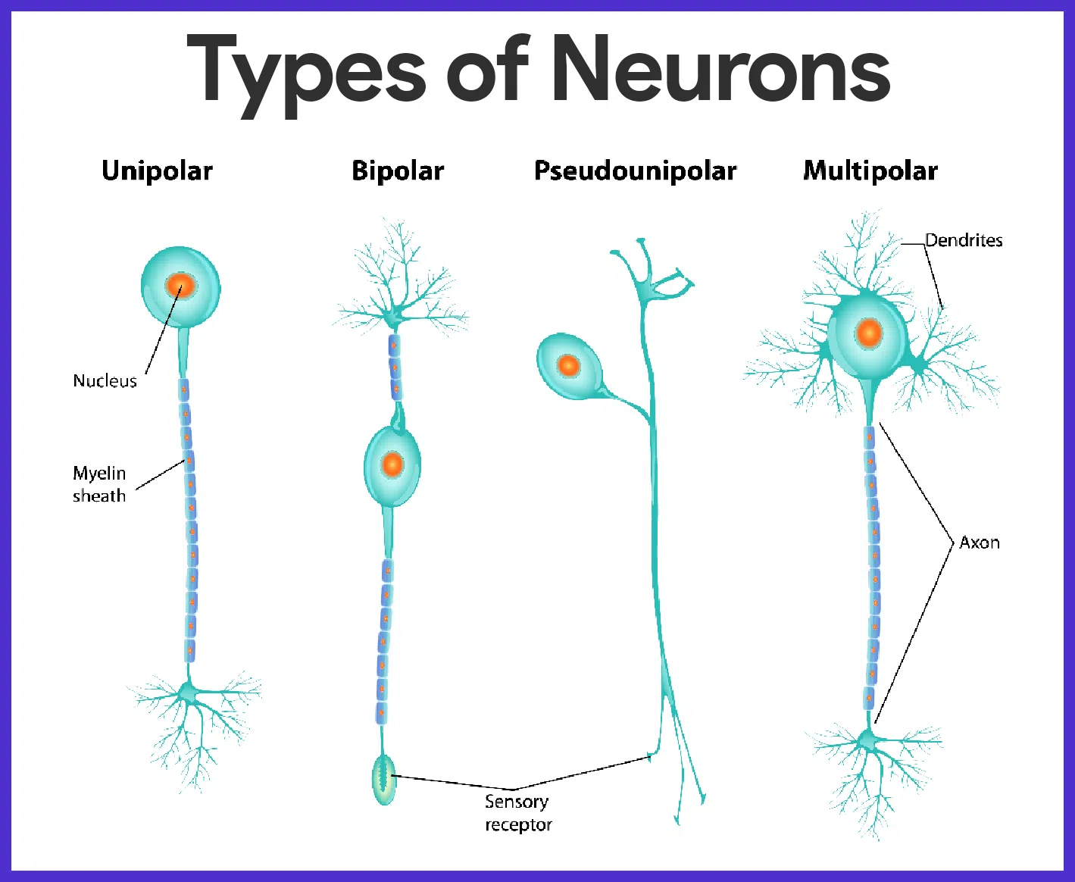

Slide 10
Thank You

