Slide 1
Basic life support BLS
By
Dr. Muhammad Abdullah Shwani
Assistant professor/Consultant urologist
Kurdistan Higher Council of Medical Specialties (KHCMS)
drmalshwani@mail.com

Slide 2
BLS includes
Sequences Of Procedures Performed To Restore The Circulation Of Oxygenated Blood After A Sudden Pulmonary And / Or Cardiac Arrest
Chest Compressions And Rescue breathing Performed By Anyone Who Knows How To Do It, Anywhere, Immediately, Without Any Other Equipment or Protective Devices

Slide 3
OBJECTIVES
How to assess the collapsed victim
How to perform chest compression and rescue breathing
How to place an unconscious breathing victim in the recovery position

Slide 4
BACKGROUND
Survival to hospital discharge presently approximately 5-10%
Bystander CPR vital intervention before arrival of emergency services – double or triple survival from SCA (sudden cardiac arrest)
Early resuscitation and prompt defibrillation (within 1-2 minutes) can result in >60% survival

Slide 5
Unresponsive adult

Slide 6
Assessing a casualty and primary survey
When you assess a casualty you first need to identify and deal with any life-threatening conditions or injuries as quickly as possible in priority order and dealt with on a “find and treat” basis. with a primary survey.
Follow A, B,C, D : Airway, Breathing, Circulation, and Disability.
If the life-threatening injuries are successfully managed, or there are none, you continue the assessment and perform a secondary survey.

Slide 7
What should be checked in primary surveys?
Airway
Breathing
Circulation - Bleeding
Disability (keep this in mind from the beginning)

Slide 8
Primary and secondary survey

Slide 9
The secondary survey
This is a detailed examination of a casualty to look for other injuries or conditions that may not be immediately apparent. To do this, carry out a head-to-toe examination. Which include :
History: What actually happened and any relevant medical history.
Symptoms: Injuries or abnormalities that the casualty tells you about.
Signs: Injuries or abnormalities that you can see.
Record your findings and pass on any relevant information to the medical team.

Slide 10
Steps / Sequences of BLS
1- APPROACH SAFELY
2-Check response
3- Shout for help
4- Open airway
5- Check breathing
6- Call 122
7- 30 chest compressions
8- 2 rescue breaths

Slide 11
APPROACH SAFELY
On discovering a collapsed casualty, you should first make sure the scene is safe in regard to :
Scene
Resecure
Victim
By standards
What to do :
Until CPR is Given and Qualified Help Arrives make sure the area is safe
The threat of fire or explosion should be excluded
The victim must be on a hard surface
Place the victim’s head slightly lower than the body

Slide 12
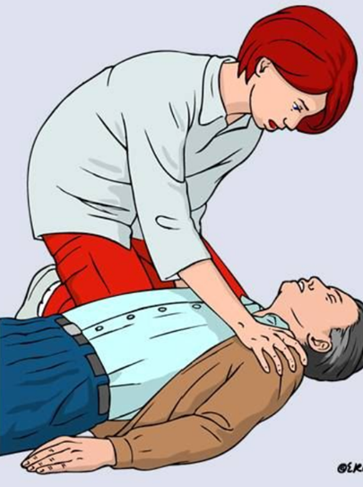
Check For Response
On discovering a collapsed casualty, you should first make sure the scene is safe and then establish whether he is :
Responsive. Or
Unresponsive.
Always approach and treat the casualty from the side, kneeling down next to his head or chest. You will then be in the correct position to perform all the stages of resuscitation

Slide 13
Check response
Shake shoulders gently
Ask “Are you all right?”
If he responds Leave as you find him.
Find out what is wrong.
Reassess regularly
Always speak loudly and clearly to the casualty

Slide 14
If there IS a response
If there is no further danger, leave the casualty in the position in which he was found.
Use the primary survey to identify the most serious injury and treat conditions in order of priority.
Ask for help if needed.
Monitor and record vital signs (HR,RR,BP, Temp) until help arrives or the casualty recovers.

Slide 15
If there is NO response
Shout for help.
Leave the casualty in the position in which he was found and open the airway.
If you are unable to open the airway in the position in which he was found, roll him on to his back and open the airway.

Slide 16
Casualty position
Position on back
All body parts rolled over at the same time
Always be aware of head and spinal cord injuries
Support neck and spinal column

Slide 17
Shout for help

Slide 18
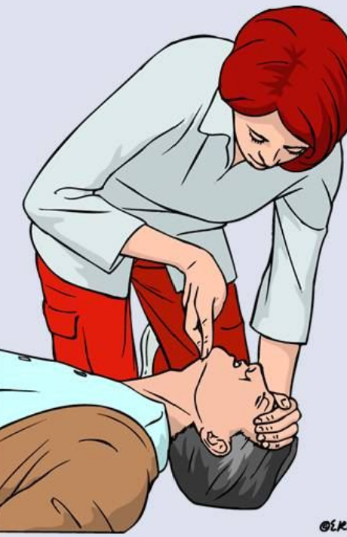
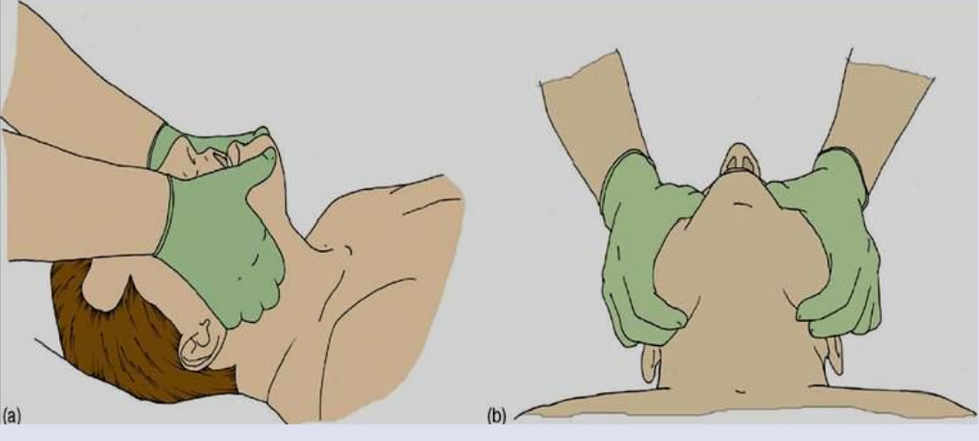
Open airway
How to open the airway?
Place one hand on his forehead. Gently tilt his head back. As you do this, the mouth will fall open slightly.
Place the fingertips of your other hand on the point of the casualty’s chin and lift the chin.

Slide 19
Check breathing
Keeping the airway open, looking, listening, and feeling for normal breathing:
Look for chest movement.
Listen for sounds of breathing.
Feel for breaths on your cheek.
Do this for no more than 10 seconds before deciding whether or not the casualty is breathing normally.

Slide 20
If the casualty IS breathing
Use the primary survey to identify the most serious injury and treat conditions in order of priority.
Place the casualty in the recovery position and call 122 for emergency help.
Monitor and record vital signs while waiting for help to arrive.

Slide 21
Place the casualty in recovery position

Slide 22
If the casualty is NOT breathing
Ask a helper to call 122 for emergency help.
Ask the person to bring an AED .
If you are alone, make the call yourself, ideally use your mobile device set to speakerphone to make the call.
Begin CPR with chest compressions – do not leave a casualty in search of an AED.

Slide 23
How to give CPR
1.Kneel beside the casualty. Place the palm of one hand on the center of the casualty’s chest.
2. Place the palm of your other hand on top of the first hand, and interlock your fingers, making sure the fingers are kept off the ribs.

Slide 24
Hand position

Slide 25
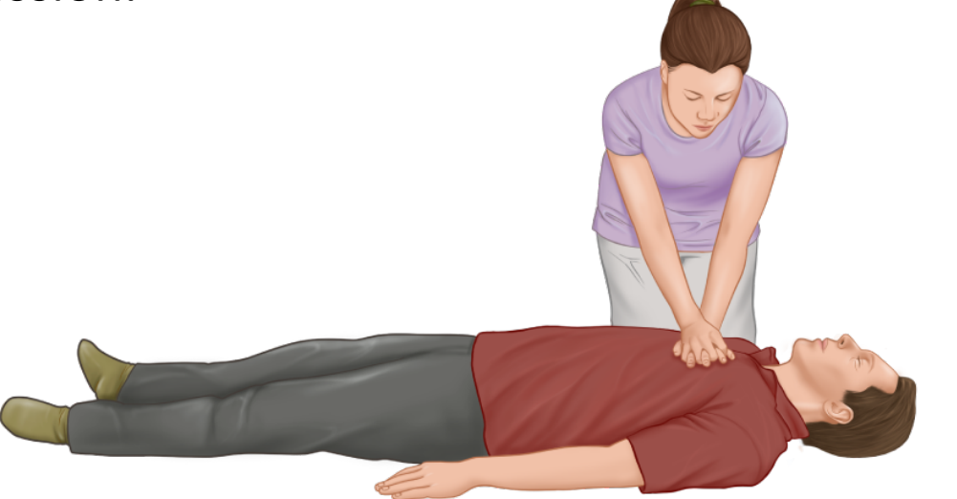
3. Leaning over the casualty, with your arms straight, press down vertically on the sternum and depress the chest by 5–6cm (2– 2½in). Release the pressure without removing your hands from his chest. Allow the chest to come back up fully (recoil) before giving the next compression.
4. Compress the chest 30 times at a rate of 100–120 compressions per minute. The time taken for compression and release should be about the same.

Slide 26
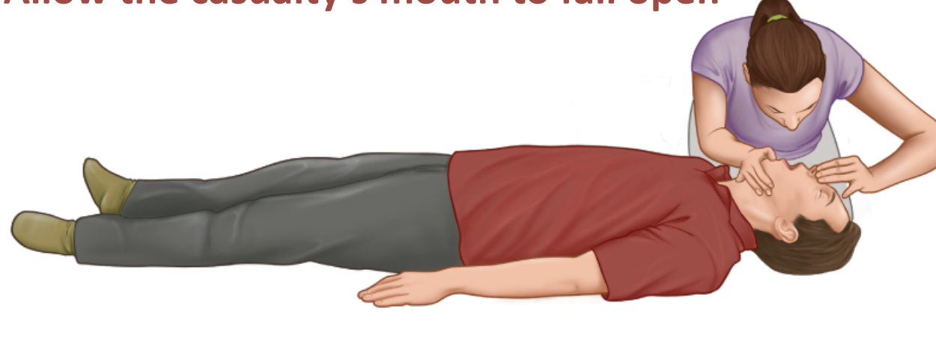
5. Move to the casualty’s head and make sure that the airway is still open. Put one hand on his forehead and two fingers of the other hand under the tip of his chin. Move the hand that was on the forehead down to pinch the soft part of the nose with the finger and thumb. Allow the casualty’s mouth to fall open

Slide 27
6. Take a breath and place your lips around the casualty’s mouth, making sure you have a good seal. Blow into the casualty’s mouth until the chest rises. A complete rescue breath should take one second. If the chest does not rise, you may need to adjust the head position.

Slide 28
7. Maintaining head tilt and chin lift, take your mouth off the casualty’s mouth and look to see the chest fall. If the chest rises visibly as you blow and falls fully when you lift your mouth away, you have given a rescue breath. Give a second rescue breath.
Make no more than two attempts to achieve rescue breaths before repeating compressions.

Slide 29
8. Continue the cycle of 30 chest compressions followed by TWO rescue breaths (30:2)
Until the emergency help arrives and takes over
The casualty shows signs of becoming responsive – such as coughing, opening his eyes, speaking, moving purposefully – and starts to breathe normally
Or you are too exhausted to continue.

Slide 30
Breathing: Mouth To Nose (when to use)
Can't open mouth
Can't make a good seal
Severely injured mouth
Stomach distension
In case of the presence of tracheostomy Mouth to a stoma (tracheotomy) is done

Slide 31
Special considerations for CPR
If you have not been trained in CPR or are unwilling or unable to give rescue breaths you can give chest compressions only.
If there is more than one rescuer, change over every 1–2 minutes, with minimal interruption to chest compressions.
If the casualty vomits during CPR, roll him away from you onto his side, ensuring that his head is turned towards the floor to allow vomit to drain away. Clear any residual debris from his mouth, then immediately roll him onto his back again and recommence CPR.

Slide 32
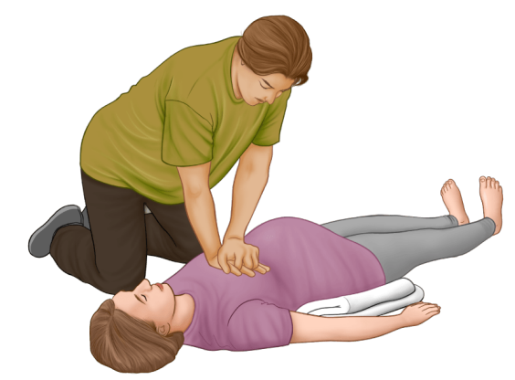
Special considerations for CPR
If a woman in the late stage of pregnancy requires CPR, raise her right hip off the ground by tilting it upwards before you begin compressions.
Ask a helper to kneel beside the woman so that his knees are underneath the raised hip.
If you are on your own, place tightly rolled-up clothing or towels under the woman’s hip to lift it.

Slide 33
Why CPR May Fail
Delay in starting
Improper procedures (ex. Forget to pinch nose)
No ACLS(advanced cardiac life support ) follow-up and delay in defibrillation
Terminal disease or unmanageable disease (massive heart attack)

Slide 34
When Can I Stop CPR?
Victim revives
Trained help arrives
Too exhausted to continue
Unsafe scene
Physician directed (do not resuscitate)
The cardiac arrest of longer than 30 minutes (controversial)

Slide 35
Complications of CPR
Rib fractures
Laceration related to the tip of the sternum causing Liver, lung, spleen
Vomiting.
What to do in case of vomiting?
Aspiration
Place victim on left side
Wipe vomit from the mouth with fingers wrapped in a cloth
Reposition and resume CPR

Slide 36
Complications of CPR
Distension of the stomach
Creates pressure against the lungs
Prevention of Stomach Distension by :
Don't blow too hard
Slow rescue breathing
Re-tilt the head to make sure the airway is open
Use mouth to nose method

Slide 37
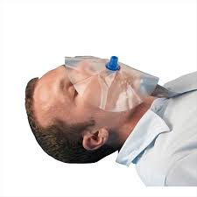
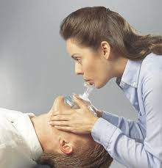
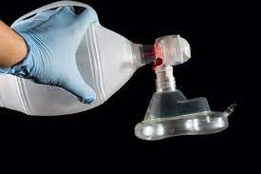
Mouth to Mouth Barrier Devices
Masks
Shields
Devices

Slide 38
When the ambulance arrives
If an AED is not already attached to the casualty, the ambulance personnel will do that. They will also use additional drugs and equipment to provide advanced care.
If you are asked to help you should listen carefully and follow the instructions given.
Any decision to stop resuscitation can only be made by a healthcare professional

Slide 39
THANK YOU

