Slide 1
Lab 2
Anatomy Practical
Digestive System
By: Goran N. Saleh (MSc. HMU)

Slide 2
The Digestive System
The digestive system is made up of the digestive tract & accessory digestive organs:
a series of hollow organs joined in a long, twisting tube from the mouth to the anus
and other organs that help the body in break down and absorption of food

Slide 3
Function of Digestive System
Digestion
The mechanical and chemical breakdown of foods for use by the body’s cells
Absorption
The passage of digested food (nutrients) from the digestive tract into the circulatory system (blood)
Metabolism
Production of cellular energy (ATP)
Elimination
The expulsion of undigested food or body wastes

Slide 4
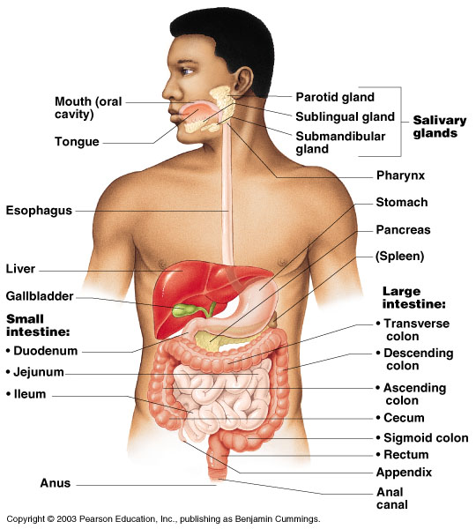
Organs of the Digestive System
Two main groups
Alimentary canal – continuous coiled hollow tube
Mouth
Pharynx
Esophagus
Stomach
Small intestine
Large intestine
Anus
Accessory digestive organs
Teeth
Salivary glands
Pancreas
Liver
Gall bladder

Slide 5
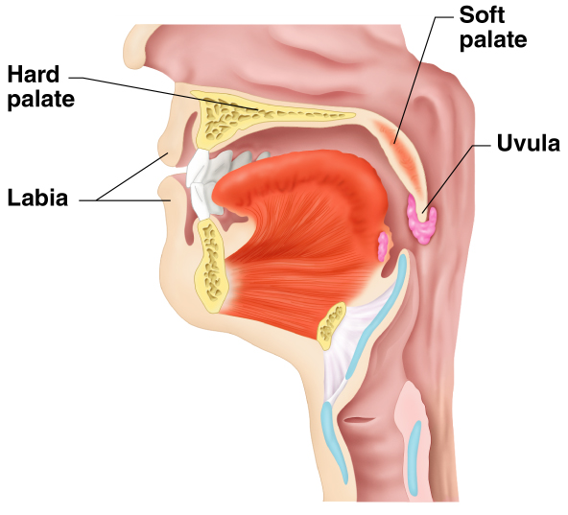
Mouth (Oral Cavity)
Orifice through which food and air enter the body
It opens to the outside at the lips and empties into the throat
Its boundaries are defined by the lips, cheeks, hard and soft palates, and uvula.
Lips (labia) – protect the anterior
opening
Cheeks – form the lateral walls
Hard palate – forms the anterior roof
Soft palate – forms the posterior roof
Uvula – fleshy projection of the soft palate

Slide 6
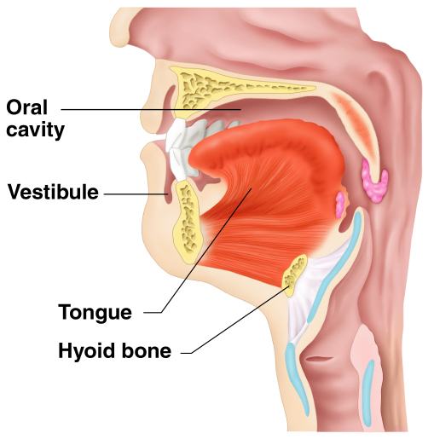
Mouth (Oral Cavity) Anatomy
It is divided into two sections:
Vestibule – space between lips & cheeks externally and teeth and gums internally
Oral cavity – area contained by the teeth

Slide 7
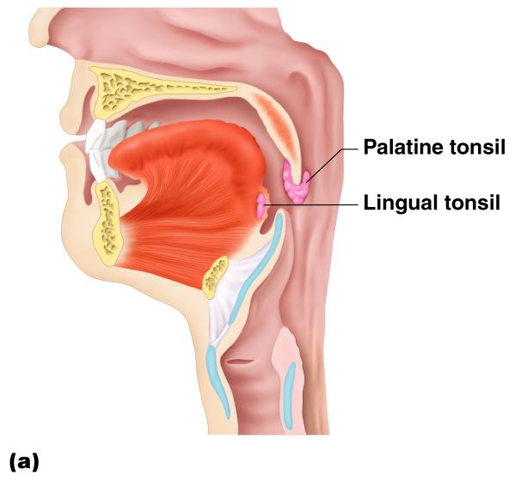
Mouth (Oral Cavity) Anatomy
Tonsils
Palatine tonsils: embedded in the lateral walls of the opening between the mouth and the pharynx
Lingual tonsil: occupying the posterior part of the tongue surface

Slide 8
Processes of the Mouth
Mastication (chewing) of food
Mixing masticated food with saliva

Slide 9
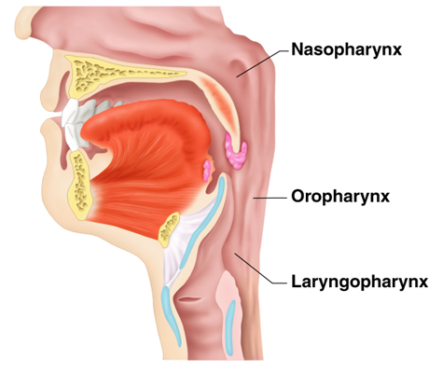
Pharynx Anatomy
The cavity of the pharynx is about 12.5 cm
Nasopharynx – superior region behind nasal cavity but not part of the digestive system
Oropharynx – middle region behind mouth
Laryngopharynx – inferior region, connected to the esophagus
Serves as a passageway for
air and food
Food is propelled to
the esophagus by alternating
contractions (peristalsis) of
two muscle layers
Longitudinal layer
Circular layer

Slide 10
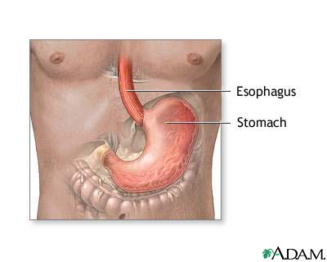
Esophagus
Approximately 25cm long
Runs from pharynx to stomach through the diaphragm
Conducts food by peristalsis (slow rhythmic squeezing)
Passageway for food only

Slide 11
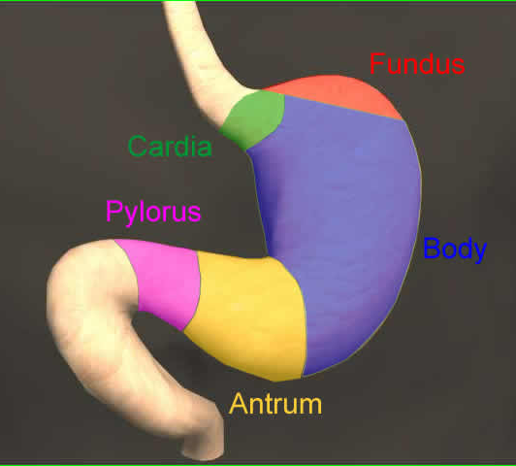
Stomach Anatomy
Usually “J” shaped, located on the left side of the abdominal cavity, anterior to the spleen between the esophagus and small intestine (duodenum)
Regions of the stomach
Cardiac region – near the heart
Fundus
Body
Antrum
Phylorus: funnel-shaped terminal end
Food empties into the small intestine at the pyloric sphincter

Slide 12
Stomach
Rugae – internal folds of the mucosa
External regions
Lesser curvature
Greater curvature
Layers of peritoneum attached to the stomach
Lesser omentum – attaches the lesser curvature to the liver
Greater omentum – attaches the greater curvature to the posterior body wall

Slide 13
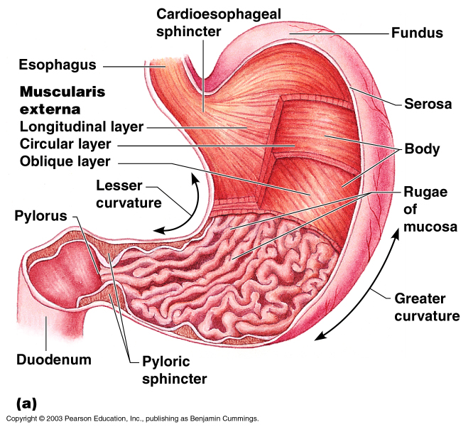
Stomach

Slide 14
Function of Stomach
Acts as a storage tank for food
Site of food breakdown
Delivers chyme (processed food) to the small intestine

Slide 15
Specialized Mucosa of the Stomach
Simple columnar epithelium
Gastric pits formed by folded mucosa
Glands and specialized cells are in the gastric gland region
Gastric glands – secrete gastric juice
Mucous cells – produce a sticky alkaline mucus
Chief cells – produce protein-digesting enzymes (pepsinogens)
Parietal cells – produce hydrochloric acid
Endocrine cells – produce gastrin

Slide 16
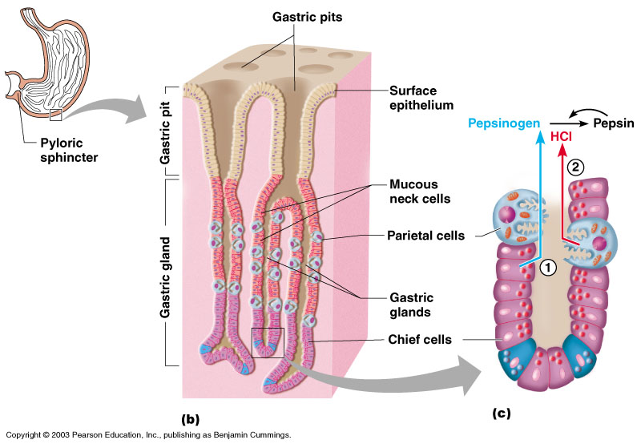
Structure of the Stomach Mucosa

Slide 17
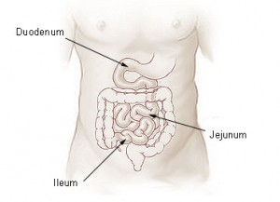
Small Intestine
The body’s major digestive organ roughly 6 meters long
Muscular tube extending form the pyloric sphincter to the ileocecal valve
Site of nutrient absorption into the blood
Duodenum
Attached to the stomach
Jejunum
Attaches anteriorly to the duodenum
Ileum
Extends from jejunum to large intestine

Slide 18
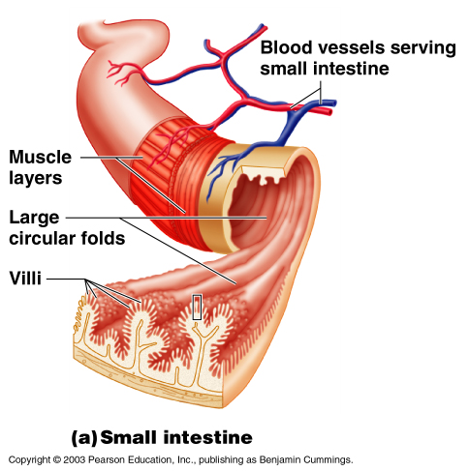
Villi of the Small Intestine
Fingerlike structures formed by the mucosa
Give the small intestine more surface area

Slide 19
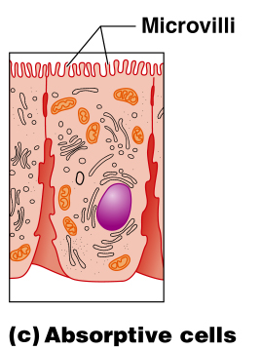
Microvilli of the Small Intestine
Small projections of the plasma membrane
Found on absorptive cells

Slide 20
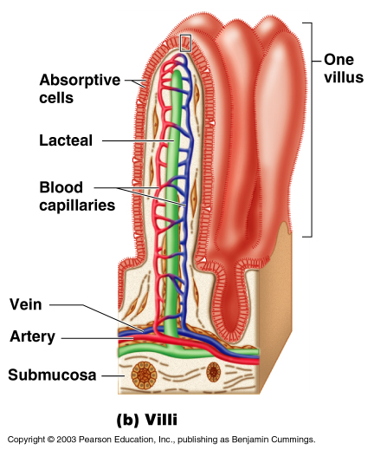
Structures Involved in Absorption of Nutrients
Absorptive cells
Blood capillaries
Lacteals (specialized lymphatic capillaries)

Slide 21
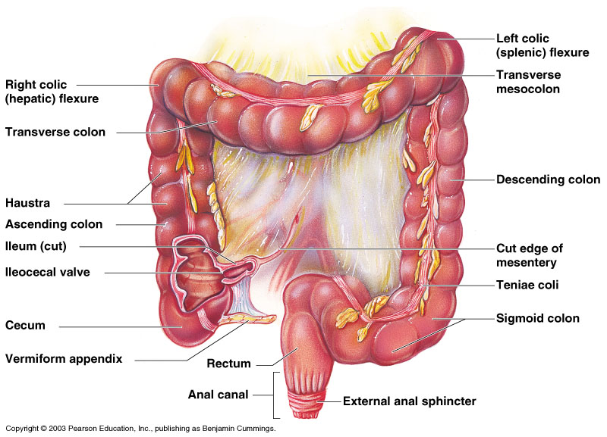
Large Intestine (About 1.5 m long)
Larger in diameter, but shorter than the small intestine
Frames the internal abdomen

Slide 22
Structures of the Large Intestine
Cecum – sac like first part of the large intestine
Vermiform Appendix
Accumulation of lymphatic tissue that sometimes becomes inflamed (appendicitis)
Hangs from the cecum
Colon
Ascending
Transverse
Descending
S-shaped sigmoidal
Rectum: About 15cm long & Stores waste before egestion
Anus (external body opening): Muscular ring that controls egestion

Slide 23
Functions of the Large Intestine
Does not participate in digestion of food
Absorption of water
Eliminates indigestible food from the body as feces
Goblet cells produce mucus to act as a lubricant

Slide 24
Accessory Digestive Organs
Teeth
Salivary glands
Pancreas
Liver
Gall bladder

Slide 25
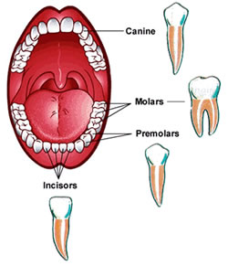
Teeth (2+1+2+3)
The role is to masticate (chew) food
(mechanical breakdown)
Incisors used for cutting
Canines used for stabbing
and holding
Premolars
Molars large surface area
used for grinding

Slide 26
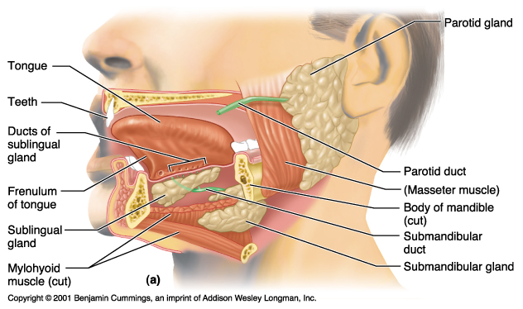
Salivary Glands
Saliva-producing glands
Parotid glands – located anterior to ears
Submandibular glands
Sublingual glands

Slide 27
Saliva
Mixture of mucus and serous fluids
Chemical breakdown
Contains salivary amylase to begin starch digestion
Helps to form a food bolus

Slide 28
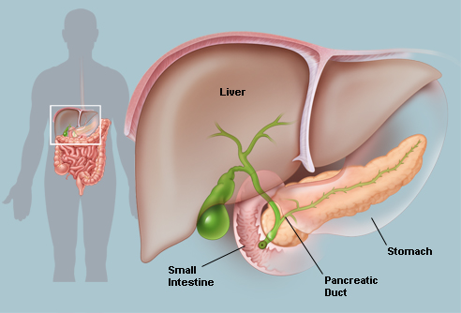
Pancreas
About 6 inches long, sits across the back of the abdomen, behind the stomach.
The head of the pancreas is on the right side of the abdomen and is connected to the duodenum through a small tube called the pancreatic duct.
Produces a wide spectrum of digestive enzymes that break down all categories
of food
Enzymes are secreted into
the duodenum

Slide 29
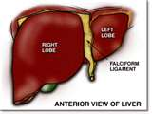
Liver
Largest gland in the body reddish-brown in color
Located on the right side of the body under the diaphragm
Consists of four lobes suspended from the diaphragm and abdominal wall by the falciform ligament
Left
Quadrate
Caudate
Right
Connected to the gall bladder
via the common hepatic duct

Slide 30
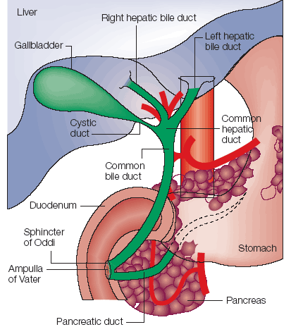
Gall Bladder
Sac found in hollow fossa of liver
Stores bile from the liver by way of the cystic duct
Bile is introduced into the duodenum in the presence of fatty food

Slide 31
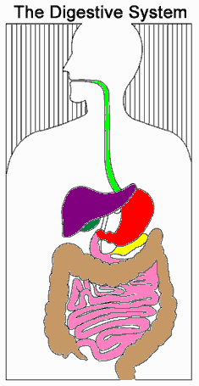
Write the name of
each colored organ:
Green:
Red:
Pink:
Brown:
Purple:
Green:
Yellow:

Slide 33
Thank you

