Slide 1
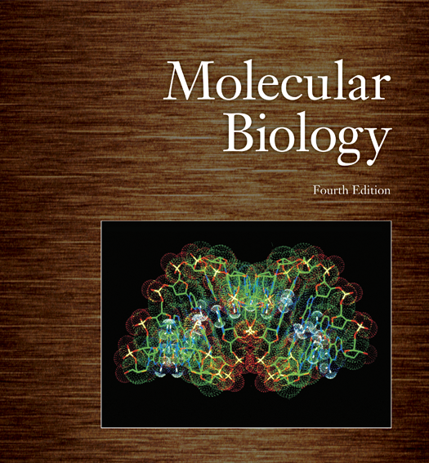
Molecular Biology & Proteomics Introduction
Name of teacher Dr. Ahmad H. Ibrahim
Molecular Biology & Proteomics
course code: PHAR 338
1st Semester / 1st week 1.10.2023

Slide 2
Outline
I. Introduction to Molecular Biology
• Definition of Molecular Biology
• Scope and Significance of Molecular Biology
II. The Chromosome Theory of Inheritance
• Chromosomes as Carriers of Genes
• Thomas Hunt Morgan and His Contributions
• Autosomes and Sex Chromosomes
• Chromosomal Composition in Males and Females

Slide 3
Outline
III. Genotype and Phenotype
• Definition of Genotype
• Definition of Phenotype
• Relationship between Genotype and Phenotype
• Wild-Type vs. Mutant Alleles

Slide 4
Outline
IV. The Relationship between Genes and Proteins
• Defective Genes and Enzyme Production
• The "One Gene-One Enzyme" Hypothesis
• Clarifying the Concept: One Gene-One Polypeptide
• Genes Encoding Non-Enzyme Proteins
V. Diversity of Gene Products
• Genes Producing Non-Polypeptide Products
• Functional RNA Molecules

Slide 5
Outline
VI. Activities of Genes
• Three Major Roles of Genes
1. Faithful Replication
2. Directing RNA and Protein Production
3. Accumulating Mutations for Evolution
VII. Conclusion
• Importance of Molecular Biology in Science and Medicine
• Summary of Key Concepts
VIII. Questions and Discussion
• Open the floor to questions and facilitate discussions related to the lecture content.

Slide 6
Objectives
1. Define Molecular Biology:
To provide a clear and concise definition of molecular biology as the scientific discipline that seeks to understand biological phenomena at the molecular level.
2. Explain the Scope of Molecular Biology:
To outline the scope of molecular biology, emphasizing its focus on gene structure and function, as well as its integration of genetics and biochemistry.
3. Introduce the Chromosome Theory of Inheritance:
To introduce the Chromosome Theory of Inheritance and explain that chromosomes are the physical carriers of genes.

Slide 7
Objectives
4. Explore Thomas Hunt Morgan's Contributions:
To discuss the contributions of Thomas Hunt Morgan, particularly his pioneering work using Drosophila melanogaster to study genetics and the inheritance of traits.
5. Describe Chromosome Types:
To explain the distinction between autosomes and sex chromosomes, including their identification as X and Y, and to clarify the chromosomal composition in males and females.
6. Define Genotype and Phenotype:
To define genotype as the combination of alleles present in an organism and phenotype as the observable characteristics resulting from the genotype.

Slide 8
Objectives
7. Differentiate Wild-Type and Mutant Alleles:
To differentiate between wild-type and mutant alleles, highlighting that mutant alleles are typically recessive.
8. Explain the Relationship between Genes and Proteins:
To elucidate the relationship between genes and proteins, emphasizing that genes are responsible for encoding polypeptides and that not all genes code for enzymes.
9. Clarify the "One Gene-One Polypeptide" Concept:
To clarify the concept that one gene may code for multiple polypeptides or subunits of proteins, challenging the oversimplified notion of "one gene-one enzyme."

Slide 9
Objectives
10. Explore the Diversity of Gene Products: - To highlight that the end products of some genes are not polypeptides, but rather functional RNA molecules or other non-protein products.
11. Describe the Three Major Roles of Genes: - To outline the three key roles of genes: faithful replication, directing the production of RNAs and proteins, and accumulating mutations that contribute to evolutionary processes.
12. Emphasize the Importance of Molecular Biology in Modern Science: - To underscore the significance of molecular biology in advancing our understanding of genetics, biochemistry, and evolution, and its critical role in various scientific and medical applications.

Slide 10
A Brief History
What is molecular biology?
The attempt to understand biological phenomena in molecular terms
The study of gene structure and function at the molecular level
Molecular biology is a melding of aspects of genetics and biochemistry

Slide 12
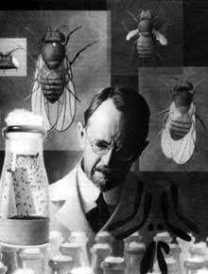
The Chromosome Theory of Inheritance
Chromosomes are discrete physical entities that carry the genes
Thomas Hunt Morgan used the fruit fly, Drosophila melanogaster, to study genetics

Slide 13
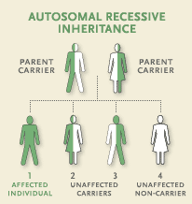
The Chromosome Theory of Inheritance
Autosomes occur in pairs in a given individual

Slide 14
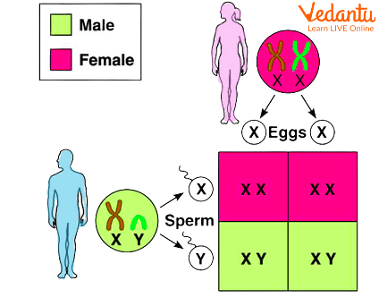
Sex chromosomes are identified as X and Y
Female has two X chromosomes
Male has one X and one Y chromosome

Slide 15
Hypothetical Chromosomes
Every gene has its place, or locus, on a chromosome
Genotype is the combination of alleles found in an organism
Phenotype is the visible expression of the genotype
Wild-type phenotype is the most common or generally accepted standard
Mutant alleles are usually recessive

Slide 16
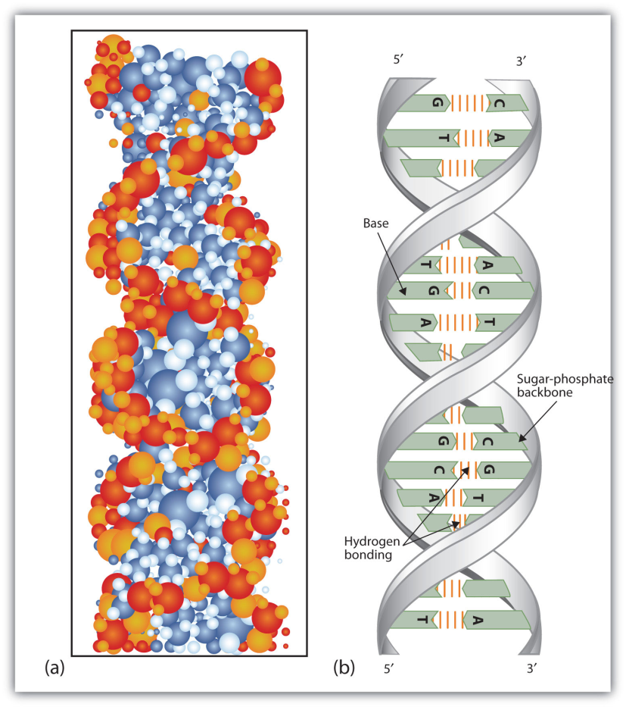
1.2 Molecular Genetics
The Discovery of DNA: The general structure of nucleic acids were found by the end of the 19th century
Long polymers or chains of nucleotides
Nucleotides are linked by sugars through phosphate groups

Slide 17
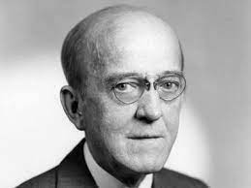
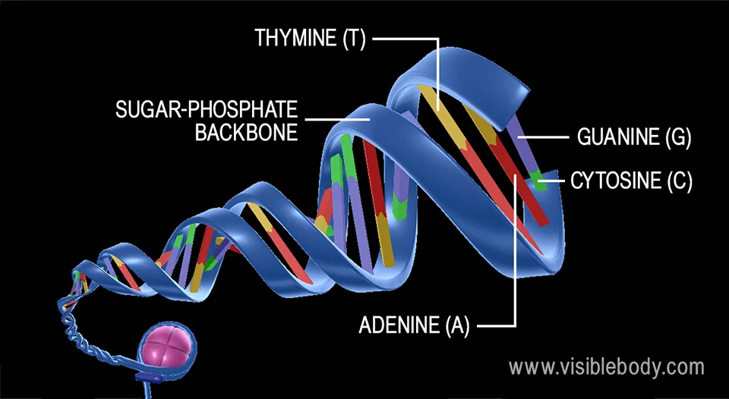
1.2 Molecular Genetics
Composition of Genes: In 1944, Avery and his colleagues demonstrated that genes are composed of nucleic acids
The sequences of nitrogenous bases on the two strands of a DNA molecule are complementary.

Slide 18
The Nature of Genetic Material
Historical Background
Miescher isolated nuclei from pus (white blood cells) in 1869
Found a novel phosphorus-bearing substance = nuclein
Nuclein is mostly chromatin, a complex of DNA and chromosomal proteins
End of 19th century – DNA and RNA separated from proteins
Levene, Jacobs, et al. characterized basic composition of DNA and RNA

Slide 19
Transformation in Bacteria
Key experiments done by Frederick Griffith in 1928
Observed change in Streptococcus pneumoniae — from virulent (S) smooth colonies where bacterial had capsules, to avirulent (R) rough colonies without capsules
Heat-killed virulent colonies could transform avirulent colonies to virulent ones

Slide 20
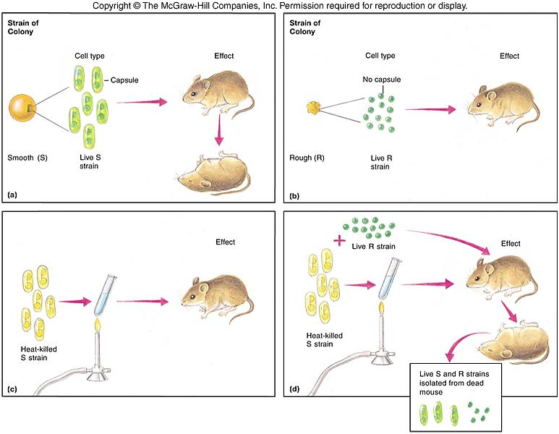
Outline of Griffith’s Transformation Experiments

Slide 21
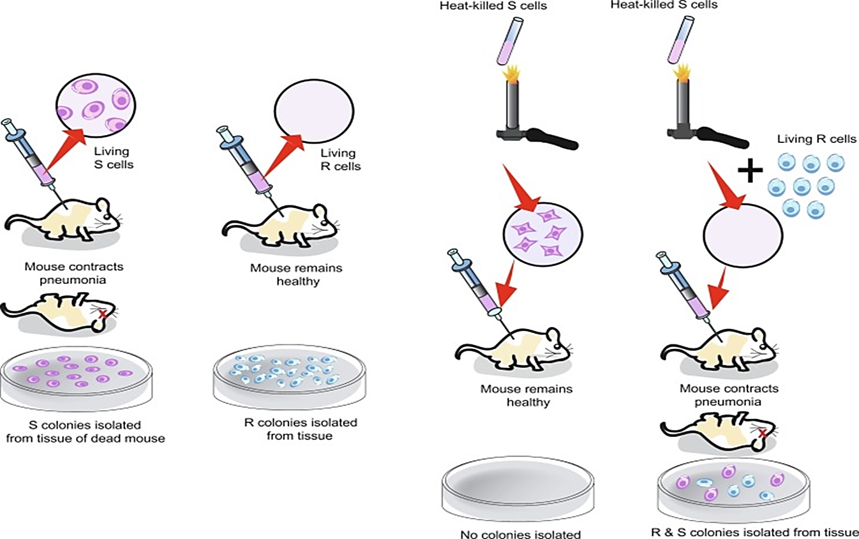
DNA: The Transforming Material
In 1944 a group used a transformation test similar to Griffith’s procedure taking care to define the chemical nature of the transforming substance.
Schematic diagram of Griffith's experiment which demonstrates bacterial transformation.C

Slide 22
DNA: The Transforming Material
Techniques used excluded both protein and RNA as the chemical agent of transformation
Other treatments verified that DNA is the chemical agent of transformation of S. pneumoniae from avirulent to virulent

Slide 23
Schematic diagram of Avery, MacLeod, and McCarty's experiment which demonstrates that DNA is the transforming principle.

Slide 24
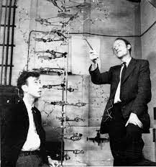
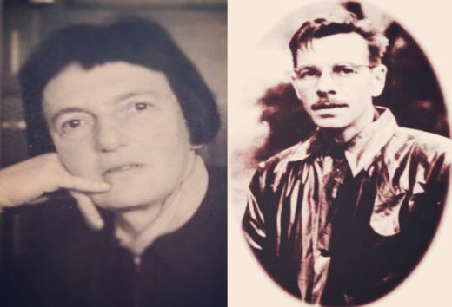
DNA Confirmation
In 1940s geneticists doubted use of DNA as it appeared to be monotonous repeats of 4 bases
By 1953 Watson & Crick published the double-helical model of DNA structure and Chargaff had shown that the 4 bases were not present in equal proportions
Hershey and Chase demonstrated that bacteriophage infection comes from DNA

Slide 25
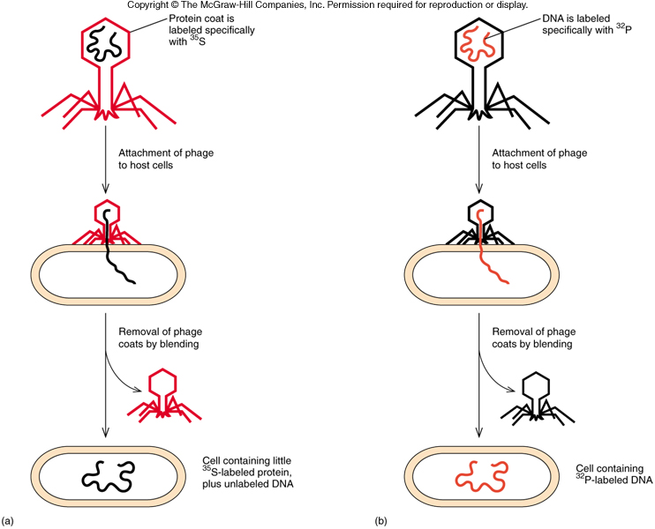
Procedure for the Hershey-Chase Transformation Experiments

Slide 26
Summary
Genes are made of nucleic acid, usually DNA
Some simple genetic systems such as viruses have RNA genes

Slide 27
References
Carson, S., Miller, H. B., Srougi, M. C., & Witherow, D. S. (2019). Molecular biology techniques: a classroom laboratory manual. Academic Press.
Craig, N. L., Green, R. R., Greider, C. C., Wolberger, C., & Storz, G. G. (2021). Molecular biology: principles of genome function. Oxford University Press, USA.
Tropp, B. E. (2012). Principles of molecular biology. Jones & Bartlett Publishers.
Robert, F. W. (2012). Molecular biology.

Slide 28
Molecular Biology & Proteomics Genetic code and translation
Name of teacher Dr. Ahmad H. Ibrahim
Molecular Biology & Proteomics
course code: PHAR 338
1st Semester / 2nd week 1.10.2023

Slide 29
The Relationship between Genes and Proteins
Experiments have shown that a defective gene gives a defective or absent enzyme
These lead to the proposal that one gene is responsible for making one enzyme
Proposal not quite correct
Enzyme may have several polypeptides, each gene codes for only one polypeptide
Many genes code for non-enzyme proteins
End products of some genes are not polypeptides

Slide 30
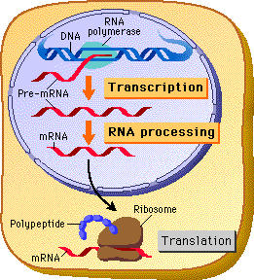
Activities of Genes
Genes perform three major roles
Replicated faithfully
Direct the production of RNAs and proteins

Slide 31
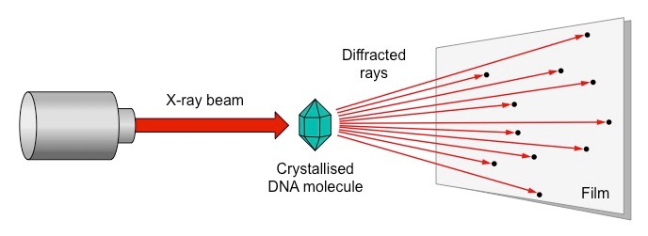
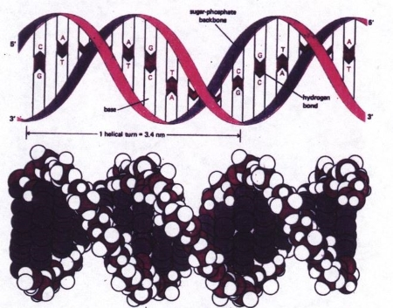
Replication
Franklin and Wilkins produced x-ray diffraction data on DNA, Watson and Crick proposed that DNA is double helix
Two DNA strands wound around each other
Strands are complementary – know the sequence of one, automatically know the sequence of the other
Semiconservative replication keeps one strand of the parental double helix conserved in each of the daughter double helices

Slide 32
Genes Direct the Production of Polypeptides
Gene expression is the process by which a gene product is made
Two steps are required
Transcription: copy of DNA is transcribed into RNA
Translation: the RNA copy is read or translated to assemble a protein
Codon: a sequence of 3 nucleic acid bases that stand for one amino acid

Slide 33
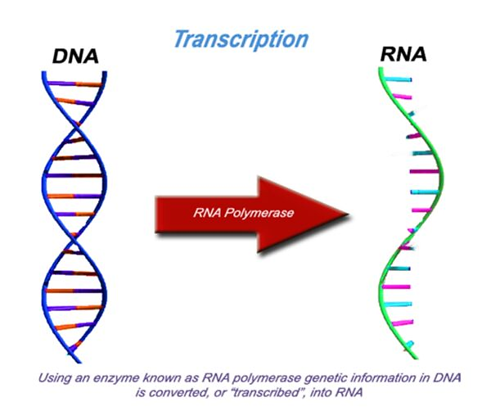
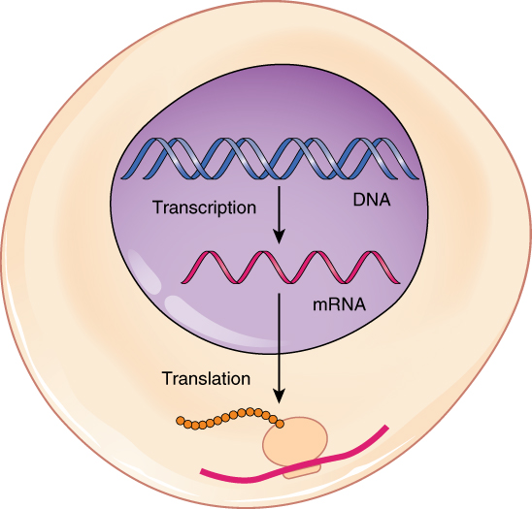
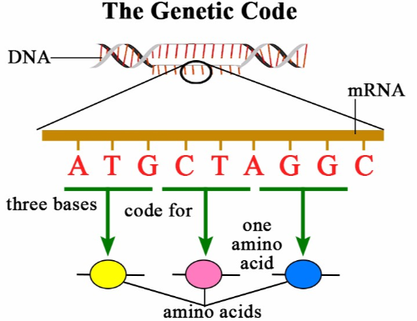
From DNA to Protein: Transcription through Translation. Transcription within the cell nucleus produces an mRNA molecule, which is modified and then sent into the cytoplasm for translation. The transcript is decoded into a protein with the help of a ribosome and tRNA molecules.

Slide 34
Genes Accumulate Mutations
Genes change in several ways
Change one base to another
Deletions of one base up to a large segment
Insertions of one base up to a large segment
As the change is more drastic, it is more likely that the gene or genes involved will be totally inactivated

Slide 35
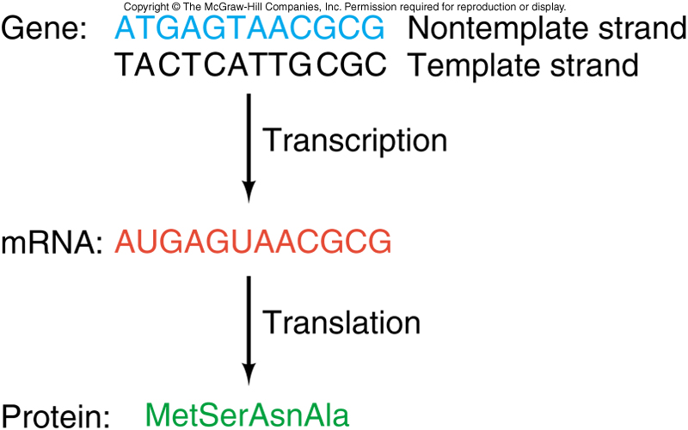
2.1 Storing Information
Producing a protein from DNA information involves both transcription and translation
A codon is the 3 base sequence that determines what amino acid is used
Template strand is the complementary DNA strand that is used to generate the mRNA
Nontemplate strand is not used in RNA transcription

Slide 36
Protein Structure
Proteins are chain-like polymers of small subunits, amino acids
DNA has 4 different nucleotides
Proteins have 20 different amino acids with:
An amino group
A hydroxyl group
A hydrogen atom
A specific side chain

Slide 37
Polypeptides
Amino acids are joined together via peptide bonds
Chains of amino acids are called polypeptides
Proteins are composed of 1 or more polypeptides
Polypeptides have polarity as does DNA
Free amino group at one end is the amino- or N-terminus
Free hydroxyl group at the other end is the carboxyl- or C-terminus

Slide 38
1.3 The Three Domains of Life
Current research theories support the division of living organisms into three domains
Bacteria
Eukaryota
Archaea living in the most inhospitable regions of the earth
Thermophiles tolerate extremely high temperatures
Halophiles tolerate very high salt concentrations
Methanogens produce methane as a by-product of metabolism

Slide 39
Summary
In summary, molecular biology is a dynamic field that unveils the molecular underpinnings of life, enriching our knowledge of genetics. This lecture equips students with foundational concepts and sets the stage for further exploration in the fascinating realm of molecular biology.

Slide 40
References
Carson, S., Miller, H. B., Srougi, M. C., & Witherow, D. S. (2019). Molecular biology techniques: a classroom laboratory manual. Academic Press.
Craig, N. L., Green, R. R., Greider, C. C., Wolberger, C., & Storz, G. G. (2021). Molecular biology: principles of genome function. Oxford University Press, USA.
Tropp, B. E. (2012). Principles of molecular biology. Jones & Bartlett Publishers.
Robert, F. W. (2012). Molecular biology.

