Slide 1
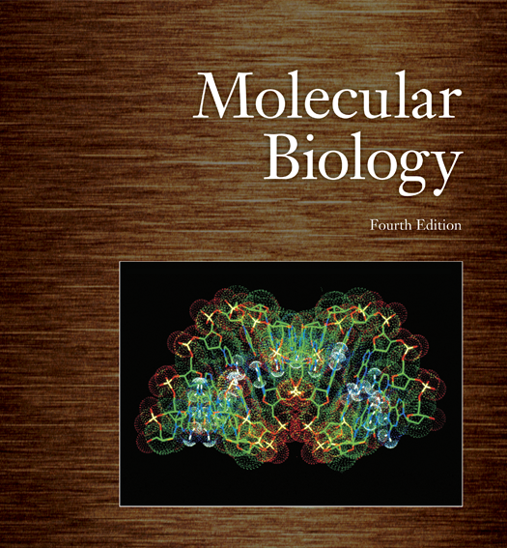
Molecular Biology & Proteomics DNA Extraction and Purification
Name of teacher Dr. Ahmad H. Ibrahim
Molecular Biology & Proteomics
course code: PHAR 338
1st Semester / 2nd week 22.10.2023

Slide 2
Outline
I. Introduction A. Brief overview of the lecture's objectives B. Importance of DNA and RNA in biology and genetics
II. Nucleotide Structure A. Definition of nucleotides B. Components of a nucleotide: base, sugar, and phosphate group C. Visual representation of a nucleotide's structure
III. Phosphodiester Bonds A. Explanation of how nucleotides are connected through phosphodiester bonds B. Role of phosphodiester bonds in forming the sugar-phosphate backbone
IV. Double Helix Structure of DNA A. Introduction to the double helix structure B. Visualization of the double helix with sugar-phosphate backbones and base pairs C. Historical context and key scientists (e.g., Watson and Crick).
V. Base Pairing Rules A. Description of base pairing in DNA (A-T, G-C) B. Significance of complementary base pairing C. Implications for DNA stability and replication

Slide 3
Outline
VI. DNA vs. RNA A. Key differences between DNA and RNA (sugar type, thymine vs. uracil) B. Functions and roles of RNA in cellular processes
VII. Significance of DNA Structure A. Discussion of the importance of DNA's structure in genetics B. How the double helix facilitates replication and transcription C. Relevance in preserving and transmitting genetic information
VIII. Biological Functions A. Overview of DNA's role as the genetic material B. Various functions of RNA in cellular processes (e.g., transcription, translation)
IX. Clinical and Scientific Applications A. Examples of applications in genetics, molecular biology, and medicine B. Modern techniques and technologies reliant on DNA and RNA knowledge

Slide 4
Objectives
Understanding Nucleotide Structure:
Define nucleotides and their components.
Explain the structure of a nucleotide, including the nitrogenous base, sugar molecule, and phosphate group.
Phosphodiester Bond Formation:
Describe how nucleotides are linked together by phosphodiester bonds.
Explain the significance of these bonds in forming the sugar-phosphate backbone of DNA and RNA.
Double Helix Structure of DNA:
Illustrate the double helix structure of DNA, with an emphasis on its sugar-phosphate backbones and the base pairs in the interior.
Base Pairing Rules:
Outline the specific base pairing rules in DNA (A with T, G with C) and their role in DNA stability and replication.
Significance of DNA Structure:
Discuss why the double helix structure is crucial for storing and transmitting genetic information.
Explain how the structure facilitates processes like DNA replication and transcription.

Slide 5
The Chemical Nature of Polynucleotides
Biochemists determined the components of nucleotides during the 1940s
The component parts of DNA
Nitrogenous bases:
Adenine (A)
Cytosine (C)
Guanine (G)
Thymine (T)
Phosphoric acid
Deoxyribose sugar

Slide 6
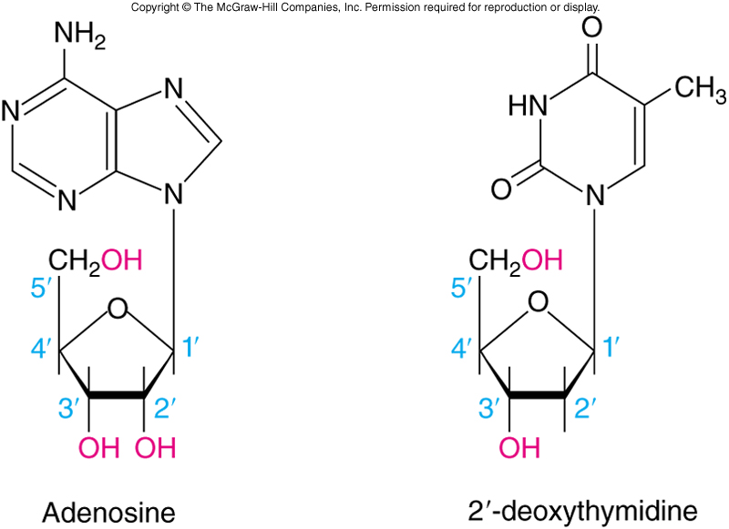
Nucleotides and Nucleosides
RNA component parts
Nitrogenous bases
Like DNA except Uracil (U) replaces Thymine
Phosphoric acid
Ribose sugar
Bases use ordinary numbers
Carbons in sugars are noted as primed numbers
Nucleotides contain phosphoric acid
Nucleosides lack the phosphoric acid

Slide 7
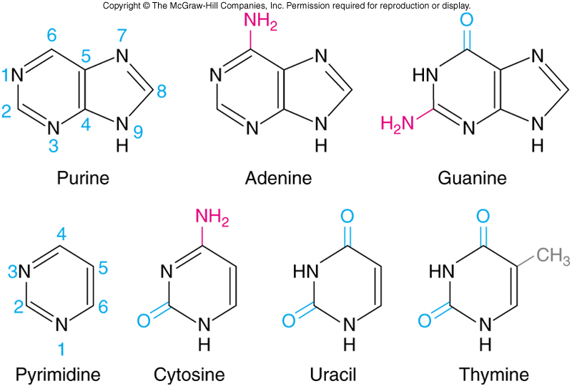
Purines and Pyrimidines
Adenine and guanine are related structurally to the parent molecule purine
Cytosine, thymine and uracil resemble pyrimidine

Slide 8
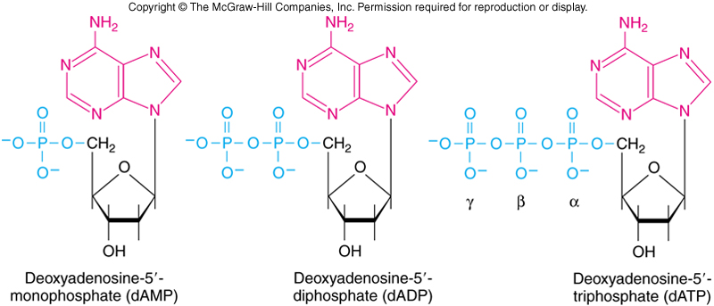
DNA Linkage
Nucleotides are nucleosides with a phosphate group attached through a phosphodiester bond
Nucleotides may contain one, two, or even three phosphate groups linked in a chain

Slide 9
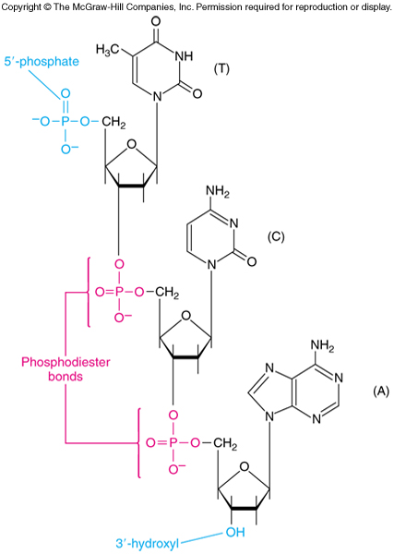
A Trinucleotide
The example trinucleotide has polarity
Top of molecule has a free 5’-phosphate group = 5’ end
Bottom has a free 3’-hydroxyl group = 3’ end

Slide 10
Natural nucleoside triphosphates include adenosine triphosphate (ATP), guanosine triphosphate (GTP), cytidine triphosphate (CTP), thymidine triphosphate (TTP) and uridine triphosphate (UTP). These terms refer to those nucleotide triphosphates that contain ribose.

Slide 13
Summary
DNA and RNA are chain-lie molecules composed of subunits called nucleotides
Nucleotides contain a base linked to the 1’-position of a sugar and a phosphate group
Phosphate joins the sugars in a DNA or RNA chain through their 5’- and 3’-hydroxyl groups by phosphodiester bonds

Slide 14
DNA Structure
The Double Helix
Rosalind Franklin’s x-ray data suggested that DNA had a helical shape
The data also indicated a regular, repeating structure
DNA was believed to require an irregular sequence
Watson and Crick proposed a double helix with sugar-phosphate backbones on the outside and bases aligned to the interior

Slide 15
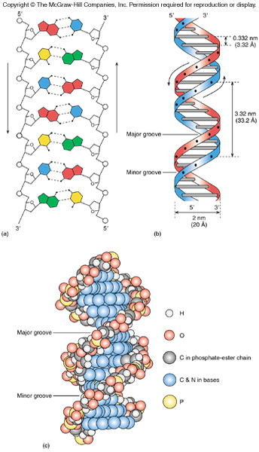
DNA Helix
Structure compared to a twisted ladder
Curving sides of the ladder represent the sugar-phosphate backbone
Ladder rungs are the base pairs
There are about 10 base pairs per turn
Arrows indicate that the two strands are antiparallel

Slide 16
Genes Made of RNA
Hershey & Chase investigated bacteriophage, virus particle by itself, a package of genes
This has no metabolic activity of its own
When virus infects a host cell, the cell begins to make viral proteins
Viral genes are replicated and newly made genes with viral protein assemble into virus particles
Some viruses contain DNA genes, but some viruses have RNA genes, either double- or single-stranded

Slide 17
Summary
The DNA molecule is a double helix, with sugar-phosphate backbones on the outside and base pairs on the inside
The bases pair in a specific way:
Adenine (A) with thymine (T)
Guanine (G) with cytosine (C)

Slide 18
Physical Chemistry of Nucleic Acids
DNA and RNA molecules can appear in several different structural variants
Changes in relative humidity will cause variation in DNA molecular structure
The twist of the DNA molecule is normally shown to be right-handed, but left-handed DNA was identified in 1979

Slide 19
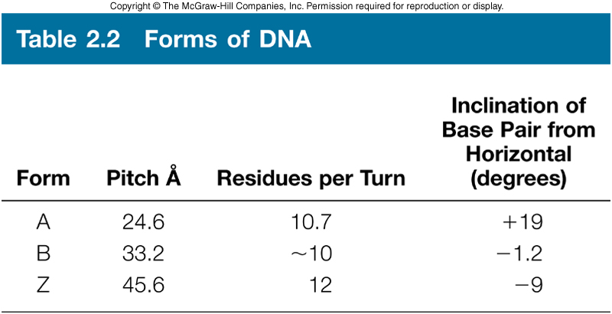
A Variety of DNA Structures
High humidity DNA is called the B-form
Lower humidity from cellular conditions to about 75% and DNA takes on the A-form
Plane of base pairs in A-form is no longer perpendicular to the helical axis
A-form seen when hybridize one DNA with one RNA strand in solution
When wound in a left-handed helix, DNA is termed Z-DNA
One gene requires Z-DNA for activation

Slide 20
Another DNA structure is called the Z form, because its bases seem to zigzag. Z DNA is left-handed. One turn spans 4.6 nm, comprising 12 base pairs.
The DNA molecule with alternating G-C sequences in alcohol or high salt solution tends to have such structure.
Comparison between B form and Z form.

Slide 21
Structural Features of A-DNA
In A-DNA, the DNA helix undergoes significant alterations compared to the common B-DNA conformation.
One of the distinctive features of A-DNA is the presence of an additional hydroxyl (OH) group in the ribose sugar of the DNA backbone.
This extra OH group contributes to the stability of the A-DNA structure.

Slide 22
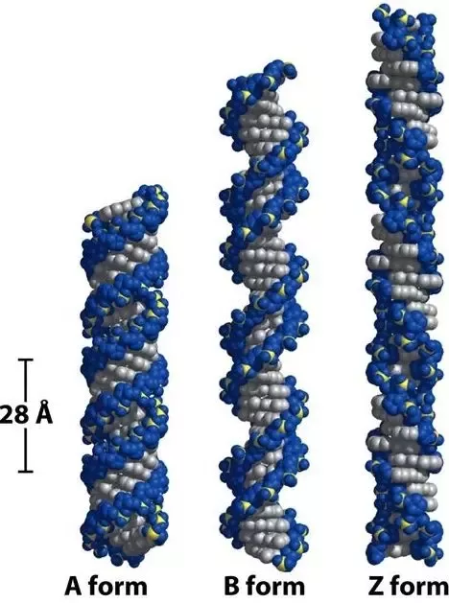
A Variety of DNA Structures
The DNA molecule exists in different forms under different conditions. The ordinary form of DNA, the B form, predominates in the cell under physiological conditions.
B-form (left), A-form (middle) and Z-DNA (right).

Slide 23
The B to A Transformation in DNA Structure
The B to A transformation occurs when the relative humidity of the environment is lowered and also during DNA-RNA duplex is formed.
A-DNA appears more stable due to the additional OH group in the ribose;
thus, in the process of replication, A-DNA always exists in the cell during transcription, reverse transcription, and RNA-primer annealing

Slide 24
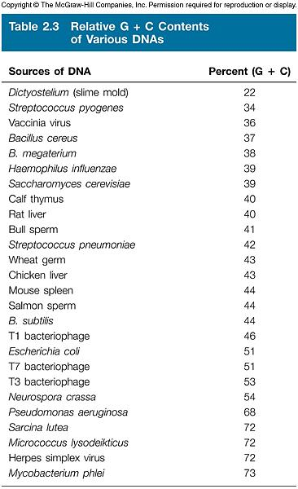
Variation in DNA between Organisms
Ratios of G to C and A to T are fixed in any specific organism
The total percentage of G + C varies over a range to 22 to 73%
Such differences are reflected in differences in physical properties

Slide 25
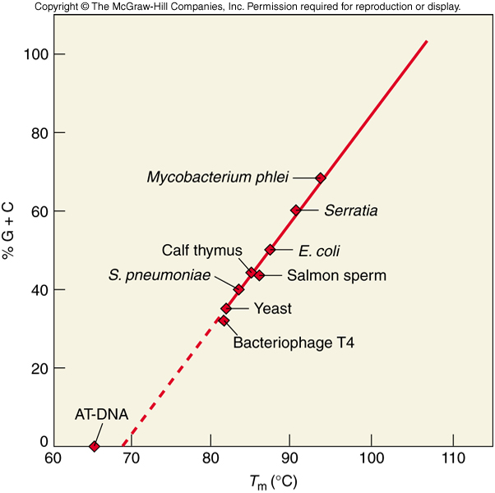
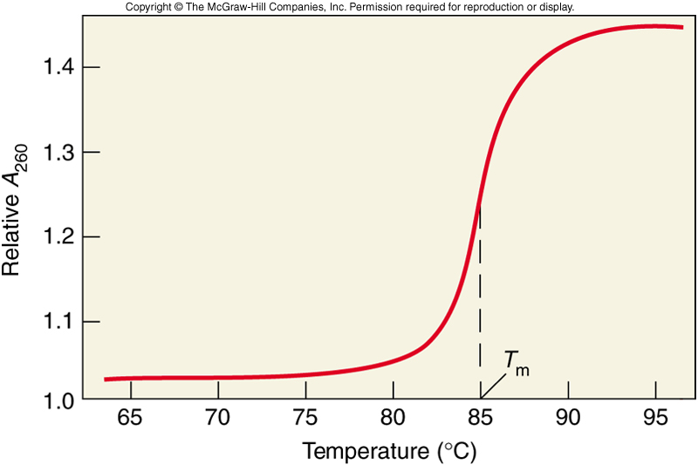
DNA Melting
With heating, noncovalent forces holding DNA strands together weaken and break
When the forces break, the two strands come apart in denaturation or melting
Temperature at which DNA strands are ½ denatured is the melting temperature or T_{m}
GC content of DNA has a significant effect on T_{m} with higher GC content meaning higher T_{m}

Slide 26
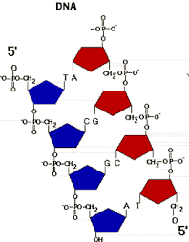
DNA Melting

Slide 27
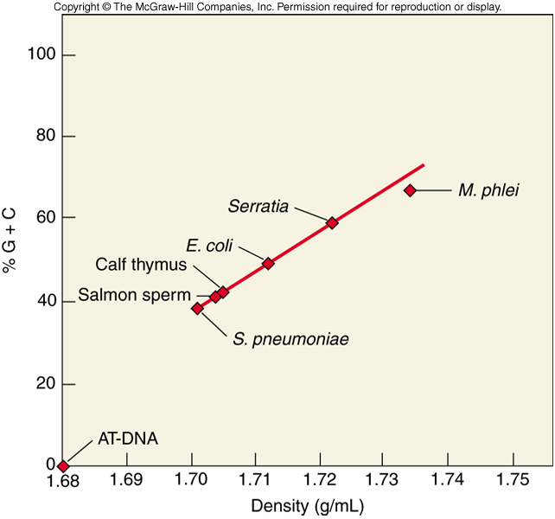
DNA Denaturation
In addition to heat, DNA can be denatured by:
Organic solvents
High pH
Low salt concentration
GC content also affects DNA density
Direct, linear relationship
Due to larger molar volume of an A-T base pair than a G-C base pair

Slide 28
Summary
GC content of a natural DNA can vary from less than 25% to almost 75%
GC content has a strong effect on physical properties that increase linearly with GC content
Melting temperature, the temperature at which the two strands are half-dissociated or denatured
Density
Low ionic strength, high pH and organic solvents also promote DNA denaturation

Slide 29
Summary
DNA, the fundamental molecule of life, exhibits dynamic structural changes under different environmental conditions and during specific biological processes.

Slide 30
References
Carson, S., Miller, H. B., Srougi, M. C., & Witherow, D. S. (2019). Molecular biology techniques: a classroom laboratory manual. Academic Press.
Craig, N. L., Green, R. R., Greider, C. C., Wolberger, C., & Storz, G. G. (2021). Molecular biology: principles of genome function. Oxford University Press, USA.
Tropp, B. E. (2012). Principles of molecular biology. Jones & Bartlett Publishers.
Robert, F. W. (2012). Molecular biology.

Slide 31
Molecular Biology & Proteomics DNA Renaturation and PCR TECHNIQUES
Name of teacher Dr. Ahmad H. Ibrahim
Molecular Biology & Proteomics
course code: PHAR 338
1st Semester / 3rd week 22.10.2023

Slide 32
Outline
I. Historical Context A. Brief exploration of the historical developments leading to the understanding of DNA and RNA B. Contributions of key scientists (e.g., Rosalind Franklin, Maurice Wilkins)
II. Reverse Transcriptase PCR (RT-PCR)
A. Introduction to RT-PCR
B. Key differences between PCR and RT-PCR
1. Starting with an mRNA, not double-stranded DNA
2. Conversion of mRNA to DNA
3. Use of forward primers to convert single-stranded DNA to double-stranded DNA

Slide 33
Outline
C. cDNA Cloning
1. Cloning cDNA from known mRNA sequences
2. Utilizing RT-PCR for cDNA cloning
D. Continuation with standard PCR
1. Transition from cDNA synthesis to DNA amplification
III. Applications and Significance
A. Application of standard PCR
B. Application of RT-PCR in cDNA cloning
C. Significance in molecular biology and biotechnology
V. Open Discussion and Q&A A. Encourage questions and discussions from the audience B. Address any additional topics, queries, or related concepts
VI. Conclusion A. Summarize key takeaways from the lecture B. Reiterate the importance of understanding DNA and RNA in modern biology
This outline should help you structure your lecture effectively and guide your audience through the essential concepts of DNA and RNA.

Slide 34
Objectives
To provide a comprehensive understanding of the principles and processes involved in Standard PCR, including the use of DNA polymerase, primers, and the amplification of specific DNA regions.
To differentiate between Standard PCR and Reverse Transcriptase PCR (RT-PCR) by highlighting the key distinctions, such as starting with mRNA, cDNA synthesis, and the transition to standard PCR.
To explore the significance and applications of both Standard PCR and RT-PCR techniques in the field of molecular biology, genetics, and biotechnology.
To discuss the role of heat-stable polymerases in PCR and the "set and forget" nature of the process, emphasizing the advantages and efficiency of this technology.
To demonstrate the importance of RT-PCR in cDNA cloning and its use in capturing and amplifying specific mRNA sequences, particularly when the mRNA sequence is known.

Slide 35
Objectives
Differences Between DNA and RNA:
Highlight the key distinctions between DNA and RNA, such as the type of sugar (deoxyribose vs. ribose) and the presence of thymine in DNA and uracil in RNA.
Biological Functions:
Explore the biological roles of DNA and RNA, including DNA's function as the genetic material and RNA's roles in various cellular processes.
Clinical and Scientific Applications:
Provide examples of how knowledge of DNA and RNA structure is applied in fields such as genetics, molecular biology, and medical research.

Slide 36
DNA Renaturation
After two DNA strands separate, under proper conditions the strands can come back together
Process is called annealing or renaturation
Three most important factors:
Temperature – best at about 25 C below T_{m}
DNA Concentration – within limits higher concentration better likelihood that 2 complementary will find each other
Renaturation Time – as increase time, more annealing will occur

Slide 37
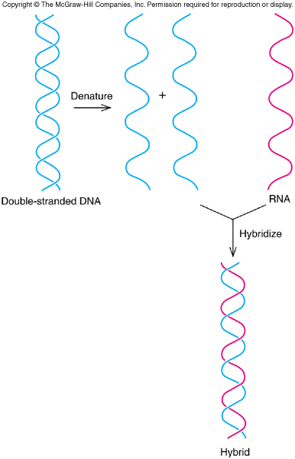
Polynucleotide Chain Hybridization
Hybridization is a process of putting together a combination of two different nucleic acids
Strands could be 1 DNA and 1 RNA
Also could be 2 DNA with complementary or nearly complementary sequences

Slide 38
DNA Sizes
DNA size is expressed in 3 different ways:
Number of base pairs
Molecular weight – 660 is molecular weight of 1 base pair
Length – 33.2 Å per helical turn of 10.4 base pairs
Measure DNA size either using electron microscopy or gel electrophoresis

Slide 39
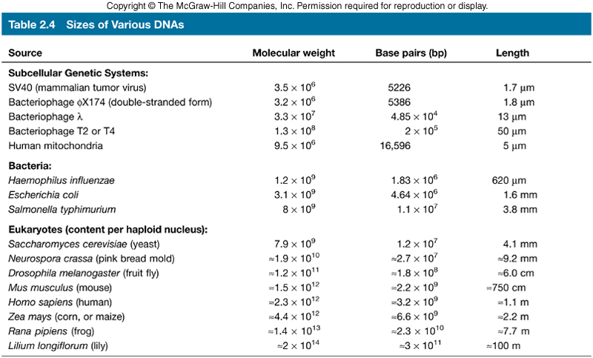
DNAs of Various Sizes and Shapes
Phage DNA is typically circular
Some DNA will be linear
Supercoiled DNA coils or wraps around itself like a twisted rubber band

Slide 40
Summary
Natural DNAs come in sizes ranging from several kilobases to thousands of megabases
The size of a small DNA can be estimated by electron microscopy
This technique can also reveal whether a DNA is circular or linear and whether it is supercoiled

Slide 41
The Polymerase Chain Reaction
Polymerase chain reaction (PCR) can yield a DNA fragment for cloning
PCR is:
More recently developed
Very useful for cloning cDNAs

Slide 42
Standard PCR
Invented by Kary Mullis and colleagues in 1980s
Use enzyme DNA polymerase to copy a selected region of DNA
Add short pieces of DNA (primers) that hybridize to DNA sequences on either side of piece of interest – causes initiation of DNA synthesis through that area, X
Copies of both strands of X and original DNA strands are templates for next round of DNA synthesis
Selected region DNA now doubles in amount with each synthesis cycle
Special heat-stable polymerases able to work after high temperatures needed to separate strands make process “set and forget” for many cycles

Slide 43
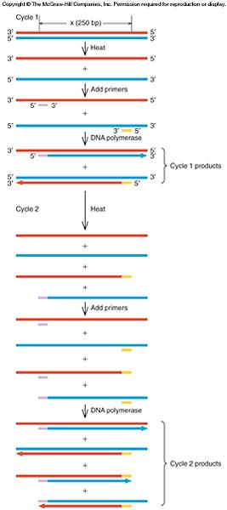
Amplifying DNA by PCR

Slide 44
Using Reverse Transcriptase (RT-PCR) in cDNA Cloning
To clone a cDNA from just one mRNA whose sequence is known, use type of PCR called reverse transcriptase PCR (RT-PCR)
Difference between PCR and RT-PCR
Start with an mRNA not double-stranded DNA
Begin by converting mRNA to DNA
Next use forward primer to convert ssDNA to dsDNA
Now standard PCR continues

Slide 45
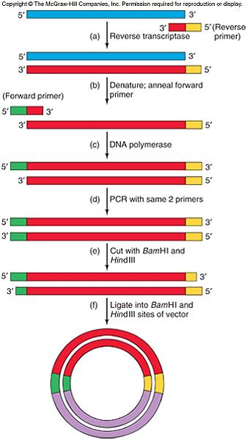
RT-PCR Can Generate Sticky Ends
With care, restriction enzyme sites can even be added to the cDNA of interest
Able to generate sticky ends for ligation into vector of choice
2 sticky ends permits directional cloning

Slide 46
Real-Time PCR
Real-time PCR quantifies the amplification of the DNA as it occurs
As DNA strands separate, anneal to forward and reverse primers, and to fluorescent-tagged oligonucleotide complementary to part of one DNA strand

Slide 47
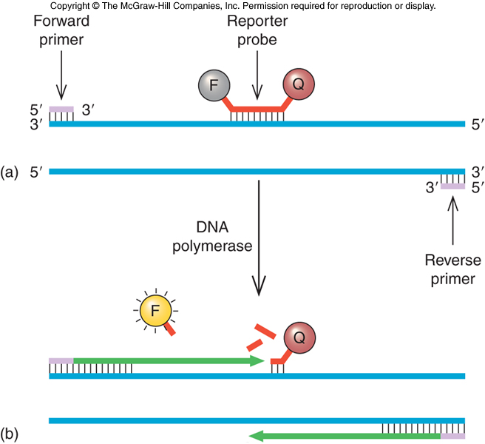
Fluorescent Tags in Real-Time PCR
This fluorescent-tagged oligonucleotide serves as a reporter probe
Fluorescent tag at 5’-end
Fluorescence quenching tag at 3’-end
With PCR rounds the 5’ tag is separated from the 3’ tag
Fluorescence increases with incorporation into DNA product

Slide 48
Summary
Standard PCR, developed in the 1980s by Kary Mullis and colleagues, uses DNA polymerase to copy a selected region of DNA. It involves the addition of DNA primers to initiate DNA synthesis, resulting in the doubling of the target DNA with each cycle.
Standard PCR utilizes heat-stable polymerases that work at high temperatures, making it a "set and forget" process with multiple amplification cycles.
Reverse Transcriptase PCR (RT-PCR) differs from standard PCR in that it starts with mRNA, not double-stranded DNA. It begins by converting mRNA to cDNA and uses forward primers to convert single-stranded DNA to double-stranded DNA. RT-PCR is essential in cDNA cloning when the mRNA sequence is known.

Slide 49
Summary
4. The lecture underscores the significance and versatility of these techniques in molecular biology, genetics, and biotechnology applications.
5. The practical applications of both Standard PCR and RT-PCR are explored, highlighting their pivotal roles in genetic research and biotechnology, and their impact on advancing our understanding of DNA and RNA manipulation
In conclusion, this lecture equips the audience with a thorough understanding of Standard PCR and RT-PCR, enabling them to appreciate the underlying principles, differences, and practical applications of these essential molecular biology tools.

Slide 50
Case Scenario Question:
Imagine you are a researcher tasked with studying the expression of a specific gene in a rare type of cancer. You have a limited sample of patient tissues, and the target gene's mRNA sequence is known. However, you need to generate a DNA copy of the mRNA for further analysis.
Which molecular technique would you choose to convert the mRNA of the target gene into DNA for amplification, and why?
Explain the key steps involved in the chosen technique and how it differs from the standard PCR method.
What are the advantages of using the selected technique in this scenario, and what potential challenges might you encounter during the process?
How can the amplified DNA be further utilized in your research to gain insights into the gene's expression and its relevance to the rare cancer type?

Slide 51
Solution:
Molecular Technique Selection: In this scenario, the most suitable molecular technique for converting the mRNA of the target gene into DNA is Reverse Transcriptase PCR (RT-PCR).
RT-PCR is the method of choice for this purpose because it allows the conversion of mRNA into complementary DNA (cDNA), which can then be amplified and analyzed.
This is particularly beneficial when studying gene expression as it allows us to measure the levels of specific mRNA in the tissue.

Slide 52
Key Steps in RT-PCR and Comparison with Standard PCR:
RT-PCR Steps:
Isolation of RNA: First, you will need to isolate total RNA from your limited patient tissue samples. This includes the mRNA of interest.
Reverse Transcription: Using the enzyme reverse transcriptase, the isolated mRNA is converted into complementary DNA (cDNA). This step is unique to RT-PCR and differs from standard PCR, which starts with DNA.
cDNA Amplification: Once the cDNA is generated, you can proceed with standard PCR to amplify the cDNA using gene-specific primers.

Slide 53
Differences from Standard PCR:
The key difference between RT-PCR and standard PCR is the initial step of converting mRNA to cDNA.
Standard PCR begins with double-stranded DNA and uses DNA primers, while RT-PCR starts with mRNA and uses reverse transcriptase to create cDNA.
This is essential when studying gene expression as it allows you to analyze the levels of mRNA.

Slide 54
Schematic representation of a cycle of amplification by PCR.

Slide 55
One-step assays combine reverse transcription and PCR in a single tube and buffer, using a reverse transcriptase along with a DNA polymerase.

Slide 56
Schematic representation of: Four different priming methods for the reverse transcription step in two-step assays of RT-qPCR.

Slide 57
Advantages of RT-PCR in this Scenario:
Specific mRNA Analysis: RT-PCR enables the specific analysis of mRNA, which is crucial for studying gene expression.
Quantitative Information: RT-PCR provides quantitative data, allowing you to measure the exact levels of the target gene's mRNA.
Limited Sample-Friendly: RT-PCR can work with limited tissue samples, making it suitable for rare cancer types.
cDNA for Further Analysis: The cDNA generated can be used for various downstream analyses, such as sequencing, cloning, or gene expression studies.

Slide 58
Potential Challenges:
RNA Quality: Ensuring high-quality RNA extraction from limited samples can be challenging.
Contamination: Avoiding contamination with DNA during RNA extraction and cDNA synthesis is crucial.
Primer Design: Designing specific primers for RT-PCR can be tricky and requires careful consideration.
Quantification: Ensuring accurate quantification of the cDNA and controlling for variations in the reverse transcription step is important.

Slide 59
Utilization of Amplified DNA:
The amplified cDNA can be further utilized for various purposes, such as:
Gene Expression Analysis: Quantify gene expression levels in the rare cancer type and compare them to normal tissues.
Mutation Analysis: Sequence the cDNA to identify any mutations in the target gene.
Functional Studies: Clone the cDNA for functional studies to understand the gene's role in the cancer.
Drug Development: Investigate how the gene's expression correlates with drug response, potentially leading to tailored treatment strategies.

Slide 60
Summary
RT-PCR is the ideal choice to convert mRNA into cDNA, allowing for specific gene expression analysis in rare cancer types.
While there are challenges, the benefits in terms of precision and utility for downstream research make it a valuable technique in this scenario.

Slide 61
References
Carson, S., Miller, H. B., Srougi, M. C., & Witherow, D. S. (2019). Molecular biology techniques: a classroom laboratory manual. Academic Press.
Craig, N. L., Green, R. R., Greider, C. C., Wolberger, C., & Storz, G. G. (2021). Molecular biology: principles of genome function. Oxford University Press, USA.
Tropp, B. E. (2012). Principles of molecular biology. Jones & Bartlett Publishers.
Robert, F. W. (2012). Molecular biology.

