Slide 1
Rheumatoid arthritis and Systemic lupus erythematosus
By
Dr. Muhammad Abdullah Shwani
Assistant professor/Consultant urologist
Kurdistan Higher Council of Medical Specialties (KHCMS)
drmalshwani@mail.com

Slide 2
Arthritis “arthro” = joint
“itis” = inflammation
Rheumatoid arthritis is an autoimmune disease in which the normal immune response is directed against an individual's own tissue, including the joints, tendons, and bones, resulting in inflammation and destruction of these tissues.
Commonest inflammatory joint disease is seen in clinical practice affecting approx. 1% of the population.
Characterized by persistent inflammatory synovitis leading to cartilage damage, bone erosions, joint deformity, and disability.

Slide 3
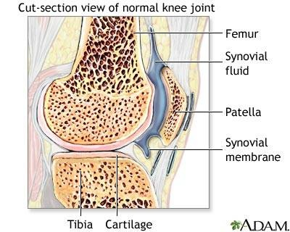
Anatomy of the Joint
Articular/hyaline cartilage
-acts as a shock absorber
- allows for friction-free movement
- not innervated!
Synovial membrane/synovium
-secretes synovial fluid
-nourishes cartilage
-cushions the bones

Slide 4
Overview
Age: Any age, commonly 3rd to 6th decade
Female: male 3:1
pattern of joint involvement could be:-
    Polyarticular: most common ( >5)
    Oligoarticular (2-4)
    Monoarticular
Morning joint stiffness > 1 hour and easing with physical activity is characteristic.
Small joints of the hand and feet are typically involved.

Slide 5
Clinical Manifestations(S&S)
Articular
Extra-articular

Slide 6
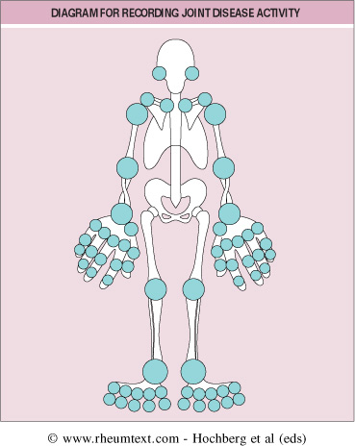
Articular manifestation
Pain and swelling in
  affected joint aggravated
  by movement is the most
  common symptom.
Morning stiffness ≥1 hr
  Joints involved -→

Slide 7
Relative incidence of joint involvement in RA
MCP and PIP joints of hands & MTP of feet 90%
Knees, ankles & wrists- 80%
Shoulders- 60%
Elbows- 50%
TM, Acromio - clavicular & SC (scapiolo-calvicular ) joints- 30%
Ulnar Deviation, MCP Swelling, Left Wrist Swelling
PIP Swelling

Slide 8
Don’t forget the cervical spine!!
  Instability at the cervical spine can lead to impingement of the spinal cord.
Thoracolumbar, sacroiliac, and distal interphalangeal joints (DIP)of the hand are NOT involved.

Slide 9
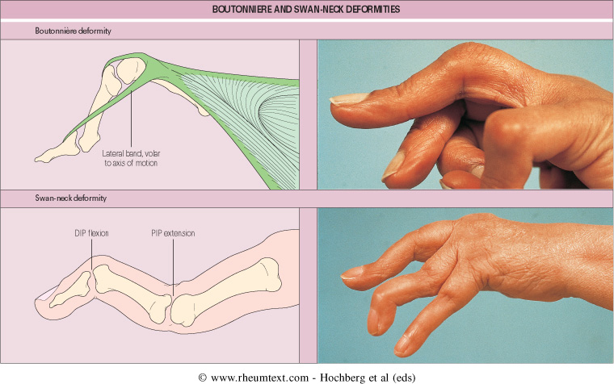

Slide 10
Extra-articular manifestations
Present in 30-40%
May occur prior to arthritis
Patients that are more likely to get are:
  High titers of RF/ anti-CCP(cyclic citrullinated peptide)
  HLA DR4+
  Male
  Early onset disability
  History of smoking

Slide 11
Extraarticular Involvement…..
Constitutional symptoms ( most common)
Rheumatoid nodules(30%)
Hematological-
  normocytic normochromic anemia
  leukocytosis /leucopenia
  thrombocytosis
Felty’s syndrome-
  Chronic nodular Rheumatoid Arthritis
  Splenomegaly
  Neutropenia

Slide 12
Extraarticular Involvement…..
Respiratory- pleural effusion, pneumonitis.....
CVS-asymptomatic pericarditis, pericardial effusion, cardiomyopathy
Rheumatoid vasculitis- cutaneous ulceration, digital gangrene, visceral infarction
CNS- peripheral neuropathy, entrapment neuropathies
EYE- kerato-conjunctivitis sicca..

Slide 13
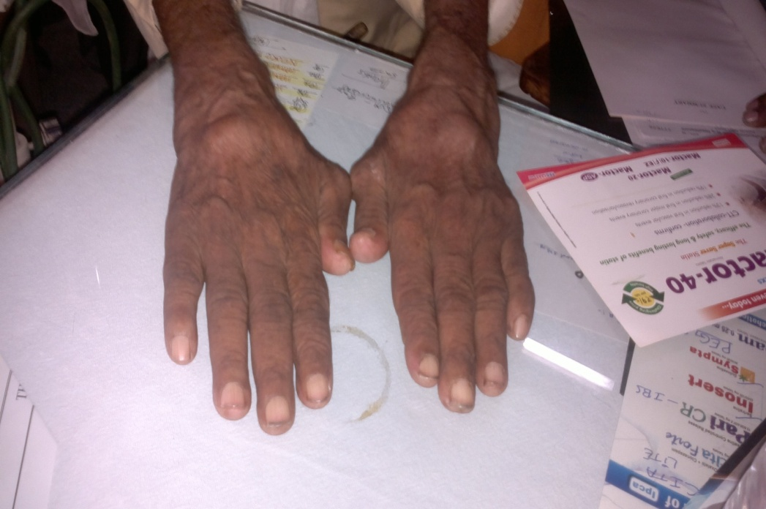
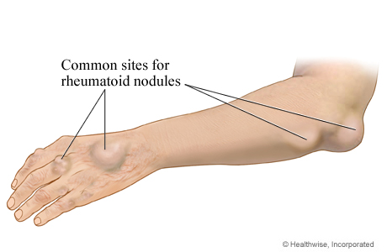
Rheumatoid nodule
These are small subcutaneous nodules
present at the extensor surfaces of
hand, wrist, elbow, and back in rheumatoid
arthritis patients.
Characteristics feature of rheumatoid
arthritis
A marker of disease activity
Can be present even if other features
of Rheumatoid Arthritis are absent

Slide 14
Laboratory investigations in RA
CBC- ESR
Acute phase reactants(APR):
  CRP
  Ferritin,
  Amyloid
Rheumatoid Factor (RF)
Anti- CCP(cyclic citrullinated peptide) antibodies
ANA (30-40%)
Inflammatory synovial fluid aspiration
Hypoalbuminemia

Slide 15
Rheumatoid Factor (RF)
Antibodies that recognize Fc portion of IgG
Can be IgM , IgG , IgA
85% of patients with RA over the first 2 years become RF+ve
PROGNOSTIC VALUE of (RF) : Patients with high titers of RF, in general, tend to have POOR PROGNOSIS and more EXTRA ARTICULAR MANIFESTATION.

Slide 16
Radiographic Features
Peri-articular osteopenia
Uniform symmetric joint space narrowing
Marginal subchondral erosions
Joint Subluxations
Joint Destruction
Collapse
Ultrasound detects early soft tissue lesions.
MRI has the greatest sensitivity to detect synovitis and marrow changes.

Slide 17
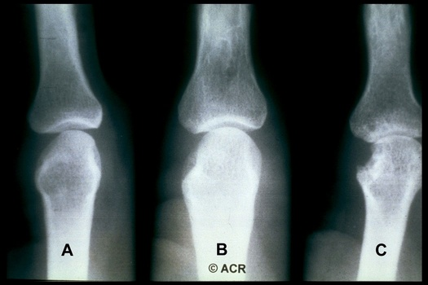

Slide 18
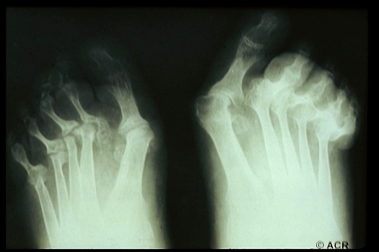

Slide 19
Diagnostic Criteria
ACR Diagnostic Criteria (American College of Rheumatology)(1987)
Description
  Morning stiffness
  Arthritis of 3 or more joints
  Arthritis of hand joints
  Symmetric arthritis
  Rheumatoid nodules
  Serum rheumatoid factor
  Radiographic changes
A person shall be said to have rheumatoid arthritis if he or she has satisfied 4 of 7 criteria, with criteria 1-4 present for at least 6 weeks.

Slide 20
Treatment modalities for RA
NSAIDS
Steroids
DMARDs
Immunosuppressive therapy
Biological therapies
Surgery

Slide 21
NSAIDs
Non-steroidal anti-inflammatories (NSAIDS) / symptom control
Reduce pain and swelling.
Do not alter the course of the disease.
Chronic use should be minimized.
Most common side effects related to GI tract.

Slide 22
Corticosteroids in RA
Corticosteroids, both systemic and intra-articular are important adjuncts in the management of RA.
Indications for systemic steroids are:-
  For treatment of rheumatoid flares.
  For extra-articular RA.
  As bridge therapy for 6-8 weeks before the action of DMARDs begins.
  In pregnancy when other DMARDs cannot be used.
  Maintenance dose of 10mg or less of prednisolone daily in patients with active RA.

Slide 23
Disease Modifying Anti-rheumatic Agents
Drugs that actually alter the disease course .
Should be used as soon as diagnosis is made.
Appearance of benefit delayed for weeks to months.
NSAIDS must be continued with them until true remission is achieved
Induction of true remission is unusual .

Slide 24
DMARDs
Commonly used Less commonly used
Methotrexate
Chloroquine
Hydroxychloroquine
Gold(parenteral &oral)
Sulphasalazine
CyclosporineA
Leflunomide
D-penicillamine/bucillamine
Minocycline/Doxycycline Levamisole
Azathioprine,cyclophosphamide,
Chlorambucil

Slide 25
Immunosuppressive therapy
Agent | Usual dose/route | Side effects
Azathioprine | 50-150 mg orally | GI side effects , myelosuppression, infection,
Cyclosporin A | 3-5 mg/kg/day | Nephrotoxic , hypertension , hyperkalemia
Cyclophosphamide | 50 -150 mg orally | Myelosuppression , gonadal toxicity ,hemorrhagic cystitis , bladder cancer

Slide 26
BIOLOGICS IN RA
Cytokines such as TNF-α ,IL-1,IL-10 etc. are key mediators of immune function in RA and have been major targets of therapeutic manipulations in RA.
Various biologicals approved in RA are:-
  Anti-TNF agents: Infliximab,Etanercept.
  IL-1 receptor antagonist : Anakinra
  IL-6 receptor antagonist : Tocilizumab
  Anti CD20 antibody: Rituximab
  T cell costimulatory inhibitor: Abatacept

Slide 27
Surgical Approaches
Synovectomy is recommended if intense synovitis is persistent despite medical treatment.
Total joint arthroplasties, particularly of the knee, hip, wrist, and elbow, are highly successful.
Release of nerve entrapments (e.g., carpal tunnel syndrome)
Arthroscopic procedures
Occasionally, removal of a symptomatic rheumatoid nodule.

Slide 28
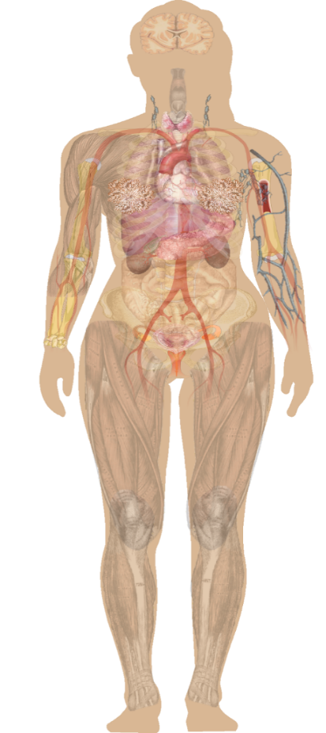
Systemic Lupus Erythematosus
Systemic lupus erythematosus (SLE) is a progressive chronic autoimmune disease that results in inflammation and tissue damage
Characterized by flares, spontaneous remission, and relapses
Highly heterogeneous
Can affect any part of the body
Often damages skin, joints, heart, kidneys, lungs, and nervous system

Slide 29
Common Signs and Symptoms of Lupus
Painful or swollen joints muscle pain Unexplained fever Rashes, most common in sun-exposed areas Chest pain upon deep breathing Unusual loss of hair | Raynaud’s phenomenon Sensitivity to the sun Edema in legs or around eyes Mouth ulcers Swollen glands Extreme fatigue

Slide 30
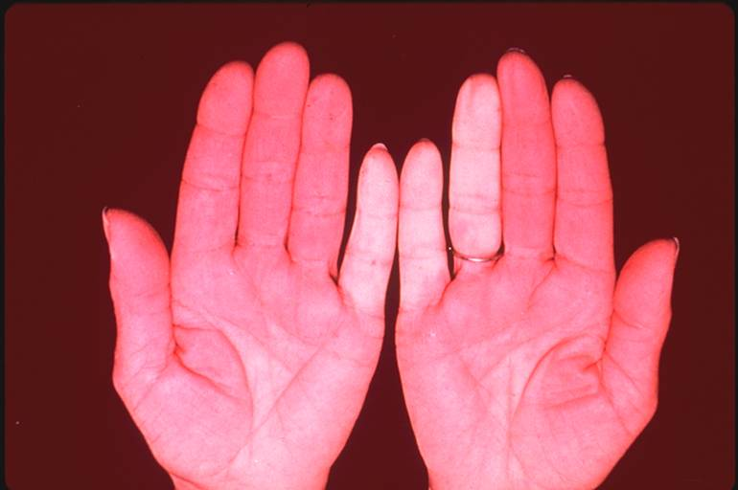
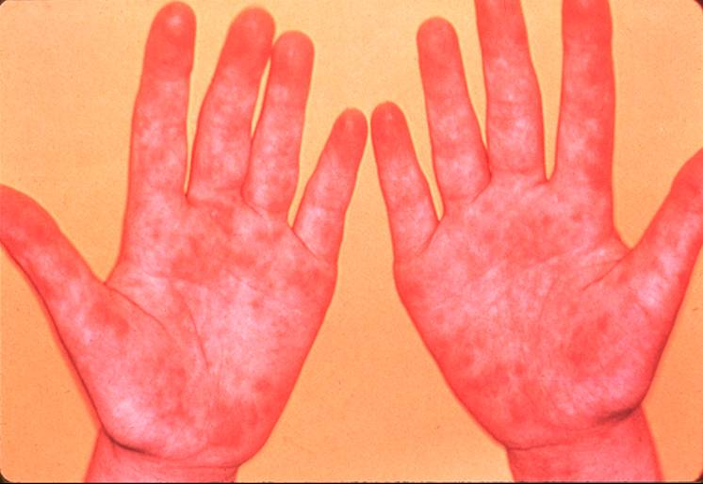
Vascular Features
Raynaud’s phenomenon
Vasomotor instability; dysautonomia

Slide 31
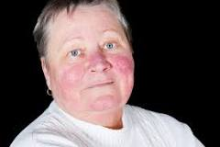
Mucocutaneous Features of SLE
Malar (butterfly) rash
Discoid lupus (DLE)
Mucosal ulcers
Alopecia
Subacute cutaneous lupus (SCLE)
Cutaneous vasculitis
Bullous lupus
Panniculitis

Slide 32
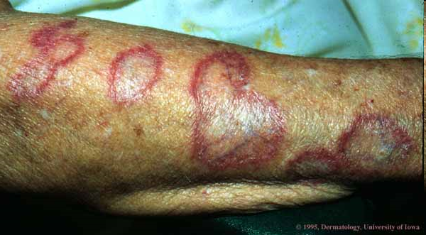
Discoid Lupus
Can occur as part of systemic lupus or exist in isolation without any other organ involvement
10% of discoid lupus patients will develop SLE
Coin-shaped scaly plaques
Can occur anywhere on the body, cause hair loss in the scalp

Slide 33
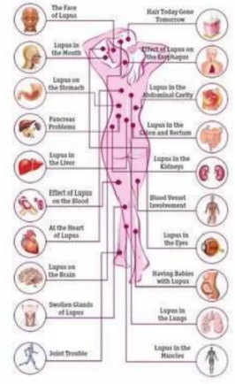
COMPLICATIONS
Some degree of long-term and often permanent organ dysfunction from either SLE or its treatment has
been found in 88% of patients.
Hypertension
Growth retardation
Chronic pulmonary impairment
Ocular abnormalities
Permanent renal damage
Neuropsychiatric symptoms
Musculoskeletal damage
Gonadal impairment

Slide 34
Serositis
Lining of heart, lungs, abdomen
  Pleuritis is inflammation of the lining of the lungs
  Pericarditis is inflammation of the lining of the heart
Symptoms include pain in chest with deep breathing or when lying flat
Fluid may accumulate (effusion) causing increased shortness of breath

Slide 35
Diagnosis
No single test can determine whether a person has lupus, but several laboratory tests may help make a diagnosis
Diagnostic Tests
  Antinuclear antibody (ANA) test
  Autoantibodies: anti-DNA, anti-Sm(anti smith), anti-RNP, anti-Ro (SSA), and anti-La (SSB)
  Anticardiolipin antibody
  Antiphospholipid antibody
  CBC-ESR (anemia, low WBC-leukopenia, Thrombocytopenia )
  LFT
  RFT
  GUE for protein
  Skin biopsy
  Kidney biopsy
  CXR
  Echocardiography

Slide 36
Kelsey’s SLE Diagnosis
Sun
Sensitivity
Malar
Rash
ANA
Discoid
Rash
Serositis
Inflammatory Arthritis

Slide 37
TREATMENT
GOALS OF THERAPY:
Control disease manifestation
Allow patient to have a good quality of life without major exacerbations
Prevent serious organ damage that adversely affects function or lifespan
drugs used
Corticosteroids Immunosuppressants NSAIDS Sunscreen

Slide 38
CORTICOSTEROIDS
Oral corticosteroids
  Decreases inflammation by suppression of the immune system
  The lowest possible dose should be used for maintenance therapy
Topical corticosteroids
  Helpful for discoid lesions especially on the scalp
  Use a less potent steroid on the face because it is more prone to atrophy
Parenteral corticosteroids
  Pulse therapy with IV corticosteroids in combination with immunosuppressive therapy is recommended for Class III and IV SLE patients with confirmed glomerulonephritis

Slide 39
HYDROXYCHLOROQUINE
Used for skin & joint manifestations
Also used for preventing flares & other constitutional symptoms
Recommended as background treatment for Class III and IV SLE patients with nephritis

Slide 40
IMMUNOSUPPRESSANTS
These agents act as immunosuppressive, cytotoxic & anti-inflammatory
Concomitant use with corticosteroids allows lower doses of immunosuppressants
  Azathioprine
  Belimumab
  Cyclophosphamide
  IV Immunuglobulin (IVIg)
  Methotrexate

Slide 41
NSAIDS
  These drugs provide symptomatic relief of fever, arthritis & mildserositiss
  Inhibit inflammatory reactions & pain by decreasing prostaglandin synthesis
  SLE patients have a high incidence of NSAID-induced hepatotoxicity
SUNSCREEN
  Patients with SLE should apply sunscreen with at least an SPF of 15 to prevent dermal or systemic disease flares upon exposure to ultraviolet light

Slide 42
Thank You

