Slide 1
Solutions
Presented by the Pharmacist
Muhanad S. Al-Ani
PHAR 201
1st semester
Week number 1
19/10/2023

Slide 2
Outline
Type of solutions
Factors effecting solubility.
Conc. expression
Real and actual solutions
Colligative properties
Calculation of M.Wt from colligative properties

Slide 3
Objectives
Define saturated solution, solubility, and unsaturated solution.
Describe and give examples of polar, nonpolar, and
Understand the factors controlling the solubility of weak electrolytes.
Describe the influence of solvents and surfactants on solubility.
6

Slide 4
Definitions
A solution is a mixture of 2 or more substances in a single phase. A solute is dissolved in a solvent.
Solute: is the substance being dissolved.
Solvent: is the substance in which the solute is dissolved.
an aqueous solution has water as solvent

Slide 5
When solid dissolved in liquid ;however the liquid being the solvent and the solid is the solute irrespective to the amount of the constituents
When water is one of the constituent so it is usually considered as the solvent.
Binary solution : is the solution that composed of only 2 substances one of the constituent is the solvent and the other is the solute .

Slide 6
Example of Solutions
Solute | Solvent | Example
solid | solid | Gold +silver mixture
solid | liquid | NaCl solution
gas | solid | H2 in palladium
liquid | liquid | Alcohol in water
gas | liquid | Carbonated water
gas | gas | air

Slide 7
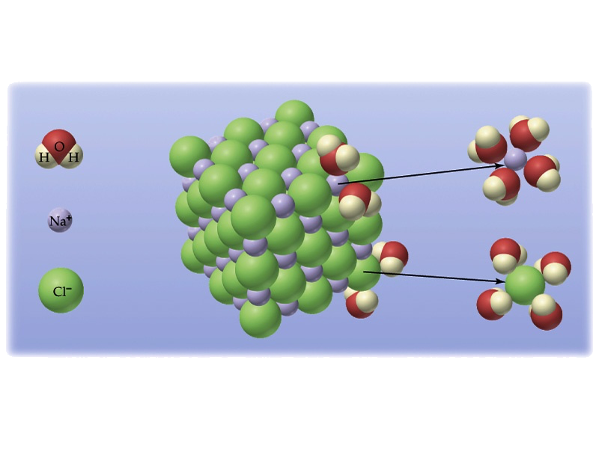
Dissolution of Solid Solute
What are the driving forces which cause solutes to dissolve to form solutions?
1. Covalent solutes dissolve by H-bonding to water
2. Ionic solutes dissolve by dissociation into their ions.

Slide 8
The solutes are divided into 2 main classes
1) Nonelectrolytes
which is substances which not yield ions when dissolved in water and therefore do not conduct an electric current through the solution. Example: sucrose, glycerin and urea.
2) Electrolytes:
Substances which form ions in solution, conduct an electric current these can be subdivided into
a. strong electrolytes
b. weak electrolytes
Depending on whether the substance is completely or partially ionized in water.(HCL is strong electrolyte while ephedrine is weak electrolyte).

Slide 9
Non-electrolyte
no conductivity
Non-electrolyte -
No dissociation,
all molecules in solution
sugar

Slide 10
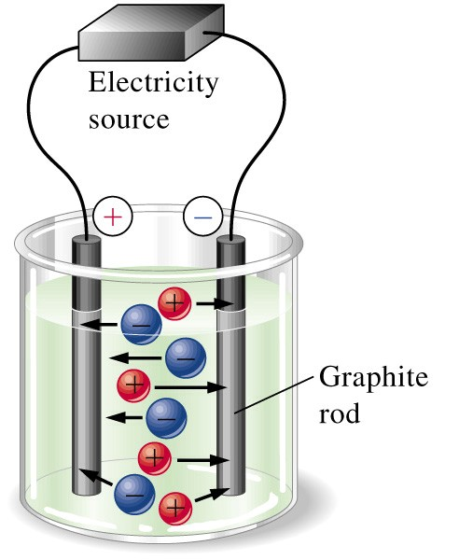
Electrolytes
Some solutes can dissociate into ions.
Electric charge can be carried.

Slide 11
high conductivity
Strong Electrolyte -
100% dissociation,
all ions in solution
Na⁺
Cl⁻

Slide 12
slight conductivity
Weak Electrolyte -
partial dissociation,
molecules and ions in solution
CH₃COOH
CH₃COO⁻
H⁺

Slide 13
Solutions can be classified as saturated or unsaturated.
A saturated solution contains the maximum quantity of solute that dissolves at that temperature.
A saturated solution represents an equilibrium: the rate of dissolving is equal to the rate of crystallization. The salt continues to dissolve, but crystallizes at the same rate so that there “appears” to be nothing happening.
An unsaturated solution contains less than the maximum amount of solute that can dissolve at a particular temperature

Slide 14
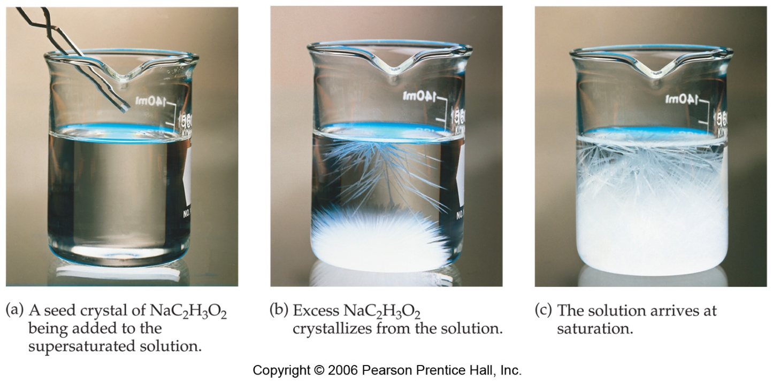
SUPERSATURATED SOLUTIONS contain more solute than is possible to be dissolved at certain temp.
Supersaturated solutions are unstable. The super saturation is only temporary, and usually accomplished in one of two ways:
Warm the solvent so that it will dissolve more, then cool the solution
Evaporate some of the solvent carefully so that the solute does not solidify and come out of solution.

Slide 15
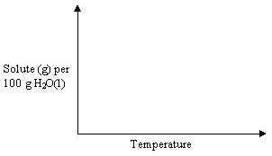
Solubility curve
Saturated
Supersaturated
Unsaturated

Slide 16
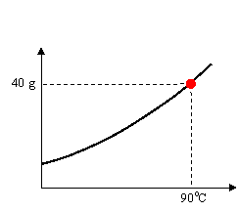
Solubility curve
Any point on a line represents a saturated solution.
In a saturated solution, the solvent contains the maximum amount of solute.
Example
At 90ºC, 40 g of NaCl(s) in 100g H₂O(l) represent a saturated solution.

Slide 17
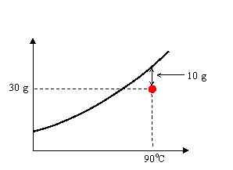
Solubility curve
Any point below a line represents an unsaturated solution.
In an unsaturated solution, the solvent contains less than the maximum amount of solute.
Example
At 90ºC, 30 g of NaCl(s) in 100g H₂O(l) represent an unsaturated solution. 10 g of NaCl(s) have to be added to make the solution saturated.

Slide 18
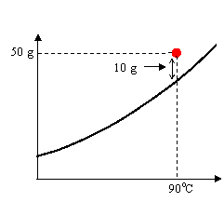
Solubility curve
Any point above a line represents a supersaturated solution.
In a supersaturated solution, the solvent contains more than the maximum amount of solute. A supersaturated solution is very unstable and the amount in excess can precipitate or crystallize.
Example
At 90ºC, 50 g of NaCl(s) in 100g H₂O(l) represent a supersaturated solution. Eventually, 10 g of NaCl(s) will precipitate.

Slide 19
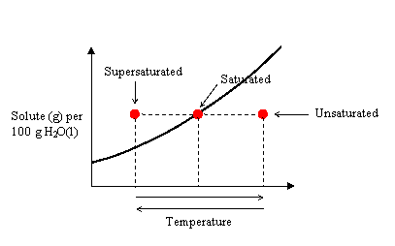
Solubility curve
Any solution can be made saturated, unsaturated, or supersaturated by changing the temperature.

Slide 20
Factors Affecting Solubility
1. Nature of Solute / Solvent: Like dissolves like
2. Temperature:
i) Solids/Liquids: Solubility increases with Temperature
Increase K.E. increases motion and collision between solute / solvent.
ii) gas – Solubility: decreases with Temperature
Increase K.E. result in gas escaping to atmosphere.
3. Pressure:
i) Solids/Liquids: Very little effect
Solids and Liquids are already close together, extra pressure will
not increase solubility.
ii) gas: Solubility increases with Pressure.
Increase pressure squeezes gas solute into solvent.

Slide 21
The rate of solution
The rate of dissolution is a measure of how fast a substance dissolves. Some of the factors determining the rate of dissolution are:
Size of the particles: When a solute dissolves, the action takes place only at the surface of each particle. When the total surface area of the solute particles is increased, the solute dissolves more rapidly. Breaking a solute into smaller pieces increases its surface area and hence its rate of solution.
2. Stirring: With liquid and solid solutes, stirring brings fresh portions of the solvent in contact with the solute, thereby increasing the rate of solution.

Slide 22
3. mount of solute already dissolved:
When there is little solute already in solution, dissolving takes place relatively rapidly. As the solution approaches the point where no solute can be dissolved, dissolving takes place more slowly.
4. Temperature: For solid, liquid and gaseous solutes, changing the temperature not only changes the amount of solute that will dissolve but also changes the rate at which the solute will dissolve.

Slide 23
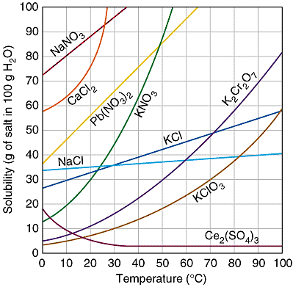
Solubilities of Solids vs Temperature
Solubilities of several ionic solid as a function of temperature. MOST salts have greater solubility in hot water.
A few salts have negative heat of solution, (exothermic process) and they become less soluble with increasing temperature.

Slide 24
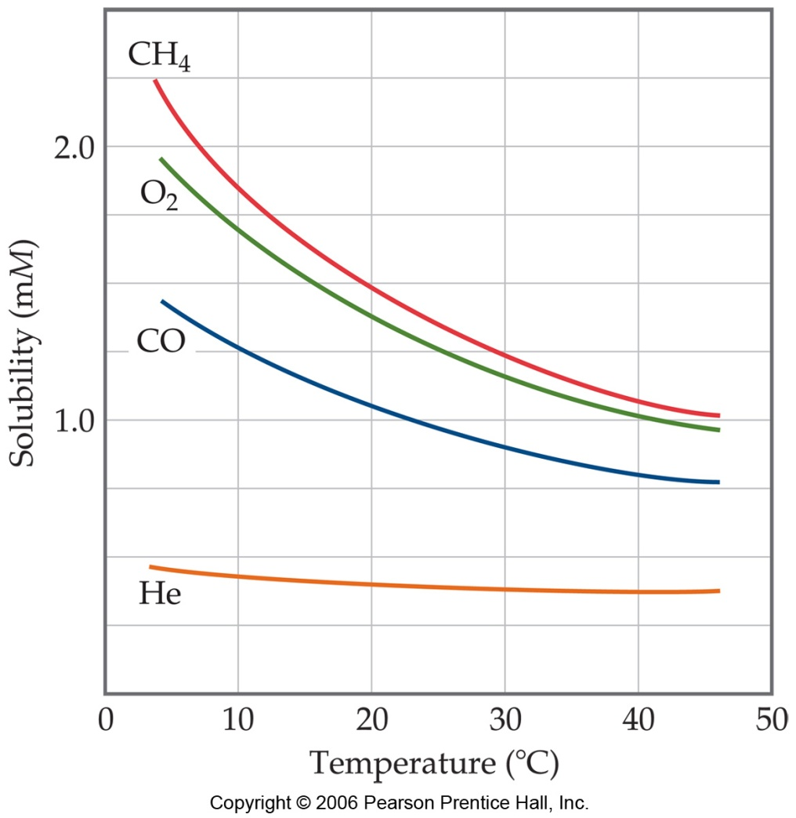
Temperature and solubility of Gas
Higher temperature drives gases out of solution.
Carbonated soft drinks are more “bubbly” if stored in the refrigerator.
Warm lakes have less O₂ dissolved in them than cool lakes.

Slide 25
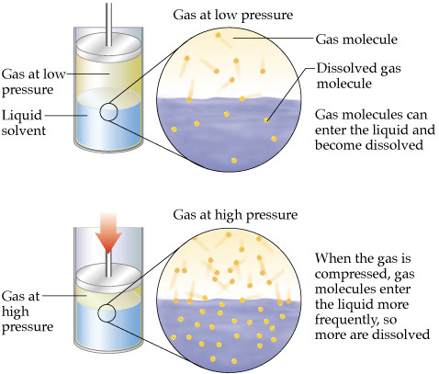
Pressure & the Solubility of Gases Henry’s Law
At pressure of few atmosphere or less, solubility of gas solute follows Henry Law which states that the amount of solute gas dissolved in solution is directly proportional to the amount of pressure above the solution.
c = k P
c = solubility of the gas (M)
k = Henry’s Law Constant
P = partial pressure of gas
Henry’s Law Constants (25°C), k
N₂ 8.42 •10⁻⁷ M/mmHg
O₂ 1.66 •10⁻⁶ M/mmHg
CO₂ 4.48•10⁻⁵ M/mmHg

Slide 26
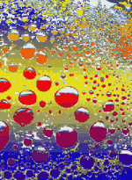
Henry’s Law & Soft Drinks
Soft drinks contain “carbonated water” – water with dissolved carbon dioxide gas.
The drinks are bottled with a CO₂ pressure greater than 1 atm.
When the bottle is opened, the pressure of CO₂ decreases and the solubility of CO₂ also decreases, according to Henry’s Law.
Therefore, bubbles of CO₂ escape from solution.

Slide 27
Solution of non electrolytes

Slide 28
Ways of Expressing Concentrations of Solutions
The conc. of a solution may be expressed either in terms of the quantity of solute in a definite volume of solution , or as the quantity of solute in a definite mass of solvent or solution .

Slide 29
Molarity (M)
mol of solute
L of solution
M =
Because volume is temperature dependent, molarity can change with temperature.
moles of solutes = weight
M.Wt
Expression of the molar conc. of ions and radical is quit difficult ex.
1 M. solution of NaCl = 1M. Na +1M.Cl
1M. Solution of NaCO3 = 2M. Na + 1M CO3

Slide 30
Example : Dissolve 5.00 g of NaCl in enough water to make 500 mL of solution. Calculate the Molarity. M.WT of NaCl =58.45 g/mol. Example : If 0.435 g of a drug is dissolved in enough water to give 750 mL of solution, what is the molarity of the drug in solution? M.WT is 158.0 g/mol. Example: What is the mass of oxalic acid, that required to make 500 mL of a 0.0500 M solution? M.WT. = 90 g/mol

Slide 31
Example: In a biochemical assay, a chemist needs to add 0.381g of glucose to a reaction mixture. Calculate the volume in mls of a 2.53M glucose solution that he should use for this addition.MW of glucose is 180.2g lmol.

Slide 32
Normality (N) = gram equivalent weight
1 liter of solution
No. of equivalents solute = g
eq. wt.

Slide 33
Disadvantages of using molarity and normality :
1. Its value change with temp. because of the expansion and contraction of liquid by temp, so should not be used when one wishes to study the properties of substance at different temp.
2. Another difficulty in the use of molarity and normality for the study of vapor pressure and osmotic pressure which related to the solvents.

Slide 34
Molality (m)
mol of solute
kg of solvent
m =
Because neither moles nor mass change with temperature, molality (unlike molarity) is not temperature dependent.

Slide 35
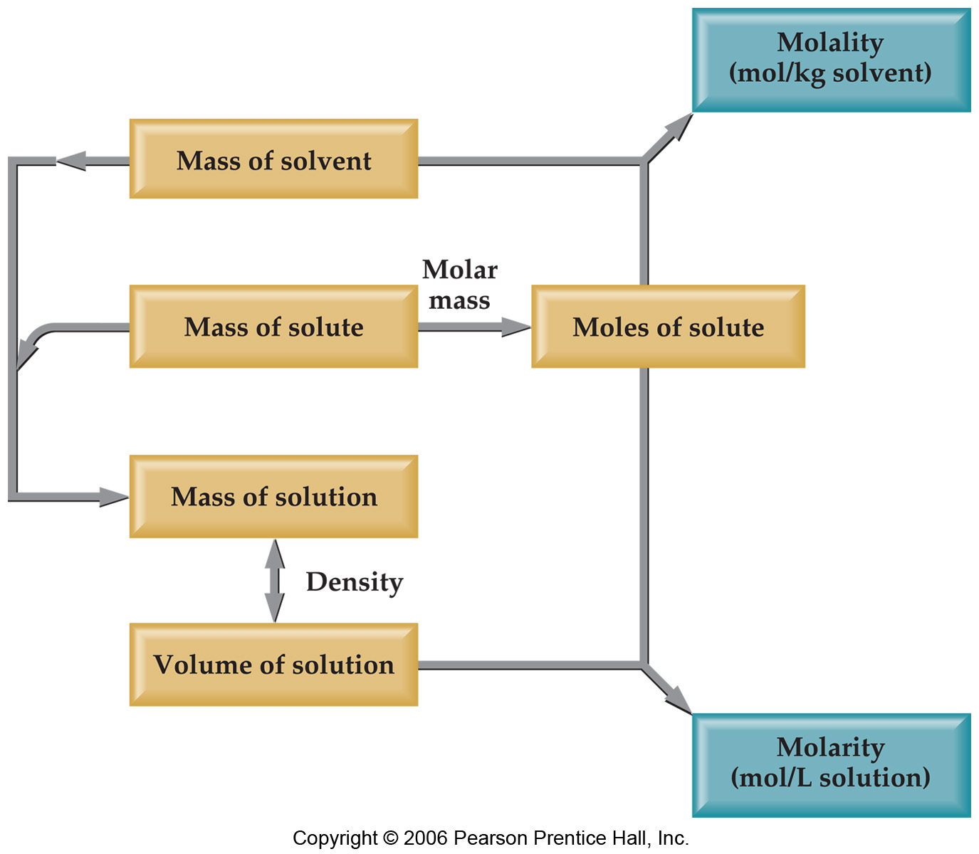
Changing Molarity to Molality
If we know the density of the solution, we can calculate the molality from the molarity, and vice versa.

Slide 36
Example on the difference between molal and molar solution .
if another solute containing neither sodium or chloride ions is added to a certain volume of one molal solution of sod.cl. The solution remain one molal in sodium and chloride although the total volume and the weight of the solution increase while molarity decreased because of increase in the volume of the solution.

Slide 37
Mole Fraction (X)
moles of A
total moles in solution
X_{A} =
In some applications, one needs the mole fraction of solvent, not solute—make sure you find the quantity you need!

Slide 38
Mole percent : is the no. of moles of one constituent in 100 moles of solution
mole percent = mole fraction x 100
Example : solution contain
0.01 mole of solute
0.04 mole of solvent
calculate the mole percent of the two constituent

Slide 39
Percent expression:
Percent by weight % w/w :gram of solute in 100 g. of solution
Percent by volume % v/v : ml.s of solute in 100 ml of solution
Percent weight by volume % w/v : grams of solute in 100 ml of solution
Milligram percent : mgs of solute in 100 ml of solution

Slide 40
An aqueous solution of ferrous sulfate was prepared by adding 41.50 g of FeSo4 to enough water to make 1000 ml of solution at 18 C° . The density of the solution is 1.0375 and the M.WT of FeSo4 is 151.9 g/mol and the M.WT of water is 18.02 g/mol
calculate 1.molarity
2. molality
3. mole fraction of water and
FeSo4
4. mole percent of water and
FeSo4
5. the % w/w of solute

Slide 41
Equivalents weights
In electrolyte replacement therapy in hospital , solutions containing various electrolyte are injected into the body to correct serious electrolytes imbalances .
The conc. usually expressed as equivalents / liter or mill equivalents / liter
Examples:
plasma Na ion is about 142 mEq/l
plasma bicarbonate is 27 mEq/l

Slide 42
Equivalents:
An equivalent (Eq) is the amount of an electrolyte or an ion that provides 1 mole of electrical charge
(+ or -).
1 mole Na⁺ = 1 equivalent
1 mole Cl⁻ = 1 equivalent
1 mole Ca²⁺ = 2 equivalents
1 mole Fe³⁺ = 3 equivalents

Slide 43
Electrolytes in Body Fluids:
Ringer’s Solution
Na⁺ 147 mEq/L Cl⁻ 155 mEq/L
K⁺ 4 mEq/L
Ca²⁺ 4 mEq/L

Slide 44
Eq.wt (g/Eq ) = g / l
Eq/l
Eq.wt ( mg/ meq. ) = mg/ l
meq/l

Slide 45
Example : human plasma contains about 5 mEq/l of calcium ions . How many mgs of calcium chloride dihydrate CaCl2.2H2O
( M.WT = 147 g/mole ) are required to prepare 750 ml of a solution equal in calcium to human plasma ?
The equivalents wt. of CaCl2.2H2O is half of its’ M.WT

Slide 46
Example:
What is the sodium ion content in mEq/l of a solution containing 5.00 g NaCl / l of solution ?
The M.WT of NaCl is 58.5 g/mol , the eq.wt of NaCl is equal to its M.WT

Slide 47
Example
Calculate the no. of Eq/l of potassium chloride present in a 1.15%w/v solution of KCl
The M.WT of KCl is 74.55 g/mole, the Eq/Wt of KCl is equal to its’ M.WT

Slide 48
Ideal and real
solutions

Slide 49
Ideal and real solutions
Ideal solutions: are solutions in which there is no change in the properties of components , other than dilution when they are mixed to form the solution.
No heat is evolved or absorbed.
The final volume of the solution represents an additive property of the individual constituents .
The constitutive properties, vapor pressure , refractive index, surface tension and viscosity of the solution are the weighted averages of the properties of the pure individual constituents.

Slide 50
Ideal solutions are formed by mixing substances with similar properties :
Example: 100 ml methanol
+ 100 ml ethanol = 200 ml
So ideal gas …..complete absence of attractive forces.
Ideal solution …...complete uniformity of attractive forces .
But if 100ml of H2SO4
+ 100 ml of water = 180ml ,heat is evolved so it is real
solution.

Slide 51
Ideal solutions and Raoults’ Law
P = Pa + Pb
Pa = Pa° Xa
Pb = Pb° Xb
Example :
what is the partial vapor pressure of a mixture of benzene and ethylene chloride in solution at a mole fraction of benzene of 0.6 ? Vapor pressure of pure benzene at 50 C° is 268 mmHg and for ethylene chloride is 236 mmHg.

Slide 52
P = Pa + Pb
P°A
P° B
Pa= Pa° Xa
Pb = Pb° Xb
A 1.o
B 1.o

Slide 53
Example :
Vapor pressure of pure propellant 11 ( M.WT = 137.4g/mol) at 21 C° is 13.4 pounds/inch² and fore propellant 12 ( M.WT =120.9 g/mol ) is 84.9 pounds/inch².
What is the partial vapor pressure of a 50:50 mixture by gram weight of P11 and P12.

Slide 54
Real solutions
Ideality in solution mean complete
uniformity of attractive forces .
cohesive forces : attractive forces between molecules of the same species.
adhesive forces : attractive forces between molecules of different species.
in real solutions if we have solution A and B so the attractive forces will be
cohesive forces < >adhesive forces< >cohesive forces
A-A A-B B-B
And this occur even though the liquid are miscible in all proportion

Slide 55
Two types of deviation from Raolts' law
1) Negative deviation
2) Positive deviation
Negative deviation:
In this case the adhesion forces > the cohesion forces this mean each molecule decrease the escaping tendency of the other molecule which lead to negative deviation.
Example : chloroform + acetone because of the formation of
H-bonding between them

Slide 56
Positive deviation:
in this case the adhesion forces < the cohesion forces, this mean the presence of A molecules decrease the interaction of B molecules , and the presence of B molecules decrease the interaction of A molecules so this results in a greater escaping tendency of both A and B molecules so the partial vapor pressure is greater than that expected from Raolts' law.
Examples: benzene and ethyl alcohol
carbon disulfide and acetone
chloroform and ethyl alcohol

Slide 57
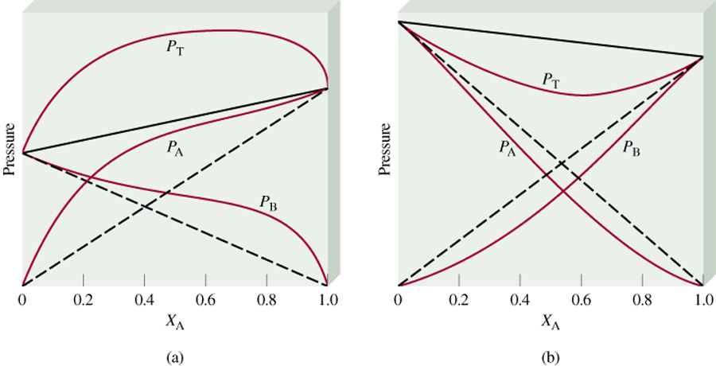
P_{T} is greater than
predicted by Raoults’s law
P_{T} is less than
predicted by Raoults’s law
Force
A-B
Force
A-A
Force
B-B
Force
A-B
Force
A-A
Force
B-B
<
&
>
&

Slide 58
Raolts law doesn't applied over the entire range conc. in a non ideal solutions, in these solutions it describes only the behavior of the substance present in high conc. i.e. solvent
P solvent = P ̊ solvent X solvent
Henrys' law: this is applied for the vapor pressure of solutes in real solutions
P solute = K solute X solute
K: is the proportionality constant which is less than the vapor
pressure of pure substances.

Slide 59
So Henrys’ law applies to the solute and Raolts’ law applies to the solvent in dilute solution of real liquid pair.
Under any circumstances , when the partial vapor pressure of both of the constituents are directly proportional to the mole fraction over the entire range , the solution is said to be ideal, Henrys’ law become identical with Raolts’ law and P°=K

Slide 60
Colligative Properties
Dissolving solute in pure liquid will change all physical properties of liquid, Density, Vapor Pressure, Boiling Point, Freezing Point, Osmotic Pressure
Colligative Properties: are properties of a liquid that change when a solute is added.
The magnitude of the change depends on the number of solute particles in the solution, NOT on the identity of the solute particles.
Vapor-Pressure Lowering
Boiling-Point Elevation
Freezing-Point Depression
Osmotic Pressure (p)

Slide 61
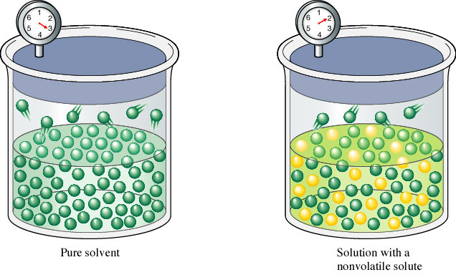
Lowering of the vapor pressure
When non volatile solutes is combined with volatile solvent , the vapor pressure above the solution is provided solely by the solvent .
The solute decrease the escaping tendency of the solvent so on the bases of Raolts law the vapor pressure of a solution containing a nonvolatile solute is lowered proportional to the relative number of the solute molecules rather than on the nature of the constituents.

Slide 62
Raoult’s Law Describes vapor pressure lowering mathematically.
The lowering of the vapour pressure when a non-volatile solute is dissolved in a volatile solvent (A) can be described by Raoult’s Law:
P_{A} = c_{A}P°_{A}
P_{A} = vapour pressure of solvent A above the solution
X_{A} = mole fraction of the solvent A in the solution
P°_{A} = vapour pressure of pure solvent A
only the solvent (A) contributes to the vapour pressure of the solution

Slide 63
P1 = P°1 X 1
if the solute non volatile so
P = P°1 X 1
X1 +X2 =1
X1=1-X2
P= P°1 (1-X2)
P°1-P=P°1 X2
P°1-P = X2
P°1
ΔP = X2 = n2
P°1 n2 +n1
So from this it is concluded that lowering of the vapor pressure is collegative property because depend only on the number of solute particles in solution and not on the nature of the solute particles.
ΔP the lowering of vapor pressure
ΔP relative vapor pressure
P°1 lowering

Slide 64
Example:
What is the vapor pressure of water above a sucrose (MW=342.3 g/mol) solution prepared by dissolving 158.0 g of sucrose in 641.6 g of water at 25 ºC?
The vapor pressure of pure water at 25 ºC is 23.76 mmHg.
M.WT of water is 18.02 g/mol
mol sucrose = (158.0 g)/(342.3 g/mol) = 0.462 mol
mol water = (641.6 g)/(18.02 g/mol) = 35.6 mol

Slide 65
Example:
Calculate the relative vapor pressure lowering at 20 C° for a
solution containing 171.2 g of sucrose in 1000 g of water
the M.WT of sucrose is 342.3 g/mole and for water is
18.02 g/mole

Slide 66
In dilute solution were the weight of solvent is equal to 1000 g , so the equation will be
ΔP = X2 = n2 So n2 will be
P1 n2 +n1 neglected
X2 = n2 = W2/M2
n1 1000/M1
so ΔP = W2/M2 = m .
P 1000/M1 1000/M1

Slide 67
Example
Calculate the vapor pressure lowering when 0.5 mole of sucrose is added to 1000 g of water at 20 C° , the vapor pressure of water at this temperature is 17.54 mmHg. M.WT of water is 18.02 g/mole

Slide 68
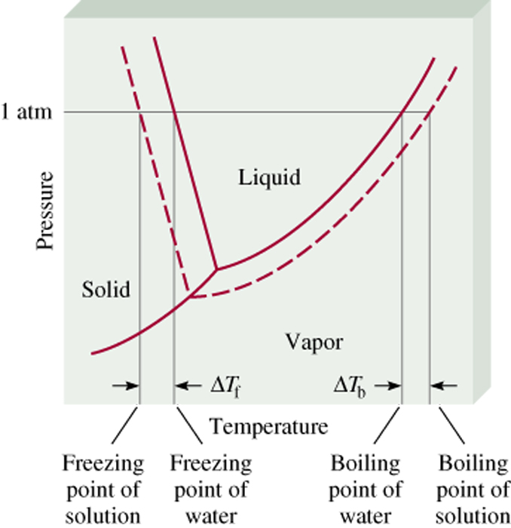
Boiling-Point Elevation
DT_{b} = T_{b} – T _{b}
0
0
T _{b} is the boiling point of
the pure solvent
T _{b} is the boiling point of
the solution
T_{b} > T _{b}
0
DT_{b} > 0

Slide 69
Elevation of boiling point
boiling point is the temperature at which vapor pressure is equal to the external pressure of 760 mmHg.
So the boiling point of solution of non volatile solute need to be
elevated ,
the ratio of this elevation of boiling point to the lowering of vapor
pressure is constant at 100 C˚
T - T°(ΔTb)/ ΔP(P°-P)
ΔTb = K‘
ΔP
ΔTb = ΔP K‘
since P° is constant so
ΔTb = ΔP K‘
P°
ΔP = X2 = m .
P° 1000/M1 in dilute solution
ΔTb = K‘ M1 m = Kb m
1000
Kb = K‘ M1
1000

Slide 70
Kb is the molal elevation constant or the ebullioscopic constant .
So the boiling point elevation depend only on the mole fraction of the solute so it is colligative property .
m = W2 in dilute solution
M2
W2 = 1000 W2
W1
m = 1000 W2
W1 M2
So ΔTb = Kb 1000 W2
W1 M2

Slide 71
Example
A 0.2 m aqueous solution of a drug have a BP of 100.103 C° calculate the approximate molal elevation constant for the solvent.

Slide 72
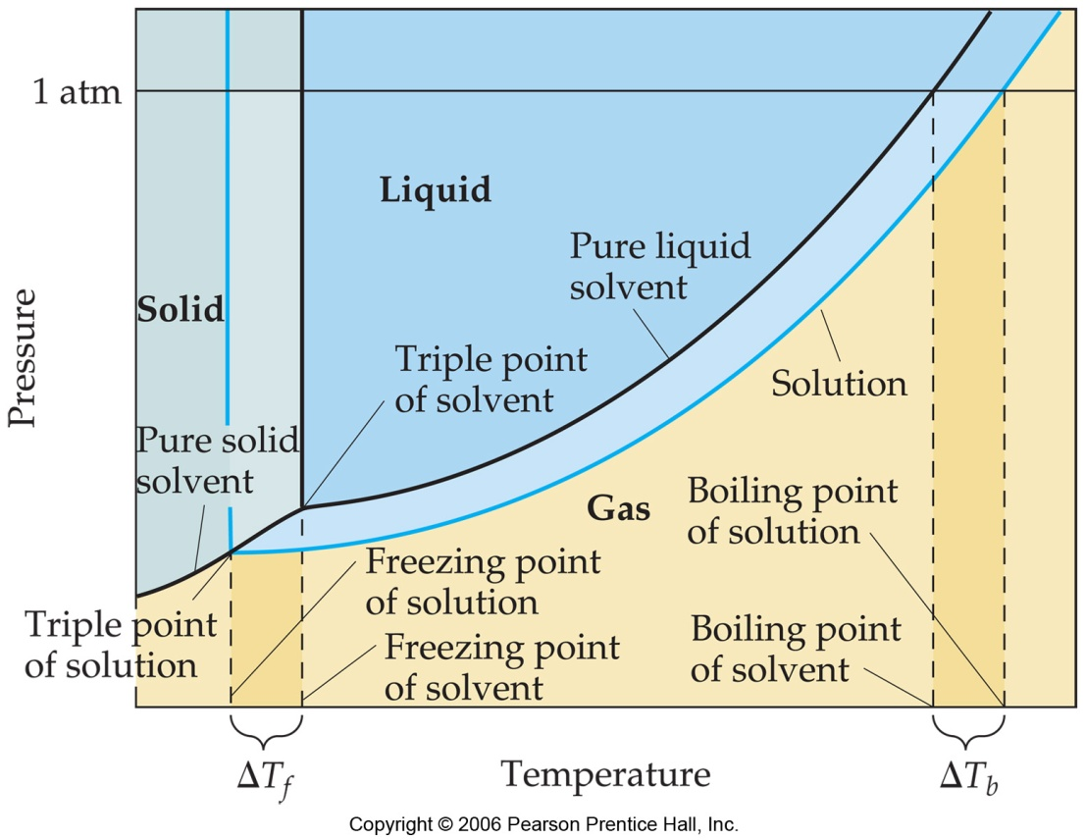
Freezing-Point Depression
0
DT_{f} = T _{f} – T_{f}
0
T _{f} is the freezing point of
the pure solvent
T _{f} is the freezing point of
the solution
0
DT_{f} > 0
T _{f} > T_{f}
ΔTf = Kf m
ΔTf = Kf 1000 W2
W1 M2
Kf : is the molal depression constant or the cryoscopic constant.

Slide 73
Depression of the freezing point
If the solute dissolved in solvent the escaping or the vapor pressure of the solvent is lowered below that of the pure solvent , also the triple point is lowered below that of the pure solvent and as the conc. of the solute increased the farther depression of the vapor pressure ,triple point and freezing point.
ΔTf = Kf m
ΔTf = Kf 1000 W2
W1 M2
Kf : is the molal depression constant or the cryoscopic constant.
So the freezing point depression is only a function of the number of solute particles so it is colligative property.

Slide 74
Example:
What is the F.P. of a solution containing 3.42 g of sucrose and 500 g of water ?
The M.WT. of sucrose is 342g/mole and Kf is equal 1.86 .
Example:
What is the freezing point depression of 1.3 m solution of sucrose in water ? Kf = 2.1

Slide 75
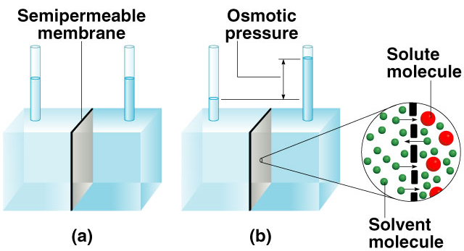
Osmotic Pressure (π):
Osmosis is the selective passage of solvent molecules through a porous membrane from a dilute solution to a more concentrated one.
A semipermeable membrane allows the passage of solvent molecules but blocks the passage of solute molecules.
Osmotic pressure (π) is the pressure required to stop osmosis.
more
concentrated
dilute

Slide 76
π V = n R T
π :is the osmotic pressure .
V :is the volume of solution in liter .
n : is the number of mole of solute .
R : is the gas constant ( 0.082 L atm.mole deg)
T : is the absolute temperature .
π = n RT = M R T ( Morse equation)
V
π = RT ln P° thermodynamic equation
Vi P
Vi : is the volume of one mole of solvent .
P° : is V.P. of solvent .
P : is the V.P. of solution .

Slide 77
Examples:
1. Calculate the osmotic pressure of a solution prepared by adding 1 gram of sucrose in 100 ml of water at 25 C°M.WT of sucrose is 342 g/mol.
2. Calculate the osmotic pressure for 1 M aqueous solution of sucrose using morse and thermodynamic equation, the V.P. of the solution is 31.207 mmHg and the V.P. of water is 31.824 mmHg at 30 C° the molar volume of water at this temperature is 0.0181 L / mole.

Slide 78
Molecular weight determination
Colligative properties can be used for the measurement of M.WT. of the non electrolyte presents as solute
By VP lowering:
ΔP = W2 M1
P° W1 M2
M2 = W2 M1 P°
W1 ΔP
2. By boiling point elevation:
ΔTb = Kb 1000 W2
W1 M2
M2 = Kb 1000 W2
W1 ΔTb

Slide 79
3. By freezing point depression:
ΔTf = Kf 1000 W2
W1 M2
M2= Kf 1000 W2
W1 ΔTf
4. By osmotic pressure:
π = MRT
π = Cg R T Cg : is the g/l of solution
M2
M2 = Cg R T
π

Slide 80
Examples:
1. A solution containing 10 g of sucrose dissolved in 100 g of water has a B.P. of 100.149 C°. What is the M.WT of
sucrose ?Kb is equal to 0.51
2. The F.P. depression of a solution of 2 g of 1,3 dinitrobenzene in 100 g of benzene was determined by equilibrium method and was found to be 0.6095 C°, calculate the M.WT of 1,3 dinitrobenzene.
Kf = 5.12

Slide 81
Example:
15 g of new drug dissolved in water to yield 1000 ml of solution at 25 C° was found to produce an osmotic pressure of 0.6 atmosphere . What is the M.WT. of the drug .

Slide 82
Choice of the colligative properties
Boiling point method can be used only when the solute is non volatile and when the substance is not decomposed at boiling temperature.
The F.P method is satisfactory for solutions containing volatile solutes such as alcohol , since the F.P. of the solution depends on the vapor pressure of solvent alone .
Osmotic pressure method is widely used method.

Slide 83
Reference MARTIN’S PHYSICAL PHARMACY AND PHARMACEUTICAL SCIENCES

