Slide 1
DISEASES OF DENTAL PULP L6

Slide 2
Pulpitis
Is the most common cause of dental pain and loss of teeth.
The usual cause is microbial invasion to pulp through caries penetrating the dentin or after fracture of tooth.

Slide 3
But there are other causes like
Acute injury (accidental blow to tooth).
Chronic injury (attrition or abrasion)
Thermal irritation (cavity preparation without water spray, or large metallic restoration with inadequate insulation).
Chemical irritations by dental material applied to dentine.
Pulpitis, if untreated, is followed by death of the pulp and spread of infection through the apical foramina into the periapical tissue.

Slide 4
CLASSIFICATION OF PULPITIS
FOCAL REVERSIBLE PULPITIS (pulp hyperemia)
Clinical features:
. It is mild transient localized inflammatory reaction in pulp.
. The tooth is sensitive to thermal changes especially to cold.
. The pain is of very short duration and disappears as soon as the thermal irritant is withdrawn. . .The young people develop focal reversible pulpitis more than the older individuals because of the more reparative capacity of the pulp tissue.

Slide 5
. The affected tooth responds to stimulation by electric pulp tester at lower level of current when compared with an adjacent tooth.
The tooth often has large carious lesion or restoration with improper insulation.
Histopathological features:
- Acute inflammatory reaction with infiltration of polymorph nuclear leukocytes
- Dilation of pulpal blood vessels with increased vascular permeability, and edema in pulp are limited to the odontoblast or subodontoblastic regions adjacent to the irritated dentinal tubules

Slide 6
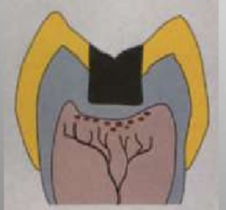
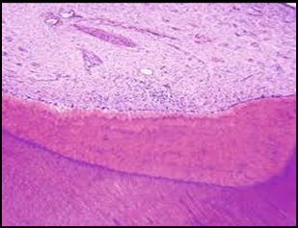
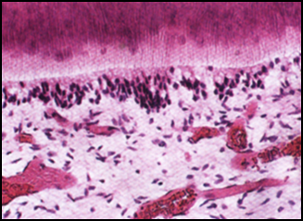
.Few odontoblast cells could be damaged in the localized area of injury.
.A
Focal reversible pulpitis
(A) Limited to the odontoblast or subodontoblastic regions adjacent to the irritated dentinal tubules. (B) Shows congestion of blood vessels in pulp.
(C) Slight disruption of odontoblastic cell layer
Treatment by eliminating of the irritating factor, if it is dental caries, removes it and placed a suitable dressing material.
(b)
c

Slide 7
ACUTE PULPITIS
Irreversible condition characterized by acute intense inflammatory reaction in pulp tissue. My be an extension of focal reversible pulpitis, or as acute exacerbation of chronic pulpitis, or may be acute from the beginning.
Clinical features:
The tooth is extremely sensitive to hot and cold stimuli
This severe and sharp pain may continue even after removal of the stimuli.
The affected tooth responds to lower level of current if electric pulp tester used.

Slide 8
As the dental pulp is lying within the solid dentinal wall, the intra pulpal pressure increase during inflammation and the pain is increased due to the:
Pressure on the irritated nerve endings by inflammatory cells infiltrate within the rigid pulp chamber
And partly due to release of pain-producing substances from the damaged tissue
Or because of lack of escape of inflammatory exudate from the small apical foramen.

Slide 9
Pain may start spontaneously, often when the patient is trying to get to sleep due to increase in local blood pressure in head and neck region.
The tooth is not tender to percussion unless the pulpal inflammation has spread beyond root apex into the periapical region.

Slide 10
Histopathological features:
. Severe edema in the pulp with hyperemia(excess blood flow)
- Moderate to severe infiltration by neutrophils.
. Focal or complete destruction of odontoblast and adjacent mesenchyme follow.
- A limited area of necrosis may result in formation of a minute abscess surrounded by neutrophils and micro-organisms.
Later, inflammation spreads until all the pulp is obliterated by dilated blood vessels and acute inflammatory cells. Necrosis follows.

Slide 11
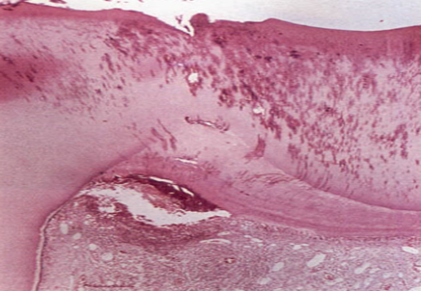
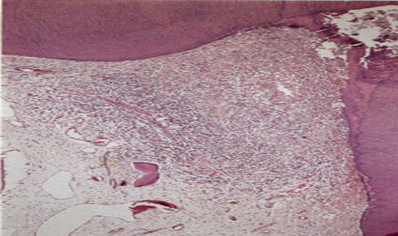
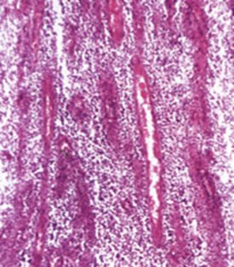
A
b
c
(A) Infection has penetrated the reactionary dentine causing inflammation to spread down the pulp and pus form in the corner. (B, C) Acute pulpitis - terminal stage. The entire pulp has been destroyed and replaced by inflammatory cells and dilated vessels.

Slide 12
CHRONIC PULPITIS
Clinical features:
.It is characterized by a low grade often persistent inflammatory reaction in pulp tissue.
.The sign and symptoms are much milder than acute pulpitis.
. The tooth is less sensitive to hot and cold stimuli.
. There may be dull and throbbing intermitted pain or may be asymptomatic for some period. .The tooth respond to a higher level of current when electric pulp tester is used due to degeneration of most of the nerve fibers in the chronically inflamed pulp.

Slide 13
Histopathological features:
The main features are a predominantly lymphocytes, plasma cells and macrophages , with formation of collagen bundles (fibrosis).
. Blood capillary are prominent.
. A small area of pulpal necrosis and pus formation may be localized by a well-defined wall of granulation tissue.
The relatively prolonged survival of chronically inflamed pulps is shown by the persistence of symptoms over a long period with occasional periods of acute exacerbations.
. However, pulp death may be the end result

Slide 14
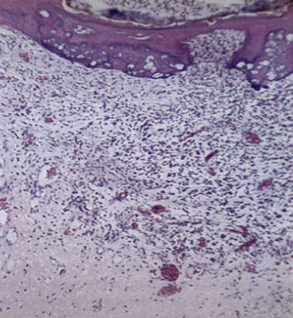
Chronic pulpitis: Formation of irregular calcific barrier, with failure to hold back the infection.

Slide 15
CHRONIC HYPERPLASTIC PULPITIS (pulp polyp)
Clinical features:
. Hyperplastic granulation tissue proliferates through the opening as a protruding mass, pink-red in color and often fills up the carious cavity.
. Mostly affects deciduous molars and first permanent molars in children and young adults. The lesion may bleed profusely upon provocation.
. The involved tooth has a large open carious cavity and usually painless or may be sensitive to thermal stimuli.

Slide 16
Histopathological features:
. It presents features of granulation tissue mass growing out through a wide exposure of the pulp consisting of inflammatory cells chiefly lymphocytes, plasma cells, and numerous proliferating fibroblasts.
Many young vessels and neutrophils sometimes are common.
The epithelium if present is mostly comes from the buccal mucosa which are carried by saliva and transplanted on the surface of the polyp

Slide 17
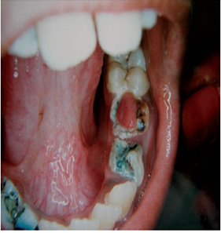
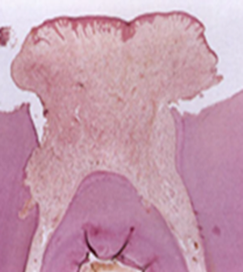
A
B
(A) Pulp polyp: Hyperplastic nodule of tissue is growing out through a wide exposure of the pulp. (B) In this broken down molar, granulation tissue is proliferating from the pulp cavity and has acquired an epithelial covering over much of its surface.

Slide 18
PULP NECROSIS
Occur due to untreated pulpitis, either acute or chronic, or due to injury causing subsequent occlusion of apical blood vessels, result in complete necrosis of the pulp tissue.

