Slide 1
OSTEOMYELITIS OF THE JAWS L8

Slide 2
Definition:
osteitis is a localized inflammation of bone with no progression through the marrow spaces, particularly which associated with infected sockets following removal of teeth (dry socket)
osteomyelitis is a more extensive inflammation of the interior of the bone involving and typically spreading through the marrow spaces.
Periostitis means inflammation of the periosteal surface of the bone and may or may not be associated with osteomyelitis

Slide 3
Osteomyelitis
Is an inflammatory condition of the bone and bone marrow along with the surrounding periosteum.
The mandibular bone has poor blood supply in comparison with maxilla, besides this it has more compact bone pattern due to which osteomyelitis occurs far more commonly in mandible than maxilla.

Slide 4
Classification of osteomyelitis
Suppurative
1. Acute
2. Chronic( primary and Secondary)
Non-Suppurative
1-Chronic sclerosing(focal& diffuse)
2- Garre’s sclerosing (periostiris ossifficance)
3- Radiation osteomyelitis

Slide 5
Etiological factors:
Direct spread of odontogenic infection into the jawbone.
Fracture of bone.
Spread of infection from overlying soft tissue.
Post radiation secondary infection.
Infection to pre-existing bony disease like Paget’s disease, fibrous dysplasia, and osteopetrosis.
Chronic specific jaw inflammations (Tuberculosis, syphilis, lepra and actinomycosis.

Slide 6
ACUTE SUPPURATIVE OSTEOMYELITIS
Clinical features:
-It cause severe pain, fever, malaise
Swelling of the jaw
Loosening of teeth
Difficulty in mouth opening
Bad breath, multiple intraoral or extraoral pus discharching sinuses
Regional lymph nodes enlargement and tenderness
Paresthesia of lip, redness of overlying skin and mucosa.

Slide 7
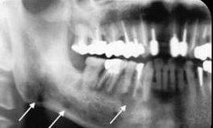
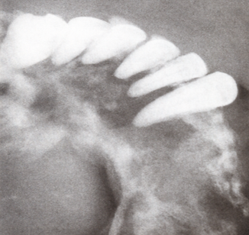
Radiographical features:
In the initial stage of the disease no noticeable radiographic changes is observed
After 10 days sufficient bone resorption may have occurred to produce irregular moth-eaten area of radiolucency.
Sequestra are seen as multiple radiopaque foci within the lesion.

Slide 8
Histopathological features:
- The bone marrow undergoes liquefaction and a purulent exudate occupies the marrow space.
A large number of neutrophils with occasional presence of lymphocytes and plasma cells are seen.
Bony trabeculae exhibit reduced osteoblastic activity and increased osteoclastic resorption which often produces scalloping at boney margins.

Slide 9
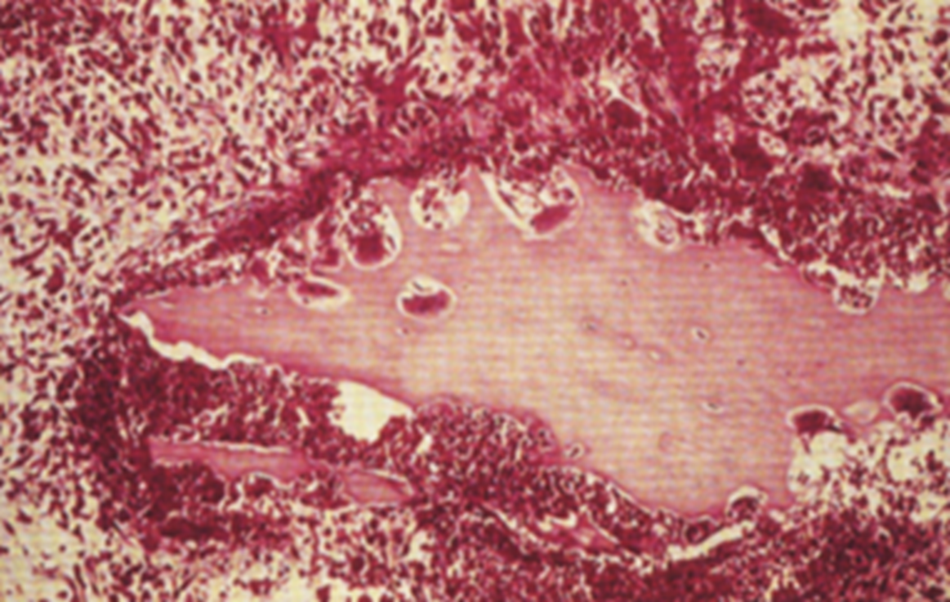
- Some areas of affected bone undergo necrosis with degeneration of both osteoblasts and osteocytes and result in development of sequestrum.
Osteoclastic resorption of bone and surrounding suppurative inflammation

Slide 10
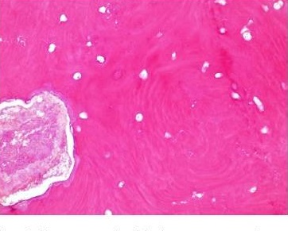
sequestrum is a dead piece of bone appears with empty lacunae and eroded scalloped out line which is produced by osteoclastic resorption.
.

Slide 11
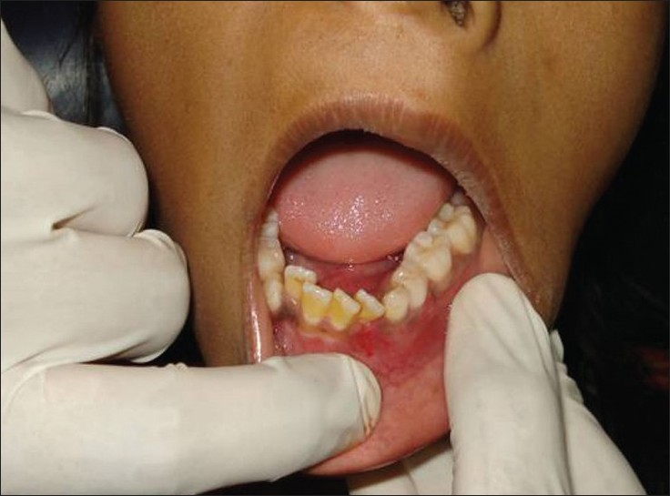
CHRONIC SUPPURATIVE OSTEOMYELITIS
Clinical features:
May be sequelae of acute form or as a chronic from the beginning.
Patients often give a history of long lasting mild and dull pain in the jaw which has developed following an acute tooth abscess, tooth fracture or extraction, etc.
On rare occasions sinus tracts may
develop intra orally or extra orally
with discharge of purulent materials.

Slide 12
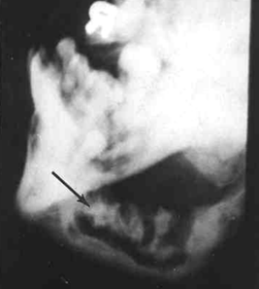
Radiographical features:
Moth eaten radiolucent area in the bone with poorly defined margins.
Radiopaque foci represent areas of sequestrum formation.
Radiopaque Sequestra (arrow) surrounded by radiolucent suppuration.

Slide 13
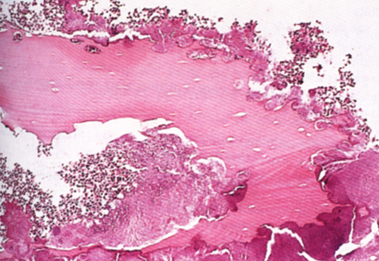
Histopathological features:
- Lymphocytes, plasma cells, and macrophages are predominant with accumulation of exudates within medullary spaces.
Osteoblastic and osteoclastic activities occur parallely with formation of irregular boney
trabeculae having reversal lines.
- Sequestrum also may be
seen.
Sequestrum and a dense surface growth of bacteria. Sequestrum appears with empty lacunae, eroded scalloped out line produced by osteoclastic resorption.

Slide 14
CHRONIC FOCAL SCLEROSING OSTEOMYELITIS (Condensing osteitis)
It is non suppurative chronic inflammatory condition of bone characterized by sclerotic bone formation around the root apex of nonvital tooth.
When the resistance of the tissue against infective organism is very high, a low grade inflammation in the jaw bone causes stimulation of osteoblasts cells which result in dense trabecular bone formation

Slide 15
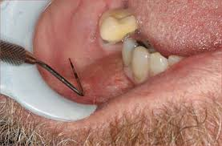
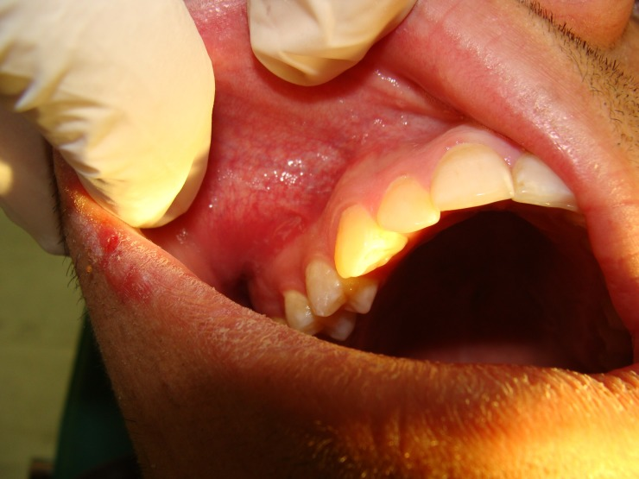
Clinical features:
- disease frequently develops in young adults before the age of 20years.
- Mandibular first molars are mostly affected, followed by mandibular second molar and premolars.
The associated tooth usually presents a large carious lesion.
The condition is a symptomatic or associated with mild pain.
.

Slide 16
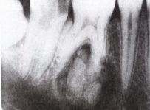
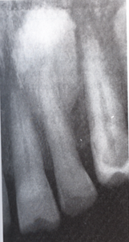

Radiographical features:
- Well circumscribed radiopaque mass around the apex of the involved tooth.
- The apex is unidentified within the radiopaque mass.
A
B

Slide 17
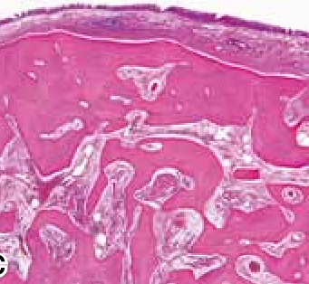
Histopathological features:
Dense mass of sclerotic bone with little or no interstitial marrow tissue, and when present it is fibrotic and infiltrated by chronic inflammatory cells.

Slide 18
CHRONIC DIFFUSE SCLEROSING OSTEOMYELITIS
It is a proliferative reaction in response to low grade inflammation or infection in the jaw bone.
The infection is wide spread in nature and are derived from the periodontal tissue or from periapical tissue

Slide 19
Clinical features:
Usually seen among elderly people.
The mandible is mostly affected, and sometimes all four quadrants of both jaws could be affected at a time
The disease is asymptomatic, but sometimes the patient may complain of vague pain in the jaw with foul taste in the mouth
.- Acute exacerbation may occur and produces mild pain and suppuration.

Slide 20
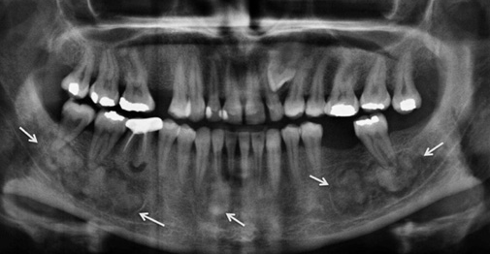
Radiographical features:
Diffuse sclerosis of bone, may be similar to cotton wool radiopacities seen in Paget’s disease of bone
.
Chronic diffuse sclerosing osteomyelitis with multiple radiopacities in the mandible

Slide 22
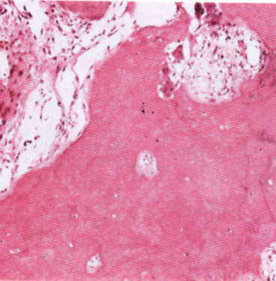
Histopathological features:
Dense irregular bone with fibrous marrow tissue which contains chronic inflammatory cells.
Chronic sclerosing osteomyelitis, the marrow spaces are fibrosed and infiltrated by inflammatory cells and osteoclasts.

Slide 23
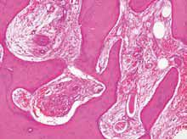
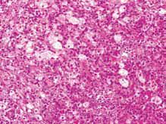

Slide 24
CHRONIC OSTEOMYELITIS WITH PROLIFERATIVE PERIOSTITIS (Garre’s osteomyelitis)
Represent a reactive periodontal osteogenesis in response to low grade infection.
It characterized by focal gross thickening of the involved bone due to sub-periosteal new bone deposition
.

Slide 25
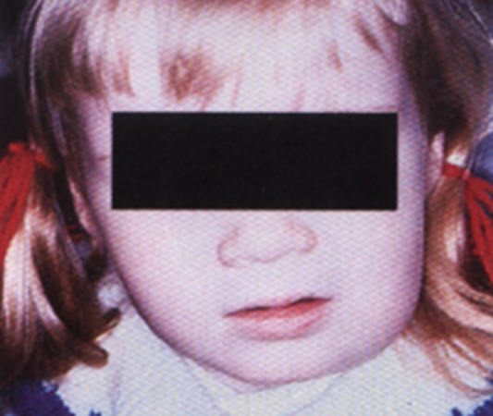
Clinical features:
- It occurs in young patients with high degree of body resistance and excellent tissue reactivity.
- Mandible is mostly affected.
The involved jaw often presents a carious non vital tooth.
The thickness of bone may be up to 1 cm, and the area may show mild tenderness.
Garre’s osteomyelitis.

Slide 26
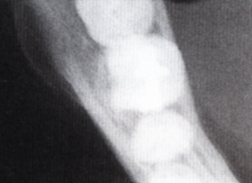
Radiographical features:
The occlusal radiograph shows smooth, convex, boney overgrowth on the outer cortex of the jaw, and exhibited many concentric opaque layers producing a typical onion skin appearance.
Few newly formed boney trabeculae are often oriented perpendicular to the onion skin layers.
Excess layers of bone on buccal plate.

Slide 27
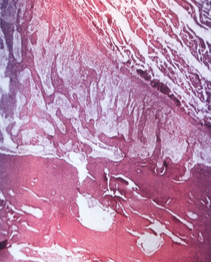
Histopathological features:
Areas of newly formed bone consisting of multiple osteoid and primitive bone tissue in sub-periosteal region.
Fibrous marrow tissue which contains chronic inflammatory cells are seen.
Sub-periosteal bone formation.

Slide 28
Radiation injury and osteoradioaccrosis
- Radiation, as part of the therapy of oral malignancy, affects the vascularity of the bone by causing a proliferation of the intima of the blood vessels (endarteritis obliterans).
This can have serious consequences in the mandible with its end-artery supply, and the inferior dental artery or its branches may become thrombosed.
The non-vital bone which results from the reduction in blood supply is sterile and asymptomatic but is very susceptible to infection and to trauma from a denture.

Slide 29
- Infection may spread rapidly through the irradiated bone, resulting in extensive osteomyelitis and painful necrosis of the bone, often associated with sloughing of the overlying oral mucosa and occasionally facial soft tissues.
Modern methods of radiotherapy have greatly reduced the incidence of this condition

