Slide 1
DISORDERS OF BONE L9
.

Slide 2
Disorders of bone are either:
. Inherited bone diseases
. Metabolic bone diseases
. Fibro-osseous lesions
. Or due to unknown cause.

Slide 3
INHIRITED BONE DISEASES
1- Cherubism : Inherited as autosomal dominant.
. The first clinical manifestation is a progressive bilateral facial swelling that appears when the patient is between 1.5 and 4 years of age.
. This change can affect the mandible and/or the maxilla, but involvement of the mandible is most common.
- Bilateral deformity, produces the characteristic cherubic facial appearance.
. Displacement of the eyes is evident especially when the maxilla is affected.

Slide 4
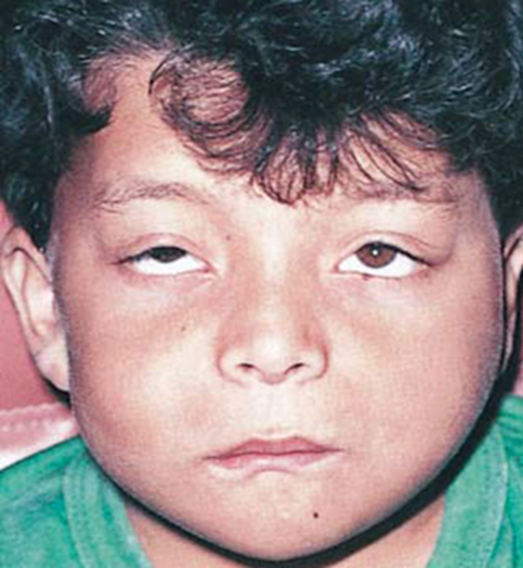
. Premature loss of deciduous teeth and displacement and lack of eruption of many permanent teeth may occur.
. The size of the jaws tends to increase rapidly until puberty and then generally remains stable.
. After the individual reaches 20 or 30 years of age,
radiographs show an almost normal bone appearance.
Symmetric bilateral enlargement

Slide 5
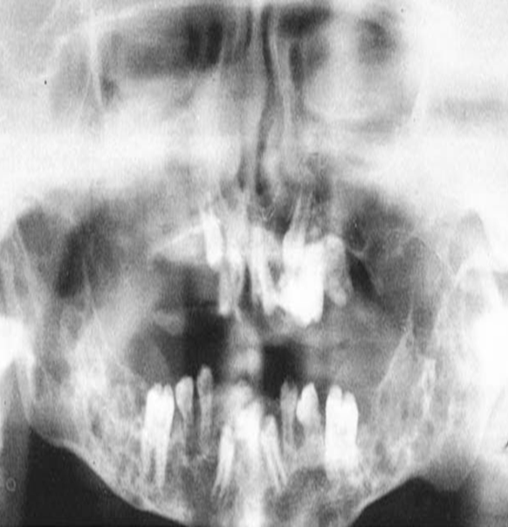
Radiographical features:
Radiographs of the jaws show a typical “soap-bubble” or multilocular radiolucency appearance, with expansion and severe thinning of the cortical plates
Radiographical picture with soup bubble appearance,

Slide 6
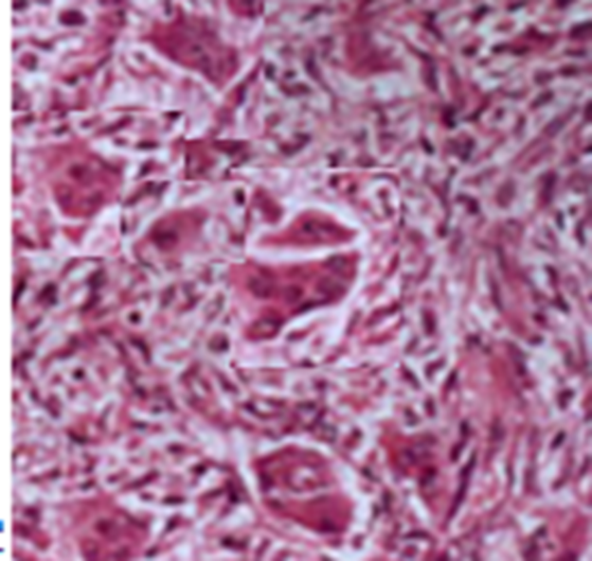
Microscopically
. it resembles a central giant cell granuloma.
. Areas of bone radiolucency are occupied by fibrous connective tissue containing multinucleated giant cells.
Extravasated red blood cells and deposits of
hemosiderin are common in the intercellular stroma.
Microscopical picture showing giant cells and fibrous tissue.

Slide 7
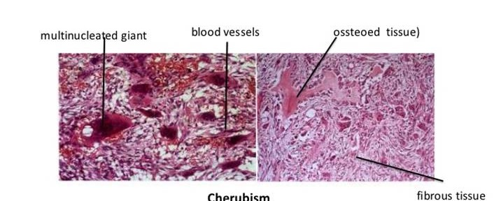

Slide 8
2. Cleidocranial dysplasia :
Abnormalities of many bones
. Fontanelles and sutures remain open
. Prominent frontal, parietal and occipital bones, depressed nasal bridge
. Partial or complete absence of clavicles
. Retention of deciduous teeth, multiple supernumerary teeth and multiple impactions of permanent teeth.

Slide 9
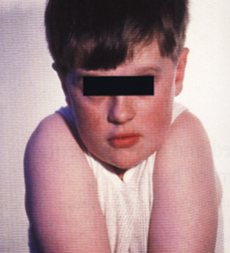
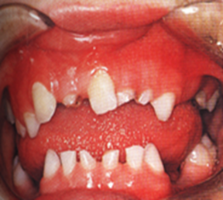
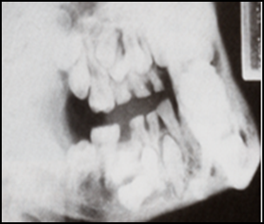
Cleidocranial dysplasia
Absence of clavicle allowing shoulders to be brought forward
Clinical and Radiographical picture shows retention of deciduous teeth and multiple impactions of permanent teeth.

Slide 10
3- Osteopetrosis – Marble bone disease :
Hereditary disease characterized by
- Excessive density of all bones with obliteration of marrow cavities,
- The bones become solidified and dense but brittle.
- Delay eruption of teeth, and osteomyelitis after tooth extraction may occur.

Slide 11
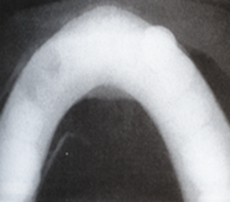
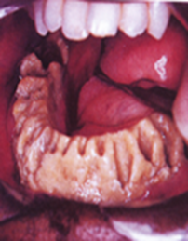
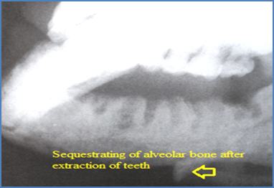

A
B
C

Slide 12
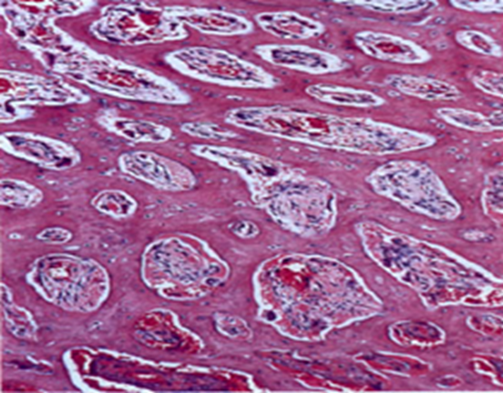
Microscopically
There is inactivity of osteoclasts and absence of normal modeling resorption, and the medullary spaces are small and fibrotic.

Slide 13
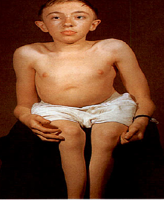
4- Osteogenesis imperfecta
. Hereditary disease in which the biosynthesis of type I collagen is defective, so that osteoblasts fail to form bone in adequate amounts, leading to fractures and abnormal dentine formation . .The bones are thin, excessively fragile and lack the usual cortex of compact bone, and composed of immature, woven bone.
.The development of epiphyseal cartilages is unimpaired so that bones can grow to their normal length.
. Many fractures can cause severe deformities.
. Often associated with dentinogenesis imperfecta.

Slide 14
5-Achondroplasia
. Genetic skeletal disorder manifests itself as short-limbed dwarfs who traditionally became circus clowns.
. The essential defect is failure of normal cartilage proliferation in the epiphyses and base of the skull.
. The limbs are therefore excessively short in relation to the trunk, while the head, which is normal in size, appears disproportionately large .

Slide 15
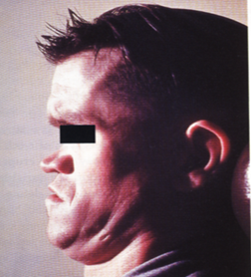

. Defective growth at the base of the skull causes the middle third of the face to be retrusive and the profile to be concave.
The mandible is often protrusive, and as a result of the disparity of growth of the jaws, there is usually severe malocclusion.

Slide 16
METABOLIC BONE DISEASES
1- Hyperparathyroidism :
- Relatively rare disease which is said to be three times as common in women as in men.
- It usually affects people of middle age, but it may occur in childhood or in later life.
-Pathologic fracture may be the first symptom of the disease, bone pain, joint stiffness,
and giant cell lesion of the bones.
The effects of the disease on bone are of special interest to dentists.
The loss of phosphorus and calcium in this disturbance results in a generalized osteoporosis with abortive attempts at bone repair and new bone formation

Slide 17
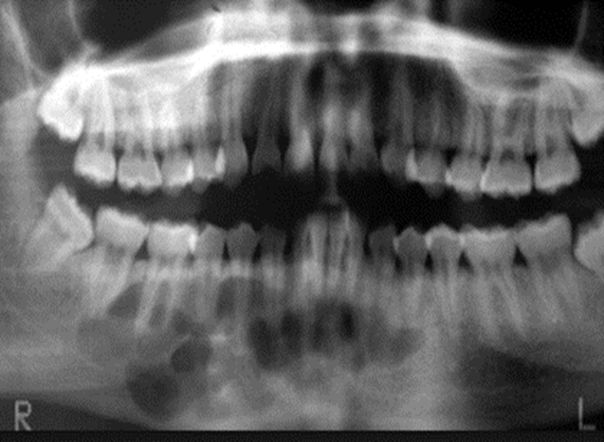
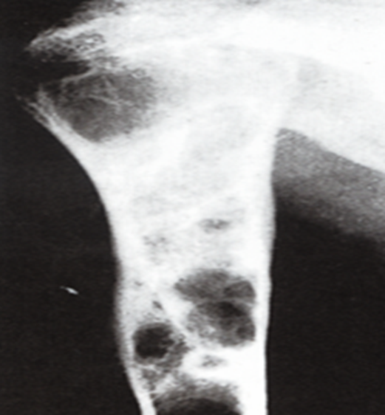
Radiographically the bones of affected person shows sharply defined round or oval cystic like radiolucent areas.
. The lamina dura around the teeth may be partially lost.
. These small cystic like areas must be differentiated from the lesions of multiple myeloma and eosinophilic granuloma in the jaws, and the diagnosis confirmed by blood investigation.
Radiographical picture shows multiple radiolucencies.

Slide 18
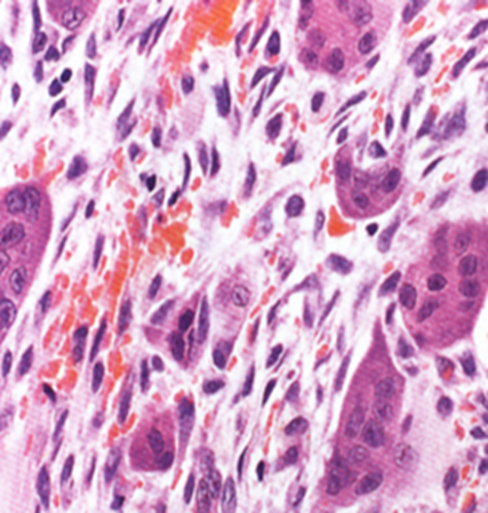
The most characteristic histological changes in the bone are an osteoclastic resorption.
. Fibrosis of the marrow spaces is marked, and in the fibrotic islands there is hemorrhage, and much hemosiderin is evidence and numerous multinucleated giant cells.
.
Microscopical picture shows multinucleated giant cells and areas of hemorrhage.

Slide 19
. This lesion is indistinguishable radiographically and histologically from the central giant cell granuloma of bone. Therefore, any patient who has a lesion diagnosed as a central giant cell lesion should be evaluated medically to rule out the possibility of hyperparathyroidism.
. Serum calcium, phosphorus, and alkaline phosphatase levels should be obtained prior to surgical removal of a giant cell granuloma, and if abnormal, parathyroid hormone (PTH) levels should be assessed.

Slide 20
FIBRO-OSSEOUS LESIONS
. Fibro-osseous lesion is a generic histologic designation for a diverse group of bone lesions that are named for the similarity of their histologic appearance.
. They are composed of cellular fibrous connective tissue and mixed with either osteoid and bone trabeculae or rounded small to large calcified masses that have traditionally been described as cementoid material.
Fibro-osseous lesions of the jaws include:
fibrous dysplasia
2. benign neoplasia
3. cemento-osseous dysplasia

Slide 21
1- FIBROUS DYSPLASIA
Fibrous dysplasia is a disease that is characterized by the replacement of bone with fibro-osseous tissue.
. The lesions consist of loose cellular fibrous tissue containing trabeculae of woven bone of variable shape that are formed by osseous metaplasia and which merge imperceptibly into surrounding normal bone.
Several forms of fibrous dysplasia have been described:

Slide 22
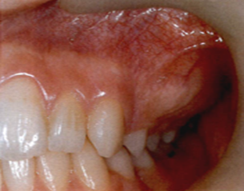
A- Monostotic fibrous dysplasia
characterized by the involvement of a single bone, the swelling starts in childhood but usually undergoes arrest in adulthood.
. The jaws are the most frequent sites in the head and neck region.
Males and females are almost equally frequently affected.
Clinically, a painless, smoothly rounded swelling, usually of the maxilla.
The mass may become large enough to disturb function and
cause malocclusion by displacing teeth.
Rounded expansion of the maxilla and intact overlying mucosa

Slide 23
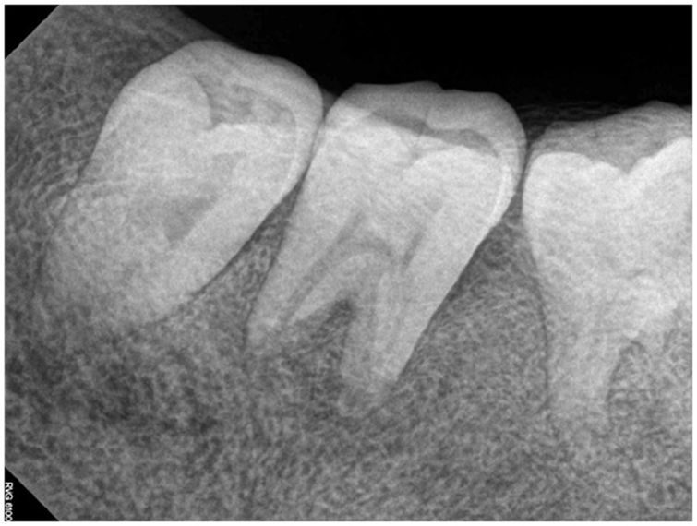
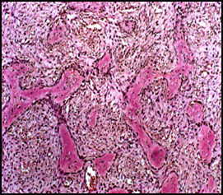
Radiographically, fibrous dysplasia classically presents with a “ground glass” appearance and may have varying degrees of radiopacity and radiolucency depending on the amount of calcified material present.
B
A
(A) Radiograph shows loss of lamina dura and the trabecular pattern produces an orange-peel or thumb –print appearance. (B) Slender trabeculae of woven bone resemble Chinese characters in shape, lying in cellular fibrous tissue.

Slide 24
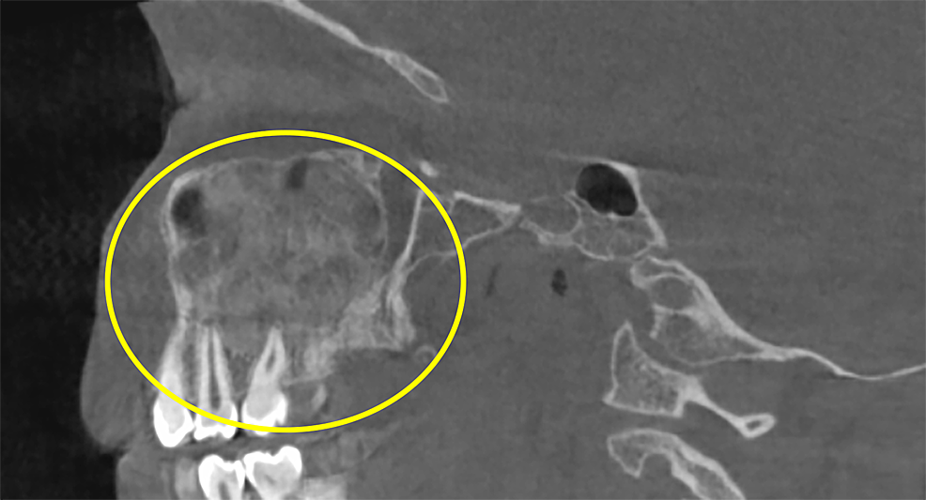

Slide 25
B- Polyostotic fibrous dysplasia:
. Involves several bones
. Females are affected mostly and the disease may be seen in childhood.
. Albright's syndrome comprises polyostotic fibrous dysplasia
. Skin pigmentation consists of brownish macules (café au lait spots) and sexual precocity

Slide 26
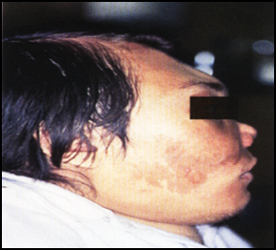
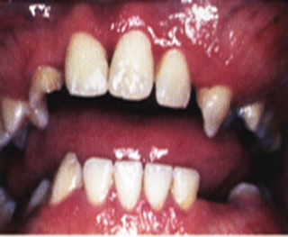
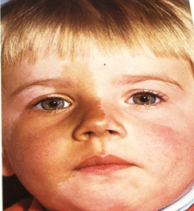
B
C
A
Polyostotic fibrous dysplasia (A) Clinical appearance of patient exhibiting disproportionate bone growth caused by multiple fibrous dysplasia lesions of craniofacial bones and café au lait pigmentations. (B) Expansile lesions of the mandible and maxilla in all quadrants. (C) Albright's syndrome with café au lait pigmentations.

Slide 27
2. BENIGN NEOPLASIA
Ossifying fibroma/cementifying fibroma
3. CEMENTO-OSSEOUS DYSPLASIA
Non-neoplastic proliferations, from periodontal ligament origin.
Three forms of this dysplastic process involving the jaws of the same microscopical picture:
A. Periapical cemental dysplasia (previously called cementoma)
. Mostly affects women, particularly the middle-aged, more common in blacks
. Mostly asymptomatic and involves the mandibular incisors region

Slide 28
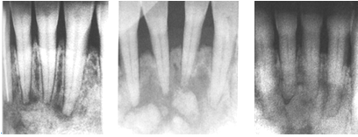
Radiographically, can be seen as rounded radiolucent areas related to the apices of the teeth(osteolytic stage), these simulate periapical granulomas but related teeth are vital.
. Later, there is calcification, starting centrally (cementoblastic stage), then the masses increase in size and the lesion become densely radiopaque (mature stage) and surrounded by thin radiolucent line.

Slide 29
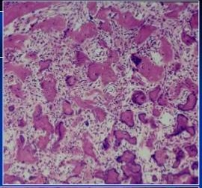
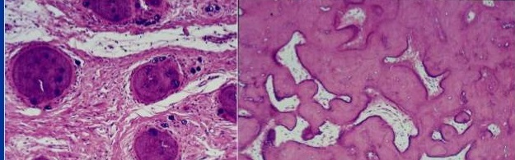
. Histologically the lesions resemble cemento-ossifying fibromas and consist, in their early stages, of cellular fibrous tissue containing foci of cementum-like tissue.
. Progressive calcification leads to the formation of a solid, bone-like mass.
A
B
C

Slide 30
B. Focal cemento-osseous dysplasia :
occurs as a single lesion and may affect posterior teeth.
C. Florid cemento-osseous dysplasia (Gigantiform dysplasia)
presents an exuberant form of cemento-osseous dysplasia.
. It may involve multiple quadrants in the maxilla as well as the mandible.
. They are asymptomatic unless they become infected, but can expand the jaw.
. Gigantiform cementoma is a rare familial variant of florid cemento-osseous dysplasia.

Slide 31
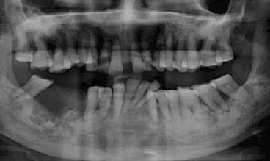
Radiographically, florid cemento-osseous dysplasia appears as radiopaque, somewhat irregular masses involving the maxilla and/or mandible.
.

Slide 32
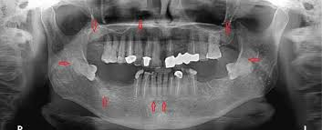
.

Slide 33
BONE DISEASES OF UNKNOWN CAUSE
Paget's disease of bone (osteitis deformans ):
. Chronic disease of the adult skeleton.
- It affects about 3% of the population over 45 years.
. The etiology of Paget’s disease is not well understood, may be due to
Autoimmunity, endocrine abnormalities related to hyperthyroid disease, vascular disorder, and viral infection, genetic factor may also be involved.
. Although some patients with Paget’s disease have no symptoms, but the narrowing of skull foramina can cause ill-defined neuralgic pains, severe headache, dizziness, and deafness.

Slide 34
. The bony lesions of Paget’s disease produce characteristic deformities of the skull, jaws, back, pelvis, and legs that are readily recognized both clinically and radiographically.
. When the jaws are affected the alveolar process becomes symmetrically and grossly enlarged, thickened without localized swellings and the palatal vault become flattened.
. The edentulous patients may complain that their dentures no longer fit.
. Spacing between the teeth and difficulty in closure of the lips can also occur.

Slide 35
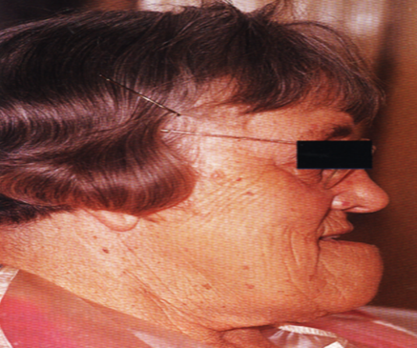
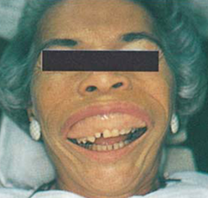
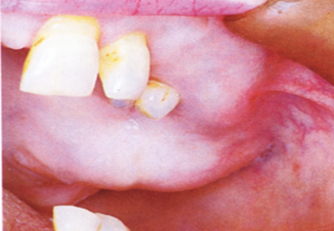

Slide 36
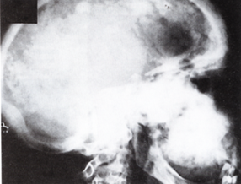
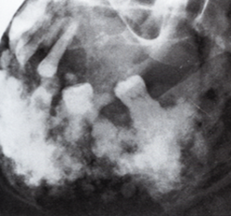
The main radiographic features are
. lower density of the bone in the early stages and sclerosis in the later stages with loss of normal trabeculation causes the bone to have a characteristic cotton-wool appearance.
. Loss of the lamina dura and hypercementosis can also be seen.
(A )Cotton-wool appearance in the skull and maxilla, and (B) in the mandible

Slide 37
. In the initial phase there is typically bone resorption (increase in osteoclasts)
. In the second phase osteolysis and osteogenesis occur, destruction and new bone formation may alternate rapidly,
The change in bony activity is marked histologically by blue-staining reversal lines producing mosaic appearance in the bone
. Many osteoblasts and osteoclasts (often abnormally large), fibrosis of the marrow spaces and increased vascularity can be seen.
. In the sclerosis phase, the osteoclasts decreases and the osteoblasts increased.

Slide 38
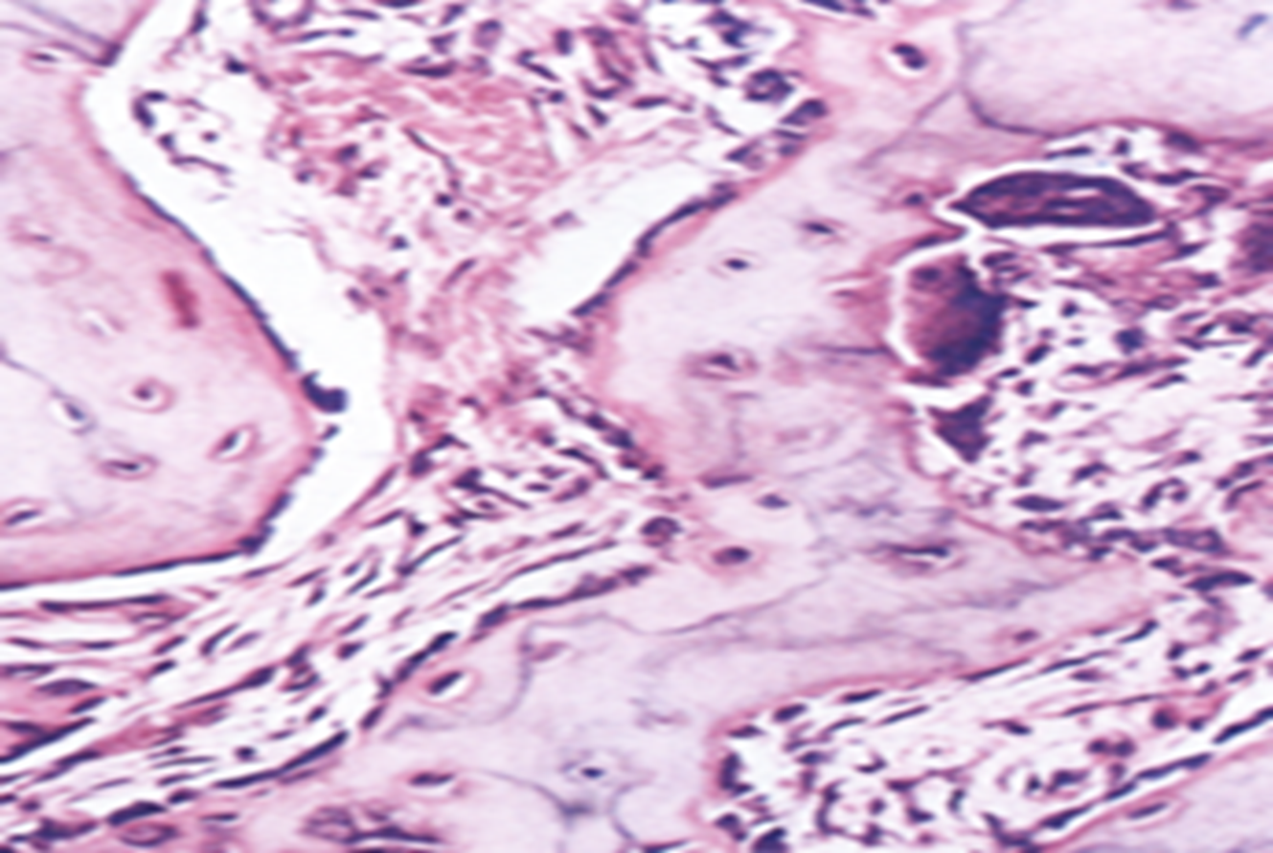
. Serum calcium and phosphorus levels are usually normal, but the alkaline phosphatase level is particularly high.
. Malignant transformation to osteosarcoma occurs in less than 1% of patients.
Microscopical picture shows:
osteoblasts, osteoclasts, and reversal lines.

Slide 39
A
B
Arrow A points to osteoclasts in Howship lacunae and arrow B points to
osteoblasts in the process of bone formation.

