Slide 1
Academic Research and Writing Chapter 4: Literature Review
Omar Farouk Al Mashhour
Academic Research And Writing (Bus 353)
2023-2024 Fall
Week Four
Monday, 6th / 7th / 8th Of November, 2023

Slide 2
Outline
What is Review?
What is Literature Review?
What is the purpose of a literature review?
Effective Literature Reviews
Steps for Literature Review
What is Data Analysis
Methods of Data Analysis
Criteria of Evaluation
Synthesizing

Slide 3
What is Review ?
Review means evaluation of a given work (a book, an article or a paper, etc.) in order to arrive at a given conclusion for its improvement or change or a fair verdict that it is either good or bad. (Bahishti, 2021)
It is also a formal assessment of something with the intention of instituting change if necessary. (Geest & Gemert, 1997)
For example, “a comprehensive review of The review of banking sector in KRG”
Review is also a critical appraisal of a book, play, film, etc. published in a newspaper or magazine. (Andersen & Basora, 1994)

Slide 4
What is Literature Review?
Literature review means a systematic evaluation of previous research works or publications that a researcher carries out in order to use in his or her research work, hence identifying gaps and justifying the need for the conduct of the research. (Chigbu, Atiku, & Plessis, 2023)
Literature review is also a well-integrated discussion and critical evaluation of the different points of view on a given research topic, as found in the relevant previous studies, highlighting their strengths, weaknesses and indicating how the research will contribute to knowledge on the topic. (Paul & Criado, 2020)

Slide 5
What is the purpose of a literature review?
To gain an understanding of the existing research and debates relevant to a particular topic or area of study
To present that knowledge in the form of a written report.
Clarification of Research Problem, Topic or Question
Development of General Explanation for the Relationship or Correlation between Phenomena or Events
Familiarization with the Methods of Data Collection and Analysis, as
Used in other Works
Provision or Suggestion of Alternative(s) or Options for Variables or Hypotheses

Slide 6
Effective Literature Reviews
Outlines important research trends in the conversation.
Assesses the strengths and weaknesses of existing research.
Identifies potential gaps in knowledge.
Establishes a need for current and/or future research projects.

Slide 7
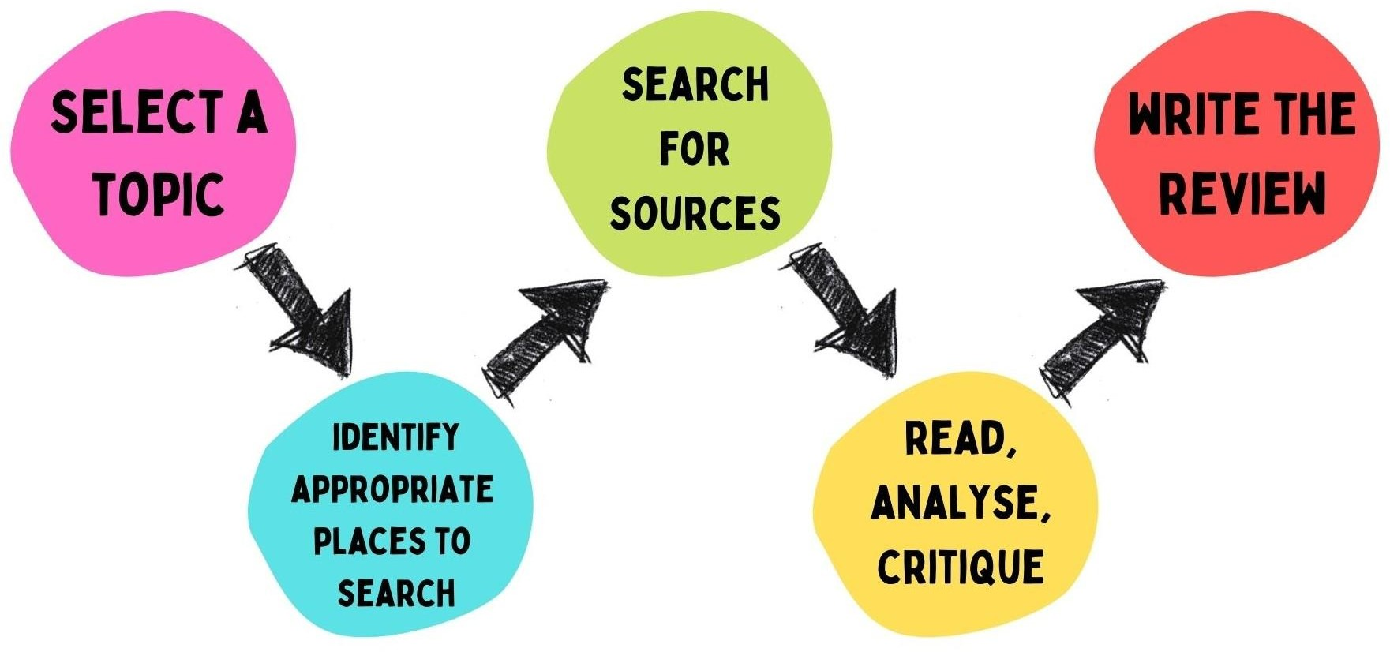
Steps for Literature Review

Slide 8
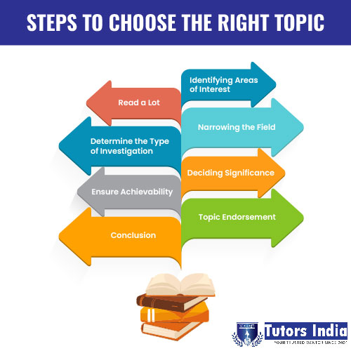
Selecting a Topic
Must be something Interesting to you (ideally, you should have come across a series of recent papers related to your line of work that call for a critical summary),
An important aspect of the field (so that many readers will be interested in the review and there will be enough material to write it),
A well-defined issue (otherwise you could potentially include thousands of publications, which would make the review unhelpful).

Slide 9
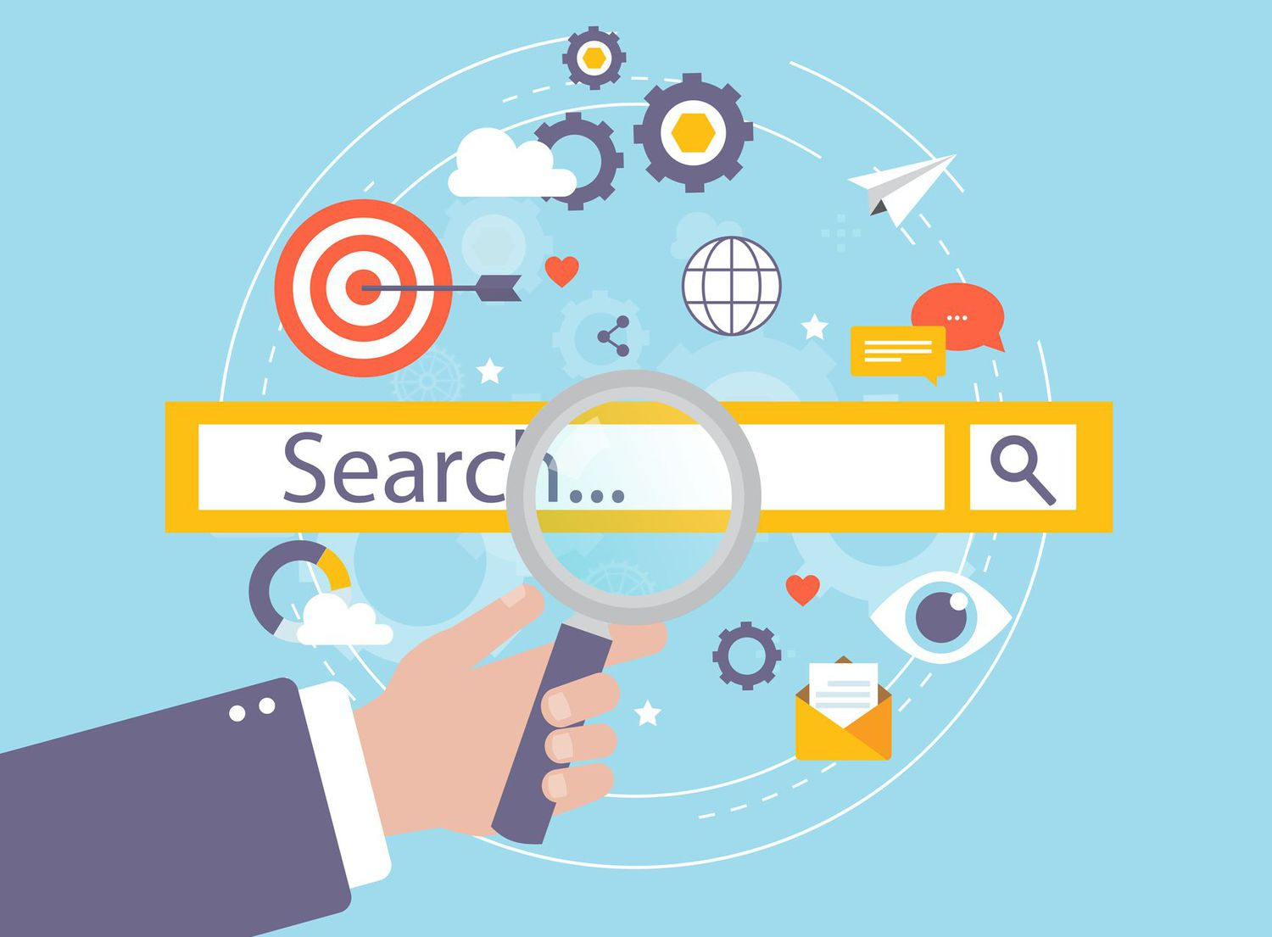
Developing A Search Strategy
Strategy involves figuring out where the information might be and identifying the best tools for finding those types of sources.
The search strategy combines the key concepts of your search question in order to retrieve accurate results.
Your search strategy will account for all:
Possible search terms
Keywords and phrases
Subject headings (where applicable)

Slide 10
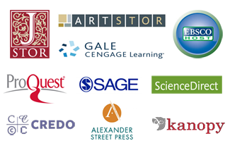
Searching and Locating Literature
Aim to be as comprehensive as possible when conducting a literature review. Knowing exactly where to search for information is important.
Start with research databases: Google Scholar, Scopus and Web of Science are good databases to start with for any research topic and literature review.
Focus your search with specific databases, Select two or three discipline/specialist databases to conduct your search for comprehensive results.
Finding books, eBooks and theses

Slide 11
Literature Resources
Books (printed or e-books)
Journals (both)
Research reports (both)
Institutional publications (both)
Government publications (both)
Various NGO’s/INGO’s publications
Internet (Online resources)
Intranet (Offline resources)
Grey Literature (wide range of different information that is produced outside of traditional publishing and distribution channels, and which is often not well represented in indexing databases.)

Slide 12
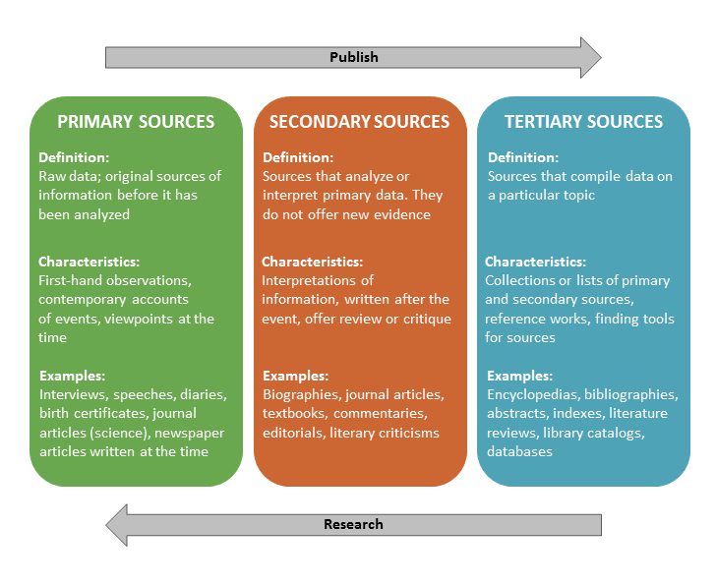
Primary & Secondary Sources
Primary sources provide raw information and first-hand evidence. Examples include interview transcripts, statistical data, and works of art. A primary source gives you direct access to the subject of your research.
Secondary sources provide second-hand information and commentary from other researchers. Examples include journal articles, reviews, and academic books. A secondary source describes, interprets, or synthesizes primary sources.
Primary sources are more credible as evidence, but good research uses both primary and secondary sources.

Slide 13
Data Collection
Data collection is the process of gathering data for use in business decision- making, strategic planning, research and other purposes. It's a crucial part of data analytics applications and research projects: Effective data collection provides the information that's needed to answer questions, analyze business performance or other outcomes, and predict future trends, actions and scenarios.
In businesses, data collection happens on multiple levels. IT systems regularly collect data on customers, employees, sales and other aspects of business operations when transactions are processed, and data is entered. Companies also conduct surveys and track social media to get feedback from customers.
For research in science, medicine, higher education and other fields, data collection is often a more specialized process, in which researchers create and implement measures to collect specific sets of data. In both the business and research contexts, though, the collected data must be accurate to ensure that analytics findings and research results are valid.

Slide 14
Methods of Data Collections
Surveys
Transactional Tracking
Interviews
Focus Groups
Observation
Online Tracking
Questionnaire
Forms
Social Media Monitoring

Slide 15
Well-designed data collection processes
Include the following steps:
Identify a business or research issue that needs to be addressed and set goals for the project.
Gather data requirements to answer the business question or deliver the research information.
Identify the data sets that can provide the desired information.
Set a plan for collecting the data, including the collection
methods that will be used.
Collect the available data and begin working to prepare it for analysis.

Slide 16
Data analysis
Data analysis is the process of cleaning, changing, and processing raw data, and extracting actionable, relevant information that helps businesses make informed decisions.
The procedure helps reduce the risks inherent in decision-making by providing useful insights and statistics, often presented in charts, images, tables, and graphs.
A simple example of data analysis can be seen whenever we take a decision in our daily lives by evaluating what has happened in the past or what will happen if we make that decision. Basically, this is the process of analyzing the past or future and making a decision based on that analysis.

Slide 17
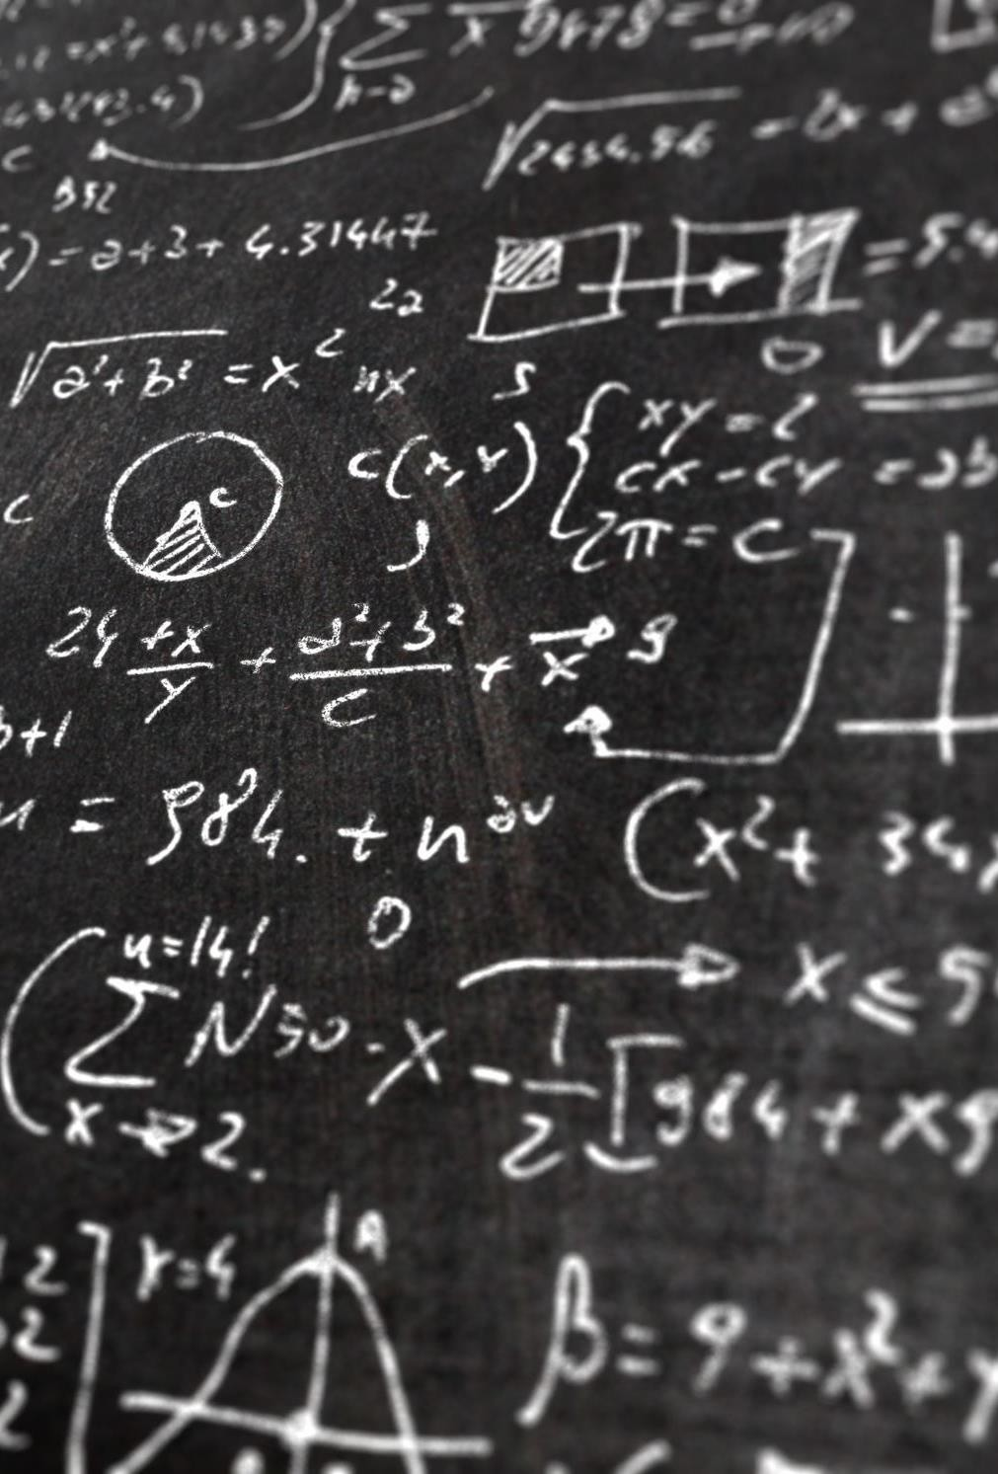
What is Quantitative Data?
Quantitative data refers to any information that can be quantified.
If it can be counted or measured, and given a numerical value, it’s quantitative data.
Quantitative data can tell you “how many,” “how much,” or “how often”—for example, how many people attended last week’s Seminar? How much revenue did the company make in 2019? How often does a certain customer group use online banking?
To analyze and make sense of quantitative data, you’ll conduct statistical analyses

Slide 18
What is Qualitative Data?
Qualitative data is information that cannot be counted, measured or easily expressed using numbers. It is collected from text, audio and images and shared through data visualization tools, such as word clouds, concept maps, graph databases, timelines and infographics.
Researchers will often turn to qualitative data to answer “Why?” or “How?”
Qualitative data also refers to the words or labels used to describe certain characteristics or traits—for example, describing the sky as blue or labeling a particular ice cream flavor as vanilla.

Slide 19
Methods of Data Analysis
Qualitative Data Analysis: The qualitative data analysis method derives data via words, symbols, pictures, and observations. This method doesn’t use statistics. The most common qualitative methods include:
Content Analysis, for analyzing behavioral and verbal data.
Narrative Analysis, for working with data culled from interviews, diaries, surveys.
Grounded Theory, for developing causal explanations of a given event by studying and extrapolating from one or more past cases.

Slide 20
Methods of Data Analysis
Quantitative Data Analysis: Statistical data analysis methods collect raw data and process it into numerical data. (Involve statistical analysis)
Quantitative analysis methods include:
Hypothesis Testing, for assessing the truth of a given hypothesis or theory for a data set or demographic. (The impact of a certain vaccine)
Assess the relationship between variable. (the relationship between employee satisfaction and business performance)
Measure the difference between groups (average height difference between different group of people)
Mean, or average determines a subject’s overall trend by dividing the sum of a list of numbers by the number of items on the list.
Sample (from the entire population) Size determination uses a small sample taken from a larger group of people and analyzed. The results gained are considered representative of the entire body.

Slide 21
EVALUATING LITERATURE REVIEWS AND SOURCES
In general, evaluation of sources means looking at quality, accuracy, relevance, bias, reputation, currency, and credibility factors in a specific work, whether it’s a book, ebook, article, website, or blog posting. Before you include a source in your literature review, you should clearly understand what it is and why you are including it?
Criteria to evaluate sources:
Authority: Who is the author? what is his/her credentials/ what university he/she is affiliated? Is it his/her area of expertise?
Usefulness: How this source is related to your topic ? How current and relevant it is to your topic?
Reliability: Does the infoímation comes from a reliable, trusted source such as an academic journal?

Slide 22
Continue..
Accuracy -- is the information reliable and error free?
Is there an editor or someone who verifies/checks the information?
Is there adequate documentation: bibliography, footnotes, credits?
Are the conclusions justified by the information presented?
Authority -- is the source of the information reputable?
How did you find the source of information: an index to edited/peer-reviewed material, in a bibliography from a published article, etc.?
What type of source is it: sensationalistic, popular, scholarly?
Objectivity -- does the information show bias?
What is the purpose of the information: to inform, persuade, explain, sway opinion, advertise? Does the source show political or cultural biases?
Currency -- is the information current? does it cover the time period you need?
Coverage -- does it provide the evidence or information you need?

Slide 23
Synthesizing
Synthesizing simply means combining.
Instead of summarizing the main points of each source in turn, you put together the ideas and findings of multiple sources in order to make an overall point. At the most basic level, this involves looking for similarities and differences between your sources. (while some of the researchers agreed, others provided a clear evidence to show their disagreement)
Putting together separate parts to make a whole. When you are asked to synthesize something in a literary sense, it most commonly means taking information presented in multiple texts and putting it together to form one new text that includes information from separate sources.

Slide 24
References
Bahishti, A. (2021). The Importance of Review Articles & its Prospects in Scholarly Literature. Extensive Reviews. https://doi.org/10.21467/exr.1.1.4293.
Geest, T., & Gemert, L. (1997). Review as a Method for Improving Professional Texts. Journal of Business and Technical Communication, 11, 433-450. https://doi.org/10.1177/1050651997011004004.
Andersen, K., & Basora, J. (1994). Book reviews: are they useful?. International Orthopaedics, 18, 59-60. https://doi.org/10.1007/BF00180184.
Chigbu, U., Atiku, S., & Plessis, C. (2023). The Science of Literature Reviews: Searching, Identifying, Selecting, and Synthesising. Publications. https://doi.org/10.3390/publications11010002.
Paul, J., & Criado, A. (2020). The art of writing literature review: What do we know and what do we need to know?. International Business Review, 29, 101717. https://doi.org/10.1016/j.ibusrev.2020.101717.

