Slide 1
Cushing Syndrome
By
Dr. Muhammad Abdullah Shwani
Assistant professor/Consultant urologist
Kurdistan Higher Council of Medical Specialties (KHCMS)
drmalshwani@mail.com

Slide 2
Definition
Cushing's syndrome is a clinical feature that results from chronic exposure to excess glucocorticoids of any etiology.
When Cushing syndrome is caused by an excess production of pituitary ACTH the condition is called Cushing disease.

Slide 3
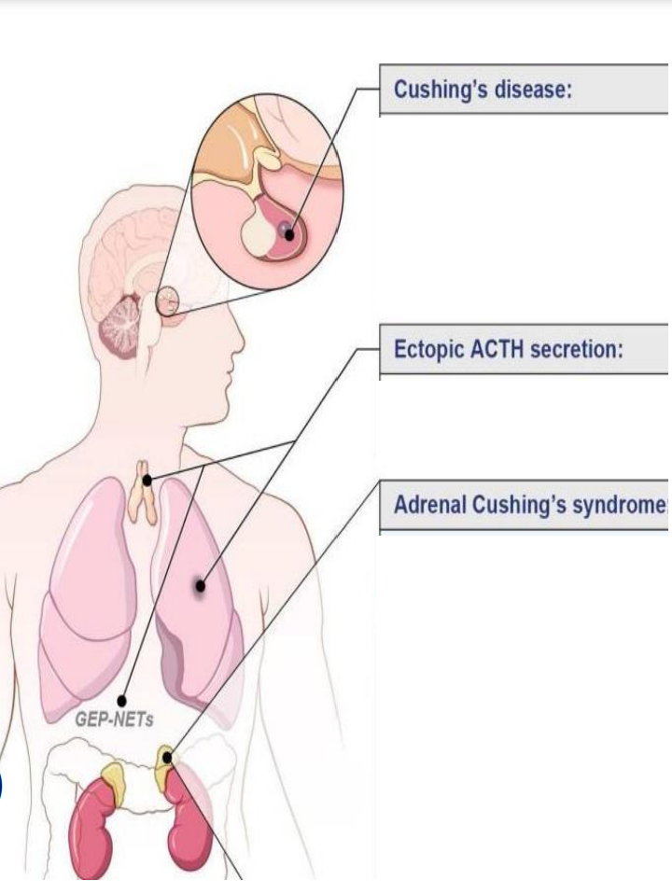

Slide 4
The Endocrine System

Slide 5
Pituitary gland hormones
Anterior and Posterior lobes :
Anterior lobe hormones (FLAT-GP):
F-FSH.
L-LH.
ACTH.
TSH.
GH.
Prolactin.
Posterior lobe hormones (OA):
Oxytocin.
ADH.

Slide 6
Adrenal glands hormones
Adrenal glands
Cortex Medulla
Mineralocorticoids ( aldosterone ).
Glucocorticoids(Cortisol, corticosterone).
Sex steroids(Androgens, testosterone , estrogen, progesterone).
Catecholamines
Epinephrine, Norepinephrine.
Dopamine .

Slide 8
Cushing Syndrome types
1-ACTH-dependent:
Pituitary adenoma.
Ectopic secretion of ACTH by nonpituitary tumors.
2- ACTH-independent:
Adrenocortical causes.
Iatrogenic (administration of exogenous glucocorticoids ).

Slide 9
Epidemiology
Cushing's syndrome is generally considered a rare disease.1–2 per 100,000 population per year.
Female /male 3-5/1.
Prepubertal Cushing syndrome is more common in boys.
Ectopic ACTH Cushing syndrome is more common in males.
Uses of Glucocorticoid drugs for medical conditions are the most common cause of Cushing Syndrome.

Slide 10
Etiology
1-Endogenous causes:
Pituitary adenomas: micro or macro) 65%.
Ectopic non-pituitary ACTH-releasing tumors :
Lungs.
Carotid body.
GIT.
Thymus.
Adrenal cortical causes 25%:
Adrenocortical adenoma.
Adrenocortical carcinoma.
Nodular adrenal hyperplasia.
2-Exogenous causes, iatrogenic use of corticosteroid drugs .

Slide 11
Clinical features/signs and symptoms

Slide 12
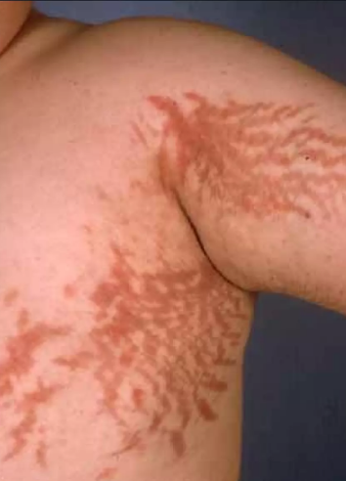
Signs and symptoms

Slide 13
Differential Diagnosis
Pseudo-Cushingoid
Chronic severe anxiety and/or depression
Prolonged excess alcohol consumption.
Obesity.
Poorly controlled diabetes.
HIV infection.

Slide 14
Diagnosis
History and physical examination.
Investigations.
Excessive plasma cortisol levels.
Increased blood glucose levels.
Decreased serum potassium level.
Plasma ACTH is elevated in patients with pituitary tumors, very low in patients with adrenal tumors.
Eosinophils decreased on complete blood count.

Slide 15
Diagnosis…..
Elevated urinary 17-hydroxycorticoids and 17- ketogenic steroids.
Overnight dexamethasone suppression test to check for:
Suppressed cortisol level in Cushing’s disease caused by a pituitary tumor.
Unsuppressed cortisol level in Cushing's syndrome caused by adrenal tumors.

Slide 16
Imaging
Skull X-ray detects erosion of the sella turcica by a pituitary tumor.
CT scan and ultrasonography locate the tumor.

Slide 17
Treatment
Conservative.
Medical.
Surgical.

Slide 18
Treatment
Treatment depends on the cause :
1-Medical treatment :
Drug therapy remains very important for normalizing cortisol levels.
Medical treatment can also be used for patients who are unwilling or unfit for surgery.
Metyrapone, ketoconazole, and mitotane can all be used to lower cortisol by directly inhibiting synthesis and secretion in the adrenal gland.
2- Surgery.The treatment of choice in most patients is surgical :
Transsphenoidal adenomectomy for pituitary tumors.
Bilateral adrenalectomy is used to treat adrenal causes.
3-Radiation therapy may be also used to treat both pituitary and adrenal tumors.

Slide 19
Prognosis
Patients with incompletely controlled Cushing's syndrome have five-fold excess mortality.
Premature death in untreated Cushing's syndrome is caused by vascular disease (MI/CVA), uncontrolled DM, and infections.
The usual course is chronic, with cyclical exacerbations and rare remissions. The prognosis is better with surgery.

Slide 20
THANK YOU

