Slide 1
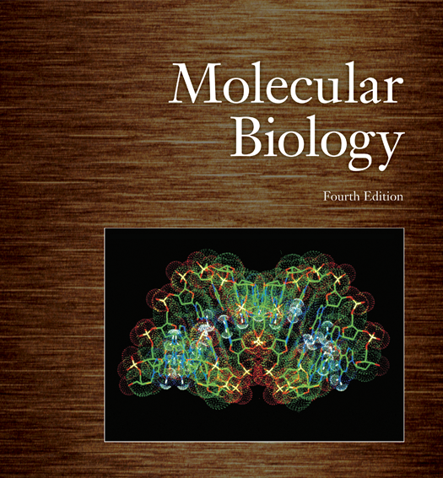
Molecular Biology & Proteomics gene Cloning
Dr. Ahmad H. Ibrahim
Molecular Biology & Proteomics
course code: PHAR 338
1st Semester / 3rd week 29.10.2023

Slide 2
Outline
1. Gene Cloning
a. Involves linking eukaryotic genes to bacterial/phage DNAs.
b. Insertion into bacterial hosts for large-scale gene production.
2. Role of Restriction Endonucleases
a. Discovered in the late 1960s.
b. Prevent invasion by foreign DNA via precise cutting.
c. Function as molecular knives.
3. Restriction Endonuclease Specificity
a. Recognize specific DNA sequences.
b. Cut only at recognized sequences.
c. Varying recognition sequence lengths, affecting cutting frequency.

Slide 3
Outline
Restriction Enzyme Naming
a. Named using source microorganism's first three letters.
b. Roman numerals for multiple enzymes from the same microorganism.
Experiment with EcoRI
a. Used EcoRI to cut plasmids.
b. Converted circular plasmids to linear DNA with sticky ends.
c. Demonstrated restriction enzyme utility in genetic engineering.

Slide 4
Objectives
Understand Gene Cloning: To grasp the concept of gene cloning and how eukaryotic genes are linked to small bacterial or phage DNAs for large-scale gene production.
Explain the Role of Restriction Endonucleases: To describe the function of restriction endonucleases in cutting foreign DNA into specific pieces and how they are used in genetic engineering.
Recognize Restriction Endonuclease Specificity: To understand how restriction endonucleases recognize specific DNA sequences and the relationship between recognition sequence length and the frequency of cuts.

Slide 5
Objectives
4. Learn Restriction Enzyme Terminology: To become familiar with the naming conventions for restriction endonucleases, including how they are named after their source microorganisms.
5. Comprehend the Practical Application: To appreciate the practical application of restriction endonucleases in genetic engineering, such as the experiment using EcoRI to convert circular plasmids into linear DNA with sticky ends for recombination.

Slide 6
Gene Cloning
Gene cloning links eukaryotic genes to small bacterial or phage DNAs and inserting these recombinant molecules into bacterial hosts
One can then produce large quantities of these genes in pure form

Slide 7
The Role of Restriction Endonucleases
Restriction endonucleases, first discovered in the late 1960s, are named for preventing invasion by foreign DNA by cutting it into pieces
These enzymes cut at sites within the foreign DNA instead of chewing from the ends
By cutting DNA at specific sites they function as finely honed molecular knives

Slide 8
Naming Restriction Endonucleases
Restriction endonucleases are named using the 1st three letters of their name from the Latin name of their source microorganism Hind III
First letter is from the genus H from Haemophilus
Next two letters are the 1st two letters of the species name in from influenzae
Sometimes the strain designation is included “d” from strain R_{d}
If microorganism produces only 1 restriction enzyme, end the name with Roman numeral I Hind I
If more than one restriction enzyme is produced, the others are numbered sequentially II, III, IV, etc.

Slide 9
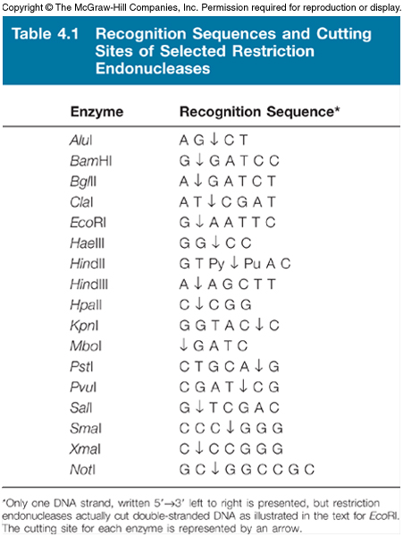
Restriction Endonuclease Specificity
Restriction endonucleases recognize a specific DNA sequence, cutting ONLY at that sequence
These enzymes can recognize 4-bp, 6-bp, 8-bp sequences
The frequency of cuts lessens when the recognition sequence is longer

Slide 10
Restriction Enzyme Terminology
A 6-bp cutter will yield DNA fragments averaging 4000-bp or 4 kilobases (4kb) in length
Heteroschizomers recognize the same DNA sequence but use a different cutting site – they are also called isochizomers
These enzymes cut DNA strands reproducibly in the same place, which is extremely useful in gene analysis

Slide 11
Use of Restriction Endonucleases
Many restriction endonucleases make staggered cuts in the 2 DNA strands
This leaves single-stranded overhangs, called sticky ends that can base-pair together briefly
This makes joining 2 different DNA molecules together much easier
Staggered cuts occur when the recognition sequence usually displays twofold symmetry, palindromes

Slide 12
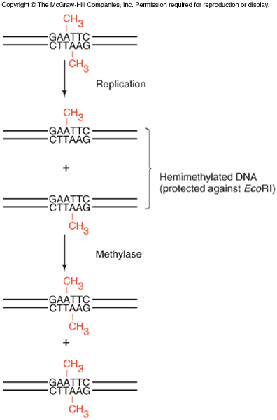
Restriction-Modification System
What prevents these enzymes from cutting up the host DNA?
They are paired with methylases
Theses enzymes recognize, methylate the same site
Together they are called a restriction-modification system, R-M system
Methylation protects DNA, after replication the parental strand is already methylated

Slide 13
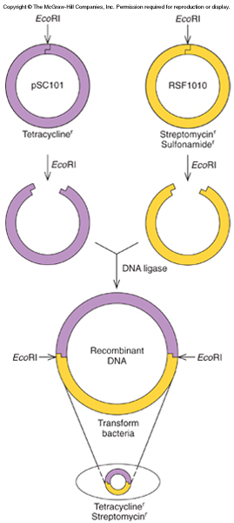
An Experiment Using Restriction Endonuclease
An early experiment used EcoRI to cut 2 plasmids, small circular pieces of DNA independent of the host chromosome
Each plasmid had 1 site for EcoRI
Cutting converted circular plasmids into linear DNA with the same sticky ends
The ends base pair
Some ends re-close
Others join the 2 pieces
DNA ligase joins 2 pieces with covalent bonds

Slide 14
Summary
Restriction endonucleases recognize specific sequences in DNA molecules and make cuts in both strands
This allows very specific cutting of DNAs
The cuts in the two strands are frequently staggered, so restriction enzymes can create sticky ends that help to link together 2 DNAs to form a recombinant DNA in vitro

Slide 15
Vectors
Vectors function as DNA carriers to allow replication of recombinant DNAs
Typical experiment uses 1 vector plus a piece of foreign DNA
Depends on the vector for its replication
Foreign DNA has no origin of replication, the site where DNA replication begins
There are 2 major classes of vectors:
Plasmids
Phages

Slide 16
Plasmids As Vectors
pBR plasmids were developed early but are rarely used today
pUC series is similar to pBR
40% of the DNA, including tetracycline resistance has been deleted
Cloning sites are clustered together into one area called the multiple cloning site (MCS)

Slide 17
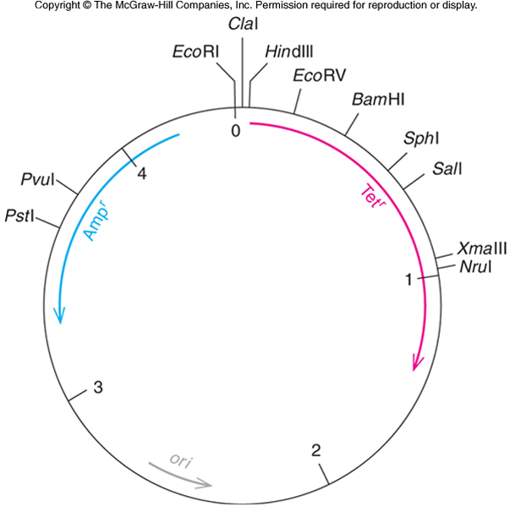
pBR322 Plasmid
pBR322 illustrates cloning methods simply
Resistance for 2 antibiotics
Tetracycline
Ampicillin
Origin of replication between the 2 resistance genes
Only 1 site for several restriction enzymes

Slide 18
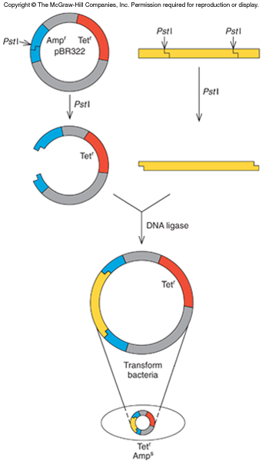
pBR322 Cloning
Clone a foreign DNA into the PstI site of pBR322
Cut the vector to generate the sticky ends
Cut foreign DNA with PstI also – compatible ends
Combine vector and foreign DNA with DNA ligase to seal sticky ends
Now transform the plasmid into E. coli

Slide 19
Bacterial Transformation
Traditional method involves incubating bacterial cells in concentrated calcium salt solution
The solution makes the cell membrane leaky, permeable to the plasmid DNA
Newer method uses high voltage to drive the DNA into the cells in process called electroporation

Slide 20
Screening Transformants
Transformation produces bacteria with:
Religated plasmid
Religated insert
Recombinants
Identify the recombinants using the antibiotic resistance
Grow cells with tetracycline so only cells with plasmid grow, not foreign DNA only
Next, grow copies of the original colonies with ampicillin which kills cells with plasmid including foreign DNA

Slide 21
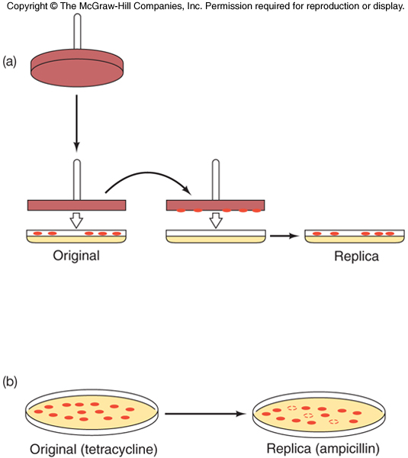
Screening With Replica Plating
Replica plating transfers clone copies from original tetracycline plate to a plate containing ampicillin
A sterile velvet transfer tool can be used to transfer copies of the original colonies
Desired colonies are those that do NOT grow on the new ampicillin plate

Slide 22
pUC and β-galactosidase
Newer pUC plasmids have:
Ampicillin resistance gene
Multiple cloning site inserted into the gene lacZ’ coding for the enzyme β-galactosidase
Clones with foreign DNA in the MCS disrupt the ability of the cells to make β-galactosidase
Plate on media with a β-galactosidase indicator (X-gal) and clones with intact β-galactosidase enzyme will produce blue colonies
Colorless colonies should contain the plasmid with foreign DNA

Slide 23
Directional Cloning
Cut a plasmid with 2 restriction enzymes from the MCS
Clone in a piece of foreign DNA with 1 sticky end recognizing each enzyme
The insert DNA is placed into the vector in only 1 orientation
Vector religation is also prevented as the two restriction sites are incompatible

Slide 24
Summary
First generation plasmid cloning vectors include pBR322 and the pUC plasmids
pBR322 has
2 antibiotic resistance genes
Variety of unique restriction sites for inserting foreign DNA
Most of these sites interrupt antibiotic resistance, making screening straightforward
pUC has
Ampicillin resistance gene
MCS that interrupts a β-galactosidase gene
MCS facilitates directional cloning into 2 different restriction sites

Slide 25
References
Carson, S., Miller, H. B., Srougi, M. C., & Witherow, D. S. (2019). Molecular biology techniques: a classroom laboratory manual. Academic Press.
Craig, N. L., Green, R. R., Greider, C. C., Wolberger, C., & Storz, G. G. (2021). Molecular biology: principles of genome function. Oxford University Press, USA.
Tropp, B. E. (2012). Principles of molecular biology. Jones & Bartlett Publishers.
Robert, F. W. (2012). Molecular biology.

Slide 26
Phages As Vectors
Bacteriophages are natural vectors that transduce bacterial DNA from one cell to another
Phage vectors infect cells much more efficiently than plasmids transform cells
Clones are not colonies of cells using phage vectors, but rather plaques, a clearing of the bacterial lawn due to phage killing the bacteria in that area

Slide 27
λ Phage Vectors
First phage vectors were constructed by Fred Blattner and colleagues
Removed middle region
Retained genes needed for phage replication
Could replace removed phage genes with foreign DNA
Originally named Charon phage
More general term, replacement vectors

Slide 28
Phage Vector Advantages
Phage vectors can receive larger amounts of foreign DNA
Charon 4 can accept up to 20kb of DNA
Traditional plasmid vectors take much less
Phage vectors require a minimum size foreign DNA piece (12 kb) inserted to package into a phage particle

Slide 29
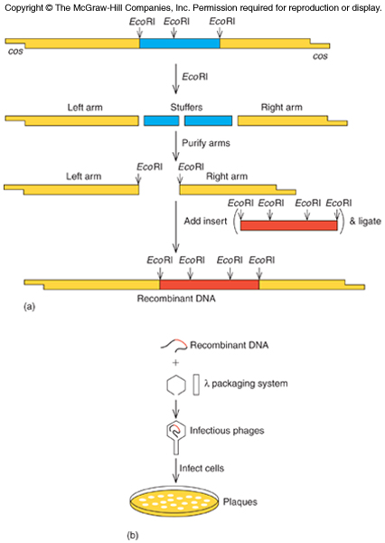
Cloning Using a Phage Vector

Slide 30
Genomic Libraries
A genomic library contains clones of all the genes from a species genome
Restriction fragments of a genome can be packaged into phage using about 16 – 20 kb per fragment
This fragment size will include the entirety of most eukaryotic genes
Once a library is established, it can be used to search for any gene of interest

Slide 31
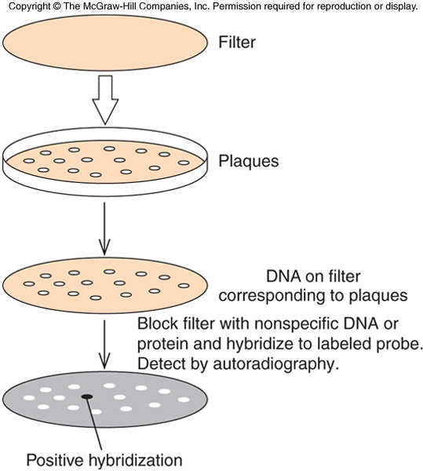
Plaque Hybridization
Searching a genomic library requires probe showing which clone contains desired gene
Ideal probe – labeled nucleic acid with sequence matching the gene of interest

Slide 32
Cosmids
Cosmids are designed for cloning large DNA fragments
Behave as plasmid and phage
Contain
cos sites, cohesive ends of phage DNA that allow the DNA to be packaged into a λ phage head
Plasmid origin of replication permitting replication as plasmid in bacteria
Nearly all λ genome removed so there is room for large inserts (40-50 kb)
So little phage DNA can’t replicate, but they are infectious carrying recombinant DNA into bacterial cells

Slide 33
M13 Phage Vectors
Long, thin, filamentous phage M13
Contains:
Gene fragment with β-galactosidase
Multiple cloning site like the pUC family
Advantage
This phage’s genome is single-stranded DNA
Fragments cloned into it will be recovered in single-stranded form

Slide 34
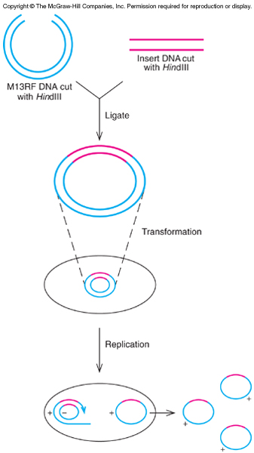
M13 Cloning to Recover Single-stranded DNA Product
After infecting E. coli cells, single-stranded phage DNA is converted to double-stranded replicative form
Use the replicative form for cloning foreign DNA into MCS
Recombinant DNA infects host cells resulting in single-stranded recombinant DNA
Phage particles, containing single-stranded phage DNA is secreted from transformed cells and can be collected from media

Slide 35
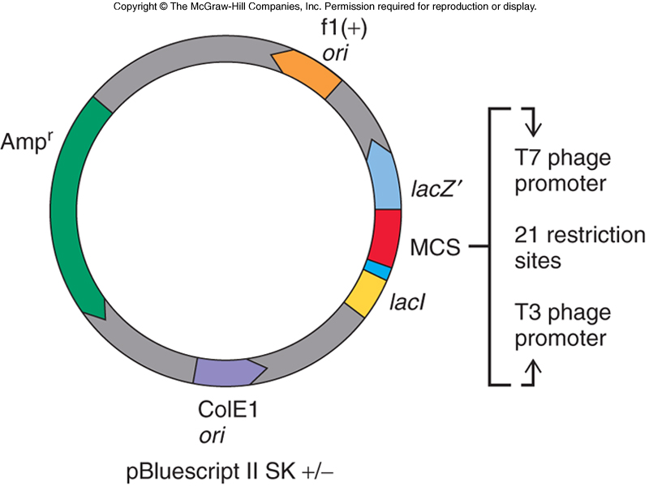
Phagemids
Phagemids are also vectors
Like cosmids have aspects of both phages and plasmids
Has a MCS inserted into lacZ’ gene to screen blue staining / white colonies
Has origin of replication of single-stranded phage f1 to permit recovery of single-stranded recombinant DNA
MCS has 2 phage RNA polymerase promoters, 1 on each side of MCS

Slide 36
Summary
Two kinds of phage are popular cloning vectors
λ phage
Has nonessential genes removed making room for inserts
Cosmids accept DNA up to 50 kb
M13 phage
Has MCS
Produces single-stranded recombinant DNA
Plasmids called phagemids also produce single-stranded DNA in presence of helper phage
Engineered phage can accommodate inserts up to 20 kb, useful for building genomic libraries

Slide 37
Eukaryotic Vectors and Very High Capacity Vectors
There are vectors designed for cloning genes into eukaryotic cells
Other vectors are based on the Ti plasmid to carry genes into plant cells
Yeast artificial chromosomes (YAC) and bacterial artificial chromosomes (BAC) are used for cloning huge pieces of DNA

Slide 38
Identifying a Specific Clone With a Specific Probe
Probes are used to identify a desired clone from among the thousands of irrelevant ones
Two types are widely used
Polynucleotides also called oligonucleotides
Antibodies

Slide 39
Polynucleotide Probes
Looking for a gene you want, might use homologous gene from another organism
If already cloned
Hope enough sequence similarity to permit hybridization
Need to lower stringency of hybridization conditions to tolerate some mismatches

Slide 40
Control of Hybridization Stringency
Factors that promote separation of two strands in a DNA double helix:
High temperature
High organic solvent concentration
Low salt concentration
Adjust conditions until only perfectly matched DNA strands form a duplex = high stringency
Lowering these conditions lowers stringency until DNA strands with a few mismatches can hybridize

Slide 41
Protein-based Polynucleotide Probes
No homologous DNA from another organism?
If amino acid sequence is known, deduce a set of nucleotide sequences to code for these amino acids
Construct these nucleotide sequences chemically using the synthetic probes
Why use several?
Genetic code is degenerate with most amino acids having more than 1 nucleic acid triplet
Must construct several different nucleotide sequences for most amino acids

Slide 42
Summary
Specific clones can be identified using polynucleotide probes binding to the gene itself
Knowing the amino acid sequence of the a gene product permits design of a set of oligonucleotides that encode part of the amino acid sequence
Can be a very quick and accurate means of identifying a particular clone

Slide 43
cDNA Cloning
cDNA is the abbreviation for complementary DNA or copy DNA
A cDNA library is a set of clones representing as many as possible of the mRNAs in a given cell type at a given time
Such a library can contain tens of thousands of different clones

Slide 44
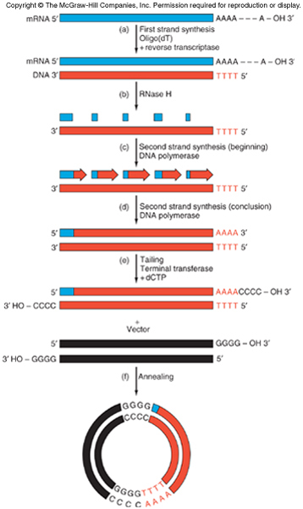
Making a cDNA Library

Slide 45
Reverse Transcriptase Primer
Central to successful cloning is the synthesis of cDNA from an mRNA template using reverse transcriptase (RT), RNA-dependent DNA polymerase
RT cannot initiate DNA synthesis without a primer
Use the poly(A) tail at 3’ end of most eukaryotic mRNA so that oligo(dT) may serve as primer

Slide 46
Ribonuclease H
RT with oligo(dT) primer has made a single-stranded DNA from mRNA
Need to start to remove the mRNA
Partially degrade the mRNA using ribonuclease H (RNase H)
Enzyme degrades RNA strand of an RNA-DNA hybrid
Remaining RNA fragments serve as primers for “second strand” DNA using nick translation

Slide 47
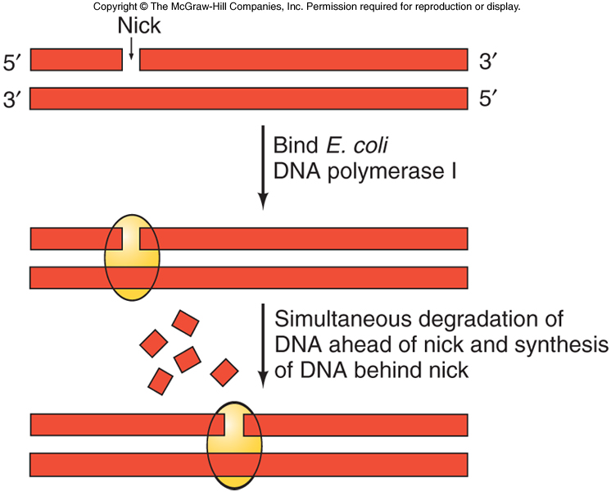
Nick Translation
The nick translation process simultaneously:
Removes DNA ahead of a nick
Synthesizes DNA behind nick
Net result moves or translates the nick in the 5’ to 3’ direction
Enzyme often used is E. coli DNA polymerase I
Has a 5’ to 3’ exonuclease activity
Allows enzyme to degrade DNA ahead of the nick

Slide 48
Trailing Terminal Transferase
Don’t have the sticky ends of genomic DNA cleaved with restriction enzymes
Blunt ends will ligate, but inefficient
Generate sticky ends using terminal deoxynucleotidyl transferase (TdT), terminal transferase with one dNTP
If use dCTP with the enzyme
dCMPs are added one at a time to 3’ ends of the cDNA
Same technique adds oligo(dG) ends to vector
Generate ligation product ready for transformation

Slide 49
Vector Choice
Choice based on method used to detect positive clones
Plasmid or phagemid like pUC or pBS will be used with colony hybridization and a labeled DNA probe
If λ phage like λgt11, cloned cDNA under control of lac promoter for transcription and translation of the cloned gene and antibody screening

Slide 50
Rapid Amplification of cDNA Ends
If generated cDNA is not full-length, missing pieces can be filled in using rapid amplification of cDNA ends (RACE)
Technique can be used to fill in either the missing portion at the 5’-end (usual problem)
Analogous technique can be used to fill in a missing 3’-end

Slide 51
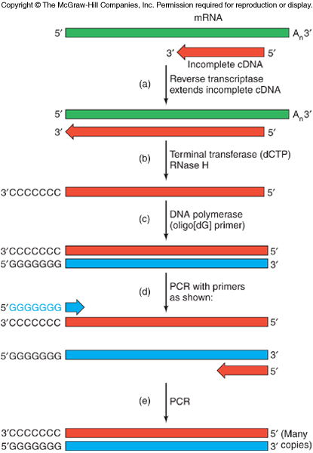
5’-RACE
Use RNA prep containing mRNA of interest and the partial cDNA
Anneal mRNA with the incomplete cDNA
Reverse transcriptase will copy rest of the mRNA
Tail the completed cDNA with terminal transferase using oligo(dC)
Second strand synthesis primed with oligo(dG)

Slide 52
Summary
Make cDNA library with synthesis of cDNAs one strand at a time
Use mRNAs from a cell as templates for 1st strands, then 1st strand as template for 2nd
Reverse transcriptase generates 1st strand
DNA polymerase I generates the second strands
Give cDNAs oligonucleotide tails that base-pair with complementary tails on a cloning vector
Use these recombinant DNAs to transform bacteria
Detect clones with:
Colony hybridization using labeled probes
Antibodies if gene product translated
Incomplete cDNA can be filled in with 5’- or 3’-RACE

Slide 53
References
Carson, S., Miller, H. B., Srougi, M. C., & Witherow, D. S. (2019). Molecular biology techniques: a classroom laboratory manual. Academic Press.
Craig, N. L., Green, R. R., Greider, C. C., Wolberger, C., & Storz, G. G. (2021). Molecular biology: principles of genome function. Oxford University Press, USA.
Tropp, B. E. (2012). Principles of molecular biology. Jones & Bartlett Publishers.
Robert, F. W. (2012). Molecular biology.

Slide 54
Molecular Biology & Proteomics •Gel electrophoresis
Dr. Ahmad H. Ibrahim
Molecular Biology & Proteomics
course code: PHAR 338
1st Semester / 5th week 5.11.2023

Slide 55
Molecular Separations
Often mixtures of proteins or nucleic acids are generated during the course of molecular biological procedures
A protein may need to be purified from a crude cellular extract
A particular nucleic acid molecule made in a reaction needs to be purified

Slide 56
Gel Electrophoresis
Gel electrophoresis is used to separate different species of:
Nucleic acid
Protein

Slide 57
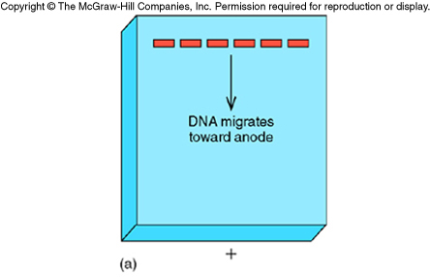
DNA Gel Electrophoresis
Melted agarose is poured into a form equipped with removable comb
Comb “teeth” form slots in the solidified agarose
DNA samples are placed in the slots
An electric current is run through the gel at a neutral pH

Slide 58
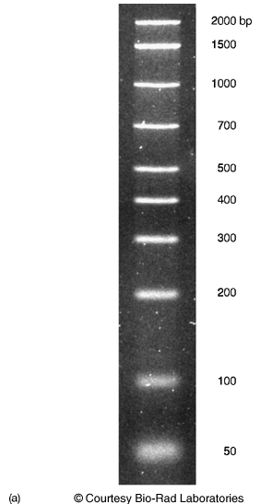
DNA Separation by Agarose Gel Electrophoresis
DNA is negatively charged due to phosphates in its backbone and moves to anode, the positive pole
Small DNA pieces have little frictional drag so move rapidly
Large DNAs have more frictional drag so their mobility is slower
Result distributes DNA according to size
Largest near the top
Smallest near the bottom
DNA is stained with fluorescent dye

Slide 59
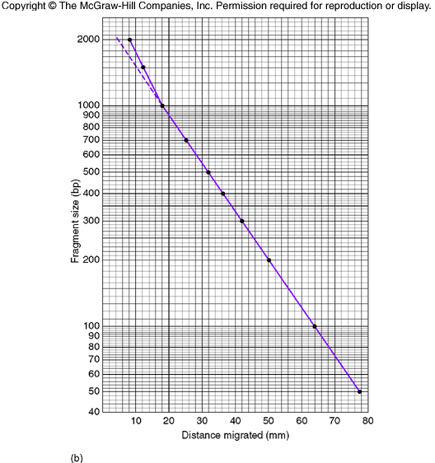
DNA Size Estimation
Comparison with standards permits size estimation
Mobility of fragments are plotted v. log of molecular weight (or number of base pairs)
Electrophoresis of unknown DNA in parallel with standard fragments permits size estimation
Same principles apply to RNA separation

Slide 60
Electrophoresis of Large DNA
Special techniques are required for DNA fragments larger than about 1 kilobases
Instead of constant current, alternate long pulses of current in forward direction with shorter pulses in either opposite or sideways direction
Technique is called pulsed-field gel electrophoresis (PFGE)

Slide 61
Labeled Tracers
For many years “labeled” has been synonymous with “radioactive”
Radioactive tracers allow vanishingly small quantities of substances to be detected
Molecular biology experiments typically require detection of extremely small amounts of a particular substance

Slide 62
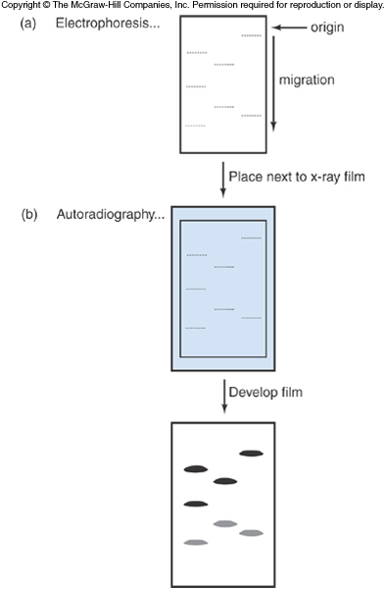
Autoradiography
Autoradiography is a means of detecting radioactive compounds with a photographic emulsion
Preferred emulsion is x-ray film
DNA is separated on a gel and radiolabeled
Gel is placed in contact with x-ray film for hours or days
Radioactive emissions from the labeled DNA expose the film
Developed film shows dark bands

Slide 63
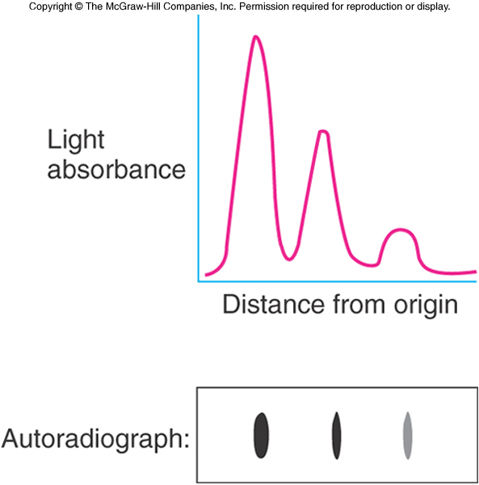
Autoradiography Analysis
Relative quantity of radioactivity can be assessed looking at the developed film
More precise measurements are made using densitometer
Area under peaks on a tracing by a scanner
Proportional to darkness of the bands on autoradiogram

Slide 64
Phosphorimaging
This technique is more accurate in quantifying amount of radioactivity in a substance
Response to radioactivity is much more linear
Place gel with radioactive bands in contact with a phosphorimager plate
Plate absorbs β electrons that excite molecules on the plate which remain excited until plate is scanned
Molecular excitation is monitored by a detector

Slide 65
Liquid Scintillation Counting
Radioactive emissions from a sample create photons of visible light are detected by a photomultiplier tube in the process of liquid scintillation counting
Remove the radioactive material (band from gel) to a vial containing scintillation fluid
Fluid contains a fluor that fluoresces when hit with radioactive emissions
Acts to convert invisible radioactivity into visible light

Slide 66
Nonradioactive Tracers
Newer nonradioactive tracers now rival older radioactive tracers in sensitivity
These tracers do not have hazards:
Health exposure
Handling
Disposal
Increased sensitivity is from use of a multiplier effect of an enzyme that is coupled to probe for molecule of interest

Slide 67
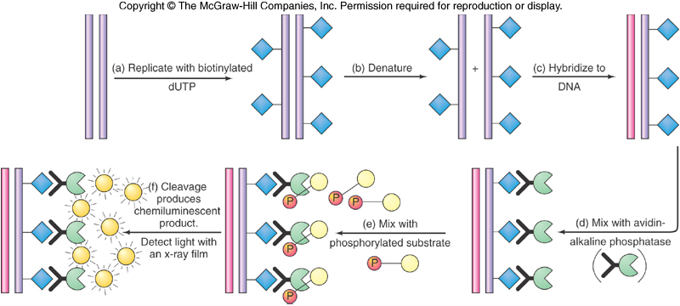
Detecting Nucleic Acids With a Nonradioactive Probe

Slide 68
Using Nucleic Acid Hybridization
Hybridization is the ability of one single-stranded nucleic acid to form a double helix with another single strand of complementary base sequence
Previous discussion focused on colony and plaque hybridization
This section looks at techniques for isolated nucleic acids

Slide 69
Southern Blots: Identifying Specific DNA Fragments
Digests of genomic DNA are separated on agarose gel
The separated pieces are transferred to filter by diffusion, or more recently by electrophoresing the bands onto the filter
Filter is treated with alkali to denature the DNA, resulting ssDNA binds to the filter
Probe the filter using labeled cDNA

Slide 70
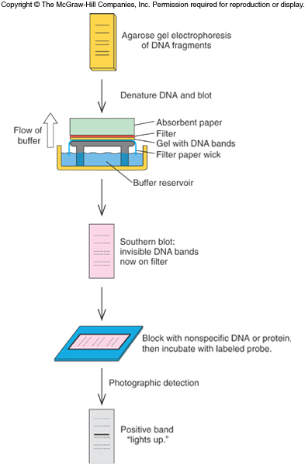
Southern Blots
Probe cDNA hybridizes and a band is generated corresponding to the DNA fragment of interest
Visualize bands with x-ray film or autoradiography
Multiple bands can lead to several interpretations
Multiple genes
Several restriction sites in the gene

Slide 71
DNA Fingerprinting and DNA Typing
Southern blots are used in forensic labs to identify individuals from DNA-containing materials
Minisatellite DNA is a sequence of bases repeated several times, also called DNA fingerprint
Individuals differ in the pattern of repeats of the basic sequence
Difference is large enough that 2 people have only a remote chance of having exactly the same pattern

Slide 72
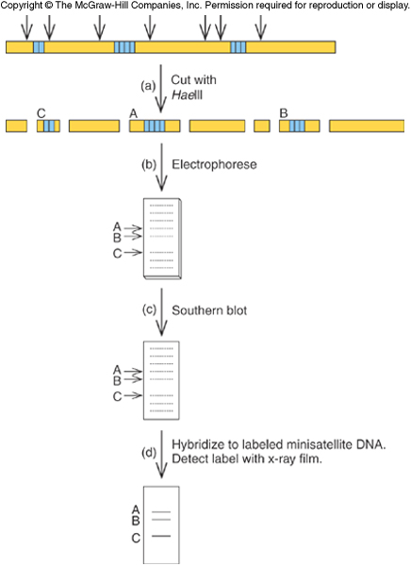
DNA Fingerprinting
Process really just a Southern blot
Cut the DNA under study
with restriction enzyme
Ideally cut on either side of minisatellite but not inside
Run digest on a gel and blot
Probe with labeled
minisatellite DNA and imaged
Real samples result in very complex patterns

Slide 73
Forensic Uses of DNA Fingerprinting and DNA Typing
While people have different DNA fingerprints, parts of the pattern are inherited in a Mendelian fashion
Can be used to establish parentage
Potential to identify criminals
Remove innocent people from suspicion
Actual pattern has so many bands they can smear together indistinguishably
Forensics uses probes for just a single locus
Set of probes gives a set of simple patterns

Slide 74
In Situ Hybridization: Locating Genes in Chromosomes
Labeled probes can be used to hybridize to chromosomes and reveal which chromosome contains the gene of interest
Spread chromosomes from a cell
Partially denature DNA creating single-stranded regions to hybridize to labeled probe
Stain chromosomes and detect presence of label on particular chromosome
Probe can be detected with a fluorescent antibody in a technique called fluorescence in situ hybridization (FISH)

Slide 75
References
Carson, S., Miller, H. B., Srougi, M. C., & Witherow, D. S. (2019). Molecular biology techniques: a classroom laboratory manual. Academic Press.
Craig, N. L., Green, R. R., Greider, C. C., Wolberger, C., & Storz, G. G. (2021). Molecular biology: principles of genome function. Oxford University Press, USA.
Tropp, B. E. (2012). Principles of molecular biology. Jones & Bartlett Publishers.
Robert, F. W. (2012). Molecular biology.

