Slide 1
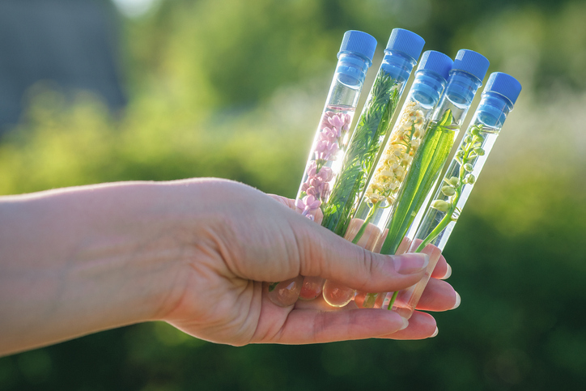
PHYTOCOSMETICS
Dr. ESRA TARIQ
PHYTOCOSMETICS INTRO
Semester-1
Week number: 1
Date : 10/10/2023

Slide 2
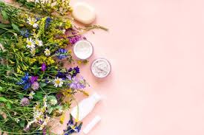
COURSE SYLLABUS
Week Topic
1 Introduction on cosmetics and products
2 Skin and skin function
3 Phytocosmetic Products
4 Herbal cosmetic formulations additives: Carriers
5 Herbal cosmetic formulations additives: Surfactants
6 Herbal cosmetic formulations additives: Thickening agents and penetration enhancers
7 Herbal cosmetic formulations additives: Preservatives
8 Midterm Exam (19-23/11/2023)
9 Plants used in cosmetics: Skincare-1
10 Plants used in cosmetics: Skincare-2
11 Plants used in cosmetics: Anticellulite
12 Plants used in cosmetics: Skin and hair protection products
13 Final Exam (2-11/1/2024)

Slide 3
Outline
WHAT IS COSMETICS?
COSMECEUTICS
WHAT IS PHYTOCOSMETICS?
COSMECEUTICAL PRODUCTS
HISTROY OF COSMETICS

Slide 4
Objectives
KNOW THE DIFFERENCE BETWEEN COSMETICS AND PHYTOCOSMETICS
DISCUSS WHAT ARE THE BENEFITS OF PHYTOCOSMETICS

Slide 5
COSMETICS
Cosmetics are articles intended to be rubbed, poured, sprinkled, or sprayed on, introduced into, or otherwise applied to the human body or any part thereof for cleansing, beautifying, promoting attractiveness, or altering the appearance without affecting structure or function
It is involved with developing, formulating, and producing cosmetics and personal care products

Slide 6
COSMECEUTICS
NUTRICOSMETICS
PHYTOCOSMETICS

Slide 7
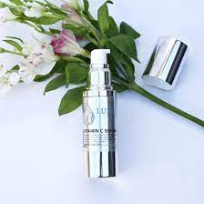
COSMECEUTICS
The term designates a product that combines cosmetics and medications. In essence, a cosmeceutical is a skincare item that includes a physiologically active ingredient that is supposed to have medicinal effects on the skin.
Cosmeceuticals are topically applied treatments that exhibit cosmetic benefits through altering the structure, and function of the skin as well as skin nutrients.
A cosmeceutical is essentially a skincare product that contains a biologically active compound that is thought to have pharmaceutical effects on the skin.

Slide 8
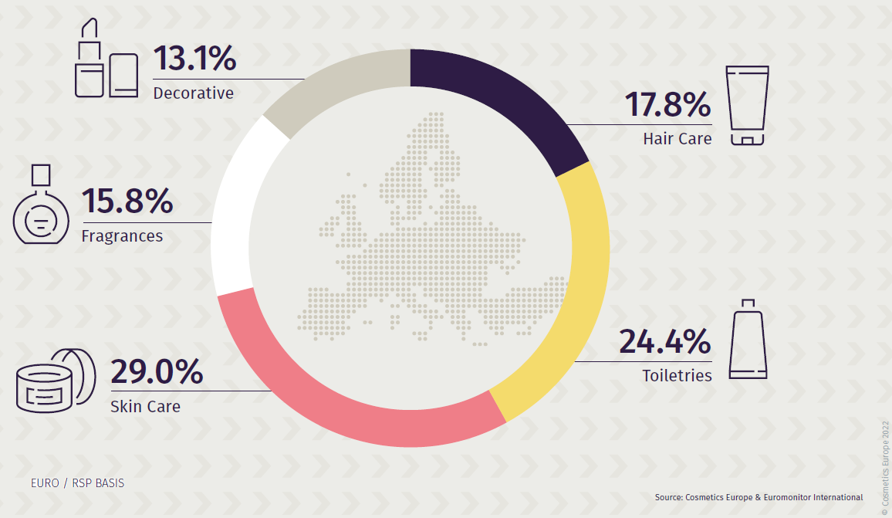
Effect of Cosmetics on Human
Decorative
Psychology
Social
Clinical effects

Slide 9
NUTRICOSMETICS
They food additives and their purpose is to support the function and structure of the skin. Also can be known as «beauty pills» or as «oral cosmetics».
The main claim is to have anti-aging effects, sun protection by fighting free radicals created by light to reduce wrinkles.
Misuse of this group of products may cause side effects.
Conscious and correct use is very important.
Therefore, our pharmacists play a big role in this issue.

Slide 10
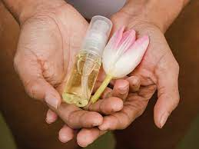
PHYTOCOSMETICS
Phytocosmetics, or cosmetics containing active ingredients derived from plants, have been utilized for aesthetic and sanitary purposes since ancient civilizations, and interest in them is still high today..

Slide 11
HISTORY
The use of cosmetics has been a significant part of human life for thousands of years.
For cultural and religious reasons, they permitted the enhancement of beauty, protection of the skin, maintenance of the teeth, use of fragrance, and painting of the skin. All cosmetic items were initially created using natural components, the majority of which came from plants, minerals, and animals.
The use of synthetic and chemically altered components in cosmetics did not become widespread until the 20th century.
Returning to earlier times, the use of natural substances in cosmetic formulations began to gain popularity in the 1990s and early 2000s. This trend was most likely sparked by customer demands and cosmetic companies' attempts to stand out from the competition.

Slide 12
SUMMARY
What distinguishes cosmetic preparations from pharmaceutical forms is only that it does not contain active ingredients.
Some cosmetic preparations although they contain active ingredients in low concentrations they are still classified as 'cosmetic'
In USA, for freckle removal and skin whitening preparations containing hydroquinone used is evaluated according to cosmetic laws if the amount of hydroquinone is low, and if the amount of hydroquinone is high, it is evaluated according pharmaceutical laws.

Slide 13
References
Peter Elsner, (2000). Cosmeceuticals , Drugs vs Cosmetics, Marcel Dekker, Inc. New York • Basel TM
Costa, I. M. (2015). Phytocosmetics–where nature meets well-being. Journal of Phytocosmetics and Natural Ingredients.

