Slide 1
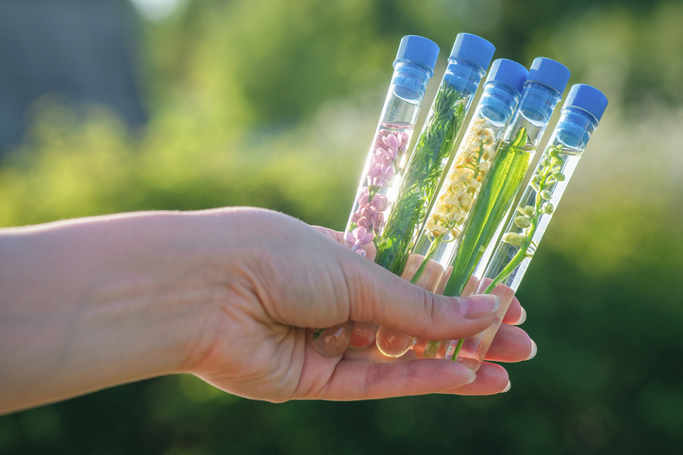
PHYTOCOSMETICS
Dr. ESRA TARIQ
Skin and Skin Function
Semester-1
Week number: 2
Date : 10/10/2023

Slide 2
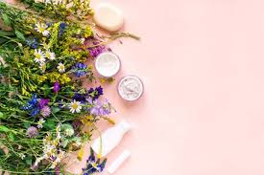
Outline
Skin Structure and Functions?
Layers of Skin
Skin Function
Skin types according to gender, hydration state and sensitivity to UV light

Slide 3
Objectives
Describe the skin and structure of the human skin
Understand functions of skin and skin layers
Know the types of skin according to gender, hydration state and sensitivity to UV light

Slide 4
Skin Structure and Function
The human body’s largest sensory and touch organ is the skin.
Adults have a surface area of roughly 1.5 to 2 m2.
The epidermis and dermis are the two primary layers of the human skin.
The hypodermis is a layer that lies beneath the dermis and is primarily made up of fat cells.

Slide 5
Skin Types in general
Hairy skin (non-glabrous)
Hairless skin (glabrous): Mostly in palms and sole

Slide 6
Skin Structure
Dead cells, epithelium, connective tissue, muscles, nerves, blood vessels, as well as the so-called appendages, such as the nails, hair, and glands, such as sebaceous and sweat glands, make up the complex organ known as the skin.

Slide 7
Skin Structure

Slide 9
Skin Layers 1- Epidermis
The epidermis differs in thickness in thin and thick skin.
Thick skin is found on the palms of the hands and soles of the feet and has all five layers. Thin skin, which covers the rest of the body, does not have a stratum lucidum and has a thinner SC than thick skin.

Slide 10
Epidermis

Slide 11
Functions of the epidermis include the following
Maintaining water content for the skin.
Limiting water loss through the skin.
Sustaining optimal lipid content.
Providing immune protection;
Acting as an antioxidant barrier against reactive oxygen species.
Synthesizing vitamin D.
Providing photoprotection.
Providing skin color.

Slide 12
Dermis
Is located under the epidermis, and it functions as a supporting frame to the epidermis, supplying it with nutrients and oxygen via the blood capillaries.
It is composed of fibrous and cellular connective tissue elements and contains nerve and vascular networks, skin appendages and many cell types.
It is arranged into two regions: The upper papillary dermis and The deeper reticular dermis.
The papillary dermis takes the contour of epidermis, and is usually no more that twice its thickness.
The reticular dermis forms the bulk of the dermal tissue

Slide 13
Dermis

Slide 14
Hypodermis
Consists mainly of adipose tissue. The body is protected by it, and it also acts as a reserve energy source.
It shields the skin.
It permits the skin's movement over the supporting structures.
It improves the appearance of the body's contours.

Slide 15
Hypodermis

Slide 16
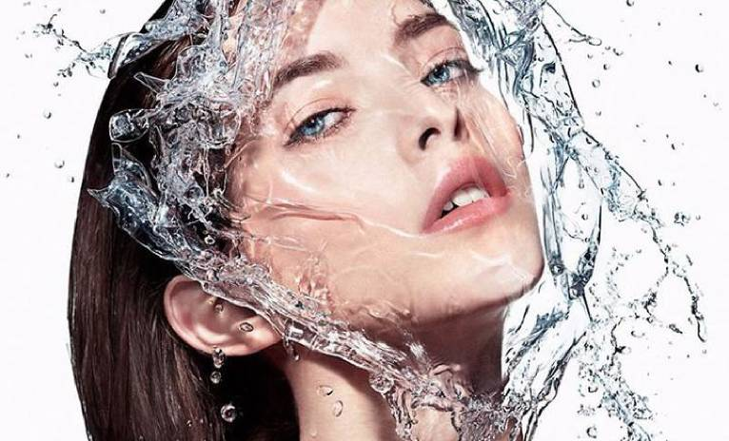
Moisture Content of Normal Skin
The water content of the skin, including the epidermis and dermis, is approximately 80%.
When the water content of the skin is normal, it appears smooth, soft, and glowing.
When its water content is lower than normal, lines are more visible, the skin feels tight and dry, and itching and redness can be experienced

Slide 17
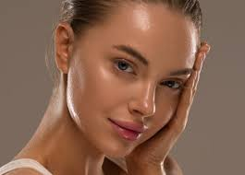
Moisture Content of Normal Skin
In normal skin, there is a continuous movement of water from the deeper layers toward the superficial layer where water eventually evaporates.
Water is necessary for the skin to maintain its flexibility. When the skin is overly dry, it loses its ability to stretch, causing it to crack and peel more easily.

Slide 18
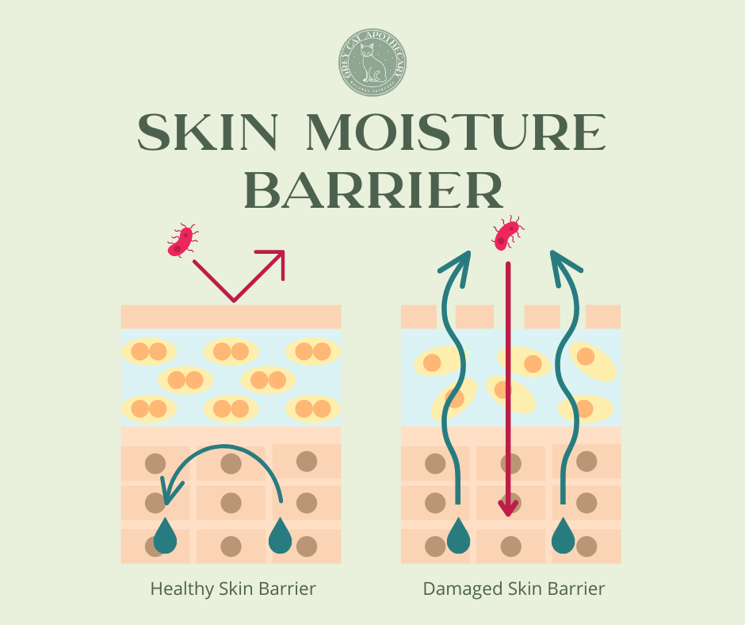
Moisture Content of Normal Skin
However, water alone will not increase the skin’s moisture level. A protective lipid layer is necessary to prevent water from evaporating off the skin.

Slide 19
Skin Flora and Skin pH
Human skin is continuously inhabited by many different bacteria and fungi, which under normal circumstances in a healthy individual are harmless and are even beneficial.
Normally, the skin surface is slightly acidic and ranges between pH 4.5 and 5.5,

Slide 20
Functions of Skin

Slide 21
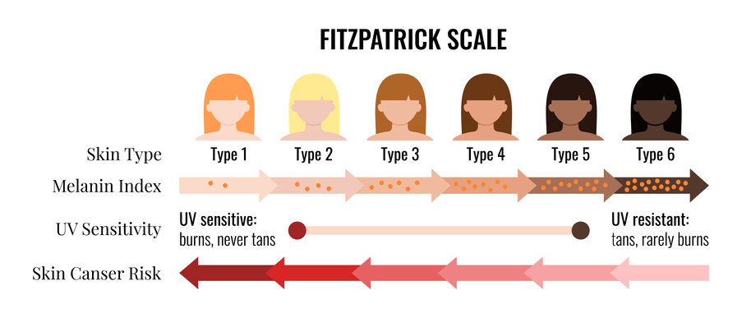
Skin Types Based on Sensitivity to Ultraviolet Light

Slide 22
References
Peter Elsner, (2000). Cosmeceuticals , Drugs vs Cosmetics, Marcel Dekker, Inc. New York • Basel TM
Costa, I. M. (2015). Phytocosmetics–where nature meets well-being. Journal of Phytocosmetics and Natural Ingredients.

