Slide 1
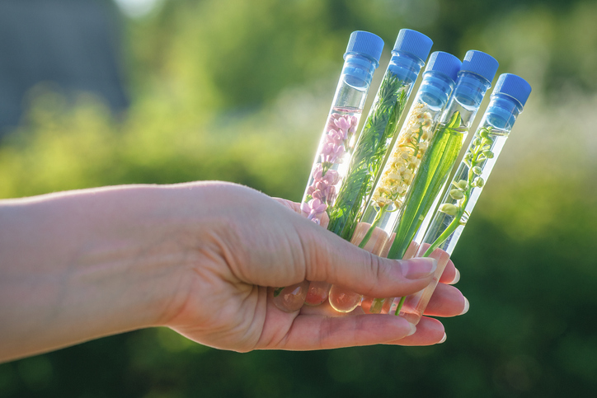
PHYTOCOSMETICS
Dr. ESRA TARIQ
Categories of Phytosmetic Products
Semester-1
Week number: 3
Date : 10/10/2023

Slide 2
Outline
PhytoCosmetic Product Categories
Skin products
Hair Products
Others

Slide 3
Objectives
Understand the difference between natural and synthetics product lists
Know the types of products used
Differentiate uses of products for skin parts (Lips, face, body), hair, nail..

Slide 4
List of Cosmetic Products ILLUSTRATIVE LIST BY CATEGORY OF COSMETIC PRODUCTS
Creams, emulsions, lotions, gels and oils for the skin (hands, face, feet, etc.).
Face masks (with the exception of chemical peeling products).
Tinted bases (liquids, pastes, powders).
Make-up powders, after-bath powders, hygienic powders etc.
Toilet soaps, deodorant soaps, etc.
Perfumes, toilet waters and eau de Cologne.
Bath and shower preparations (salts, foams, oils, gels, etc.).

Slide 5
List of Cosmetic Products ILLUSTRATIVE LIST BY CATEGORY OF COSMETIC PRODUCTS
Depilatories.
Deodorants and anti-perspirants.
Hair care products:
hair tints and bleaches,
products for waving, straightening and fixing, setting products, o cleansing products (lotions, powders, shampoos),
conditioning products (lotions, creams, oils),
hairdressing products (lotions, lacquers, brilliantines)

Slide 6
List of Cosmetic Products ILLUSTRATIVE LIST BY CATEGORY OF COSMETIC PRODUCTS
Shaving products (creams, foams, lotions, etc.).
Products for making-up and removing make-up from the face and the eyes
Products intended for application to the lips.
Products for care of the teeth and the mouth.
Products for nail care and make-up.
Products for external intimate hygiene.

Slide 7
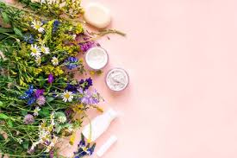
List of Cosmetic Products ILLUSTRATIVE LIST BY CATEGORY OF COSMETIC PRODUCTS
Sunbathing products.
Products for tanning without sun.
Skin-whitening products.
Anti-wrinkle products

Slide 8
Hair styling Phytocosmetic Products & Shampoo
Urtica dioica
Matricaria chamomilla
Achillea millefolium
Shampoo Product:
Triticum vulgare
Urtica dioica

Slide 9
Hair bleaching phytocosmetic product:
Matricaria chamomilla
Hair Conditioner and care products
Triticum vulgare ,
Urtica dioica ,
Simmondsia chinensis
Cream:
Butyospermum parkii
Vitis vinifera
Lotion and serum:
Helianthus annuus (18),
Glycine max

Slide 10
Tonic and skin cleansing agents:
Rosa damascena
Skin depigmantation and ant blemish products:
Achillea millefolium
Camellia sinensis
Glycyrrhiza glabra
Melissa officinalis
Sun protection and tanning products:
Vitis vinifera
Camellia sinensis
Soap
Olea europaea
Laurus nobilis

Slide 11
Mask, peeling and gels:
Vitis vinifera
Butyrospermum parkii
Aromatherapy and caring oils:
Helianthus annuus
Olea europaea

Slide 12
Eye contour care products:
Camellia sinensis
Butyrospermum parkii
Bath and hand care products:
Aloe barbadensis
Olea europaea
Mouth and lip care products:
Helianthus annuus
Glycine max
Butyrospermum parkii
Homework:
Write the function of each ingredient in phytocosmetic formulations for each purpose mentioned.

Slide 13
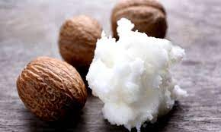
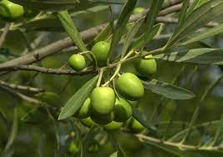
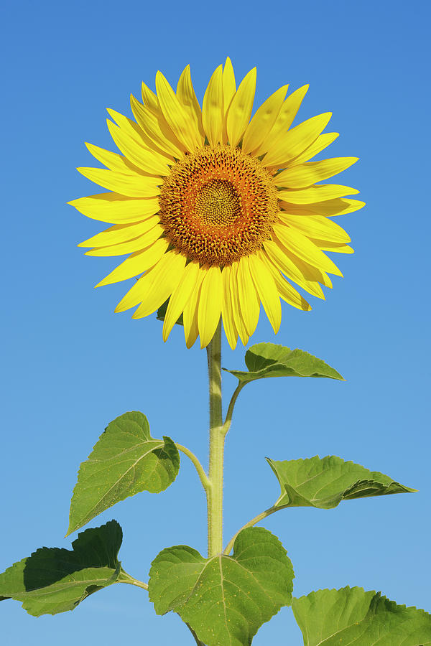
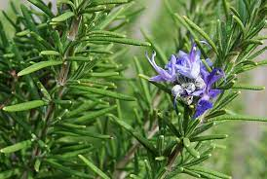
Most10 natural products that are found in dermal products:
Butyrospermum parkii (Shea butter) ,
Vitis vinifera ,
Helianthus annuus ,
Olea europaea ,
Glycine max ,
Rosmarinus officinalis ,
Simmondsia chinensis (Jojoba),
Citrus aurantium var. dulcis (Citrus sinensis),
Aloe barbadensis
Citrus medica var. limonum

Slide 14
References
Peter Elsner, (2000). Cosmeceuticals , Drugs vs Cosmetics, Marcel Dekker, Inc. New York • Basel TM
Costa, I. M. (2015). Phytocosmetics–where nature meets well-being. Journal of Phytocosmetics and Natural Ingredients.

