Slide 1
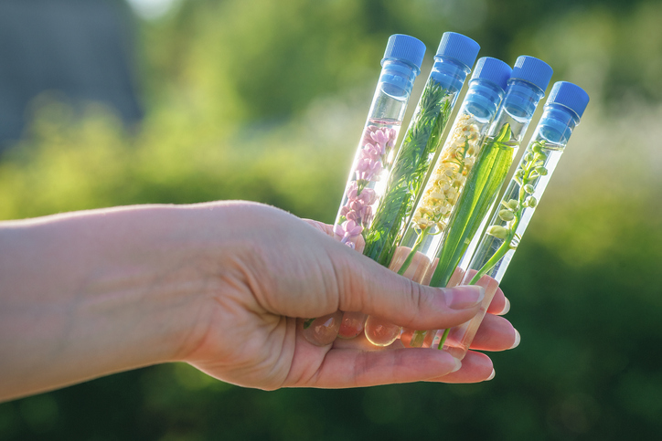
PHYTOCOSMETICS
Dr. ESRA TARIQ
Reasons for use of Plants in Cosmetic Products According to Phytochemical Groups
Semester-1
Week number: 4
Date : 10/10/2023

Slide 2
Outline
Phytochemical groups of plants
Functions of plant extracts used in cosmetic products
Antioxidants
Herbal cosmetics formulations
Carriers

Slide 3
Phytochemical groups of plants
Carbohydrates
Volatile oils
Fixed Oils
Mucilage and poliholozide
Polphenols (Flavonoid, Tanen,..)
Amino acid and Peptide
Organic acids
Coloring agents
Saponosides
Vitamin and minerals

Slide 4
Functions of plant extracts used in cosmetic products
Antibacterial effect
Astrengent
Antioxidant
Antiperisperant
Sebum regulation
Tonic
Calming effect for skin
Emolient
Anticelullite
Coloring

Slide 5
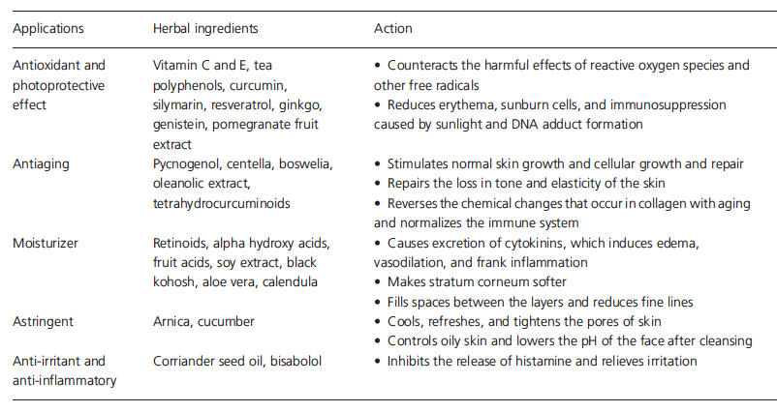
Application of Herbal Extracts with actions

Slide 6
Chemical classification of phytoconstituents

Slide 7
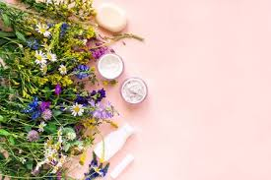
Antioxidants
What is Antioxidant?
Why it is important?
Homework…

Slide 8
Herbal cosmetic Formulations
Some ingredients are essential in cosmetic formulations such as:
Carriers, surfactants, thickening agents, penetration enhancers, preservatives.
Homework:
What is the function of each ingredient in phytocosmetic products?
Give 2 example for each

Slide 9
Carriers
Efficacy of cosmeceutical products are affected by the carrier type and active ingredient content.
In general when the active ingredient penetrate the dermal layer, the effect start
Choosing the right carrier will affect penetration of the product into skin.

Slide 10
References
Peter Elsner, (2000). Cosmeceuticals , Drugs vs Cosmetics, Marcel Dekker, Inc. New York • Basel TM
Costa, I. M. (2015). Phytocosmetics–where nature meets well-being. Journal of Phytocosmetics and Natural Ingredients.

