Slide 1
Unresponsive child 1 year to puberty
By
Dr. Muhammad Abdullah Shwani
Assistant professor/Consultant urologist
Kurdistan Higher Council of Medical Specialties (KHCMS)
drmalshwani@mail.com

Slide 2
Discovering a collapsed child
You should first make sure the scene is safe and then establish whether he is responsive or unresponsive.
Observe the casualty as you approach.
Always approach and treat the casualty from the side, kneeling down next to his head or chest.
You will then be in the correct position to perform all the stages of resuscitation

Slide 3
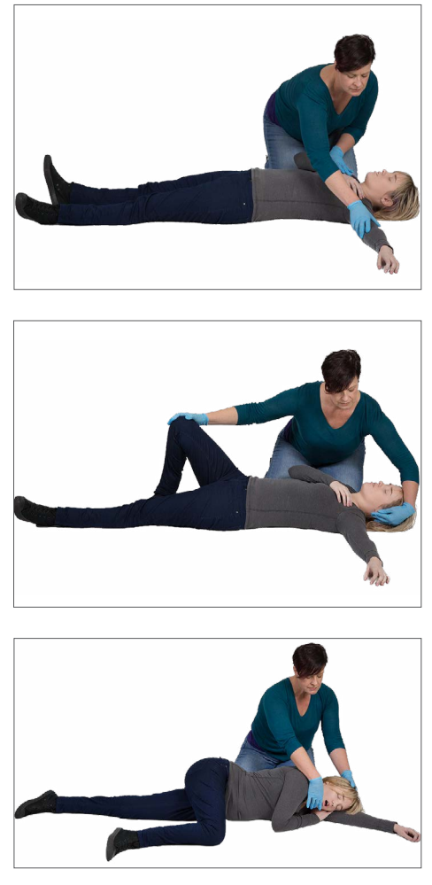
Recovery position

Slide 4
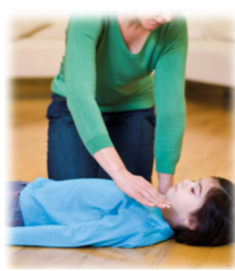
How to check the response
Do this by speaking loudly and clearly to the child. Ask “What has happened?”
Or give a command such as, “Open your eyes”.
Place one hand on their shoulder, and gently tap to see if there is a response.

Slide 5
How to place a child in recovery position (video)

Slide 6
Responsive or Not?
1. If there is a response Check for Breathing :
If breathing put the casualty in the recovery position
If no breathing CPR
2. If there is no pulse CRP.

Slide 7
How to perform CPR on a child
Ensure the airway is still open by keeping one hand on the child’s forehead and two fingers of the other hand on the point of the chin.
Pick out any visible obstructions from the mouth.
Do NOT sweep the mouth with your finger to look for obstructions.

Slide 8
How to give CPR on a child
Pinch the soft part of the child’s nose with the finger and thumb of the hand that was on the forehead. Make sure that the nostrils are closed to prevent air from escaping, this will allow the mouth to fall open.
Take a deep breath in before placing your lips around the child’s mouth, making sure that you form an airtight seal. Blow steadily into the child’s mouth; the chest should rise.

Slide 9
How to give CPR on a child
Maintaining head tilt and chin lift, take your mouth off the child’s mouth and look to see the chest fall. If the chest rises visibly as you blow and falls fully when you lift your mouth, you have given a rescue breath.
Each complete rescue breath should take one second. If the chest does not rise you may need to adjust the head.
Give a child FIVE initial rescue breaths.

Slide 10
How to give CPR on a child
Kneel at level with the child’s chest. Place one hand on the center of the chest.
Lean over the child, with your arm straight, and then press down vertically on the sternum with the palm of your hand. Depress the chest by at least one-third of its depth.
If the child is large, or the rescuer is small, you can give chest compressions using both hands, as for an adult casualty.
Release the pressure without removing your hand from the chest. Allow the chest to come back up completely (recoil) before you give the next compression.

Slide 11
How to give CPR on a child
Compress the chest 30 times, at a rate of 100–120 compressions per minute.
The time taken for compression and release should be about the same.
Return to the child’s head, open the airway and give TWO further rescue breaths. (30:2)

Slide 12
If you are on your own, alternate 30 chest compressions with TWO rescue breaths (30:2) for one minute, then stop to call for emergency help.
Continue CPR until:
Emergency help arrives and takes over
The child shows signs of becoming responsive – such as coughing, opening the eyes, speaking, or moving purposefully – and starts to breathe normally
Or you become too exhausted to continue.

Slide 13
AED on children
Standard adult AEDs can be used on children over the age of eight
years.
For children between the ages of one and eight, use a pediatric AED or a standard machine and pediatric pads.
If neither is available, then a standard AED and pads can be used.
Never use an AED on an infant under one year.

Slide 14
Unresponsive infant

Slide 15
Unresponsive Infant

Slide 16
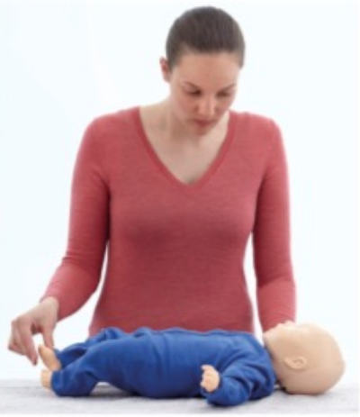
How to check the response
Gently tap or flick the sole of the infant’s foot and call his name to see if he responds.
Never shake an infant.

Slide 17
How to place an infant in a recovery position

Slide 18
How to give CPR on an infant
Place the infant on his back on a firm surface
Make sure that the airway is still open by keeping one hand on the infant’s forehead and one fingertip of the other hand under the tip of his chin.
Pick out any visible obstructions from mouth and nose.
Do not sweep the mouth with your finger looking for obstructions.

Slide 19
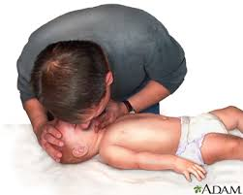
Take a breath. Place your lips around the infant’s mouth and nose to form an airtight seal.
If this is not possible, close the infant’s mouth and make a seal around the nose only.
Blow gently and steadily into the infant’s nose for one second; the chest should rise.

Slide 20
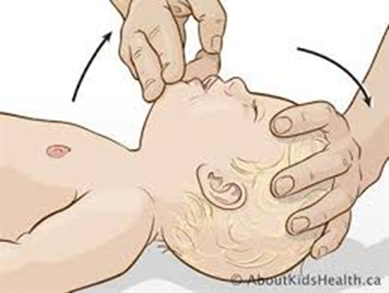
Maintaining head tilt and chin lift, take your mouth off the infant’s mouth and see if his chest falls.
If the chest rises visibly as you blow and falls fully when you lift your mouth, you have given a breath.
Each complete rescue breath should take one second.
Give FIVE rescue breaths.

Slide 21
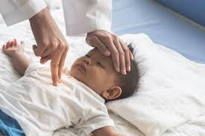
Place two fingertips of your lower hand on the center of the infant’s chest.
Press down vertically on the infant’s breastbone and depress his chest by at least one-third of its depth.
Release the pressure without moving your fingers from the sternum. Allow the chest to come back up fully (recoil) before giving the next compression.

Slide 22
The time taken for compression and release should be about the same.
Repeat to give 30 compressions at a rate of 100–120 times per minute.
Return to the infant’s head, open the airway and give TWO further rescue breaths.

Slide 23
Choking adult

Slide 24
A foreign object that is stuck in the throat may block it and cause muscular spasms.
If blockage of the airway is mild, the casualty may be able to clear it; if it is severe, the casualty will be unable to speak, cough, or breathe, and will eventually become unresponsive.
Because choking cuts off oxygen to the brain, give first aid as quickly as possible. Be prepared to begin rescue breaths and chest compressions.

Slide 25
Choking/Causes
The tongue is the most common obstruction in the unconscious victim
Vomiting
Foreign body
Balloons
Foods
Swelling (allergic reactions/ irritants)
Spasm (water if inhaled suddenly)

Slide 26
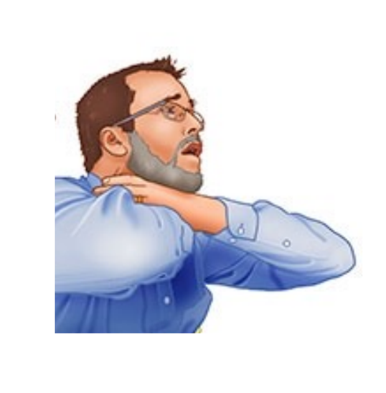
Signs
The universal sign for choking is hands clutched to the throat. If the person doesn't give the signal, look for these indications:
Inability to talk
Difficulty in breathing
Squeaky sounds (noisy breathing )when trying to breathe
Cough, which may either be weak or forceful
Skin, lips, and nails turning blue or dusky
Loss of consciousness

Slide 27
Severity of Chocking
Ask the casualty: “Are you choking?”
Mild obstruction: Casualty able to speak, cough and breathe
Severe obstruction: Casualty unable to speak, cough or breath, and eventually becomes unresponsive
Reassure the patient al the time.

Slide 28
Treatment and actions to be done
Step 1:
If the casualty is breathing, encourage him to continue coughing
Remove any obvious obstruction from the mouth

Slide 29
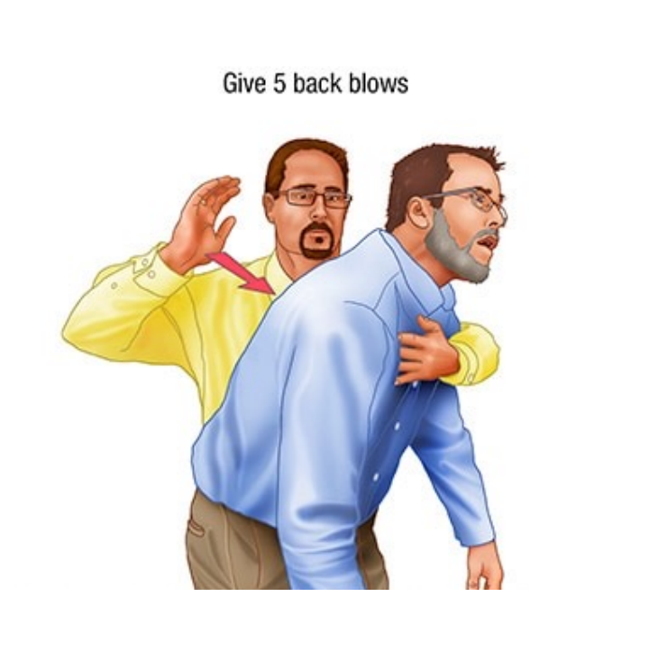
Back blows/Step 2
If the casualty cannot speak or stops coughing or breathing, carry out back blows.
Support his upper body with one hand, and help him to lean well forward.
Give up to five sharp blows between his shoulder blades with the palm of your hand.
Stop if the obstruction clears.
Check the mouth or any foreign bodies ..

Slide 30
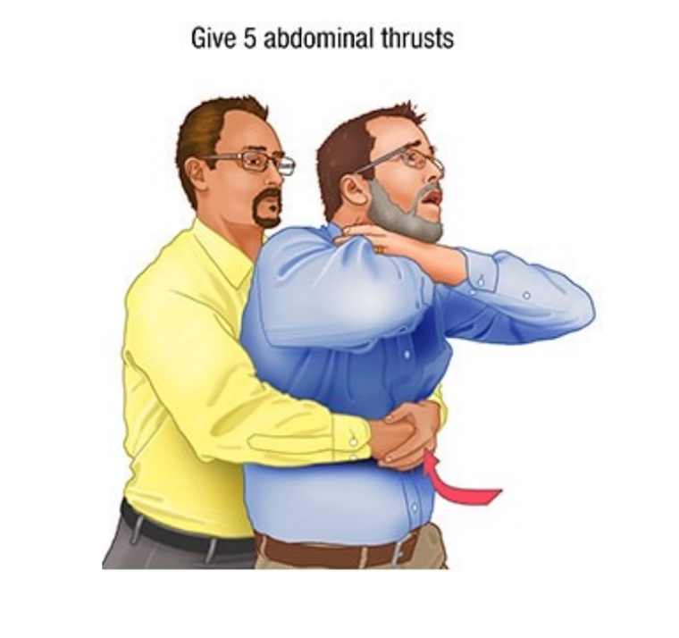
Abdominal thrust/ Step 3
If back blows fail to clear the obstruction, try abdominal thrusts.
Stand behind the casualty and put both arms around the upper part of his abdomen.
Make sure that he is still bending well forward.
Clench your fist and place it between the navel (umbilicus) and the bottom of his sternum.
Grasp your fist firmly with your other hand.
Pull sharply inwards and upwards up to five times.

Slide 31
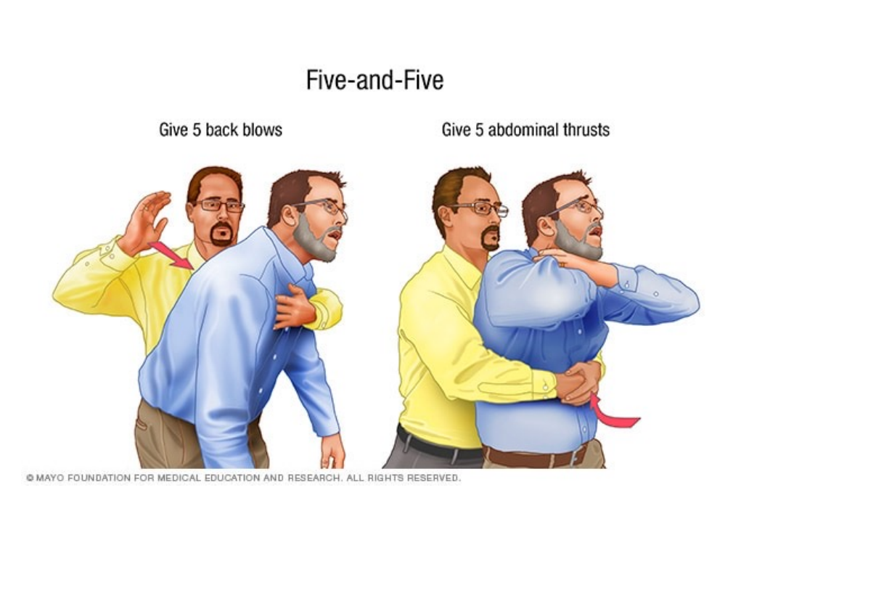
Choking Adult

Slide 32
Step 4
Check the mouth.
If the obstruction has not cleared, call 122 for
emergency help.
Repeat steps 2 and 3
Rechecking the mouth after each step – until help arrives or the casualty becomes unresponsive

Slide 33
Mature FBAO Treatment

Slide 34
If the casualty becomes unresponsive
If at any stage the casualty becomes unresponsive
Open the airway and check breathing.
If he is not breathing, begin CPR.

Slide 35
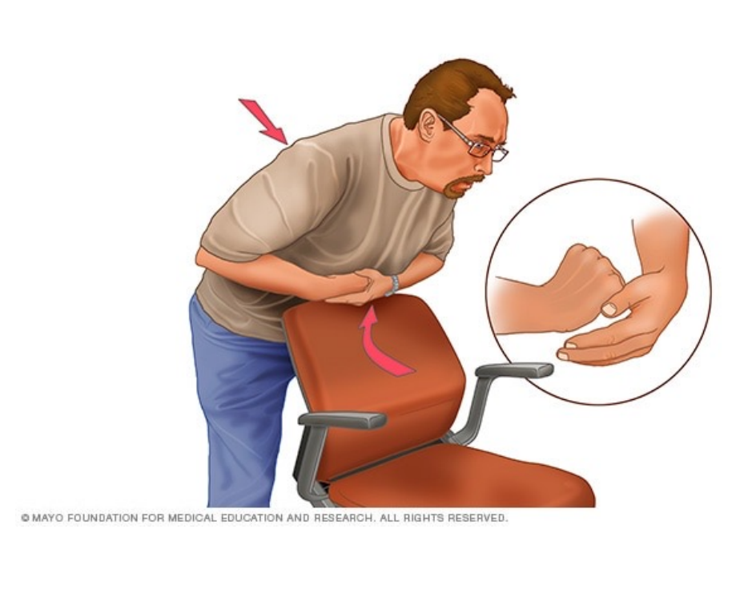
How to perform abdominal thrusts (Heimlich maneuver) on yourself
To perform abdominal thrusts (Heimlich maneuver) on yourself, place a fist slightly above your navel.
Grasp your fist with the other hand and bend over a hard surface (corner of furniture).
Be creative

Slide 36
Choking Infant
An infant is more likely to choke on food or small objects than an adult.
The infant will rapidly become distressed, and you need to act quickly to clear any obstruction.
If the infant becomes unresponsive, Be prepared to begin rescue breaths and chest compressions(CPR).

Slide 37
What to do

Slide 38
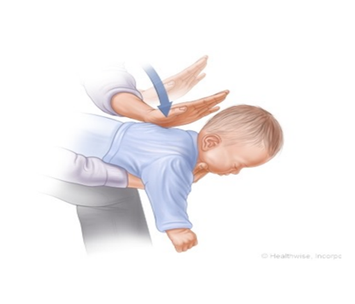
Step 1
If the infant is unable to cry, cough or breathe, lay the face down along your forearm and thigh and support the head.
Give up to five back blows between the shoulder blades, with the palm of your hand.

Slide 39
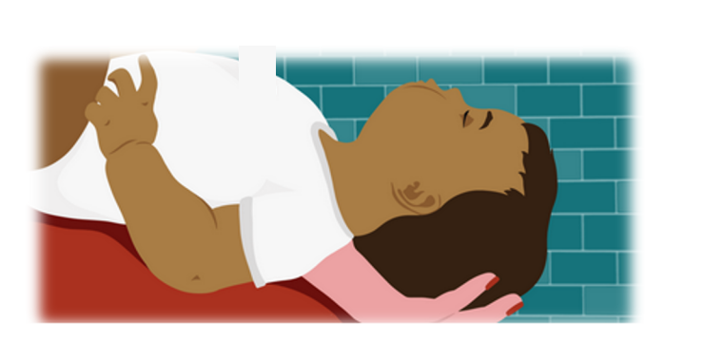
STEP 2
Turn the infant over so that his face is up along your other leg and check his mouth.
Remove any obvious obstructions with your fingertips.
Do not sweep the mouth with your finger as this may push the object further down the throat.

Slide 40
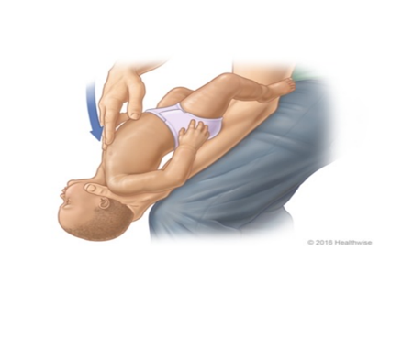
STEP 3
If back blows fail to clear the obstruction, try chest thrusts. These are similar to chest compressions, but sharper in nature and delivered at a slower rate.
Lay the infant face up on your leg, place two fingers on the lower part of the sternum one finger’s breadth below the nipple line, and push downwards. Give up to five chest thrusts.

Slide 41
Check the mouth. If the obstruction still has not cleared, call 122 for emergency help.
Repeat steps 1 to 3 – rechecking the mouth after each step – until help arrives or the infant becomes unresponsive
If at any stage the infant becomes unresponsive, open the airway and check breathing.
If the infant is not breathing, begin CPR , try to relieve the obstruction.

Slide 42
THANK YOU

