Slide 1

Cells of Immune System
Zhikal O. Khudhur
Immunology Bio 313
Fall Semester
Week number: 5
Date: 11/2023

Slide 2
Objectives
Innate immunity and its components
Humoral immunity
Cell mediated immunity
Phagocytic cells
Phagocytosis

Slide 3
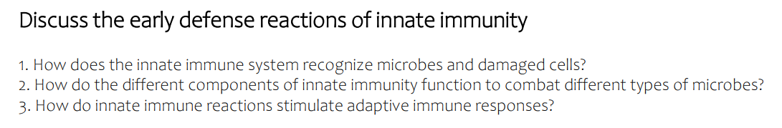

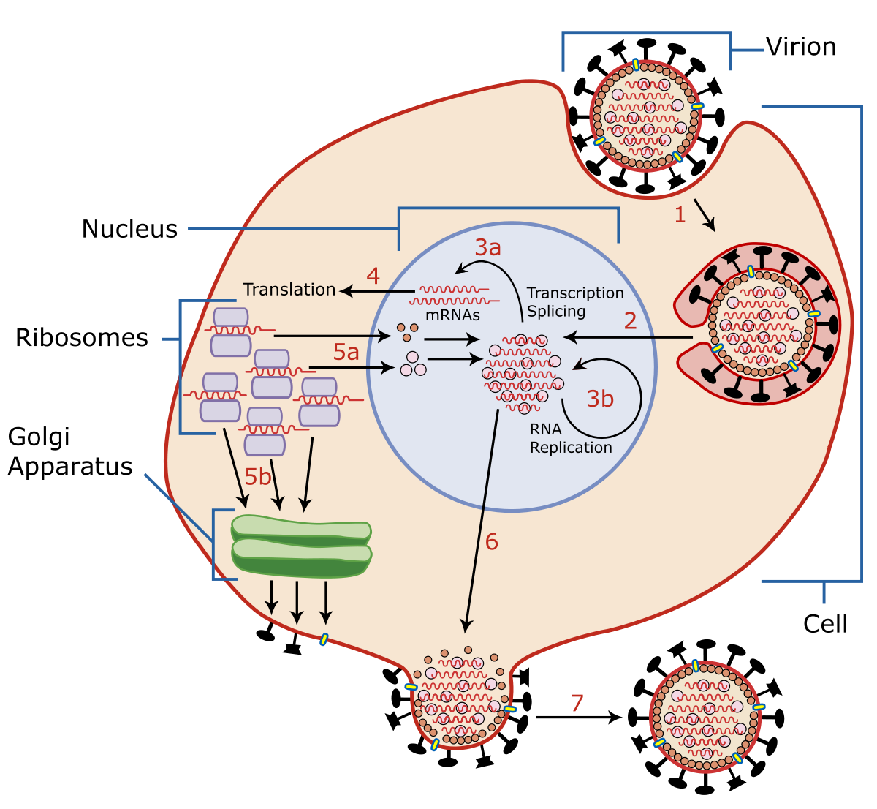
Viral replication
The two principal types of reactions of the innate immune system are inflammation and antiviral defense. Inflammation consists of the accumulation and activation of leukocytes and plasma proteins at sites of infection or tissue injury. These cells and proteins act together to kill mainly extracellular microbes and to eliminate damaged tissues.
Innate immune defense against intracellular viruses is mediated by natural killer (NK) cells, which kill virus-infected cells, and by cytokines called type I interferons, which block viral replication within host cells.

Slide 4
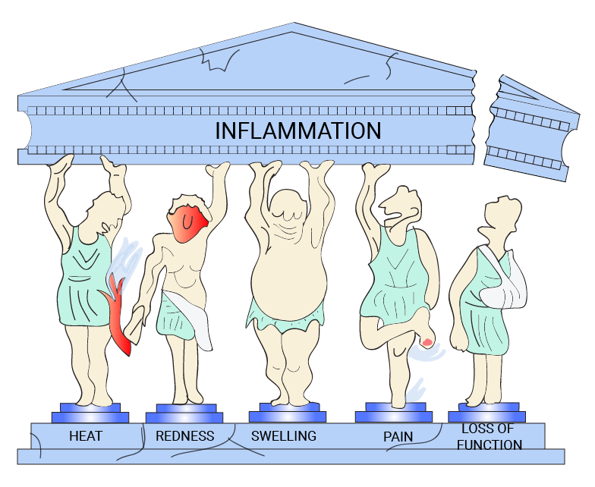
signs of inflammation Calor, dolor, rubor, and tumor: Heat, pain, redness, and swelling.

Slide 5
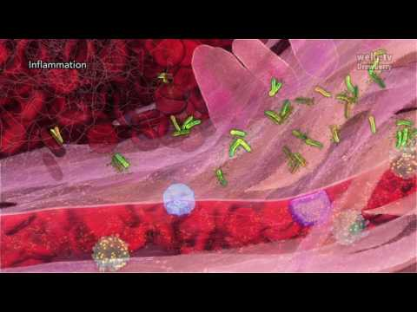

Slide 6

The innate immune system responds in essentially the same way to repeat encounters with a microbe, whereas the adaptive immune system mounts stronger and more effective responses to each successive encounter with a microbe. In other words, the innate immune system does not remember prior encounters with microbes and resets to baseline after each such encounter, whereas memory is a cardinal feature of the adaptive immune response.
The innate immune system recognizes structures that are shared by various classes of microbes and are not present on normal host cells. Each component of innate immunity may recognize many bacteria, viruses, or fungi.

Slide 7
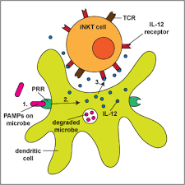
The microbial molecules that stimulate innate immunity are often called pathogen-associated molecular patterns (PAMPs) to indicate that they are present in infectious agents (pathogens) and shared by microbes of the same type (i.e., they are molecular patterns). The receptors of innate immunity that recognize these shared structures are called pattern recognition receptors.
the components of innate immunity have evolved to recognize structures of microbes that are often essential for the survival and infectivity of these microbes.
The innate immune system also recognizes molecules that are released from damaged or necrotic host cells. Such molecules are called damage-associated molecular patterns (DAMPs).

Slide 8
at the portals of entry for microbes: Most microbial infections are acquired through the epithelia of the skin and gastrointestinal and respiratory systems. The earliest defense mechanisms active at these sites are epithelia, providing physical barriers and antimicrobial molecules and lymphoid cells.
in the tissues: Microbes that breach epithelia, as well as dead cells in tissues, are detected by resident macrophages, dendritic cells, and mast cells. Some of these cells react by secreting cytokines, which initiate the process of inflammation, and phagocytes residing in the tissues or recruited from the blood destroy the microbes and eliminate the damaged cells.

Slide 9
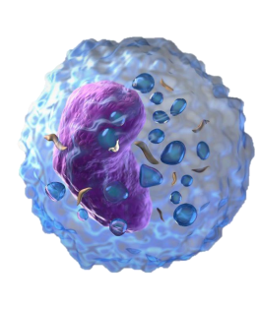
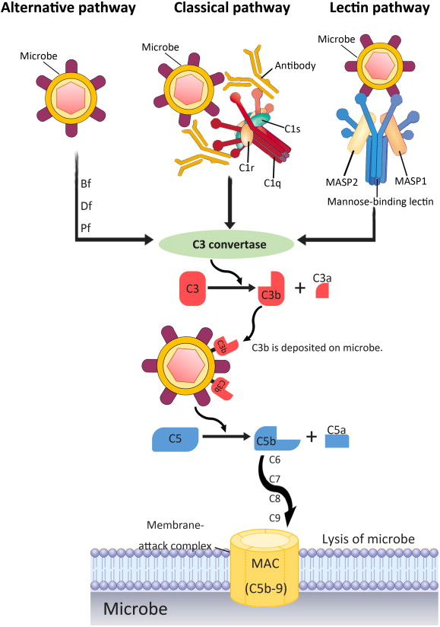
The blood: Plasma proteins, including proteins of the complement system, react against microbes and promote their destruction.​
Viruses elicit special reactions, including the production of interferons from infected cells that inhibit infection of other cells and the killing of infected cells by NK cells.​

Slide 11
Phagocytosis
Is the process of Engulfment harmful agents that comes to contact with the immune system mediated by specific cells known as phagocytic cells
This important Biological process involves the ingestion and digestion of the following:
Microorganisms
Insoluble particles
Damaged or dead host cells
Cell debris
Activated clotting factors
Phagocytic cells are; Macrophages, dendritic cells and neutrophils.

Slide 12
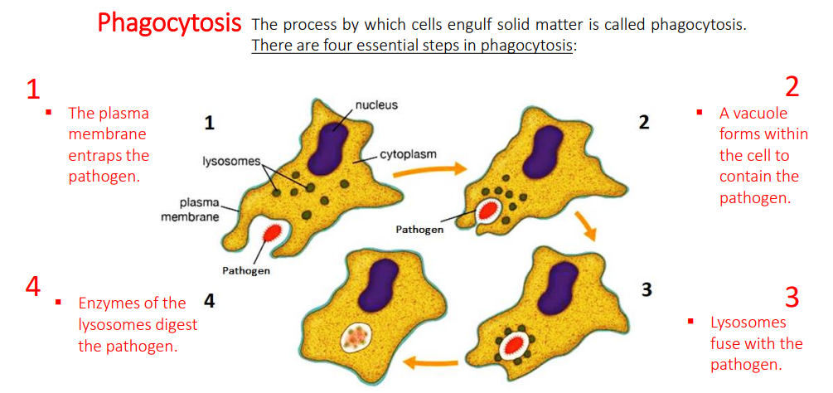

Slide 13
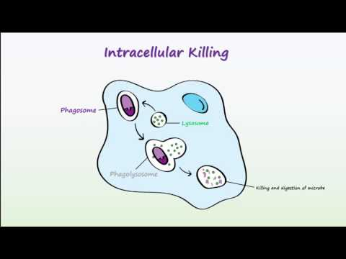

Slide 14
Steps of Phagocytosis
1. Activation
Resting phagocytes are activated by inflammatory mediators including bacterial products, complement proteins, cytokines, and prostaglandins.
As a result, the phagocytes produce surface glycoprotein receptors that increase their ability to adhere to surfaces and recognize microbes. These glycoprotein molecules, known as endocytic pattern- recognition receptors, because they recognize and bind to pathogen-associated molecules (such as peptidoglycan, teichoic acids, lipopolysaccharide, and mannose that are not found in human cells).

Slide 15
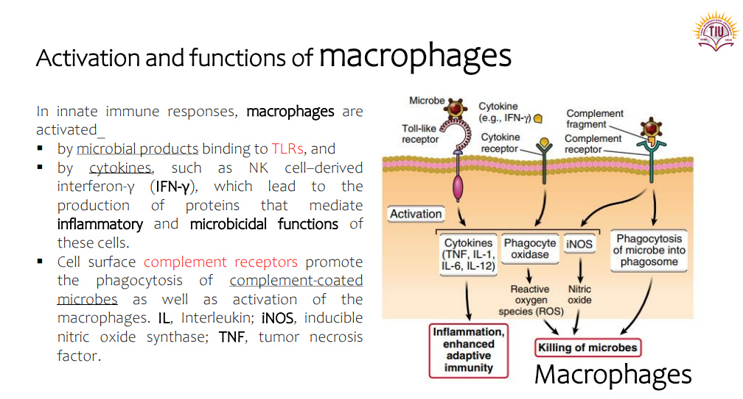

Slide 16
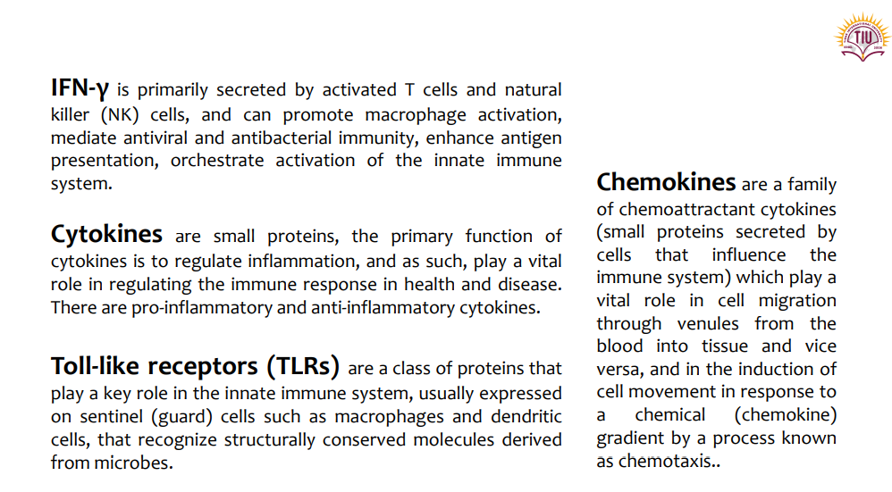

Slide 17
2. Chemotaxis:
This is the movement of cells up a gradient of chemotactic factors, which may be directly induced by a substance such as C5a, or indirectly induced as a consequence of release of preformed mediators within mast cells by the action of C3a or C5a e.g. eosinophil chemotactic factor, or neutrophil chemotactic factor. Leukotrienes.

Slide 18
3. Adherence
This works reasonably well for whole bacteria or viruses, but less so for proteins or encapsulated bacteria. In order to deal more effectively with encapsulated bacteria, antibodies directed against the capsule enable the phagocytic cells to ingest the organisms, using their Fc receptors.

Slide 19
4. Pseudopodium formation
This is the protrusion of membranes to flow round the "prey".
5. Phagosome formation
Fusion of the pseudopodium with a membrane enclosing the "prey" leads to the formation of a structure termed a phagosome.
6. Phago-lysosome formation
Integration of phagosome with lysozyme (its enzyme contents)

Slide 21
7. Destruction of the agents:
The following are important factors that help destroy microorganisms within a phagolysosome:
Hydrogen Ion Transport. Transporters for hydrogen ions acidify the phagolysosome, which kills various microorganisms.
Oxygen Radicals. A complex of proteins called NADPH oxidase in the membrane of a phagolysosome generates oxygen radicals in the phagosome. These highly reactive molecules react with proteins, lipids and other biological molecules

Slide 22
Nitric Oxide. Nitric oxide synthase synthesizes nitric oxide, a reactive molecule that damages various biological molecules.
Anti-Microbial Proteins. Such as lysozyme, an enzyme that attacks the cell walls of certain (gram positive) bacteria, and special proteases which break down protein when in an acid environment.
Anti-Microbial Peptides. Defensins and certain other peptides attack bacterial cell membranes. Similar molecules are found throughout much of the animal kingdom.
Binding Proteins. Lactoferrin binds iron ions, which are necessary for growth of bacteria. Another protein binds vitamin B12.

Slide 23
https://www.creative-diagnostics.com/phagocytosis.htm

Slide 24
References
Abbas, A. K., Lichtman, A. H., & Pillai, S. (2014). Basic immunology: functions and disorders of the immune system. Elsevier Health Sciences.
Abbas, A. K., Lichtman, A. H., & Pillai, S. (2010). Cellular and Molecular Immunology. Updated 6th.

Slide 25
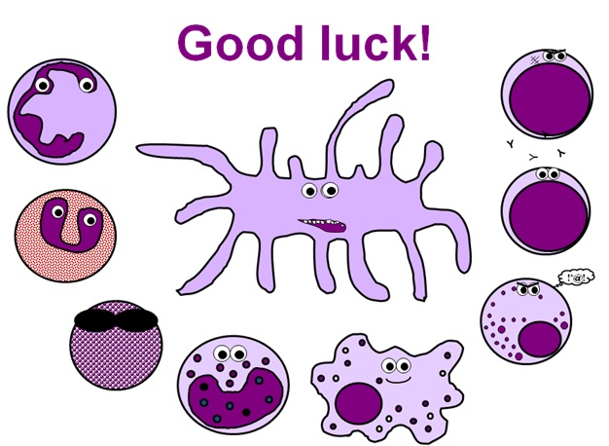
Thank you

