Slide 1
Pituitary gland disorders
By
Dr. Muhammad Abdullah Shwani
Assistant professor/Consultant urologist
Kurdistan Higher Council of Medical Specialties (KHCMS)
drmalshwani@mail.com

Slide 2
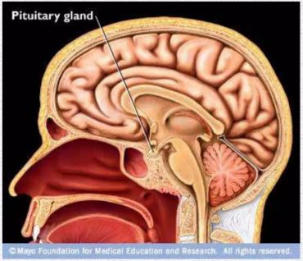
Causes
Mainly 2 reasons for pituitary disorders :
Hyperactivity
Hypoactivity

Slide 4
Pituitary gland hormones
Anterior and Posterior lobes :
Anterior lobe hormones (FLAT-GP):
F-FSH.
L-LH.
ACTH.
TSH.
GH.
Prolactin.
Posterior lobe hormones (OA):
Oxytocin.
ADH.

Slide 5
Disorders of Pituitary Gland
Parts involved | Hyperactivity | Hypoactivity
Anterior Pituitary | 1. Gigantism 2. Acromegaly 3. Acromegalic Gigantism 4. Cushing's disease | Dwarfism 2. Acromicria 3. Simmond's disease
Posterior Pituitary | Syndrome of inappropriate hypersecretion of ADH (SIADH) | Diabetes insipidus
 |  | Dystrophia adiposogenitalis
Anterior and Posterior

Slide 6
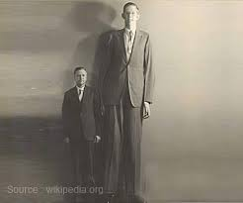
Gigantism
A pituitary disorder characterized by:
Excess growth of the body
Average height is approximately 7-8 feets

Slide 7
Causes of Gigantism
Hypersecretion of GH in childhood or in pre-adult before fusion of epiphysis with the shaft of bone.
Tumor of acidophilic cells of the Anterior pituitary lobe

Slide 9
Signs and Symptoms
Huge stature: 7 or 8 feet in height
Headache due to tumor of pituitary gland
Very large hands and feet
Thick toes and fingers
A prominent jaw and forehead
Coarse facial features
Weakness
Insomnia and other sleep disorders

Slide 10
Visual disturbances
Diabetes insipidus (less secretion of ADH)
Delayed puberty in both boys and girls
Irregular menstrual periods in girls

Slide 11
DIAGNOSTIC TESTS
Blood test to measure levels of growth hormones.
MRI scan of the pituitary gland
Insulin-like growth factor 1 (IGF-1), which is a hormone produced by the liver.
Oral glucose tolerance test:- patient will drink a special beverage containing glucose, blood samples will be taken before and after the beverage. In a normal body, growth hormone levels will drop after eating or drinking glucose. If levels remain the same, it means his body is producing too much growth hormone.

Slide 12
TREATMENT
Treatments for gigantism aim to stop or slow the production of growth hormones.
Somatostatin analogs such as octreotide which reduce growth hormone release.
Surgery Hypophysectomy:-Removing the tumor is the preferred treatment for gigantism if it's the underlying cause.
Radiation therapy Has also been used to bring growth hormone levels to normal if surgery and medication fail.

Slide 13
Disorders of Pituitary Gland
Parts involved | Hyperactivity | Hypoactivity
Anterior Pituitary | 1. Gigantism 2. Acromegaly 3. Acromegalic Gigantism 4. Cushing's disease | Dwarfism 2. Acromicria 3. Simmond's disease
Posterior Pituitary | Syndrome of inappropriate hypersecretion of ADH (SIADH) | Diabetes insipidus
 |  | Dystrophia adiposogenitalis
Anterior and Posterior

Slide 14
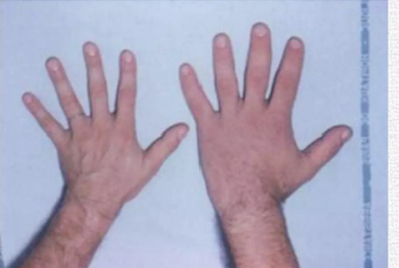
Acromegaly
An anterior pituitary disorder characterized by:
abnormal growth of the hands, feet, and face, caused by overproduction of growth hormone by the pituitary gland.
Enlargement, thickening, and broadening of bones
Particularly extremities of the body

Slide 15
Causes of Acromegaly
Hypersecretion of GH after fusion of epiphysis with shaft of bone
Adenomatous tumor of anterior pituitary involving the acidophilic cells.

Slide 16
Signs and symptoms
Striking features of acromegalic or guerrilla faces are :
Supraorbital ridge
Broadening of nose
Thickening of lips
Thickening and wrinkles formation in the forehead
Lower jaw (prognathism)
Face with these features are called acromegalic or guerrilla faces

Slide 17
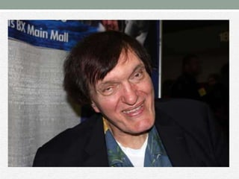
ACROMEGALIC OR GUERILLA FACE

Slide 18
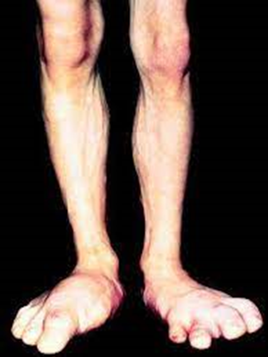
Kyphosis
Enlargement of hands and feet with bowing spine
The scalp is thickened and thrown into folds
Overgrowth of body hair
Visceral organs are enlarged

Slide 19
Thyroid, parathyroid, and adrenal glands hyperactivity
Hyperglycemia and glucosuria
Hypertension
Headache
Visual disturbance –bitemporal hemianopia

Slide 21
TREATMENT
SAME AS GIGANTISM

Slide 22
Disorders of Pituitary Gland
Parts involved | Hyperactivity | Hypoactivity
Anterior Pituitary | 1. Gigantism 2. Acromegaly 3. Acromegalic Gigantism 4. Cushing's disease | Dwarfism 2. Acromicria 3. Simmond's disease
Posterior Pituitary | Syndrome of inappropriate hypersecretion of ADH (SIADH) | Diabetes insipidus
 |  | Dystrophia adiposogenitalis
Anterior and Posterior

Slide 23
ACROMEGALIC GIGANTISM
Rare disorder
Due to hypersecretion of GH in children before fusion of epiphysis with the shaft of bone results in Gigantism
If hypersecretion of GH is continued after the fusion of epiphysis the symptoms of Acromegaly also appear

Slide 25
CAUSES, SYMPTOMS & TREATMENT
SAME AS GIGANTISM AND ACROMEGALY

Slide 26
Disorders of Pituitary Gland
Parts involved | Hyperactivity | Hypoactivity
Anterior Pituitary | 1. Gigantism 2. Acromegaly 3. Acromegalic Gigantism 4. Cushing's disease | Dwarfism 2. Acromicria 3. Simmond's disease
Posterior Pituitary | Syndrome of inappropriate hypersecretion of ADH (SIADH) | Diabetes insipidus
 |  | Dystrophia adiposogenitalis
Anterior and Posterior

Slide 27
Disorders of Pituitary Gland
Parts involved | Hyperactivity | Hypoactivity
Anterior Pituitary | 1. Gigantism 2. Acromegaly 3. Acromegalic Gigantism 4. Cushing's disease | Dwarfism 2. Acromicria 3. Simmond's disease
Posterior Pituitary | Syndrome of inappropriate hypersecretion of ADH (SIADH) | Diabetes insipidus
 |  | Dystrophia adiposogenitalis
Anterior and Posterior

Slide 28
DWARFISM
Pituitary disorder in children is characterized by stunted growth.

Slide 29
CAUSE OF DWARFISM
Reduction in the GH in infancy or early childhood
Deficiency of GH-releasing hormone from the hypothalamus
Atrophy of acidophilic cells (Anterior pituitary lobe )
Tumor of chromophobe
Panhypopituitarism

Slide 30
SIGNS AND SYMPTOMS
Stunted skeletal growth
Maximum height of approximately 3 feets
Head becomes slightly larger in relation of the body
Mental activity is normal without any deformity
Reproductive system is not affected due to lack of GH but in Panhypopituitarism puberty is not obtained due to lack of gonadotropic hormone(ACTH).

Slide 31
TYPES OF DWARFISM
Laron dwarfism
Psychogenic dwarfism (Stress dwarfism)
Dwarfism in dystrophia adiposogenitalis

Slide 32
Disorders of Pituitary Gland
Parts involved | Hyperactivity | Hypoactivity
Anterior Pituitary | 1. Gigantism 2. Acromegaly 3. Acromegalic Gigantism 4. Cushing's disease | Dwarfism 2. Acromicria 3. Simmond's disease
Posterior Pituitary | Syndrome of inappropriate hypersecretion of ADH (SIADH) | Diabetes insipidus
 |  | Dystrophia adiposogenitalis
Anterior and Posterior

Slide 33
ACROMICRIA
A rare disease in adults characterized by the atrophy of the extremities of the body.

Slide 34
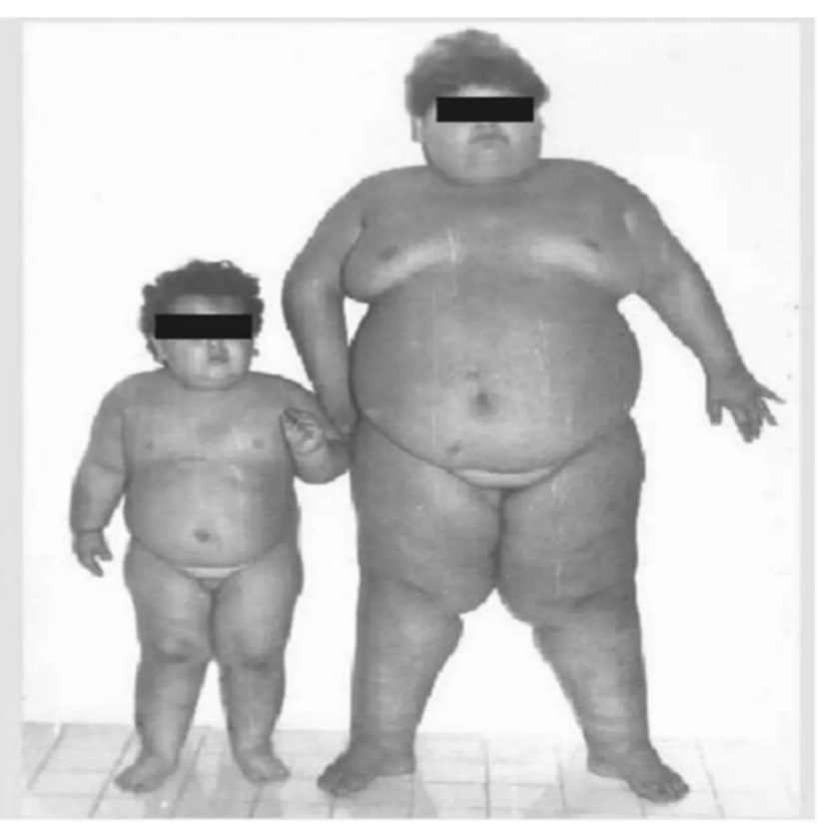
CAUSES OF ACROMICRIA
Deficiency of GH in adults
Secretion of GH decreases in the following conditions:
Deficiency of GH-releasing hormone
Atrophy of acidophilic cells in the anterior pituitary
Tumor of chromophobes
Panhypopituitarism

Slide 35
SIGNS AND SYMPTOMS
Atrophy and thinning of extremities ( major symptoms )
Associated with hypothyroidism
Hyposecretion of adrenocortical hormone
Person becomes lethargic and obese
Loss of sexual function

Slide 36
Disorders of Pituitary Gland
Parts involved | Hyperactivity | Hypoactivity
Anterior Pituitary | 1. Gigantism 2. Acromegaly 3. Acromegalic Gigantism 4. Cushing's disease | Dwarfism 2. Acromicria 3. Simmond's disease
Posterior Pituitary | Syndrome of inappropriate hypersecretion of ADH (SIADH) | Diabetes insipidus
 |  | Dystrophia adiposogenitalis
Anterior and Posterior

Slide 37
SIMMOND'S DISEASE
Rare pituitary disease:-
Weakness and wasting of the body due to severe chronic illness.
Also called cachexia
Occurs mostly in Panhypopituitarism
Atrophy (shrinking and reduced function) of the cells and organs that are normally stimulated by pituitary hormones.

Slide 38
CAUSES
Tumor
Presure on the optic nerve and surrounding brain structures.
complications of pregnancy.
Postpartum hypopituitarism (decreased functioning of the pituitary gland), caused by ischemic necrosis due to blood loss and hypovolemic shock during and after childbirth (postpartum).

Slide 39
SIGNS AND SYMPTOMS
Developing senile decay (decreased mental status ).
Loss of hair.
The skin on the face becomes dry and wrinkled.

Slide 40
SIMMOND'S DISEASE

Slide 41
Disorders of Pituitary Gland
Parts involved | Hyperactivity | Hypoactivity
Anterior Pituitary | 1. Gigantism 2. Acromegaly 3. Acromegalic Gigantism 4. Cushing's disease | Dwarfism 2. Acromicria 3. Simmond's disease
Posterior Pituitary | Syndrome of inappropriate hypersecretion of ADH (SIADH) | Diabetes insipidus
 |  | Dystrophia adiposogenitalis
Anterior and Posterior

Slide 42
Syndrome of inappropriate hypersecretion of antidiuretic hormone(ADH)
A disease characterized by loss of sodium through the urine due to hypersecretion of ADH

Slide 43
CAUSES
Cerebral tumors
Lung cancers because the tumor cells secrete ADH.

Slide 44
SIGNS AND SYMPTOMS
Loss of appetite
Weight loss
Nausea and vomiting
Headache
Muscle weakness, spasm, and cramps
Fatigue
Restlessness and irritability
In severe conditions patients die because of coma and convulsions

Slide 45
Disorders of Pituitary Gland
Parts involved | Hyperactivity | Hypoactivity
Anterior Pituitary | 1. Gigantism 2. Acromegaly 3. Acromegalic Gigantism 4. Cushing's disease | Dwarfism 2. Acromicria 3. Simmond's disease
Posterior Pituitary | Syndrome of inappropriate hypersecretion of ADH (SIADH) | Diabetes insipidus
 |  | Dystrophia adiposogenitalis
Anterior and Posterior

Slide 46
DIABETES INSIPIDUS
A posterior Pituitary disorder characterized by excess excretion of water through urine

Slide 47
CAUSES
Deficiency of ADH which occurs in the following conditions:
Lesion (injury) or degradation of supra-optic and paraventricular nuclei of the hypothalamus.
Lesion in the hypothalamo-hypophyseal tract
Atrophy of posterior pituitary .

Slide 48
SIGNS AND SYMPTOMS
1. Polyuria
Excretion of a large quantity of dilute urine with increased frequency of voiding
Daily urine output is >4litres.
2. Polydipsia
Intake of excess water
Because of polyuria, thirst center in the hypothalamus is stimulated resulting in intake of a large quantity of water

Slide 49
3. Dehydration In some cases, the thirst center in the hypothalamus is also affected by the lesion. Therefore water intake decreases in these patients and, the loss of water through urine is not compensated.
Dry mouth
Changes in skin elasticity
Low blood pressure (hypotension)
Elevated blood sodium (hypernatremia)
Fever
Headache
Electrolyte imbalance

Slide 50
DIAGNOSIS
Genetic testing
Genetic testing is used to detect altered genes that may cause illness or disease.
MRI
Urine analysis

Slide 51
TREATMENT
Prevent dehydration.
Wear a medical alert bracelet or carry a medical alert card in hand.
Desmopressin oral, nasal spray or injection

Slide 52
Disorders of Pituitary Gland
Parts involved | Hyperactivity | Hypoactivity
Anterior Pituitary | 1. Gigantism 2. Acromegaly 3. Acromegalic Gigantism 4. Cushing's disease | Dwarfism 2. Acromicria 3. Simmond's disease
Posterior Pituitary | Syndrome of inappropriate hypersecretion of ADH (SIADH) | Diabetes insipidus
 |  | Dystrophia adiposogenitalis
Anterior and Posterior

Slide 53
DYSTROPHIA ADIPOSOGENITALIS
Characterized by obesity and hypogonadism affecting mainly adolescent boys .

Slide 54
DYSTROPHIA ADIPOSOGENITALIS

Slide 55
Treatment
Medical
Hormonal replacements
Supportive measures and treatment
Surgery for tumors
Radiotherapy

Slide 56
THANK YOU

