Slide 1
BIOPSY l10

Slide 2
Definition of biopsy: It is the removal of a part or a whole of a lesion for the purpose of microscopical examination.
The indications for biopsy should include any progressive lesion which has been present or fails to respond to' therapy for two to three weeks, should be biopsied.
The uses of biopsy are to establishing a diagnosis of a clinically suspicious lesion and planning proper treatment

Slide 3
Types of biopsy:
Surgical biopsy
A. Excisional biopsy is used if the lesion is totally excised for histological evaluation.
This type of biopsy is usually done in case of small lesions for the purpose of diagnosis and treatment.
B. When only a small section of tissue is removed from a lesion for the purpose of histological evaluation, it is called incisional biopsy.
This type is indicated in the case where the lesion is too large to excise initially without knowing the exact diagnosis

Slide 4
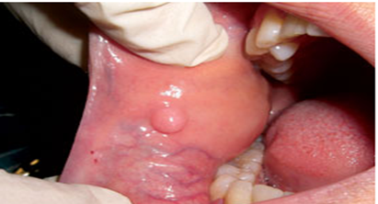
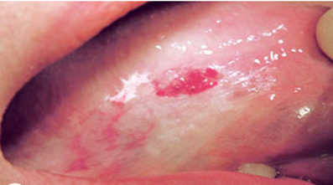
(A) Lesion needs excisional biopsy. (B) Incisional biopsy for leukoplakia

Slide 5
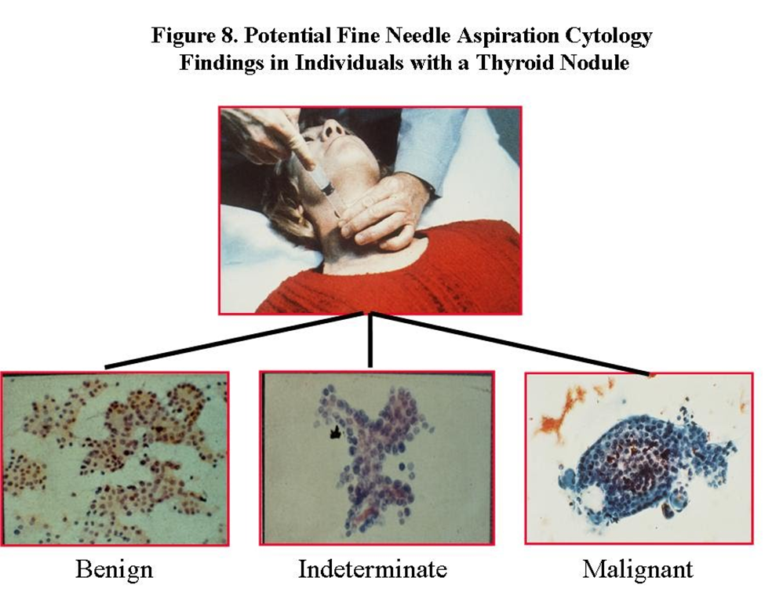
2. Fine Needle biopsy: The tissue obtain by puncture of a tumor, and the tissue within the lumen of the needle being detached by rotation and needle withdrawn.
It is rapid and usually effective aid to diagnosis of swellings in lymph nodes and parotid tumors especially.
Cells can be fixed, stained and examined under microscope.

Slide 6
3-A core needle biopsy (CNB):
It is much like an FNA.
A slightly larger, hollow needle is used to withdraw small cylinders (or cores) of tissue from the abnormal area in the breast.
It needs local anesthesia.
It’s more likely to give a clear result because more tissue is taken to be checked.

Slide 7
4.Endoscopic biopsy:
This is probably the most commonly performed type of biopsy.
It is done through a fiber optic endoscope the doctor inserts into the gastrointestinal tract, urinary bladder, abdominal cavity, joint cavity or trachea and bronchial system, either through a natural body orifice or a small surgical incision.
The endoscopist can directly visualize an abnormal area on the lining of the organ in question and pinch off tiny bits of tissue with forceps attached to a long cable that runs inside the endoscope.

Slide 8
5. Frozen section technique: Performed in order to get an immediate histological report to evaluate the margin of an excised cancer to ascertain that the entire lesion is removed at the time of surgery.
. The stained slide examined within 10 minutes of taking the specimen.
. The tissue is sent fresh to the laboratory to be quickly frozen, preferably to about -70°C, ( immersion in liquid nitrogen).
. A section is then cut on a refrigerated microtome and stained.

Slide 9
6. Exfoliative cytology: Is the microscopic study of cells scrapped from the surface of lesion.
. After suitable staining it is evaluated for possible changes like dysplasia indicative of their cancerous origin or malignancy.
. The neoplastic cells are less cohesive than the other normal cells and usually they shed on the surface of the lesion or into the saliva.

Slide 10
. The technique is done by gentle scraping on the surface of the lesion with a metal cement spatula or a moistened tongue blade for several times, the collected material is then evenly spread over a microscope slide and fixed immediately with 95% alcohol, and then stained by special stain called papanicolaou stain (PAP stain).
Exfoliative cytology samples only the surface cells and provides no information on deeper tissues.

Slide 11
This procedure is quick, simple and painless, and helpful in following up, detection of recurrent cancer cases like oral squamous cell carcinoma, and can be helpful in establishing the diagnosis of some oral lesions like: Herpes simplex, Herpes zoster, and Pemphigus vulgaris.

Slide 12
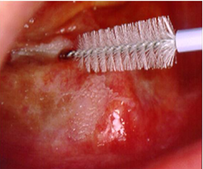
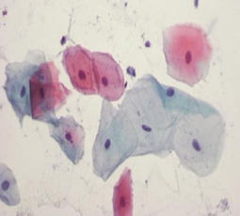
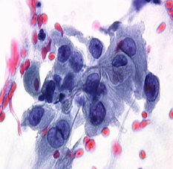
7. Brush biopsy: This technique uses a round stiff bristle brush to collect cells from the surface and subsurface layers of a lesion by vigorous abrasion like in oral squamous cell carcinoma.
: (A) Brush biopsy (B)Normal cells (C)Malignant cells

Slide 13
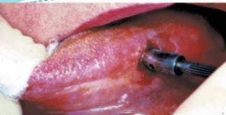
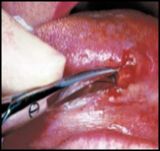
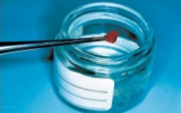
8. Punch biopsy: Punch biopsy may be used for either incisional biopsy or excision of a small lesion .The lateral tongue and buccal mucosa are appropriate sites for punch biopsy, as it must be feasible for the device to approach the mucosal surface perpendicularly.
The punch is placed on the lesion tissue, and a downward twisting motion is applied. The tissue core is then severed at the base with curved scissors
A
B
C

Slide 14
Principles of biopsy:
It is important to develop a systematic approach in evaluating a patient with a lesion in the oral and maxillofacial region.
These steps include:
1-A detailed health history
2-History of the lesion and clinical examination:
3. Radiographic examination
4. Laboratory investigation

Slide 15
Labelling of the Biopsy sample
Patient data
Date& time
Type &site of Biopsy
clinical &radiological features
Provisional diagnosis

Slide 16
Techniques of Biopsy
. Clean the area
. Area anesthetized
. A section of tissue from the identified site is removed
. Section cleaned & put in 10%formaline
. Biopsy site is sutured
. Biopsy specimen is sent for histopathologist
If the specimen is a calcified tissue (bone and tooth) then decalcification is to be done (EDTA)

Slide 17
Important points to remember when performing biopsy
. Avoid painting
. The anesthetic solution should not be injected directly inside the lesion. (avoid distortion)
. Sharp instruments are to be used to avoid tissue tearing.
. Avoid repeated cutting
. The tissue obtained must include both the diseased as well as some normal tissue, and must be of sufficient thickness and depth.
If the lesion is multifocal, it is ideal to obtain more than one biopsy specimens from different sites for more accurate diagnosis.

Slide 18
Laboratory procedures:
. Specimens placed in alcohols
. Fixation (The usual routine fixative is 10% formal saline)
. The fixed tissue is dehydrated by immersion in a series of solvents,
(series of alcohols; 70% to 95% to 100%. )
. Finally the tissue is impregnated with paraffin wax
. The wax block is mounted on a microtome and sections, usually 4 um thick,
are cut and mounted on glass microscope slides for staining( hematoxylin and eosin)

Slide 19
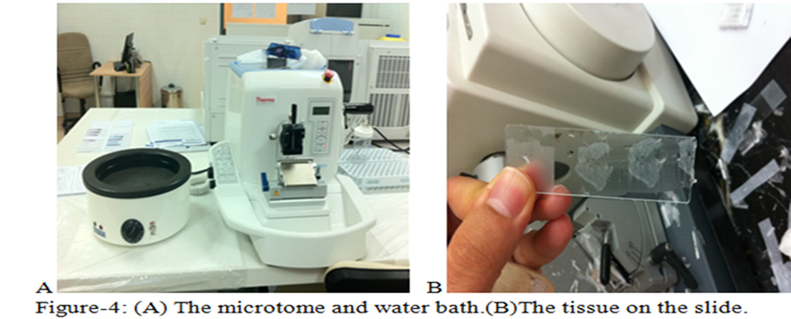

Slide 20
References
ORAL PATHOLOGY, Clinical pathologic correlation.3rd Edition REGEZI and SCIUBBA
ORAL PATHOLOGY. Fourth Edition, SOAMES and SOUTHAM..
3. Cawson 's Essentials of Oral Pathology and Oral Medicine 7th Edition.

