Slide 1
ODONTOGENIC TUMORS AND TUMOR LIKE LESIONS
L11

Slide 2
Odontogenic tumors represent a spectrum of lesions ranging from malignant (rare) and benign neoplasms to dental hamartomas, all arising from dental formative tissues or their remnants.
Hamartoma a benign growth made up of an abnormal mixture of cells and tissues normally found in the area of the body where the growth occurs.

Slide 3
TUMORS OF ODONTOGENIC EPITHELIUM

Slide 4
AMELOBLASTOMA
It may be arise from the enamel organ of developing tooth germ, reduced enamel epithelium, dental lamina, Hertwig’s sheath, cell rests of Malassez, epithelium of odontogenic cysts (particularly the dentigerous cyst), or basal cells of the surface epithelium of the jaws.

Slide 5
Clinical features:
It is the most common neoplasms of the jaws
Mostly appear between the ages of 30 and 50 y.
Male mostly affected.
8% form in the mandibular posterior molar region, and often involve the ramus.
They are symptomless until the swelling enlarged and causes expansion and distortion of the cortical plates of jaw bones, displacement and mobility of the regional teeth, and pathological fracture

Slide 6
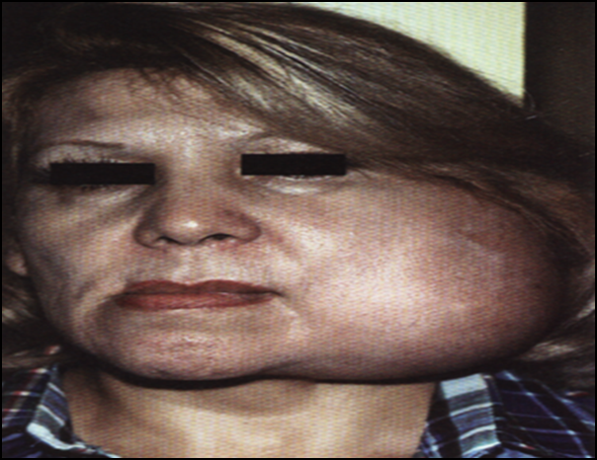

Slide 7
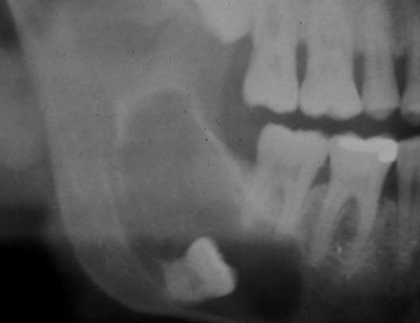
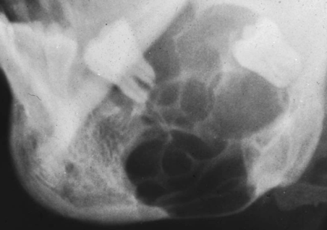
Radiographical features:
Ameloblastoma form unilocular radiolucent areas with moderately well-defined margins and may appear multilocular or honeycomb pattern.
Resorption of roots is often seen in rabidly growing lesions.
Radiographical pictures appear as unilocularor or multilocular radiolucent lesion.

Slide 8
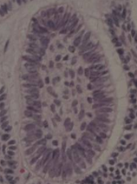
Histopathological features
The subtypes of ameloblastoma are:
follicular ameloblastoma, which are the most common type
-The neoplastic odontogenic epithelial cells proliferate to form follicles within fibrous connective tissue stroma.
-The follicle consist of a well-organized single layer of columnar, ameloblast-like cells and surround
a core of cells, resembling stellate
reticulum.

Slide 9

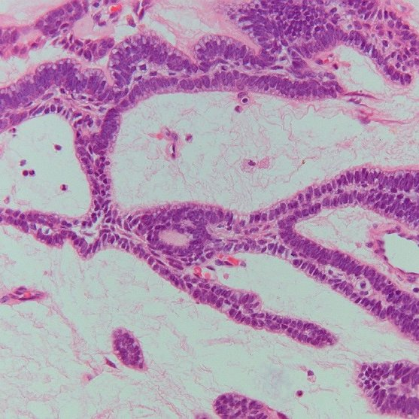
plexiform ameloblastoma
The neoplastic odontogenic epithelial cell proliferate in form of anastomosing strands. (An anastomosis is a connection or opening between two things that are normally diverging or branching )
- peripheral layer of cells are columnar resemble ameloblasts and the cells situated in the center often resemble the stellate reticulum.

Slide 10
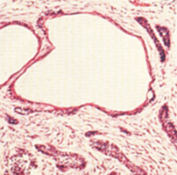

Cystic type is common, due to cystic
degeneration within follicular type.
Acanthomatous ameloblastoma
show squamous metaplasia of the central cores of neoplastic epithelium.

Slide 11
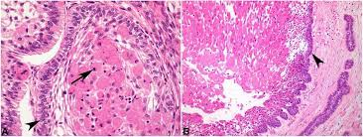

Granular cell ameloblastoma
usually resemble the follicular type, but the epithelium forms sheets of large eosinophilic granular cells.

Slide 12
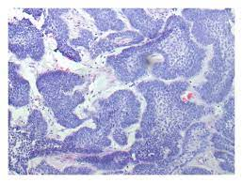

. Basal cell ameloblastoma
Consist of more darkly staining cuboidal cells predominantly in a follicular pattern with little evidence of palisading at the periphery.
-They have been mistaken for basal cell carcinomas.
a palisade is a single layer of relatively long cells, arranged loosely perpendicular to a surface and parallel to each other.

Slide 13
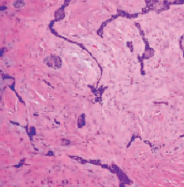
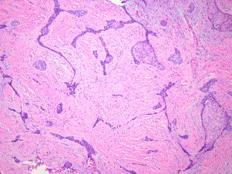
. Desmoplastic ameloblastoma
- Appear as a thin strands and cords of epithelium rather than in an island like pattern found in a dense collagen stroma.

Slide 14
.
Malignant ameloblastoma and ameloblastic carcinoma:
Malignant ameloblastoma is a histologically typical ameloblastoma, but may gives rise to metastases.
Ameloblastic carcinoma is a malignant epithelial proliferation that is associated with an ameloblastoma, and demonstrates greater cytologic atypia and mitotic activity than ameloblastoma.
Atypia is a word pathologists use to describe cells that look abnormal either in shape, color, or size compared to normal, healthy cells in the same location

Slide 15
ADENOMATOID ODONTOGENIC TUMOUR
Is a benign non-invasive odontogenic tumour
Probably arises from the reduced enamel epithelium, may occur within the jaw bones or the gingiva.

Slide 16
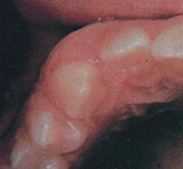
Clinical features:
Found either in late adolescence or young adults.
Females are twice as frequently affected as males.
The tumor is most frequently occurs in the anterior maxilla especially in canine area (rarely involves the mandible) and forms a very slow-growing swelling causes elevation of the upper lip.

Slide 17
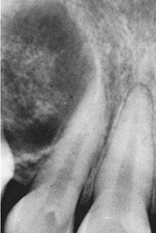
Radiographical features:
Appear as a well defined unilocular radiolucent area, may enclose impacted tooth, multiple small radiopaque foci may be present inside the lesion.
Multilocular cases have been reported and a scalloped border is observed occasionally.
Expansion and distortion of cortical
plate and displacement of the roots of
adjacent teeth may be seen.
Unilocular radiolucent lesion with multiple ares of radiopacities.

Slide 18
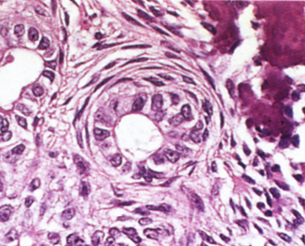
Histopathological features:
Shows a well-defined capsule encloses nests or strands of odontogenic epithelium
They may proliferate in a variety of patterns and in multiple duct like structure filled by a homogenous eosinophilic coagulum
bordered by a single tall columnar cells
resemble ameloblasts, and give the lesion
an adenomatoid or glandular structure.
Small foci of calcifications are often seen.
Odontogenic epithelium proliferate
in a duct like structure.

Slide 19
CALCIFYING EPITHELIAL ODONTOGENIC TUMOUR
(Pindborg tumor) :
- Aggressive neoplasm arises from stratum intermedium or reduced enamel epithelium.
An extra-osseous tumor is also known but is quite rare.
Clinical features:
Adults are mainly affected at an average age of about 40.
The typical site is the posterior body of the mandible.

Slide 20
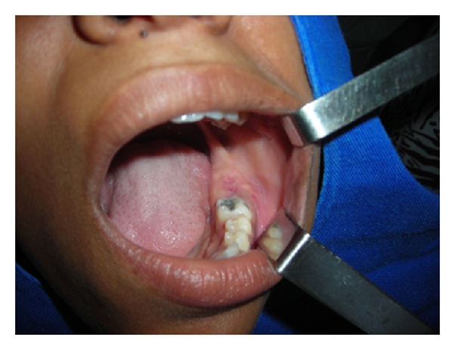
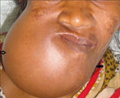
Appear as painless slowly growing tumor of the jaw with expansion and distortion of cortical plate, causing facial asymmetry and derangement of occlusion.

Slide 21
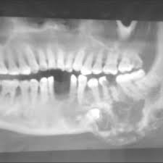
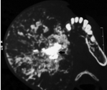
Radiographical features:
Well defined multilocular radiolucent area seen, while in some cases may appear as unilocular.
Within the radiolucency multiple radiopaque foci often present.
Radiolucent lesion with multiple areas of radiopacities.

Slide 22
Histopathological features:
Consist of sheets, islands or strands of epithelial cells in a connective tissue stroma.
The epithelial cells are polyhedral and show variation in nuclear size and have a distinct outlines and intercellular bridges.
Within the tumor, there are typically homogeneous hyaline areas, with the staining characteristics of amyloid.
These may calcify and may form large masses.

Slide 23
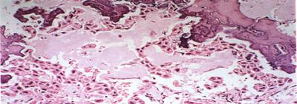
. Calcifying epithelial odontogenic tumors are not encapsulated, are locally invasive and behave similarly to ameloblastoma.
The tumor cells with the hyaline and calcified masses

Slide 24
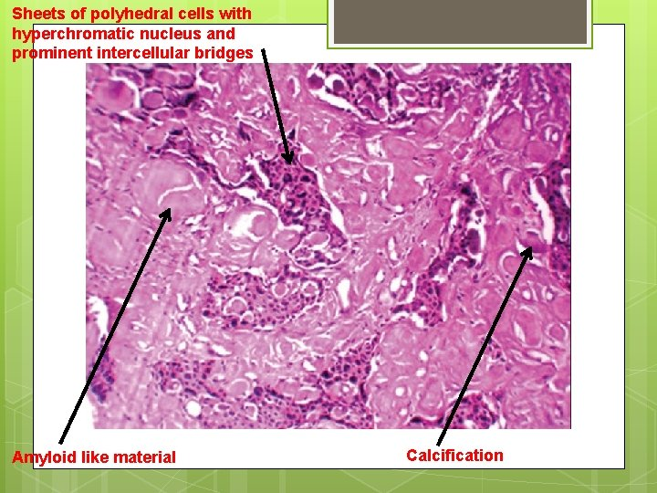

Slide 25
2. MIXED ODONTOGENIC TUMOR
AMELOBLASTIC FIBROMA
- Benign odontogenic tumor in which both the epithelial and mesenchymal elements are neoplastic (in ameloblastoma only the epithelium is neoplastic).
- Characterized by the simultaneous proliferation of both epithelial and mesenchymal tissue without the formation of enamel or dentine.

Slide 26
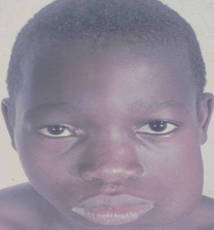
Clinical features:
Arising most commonly in the molar region of the mandible.
Usually affect young persons (of average age 15years)
Male mostly affected,
May be associated with impacted teeth.
-The tumor is slowly growing, causing hard bony swelling and usually asymptomatic, but eventually
expand the jaw causing facial
asymmetry and displacement of
regional teeth.

Slide 27
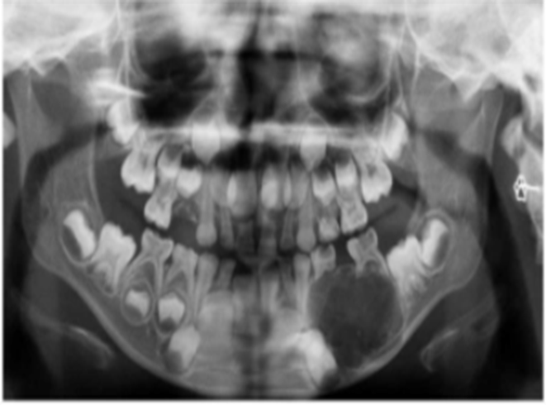
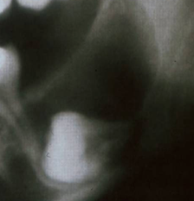
Radiographical features:
-They can appear as a multilocular or unilocular radiolucency which has a rather smooth outline, often with a sclerotic border.
Radiolucent lesion associated with impacted tooth.

Slide 28
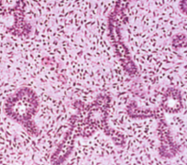
Histopathological features:
The epithelium consists of ameloblast-like cells forming strands or islands which bordered at the periphery by a layer of columnar cells resembling ameloblast.
The cells in the center of islands or strands resemble stellate reticulum cells.
The mesenchymal component consists
of highly cellular fibroblastic stroma which
resembles the immature dental papilla.

Slide 29
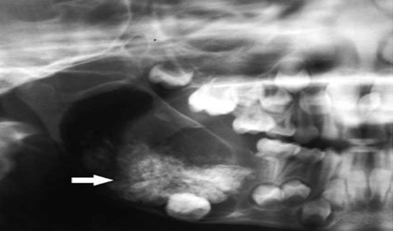
Ameloblastic fibroma may rarely be combined with mixed calcifying dental tissues (ameloblastic fibro-odontoma), and radiographs typically show the opaque dental tissues in the radiolucent area
: Ameloblastic fibro-odontoma. The odontoma component is complex in nature.

Slide 30
ODONTOMAS
Growth in which both the epithelial and the mesenchymal cells exhibit complete differentiation, with the result that functional ameloblasts and odontoblasts form enamel and dentine in
an- organized fashin.
Considered as a developmental malformations (hamartomas) of dental tissues, not neoplasms.

Slide 31
- Most odontomas are asymptomatic, although occasionally signs and symptoms relating to their presence do occur.
- Usually occur among children or young adults.
- Both sexes are affected with male predominance.

Slide 32
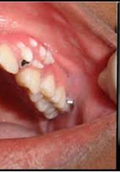
Compound odontoma:
The compound odontoma had a predilection for the anterior maxilla.
- Consist of many separate, small, tooth-like structures (denticles), probably produced by localized, multiple budding off from the dental lamina and formation of many tooth germs.
small tooth-like structures erupted in the gingiva

Slide 33
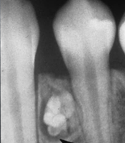
Radiographically
The denticles may be seen as numerous small teeth like structures.
Surrounded by a thin radiolucent zone
which represents the fibrous capsule.
shows many tooth-like structures.

Slide 34
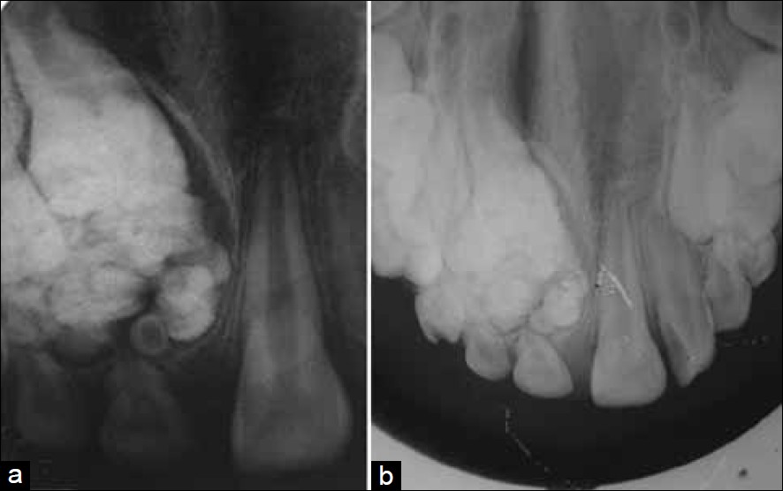

Slide 35
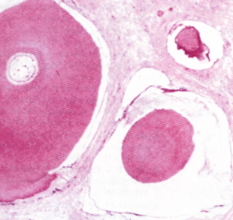
. Microscopically
appear as separate denticles in fibrous tissue stroma.

Slide 36
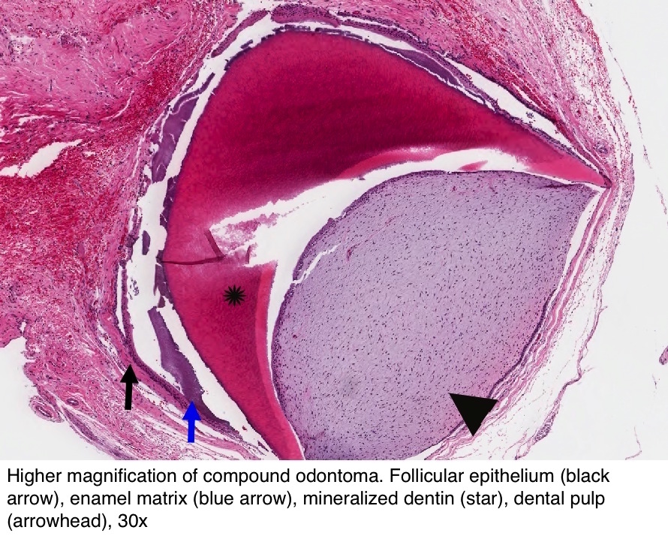

Slide 37
Complex odontoma:
In general, complex odontomas had a predilection for the posterior jaws.
Consist of an irregular mass of hard and soft dental tissues, having no morphological resemblance to a tooth and frequently forming a cauliflower-like mass.

Slide 38
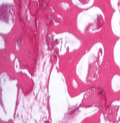
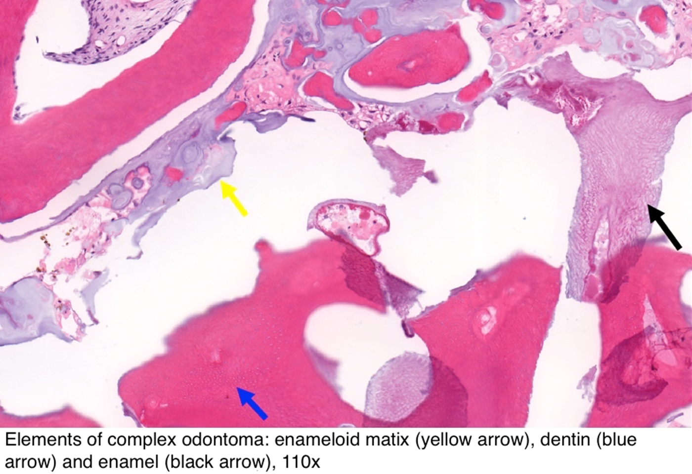
Microscopically:
Appear as an irregularly arranged enamel, dentine, cementum and pulp.
Complex odontoma, microscopical pictures shows irregular mass of hard dental tissues.

Slide 39
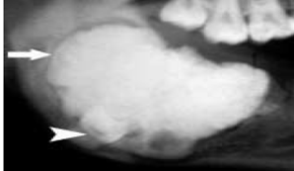
. Radiographically,
Appear as irregular radiopaque mass sometimes with radiolucency. Surrounded by a thin radiolucent zone which represents the fibrous capsule..
Complex odontoma, radiographical and microscopical pictures shows irregular mass of hard dental tissues.

Slide 40
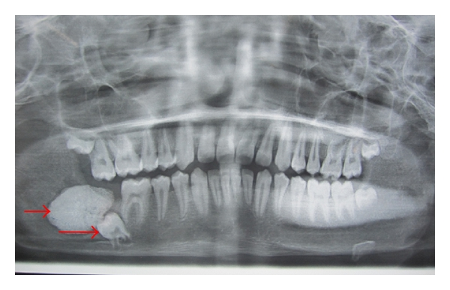
The ameloblastic odontoma is an odontogenic neoplasm characterized by the simultaneous occurrence of an ameloblastoma and a composite odontoma.

Slide 41
L12

Slide 42
TUMORS OF ODONTOGENIC MESENCHYMA
CENTRAL ODONTOGENIC FIBROMA:
Clinical features:
Derived from dental mesenchyme
Occur more frequently in children and young adults
Has a predilection for occurrence in the mandible.
It is generally asymptomatic except for swelling of the jaw causing displacement of teeth.

Slide 43
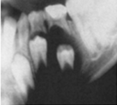
Radiographic features:
Unilocular radiolucent area in the jaw, sometimes multilocular similar to that of the ameloblastoma.
Radiographically appear as radiolucent lesion

Slide 44
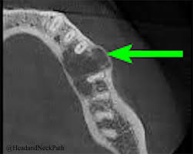

Slide 45
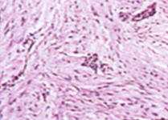
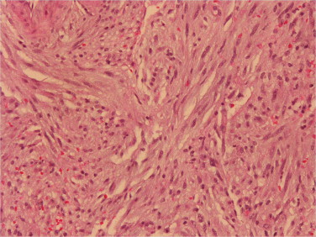
Histopathological features:
Tumor mass made up of mature collagen fibers interspersed usually by many fibroblasts.
Small nests or islands of odontogenic epithelium are present in variable amounts.
Cellular connective tissue containing odontogenic epithelium

Slide 46
CENTRAL ODONTOGENIC MYXOMA:
Aggressive neoplasm derived from embryonic dental mesenchyme
Clinical features:
- Young people are predominantly affected.
- Mandibular lesion is common.
.

Slide 47
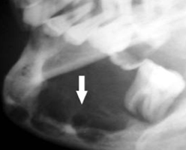
Radiographic features:
- Appear as multilocular radiolucent area with a soap-bubble appearance.
- Sometimes appear unilocular.
radiolucent lesion.

Slide 48
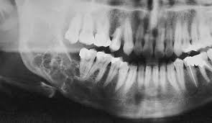
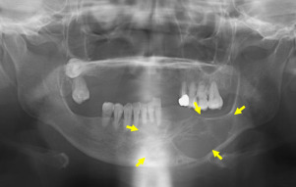
radiolucent lesion.

Slide 49
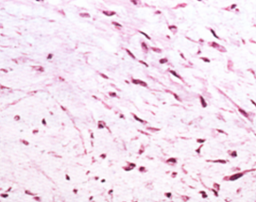
Histopathological features:
Consist of scanty spindle shaped or angular cells with long fine anastomosing processes, distributed in a mucoid background substance.
The margins of the tumor are
ill-defined and peripheral bone is
progressively resorbed.
Stellate or angular cells with long fine anastomosing processes, distributed in a mucoid background substance.

Slide 50
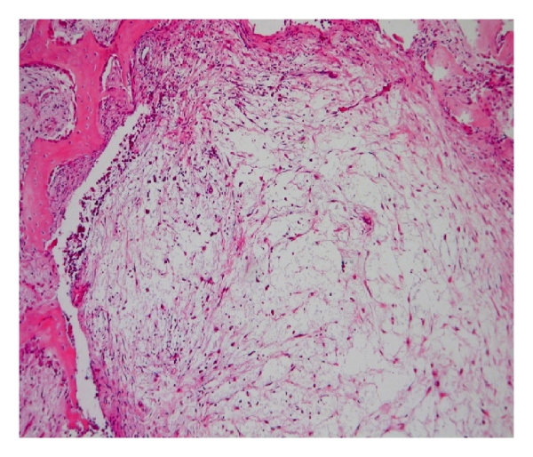

Slide 51
TUMOURS AND DYSPLASIAS OF CEMENTUM
CEMENTOBLASTOMA
Benign neoplasm arising from cementoblast cells and forms a mass of cementum-like tissue attached to the root of a tooth usually a mandibular first molar
- Mainly affect young adults, particularly males, typically below the age of 25.
They are slow-growing and the jaw is not usually expanded
A Cementoblastoma rarely causes gross bony swelling and pain..

Slide 52
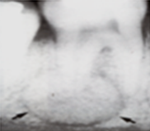
Radiographically
- There is typically a radiopaque mass with a thin radiolucent margin, attached to the roots of a tooth.
- Resorption of related roots is common, but the tooth remains vital.
Radiopaque mass with a thin radiolucent margin attached to the roots of a tooth.

Slide 53
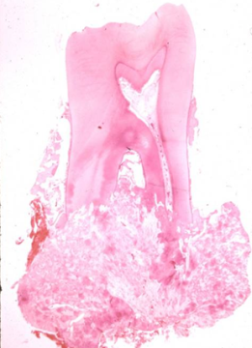
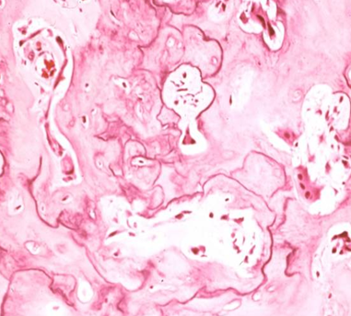
Microscopically
- The mass consists of cemental tissue which shows the presence of reversal lines
- The intervening connective tissue stroma is soft and vascular and contains many cementoblast or cementoclast cells.
Mass consists of cemental tissue.

Slide 54
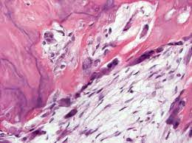

Slide 55
CEMENTIFYING FIBROMA
Slow growing
well-circumscribed, encapsulated, benign tumor of bone, similar to ossifying fibroma. They are very similar and probably arise from cells of the periodontal ligament.
These benign tumors occur in the mandible more frequently than the maxilla.
They are usually diagnosed in the third to fourth decades of age.
Tumor shows a female predilection.

Slide 56
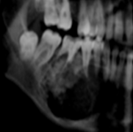
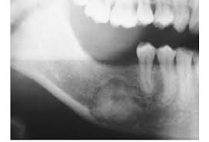
Radiographically
Cementifying fibroma and ossifying fibroma both show well-circumscribed margins of radiolucency and contain different amount of radiopacities.
Circumscribed radiolucency containing radiopacities.

Slide 57
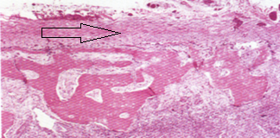
The cementifying fibroma is usually classified as an odontogenic tumor.
The ossifying fibroma is classified as a benign fibro-osseous lesion(neoplasm)
that is histologically composed of cellular fibrous connective tissue containing varying amounts of osteoid and bone
Ossifying fibroma surrounded by capsule, (arrow)

Slide 58
cementifying fibroma showing a dense, cellular, fibrous connective tissue stroma comprising of plump proliferating fibroblasts and areas of basophilic cementum-like calcifications.

Slide 59
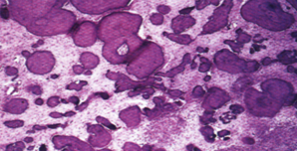
- The cementifying fibroma has rounded cementoid calcifications.
.
Cementifying fibroma, the fibrous connective tissue contains cementoid calcifications.

Slide 60

- Some tumors exhibit combinations of both types of calcification and these are generally diagnosed as cemento-ossifying fibromas
cemento-ossifying fibroma showing globular masses of cementum (C) like deposition and bony (B) deposits (×40).

Slide 61


Slide 62
NON-NEOPLASTIC ODONTOGENIC LESIONS
CEMENTO-OSSEOUS DYSPLASIA
Non-neoplastic proliferations, from periodontal ligament origin. Three forms of this dysplastic process involving the jaws of the same microscopical picture:
,

Slide 63

Periapical cemental dysplasia (previously called cementoma)
- Affects mostly women, particularly the middle-aged
More common in black people
Mostly asymptomatic and involves the mandibular incisors region,

Slide 64

Radiographically, can be seen as rounded radiolucent areas related to the apices of the teeth(osteolytic stage), these simulate periapical granulomas but related teeth are vital.
. Later, there is calcification, starting centrally (cementoblastic stage), then the masses increase in size and the lesion become densely radiopaque (mature stage) and surrounded by thin radiolucent line.
Periapical cemental dysplasia, the radiograph of the three stages.

Slide 65
histologically
The lesions resemble cemento-ossifying fibromas and consist, in their early stages, of cellular fibrous tissue containing foci of cementum-like tissue.
Progressive calcification leads to the formation of a solid, bone-like mass.

Slide 66


2. Focal cemento-osseous dysplasia
occurs as a single lesion and may affect posterior teeth.

Slide 67
3. Florid cemento-osseous dysplasia (Gigantiform dysplasia)
presents an exuberant form of cemento-osseous dysplasia.
It may involve multiple quadrants in the maxilla as well as the mandible.
They are asymptomatic unless they become infected, but can expand the jaw.

Slide 68

Radiographically
Florid cemento-osseous dysplasia appears as radiopaque, somewhat irregular masses involving the maxilla and/or mandible.
Florid cemento-osseous dysplasia with multiple radiopacities.

Slide 69
Gigantiform cementoma is a rare familial variant of florid cemento-osseous dysplasia, and inherited as an autosomal dominant trait, appear during childhood

Slide 70


