Slide 1
Addison disease
By
Dr. Muhammad Abdullah Shwani
Assistant professor/Consultant urologist
Kurdistan Higher Council of Medical Specialties (KHCMS)
drmalshwani@mail.com

Slide 2
Definition
Impairment of the production of adrenocortical hormones glucocorticoids (cortisol) and mineralocorticoids (aldosterone) leads to a life-threatening situation.
First described by Thomas Addison in a patient with adrenal Tuberculosis(TB)in 1885.

Slide 3
Classification
Primary due to failure of adrenal glands (Addison’s disease).
Secondary :
Pituitary failure is usually due to chronic exogenous glucocorticoid administration
Tertiary Hypothalamic dysfunction.

Slide 5
Primary Adrenal Insufficiency
Loss of all three types of adrenal steroids.
High functional reserve.
90 of glands must be destroyed to manifest clinically.
Progressive neurological symptoms from demyelination.

Slide 6
Causes of primary adrenal failure
The most common cause is autoimmune.
Thrombosis.
Hemorrhage.
Sepsis.
DIC(disseminated intravascular coagulation) .
Antiphospholipid syndrome.
Infiltrative diseases e.g. amyloidosis.
Bilateral secondary metastasis(cancer ).
Hemosiderosis .
TB (tuberculosis) .
HIV .
CMV( cytomegalovirus) infection.
Drugs e.g. ketoconazole use(antifungal ).

Slide 7
Secondary Adrenal Insufficiency/Causes
HPA axis failure:
Deficiency of glucocorticoids and adrenal androgens.
Mineralocorticoids are unaffected.
Most common causes are chronic exogenous glucocorticoid :
Suppresses diurnal CRH release.
Both time- and dose-related.
Reversible.
Recovery may take up to a year.

Slide 8
Causes
Less common causes are:
Postpartum necrosis (Sheehan syndrome).
Adenoma.
Pituitary surgeries.
Hemorrhage.
Pituitary destruction from head trauma :
typically have associated focal neurological changes, visual deficits, diabetes insipidus or panhypopituitarism.

Slide 9
Causes of Tertiary adrenal insufficiency
The most common cause is the sudden stopping of corticosteroids after taking them for a long period of time(exogenous-iatrogenic) which impair the release of CRH by the hypothalamus .

Slide 10
Chronic Insufficiency/Clinical presentation
Nonspecific:
Fatigue anorexia, weight loss, loss of libido.
Neurological:
Headaches, visual changes, diabetes insipidus.
Gastrointestinal:
Abdominal Pain, nausea, vomiting, diarrhea.
Hypotension/Orthostasis(Postural hypotension):
Cachexia.
Hypoglycemia.
Normocytic anemia, lymphocytosis, eosinophilia.

Slide 11
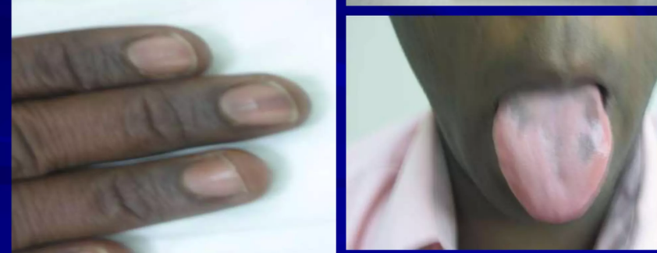
Chronic Insufficiency/Clinical Presentation …….
8.Dermatological :
Hyperpigmentation.
Darked skin creases Pressure points, axillae, palmar creases, perineum, oral mucosa .
Pallor out of proportion to anemia.
9. Sexual characteristic:
Loss of axillary and pubic hair in females.
Loss of libido in male.

Slide 12
Investigation
High Plasma Renin Activity (Earliest Abnormality).
Random plasma cortisol level is Usually low but maybe within the normal range.
Increased Night time ACTH levels.
Plasma calcium (high).
Plasma aldosterone(low).
Low ACTH stimulated Cortisol responses.
Serum electrolytes especially during Crises :
Hyponatremia, Hypoglycemia, Hyperkalemia
CBC:
Eosinophilia
Lymphocytosis
Anemia

Slide 13
Investigation ………
Tests to find out causes-
Chest X-ray (tuberculosis).
Plain X-ray of abdomen (to see adrenal calcification in tuberculosis).
Adrenal auto-antibody.
Ultrasonography or CT scan of adrenals.
HIV test.

Slide 14
Diagnostic criteria of Addison's Disease
Triad of :
Weakness or emaciation (100% cases).
Pigmentation (90% cases).
Hypotension.

Slide 15
Treatment Of Chronic adrenal Insufficiency
Replace missing hormones :
Glucocorticoids(hydrocortisone-15 mg on waking and 5 mg at 6p.m) & mineralocorticoids (fludrocortisone 0.05 to 0.1mg daily) in primary Adrenal insufficiency
Glucorticoids in secondary Adrenal insufficiency.
Females may benefit from adrenal androgen replacement with DHEA at 25-50 mg/day (improves sexual function & well-being).
Supportive treatment and treatment of cause:
e.g. if TB- antitubercular therapy
General advice to the patient:
Good nutrition, regular meals, high carbohydrate, and sufficient salt
When oral therapy is not possible, injection of hydrocortisone should be taken
Education Of Critical Importance To Avoid Morbidity And Death

Slide 16
Complications
The complications of untreated Addison's disease include cardiovascular collapse, coma, and death.

Slide 17
Adrenal Crisis/Acute adrenal insufficiency
life-threatening emergency.
Abrupt adrenal failure.
May be primary or secondary.
Typically resistant to catecholamine and IVF resuscitation.

Slide 18
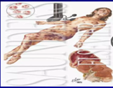
Causes
Stress: Acute: precipitated by infection, trauma, surgery, emotional, etc…
Failure to increase steroid.
Bilateral adrenal hemorrhage.
Bilateral adrenal arterial emboli.
Bilateral adrenal vein thrombosis.
Bilateral adrenalectomy for any reason.
Contrast studies involving adrenal glands.

Slide 19
CLINICAL FEATURES OF ADRENAL CRISIS
Dehydration.
Hypotension, or shock out of proportion to the severity of the current illness.
Nausea and vomiting with a history of weight loss.
Unexplained hypoglycemia.
Unexplained fever.
Hyperpigmentation or vitiligo.
Other autoimmune endocrine disease manifestations like: hypothyroidism or hypogonadism.

Slide 20
Investigations
Blood investigations:
Hyponatremia.
Hypoglycemia.
Hyperkalemia.
Azotemia(uremia).
Hypercalcemia.
Eosinophilia.

Slide 21
Treatment of Acute Adrenal insufficiency (Adrenal Crisis)
Emergency Measures
Establish an intravenous line with a large -gauge needle .
Draw blood :
for electrolytes.
glucose.
Cortisol.
ACTH.
DO NOT wait for results.
Infuse 2 to 3 L of isotonic saline or 10% glucose in case of hypoglycemia:
Monitor for signs of volume overload.
Reduce infusion rate, if indicated.
IV hydrocortisone 100 mg 6 hourly until GlT symptoms abate then oral therapy.
Precipitating factors should be found out and treated.
Antibiotic if indicated.
Supportive measures as needed.

Slide 22
Summary
Unexplained hyponatremia and hyperkalemia in the setting of hypotension unresponsive to catecholamine and fluid administration should receive 100mg hydrocortisone intravenously.

Slide 23
THANK YOU

