Slide 1
Academic Research and Writing
Critical Reading and analysis
Omar Farouk Al Mashhour
Academic Research And Writing (Bus 149)
2023-2024
Week Eleven
Sunday, 10th Of December 2023

Slide 2
Learning Outcomes
Understand what it means to write critically.
Apply higher-order critical skills to your own writing.
Evaluate your work and the work of others using different types of questioning prompts.

Slide 3
Have you ever read something and realized later that you completely missed the underlying message or bias?
Did you know that our ability to critically analyze information affects not just our academic success, but also our day-to-day decision-making?

Slide 4
In our world of information overload, the ability to discern (difference), analyze, and evaluate information is more crucial than ever. These skills empower us not just to be better learners, but also more informed citizens.
Today, we explore three pivotal academic skills: Critical Reading, Critical Thinking and Critical Writing.
These skills empower us to interpret, analyze, and engage with information in a profound way, essential in our journey as scholars and informed citizens."

Slide 5
Guys, Be critical!!!
Academic tutors often tell students to “be more critical” in their writing. Or to “be less descriptive.”
But often they don’t explain what that means.

Slide 6
“A conversation among scholars”
Think of your discipline as a conversation among scholars.
By reading what other scholars before you have written on a subject, you are listening along to that conversation.
You'll use your existing knowledge to understand what's being said and analyse the different perspectives.

Slide 7
When it’s your turn to speak, it’s good to refer to what other scholars have already said. But you don’t want to just repeat it.
Instead, you want to try to build on it to make a point of your own.
This is what is meant by “being critical.”

Slide 8
Critical Reading And Critical Thinking
Critical reading is a technique used to read texts actively, absorbing deeper meaning rather than just surface-level information. Yasemin (2020)
Critical thinking happens during and after the reading. (Al Roomy, 2022)
It is a technique that is used to evaluate and reflect on the information we are absorbing from texts in order to
decipher the author’s meaning
Form your personal thoughts and options in reaction to it. (Lane, 2021)

Slide 9
Source: Din (2020)

Slide 10
Critical Reading
Sources are not equally valid or equally useful, so you must learn to distinguish critically among them. Through evaluation, you determine the extent to which sources are reliable.
Critical reading require discernment (Judgement); sensitivity; imagination; knowledge of the subject; and, above all, willingness to become involved in what you read. (Li & Wan, 2022)
These skills are developed only through repeated practice.

Slide 11
Example Of Sources Which Are Subject To Critical Reading and Thinking
Academic textbooks
Journals
Policy reports
Biographies/autobiographies
Websites
Information from campaigns
Newspapers and magazines
TV programmes

Slide 12
Key Components of Critical Reading
Understanding the Main Idea: Grasping the central concept or argument.
Analyzing the Structure: How is the argument constructed and supported?
Evaluating the Argument: Is the reasoning sound and evidence credible?
Recognizing Biases and assumptions: Identifying the author's perspective and potential biases.
Source: (Li & Wan, 2022)

Slide 13
Let’s discuss and understand each of them

Slide 14
Understanding the Main Idea
This involves identifying the central theme or argument of the text. What is the author trying to convey? This is the starting point of critical reading. Understanding this helps to frame the rest of the paper.
In a research paper, the main idea could be a new scientific discovery or theory.
Analyzing the Structure
This refers to examining how the text is organized. How does the author build their argument? Look at the sequence of ideas, the use of headings, paragraphs, introduction, and conclusion.
In an essay, note how the introduction sets up the argument, each paragraph presents a specific point, and the conclusion ties everything together.
Evaluating the Argument
Here, you assess the strength and validity of the arguments presented. Are the claims supported by evidence? Is the reasoning sound and logical?
When reading an opinion piece, evaluate whether the author’s arguments are backed by facts, statistics, or expert opinions, or if they rely heavily on emotional appeal or anecdotal evidence.

Slide 15
Recognizing Biases
This involves identifying any biases the author might have. What perspectives or potential prejudices are influencing their argument? Are they omitting important points of view or evidence?
In a news article, look for signs of bias in the choice of words, which aspects of a story are emphasized, and which perspectives are given prominence.
Recognizing Assumptions
Detect any underlying assumptions in the text. What beliefs or values does the author take for granted? How do these assumptions shape the argument?
In a historical analysis, the author might assume that certain historical events were inevitable, affecting their interpretation of those events.

Slide 16
What are the Strategies for Critical Reading?

Slide 17
Strategies for Critical reading
Active Reading
Active reading involves engaging with the text in a dynamic way. This means not just passively reading the words but actively thinking about and interacting with the content. It involves making connections, drawing inferences, and considering implications.
While reading a chapter in a textbook, pause after a few paragraphs to summarize what you've read in your own words. This helps in consolidating understanding and retaining information.
Annotating
Annotating is the practice of adding notes, comments, or symbols to a text while reading. This can include underlining or highlighting key phrases, writing margin notes, or marking sections with symbols to denote importance or confusion.
When reading an article, you might underline key terms, jot down questions or comments in the margins, or use symbols like a question mark to indicate areas that are unclear or require further research.
Source: (Sutherland & Incera, 2021)

Slide 18
Questioning the Text
This strategy involves actively questioning the text as you read. Ask questions like 'What is the author's main point?', 'Why is this argument being made?', and 'How does this information connect to what I already know or to other parts of the text?
In a historical text, ask why the author chooses to focus on certain events over others, or how the interpretation presented might differ from other historical perspectives.
Looking for Underlying Assumptions
This involves identifying the assumptions that underpin the text. These are the beliefs or principles that are not explicitly stated but are necessary for the arguments to make sense.
In an economic analysis, an author might assume that free markets always lead to the best outcomes. Recognizing this assumption helps you understand the basis of the author’s arguments and evaluate them critically.

Slide 19
The Characteristics of a Critical Reader
Does not believe everything they read​ ​
Questions what they read​ ​(whether it makes sense or no)
Rereads if necessary​ ​to make sure he/she covers everything
Understands the influence of style​ ​of writing and type of material
Analyses arguments​ ​
Discounts arguments that are unsupported or based on faulty reasoning
Has a justified reasons for believing some things and disbelieving others (for agreeing and disagreeing with others).

Slide 20
How About Critical Thinking?
Critical thinking is a mental activity, governed by rules of logic and reasoning, aimed at verifying something and evaluating it based on acceptable criteria. (El Soufi & See, 2019)
It requires evaluating evidence, considering alternative views, and being genuinely fair-minded in accurately presenting opposing views.
Critical thinkers make a genuine effort to critique fairly all views, preferred and unpreferred using identical rigorous criteria.

Slide 21
Imagine, for example, that you’re reading a history textbook. You wonder who wrote it and why, because you detect certain assumptions in the writing.
You find that the author has a limited scope of research focused only on a particular group within a population. In this case, your critical thinking reveals that there are “other sides to the story.”

Slide 22
Critical thinking, occurring during and after reading
Critical thinking is the objective analysis and evaluation of an issue to form a judgment.

Slide 23
The Research By Brown And Keely 2013
So, the sponge involves the basic premise of passively absorbing information without the use of critical thinking.
The two benefits of this style are that the person can absorb large amounts of information to view the world from different perspectives, and it does not require huge amounts of mental exertion. However, this process of thinking offers no dependable procedure for determining which opinions or information to trust and which ones to reject.
…………………………………………………………………………………………..
The second approach, which is referred to as panning for gold. You separate particles of gold from soil by washing in a pan with water.
It highlights that critical thinking is carefully inspecting and examining the information you read.
This process is beneficial as it asks active readers and listeners to frequently ask critical questions and take time to contemplate whether the information is reliable and factual. Obviously this type of thinking is challenging and often repetitive, but failure to do this will lead to a passive acceptance of ideas without critical analysis.

Slide 24
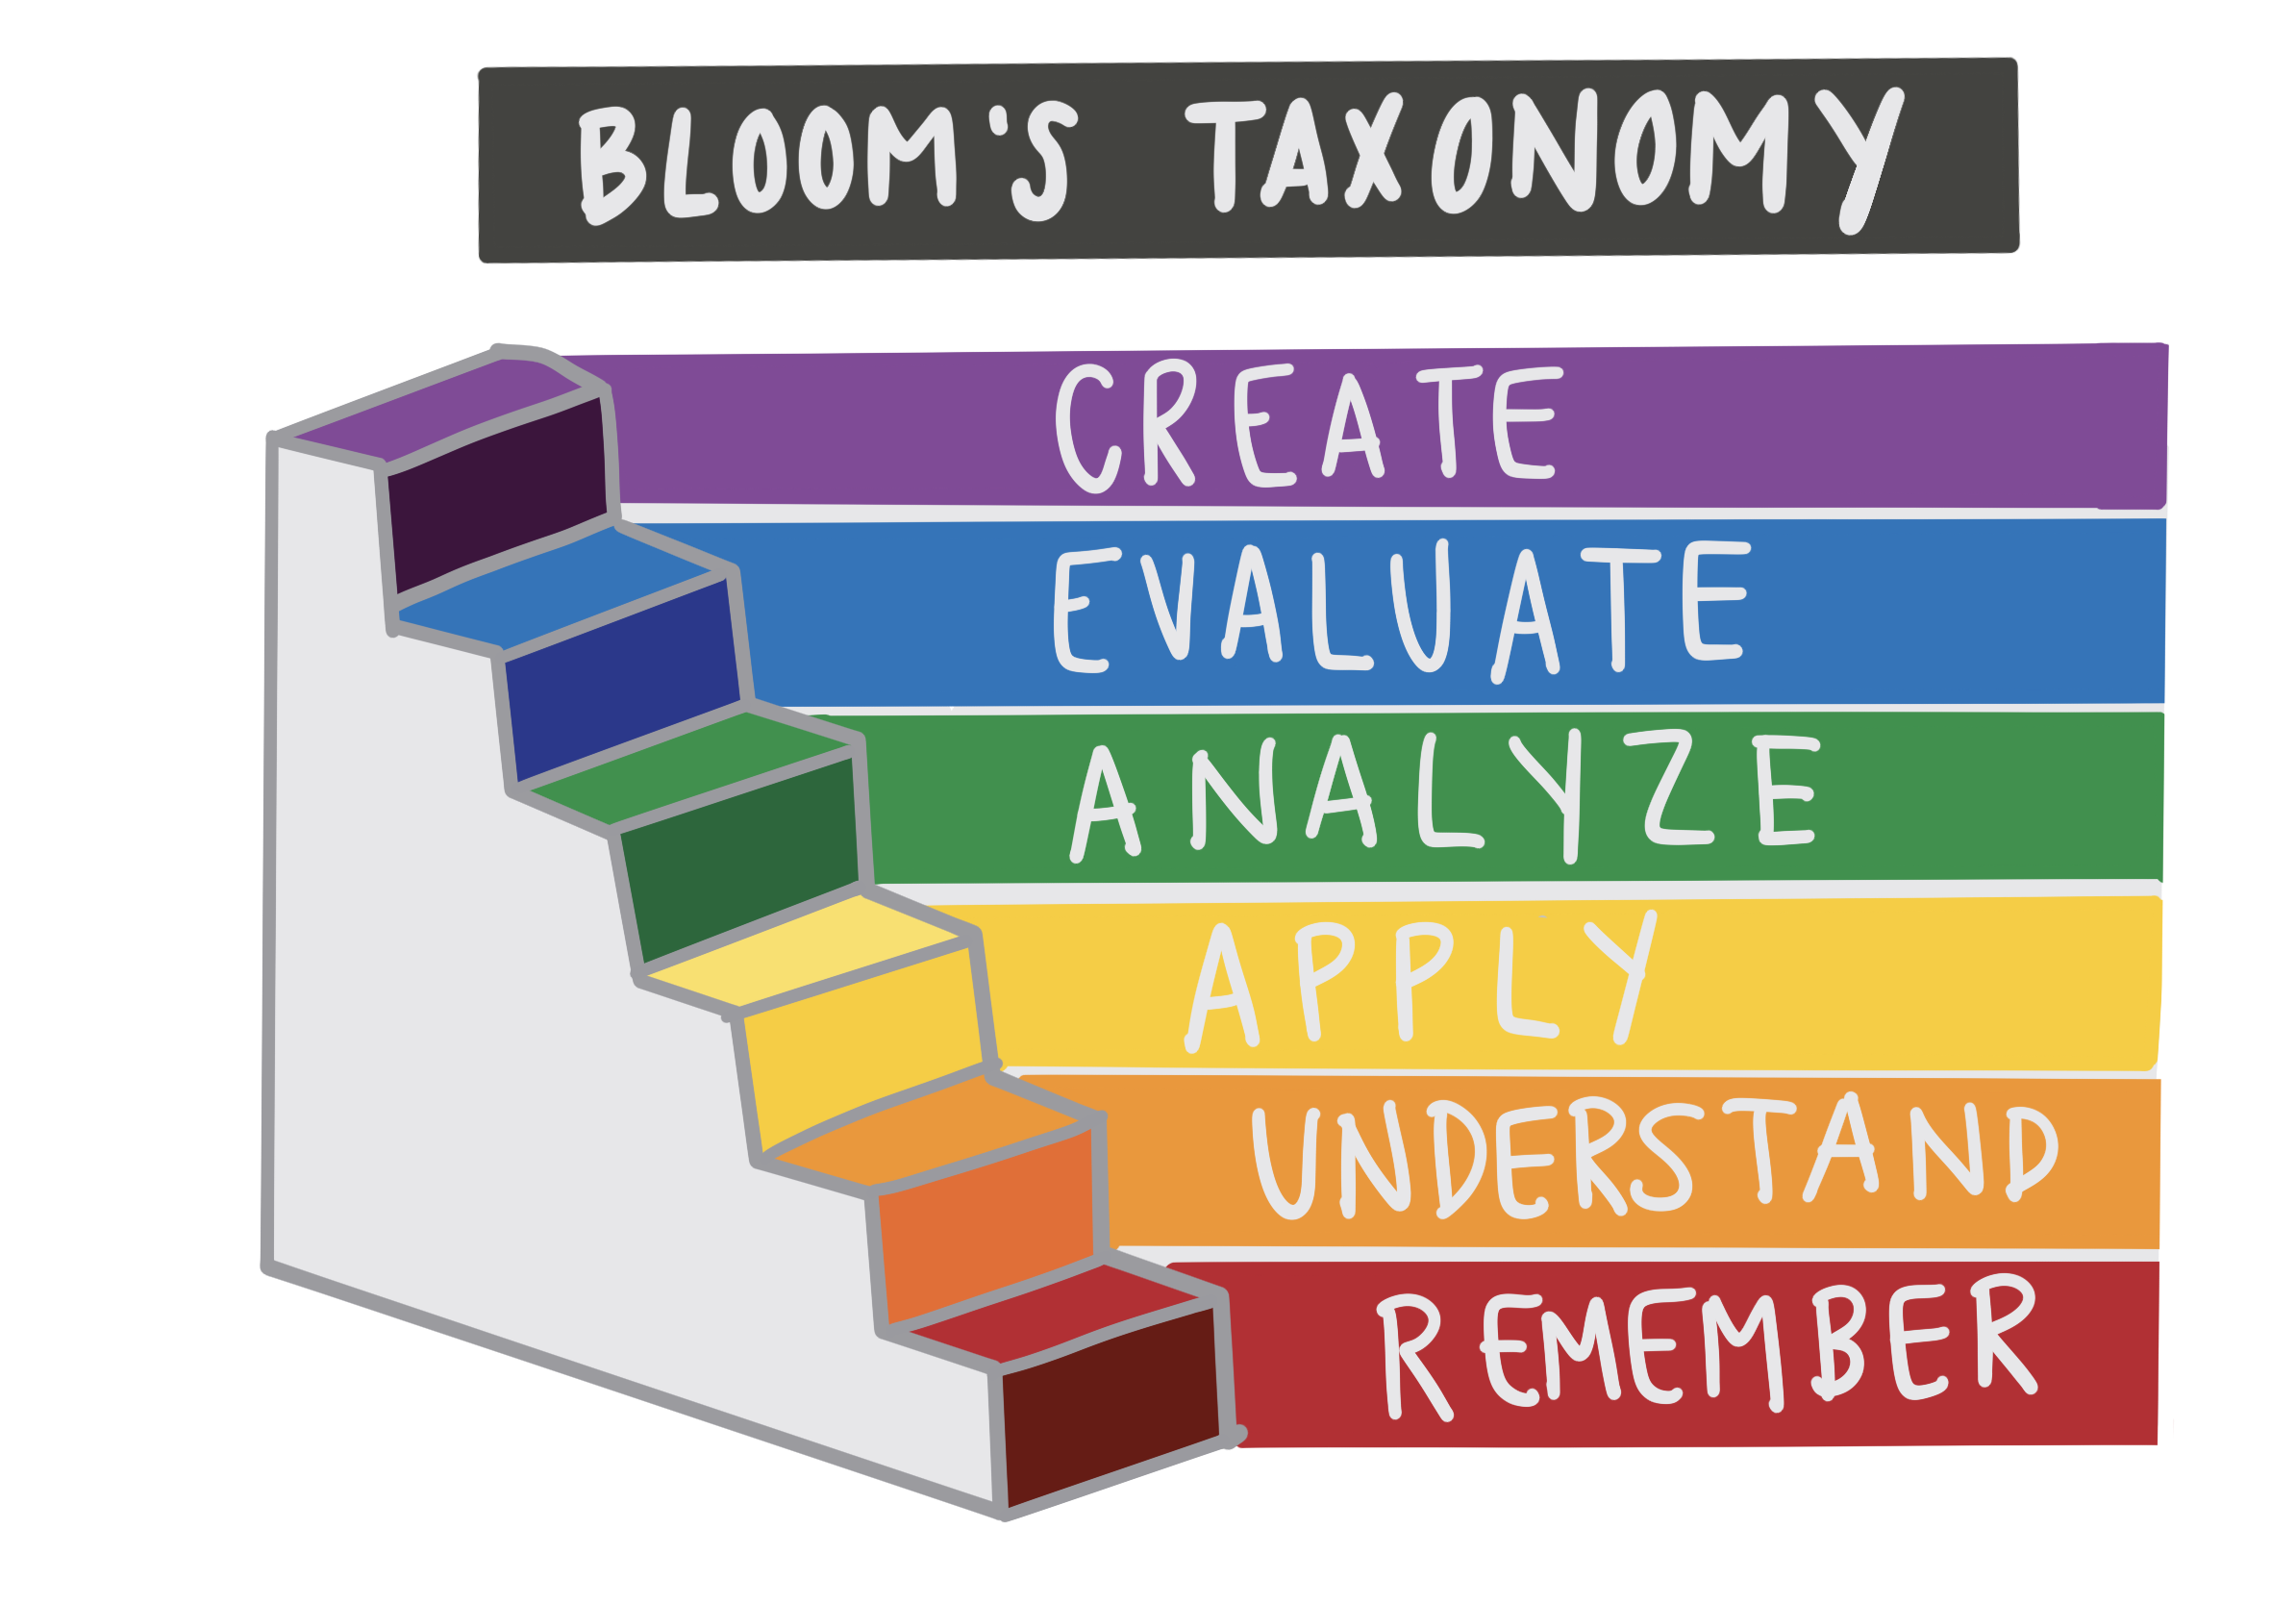
This leads nicely into Blooms taxonomy. This is a classification pyramid of learning levels which maps the way we think and process information.
The lower levels of learning are remembering, understanding and applying. These can be seen as the sponge or lower order thinking skills where information is given and absorbed.
The higher order thinking skills are analyzing, evaluating, and creating. These are Panning for Gold or your critical thinking skills.

Slide 25
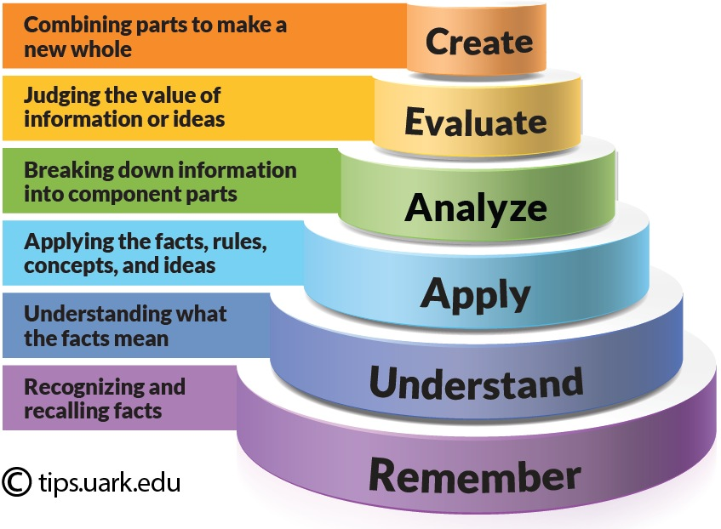
Let's Focus On The Higher Order Thinking Skills
Analyzing
is breaking the information down into separate components and looking for relationships between ideas and overall structures through analyzing content.
You will recognize unstated assumptions, logical reasoning, and relevancy of data. At this level you can answer questions like why, how, and what if
Evaluating
is judging, assessing, and criticizing information. Through using what you know to make a decision and support your views. To be successful at this, you need a profound understanding of the topic or idea you are evaluating. At this level you can answer questions like So what and what's next?
Creating
is the highest level where you combine all elements of the taxonomy to produce new or original work. At It requires inventiveness and originality to form new opinions and structures. this level you can answer questions like. How can it be improved or how can it be changed or adapted

Slide 26
Principles Of Critical Thinking
Think independently
Listen to other points of view, but do not follow any viewpoint without examining it first from different angles. Especially be cautious not to blindly accept claims and statements just because they are issued by an authority or expert.
Everybody can be wrong, and facts can change as knowledge develops. Therefore, develop your own informed opinion.
Think objectively
Try to see situations from another person’s point of view, beyond your own personal concerns. Do not become too attached to a theory or hypothesis because it is yours, or because you have believed it to be correct up to now.
Examine why you believe this theory or hypothesis to be accurate and compare it fairly with alternatives. If the theory survives the test, you will be more prepared to defend it when the occasion arises
Source: (Supriyatno, Susilawati, & Hassan, 2020)

Slide 27
Principle of Critical Thinking
Develop Intellectual Perseverance
Show that you have the persistence to think through all the aspects of a problem. Do not be tempted to give up because a problem is too challenging.
If there is something to be explained, think of different ways it could be explained. Then think of how you would test each of the alternatives.
Develop Observation Skills
When you read or listen critically, make sure that you clarify and understand key words, ideas and conclusions.
Generate questions about what you read.
For example, find out about the audience that the information is directed towards, and identify how the needs of the audience influence the selection of information and the way it is presented. Find out who generated the information, and by what methods

Slide 28
Practical Applications in Academia and Beyond
Academic Research: These skills are crucial for dissecting literature, formulating research questions, and interpreting data.
Professional Settings: In careers, they assist in making informed decisions, solving problems, and innovating.
Personal Life: They enable us to navigate the complexity of daily information and make sound decisions.
Example: "In a professional context, these skills might be used to evaluate the feasibility of a new business proposal."

Slide 29
Understanding The Act Of Critical Writing
The ability to communicate your critical thinking in your assignment and course works is important to your success in your academic career. Critical writing helps you to do so.
Academic essays consist of two writing styles: descriptive writing and critical writing. To understand critical writing fully, let’s examine what descriptive and the difference between it and critical writing.

Slide 30
Descriptive writing
Describe what something is ; a topic, problem, situation, or context of the subject under discussion.
May describe where the situation takes place, who is involved when it occurs.
Provide some background information to the discussion
A good way to remember descriptive writing is that it provides information on: what, who, where, when.
It demonstrate to your marker the knowledge that you have of a subject.

Slide 31
Critical Writing
Critical writing requires that you to apply analysis and evaluation to the description you have provided. (Wallace & Wray, 2021)

Slide 32
How to write critically
It is important to remember that having lots of critical analysis will not matter if your ideas are not clearly structured.
To maintain structure in your critical writing it is important to use paragraphs correctly. Using a good paragraph structure will enable the reader to clearly see your descriptive writing followed by your critical writing. (Nosich, 2021)
The paragraph consist of three sentences:
Descriptive statement (who, when , what)
Critical statement
Judgement statement.

Slide 33
Descriptive Statement
According to research by the health agency published in 2023, there may be a link between late nights and childhood obesity in children.
Critical
However, this research focuses only on the area of sleep and doesn’t consider many of the other factors associated with the late nights , such as what children eat when they stay up late
Judgment Statement
Compared to other known factors influencing childhood obesity, there is insufficient evidence about the effect of late night for this to be taken very seriously by policymakers though this may change with further research.
Example

Slide 34
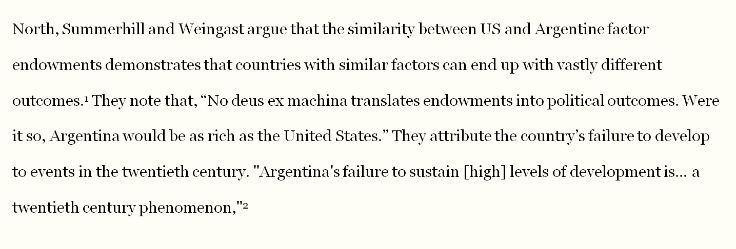
Descriptive Writing
Narrates an author’s argument

Slide 35
Descriptive Writing
Introduces quotes without criticising/relating to author’s own argument

Slide 36
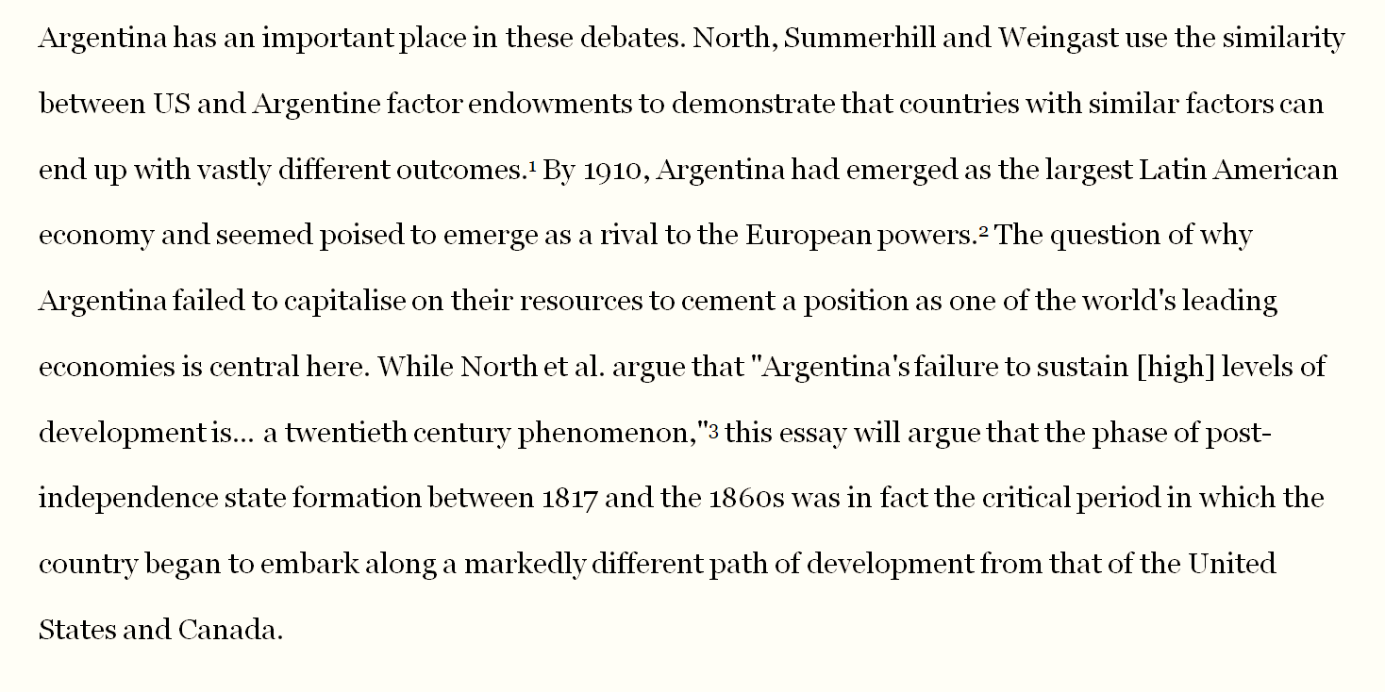
Critical Writing
Uses topic sentences that relate content of paragraph to over-all question
Introduces quotes to highlight points of agreement/disagreement

Slide 37
Critical writing
Paraphrases instead of quoting where possible

Slide 38
Critical writing
Uses thesis statements to clarify argument
Integrates a variety of sources and the author’s own thoughts in the same paragraph

Slide 39
Paragraph structure of critical writing
It is good academic practice to follow a three-sentence structure where you can provide description, analysis and evaluation
See below for a breakdown:
Descriptive + Critical + Judgement statement
According to … However… Overall…
This structure helps you to include both description and critical analysis and shows visually where this section begin and end
Moreover, it allows you to check the balance between description and critical writing and ensure you have enough critical content

Slide 40
Phrases For Demonstrating Your Critical Thinking
When writing your critical and evaluation statement, think carefully about the point you are trying to make, and use the corresponding language to highlight this to the reader
When you are comparing / contrasting : Similary / on the other hand etc..
When you are offering an alternative point of view: an alternative argument ….
When you are highlighting a weakness in a theory: one of the major drawback of this approach …..

Slide 41
Reference And Sources To Expand Your Knowledge
Yasemin, B. A. K. I. (2020). The effect of critical reading skills on the evaluation skills of the creative reading process. Eurasian Journal of Educational Research, 20(88), 199-224.
Al Roomy, M. A. (2022). Investigating the Effects of Critical Reading Skills on Students' Reading Comprehension. Arab World English Journal, 13(1), 366-381.
Wallace, M., & Wray, A. (2021). Critical reading and writing for postgraduates. Sage.
El Soufi, N., & See, B. H. (2019). Does explicit teaching of critical thinking improve critical thinking skills of English language learners in higher education? A critical review of causal evidence. Studies in educational evaluation, 60, 140-162.
Supriyatno, T., Susilawati, S., & Hassan, A. (2020). E-learning development in improving students' critical thinking ability. Cypriot Journal of Educational Sciences, 15(5), 1099-1106.
Din, M. (2020). Evaluating university students’ critical thinking ability as reflected in their critical reading skill: A study at bachelor level in Pakistan. Thinking Skills and Creativity, 35, 100627.
Li, C. S., & Wan, R. (2022). Critical reading in higher education: A systematic review. Thinking Skills and Creativity, 44, 101028.
Wallace, M., & Wray, A. (2021). Critical reading and writing for postgraduates. Sage.
Wexler, J., Swanson, E., Kurz, L. A., Shelton, A., & Vaughn, S. (2020). Enhancing reading comprehension in middle school classrooms using a critical reading routine. Intervention in school and clinic, 55(4), 203-213.
Nosich, G. (2021). Critical writing: a guide to writing a paper using the concepts and processes of critical thinking. Rowman & Littlefield.
Sutherland, A., & Incera, S. (2021). Critical Reading: What Do Faculty Think Students Should Do?. Journal of College Reading and Learning, 51(4), 267-290.

