Slide 1
Culture and Society - Elective
Dr Sultana
1

Slide 2
Profile:
Dr. Sultana Begum
Ass. Professor,
Department of Business and Management Faculty of Administrative Sciences and Economics Tishk International University,
Erbil, Kurdistan Region of Iraq
Reach out to me at :
Sultana.begum@tiu.edu.iq
Copyright © 2013 Pearson Education
2

Slide 3
Bus – 125/A Culture and Society Chapter –I
Week 1
Lesson 1
Topic : Introduction to the course

Slide 4
Objective
This course addresses fundamental concepts and issues around culture and society. The encompassing areas of culture contains within its territory such concepts as social structure, family, education, social interaction, social structure and so on.
These concepts are both part and parcel of other
related larger areas in sociological studies such as religion, government, politics and the environment.
The course attempts to cover these areas and relate them to contemporary challenges in society both at the local, national and the global level.

Slide 5
Syllabus
Introduction to the course
Culture and Society
Group and Inter Group Relations
Education in a Social Context
Media and Society
Religion and Society
Diversity and Social Cohesion
Ethics in Society
Culture in the Business Environment

Slide 6
Text Book
Dr Sultana

Slide 7
Today’s Lesson Objectives are:
Today’s Lesson Objectives:
To acknowledge that we are part of a culture. To know how culture operates.
To be able to define our own culture
To know different groups within your own culture.

Slide 8
What is Culture?
Discuss the term in your groups and see if you can come up with a definition of what culture is.

Slide 9
What is Culture?
What are the rules when you pass an acquaintance at school, work, in the grocery store, or in the mall? Generally, we do not consider all of the intricacies of the rules of behavior. We may simply say, "Hello!" and ask, "How was your weekend?" or some other trivial question meant to be a friendly greeting. Rarely do we physically embrace or even touch the individual.
Another Scenario..

Slide 10
What is Culture?
These examples are all aspects of culture, which is shared beliefs, values, and practices, that participants must learn. Sociologically, we examine in what situation and context certain behavior is expected, and in which situations perhaps it is not. These rules are created and enforced by people who interact and share culture.

Slide 11
What is Culture?
In everyday conversation, people rarely distinguish between the terms culture and society, but the terms have slightly different meanings, and the distinction is important to a sociologist. A society describes a group of people who share a community and a culture. By “community,” sociologists refer to a definable region—as small as a neighborhood (Brooklyn, or “the east side of town”), as large as a country (Ethiopia, the United States, or Nepal.

Slide 12
To clarify, a culture represents the beliefs and practices of a
group, while society represents the people who share those beliefs and practices. Neither society nor culture could exist without the other. In this chapter, we examine the relationship
between culture and society in greater detail and pay special attention to the elements and forces that shape culture, including diversity and cultural changes.

Slide 13
Culture
Briefly explained, culture is a shared experience.
It is the experience of living in a certain time in a certain place with a certain bunch of people.
Please write a paragraph in your books of
what you think culture is……
Imaging someone belong to the British culture.
What are some of the symbols of British Culture?

Slide 14
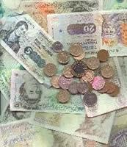
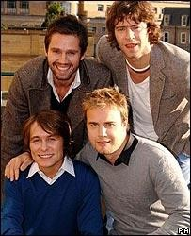
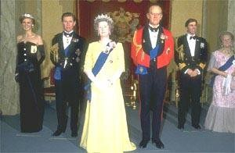
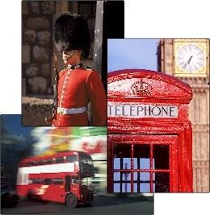
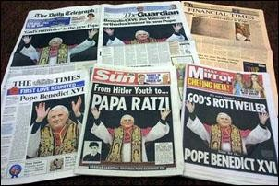
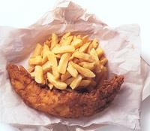
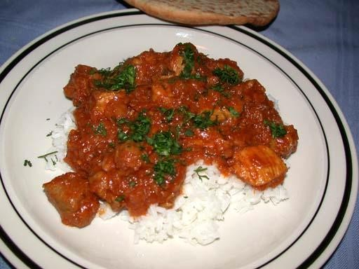
Symbols Of British Culture

Slide 15
First Impressions?
What are the first words or images that you associate with the following cultures?
Teenage
Indian
Australian
American
Irish
Chinese
Italian
Japan
When we say that we belong to a particular culture, others see that culture in a certain light. For example…..

Slide 16
Thank You
See you in the next session
What is Culture?
What is society?

Slide 17
Where do you think these
impressions come from…
Impressions come from the Media and our shared understanding.
They come from messages that are passed to us from those both inside and outside of the culture.
They come from stories and heritage.
The impressions that we get of other
cultures come from…
For example….

Slide 18
There are also sub groups of
culture
For example, girls in Britain have a different experience to boys in Britain. Therefore, each group can belong to a different culture.
What sub- groups / other cultures can you think of?

Slide 19
Defining Ourselves…
These cultures are what we define ourselves by.
We decide which group we belong to and define ourselves accordingly.
This is one of the places that stereotypes come from.

Slide 20
Defining Ourselves…
For example…. What is the stereotype
of a teacher?
Or a Goth?
A Male?
A Female
Lastly, a teenager?

Slide 21
Homework
Think about the film that you saw and the cultural differences portrayed.
Put a heading in your book – ‘Different Cultures’
Divide your page into half and put two headings – Similarities and Differences
Write a list of the cultural differences/similarities shown in the film

Slide 22
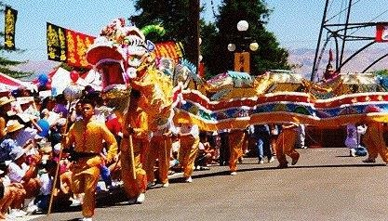
1
Chinese

Slide 23
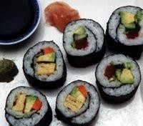
2
Japanese.

Slide 24
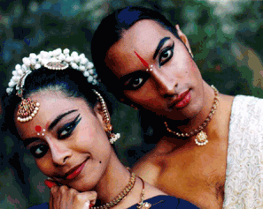
3
Indian

Slide 25
4
French

Slide 26
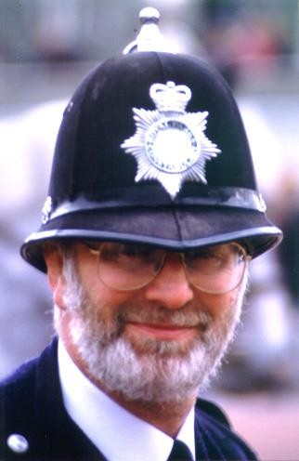
5
British

Slide 27
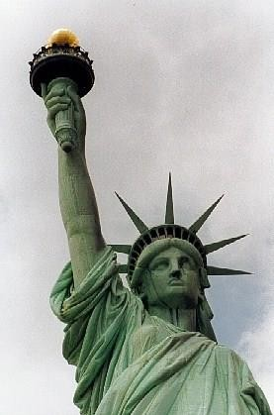
6
American

Slide 28
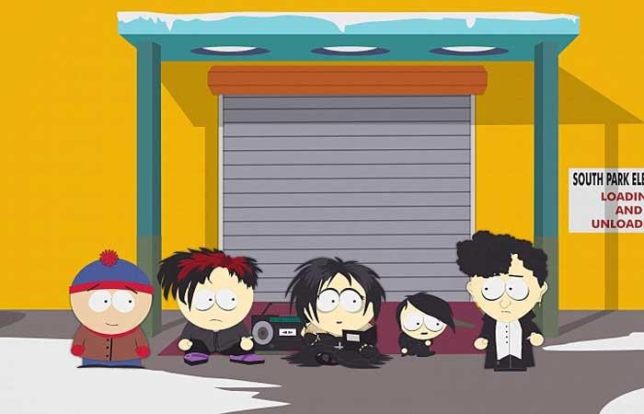
7
Goth’s ?!

Slide 29
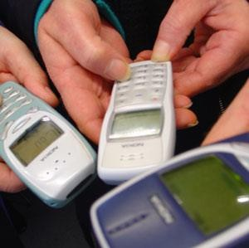
8
Teenage?

Slide 30
Today’s Lesson Objectives are:
Today’s Lesson Objectives:
To acknowledge that we are part of a culture. To know how culture operates.
To be able to define our own culture
To know different groups within our own culture.

Slide 32
What is Society?

Slide 34
Next Session
Some other aspects of Culture

Slide 35
Thank You
See You..

