Slide 1
HEPATITIS
By
Dr. Muhammad Abdullah Shwani
Assistant professor/Consultant urologist
Kurdistan Higher Council of Medical Specialties (KHCMS)
drmalshwani@mail.com

Slide 2
What is HEPATITIS?
Hepatitis refers to an inflammatory condition of the liver commonly caused by a viral infection
Viral hepatitis is a major public health problem, occurring endemically in all areas of the world

Slide 3
Types of viral hepatitis
There are 5 main hepatitis viruses, referred to as types A, B, C, D and E.
These 5 types are of greatest concern because of the burden of illness and death they cause and the potential for outbreaks and epidemic spread.

Slide 4
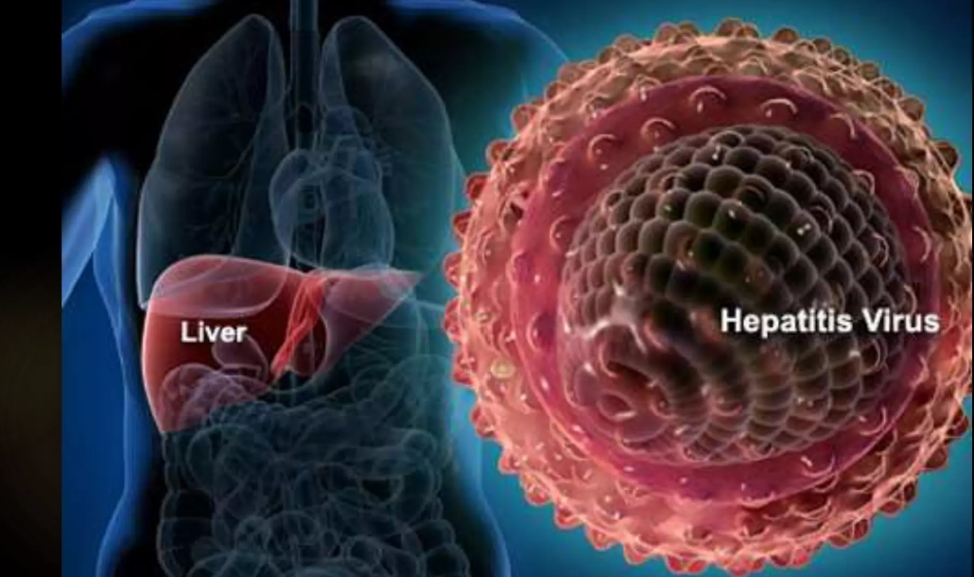

Slide 5
Causes of viral hepatitis in general
Hepatitis A and E are typically caused by the ingestion of contaminated food or water.
Hepatitis B, C, and D usually occur as a result of parenteral contact with infected body fluids.

Slide 6
Causes of Non-viral Hepatitis
Alcohol: Hepatitis can be caused by liver damage from excessive alcohol consumption. This is referred to as alcoholic hepatitis.
Drug overuse or overdose
Exposure to poisons.
Autoimmune Diseases

Slide 7
Fate of viral hepatitis
The condition can be self-limiting or
Can progress to:
  fibrosis (scarring)
  cirrhosis
  liver cancer.

Slide 8
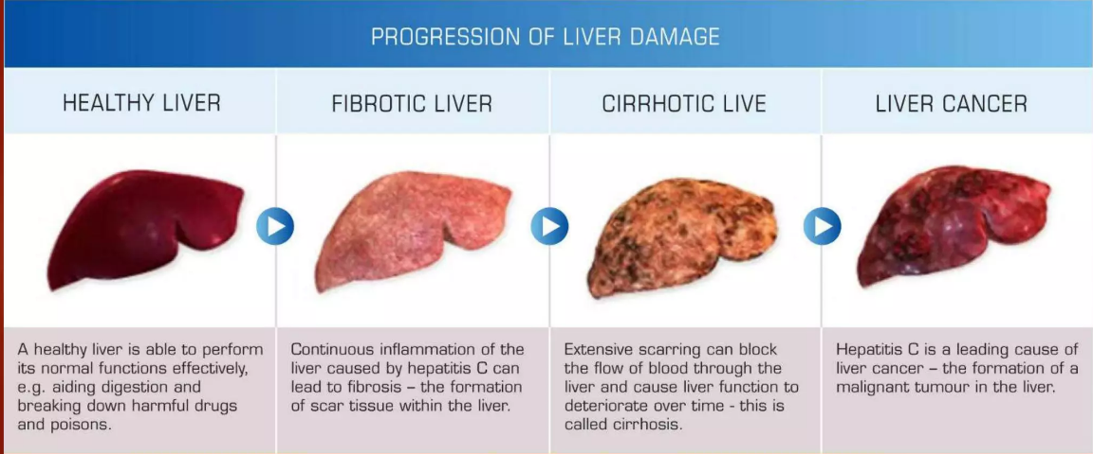

Slide 9
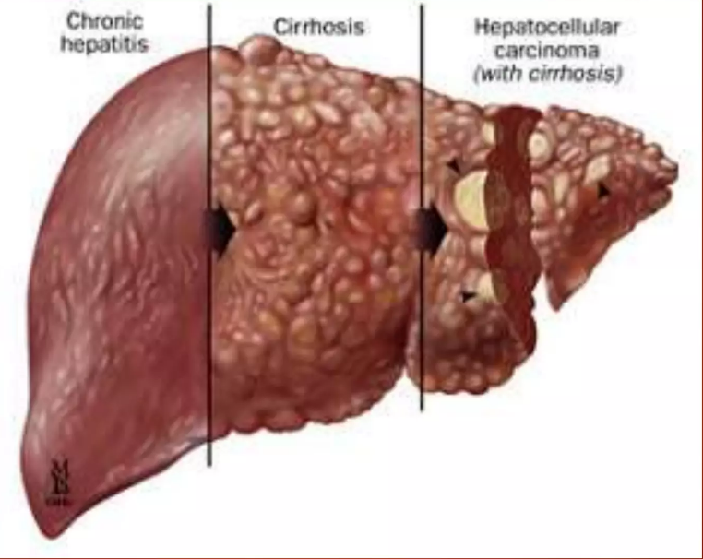

Slide 10
Clinicopathological patterns
Although structurally quite different, the Hepatitis Viruses produce similar morphological and clinical pictures.
pictures can develop depending on the timescale of infection which is largely determined by the exuberance of the immune response to the virus.
Three basic clinicopathological Patterns :
  Acute Viral Hepatitis: Strong Immune Response
  Chronic Viral Hepatitis: Absent or Low Immune Response
  Fulminant Hepatitis: Catastrophically exuberant immune response

Slide 11
Acute Viral Hepatitis
Definition:
Acute Viral Hepatitis refers to a clinicopathological pattern of disease caused by infection with Hepatitis Viruses that results in Short-term inflammation of the liver.

Slide 12
Acute viral hepatitis /Etiologies
Infection with any of the Hepatitis Viruses (HAV, HBV, HCV, HDV, HEV) can initiate acute viral hepatitis.

Slide 13
Classic clinical syndrome course
Incubation Period
prodrome Phase
Icteric
Recovery Phase

Slide 14
Incubation Period
All Hepatitis Viruses possess an incubation period where there is no clinical or serological evidence of infection.
Generally last between one to two months.

Slide 15
Prodrome
Characterized by nonspecific symptoms associated with systemic infection (constitutional symptoms-Flue–like) with malaise, fatigue, and anorexia.
Rapid viral proliferation before the development of an immune response.
Serological markers of viral proteins, as well as serum aminotransferase (ALT and AST) levels, will be elevated.

Slide 16
Icteric Phase
Clinical signs of jaundice will appear .
Right upper quadrant tenderness may develop due to enlargement of the liver.
This phase coincides with a building immune response which begins to bring the virus under control
During this period lgM antibodies to certain viral antigens begin to develop.
Constitutional Symptoms also decrease in intensity and serum aminotransferases (Liver enzymes)begin to fall.

Slide 17
Recovery Phase
During this phase, clinical signs of jaundice subside and of the most constitutional symptoms.
The immune response also matures and many of the anti-viral lgM antibodies begin to switch to the lgG subtype.
Levels of serum aminotransferases also return to normal.

Slide 18
How Is Hepatitis Diagnosed?
Physical Exam
Lab blood tests.
Abdominal Ultrasound.
Liver Biopsy

Slide 19
LAB TESTS
Liver enzymes :
  Alanine aminotransferase (ALT) and aspartate aminotransferase (AST)
    10 to 100-fold increase can be expected
Serum bilirubin:
  Hyperbilirubinemia
    Levels must approach 3mg/100ML to manifest as jaundice
Prothrombin time:
  higher the prothrombin time (pt), the more severe the hepatic damage.
4)Serological Viral Antibody Testing

Slide 20
HEPATITIS A (HAV)
Single-stranded RNA virus
Spread mainly by oral-fecal route
Incubation Period 15-50 Days
Usually disease of young but can affect adults.
Often asymptomatic illness
Usually self-limiting recovery is complete
Does not need any specific treatment
No evidence of chronic form or carrier state of HAV

Slide 21
No treatment is needed for hepatitis A since the infection almost always resolves on its own(self-limiting).
Nausea is common, though transient, and it is important to stay hydrated.
It is recommended that strenuous exercise be avoided until the acute illness is over.

Slide 22
Prevention
Two-dose Vaccine
6 Months Apart
Available Since 1994
Health Care Providers- Recommended

Slide 23
Hepatitis B virus
100 times more infectious than HIV
10 times more infectious than HCV
The most common carcinogen after tobacco in man
Can Cause Acute / And Chronic Hepatitis
Can also cause Carrier State
40 -180 Day Incubation Period
Many cases are subclinical and most are an icteric(No jaundice)

Slide 24
HBV transmistion
Hepatitis B virus (HBV) is transmitted through :
  Exposure to infective blood, semen, and other body fluids.
  From infected mothers to infants at the time of birth
  From family member to infant in early childhood.
  Contaminated instrumets during medical procedures,
  Through drug injection.
  Healthcare workers who Sustain accidental needle stick injuries while caring for infected-HBV patients.
  Absorption through mucosal surfaces of infectious secretions (Saliva Or Semen)

Slide 25
WHO IS AT GREATEST RISK FOR HBV INFECTION?
Lab personnel working with blood products.
Medical/dental personnel(3- 10% via needle stick from infected patient) .
IV drug users and abusers.
Blood product recipients.
Hemodialysis patients.

Slide 26
Clinical Features
Can be asymptomatic (subclinical)
Symptomatic case pass through 3 phases:
Prodromal phase
lcteric phase
Recovery phase
Persistence of infection beyond 6 months indicate progression to chronic phase

Slide 27
Diagnosis
Serological;
Detection of HBV antigen and antibodies.

Slide 28
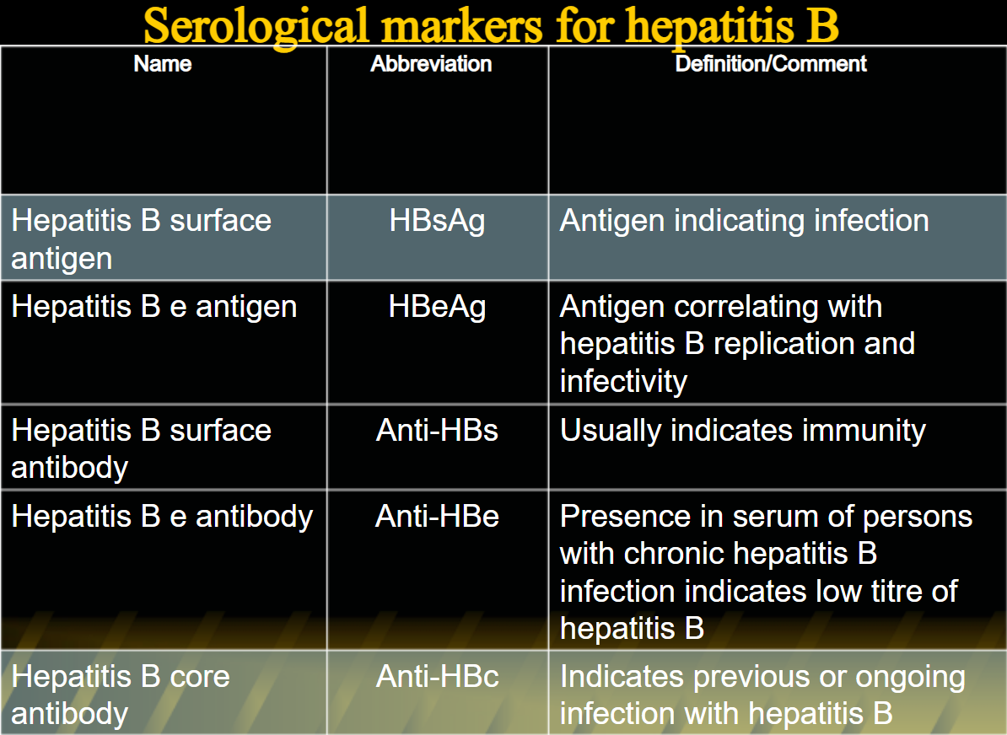

Slide 29
Outcome of Infection
Complete resolution in 6 months (95% OF ADULTS)
Chronic infection
5% of adults chronic carriers
20% of children are chronic carriers
80-90% of neonates and infants become chronic carriers

Slide 30
PREVENTION
Passive Immunity:
  Injection of immunoglobulin.
  Transferring preformed antibodies from an immunized host to A person in need of immunity
  Protection is transitory, but onset is immediate

Slide 31
Active immunity
Using HBV vaccine
  Act by stimulating own immune response using HBV vaccine
  Protection after latent period
  Long-term immunity is provided

Slide 32
Treatment
For hepatitis B, treatment is aimed at controlling the virus and preventing damage to the liver
Antiviral medications are available that will benefit the most people, and the treatment needs to be monitored carefully

Slide 33
Hepatitis c virus
Single-stranded RNA virus
HCV may produce ~1 trillion new viral particles each day
A global health problem affecting over 170 million people worldwide.
Is a leading cause of end-stage liver disease and hepatocellular carcinoma.
Spread Mainly By Parental Route
Accounts For 90-95% Of Post Transfusion Hepatitis

Slide 34
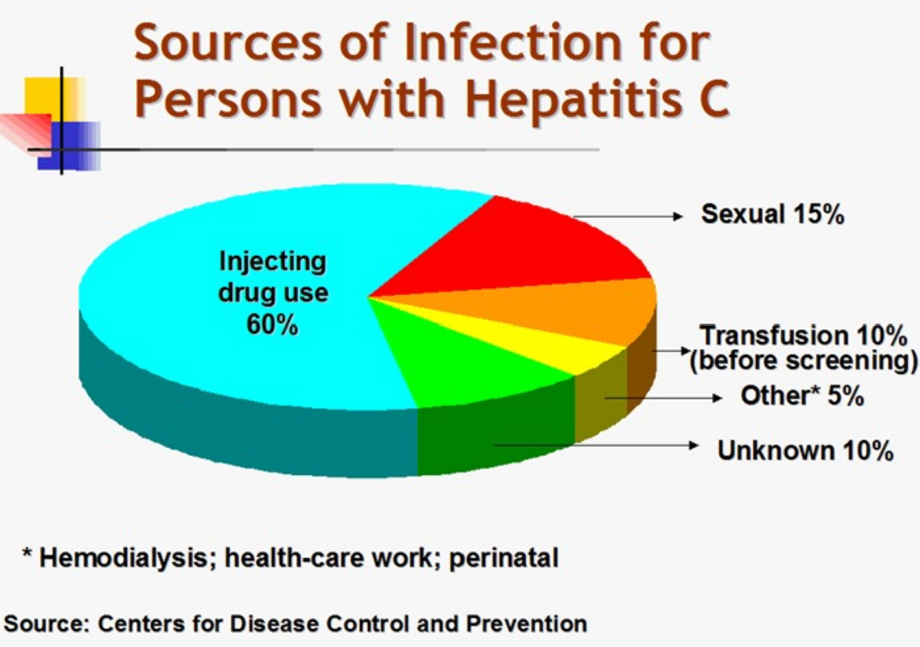

Slide 35
Clinical features
30-180 day incubation period
Acute infection can be asymptomatic.
Symptomatic cases present through 3 clinical phases
Outcome UP TO 90% = CHRONIC CARRIERS

Slide 36
Diagnosis
HCV antibody
HCV RNA (PCR)
A positive antibody test should be repeated for confirmation

Slide 37
Treatment
Treatment of chronic hepatitis C has evolved
The drugs currently used (as of March 2016) are:
    pegylated interferon ribavirin, elbasvir, grazoprevir, ombitasvir, dasabuvir, simeprevir, daclatasvir.
These are always Used in various combinations, never alone.
Interferon is given by injection while the other medications are pills.
Studies have shown that combinations of these drugs can cure all patients

Slide 38
Complications of viral hepatitis
HAV - Relapse; In Rare Cases - Fulminant Hepatitis
HBV - Chronic Liver Disease Including,
  Cirrhosis
  Primary Hepatocellular Carcinoma
  Fulminant Hepatitis
HCV - Chronic Liver Disease Including
  Cirrhosis
  Primary Hepatocellular Carcinoma

Slide 39
Dental Management
Difficult to identify all patients through history, many acute cases of Hep B and C are mild.
MUST use universal precautions for all.
Screening is recommended for patients from high-risk groups.

Slide 40
Guidelines for blood exposure From patients
with
Hepatitis B:
Determine the titer of anti-HBs in the healthcare professional :
  If adequate: no treatment is needed
  If inadequate give Hepatitis B Immunoglobulin

Slide 41
From patients with hepatitis C
  Exposed professional gets baseline and follow-up testing for anti-HCV and liver enzymes.
From patients with unknown
  Ask for serological testing of the patient.

Slide 42
The presence of HCV-RNA in saliva
The presence of HCV-RNA in saliva provides a biological basis for saliva as a possible source of HCV infection
Dentists were at a high risk of infection due to the procedures and instruments for dental treatment.

Slide 43
Chronic Viral Hepatitis
Definition
Chronic Viral Hepatitis refers to a clinicopathological pattern of disease caused by infection with certain Hepatitis Viruses that results in greater than 6 months of hepatic inflammation and injury.

Slide 44
Fulminant Hepatitis
Definition
Fulminant Hepatitis is a complication of acute viral hepatitis that manifests as rapid functional decompensation of the liver.

Slide 45
Etiology and Pathogenesis
It is rare during hepatitis A or C virus infection.
Most cases are due to Hepatitis B Virus infection with or without Hepatitis D Virus.
It is most likely the result of a massive immune response to the presence of the virus, resulting in rapid inflammatory damage to the liver.

Slide 46
Clinical Consequences
Fulminant Hepatitis is characterized by certain signs of hepatic failure :
  Hepatic Encephalopathy: Characterized by altered mental status, confusion, or coma.
  Hepatorenal Syndrome: Which may result in acute renal failure Generalized edema: Due to rapid hypoalbuminemia
  Prolonged Prothrombin Time (PT) : Due to reduced synthesis of coagulation proteins
  Jaundice: Due to hyperbilirubinemia
Prognosis:
  Fulminant Hepatitis has a high degree of mortality and is rapidly fatal.

Slide 47
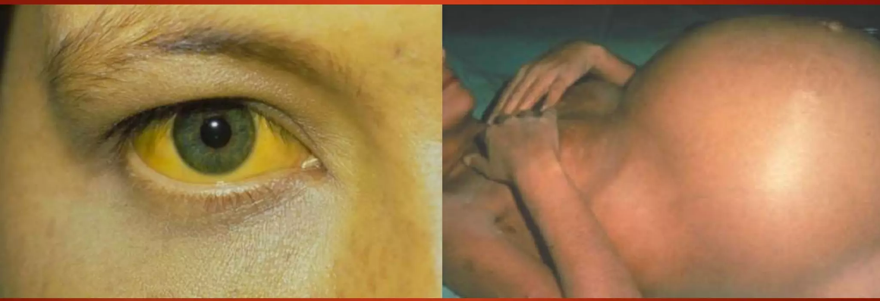

Slide 48
THANK YOU

