Slide 1
Injections
By
Dr. Muhammad Abdullah Shwani
Assistant professor/Consultant urologist
Kurdistan Higher Council of Medical Specialties (KHCMS)
drmalshwani@mail.com

Slide 2
IM, IV, subcutaneous injections
Objectives
• indications
• contraindications
• technique

Slide 3
Routes of giving medications
• oral (Tablets, Capsules, Syrups)
• local (ointments, creams, lotions)
• parenteral :
• intramuscular
• Intravenous
• Subcutaneous
• intradermal
• intra arterial

Slide 5
Intramuscular ( IM )
Indications:
1) drug factor :
• rapid absorption
• bypassing first pass metabolism of GIT
• depot administration
2) patients factors:
• non-compliant
• uncooperative
• reluctant
• cant take drugs orally
• cant tolerate oral medications

Slide 6
Intramuscular( IM )
Contraindications :
• low platelet count or coagulopathy
• Shock
• myopathy or muscle atrophy
• myocardial infarction
• site of the injection pathology

Slide 7
• Site of injection :
• deltoid
• lateral thigh
• gluteal
• Technique :
• aseptic measures
• 90 degree angle
• Z line technique
• upper lateral quadrant

Slide 8
Intravenous (IV)
• Indications:
Rehydration
providing nutrients
medications :
• rapid effect
• bioavailability 100%
• emergencies
• drugs causing tissue necrosis, pain, and plaque if given by IM route
blood products
electrolyte replacement
imaging

Slide 9
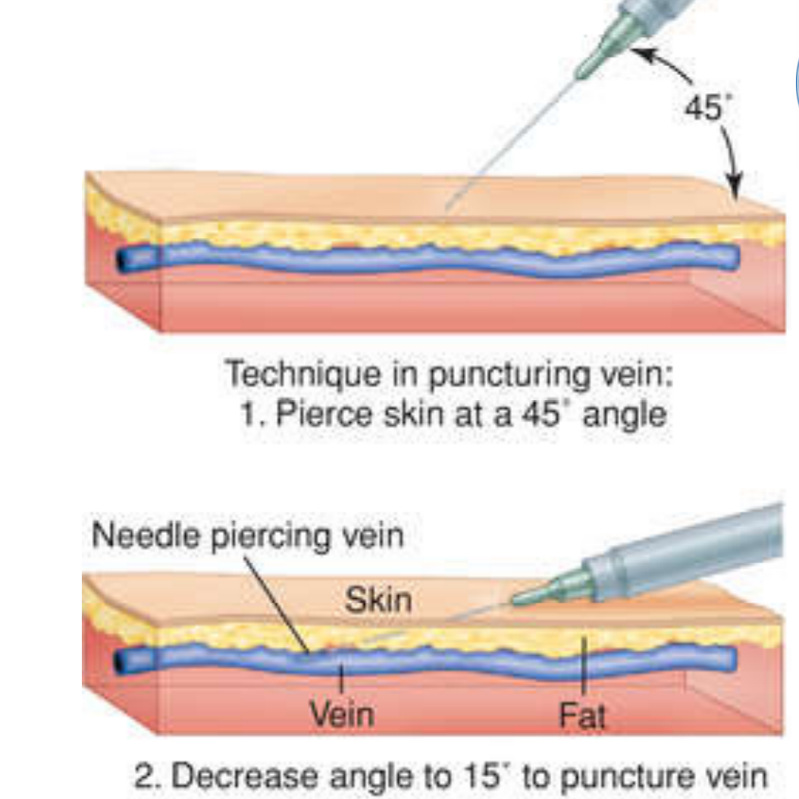
Contraindication
• drugs strongly stimulating CVS
• Oily drugs
• uncooperative patients
Technique:
•aseptic measures
• finding a vein
• Bolus or infusion
• direct iv or via venous cannula

Slide 10
Subcutaneous (SC )
• Indications:
slow absorption depot effect
insulin
heparin
monoclonal antibodies
morphine
vaccines ( BCG, MMR,etc..)

Slide 11
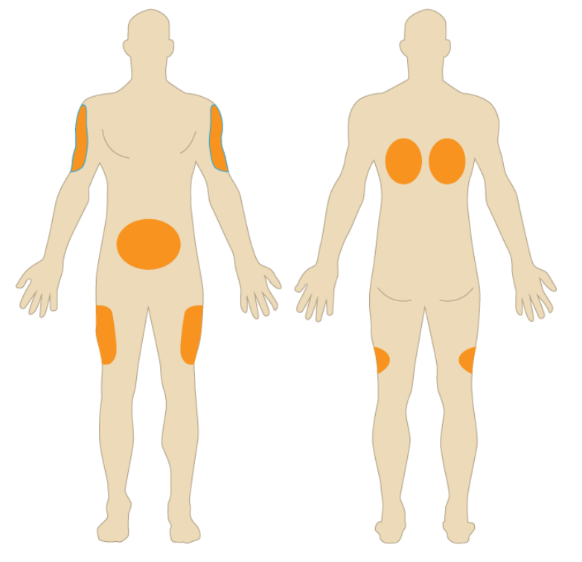
Contraindication:
• if > 2 ml needed to be injected
• medications causing necrosis
Technique:
• site
• aseptic measures
• type of the needle ( needle, injector pen, pump )
• angle

Slide 18
https://www.youtube.com/watch?v=xIutkc2Yxig

Slide 19
Thank you

