Slide 1
Female reproductive organ
Goran N. Saleh
Anatomy Practical II
First Semester
4th Week
12-2023

Slide 2
Component Parts
Internal female reproductive organs
External female reproductive organs

Slide 3
External female reproductive organs
Collectively, the external female reproductive organs are called the Vulva.
Which means covering
Function: protect the urethral and vaginal openings

Slide 5
External Female Structures (Vulva)
Mons Pubis.
Labia Majora & Minora.
Clitoris.
Vestibule.
Perineum

Slide 6
Internal Female Reproductive Organs
Vagina
Uterus
Fallopian tubes
Ovaries

Slide 7
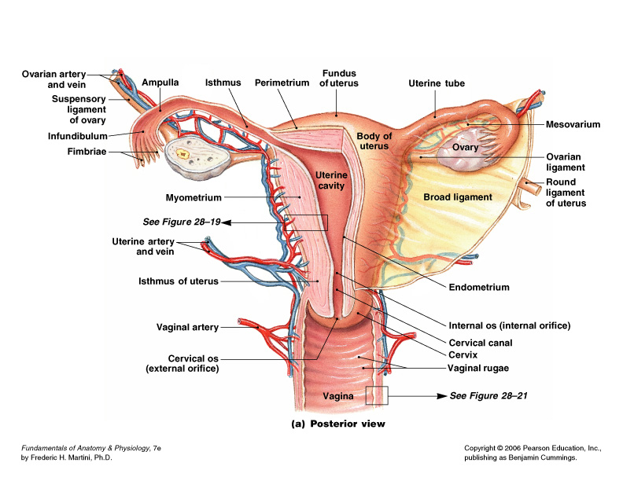

Slide 10
Thank you

