Slide 1


Lecture 1:
Numbers
Logical Operators
Significant Figures
Scientific Notation
Factorial
Ms. Togzhan Nurtayeva
Course Code: IT 161/A
Semester 1
Week 1-2
Date: 10.12.2023

Slide 2
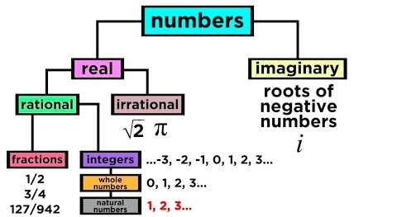
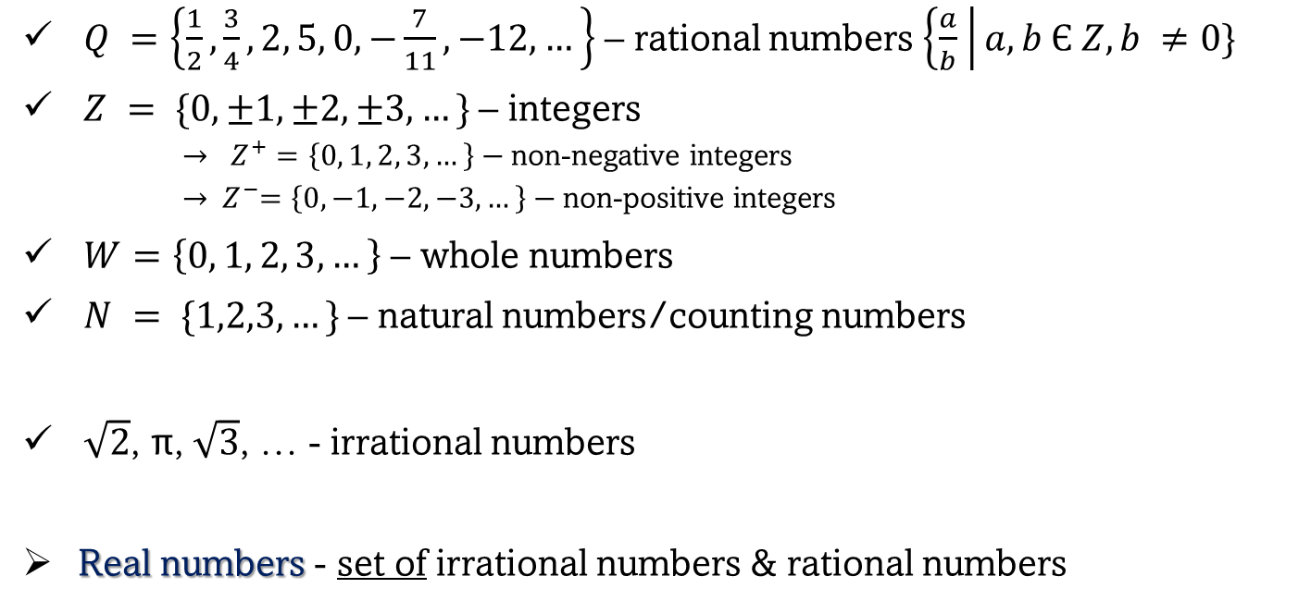
Number Classifications
$Q =\left\{\frac{1}{2}, \frac{3}{4}, 2, 5, 0, −\frac{7}{11}, −12, …\right\}$ – rational numbers $\left\{\frac{a}{b} \right|a,b Є Z, b ≠0\}$
$Z = \{0, ±1, ±2, ±3,…\}$– integers
  $→ Z^{+}=\left\{0, 1, 2, 3, …\right\}−$non-negative integers
  $→{ Z}^{−}=\left\{0, −1, −2, −3, …\right\}−$non-positive integers
$W=\left\{0, 1, 2, 3, …\right\}$ – whole numbers
$N = \{1,2,3,…\}$– natural numbers/counting numbers
$\sqrt{2}$, π, $\sqrt{3}$, … - irrational numbers
Real numbers - set of irrational numbers & rational numbers

Slide 3
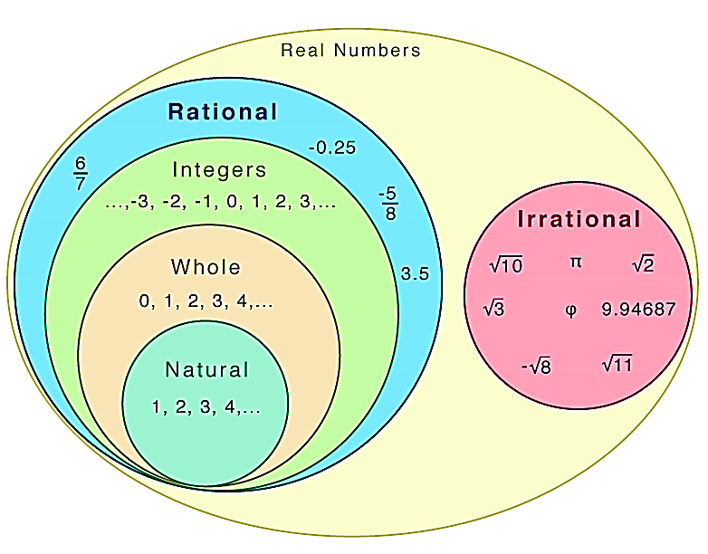

Slide 4

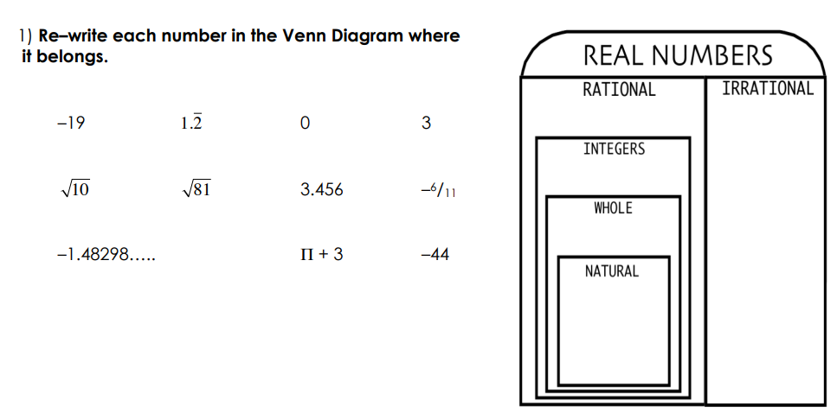

Slide 5
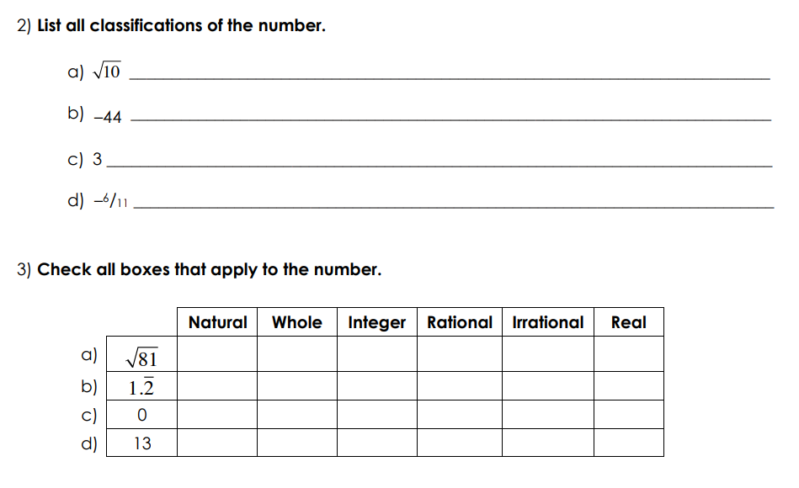


Slide 6
Types of Numbers
Even
Odd
Prime
Composite
Perfect

Slide 7
Types of Numbers
Even
Odd
Prime
Composite
Perfect
A number that can be exactly divided by 2.
Even numbers always end up with the last digit as 0, 2, 4, 6 or 8.
The general form of even numbers is given by $2k$, where $k∈Z$

Slide 8

Ahmad has 30 pencils. He distributed 14 of those among his friends. Will he have an even number of pencils left? How do you know?
When you buy a dozen bananas, are you getting an even number or an odd number of bananas?
State true or false: 0 is an even number.
Select the pair of consecutive even numbers from the following:
24 and 28
91 and 93
84 and 86
39 and 42
Select the even numbers from the following:
a.) 778
b.) 912
c.) 223

Slide 9
Types of Numbers
Even
Odd
Prime
Composite
Perfect
A number which is not divisible by 2.
An odd number always ends in 1, 3, 5, 7, or 9.
The general form of odd numbers is given by $2k+1$, where $k∈Z$

Slide 10
Determine whether 135 is an odd number or not.
Is 350 an odd number or an even number?
State true or false with respect to odd numbers.
a.) The sum of two odd numbers is always an even number.
b.) The smallest odd number is 5.
c.) 9 is an odd number.
Will the sum of 23 + 35 result in an odd number?
Answer the following questions with reference to odd numbers:
a.) 1 is odd or even?
b.) Which is the smallest 4 digit odd number?
c.) What is the sum of any two odd numbers?
d.) Is 2 an odd number?

Slide 11
Types of Numbers
Even
Odd
Prime
Composite
Perfect
A natural number that are divisible by only 1 and the number itself.
Ex: 2, 3, 5, 7, 11, 13, …

Slide 12
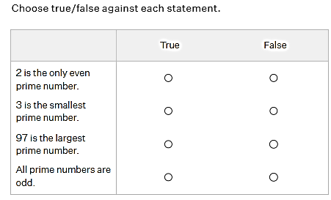
Which of the two numbers is a prime number, 13 or 15?
Which of the following numbers is a prime number?
4
10
33
43
Why is 20 not a prime number?
State true or false with respect to prime numbers.
a.) 1 is a prime number.
b.) The only even prime number is 2.
c.) The first five prime numbers are 2, 3, 5, 7, and 9.
d.) All prime numbers are odd.

Slide 13
Types of Numbers
Even
Odd
Prime
Composite
Perfect
A natural number or a positive integer which has more than two factors.
Ex: 15 has factors 1, 3, 5 and 15.
Always remember that 1 is neither prime nor composite

Slide 14
Which of the following is a composite number?
Aya is listing all the composite numbers between 3 and 10. Can you help her choose the correct option?
4, 6, 8, 9
4, 9
4, 5, 6, 7, 8, 9
4, 8, 9
34
31
39
Fill in the blanks:
a.) The smallest composite number is __.
b.) The smallest odd composite number is __.
The smallest composite number is 2.
True
False
State true or false with respect to composite numbers.
a.) All even numbers are composite numbers.
b.) 1 is a composite number.

Slide 15
Types of Numbers
Even
Odd
Prime
Composite
Perfect
A positive integer that is equal to the sum of its positive factors, excluding the number itself.
Ex: 6, 28, 496, 8128, 33550336, …
All the perfect numbers are also complete numbers.

Slide 16
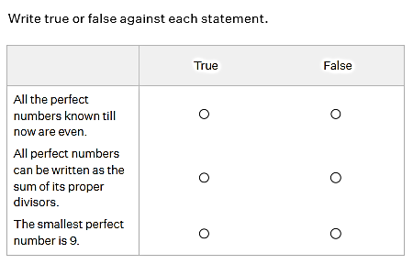
Is 28 a perfect number?
Check whether the given numbers are perfect numbers or not by finding the sum of their factors:
a.) 8
b.) 25
Select the perfect numbers from the following.
5
6
32
28
9
State true or false:
a.) Perfect numbers are the positive integers that are equal to the sum of its factors except for the number itself.
b.) All the perfect numbers are odd numbers.
Notes:
Perfect Numbers: 1) Yes 2) a) No, b) No 3) a) True b) False

Slide 17
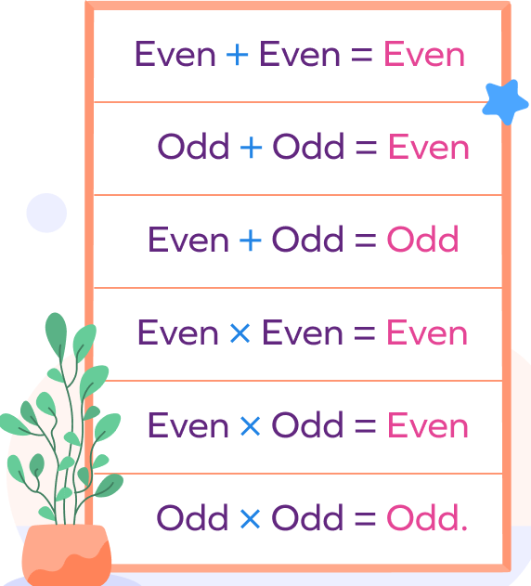


Slide 18
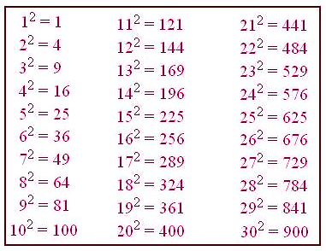
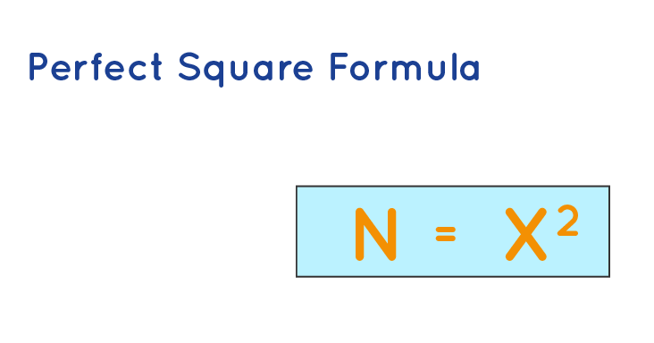
Perfect Square Numbers
Perfect squares are the squares of a whole number (when a number is multiplied by itself two times).

Slide 19
Is 100 a perfect square number?
Which of the following is not a perfect square?
900
800
400
100
In an auditorium, the number of rows is the same as the number of columns. If there are 60 chairs in a row, how many chairs are there in the auditorium?
What will be the area of a square having a side of 16 meters?
What smallest whole number is to be added to 75 to make it a perfect square?

Slide 20
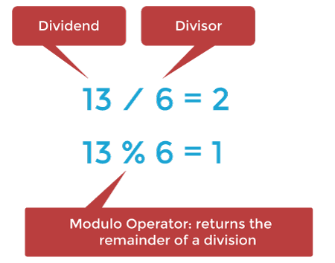


Modulo Operator
Mod is also known as modulus or modulo.
It gives the remainder after dividing one number by another number.
Modulus of any real number $x$ will always give positive value as it's output.

Slide 21









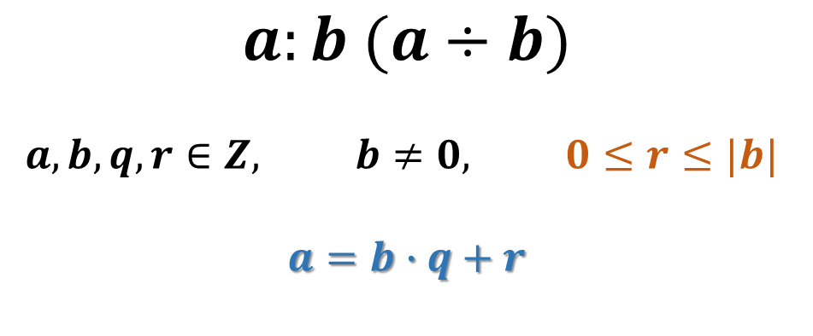






$a:b$ $(a÷b)$
$$a, b, q, r∈Z, b≠0, 0≤r≤|b|$$
$a=b∙q+r$
$$27 mod 4=27:4⟹$$
$$4∙6+3$$
$$113:\left(−3\right)⟹$$
$$−37∙\left(−3\right)+2$$
$$3∙\left(−7\right)+6$$
$$−15:4⟹$$
$$−3∙4+\left(−3\right)=−15$$
$$−15:\left(−7\right)⟹$$
$$−1∙9+4$$
$$−5 mod 9=$$
$0≤r≤|b|$
$$−3∙9+8$$
$$−19 mod 9=$$
$$−15:4⟹$$
$$−4∙4+1=−15$$

Slide 22
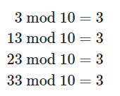
What is -6 mod 18 ?
= 12
What is -29 mod 4?
= 3
What is -4 mod 9?
= 5
What is -29 mod 3?
= 1
-9 mod 9
= 0
What is 6 mod 18?
= 6
What is -9 mod 6?
= 3
-8 mod 9
= 1
What is 9 mod -6?
= 3
What is -13 mod 1?
= 0
-7 mod 9
= 2
What is 4 mod 9?
= 4
What is 17 mod 7?
= 3
-4 mod 9
= 5
What is -6 mod 18?
= 12
What is -49 mod 5?
= 1
-2 mod 9
= 7
= 1
What is 7 mod 6?
-1 mod 9
= 8
What is -14 mod 2?
= 0

Slide 23





Find the largest negative integer that when divided by nine leaves a remainder of one.
$$10:9=1∙9+1$$
$$1:9=0∙9+1$$
$$−8:9=−1∙9+1$$
The largest negative integer is $−8$ .
When a certain integer is divided by 12, the remainder is 5. What remainder is obtained when this number is divided by 4?

Slide 24

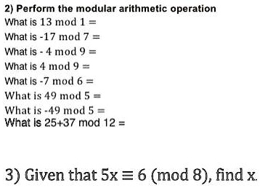

1)
What is the remainder value:
108 is divided by 3.
129 is divided by 7.
Find the product $23∙43$ modulo 8
Find 11 mod 8.
Find -3 mod 8.
Find 49 mod 5.

Slide 25




MOD in programming languages and calculators
Many programming languages, and calculators, have a mod operator, typically represented with the % symbol. If you calculate the result of a negative number, some languages will give you a negative result.
-5 % 3 = -2
Modulus of any real number $x$ will always give positive value as it's output.

Slide 26
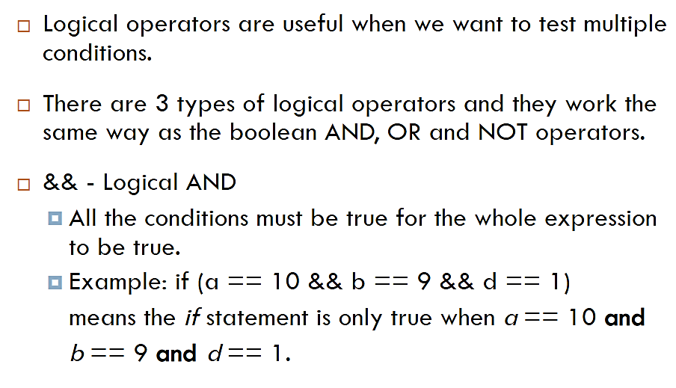
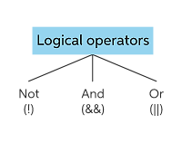
Logical Operators

Slide 27
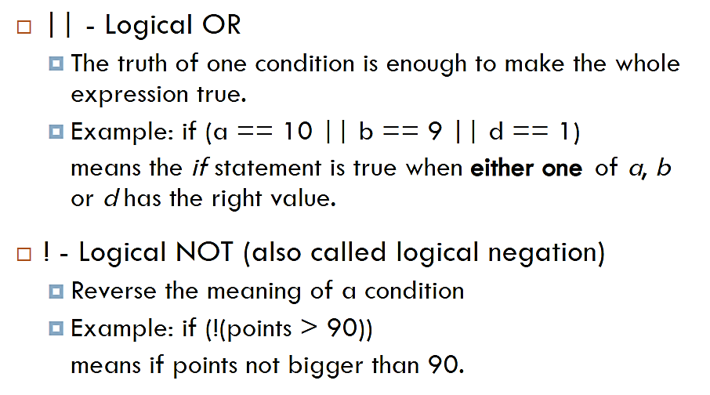

Logical Operators

Slide 28

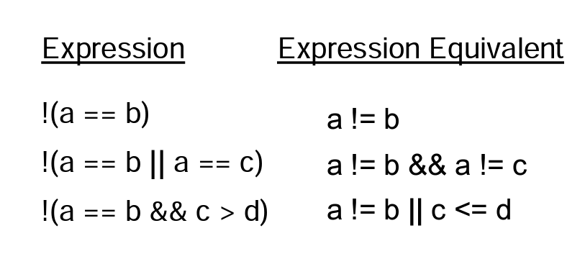
Logical Operator

Slide 29


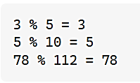
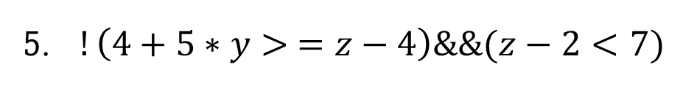
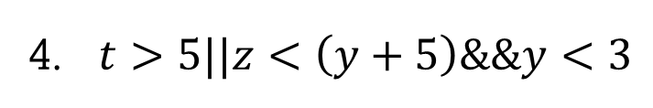
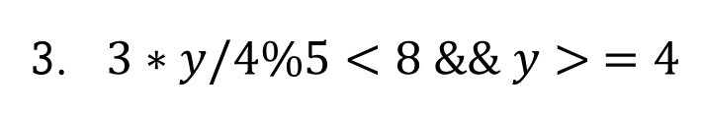
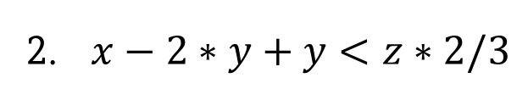
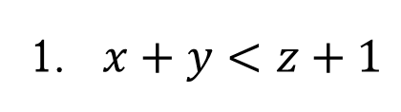
Answer for the following questions: True or False
If $x=−2, y=5, z=0,$and $t=−4$, what is the value of each of the following expressions:
1. $x+y<z+1$
2. $x−2∗y+y<z∗2/3$
If the numerator is smaller than the denominator, then the remainder is equal to the numerator. 3 % 10 =3
3. $3∗y/4\%5<8 \&\& y> =4$
4. $t>5||z<\left(y+5\right)\&\&y<3$
5. $!\left(4+5∗y> =z−4\right)\&\&(z−2<7)$

Slide 30
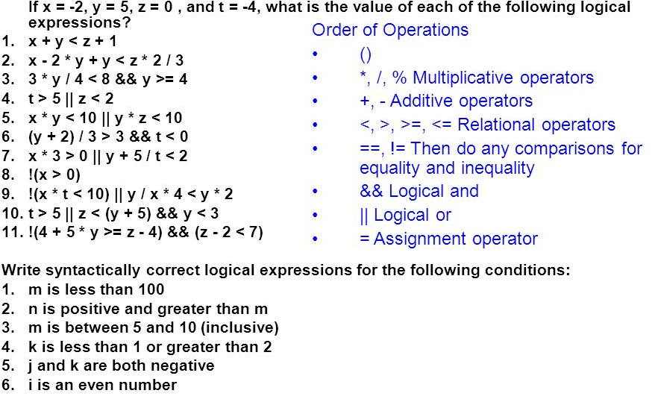




Slide 31

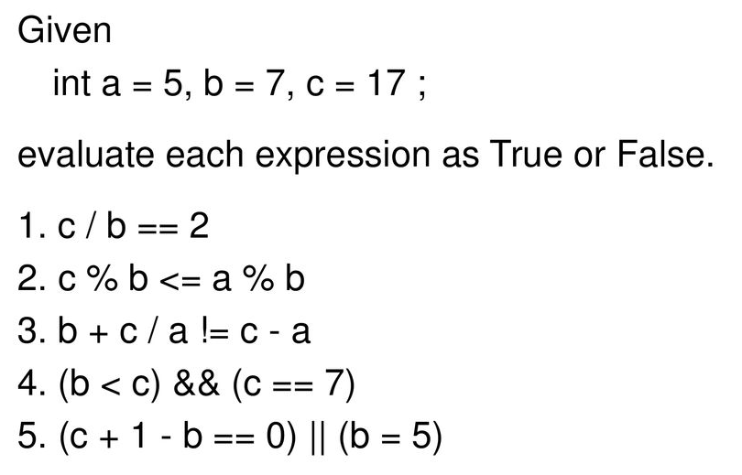


Slide 32
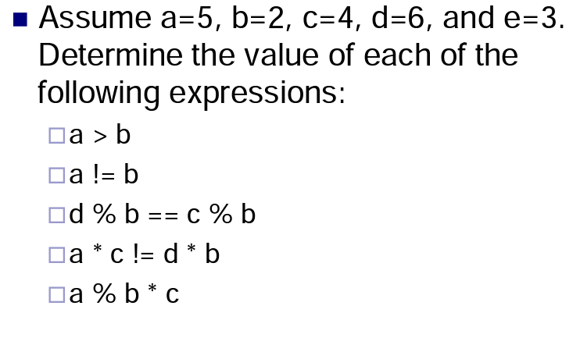
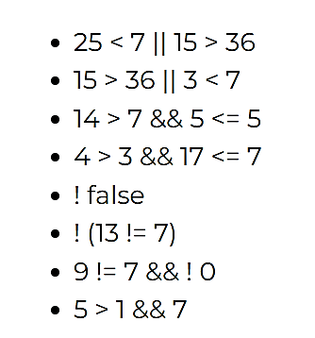



Slide 33

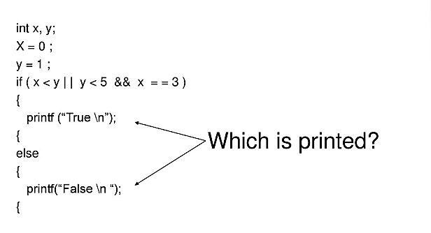

Slide 34

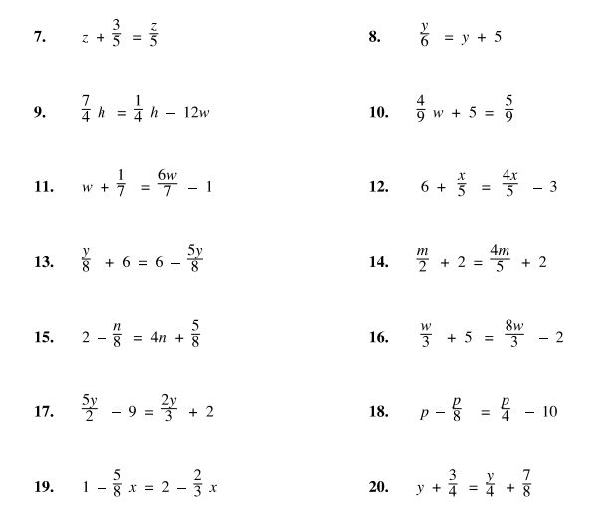

Slide 35

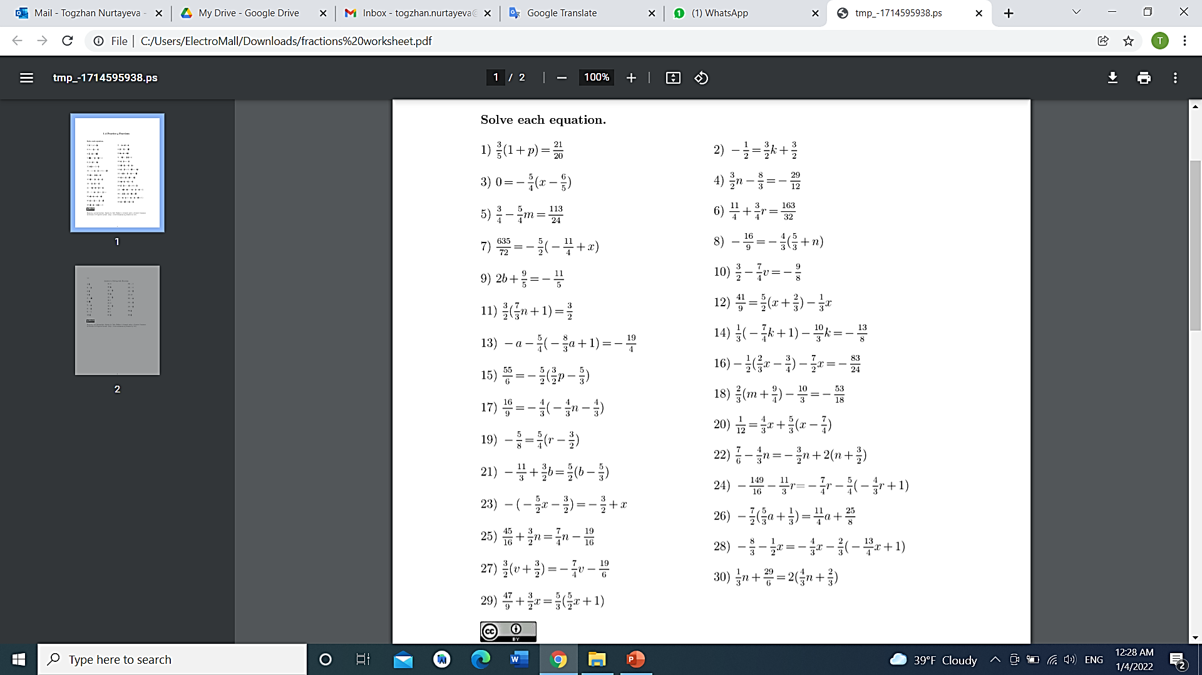
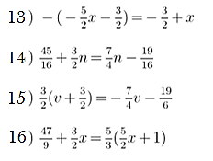
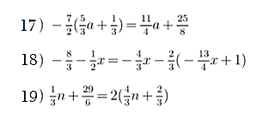

Practice

Slide 36
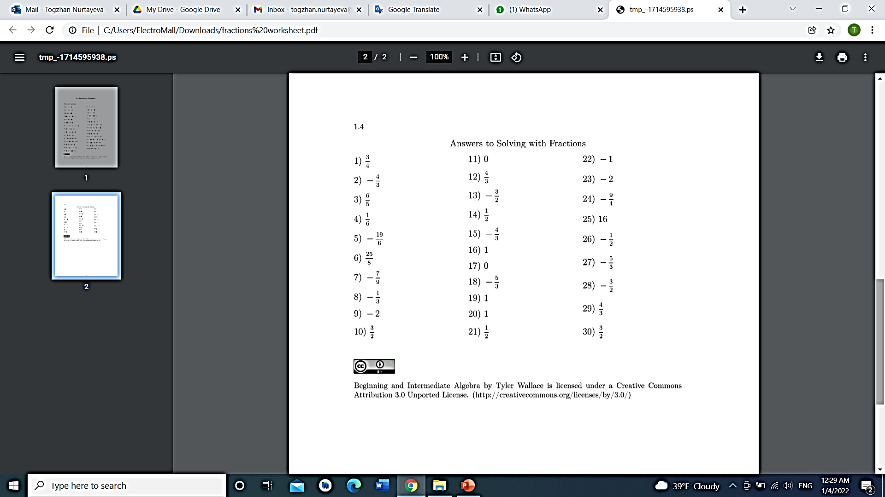








Answers to check

Slide 37


Significant figures are important to show the precision of your answer. This is important in science and engineering because no measuring device can make a measurement with 100% precision. Using Significant figures allows the scientist to know how precise the answer is, or how much uncertainty there is.
2002 has two significant zeroes, but 0.0103 has only 1 significant zero.

Slide 38
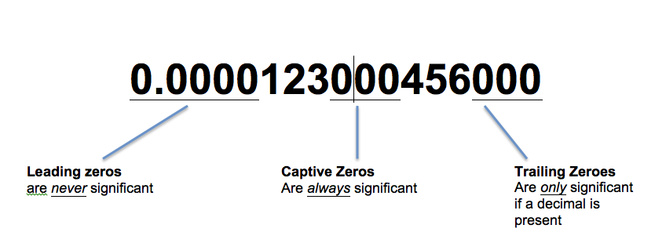
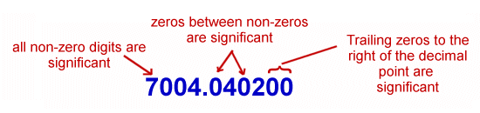
Significant Figures
The number of digits counted to the right from the leftmost positive digit is called the number of significant figures. For example,
26.103, 0.00304, 202.000 and 0.003040 are quoted to 5, 3, 6, 4 significant figures respectively.

Slide 39
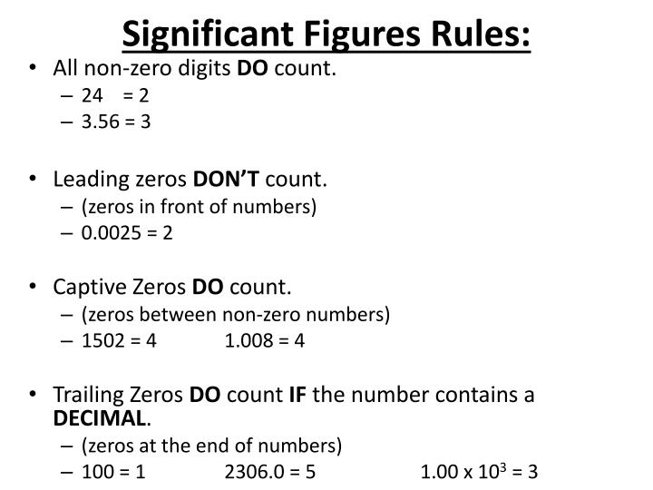


Slide 40
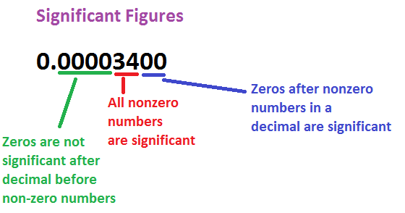
Sometimes, you'll be asked to round with significant figures. Significant figures have to do with the number of digits known with a degree of certainty. Keeping track of this number is important when gathering data from an experiment because it minimizes error. Here are the rules for significant figures:
1. All nonzero digits are significant.
2. All zeroes between nonzero digits are significant.
3. Trailing zeroes to the right of a decimal point are significant.
4. Leading zeroes to the left of the first non-zero number are not significant.
Here are some examples. Can you see which rule applies?
1.23 has _____________ figures
1001 has ____________ figures
2.03 has ____________ figures
0.033 has ____________ figures
0.20 has _______________ figures
3 significant
4 significant
3 significant
2 significant
2 only significant

Slide 41
1. Find the number of significant figure in each of the following:
(a) 7.3
(b) 162.5 m
(c) 306 g
(d) 3.57 m
(e) 7.005 kg
(f) 0.045 km
(g) 0.00234 l
(h) 82.030 mg
2. Round off each of the following correct up to 3 significant figures:
(a) 56.4517 g
(b) 5.20763 kg
(c) 33.311 km
(d) 50.001 cm
(e) 0.0012485 m
(f) 0.0013020 l

Slide 42
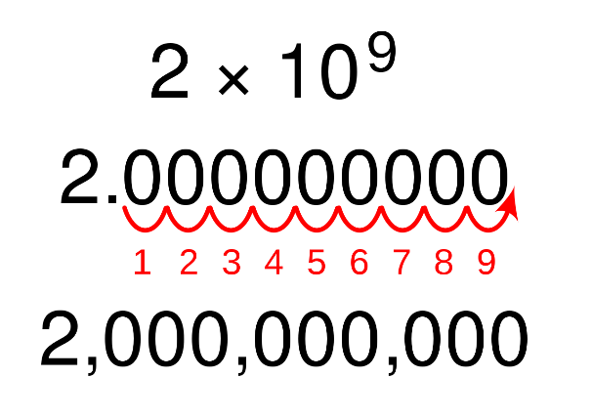
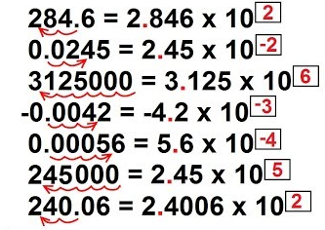
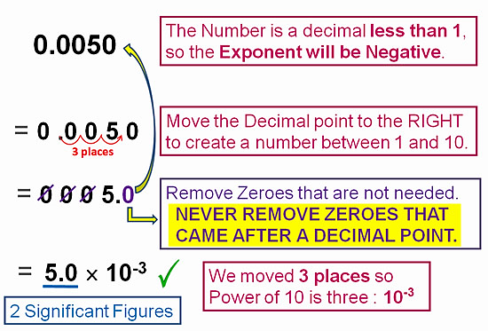
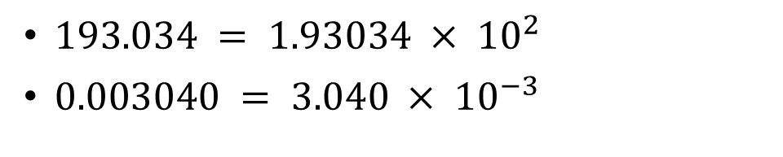
Scientific Notation
$193.034 = 1.93034 × {10}^{2}$
$0.003040 = 3.040 × {10}^{−3}$

Slide 43

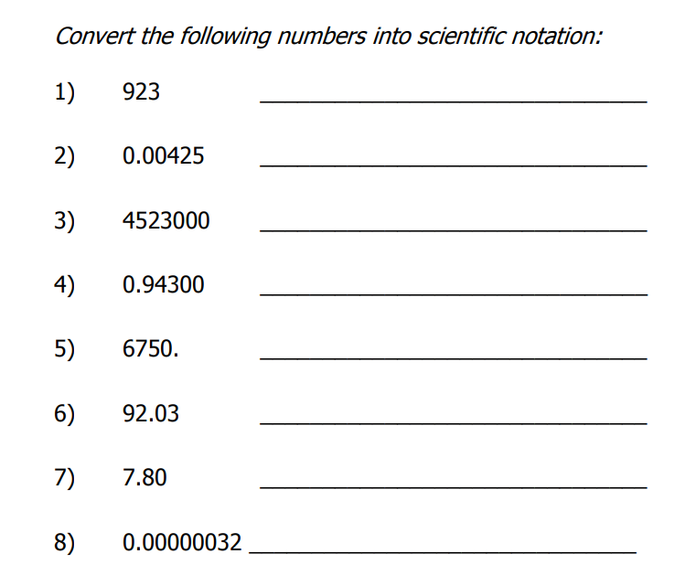
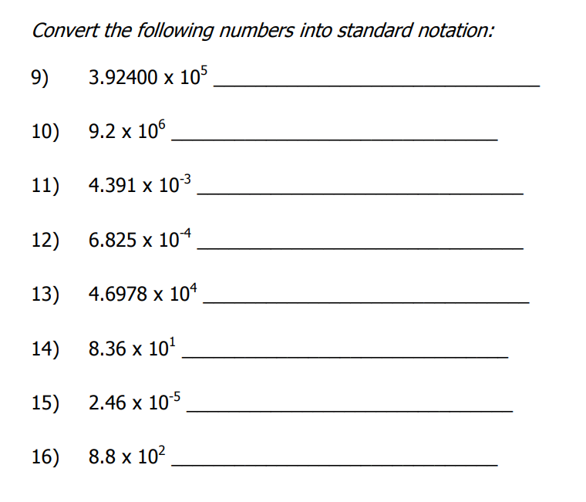
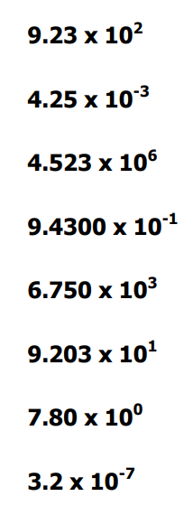
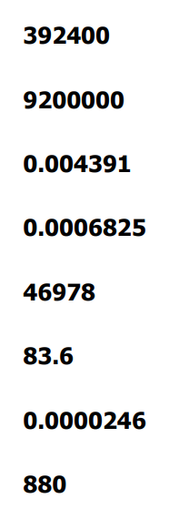

Slide 44

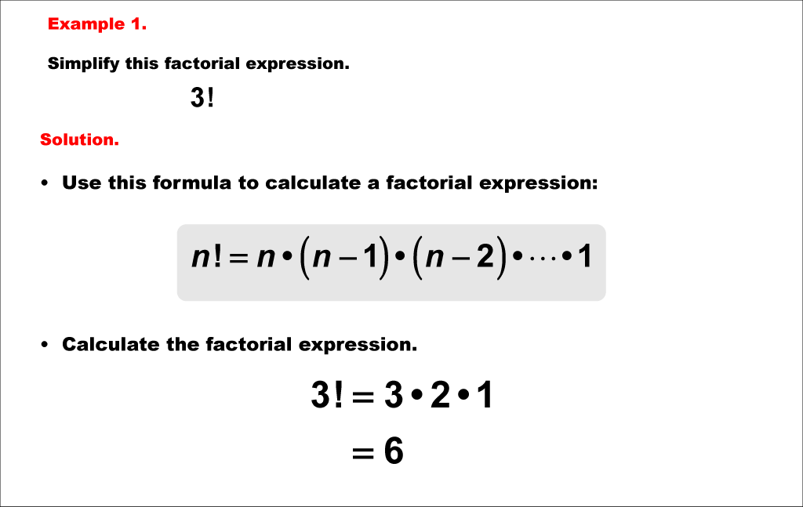

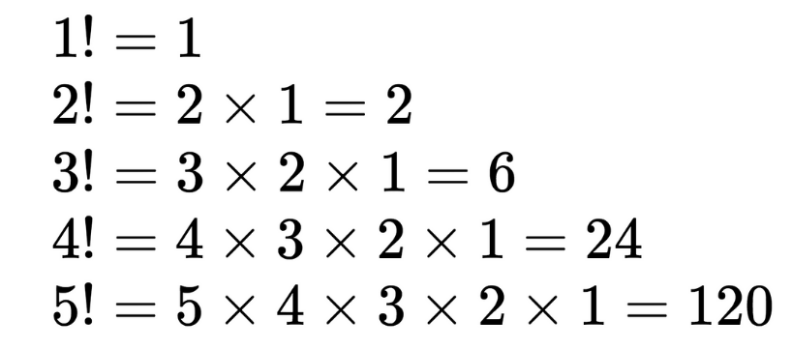

Factorial
exclamation mark
$$0!=1$$
Notes:
Remember: 0! = 1

Slide 45


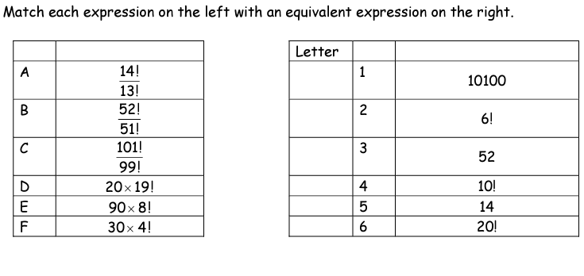
Notes:
Answer: (A,5) , (B,3) , (C,1) , (D,6) , (E,4) , (F,2)

Slide 46
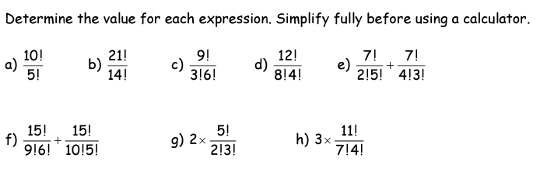



Notes:
Answer: a) 30240 b) 586051200 c) 84 d) 495 e) 56 f) 8008 g) 20 h) 990

Slide 47









Slide 48




Slide 49



What makes a good life? Lessons from the longest study on happiness
Robert Waldinger
What keeps us healthy and happy as we go through life?
https://www.youtube.com/watch?v=8KkKuTCFvzI

