Slide 1
Molecular Biology & Proteomics Genomic And Proteomic Technologies
Dr. Ahmad H. Ibrahim
338
Semester 1
Week 10
Date 10/12/2023

Slide 2
Outline
Understanding Repressor-DNA Interaction Specificity:
Students will grasp the fundamental concept that the specificity of repressor-DNA interactions relies on recognition helices and amino acids.
Recognition helices lying in the major groove of the operator will be highlighted as a critical structural element.
Appreciating the Role of Amino Acids in Binding Specificity:
Students will learn how certain amino acids on the DNA side of the recognition helix establish specific contacts with bases in the operator.
The importance of these contacts in determining the overall specificity of protein-DNA interactions will be emphasized.

Slide 3
Outline
Exploring Mutagenesis Techniques in Probing Specificity:
The concept of site-directed mutagenesis will be introduced as a tool to probe binding specificity.
Students will understand how changing specific amino acids in the recognition helix can alter the specificity of the repressor.
Comparative Analysis of l Repressor and Cro:
A comparative analysis of the l repressor and Cro, highlighting differences in amino acids and binding motifs, will be presented.
Microspecificities for OR1 or OR3 will be discussed, demonstrating how interactions between amino acids and base pairs determine these specificities.

Slide 4
Objectives
Comprehend Repressor-DNA Interaction Basics:
Provide a foundational understanding of how repressors recognize and interact with DNA in the context of the major groove and recognition helices.
Analyze Amino Acid Contributions to Binding Specificity:
Explore the role of specific amino acids on the DNA side of the recognition helix and how they contribute to the specificity of protein-DNA interactions.

Slide 5
Objectives
Master the Principles of Site-Directed Mutagenesis:
Familiarize students with the principles and applications of site-directed mutagenesis in probing and manipulating the specificity of repressor-DNA interactions.
Distinguish Microspecificities in l Repressor and Cro:
Illustrate how the l repressor's extra motif (amino-terminal arm) influences its binding by embracing DNA, and how this contributes to microspecificities for OR1 or OR3.
Emphasize the role of different amino acids in recognition helices and base pairs in determining these specificities.

Slide 6
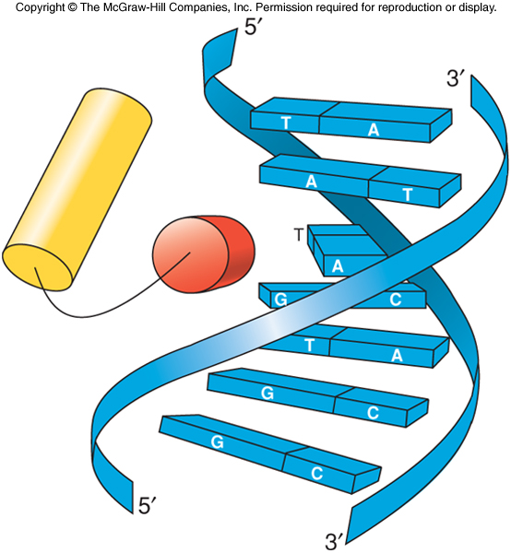
The λ Family of Repressors
Repressors have recognition helices that lie in the major groove of appropriate operator
Specificity of this binding depends on amino acids in the recognition helices

Slide 7
What is A repressor
A repressor is a type of protein that can regulate gene expression by binding to a specific DNA sequence known as the operator. This binding typically prevents the transcription of the adjacent gene or genes. Repressors are a key component of regulatory systems in cells, helping to control when and to what extent genes are expressed.
The binding of a repressor to the operator site on DNA can block the RNA polymerase enzyme's access to the gene promoter, thereby inhibiting the initiation of transcription. This regulatory mechanism is often associated with negative control of gene expression, as the presence of the repressor negatively influences transcription.

Slide 8
Repressors are commonly found in prokaryotic and eukaryotic organisms, and they play crucial roles in various cellular processes, including responses to environmental stimuli. The activity of repressors can be modulated by small molecules, which act as inducers or co-repressors, leading to changes in gene expression in response to specific signals or conditions.

Slide 9
Binding Specificity of Repressor-DNA Interaction Site
Repressors of λ-like phage have recognition helices that fit sideways into the major groove of the operator DNA
Certain amino acids on the DNA side of the recognition helix make specific contact with bases in the operator
These contacts determine the specificity of protein-DNA interactions
Changing these amino acids can change specificity of the repressor

Slide 10
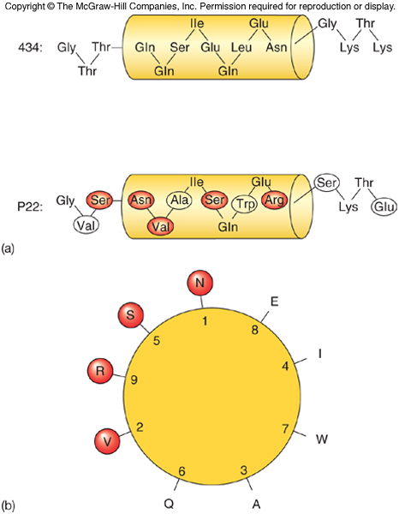
Probing Binding Specificity by Site-Directed Mutagenesis
Key amino acids in recognition helices of 2 repressors are proposed
These amino acids are largely different between the two repressors

Slide 11
λ Repressor
The λ repressor has an extra motif, an amino-terminal arm that aids binding by embracing the DNA
Crop and λ repressor share affinity for the same operators, but have microspecificities for O_{R}1 or O_{R}3
These specificities are determined by interactions between different amino acids in the recognition helices of the 2 proteins and different base pairs in the 2 operators

Slide 12
What is the cI Repressor (Cro Repressor):
Name: The cI repressor is often referred to as the Cro repressor in the context of the lambda phage.
Function: The cI repressor is a protein encoded by the cI gene of the lambda phage, a type of bacteriophage that infects Escherichia coli (E. coli) bacteria. The cI repressor plays a central role in the lambda phage life cycle. It is involved in the decision between lysogeny and lysis after the phage infects the bacterial cell.
Mechanism: The cI repressor can bind to specific DNA sequences, such as the operators (OR) on the phage genome. By binding to these operators, the cI repressor prevents the expression of genes involved in the lytic cycle, promoting the lysogenic pathway where the phage DNA integrates into the bacterial genome and becomes a prophage.
.

Slide 13
High-Resolution Analysis of λ Repressor-Operator Interactions
General Structural Features
Recognition helices of each repressor monomer nestle into the DNA major grooves in the 2 half-sites
Helices approach each other to hold the two monomers together in the repressor dimer
DNA is similar in shape to B-form DNA
Bending of DNA at the two ends of the DNA fragment as it curves around the repressor dimer

Slide 14
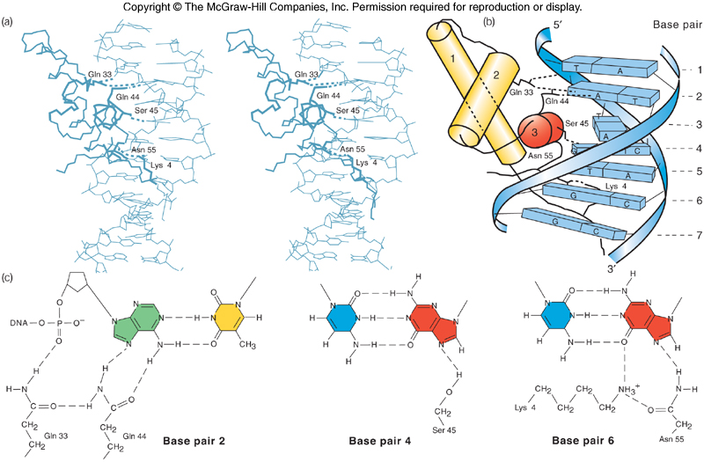
Interactions With Bases

Slide 15
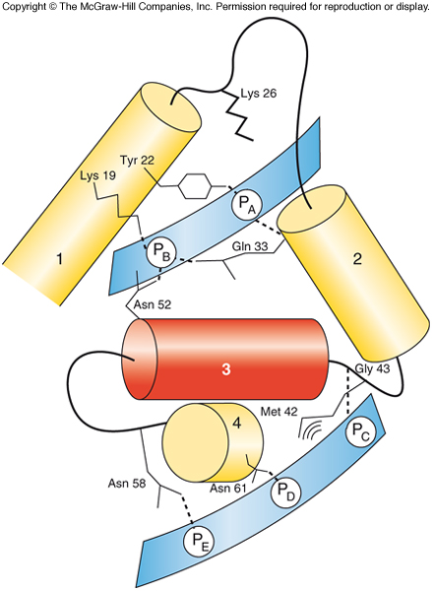
Amino Acid/DNA Backbone Interactions
Hydrogen bond at Gln 33 maximizes electrostatic attraction between positively charged amino end of a-helix and negatively charged DNA
The attraction works to stabilize the bond

Slide 16
High-Resolution Analysis of Repressor-Operator Interactions
X-ray crystallography of repressor-fragment/operator-fragment complex shows H bonding at 3 Gln residues in recognition helix to 3 base pairs in repressor
Potential van der Waals contact between one of these glutamines and base in the operator also revealed

Slide 17
Effects of DNA Conformation
Analysis of partial phage 434 repressor-operator complex shows that DNA deviates significantly from its normal regular shape
The DNA bends somewhat to accommodate necessary base/amino acid contacts
Central part of helix is wound extra tightly
Outer parts are wound more loosely than normal
Base sequence of the operator facilitates these departures from normal DNA shape

Slide 18
Genetic Tests of the Model
Contacts between phage 434 repressor and operator predicted by x-ray crystallography can be confirmed by genetic analysis
When amino acids or bases predicted to be involved in interaction are altered, repressor-operator binding is inhibited
Binding is inhibited when DNA is mutated so it cannot readily assume shape it has in the repressor-operator complex

Slide 19
9.2 The trp Repressor
The trp repressor uses a helix-turn-helix DNA binding motif
The aporepressor is not active
Crystallography sheds light on the way trp repressor interacts with its operator

Slide 20
The Role of Tryptophan
The trp repressor requires tryptophan to force the recognition helices of the repressor dimer into proper position for interacting with the trp operator

Slide 21
General Considerations on Protein-DNA Interactions
Specificity of binding between a protein and a specific stretch of DNA relates to:
Specific interactions between bases and amino acids
Ability of DNA to assume a certain shape that directly relates to the DNA’s base sequence

Slide 22
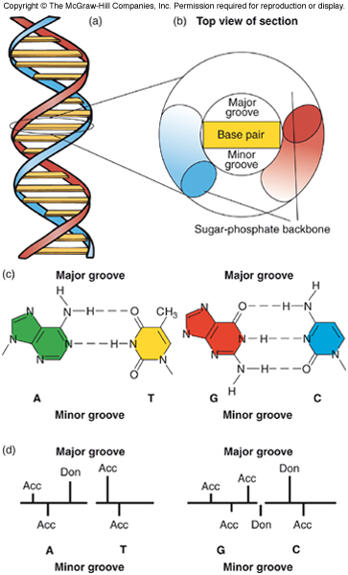
Hydrogen Bonding Capabilities of the Four Different Base Pairs
The four different base pairs present four different hydrogen-bonding profiles to amino acids approaching either major or minor groove

Slide 23
The Importance of Multimeric DNA- Binding Proteins
Target sites for DNA-binding proteins are usually symmetric or repeated
Most DNA-binding proteins are dimers that greatly enhances binding between DNA and protein as the 2 protein subunits bind cooperatively

Slide 24
DNA-Binding Proteins: Action at a Distance
There are numerous examples in which DNA-binding proteins can influence interactions at remote sites in DNA
This phenomenon is common in eukaryotes
It can also occur in several prokaryotes

Slide 25
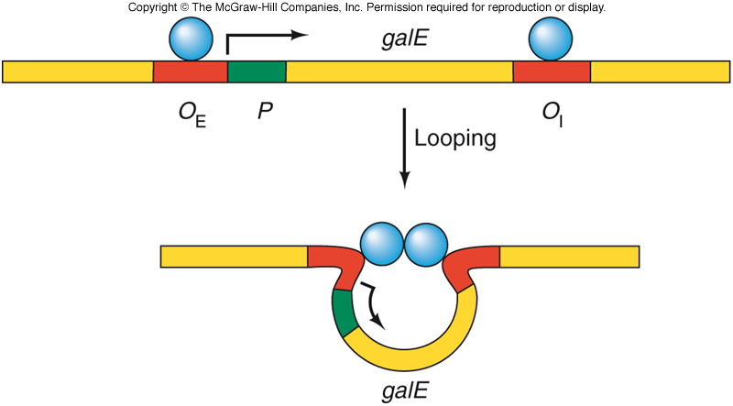
The gal Operon
The E. coli gal operon has two distinct operators, 97 bp apart
One located adjacent to the gal promoter
External operator, O_{E}
Other is located within first structural gene, galE
2 separated operators -both bind to repressors that interact by looping out the intervening DNA

Slide 26
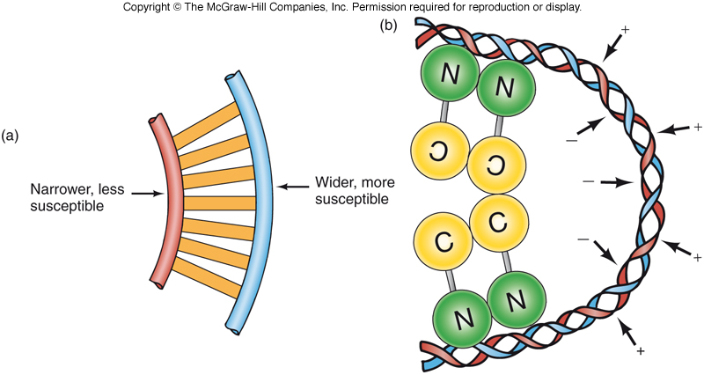
Effect of DNA Looping on DNase Susceptibility
Operators separated by
Integral number of double-helical turns can loop out DNA to allow cooperative binding
Nonintegral number of turns requires proteins to bind to opposite faces of DNA and no cooperative binding

Slide 27
Enhancers
Enhancers are nonpromoter DNA elements that bind protein factors and stimulate transcription
Can act at a distance
Originally found in eukaryotes
Recently found in prokaryotes

Slide 28
References
Carson, S., Miller, H. B., Srougi, M. C., & Witherow, D. S. (2019). Molecular biology techniques: a classroom laboratory manual. Academic Press.
Craig, N. L., Green, R. R., Greider, C. C., Wolberger, C., & Storz, G. G. (2021). Molecular biology: principles of genome function. Oxford University Press, USA.
Tropp, B. E. (2012). Principles of molecular biology. Jones & Bartlett Publishers.
Robert, F. W. (2012). Molecular biology.

Slide 29
Prokaryotic Genes Can Use Enhancers
E. coli glnA gene is an example of a prokaryotic gene depending on an enhancer for its transcription
Enhancer binds the NtrC protein interacting wit polymerase bound to the promoter at least 70 bp away
Hydrolysis of ATP by NtrC allows formation of an open promoter complex
The two proteins interact by looping out the DNA
Phage T4 late enhancer is mobile, part of the phage DNA-replication apparatus

