Slide 1

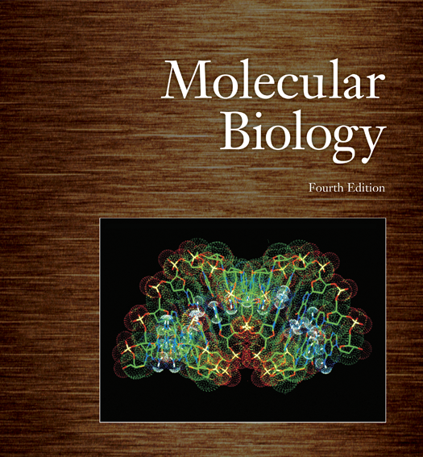
Molecular Biology & Proteomics
Mass Spectrometry In Proteomics,
Two-dimensional Gel Electrophoresis,
Proteomics Applications And Biomarker Discovery
Lecture 1
Name of teacher Dr. Ahmad H. Ibrahim
Molecular Biology & Proteomics
course code: PHAR 338
^{st} Semester / 11& 12th week 17.1.2023

Slide 2

“Proteomics”
This Lecture will give an introduction to the available proteomic technologies and the data mining tools.
Theme:
Mass spectrometry in proteomics
Two-dimensional gel electrophoresis
Proteomics Applications and Biomarker discovery,

Slide 3
Outline
Protein Identification and Expression Profiling:
  Identification of as many proteins as possible in a given sample.
  Protein expression profiling involves recognizing proteins in a sample based on the specific state of the organism or cell.
  Functional proteomics includes protein quantitation or differential analysis.
Structural Proteomics:
  Focuses on post-translational modifications, understanding how and where proteins are modified.
  Examines protein-protein interactions and maps protein networks.
Tools of Proteomics:
  Protein separation technology is used to simplify complex protein mixtures.
  Mass spectrometry (MS) provides accurate molecular mass measurements of intact proteins and peptides.
  Databases and software collections match MS data with specific protein sequences.

Slide 4
Outline
Proteome Dynamics:
  The proteome in a cell represents a subset of all possible gene products.
  Proteome composition varies between different cells, tissue types, and growth stages.
  Environmental factors, diseases, drugs, stress, and growth conditions influence the proteome.
Cycle of Proteins:
  Proteins undergo a life cycle involving folding, translocation, post-translational processing, and degradation.
  Damage to proteins can occur through processes like proteolytic cleavage, acylation, methylation, phosphorylation, and others.
Molecular Structures and Functional Families:
  Proteins have primary, secondary, tertiary, and quaternary structures.
  Amino acids exhibit preferences for specific structural conformations.
  Proteins are organized into motifs, domains, and functional families.
Sequence Alignment and Structural Motifs:
  Sequence alignment helps arrange primary sequences based on shared properties.
  Structural alignment identifies significant structural motifs.
  Motifs and domains confer unique functions and properties to proteins.

Slide 5
Outline
Protein Family Classification:
  Proteins are grouped into functional families based on their related functions.
  Protein family classification databases include PROSITE, Pfam, and SMART.
Proteome Complexity and Protein Heterogeneity:
  Genomic sequences influence proteome complexity.
  Protein heterogeneity involves various modification forms, and a single protein may carry several modifications.
Expression Profiling and Genomic Sequencing:
  Codon bias and transcription rates influence protein expression.
  Expression profiling identifies genes expressed in specific cells under particular conditions.
Proteomics Analysis Workflow:
  Separation techniques, enrichment/fractionation, and protein extraction are crucial steps.
  Protein digestion is essential for accurate mass measurements and sensitivity in mass spectrometry.

Slide 6
Objectives
Understand the key principles of protein identification and expression profiling.
2. Explore the tools and techniques employed in structural proteomics.
3. Examine the dynamic nature of the proteome in different cells and under various conditions.
4. Comprehend the life cycle of proteins, including folding, modification, and degradation.

Slide 7
Objectives
5. Gain insights into molecular structures, functional families, and the significance of motifs and domains.
6. Learn about sequence alignment, structural motifs, and protein family classification.
7. Understand proteome complexity, protein heterogeneity, and the influence of genomic sequences.

Slide 8
Objectives
8. Explore the role of expression profiling and genomic sequencing in proteomics analysis.
9. Familiarize oneself with the workflow of proteomics analysis, including separation techniques and protein extraction.
Understanding Gel Electrophoresis:
Grasping the classical process of gel electrophoresis.
Learning about its high resolving power for visualizing protein forms.
Quantitative Analysis:
Understanding the use of gel electrophoresis for quantitative analysis of proteins.
Identifying proteins within the proteome.
Post-translational Modifications:
Recognizing the capability of gel electrophoresis in detecting post-translational modifications of proteins.
Protein Fixing and Staining:
Learning various protein fixing, staining, and blotting methods used in gel electrophoresis.
Isoelectric Point (pI):
Understanding the concept of the isoelectric point (pI) and its significance in protein charge.
2D Gel Electrophoresis:
Grasping the principles of 2D gel electrophoresis, including Isoelectric Focusing (IEF) and limitations.
Exploring advanced techniques like Preparative IEF and 2D Fluorescence Difference Gel Electrophoresis (DIGE).
Multidimensional HPLC and Mass Spectrometry (MS):
Understanding the role of separation techniques and fractionation in protein analysis.
Grasping the principles of mass spectrometry for accurate molecular mass measurements and protein identification.
Mass Spectrometry Techniques:
Learning about various mass spectrometry techniques, including MALDI and ESI.
Understanding the principles of Time of Flight (TOF), Quadrupole, and Ion Trap mass analyzers.
MS/MS and Protein Identification:
Understanding tandem MS analysis and associated terminology.
Grasping the concept of hybrid instruments and protein identification using cross-correlation algorithms.
SELDI (Surface Enhanced Laser Desorption Ionization):
Understanding the principles of SELDI as a combination of chromatography and MALDI-TOF MS.
Recognizing its advantages, such as small sample requirements and quick protein mapping.

Slide 9
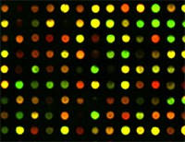
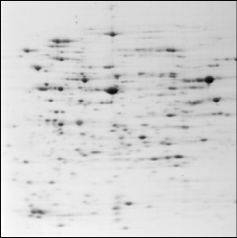
“-ome”
CGTCCAACTGACGTCTACAAGTTCCTAAGCT
DNA
Genome “Genomics”
DNA sequencing
Transcriptome
RNA
cDNA arrays
Cell functions
Proteins
Proteome “Proteomics”
2D PAGE, HPLC
Reactome, the chemical reactions involving a nucleotide

Slide 10
Protein Chemistry/Proteomics
Protein Chemistry
  Individual proteins
  Complete sequence analysis
  Emphasis on structure and function
  Structural biology
Proteomics
  Complex mixtures
  Partial sequence analysis
  Emphasis in identification by database matching
  System biology

Slide 11
Why are we studying proteins?
Proteins are the mediators of functions in the cell
Deviations from normal status denotes disease
Proteins are drug/therapeutic targets

Slide 12

How to select proteome?
A proteome is defined by the state of the organism, tissue, or cell that produces it.
Because these states are constantly changing, so are the proteomes.
Example of proteomes:
different kind of cells; liver, …
extracellular fluids; blood plasma, urine, CSF…

Slide 13
What are the Applications for Proteomics?
Systems biology - understand cell-pathways, network, and complex interacting.
Biological processes - characterize sub-proteomes such as protein complexes, cellular machines, organelles
Biomarkers - discovery of disease (serological, urine, other biological fluids) - diagnostics, treat patients, monitor therapies
Drug targets - evaluate toxicity & other biological or pharmaceutical parameters associated with drug treatment

Slide 14
Strategy for Biomarker Discovery
Genomic analysis
mRNA level
Disease vs. Normal
Proteomic analysis
(2D gels / MS)
Discovery
Candidate gene
Validation
in situ hybridization Immunohistochemistry
Application
Large # samples
Small # candidates
Clinical Application
Diagnostic
Prognostic
Therapeutic

Slide 15
Proteins as biomarkers
The protein composition may be associated with disease processes in the organism and thus have potential utility as diagnostic markers.
Proteins are closer to the actual disease process, in most cases, than parent genes
Proteins are ultimate regulators of cellular function
Most cancer markers are proteins
The vast majority of drug targets are proteins
Individual biomarkers are not sufficient for accurate disease detection
Panel of biomarkers should be established

Slide 16

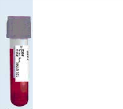

Benefits of Molecular Diagnostics
proteins
MS
Patient’s blood sample
Ovarian pattern
Create new cancer screening tools
Inform design of new treatments
Monitor treatment effectiveness
Predict patient’s response to treatment

Slide 17
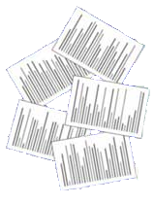
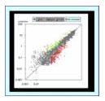



From known samples to serum proteins
no cancer
Patterns as screening tool
proteins
MS
Protein patterns
Early diagnosis
of disease
Early warning
of toxicity
proteins
MS
cancer

Slide 18
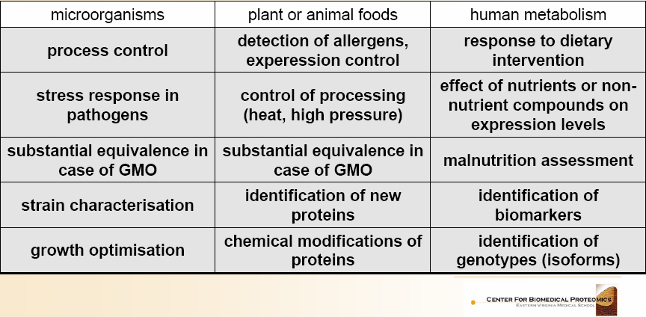
Proteomics in nutrition of food
Development of fingerprinting techniques to identify changes in modified organisms at different integration levels (2D gels, MALDI) MALDI-MS).

Slide 19
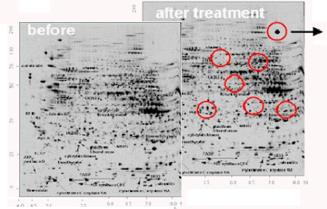
Identification of unintended side effects
A proteome analysis of livers from mice traeted with WY14.643
Isolation of protein spots
Peptide mapping
MALDI-TOF analysis
Amino acid sequence
Data base
16 proteins
Protein identified
Liver proteins from control
Proteins from animals after treatment

Slide 20
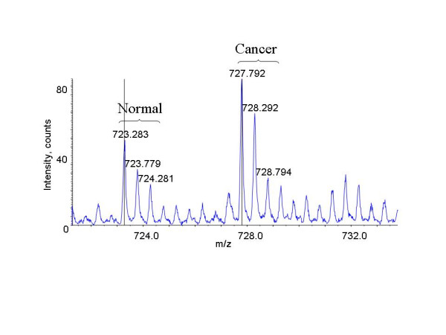
Identification of breast cancer biomarkers by iCAT LC-MS

Slide 21
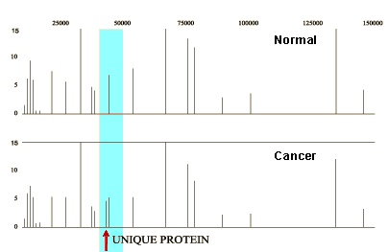
Biomarker Discovery
Markers can be easily found by comparing protein maps.
SELDI is faster and more reproducible than 2D PAGE.
Has been used to discover protein biomarkers of diseases such as ovarian cancer, breast cancer, prostate and bladder cancers.

Slide 22
Protein Profiling
Measure the expression of a set of proteins in two samples and compare them - Comparative proteomics
2D gel electrophoresis
Difference gel electrophoresis (DIGE)
LC-MS/MS using coded affinity tagging
(ICAT, iTrac, SILAC..)
ProteinChip Array (SELDI analysis)
Antibody arrays

Slide 23


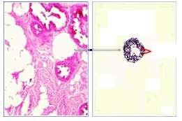


Laser-Capture Micro dissection, LMC
Technique for selectively sampling certain cells within a tissue
Biopsy
Transfer film
Tissue sample
Glass slide
Tumor
Laser beam activates film
Cells
Selected cells are transferred
Genomic/proteomic analysis

Slide 24
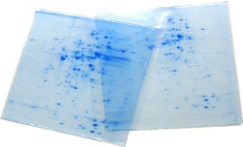
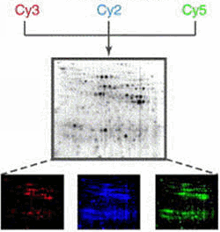
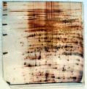
2D gels, DIGE
High resolving power
Absolute / relative quantity
Easily archived for further comparison
Detects some PTMs and alternatives splices
Low troughput
Poor detection of large, acidic, basic and membrane proteins
Only high abundance proteins
Coomassie blue stained gels
Silver stained

Slide 25


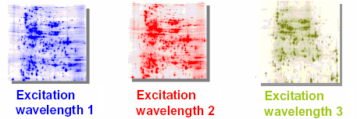
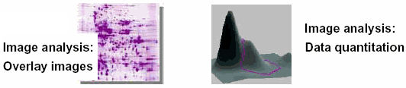
DIGE
Proteins are labeled prior to running the first dimension with up to three different fluorescent cyanide dyes
Mix labeled extracts
Internal standard
Allows use of an internal standard in each gel-to-gel variation, reduces the number of gels to be run
Adds 500 Da to the protein labeled
Additional post-electrophoretic staining needed

Slide 26
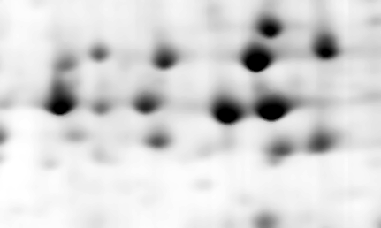
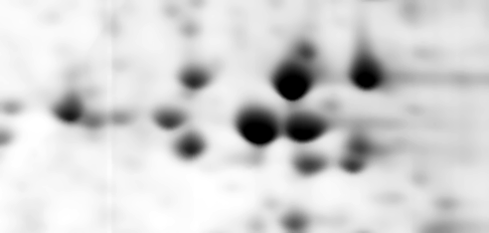
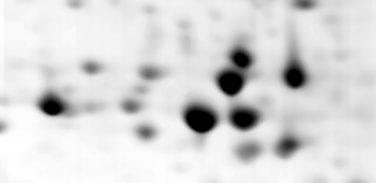

Human brain proteins
Differences in Expression Level in Thalamus
Control
phosphoglycerate mutase
phosphoglycerate mutase
Alzheimer’s Disease
phosphoglycerate mutase
phosphoglycerate mutase

Slide 27
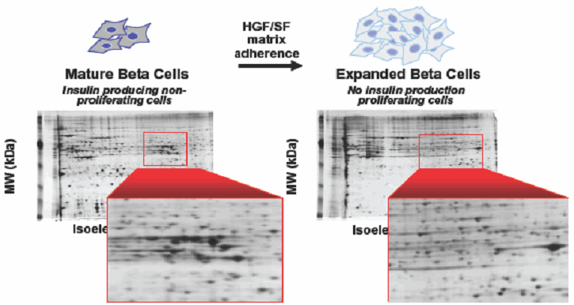
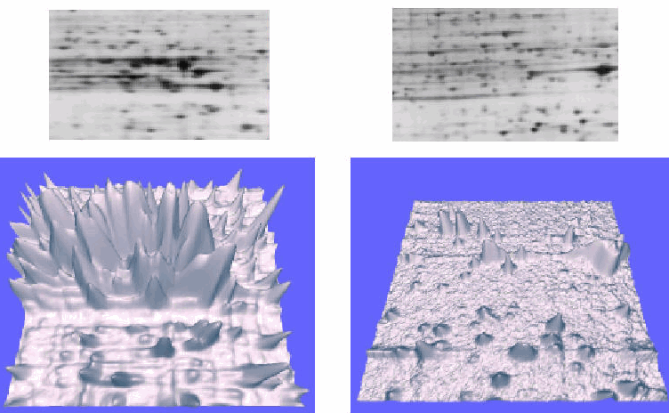
Example of different expression

Slide 28
Proteomics Applications
Protein Expression Profiling
Identification of proteins in a particular sample as a function of a particular state of the organism or cell
Proteome Mining
Identifying as many as possible of the proteins in your sample
Post-translational modifications
Identifying how and where the proteins are modified
PROTEOMICS
Functional proteomics
Protein-protein interactions Protein-network mapping
Determining how the proteins interact with each other in living systems
Protein quantitation or differential analysis
Structural Proteomics
Notes:
From Graves and Haystead, 2002

Slide 29
Tools of Proteomics
Protein separation technology
  Simplify complex protein mixtures
  Target specific proteins for analysis
Mass spectrometry (MS)
  Provide accurate molecular mass measurements of intact proteins and peptides
Database
  Protein, EST, and complete genome sequence databases
Software collection
  Match the MS data with specific protein sequences in databases

Slide 30
The Proteome
The proteome in any cell represents a subset of all possible gene products
Not all the genes are expressed in all the cells.
It will vary in different cells and tissue types in the same organism and between different growth and developmental stages
The proteome is dependent on environmental factors, disease, drugs, stress, growth conditions.
Cycle of Proteins
Proteins as Modular Structures – motifs, domains
Functional Families
Genomic Sequences
Protein Expression /Protein level

Slide 31

Life cycle of a protein
Information found in DNA is used for synthesis of the proteins
mRNA
Protein
Folding
Translocation
to specific subcellular or extracellular compartments
Posttranslational Processing
Proteolytic Cleaveage
Acylation
Methylation
Phosphorylation
Sulfation
Selenoproteins
Ubiquination
Glycolisation
Degradation
Damage
-free radicals
Environmental
-chemicals
radioactiivty

Slide 32


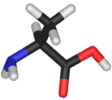


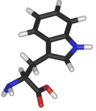
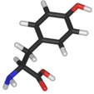
Molecular Structures
Primary structure a chain of amino acids
Amino acids vary in their ability to form the various secondary structure elements.
Secondary structure three dimensional form, formally defined by the hydrogen bonds of the polymer
Amino acids that prefer to adopt helical conformations in proteins include methionine, alanine, leucine, glutamate and lysine ("MALEK" in amino acid 1-letter codes)
α-helices
The large aromatic residues (tryptophan, tyrosine and phenylalanine) and Cβ-branched amino acids (isoleucine, valine and threonine) prefer to adopt β-strand conformations.
β-sheets
Confer similar properties or functions when they occur in a variety of proteins

Slide 33
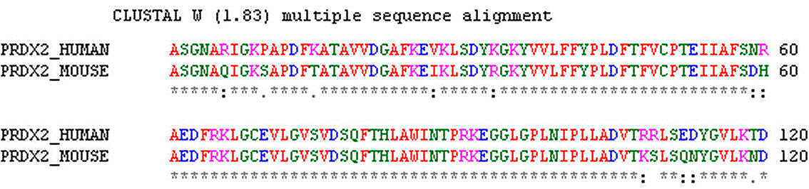
Sequence alignment
Sequence alignment is a way of arranging primary sequences (of DNA, RNA, or proteins) in such a way as to align areas sharing common properties.
The degree of relatedness, similarity between the sequences is predicted computationally or statistically
A software tool used for general sequences alignment tasks is ClustalW

Slide 34
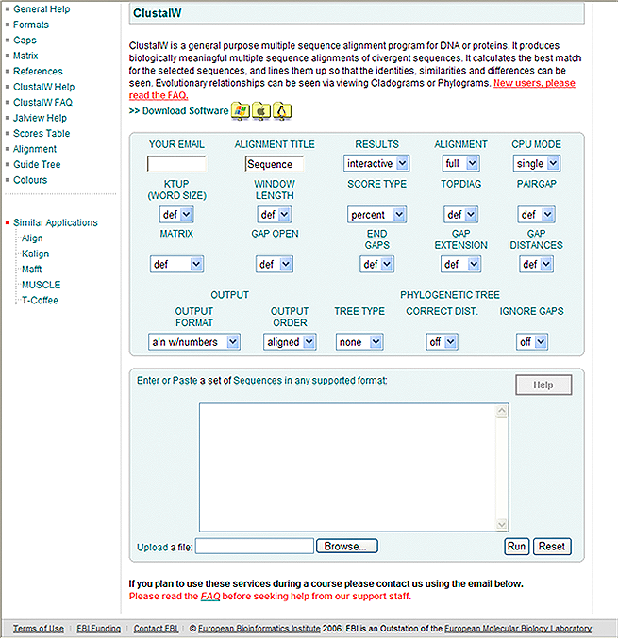
ClustalW

Slide 35

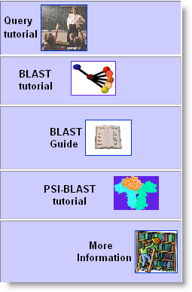
BLAST
Basic Local Alignment Search Tool
It is used to compare a novel sequence with those contained in nucleotide and protein data bases by aligning the novel sequence with the previously characterized genes.
The emphasis of this tools is to find regions of sequence similarity, which will yield functional and evolutionary clues about the structure and function of this novel sequence.
NCBI BLAST
http://www.ncbi.nlm.nih.gov/BLAST/

Slide 36
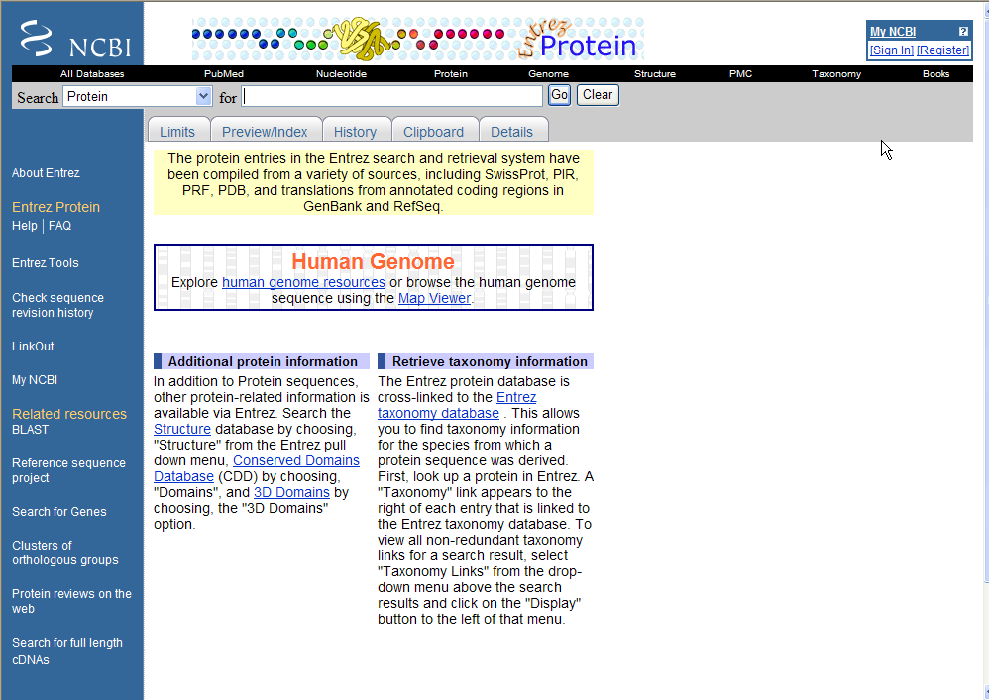

Slide 37
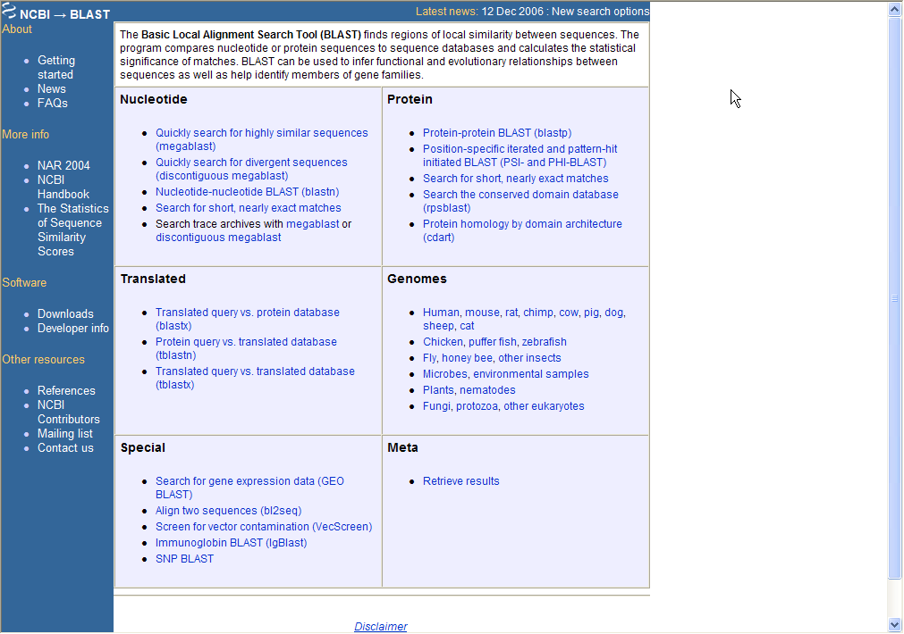

Slide 38
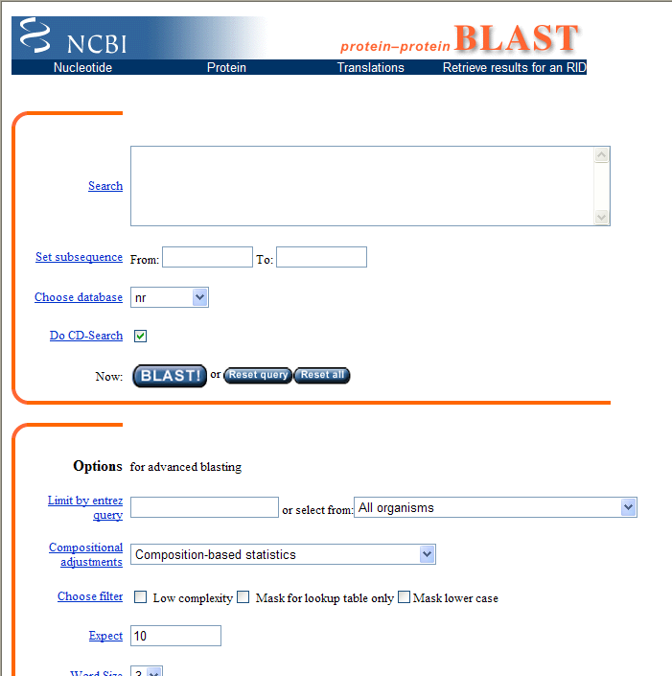

Slide 39
Molecular Structures / Functional Families
Tertiary structure the overall shape of the protein (fold)
the process by which a protein assumes its characteristic function
The three-dimensional shape of the proteins might be critical to their function. For example, specific binding sites for substrates on enzymes
Specific sequences that also confer unique properties and functions, motifs or domains
Quaternary structure -formation usually involves the "assembly" or "coassembly" of subunits that have already folded
Incorrectly folded proteins are responsible for illnesses such as Creutfeltdt_Jakob disease and Bovine spongiform encephalopathy (mad cow disease), and amyloid related illnesses such as Alzheimer’s.

Slide 40
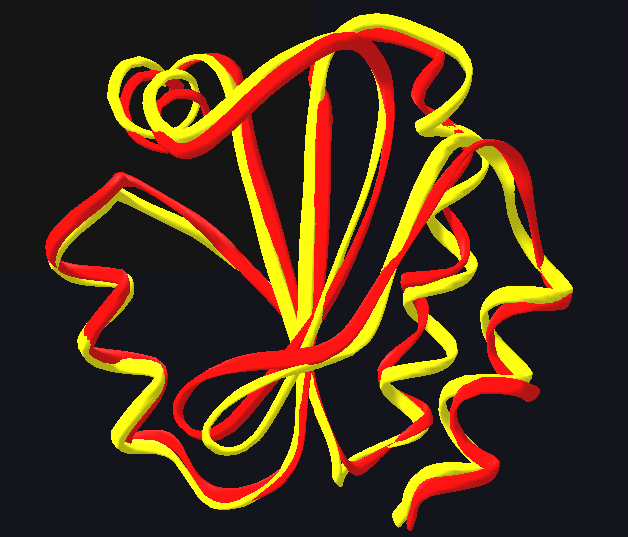
Domains / Motifs
Motifs: short conserved sequences, which appear in a variety of other molecules.
Domains: part of the sequence that appear as conserved
modules in proteins that are not related, in global terms.
Usually with a distinct three dimensional fold, carrying a unique function and appearing in different proteins
Repeats: structurally or functionally interdependent modules.
Structural alignment: a method for discovering significant structural motifs.
-Based on comparison of shape
Structural alignment of thioredoxins from humans (red)and the fly Drosphila melangaster (yellow).

Slide 41








Functional families
Proteins can be grouped into functional families; proteins that carry out related functions
Structural
Signaling pathways
Metabolic
Transportation
Domains are clustered into families in which significant sequence similarity is detected as well as conservation of biochemical activity.
SCOP-a structural classification of proteins
By associating a novel protein with a protein family, one can predict the function of the novel protein
Protein family classification databases:
PROSITE. Database of protein families and domain, defined by patterns and profiles, at ExPASY. http://au.expasy.org/prosite/
Pfam. Multiple sequence alignments and HMMs of protein domains and families, at Sanger Institute. http://www.sanger.ac.uk/Software/Pfam/help/index.shtml
SMART Simple Modular Architecture Research Tool, at EMBL. http://smart.embl-heidelberg.de/

Slide 42
Protein function chart

Slide 43

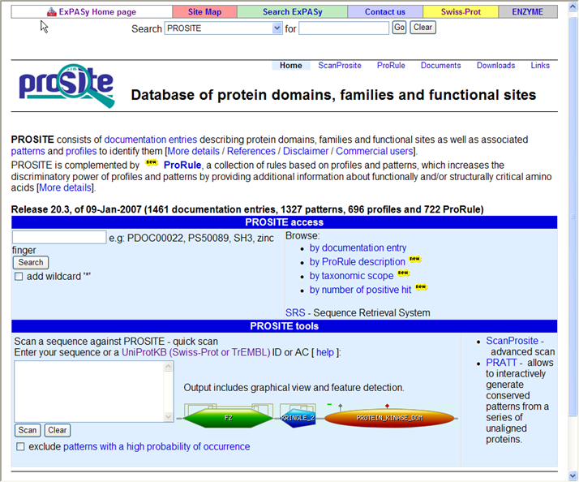
A Pseudo-Rotational Online Service and Interactive Tool

Slide 44
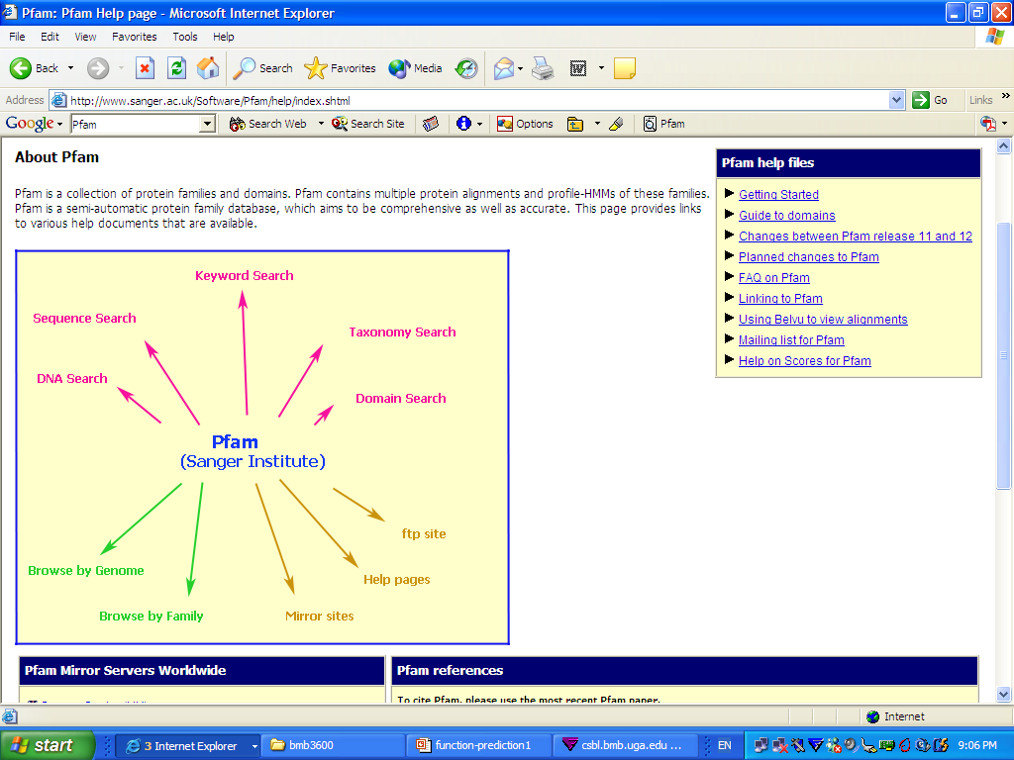
Pfam

Slide 45
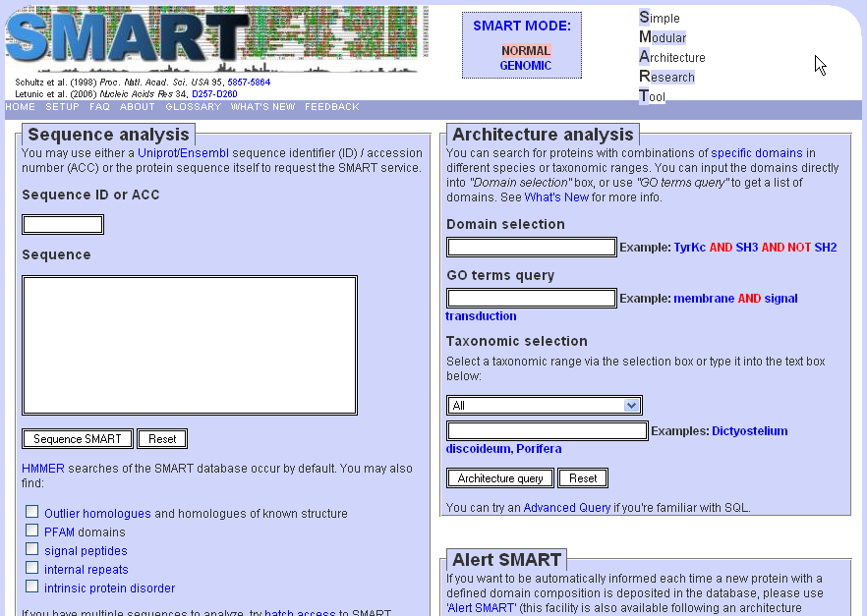

Slide 46
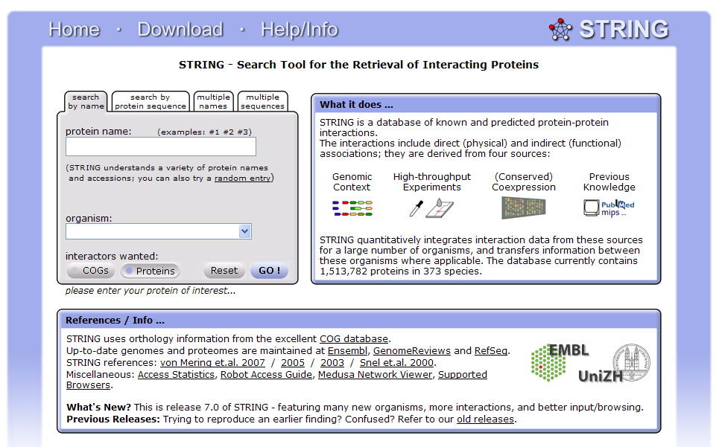
STRING
http://string.embl.de

Slide 47
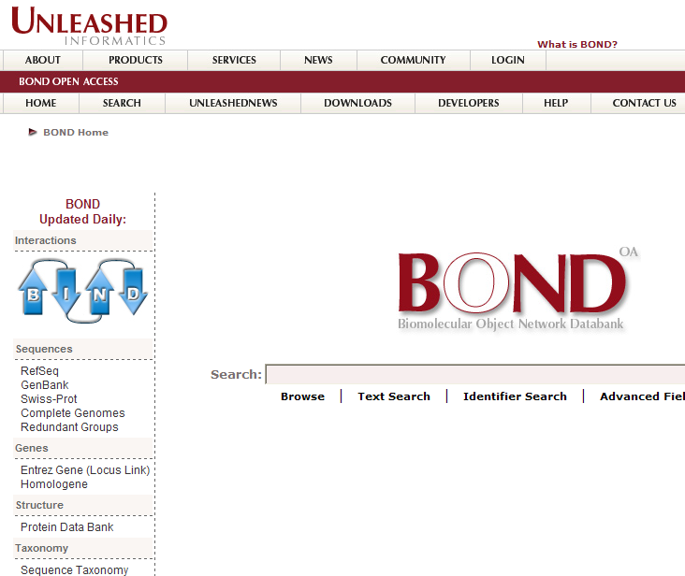
BOND
Biomolecular Object Network Databank
http://bond.unleashedinformatics.com

Slide 48
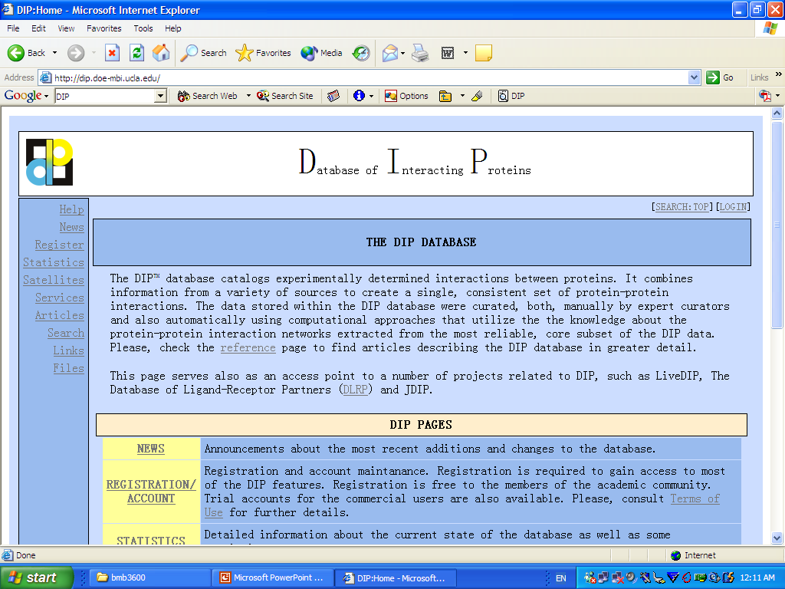
Database of Interacting Proteins
The DIP database catalogs experimentally determined interactions between proteins. It combines information from a variety of sources to create a single, consistent set of protein-protein interactions.
http://dip.doe-mbi.ucla.edu/

Slide 49
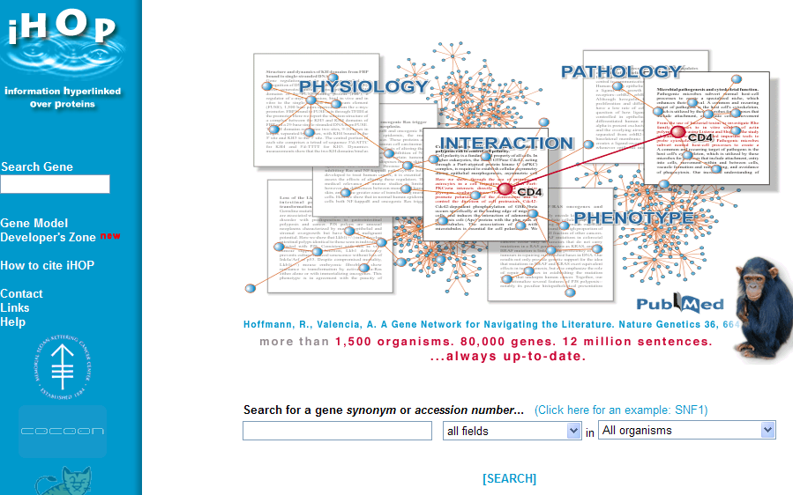
ihop
http://www.ihop-net.org/UniPub/iHOP/

Slide 50

Sequence-Structure-Function
Homology searching (BLAST)
Sequence
Structure
Function
Threading
Structure more conserved than sequence
Threading techniques try to match a target sequence on a library of known three-dimensional structures by “threading” the target sequence over the known coordinates.
In this manner, threading tries to predict the three-dimensional structure starting from a given protein sequence. It is sometimes successful when comparisons based on sequences or sequence profiles alone fail to a too low similarity.

Slide 51






Genomic sequencing/ Protein level
Genome size (bp)
5.386
580.000
12,1 × 10⁶
3,2 × 10⁹
90 × 10⁹
670 × 10⁹
Biological complexity does not come simply from greater number of genes.
φX-174 virus
Mycoplasma genitalium
Yeast (S. Cerevisiae)
Human
Lilium longiflorum
Amoeba dubia
complexity

Slide 52





Complexity

Slide 53
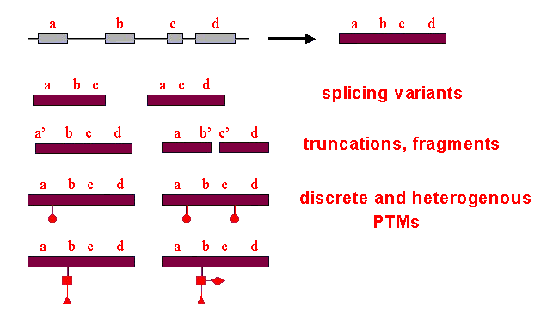
Proteome complexity

Slide 54
Protein Heterogeneity
Much larger number of spots compared to protein species they represent
H.influenza : 1500 spots 500 different proteins
More than 100 modification forms known
A single protein may carry several modifications
Modified proteins show different properties compared to
unmodified counterparts
In most cases, we do not know the origin or the biological
significance of the observed heterogeneities

Slide 55
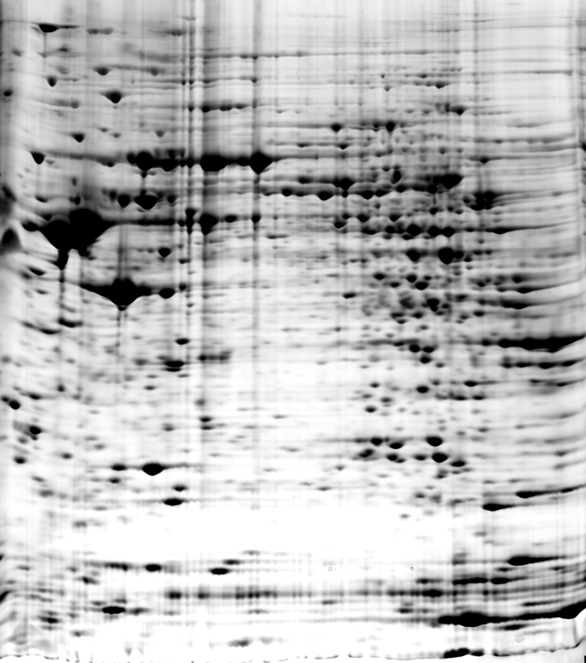


2D gel image of brain proteins
γ-enolase
B
A
Partial 2D-gel images showing γ-enolase from human brain. The protein is represented by one spot when IEF was performed on pH 3-10 non-linear IPG strips (A),
and by six spots when IEF was performed on pH 4-7 strips (B).
Increased Resolution and Detection of
More Spots with the Use of Narrow pH
Gradient Strips
About 3000 Spots after Coomassie Stain
4.5
Electrophoresis, 1999, 20 (14) 2970
pI

Slide 56
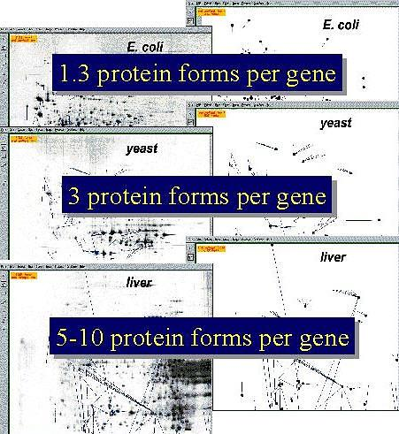
Taken from http://www.lcb.uu.se/course by 15.12.2023

Slide 57
Genomic sequencing
Homologues are similar sequences in two different organisms that have been derived from a common ancestor sequence.
Orthologues are similar sequences in two different organisms that have arisen due to a speciation event.
Paralogues are similar sequences within a single organism that have arisen due to a gene duplication event.

Slide 58
Pattern / Profile
Pattern –conserved sequence of a few amino acids
identify various important sites within protein
Enzyme catalytic site
Prosthetic group attachment
Metal ion binding site
Cysteines for disulphide bonds
Protein or molecular binding
Profile a multiple alignment with matrix frequencies- describe protein families or domains conserved in sequence.
Score-based representations
Position-specific scoring matrix (PSSM)
Hidden Markov model (HMM)
Database: PROSITE Patterns
Patterns and Profiles are used to search for motifs/ domains of biological significance that characterize protein family

Slide 59
Protein level
The level of any protein in a cell at a given time:
  Transcription rate
  Efficiency of translation in the cell
  The rate of degradation of the protein
Larger genomes have larger gene families (the average family size also increases with genome size)
Codon bias- the tendency of an organism to prefer certain codons over others that code for the same amino acid in the gene sequence.

Slide 60
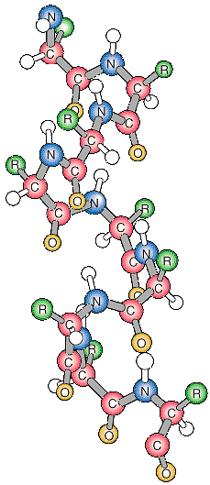
Protein expression
Protein
It consists of the stages after DNA has been translated Amino acid chains chains which is ultimately folded into proteins
Expression profiling what genes are expressed in a particular cell type of an organism, at a particular time, under particular conditions? As the expression of many genes is known to be regulated after transcription, an increase in mRNA concentration need not always increase expression

Slide 61

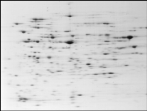
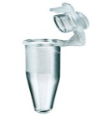





General workflow of proteomics analysis
separation
proteins
digestion
MALDI, MS/MS
digestion
Identification
peptides
(LC)-MS/MS
ESI-MS
Electrospray Ionization tandem MS
MALDI-TOF
Matrix Assisted Laser Desorption Ionization –Time of Flight

Slide 62



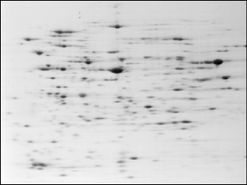



Separation of Protein Mixtures
Detergents
Reductants
Denaturing agents
Enzymes
The less complex a mixture of proteins is, the better chance we have to identify more proteins.
digestion

Slide 63
Separation techniques
Separation techniques used with intact proteins
1D- and 2D-SDS PAGE
Preparative IEF isoelectric focusing
HPLC
Separating intact proteins to take advantage of their diversity in physical properties
Separation techniques for peptides
MS-MS
HPLC (MudPIT)
SELDI
Differential display proteomics
Difference gel electrophoresis (DIGE)
Isotope-coded affinity tagging (ICAT)

Slide 64

Enrichment /Fractionation
For the detection of low-abundance proteins, a separation of complex mixtures into fractions with fewer components is necessary
Enrichment from larger volumes
Selective precipitation
Selective centrifugation
Preparative approaches
Combination of 2DE with LC
Multi-dimensional LC

Slide 65
Protein extraction
Detergents: solubilize membrane proteins-separation from lipids
Reductants: Reduce S-S bonds
Denaturing agents: Disrupt protein-protein interactions-unfold proteins
Enzymes: Digest contaminating molecules (nucleic acids etc)
Protease inhibitors
Aim: High recovery-low contamination-compatibility with separation method

Slide 66

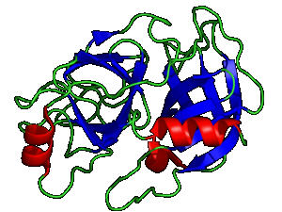
Protein digestion
Trypsin
Cleaves at lysine and arginine, unless either is followed by proline in C-terminal direction
Why digest the protein?
Accuracy of mass measurements
Suitability
Sensitivity
The ideal protein digestion approach would cleave proteins at certain specific amino acid residues to yield fragments that are most compatible with MS analysis.
Good activity both in gel digestion and in solution
Peptide fragments of between 6 – 20 amino acids are ideal for MS analysis and database comparisons.
Other enzymes with more or less specific cleavage:
Chymotrypsin
Glu C (V8 protease)
Lys C
Asp N

Slide 67
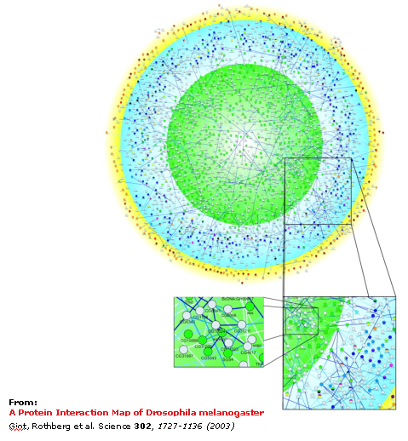
Protein-Protein Interactions
Proteins “work together” forming multi complexes to carry out the specific functions

Slide 68
Identification of interactions
Experimental
  x-ray crystallography
  NMR spectroscopy
  Mass spectrometry
        (Tandem affinity purification)
  Immunoprecipitation
  Yeast two-hybrid
  Microarrays
Computational
  Genomic data
  Phylogenetic profiling
  Gene context
  Gene fusion
  Symmetric evolution
  Structural data
  Sequence profile
  3D structural distance matrix
  Surface patches
  Binding interactions

Slide 69
Summary:
The Proteome Mining lecture covers a wide range of topics in proteomics, emphasizing the identification and analysis of proteins within biological samples. It delves into protein expression profiling, structural proteomics, and tools like mass spectrometry.
The lecture explores the life cycle of proteins, emphasizing their modular structures, post-translational modifications, and interactions.
Molecular structures, including primary and secondary structures, are discussed, along with techniques like sequence alignment.

Slide 70
Summary:
The importance of structural alignment, functional families, and protein family classification databases is highlighted. Proteome complexity, protein heterogeneity, and various proteomics analysis workflows, including protein separation and enrichment techniques, are addressed.
The lecture also covers protein digestion, isoelectric point, and key concepts in mass spectrometry, including tandem MS and hybrid instruments. The integration of proteomics with genomics and the significance of environmental factors on the proteome are emphasized.
Overall, the lecture provides a comprehensive overview of proteome mining concepts and methodologies.

Slide 71
References
Carson, S., Miller, H. B., Srougi, M. C., & Witherow, D. S. (2019). Molecular biology techniques: a classroom laboratory manual. Academic Press.
Craig, N. L., Green, R. R., Greider, C. C., Wolberger, C., & Storz, G. G. (2021). Molecular biology: principles of genome function. Oxford University Press, USA.
Tropp, B. E. (2012). Principles of molecular biology. Jones & Bartlett Publishers.
Robert, F. W. (2012). Molecular biology.

Slide 72
Molecular Biology & Proteomics
Mass Spectrometry In Proteomics,
Two-dimensional Gel Electrophoresis,
Proteomics Applications And Biomarker Discovery,
Lecture 2
Name of teacher Dr. Ahmad H. Ibrahim
Molecular Biology & Proteomics
course code: PHAR 338
^{st} Semester / 11& 12th week 17.1.2023

Slide 73
Outline
Classical Gel Electrophoresis:
  High resolving power for visualizing thousands of protein forms.
  Quantitative analysis and identification of proteins within the proteome.
  Detection of post-translational modifications.
  Various protein fixing, staining, or blotting methods.
Detection Methods:
  General staining methods using organic dye, silver, Coomassie blue, etc.
  Radioactive labeling methods.
  Reverse stain methods.
  Fluorescence methods (e.g., Supro Ruby).
  Gel scanning for image storage in a database.
Isoelectric Point (pI):
  Proteins are amphoteric molecules with both acidic and basic functional groups.
  Isoelectric point (pI) is where the protein has no net charge.
  Protein charge depends on the pH of the solution.
2D Gel Electrophoresis:
  First dimension: Isoelectric Focusing (IEF) based on pI.
  Second dimension: Limitations include reproducibility, dynamic range, and protein heterogeneity.
  Preparative IEF and 2D Fluorescence Difference Gel Electrophoresis (DIGE) for improved resolution.

Slide 74
Outline
Multidimensional HPLC and Mass Spectrometry (MS):
  Separation techniques and fractionation for protein analysis.
  Multidimensional Protein Identification Techniques (Mud PIT) using dissimilar separation modes.
  MS for accurate molecular mass measurements and protein identification.
Mass Spectrometry Techniques:
  MALDI (Matrix-Assisted Laser Desorption and Ionisation) and ESI (ElectroSpray Ionisation) methods.
  Time of Flight (TOF), Quadrupole, and Ion Trap mass analyzers.
  Sensitivity, resolution, and mass accuracy as figures of merit for mass analyzers.
MS/MS and Protein Identification:
  Tandem MS analysis and terminology (molecular ion, fragment ions).
  Hybrid instruments for combining mass analyzers.
  Protein identification using cross-correlation algorithms.
SELDI (Surface Enhanced Laser Desorption Ionization):
  Combination of chromatography and MALDI-TOF MS.
  Protein capture and enrichment on a chemically or bio-affinity active solid phase.
  Ideal for discovering biomarkers quickly.

Slide 75
Objectives
1. Understanding Gel Electrophoresis:
Grasping the classical process of gel electrophoresis.
Learning about its high resolving power for visualizing protein forms.
2. Quantitative Analysis:
Understanding the use of gel electrophoresis for quantitative analysis of proteins.
Identifying proteins within the proteome.
3. Post-translational Modifications:
Recognizing the capability of gel electrophoresis in detecting post-translational modifications of proteins.

Slide 76
Objectives
4. Protein Fixing and Staining:
Learning various protein fixing, staining, and blotting methods used in gel electrophoresis.
5. Isoelectric Point (pI):
Understanding the concept of the isoelectric point (pI) and its significance in protein charge.
6. 2D Gel Electrophoresis:
Grasping the principles of 2D gel electrophoresis, including Isoelectric Focusing (IEF) and limitations.
Exploring advanced techniques like Preparative IEF and 2D Fluorescence Difference Gel Electrophoresis (DIGE).

Slide 77
Objectives
7. Multidimensional HPLC and Mass Spectrometry (MS):
Understanding the role of separation techniques and fractionation in protein analysis.
Grasping the principles of mass spectrometry for accurate molecular mass measurements and protein identification.
8. Mass Spectrometry Techniques:
Learning about various mass spectrometry techniques, including MALDI and ESI.
Understanding the principles of Time of Flight (TOF), Quadrupole, and Ion Trap mass analyzers.

Slide 78
Objectives
9. MS/MS and Protein Identification:
Understanding tandem MS analysis and associated terminology.
Grasping the concept of hybrid instruments and protein identification using cross-correlation algorithms.
10. SELDI (Surface Enhanced Laser Desorption Ionization):
Understanding the principles of SELDI as a combination of chromatography and MALDI-TOF MS.
Recognizing its advantages, such as small sample requirements and quick protein mapping.

Slide 79


Gel electrophoresis
Classical process
High resolving power: visualization of thousands of protein forms
Quantative
Identifying proteins within proteome
Up/ down regulation of proteins
Detection of post-translational modifications
Protein fixing and staining or blotting
General detection methods (staining)
Organic dye – and silver based methods Coomassie blue, Silver
Radioactive labeling methods
Reverse stain methods
Fluorescence methods (Supro Ruby)
Coomassie blue stained gels
Gel scanning
(storage of image in a database)
Ruby red
Silver stained

Slide 80
Isoelectric point
Proteins are amphoteric molecules
i.e. they have both acidic and basic functional groups
pI= isoelectric point, is where the protein does not have any net charge
The protein charge depends on the pH of the solution.

Slide 81
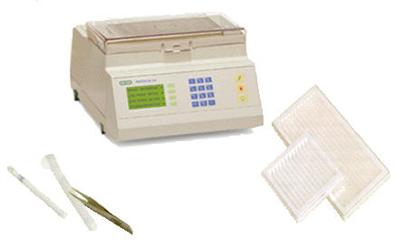
1st dimension
IsoElectric Focusing, IEF
Immobilized pH gradients (IPGs)
A pH gradient is generated by a limited number of well defined chemicals (immobilines) which are co-polymerized with the acrylamide matrix.
Migration of proteins in a pH gradient: protein stop at pH=pI
Individual strips:
24,18,11,7 cm long
3 mm wide
0,5 mm thickness
Loading quantities (18 cm strip)
Analytical run: 50-100 μg
Micropreparative runs: 0,5 – 10 mg
Use narrow range IPG strips to focus on particular pI range

Slide 82
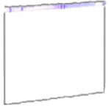

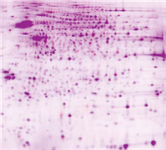

2nd dimension
pI
The strip is loaded onto a SDS gel
Mw
Staining !
pH 3
pH 10
Proteins that were separated on IEF gel are next separated in the second dimension based on their molecular weights.
Notes:
SDS denaturates and lineasrises the protein (to make movement solely dependent on mass, not shape)
After solubilisation with SDS, proteins getting negatively charged. They will migrate into polyacrylamid gels to separate by sieving (SDS-PAGE)

Slide 83

Limitations/difficulties with the 2D gel
Reproducibility
Samples must be run at least in triplicate to rule out effects from gel-to-gel variation (statistics)
Small dynamic range of protein staining as a detection technique- visualization of abundant proteins while less abundant might be missed.
Posttranscriptional control mechanisms
Co-migrating spots forming a complex region
Incompatibility of some proteins with the first dimension IEF step (hydrophobic proteins)
Marginal solubility leads to protein precipitation and degradation- smearing
(Glycolysation, oxidation)
Streaking and smearing
Weak spots and background

Slide 84

Brain Proteins
(About 3000 Spots after Coomassie Stain)
A
kDa
B
90
20
4.5
9.5
Electrophoresis, 1999, 20 (14) 2970
pI

Slide 85
Protein Heterogeneity
γ-enolase
A
B
Partial 2D-gel images showing γ-enolase from human brain. The protein is
represented by one spot when IEF was performed on pH 3-10 non-linear IPG strips (A),
and by six spots when IEF was performed on pH 4-7 strips (B).
Increased Resolution and Detection of
More Spots with the Use of Narrow pH
Gradient Strips

Slide 86




Preparative IEF
The protein mixture is injected into the focusing chamber
Proteins are focused as in standard IEF
Vacuum assisted aspiration into sample tubes
The pH gradient is achieved with soluble ampholytes
Large amount of proteins (up to 3g protein)

Slide 87

DIGE
2D Fluorescence Difference Gel Electrophoresis
Quantification of Spot Relative Levels
Proteins are labeled prior to running the first dimension with up to three different fluorescent cyanide dyes
Allows use of an internal standard in each gel-to-gel variation, reduces the number of gels to be run
Adds 500 Da to the protein labeled
Additional postelectrophoretic staining needed

Slide 88


Separation by LC
Salt gradient
UV detector
column
EC detector
waste
Number of peaks indicates the complexity of starting material
Peak position (i.e. elution time) may provide qualitative information about the sample (comparison with standards)
Peak area may provide information on relative concentration of components.
If coupled to MS protein identification (MW) can be provided
Notes:
UV/Vis detector
Electro chemcial detector EC
Fluorescence detector
Refractive index ( ex. sugar)

Slide 89


Multidimensional HPLC
Mud PIT
Multidimensional Protein Identification Techniques or Tandem HPLC
the combination of dissimilar separation modes will allow a greater resolution of peptides in mixture.
Ion-exchange
Reversed phase
Reversed phase, hydrophobicity
Ion exchange, net positive/negative charge
Size exclusion, peptide size, molecular weight
Affinity chromatography, interaction with specific functional groups

Slide 90

Multidimensional LC

Slide 91
A Mass Spectrometer
source
analyzer
detector
The sample has to be introduced into the ionization source of the instrument. Once inside the ionization source the sample molecules are ionized, because ions are easier to manipulate than neutral molecules.
These ions are extracted into the analyzer region of the mass spectrometer where they are separated according to their mass (m)-to-charge (z) ratios (m/z).
The separated ions are detected and this signal sent to a data system where the m/z ratios are stored together with their relative abundance for presentation in the format of a m/z spectrum.
The analyzer and detector of the mass spectrometer, and often the ionization source too, are maintained under high vacuum to give the ions a reasonable chance of traveling from one end of the instrument to the other without any hindrance from air molecules.

Slide 92


..consists of..
source
analyzer
detector
Source -produces the ions from the sample (vaporization /ionization)
MALDI, Matrix-Assisted Laser Desorption and Ionisation
ESI, ElectroSpray Ionisation
Mass Anlyzer - resolves ions based on their mass/charge (m/z) ratio
Generate different, but complementary information
Detector –detection of mass separated ions

Slide 93
MALDI
Matrix Assisted Laser Desorption and Ionisation
laser
Peptides co-crystallised with matrix
Produces singly charged protonated molecular ions High throughput Single proteins
ions
+
+
+
+
+
-
-
-
+
-
Rapid procedure, high rate of sample throughput
large scale identification (“first look at a sample”)

Slide 94

TOF
Time of flight
Measures the time it takes for the ions to fly form one end to other and strike the detector.
The speed with which the ions fly down the analyzer tube is proportional to their m/z values.
The greater the m/z the faster they fly
Separate ions o f different m/z based on flight time
Fast
Requires pulsed ionization

Slide 95

MALDI-TOF
Matrix-assisted laser desorption ionization-time of flight
+
+
+
+
+
-
-
-
+
-
TOF analyzer
Quick, easy, inexpensive
Highly tolerant to contaminents
High sensitivity
Good accuracy in mass determination
Compatible with robotic devices for high-throughput proteomics work
Best suited to measuring peptide masses
Low reproducibility and repeatability of single shot spectra (Averaging)
Low resolution
Matrix ions interfere in the low max range

Slide 96


MALDI-TOF data
Every peak corresponds to the exact mass (m/z) of a peptide ion
112.1
234.4
890.5
1296.9
1876.4
1987.5
…….
=
fingerprint
Peak List = List of masses

Slide 97
MALDI-TOF data
Every peak corresponds to the exact mass (m/z) of a peptide ion
112.1
234.4
890.5
1296.9
1876.4
1987.5
…….
=
fingerprint
Peak List = List of masses

Slide 98


ElectroSpray Ionization, ESI
Voltage
Heated desolvation region
++
+
+
+
+
++
++
+
+
+
+
Capillary column
Charged droplets
Peptide ions
Ions are generated by spraying a sample solution through a charged inlet
Produces multiply protonated molecular ions of biopolymers
Samples in solution
Compatible with HPLC
Complex mixtures
Tandem MS analysis
Peptide sequence
Nanospray needles, fine tipped gold coated needles
Single samples
Nanospray LC probe, connects directly to HPLC outlet – automated sample injection

Slide 99
Analyzers
source
analyzer
detector
Source -produces the ions from the sample (vaporization /ionization)
MALDI, Matrix-Assisted Laser Desorption and Ionisation
ESI, ElectroSpray Ionisation
Mass Anlyzer - resolves ions based on their mass/charge (m/z) ratio
Time of Flight, TOF
The Quadrupole, Q
Ion Trap
Detector –detection of mass separated ions

Slide 100


The Quadrupole
source
detector
The quadrupole consists of four parallel metal rods. Ions travel down the quadropole in between the rods.
Only ions of a certain m/q will reach the detector for a given ratio of voltages: other ions have unstable trajectories and will collide with the rods.
This allows selection of a particular ion, or scanning by varying the voltages.
Voltage
Filters out all m/z values except the ones it is set to pass
Obtains a mass spectrum by sweeping across the entire mass range

Slide 101

Ion Trap Mass Analyzer
The trap consists of a top and a bottom electrode and a ring electrode around the middle.
Ions are ejected on the basis of their m/z values.
To monitor the ions coming from the source, the trap continuoulsy repeats a cylcle of filling the trap with ions and scanning the ions according to their m/z values.
Ions in
Trapped ions
Ions out
Collects and store ions in order to perform MS-MS analyses on them.
Separates the mass analysis and ion isolation events in time (using a single mass analyzer)
parent ion isolation/ fragmentation
daughter ion detection
Ionization
ion transfer/trapping

Slide 102
Note:
Ions are fragmented by collision with helium gas and their daughter ions analyzed within the trap. Selected daughter ions can undergo further fragmentation, thus allowing MSn.
This is important for structural experiments. The ion trap has a high efficiency of transfer of fragment ions to the next stage of fragmentation (unlike the triple quadrupole instrument.

Slide 103
MS
Sensitivity amounts of proteins are limited
Resolution how well we can distinguish ion of very similar m/z values (the ability of the instrument to resolve two closely placed peaks in the mass spectrum)
Mass accuracy the measured values for the peptide ions must be as close as possible to their real values. (the relative percent difference between the measured mass and the true mass, usually represented in ppm.)
Figures of merit for mass analyzers
type | m/z range | Resolving power | cost
Quadrupole | 1-4000 | 1000 | $$
Ion trap | 10-4000 | 1000 | $$
Time of flight | 1-100.000 | 30.000 | $$$
Fourier transform | 18-10.000 | >100.000 | $$$$

Slide 104

Mass Resolution
The ability of the instrument to resolve two closely placed peaks.
intensity
R = m/Δm = m/(m2-m1)

Slide 105

Mass accuracy
The relative per cent difference between the measured mass and the true mass (usually represented in ppm).
(The lower the number the better the mass accuracy)

Slide 106
MS/MS terminology
Molecular ion / precursor ion
Ion formed by ionization of the analyte species
Fragment ions / product ions
Ions formed by the gas-phase dissociation of the
molecular ion
Relative Abundance
Relative Abundance is a measure of the relative amount of ion signal recorded by the detector

Slide 107
Hybrid instruments /Tandem MS
Combines two or more mass analyzers of the same or different types
First mass analyzer isolates the ion of interest (parent ion)
The ions are then fragmented between the first and second mass analyzer via collisions or irridation with UV light
The last mass analyzer obtains the mass spectrum of the fragments ions (daughter ions spectrum)
MS-MS spectra reveal fragmentation patterns
to provide structural information about a molecule
Protein identification by cross-correlation algorithms

Slide 108

Q-TOF
Quadruple Time of Flight mass analyzer
Higher mass resolution, increased mass accuracies
More effectively used in software-assisted data interpretation

Slide 109








SELDI
Surface Enhanced Laser Desorption Ionization
A combination of chromatography (protein chips) and MALDI-TOF MS
washing
EAM, energy absorbing molecule
Protein capture and enrichment on a chemically or bio affinity active solid phase surface
Retained proteins are “eluted” from the Protein Chip array by Laser Desorption and Ionization
Ionized proteins are detected and their mass accurately determined by Time-of-Flight Mass Spectrometry
  Advantages of SELDI technology:
  Uses small amounts (< 1μl/ 500-1000 cells) of sample (biopsies, microdissected tissue).
  Quickly obtain protein mapping from multiple samples at same conditions.
  Ideal for discovering biomarkers quickly.

Slide 110










The chip
Chemical Surfaces
(Hydrophobic)
(Anionic)
(Cationic)
(Metal Ion)
(Normal Phase)
Biological Surfaces
(PS10 or PS20)
(Antibody - Antigen)
(Receptor - Ligand)
(DNA - Protein)

Slide 111
SELDI
Surface Enhanced Laser Desorption Ionization
Ionized proteins are detected and their mass accurately determined by Time-of-Flight Mass Spectrometry
High throughput
Small amounts of sample
More reproducible than 2DE, but lower resolving power
Applied for the analysis of crude samples
Process is not standardized

Slide 112
Antibody arrays
Not discovery based
Must have 1 or 2 specific high affinity antibodies
Very high throughput
Can be highly quantitative - relative and absolute
Can design reagents to detect PTMs, splice forms

Slide 113


Antibody array
Forward phase
Reverse phase
Sandwich assay
Direct assay
Detection with 2nd Antibody
Detection with Labeled Analyte
Detection with Labeled Antibody
Analyte
Antibody immobilized on glass substrate
Analytes immobilized on glass substrate

Slide 114

Microarray co-expression
Microarray: study the expression of genes as a a function of time, or
following treatment with a drug, …
Co-expression of genes are usually a sign that the two proteins interact.
Gene A
Gene B
Expression level
Time or treatment

Slide 115



X-ray crystallography
Crystals hard to obtain
Good for large proteins

Slide 116



Nuclear Magnetic Resonance
Multidimensional NMR
NMR Spectroscopy
For proteins in solution
Better for small proteins than large ones

Slide 117



Identification by mass spectrometry
Protein complex
SDS-PAGE
Immunoprecipitate
anti-
MALDI-TOF
Peptide mixture
LC-MS-MS
“shotgun” identification

Slide 118
Immunoprecipitation
Immunoprecipitation of a protein of interest, analyzed by 1D-SDS-PAGE
Electrophoretically transferred to membrane, the membrane is probed with antibodies suspected as partners of the target protein
SDS-PAGE
anti-
anti-
Protein complex
anti-
Immunoprecipitation
Western blot
undetected
anti-
Only detects what one sets out to look for.
Obtaining a suitable antibody is important.
The antibody might immuno-precipitate the protein successfully, but not when other interacting proteins are present.

Slide 119


Yeast Two-Hybrid System
A transcription factor is split into 2 domains and two hybrid proteins are designed.
One protein of interest (bait) is typically fused to a DNA-binding domain.
The proteins being screened for interactions with the bait (preys) are fused to a transcription-activating domain.
An interaction between the bait and a prey will bring these 2 domains close together which in turn results in the transcription of a reporter gene.
The reporter can be:
essential, in which case the colony dies if no interaction reversely, the reporter gene can be attached to a green fluorescent protein
Bait protein
Prey protein
mRNA
Binding
Domain
Activation
Domain
Promoter Region
Reporter Gene
The rate of false positive is high (estimated > 45%)

Slide 120
Software for MS
        PeptIdent
        MultiIdent
        ProFound
        PepSea
        MASCOT
        MS-Fit
        SEQUEST
        PepFrag
        MS-Tag
        Sherpa
Task for students: find the appropriate url for each above mentioned tool

Slide 121

Proteomics in human diseases

Slide 122




Fingerprinting of bladder cancer
Combination of protein extract
MALDI-TOF/TOF
Laser
Flight tube
LC
+
+
+
+
blood/urine
Identification of diagnostic proteomic patterns
Application of bioinformatics tools
(feature extraction, classification algorithms)
Bladder Cancer
Benign
Disease classification

Slide 123
Gene Ontology
A knowledge representation about the word or some part of it.
An ontology is used as a description of the concepts and relationships that exist for a community of agents.
Ontology generally describes:
  Individuals: the basic or “ground level” objects
  Classes: sets, collections, or types of objects
  Attributes: properties, features, characteristics, or parameters that objects can have and share
  Relations: ways that objects can be related to one another

Slide 124

Goals
Develop a set of controlled, structured vocabularies – gene ontology (GO) to describe aspects of molecular biology
Describe gene products using vocabulary terms (annotation)
Provide a public resource, allowing access to the GO, annotations and software tools developed for use with the GO data
www.geneontology.org

Slide 125
The Three Ontologies
Molecular Function — describes activities, or tasks, performed by individual or by assembled complexes of gene products.
DNA binding, transcription factor
Biological Process — a series of events accomplished by one or more ordered assemblies of molecular functions.
NOT a “pathway”!
mitosis, signal transduction, metabolism
Cellular Component — location or complex , a component of a cell, that also is part of some larger object
nucleus, ribosome, origin recognition complex

Slide 126
Relationships between terms
Directed acyclic graph: each child may have one or more parents
Every path from a node back to the root must be biologically accurate (the true path rule)
Relationship types:
is_a; class-subclass relationship, meaning that a is a type of b
Exemple: nuclear chromosome is_a chromosome.
part_of :physical part of (component) subprocess of (process)
part_of c part_ of d, meaning that whenever c is present, it is a part of d, but c doesn’t always have to be present.
Example: nuleus part_of cell ; meaning that nuclei are always part of a cell, but not all cells have nuclei.

Slide 127
Relationships between terms
Example:
the biological process term hexose biosynthesis has two parents, hexose metabolism and monosaccaride biosynthesis. This is because biosynthesis is a subtype of metabolism, and a hexose is a subtype of monosaccharide.
When any gene involved in hexose biosynthesis is annotated to this term, it is automatically annotated to both hexose metabolsim and monosaccharide biosynthesis, because every GO term must obey the “true path rule”, if the child term deescribes the gene product, then all its parent terms must also apply to that gene product..

Slide 128
Evidence codes
IC: Inferred by Curator
IDA: Inferred from Direct Assay
IEA: Inferred from Electronic Annotation
IEP: Inferred from Expression Pattern
IGC: Inferred from Genomic Context
IGI: Inferred from Genetic Interaction
IMP: Inferred from Mutant Phenotype
IPI: Inferred from Physical Interaction
ISS: Inferred from Sequence or Structural Similarity
NAS: Non-traceable Author Statement
ND: No biological Data available
RCA: Inferred from Reviewed Computational Analysis
TAS: Traceable Author Statement
NR: Not Recorded
Notes:
IEA - IC - IDA - Enzyme assays
In vitro reconstitution (e.g. transcription)
Immunofluorescence (for cellular component)
Cell fractionation (for cellular component)
Physical interaction/binding
IGC – IEP –
Transcript levels (e.g. Northerns, microarray data)
Protein levels (e.g. Western blots)
Operon structure
Syntenic regions
Pathway analysis
Genome-scale analysis of processes
IGI -
"Traditional" genetic interactions such as suppressors, synthetic lethals, etc.
Functional complementation
Rescue experiments
Inference about one gene drawn from the phenotype of a mutation in a different gene.
IMP -
Any gene mutation/knockout
Overexpression/ectopic expression of wild-type or mutant genes
Anti-sense experiments
RNAi experiments
Specific protein inhibitors
Polymorphism or allelic variation
IPI -
2-hybrid interactions
Co-purification
Co-immunoprecipitation
Ion/protein binding experiments
ISS –
Sequence similarity (homologue of/most closely related to)
Recognized domains
Structural similarity
Southern blotting
RCA -
Large-scale protein-protein interaction experiments
Microarray experiments
Integration of large-scale datasets of several types
Text-based computation

Slide 129

Gene Ontology Home

Slide 130


GO tools
search for gene products and view the terms with which they are associated;
search or browse the ontology for GO terms of interest and see term details and gene product annotations.
AmiGO also provides a BLAST search engine, which searches the sequences of genes and gene products that have been annotated to a GO term and submitted to the GO Consortium.

Slide 131

Annotation tools

Slide 132


ReBIL

Slide 133


Gene expression tools

Slide 134
Summary:
The lecture on Gel Electrophoresis and Mass Spectrometry in Proteome Mining covers key aspects of protein analysis techniques. Gel electrophoresis is explored for its classical process, high resolving power, and quantitative analysis capabilities, aiding in the identification of proteins within the proteome. Post-translational modifications and protein fixing/staining methods are discussed.
The concept of the isoelectric point (pI) and its role in protein charge is introduced. Two-dimensional gel electrophoresis, including Isoelectric Focusing (IEF), is explained along with advanced techniques like Preparative IEF and 2D Fluorescence Difference Gel Electrophoresis (DIGE).

Slide 135
Summary:
Multidimensional High-Performance Liquid Chromatography (HPLC) and mass spectrometry (MS) are explored for their significance in separating proteins and providing accurate mass measurements. Various mass spectrometry techniques, including MALDI and ESI, are discussed, along with mass analyzers such as TOF, Quadrupole, and Ion Trap.
The lecture covers MS/MS analysis, tandem MS, and protein identification using cross-correlation algorithms. The principles of hybrid instruments and Surface Enhanced Laser Desorption Ionization (SELDI) are explained, highlighting SELDI's advantages, including small sample requirements and quick protein mapping.
By achieving these objectives, the lecture covered a comprehensive understanding of gel electrophoresis and mass spectrometry techniques, enabling effective application in protein analysis and identification within the proteome.

Slide 136
References
Carson, S., Miller, H. B., Srougi, M. C., & Witherow, D. S. (2019). Molecular biology techniques: a classroom laboratory manual. Academic Press.
Craig, N. L., Green, R. R., Greider, C. C., Wolberger, C., & Storz, G. G. (2021). Molecular biology: principles of genome function. Oxford University Press, USA.
Tropp, B. E. (2012). Principles of molecular biology. Jones & Bartlett Publishers.
Robert, F. W. (2012). Molecular biology.

