Slide 1
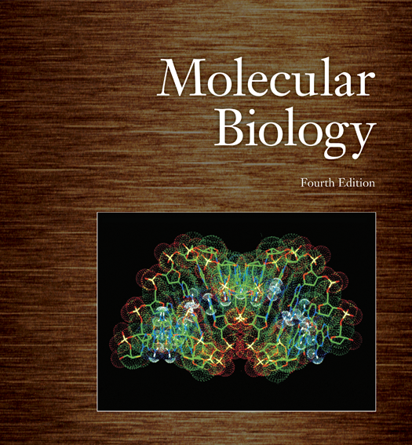
Molecular Biology & Proteomics Transformation and selection of recombinant DNA Lec. 1
Name of teacher Dr. Ahmad H. Ibrahim
Molecular Biology & Proteomics and course code
1st Semester
7th week 11.26.2023

Slide 2
Outline
1. Overview of Information Storage and Processing in Cells
Introduction to the central dogma: DNA to RNA to Protein.
Explanation of transcription and translation processes.
Importance of codons in determining amino acids.
Distinction between template and non-template strands in transcription.
2. Polypeptide Structure and Assembly
Amino acid structure and peptide bond formation.
Definition and characteristics of polypeptides.
Polarity in polypeptides and its relation to DNA.
Understanding the N-terminus and C-terminus.

Slide 3
Outline
3. Secondary Structures: Helices and Sheets
Exploration of alpha-helix secondary structure.
Examination of beta-sheet secondary structure.
Importance of hydrogen bonding in these structures.
Visualization of helical and sheet configurations.
4. Tertiary and Quaternary Protein Structures
Definition and significance of tertiary structure.
A closer look at the three-dimensional shape of polypeptides.
Introduction to protein domains and their structural motifs.
Understanding quaternary structure and interactions between polypeptides.

Slide 4
Outline
5. Protein Function and Genetic Basis
Roles of proteins in cellular structure, signaling, transport, and gene regulation.
Historical perspective: Linking genes and proteins.
One-gene/One-polypeptide hypothesis and its development.
The discovery of messenger RNA and its role in information transfer.

Slide 5
Objectives
Understanding the Central Dogma:
Explain the flow of genetic information from DNA to RNA to protein.
Differentiate between transcription and translation processes.
Molecular Basis of Protein Formation:
Define and describe the role of codons in protein synthesis.
Differentiate between template and non-template DNA strands in transcription. Understanding Base-Pairing in Transcription:
Recognize the base-pairing rules in transcription.
Differentiate the role of U (uracil) from T (thymine) in RNA.
RNA Polymerase and Transcription Phases:
Identify RNA polymerase as the enzyme responsible for transcription.
Define the three phases of transcription: Initiation, Elongation, and Termination.
Initiation Phase in Detail:
Explain how RNA polymerase recognizes promoters.
Outline the steps involved in localized DNA strand separation during initiation.
Elongation and Directionality:
Explore the elongation phase and the 5' to 3' directionality of transcription.
Describe the movement of RNA polymerase along the DNA template.
Distinguishing Transcription from Replication:
Highlight the asymmetry of transcription in contrast to the semiconservative nature of DNA replication.
Explain the differences in DNA melting during transcription and replication.

Slide 6
Objectives
3. Comprehending Polypeptide Structures:
Identify the structure of amino acids and how peptide bonds link them.
Understand the concept of polypeptides, their chains, and polarity.
Recognize the significance of N-terminus and C-terminus in polypeptide chains.
4. Exploring Protein Structures:
Investigate the secondary structures of proteins, including helices and sheets.
Examine the tertiary structure and the role of amino acid side chains.
Introduce the concept of protein domains and their relevance in protein structure.
5. Linking Genes, Proteins, and Function:
Discuss the diverse functions of proteins in cellular processes.
Explore the historical context of linking genes to proteins.
Understand the one-gene/one-polypeptide hypothesis.
Explain the role of messenger RNA in carrying genetic information and its experimental verification.

Slide 7
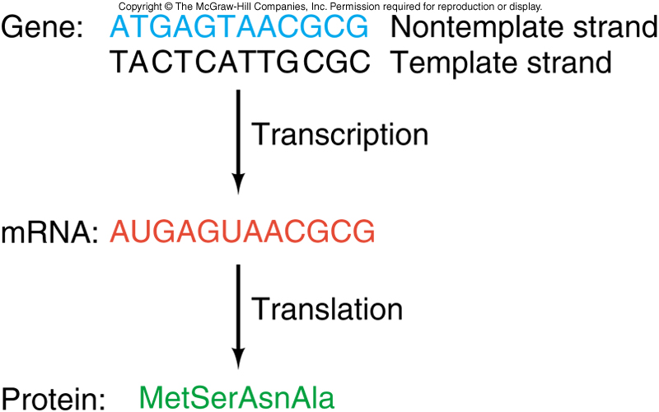
3.1 Storing Information
Producing a protein from DNA information involves both transcription and translation
A codon is the 3 base sequence that determines what amino acid is used
Template strand is the complementary DNA strand that is used to generate the mRNA
Nontemplate strand is not used in RNA transcription

Slide 8
Polypeptides
Amino acids are joined together via peptide bonds
Chains of amino acids are called polypeptides
Proteins are composed of 1 or more polypeptides
Polypeptides have polarity as does DNA
Free amino group at one end is the amino- or N-terminus
Free hydroxyl group at the other end is the carboxyl- or C-terminus

Slide 9
Types of Protein Structure
Linear order of amino acids is a protein’s primary structure
Interaction of the amino acids’ amino and carboxyl groups gives rise to the secondary structure of a protein
Secondary structure is the result of amino acid and carboxyl group hydrogen bonding among near neighbors
Common types of secondary structure:
α−helix
β−sheet

Slide 10
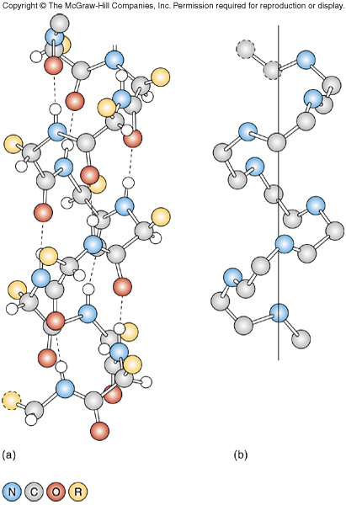
Helical Secondary Structure
In α-helix secondary structure polypeptide backbone groups H bond with each other
Dashed lines in figure indicate hydrogen bonds between nearby amino acids

Slide 11
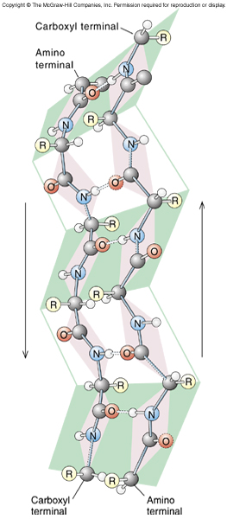
Sheet Secondary Structure
The β-sheet pattern of 2° structure also occurs when polypeptide backbone groups form H bonds
In the sheet configuration, extended polypeptide chains are packed side by side
This side-by-side packing creates a sheet appearance

Slide 12
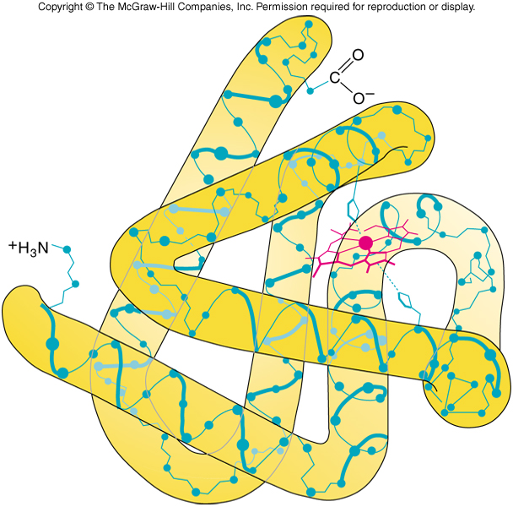
Tertiary Structure
Total three-dimensional shape of a polypeptide is its tertiary structure
A prominent aspect of this structure is interaction of the amino acid side chains
The globular form of a polypeptide is a roughly spherical structure

Slide 13
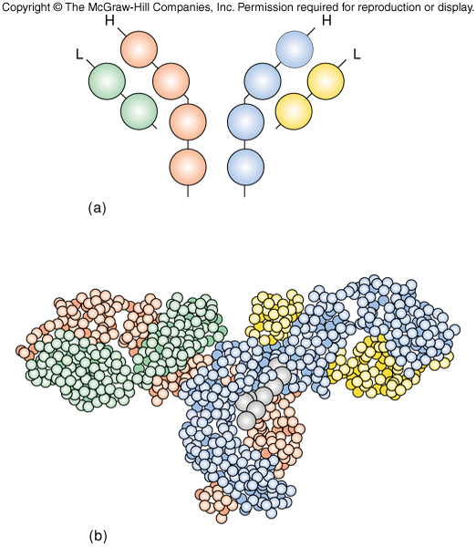
Protein Domains
Compact structural regions of a protein are referred to as domains
Immunoglobulins provide an example of 4 globular domains
Domains may contain common structural-functional motifs
Zinc finger
Hydrophobic pocket
Quaternary structure is the interaction of 2 or more polypeptides

Slide 14
Summary
Proteins are polymers of amino acids linked through peptide bonds
Sequence of amino acids in a polypeptide (primary structure) gives rise to that molecule’s:
Local shape (secondary structure)
Overall shape (tertiary structure)
Interaction with other polypeptides (quaternary structure)

Slide 15
Protein Function
Proteins:
Provide the structure that helps give cells integrity and shape
Serve as hormones carrying signals from one cell to another
Bind and carry substances
Control the activities of genes
Serve as enzymes that catalyze hundreds of chemical reactions

Slide 16
Relationship Between Genes and Proteins
1902 Dr. Garrod suggested a link between a human disease and a recessive gene
If a single gene controlled the production of an enzyme, lack of that enzyme could result in the buildup of homogentisic acid which is excreted in the urine
Should the gene responsible for the enzyme be defective, then the enzyme would likely also be defective

Slide 17
One-gene / One-polypeptide
Over time many experiments have built on Garrod’s initial work
Many enzymes contain more than one polypeptide chain and each polypeptide is usually encoded in one gene
These observations have lead to the one gene one polypeptide hypothesis:
Most genes contain the information for making one polypeptide

Slide 18
Information Carrier
In 1950s and 1960s, the concept that messenger RNA carries information from gene to ribosome developed
An intermediate carrier was needed as DNA is found in the nucleus, while proteins are made in the cytoplasm
Some type of molecule must move the information from the DNA in the nucleus to the site of protein synthesis in the cytoplasm

Slide 19
Discovery of Messenger RNA
Ribosomes are the cytoplasmic site of protein synthesis
RNA from ribosomes does not move between the nucleus and cytoplasm
Jacob proposed an alternative of non-specialized ribosomes that translate unstable RNAs that are called messengers
These messengers are independent RNAs that move information from genes to ribosomes

Slide 20
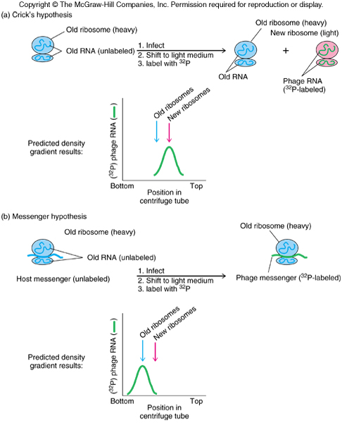
Experiment to Test mRNA

Slide 21
Crick and Jacob Experiments
Radio-labeled phage RNA in experiments was found to be associated with old ribosomes whose rRNA was made before infection
rRNA doesn’t carry information from DNA
A different class of unstable RNAs associate transiently with ribosomes

Slide 22
Summary
Messenger RNAs carry the genetic information from the genes to the ribosomes, which then synthesize polypeptides

Slide 23
Molecular Biology & Proteomics Transformation and selection of recombinant DNA Lec. 2
Name of teacher Dr. Ahmad H. Ibrahim
Molecular Biology & Proteomics and course code
1st Semester
7th week 11.26.2023

Slide 24
Outline
1. Overview of Transcription:
Brief introduction to transcription as a process of genetic information transfer.
Highlight the base-pairing rules in transcription, emphasizing the substitution of U for T.
Introduction to RNA polymerase as the key enzyme in transcription.
Explanation of the three phases of transcription: Initiation, Elongation, and Termination.
2. Initiation Phase in Transcription:
Define the initiation phase and its significance in transcription.
Explanation of how RNA polymerase recognizes the promoter region.
Detail the steps of promoter binding and localized DNA strand separation.
Describe the initiation of RNA chain synthesis by adding ribonucleotides.

Slide 25
Outline
3. Elongation Phase in Transcription:
Explore the elongation phase and its role in building the RNA chain.
Explain the directionality of ribonucleotide addition (5' to 3').
Describe the movement of RNA polymerase along the DNA template.
Discuss the reformation of the double helix as transcription proceeds.
4. Differences Between Transcription and DNA Replication:
Highlight the fundamental differences between transcription and DNA replication.
Emphasize the asymmetry of transcription compared to the semiconservative nature of replication.
Discuss the limited and transient DNA melting during transcription versus permanent separation in replication.
5. Termination and Transcription Landmarks:
Explain the termination phase in transcription and its role in stopping the process.
Discuss the terminator regions and their interaction with RNA polymerase.
Describe the dissociation of RNA from the polymerase and the DNA template.
Highlight transcription landmarks, including the 5' to 3' orientation and the relationship between genes and promoters.
on to transcription as a process of genetic information transfer.

Slide 26
Objectives
Differentiate between template and non-template DNA strands in transcription. Understanding Base-Pairing in Transcription:
Recognize the base-pairing rules in transcription.
Differentiate the role of U (uracil) from T (thymine) in RNA.
RNA Polymerase and Transcription Phases:
Identify RNA polymerase as the enzyme responsible for transcription.
Define the three phases of transcription: Initiation, Elongation, and Termination.
Initiation Phase in Detail:
Explain how RNA polymerase recognizes promoters.
Outline the steps involved in localized DNA strand separation during initiation.

Slide 27
Objectives
4. Elongation and Directionality:
Explore the elongation phase and the 5' to 3' directionality of transcription.
Describe the movement of RNA polymerase along the DNA template.
5. Distinguishing Transcription from Replication:
Highlight the asymmetry of transcription in contrast to the semiconservative nature of DNA replication.
Explain the differences in DNA melting during transcription and replication.

Slide 28
Transcription
Transcription follows the same base-pairing rules as DNA replication
Remember U replaces T in RNA
This base-pairing pattern ensures that the RNA transcript is a faithful copy of the gene
For transcription to occur at a significant rate, its reaction is enzyme mediated
The enzyme directing transcription is called RNA polymerase

Slide 29
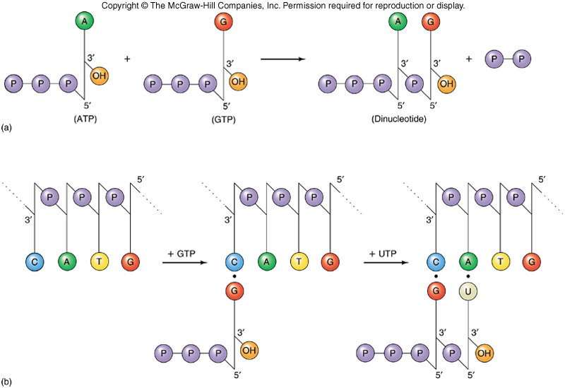
Synthesis of RNA

Slide 30
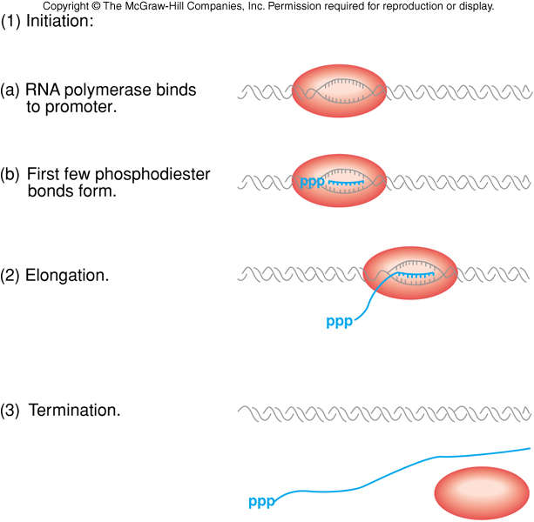
Transcription Phases
Transcription occurs in three phases:
Initiation
Elongation
Termination

Slide 31
Initiation
RNA polymerase recognizes a region, the promoter, which lies just upstream of gene
Polymerase binds tightly to promoter causing localized separation of the two DNA strands
Polymerase starts building the RNA chain adding ribonucleotides
After several ribonucleotides are joined together the enzyme leaves the promoter and elongation begins

Slide 32
Elongation
RNA polymerase directs binding of ribonucleotides in the 5’ to 3’ direction
Movement of the polymerase along the DNA template causes the “bubble” of separated DNA strands to move also
As DNA transcription passes, the two DNA strands reform the double helix

Slide 33
Differences Between Transcription and DNA Replication
There are two fundamental differences between transcription and DNA replication
RNA polymerase only makes one RNA strand during transcription, it copies only one DNA strand in a given gene
This makes transcription asymmetrical
Replication is semiconservative
DNA melting is limited and transient during transcription, but the separation is permanent in replication

Slide 34
Termination
Analogous to the initiating activity of promoters, there are regions at the other end of genes that serve to terminate transcription
These terminators work with the RNA polymerase to loosen the association between RNA product and DNA template
As a result, the RNA dissociates from the RNA polymerase and the DNA and transcription stops

Slide 35
Transcription Landmarks
RNA sequences are written 5’ to 3’, left to right
Translation occurs 5’ to 3’ with ribosomes reading the message 5’ to 3’
Genes are written so that transcription proceeds from left to right
The gene’s promoter area lies just before the start area, said to be upstream of transcription
Genes are therefore said to lie downstream of their promoters

Slide 36
Summary
Transcription takes place in three stages:
Initiation
Elongation
Termination
Initiation involves binding RNA polymerase to the promoter, local melting and forming the first few phosphodiester bonds
During elongation, the RNA polymerase links together ribonucleotides in the 5’ to 3’ direction to make the rest of the RNA
In termination, the polymerase and RNA product dissociate from the DNA template

Slide 37
Translation - Ribosomes
Ribosomes are the protein synthesizing machines
Ribosome subunits are designated with numbers such as 50S or 30S
Number is the sedimentation coefficient - a measure of speed with which the particles sediment through a solution spun in an ultracentrifuge
Each ribosomal subunit contains RNA and protein

Slide 38
Ribosomal RNA
The two ribosomal subunits both contain ribosomal RNA (rRNA) molecules and a variety of proteins
rRNAs participate in protein synthesis but do NOT code for proteins
No translation of rRNA occurs

Slide 39
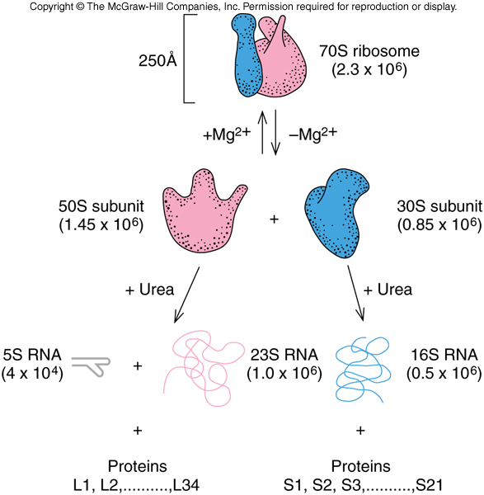
Summary
Ribosomes are the cell’s protein factories
Bacteria contain 70S ribosomes
Each ribosome has 2 subunits
50 S
30 S
Each subunit contains rRNA and many proteins

Slide 40
Translation Adapter Molecule
Generating protein from ribosomes requires change from the nucleic acid to amino acid
This change is described as translation from the nucleic acid base pair language to the amino acid language
Crick proposed that some type of adapter molecule was needed to provide the bridge for translation, perhaps a small RNA

Slide 41
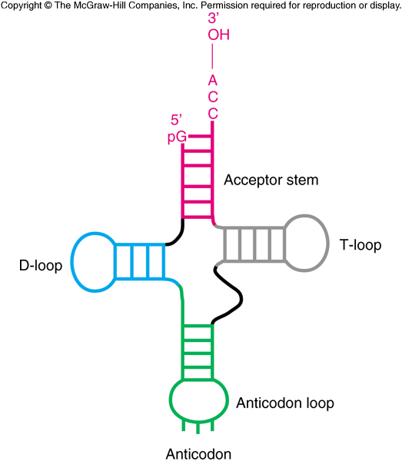
Transfer RNA: Adapter Molecule
Transfer RNA is a small RNA that recognizes both RNA and amino acids
A cloverleaf model is used to illustrate tRNA function
One end (top) binds amino acid with sequence specific to a particular amino acid
Bottom end contains a 3 base pair sequence that pairs with complementary 3-bp sequence in mRNA

Slide 42
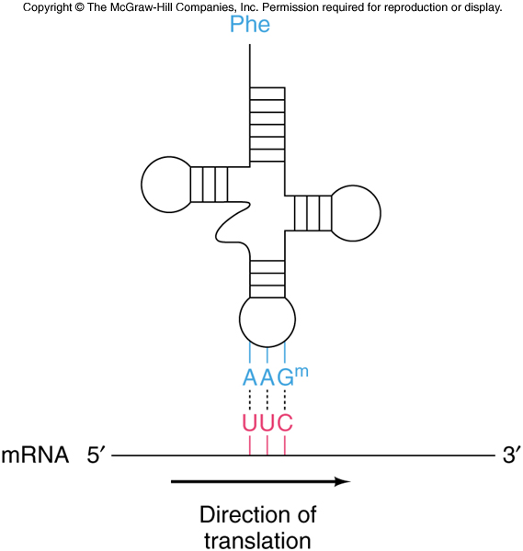
Codons and Anticodons
Enzymes that catalyze attachment of amino acid to tRNA are aminoacyl-tRNA synthetases
A triplet in mRNA is called a codon
The complementary sequence to a codon found in a tRNA is an anticodon

Slide 43
Summary
Two important sites on tRNAs allow them to recognize both amino acids and nucleic acids
One site binds covalently to an amino acid
The site contains an anticodon the base-pairs with a 3-bp codon in mRNA
The tRNAs are capable of serving the adapter role postulated by Crick and are the key to the mechanism of translation

Slide 44
Initiation of Protein Synthesis
The initiation codon (AUG) interacts with a special aminoacyl-tRNA
In eukaryotes this is methionyl-tRNA
In bacteria it is a derivative called N-formylmethionyl-tRNA
Position of the AUG codon:
At start of message AUG is initiator
In middle of message AUG is regular methionine
Shine-Dalgarno sequence lies just upstream of the AUG, functions to attract ribosomes
Unique to bacteria
Eukaryotes have special cap on 5’-end of mRNA

Slide 45
Translation Elongation
After initiation, initiating aminoacyl-tRNA binds to a site on the ribosome, P site
Elongation adds amino acids one at a time to the initiating amino acid
First elongation step is binding second aminoacyl-tRNA to another site on the ribosome, A site
This process requires:
An elongation factor, EF-Tu
Energy from GTP

Slide 46
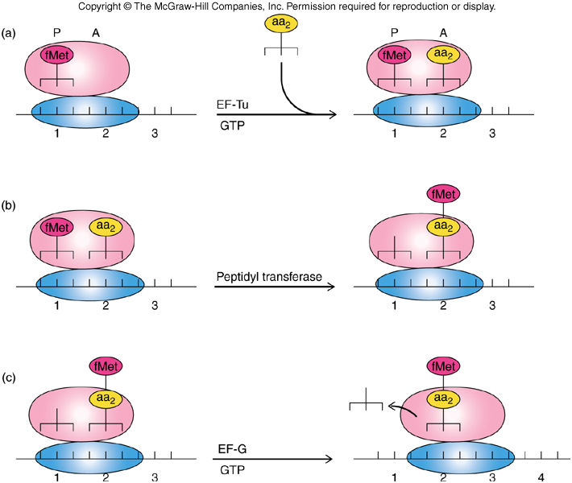
A Summary of Translation Elongation

Slide 47
Termination of Translation and mRNA Structure
Three different codons (UAG, UAA, UGA) cause translation termination
Proteins called release factors recognize these stop codons causing
Translation to stop
Release of the polypeptide chain
Initiation codon and termination codon at the ends define an open reading frame (ORF)

Slide 48
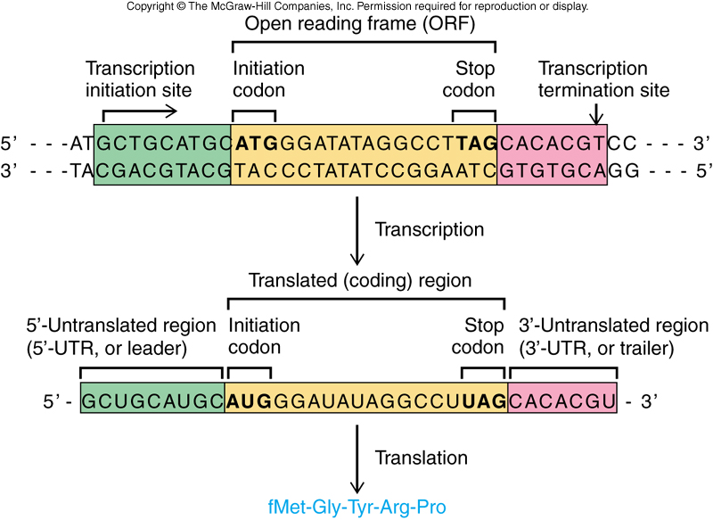
Structural Relationship Between Gene, mRNA and Protein
Transcription of DNA (top) does not begin or end at same places as translation
Transcription begins at first G
Translation begins 9-bp downstream
This mRNA has a 9-bp leader or 5’-untranslated region / 5’-UTR

Slide 49
Structural Relationship Between Gene, mRNA and Protein
A trailer sequence is present at the end of the mRNA
It lies between stop codon and transcription termination site
This mRNA has a 3’-untranslated region or a 3’-UTR

Slide 50
3.2 Replication
Genes replicate faithfully
Semiconservative replication produces new DNA with each daughter double helix having 1 parental strand and one new strand

Slide 51
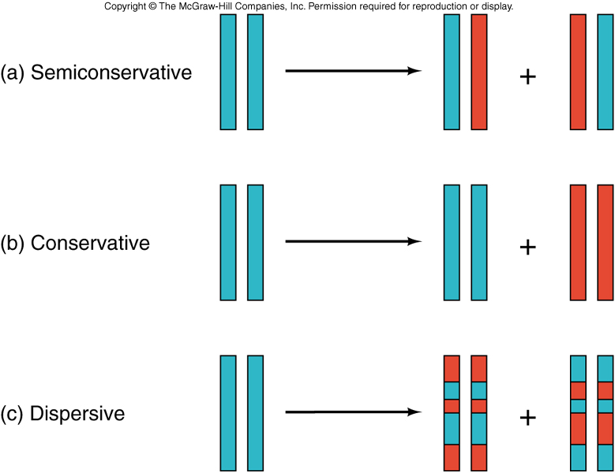
Types of Replication
Alternative theories of replication are:
Semiconservative: each daughter has 1 parental and 1 new strand
Conservative: 2 parental strands stay together
Dispersive: DNA is fragmented, both new and old DNA coexist in the same strand

Slide 52
3.3 Mutations
Genes accumulate changes or mutations
Mutation is essential for evolution
If a nucleotide in a gene changes, likely a corresponding change will occur in an amino acid of that gene’s protein product
If a mutation results in a different codon for the same amino acid it is a silent mutation
Often a new amino acid is structurally similar to the old and the change is conservative

Slide 53
Sickle Cell Disease
Sickle cell disease is a genetic disorder
The disease results from a single base change in the gene for β-globin
Altered base causes insertion an incorrect amino acid into one position of the β-globin protein
Altered protein results in distortion of red blood cells under low-oxygen conditions
This disease illustrates that a change in a gene can cause corresponding change in the protein product of the gene

Slide 54
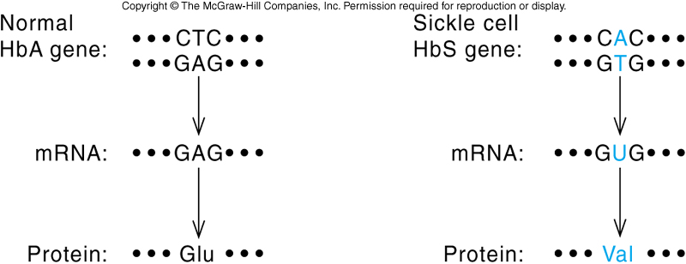
Gene and Protein Mutation
The glutamate codon, GAG, is changed to a valine codon, GUG
Changing the gene by one base pair leads to a disastrous change in the protein product

Slide 55
References
Carson, S., Miller, H. B., Srougi, M. C., & Witherow, D. S. (2019). Molecular biology techniques: a classroom laboratory manual. Academic Press.
Craig, N. L., Green, R. R., Greider, C. C., Wolberger, C., & Storz, G. G. (2021). Molecular biology: principles of genome function. Oxford University Press, USA.
Tropp, B. E. (2012). Principles of molecular biology. Jones & Bartlett Publishers.
Robert, F. W. (2012). Molecular biology.

Slide 56
Molecular Biology & Proteomics Transformation and selection of recombinant DNA Lec. 3
Name of teacher Dr. Ahmad H. Ibrahim
Molecular Biology & Proteomics and course code
1st Semester
7th week 11.26.2023

Slide 57
Methods of Expressing Cloned Genes
Cloning a gene permits
Production of large quantities of a particular DNA sequence for detailed study
Large quantities of the gene’s product can also be obtained for further use
Study
Commerce

Slide 58
Expression Vectors
Vectors discussed so far are used to first put a foreign DNA into a bacterium to replicate and screen
Expression vectors are those that can yield protein products of the cloned genes
For high level expression of a cloned gene best results often with specialized expression vectors
Bacterial vectors have a strong promoter and a ribosome binding site near ATG codon

Slide 59
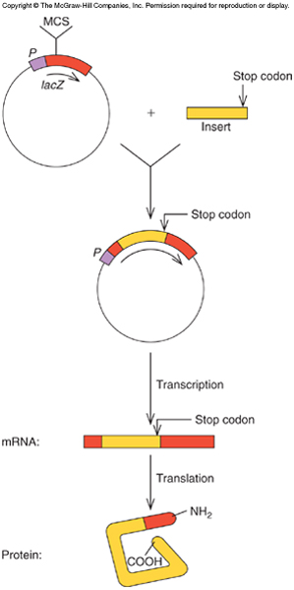
Fusion Proteins
Some cloning vectors, pUC and pBS, can work as expression vectors using lac promoter
If inserted DNA is in the same reading frame as interrupted gene, a fusion protein results
These have a partial β-galactosidase sequence at amino end
Inserted cDNA protein sequence at carboxyl end

Slide 60
Inducible Expression Vectors
Main function of expression vector is to yield the product of a gene – usually more is better
For this reason, expression vectors have very strong promoters
Prefer keep a cloned gene repressed until time to express
Large quantities of eukaryotic protein in bacteria are usually toxic
Can accumulate to levels that interfere with bacterial growth
Expressed protein may form insoluble aggregates, inclusion bodies

Slide 61
Controlling the lac Promoter
lac promoter is somewhat inducible
Stays off until stimulated
Actually repression is incomplete or leaky
Some expression will still occur
To avoid this problem, express using a plasmid or phagemid carrying its own lacI repressor gene, such as pBS

Slide 62
Arabinose Promoter
The hybrid trc promoter combines strength of the trp (tryptophan operon) promoter with inducibility of lac promoter
Promoter from ara operon, P_{BAD}, allow fine control of transcription
Inducible by arabinose, a sugar
Transcription rate varies with arabinose concentration

Slide 63
Tightly Controlled Promoter
Lambda (λ) phage promoter, P_{L}, is tightly controlled
Expression vectors with this promoter-operator system are used in host cells with temperature-sensitive λ repressor gene
Repressor functions are low temperatures
Raise temperature to nonpermissive temperature, the repressor doesn’t function and cloned gene is expressed

Slide 64
Summary
Expression vectors are designed to yield the protein product of a cloned gene
When a lac inducer is added, cell begins to make T7 polymerase which transcribes the gene of interest
Many molecules of T7 polymerase are made, so gene is turned on to a very high level with abundant amount of protein product made

Slide 65
Expression Vectors That Produce Fusion Proteins
Most vectors express fusion proteins
The actual natural product of the gene isn’t made
Extra amino acids help in purifying the protein product
Oligohistidine expression vector has a short sequence just upstream of MCS encoding 6 His
Oligohistidine has a high affinity for divalent metal ions like Ni²⁺
Permits purification by nickel affinity chromatography
His tag can be removed using enzyme enterokinase without damage to the protein product

Slide 66
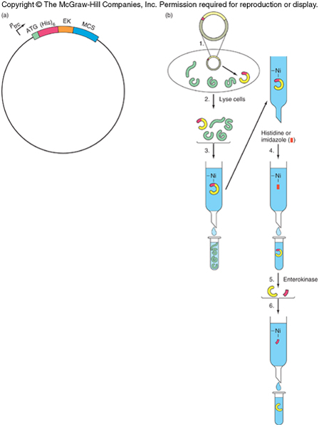
Oligohistidine Expression Vector

Slide 67
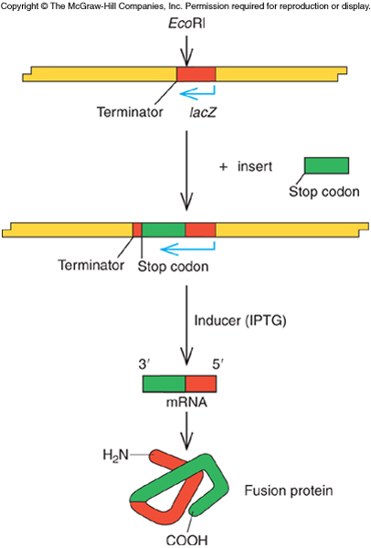
Fusion Proteins in λgt11
This phage contains lac control region and lacZ gene
Products of gene correctly inserted will be fusion proteins with a β-galactosidase leader

Slide 68
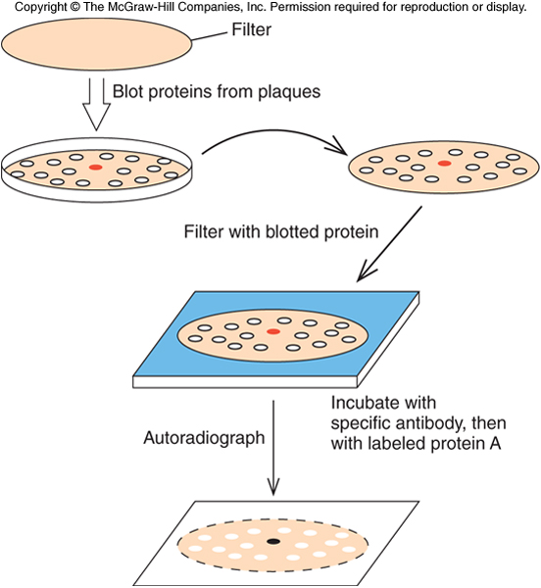
Antibody Screening With λgt11
Lambda phages with cDNA inserts are plated
Protein released are blotted onto a support
Probe with antibody to protein
Antibody bound to protein from plaque is detected with labeled protein A
Partial cDNAs can be completed with RACE

Slide 69
Summary
Expression vectors frequently produce fusion proteins
One part of the protein comes from coding sequences in the vector
Other part from sequences in the cloned gene
Many fusion proteins have advantage of being simple to isolate by affinity chromatography
Vector lgt11 produces fusion proteins that can be detected in plaques with a specific antiserum

Slide 70
Bacterial Expression System Shortcomings
There are problems with expression of eukaryotic proteins in a bacterial system
Bacteria may recognize the proteins as foreign and destroy them
Posttranslational modifications are different in bacteria
Bacterial environment may not permit correct protein folding
Very high levels of cloned eukaryotic proteins can be expressed in useless, insoluble form

Slide 71
Eukaryotic Expression Systems
Avoid bacterial expression problems by expressing the protein in eukaryotic cell
Initial cloning done in E. coli using a shuttle vector, able to replicate in both bacterial and eukaryotic cells
Yeast is suited for this purpose
Rapid growth and ease of culture
Still a eukaryote with more appropriate posttranslational modification
Secretes protein in growth medium so easy purification

Slide 72
Use of Baculovirus As Expression Vector
Viruses in this class have a large circular DNA genome, 130 kb
Major viral structural protein is made in huge amounts in infected cells
Promoter for this protein, polyhedrin, is very active
These vectors can produce up to 0.5 g of protein per liter of medium
Nonrecombinant viral DNA entering cells cannot result in infectious virus as it lacks an essential gene supplied by the vector

Slide 73
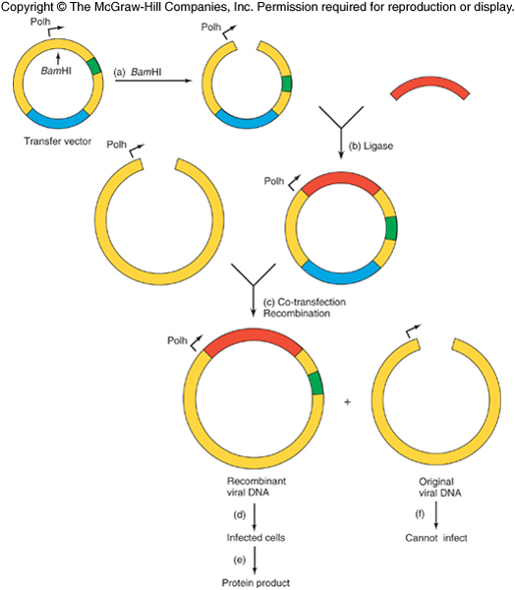
Baculovirus Expression

Slide 74
Animal Cell Transfection
Calcium phosphate
Mix cells with DNA in a phosphate buffer
Then solution of calcium salt added to form a precipitate
Cells take up the calcium phosphate crystals which include some DNA
Liposomes
DNA mixed with lipid to form liposomes, small vesicles with some of the DNA inside
DNA-bearing liposomes fuse with cell membrane carrying DNA inside the cell

Slide 75
Summary
Foreign genes can be expressed in eukaryotic cells
These eukaryotic systems have advantages over prokaryotic ones
Made in eukaryotic cells tend to fold properly and are then soluble rather than aggregated into insoluble inclusion bodies
Posttranslational modifications are made in a eukaryotic manner

Slide 76
Using the Ti Plasmid to Transfer Genes to Plants
Genes can be introduced into plants with vectors that can replicate in plant cells
Common bacterial vector promoters and replication origins are not recognized by plant cells
Plasmids are used containing T-DNA
T-DNA is derived from a plasmid known as tumor-inducing (Ti)
Ti plasmid comes from bacteria that cause plant tumors called crown galls

Slide 77
Ti Plasmid Infection
Bacterium infects plant, transfers Ti plasmid to host cells
T-DNA integrates into the plant DNA causing abnormal proliferation of plant cells
T-DNA genes direct the synthesis of unusual organic acids, opines which can serve as an energy source to the infecting bacteria but are useless to the plant

Slide 78
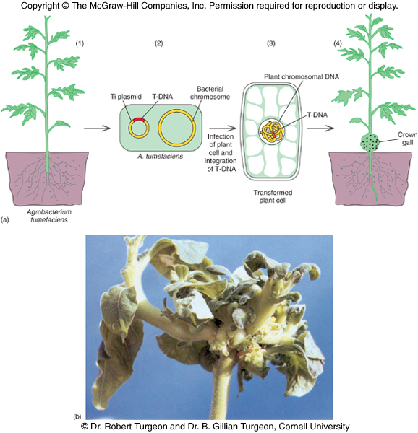
Ti Plasmid Transfers Crown Gall

Slide 79
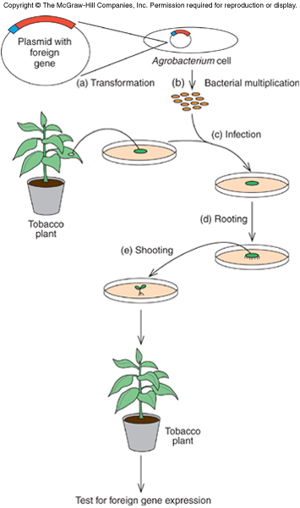
Use of the T-DNA Plasmid

Slide 80
References
Carson, S., Miller, H. B., Srougi, M. C., & Witherow, D. S. (2019). Molecular biology techniques: a classroom laboratory manual. Academic Press.
Craig, N. L., Green, R. R., Greider, C. C., Wolberger, C., & Storz, G. G. (2021). Molecular biology: principles of genome function. Oxford University Press, USA.
Tropp, B. E. (2012). Principles of molecular biology. Jones & Bartlett Publishers.
Robert, F. W. (2012). Molecular biology.

