Slide 1
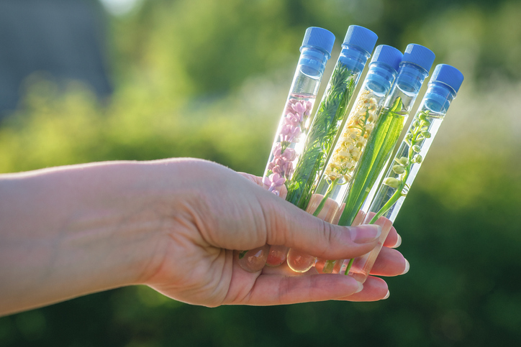
PHYTOCOSMETICS PHAR 535
Dr. ESRA TARIQ
Herbal Ingredients Used in Hair Care
Semester-1
Week number: 10
Date : 13/12/2023

Slide 2
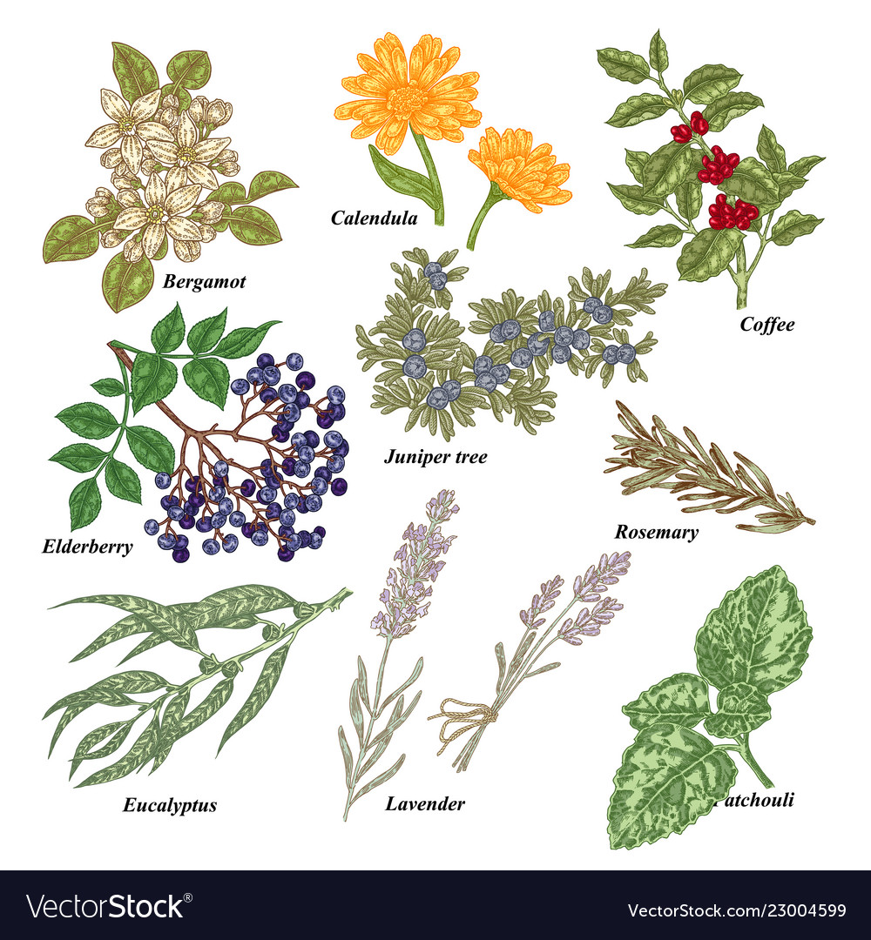
Outline
Herbals hair care

Slide 3
Herbal ingredients used in the cosmetics for hair care
Anti-dandruff : soap nut ,shikakai , arnica, thyme , rosemary , Aloe Vera , parsley ,
Anti-lice : kachur-sugandhi ,sitaphal
Hair tonic : Jatamansi , coconut oil, sesame oil , Hibiscus , rosemary ,
Hair wash : Amla , soap nut , shikakai
Hair dye : Eclipta , Amla, Henna, Hibiscus , Sage, Chamomile
Hair conditioner :Eclipta , rosemary, henna ,Amla , hibiscus
Shinning of hair : soap nut , shikakai , sage
Reduce hair falls : Amla , arnica

Slide 4
Types of Herbal cosmetics preparation for Hair
1) Hair oil
2) Shampoos
3) Hair dye
4) Hair lotion

Slide 5
Types of Herbal cosmetics preparation for Hair
1- Hair Oil
The hair oils are used for dressings and nourishing the hair. This preparations is generally used to increase the growth of hair and to make them healthy.
Herbal hair oil not only moisturizes scalp but also reverses dry scalp and dry hair condition. It provides numerous essential nutrients required to maintain normal functions of sebaceous gland and promote natural hair growth.

Slide 6
Types of Herbal cosmetics preparation for Hair
Hair oil should have the following characteristics
They should give luster to the hair.
Retain them soft and flowing.
Invigorate their growth.
Keep the brain cool.
Should not be sticky.

Slide 7
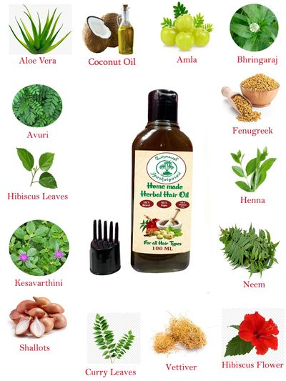
Ingredients Used in Herbal Hair Oil

Slide 8
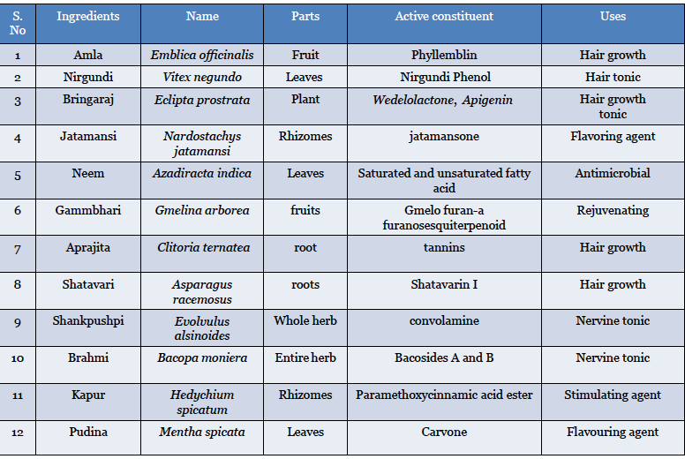
Ingredients Used in Herbal Hair Oil

Slide 9
2- SHAMPOO
Herbal shampoos are the cosmetic preparations that with the use of traditional ayurvedic herbs are meant for cleansing the hair and scalp just like the regular shampoo.
They are used for removal of oils, dandruff, dirt, environmental pollutions etc..
Functions
Lubrication
Conditioning
Hair growth
Maitainence of hair colour
Medication

Slide 10
Herbal shampoo
1) Preparation of extract
About 100 g of each powdered plant materials, namely H. rosa-sinensis, E. officinalis, A. concinna, S. indica, E. prostrate, A. barbadensis, and C. auriculata, were homogenized.
The powdered material was extracted with distilled water by boiling for 4 h. The extract of each plant material was separated and evaporated.
2) Formulation of herbal shampoo
To the gelatin solution (10%), added the herbal extract and mixed by shaking continuously at the time interval of 20 min. 1 ml of lemon juice was also added with constant stirring.
To improve aroma in the formulation, sufficient quantity of essential oil (rose oil) was added and made up the volume to 100 ml with gelatin.

Slide 11
Formulation of herbal shampoo
3) Hair dye
These are preparations which are used for the coloring of the hairs.
They enhances the attractiveness of gray hair.
They are applied externally on the hair with help of brush
4) Hair lotion
Hair lotion has a stimulating effect upon the hair follicles.
They are generally perfumed with oil of rosemary and others ascenes as it posses a good stimulating property.

Slide 12
References
Peter Elsner, (2000). Cosmeceuticals , Drugs vs Cosmetics, Marcel Dekker, Inc. New York • Basel TM
Bruno Burlando, Luisella Verotta, Laura Cornara, Elisa Bottini-Massa, Herbal Principles in Cosmetics: Properties and Mechanisms of Action, 2010, CRC Press.

