Slide 1
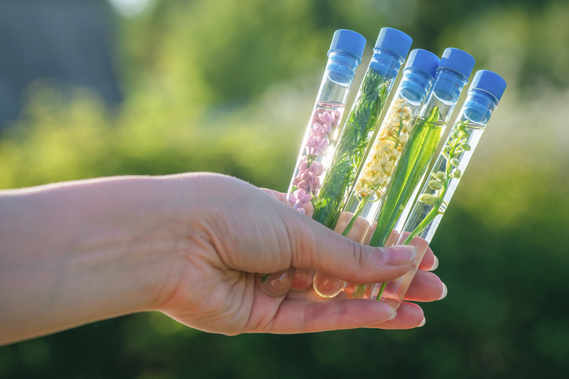
PHYTOCOSMETICS PHAR 535
Dr. ESRA TARIQ
Herbal Extracts in Cosmetic Use-II
Semester-1
Week number: 8
Date : 13/12/2023

Slide 2
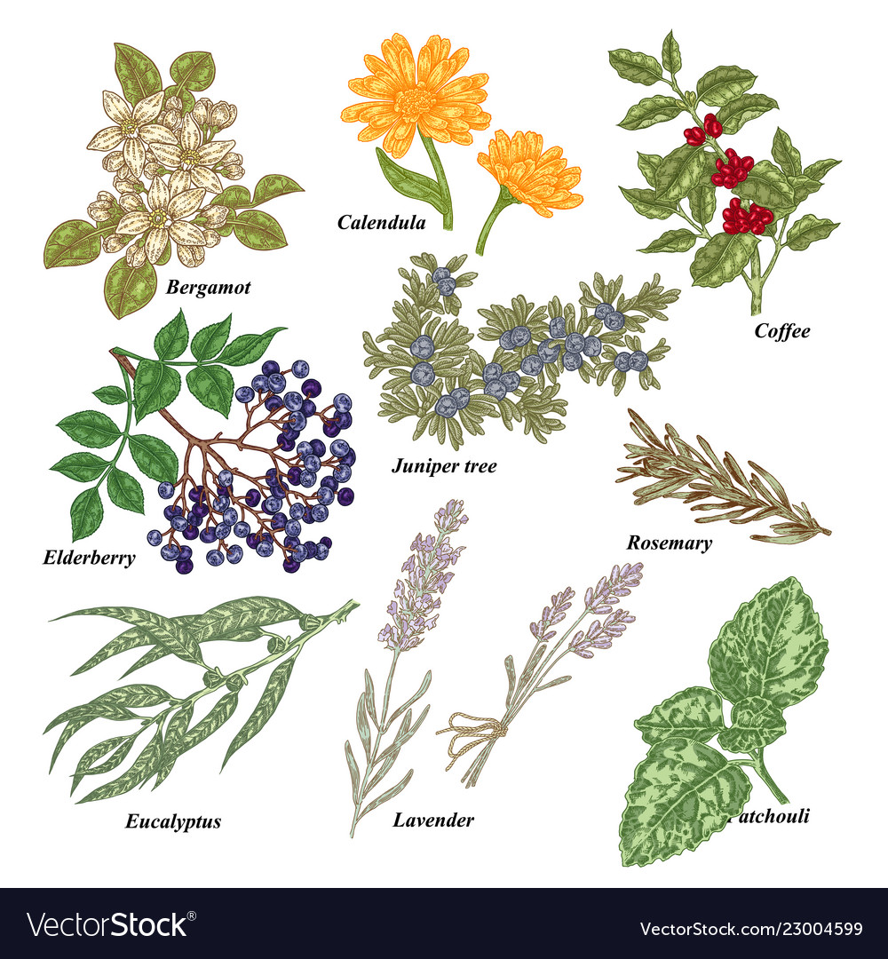
Outline
Herbals in skin care

Slide 3
Herbal Skin Care Products
Almond
Scientific name: Prunus dulcis (Mill.) D. A. Webb var. dulcis
P. dulcis (Mill.) D. A. Webb var. amara (DC) H. Moore
Family: Rosaceae
Parts used: Seeds
The seed is composed of triglycerides (45–50%), proteins (20–25%), mineral salts (2–3%), cellulose fiber (4–5%), mono- and disaccharides (5–6%), and vitamins (A, B1, B2, B3, B6). The seed also contains an enzymatic complex, including emulsin (β-glucosidase), amylase, and oxynitrilase.

Slide 4
Dermatologic and Cosmetic Use
About 95% of the oil is represented by ω-3 fatty acids (mostly oleic and linoleic).
The oil is therefore widely used in cosmetics for its emollient, lenitive, and nourishing properties.
It is indicated for the skin of adults and kids, and even for the particularly delicate skin of newborns. It is used as a lubricant, sebum restitutive, and reepithelialization agent, and is recommended for dry skins and to alleviate itching caused by dermatitis, eczema, measles, and chickenpox. The oil can also be used against stretch marks caused by birth or slimming diets and to soften and moisturize dry or frizzy hair, or hair bleached by sun and saltiness. It can be mixed with essential oils for massage for joint pain or after physicalexercise

Slide 5
Herbal Skin Care Products
Bearberry
Scientific name: Arctostaphylos uva-ursi (L.) Spreng.
Family: Ericaceae
Parts used: Leaves
The plant is used in skin care products mostly for its depigmenting action. Hydroquinones are well-known inhibitors of tyrosinase, the enzyme responsible for L-tyrosine oxidation in the biosynthetic pathway of melanin. An in vitro experimental study has shown that arbutin inhibits the synthesis of melanin in human melanoma cells and in a three-dimensional human skin model.
Ursolic acid exerts an anti-inflammatory action on the skin, and moreover, it inhibits elastase, hence being an interesting compound for antiaging products. Allantoin is used as an active principle in creams against herpes and vaginal infections

Slide 6
Herbal Skin Care Products
Cinnamon
Scientific name: Cinnamomum verum J. Presl (syn. Cinnamomum zeylanicum Bl.)
Family: Lauraceae
Parts used: Bark and leaves
The essential oil obtained from the bark and leaves (0.5–1.0% and 1.6–1.8%, respectively) is very aromatic and spicy

Slide 7
Dermatologic and Cosmetic Use
The essential oil is used in perfume and cosmetic industries,29 but the dosage must be carefully controlled due to the oil’s capability of inducing irritation and sensitization on the skin and mucosae. Noxious effects are mainly due to the presence of cinnamaldehyde.
In aromatherapy it is preferable to use the oil extracted from leaves, owing to a lower content in cinnamaldehyde. Cinnamon oil is used for tonifying massage, since it exerts a vasodilatory effect caused by cinnamaldehyde.
Such a property is responsible for the emmenagogue effect of the plant, while it can also be exploited for aesthetic purposes, such as lip volumizers, or in the treatment of cellulite

Slide 8
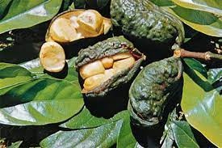
Herbal Skin Care Products
Cola
Scientific name: Cola acuminata (P. Beauv.) Schott & Endl. C.nitida (Vent.) Schott & Endl.
Family: Malvaceae
Parts used: Seeds

Slide 9
Herbal Skin Care Products
Dermatologic and Cosmetic Use
Plant extracts based on cola nut induce an increase of lipolysis (similar to those of Coffea arabica, the coffee plant, and of Camellia sinensis, the tea plant), also involving a reduction of adipocytes in peripheral body areas. These preparations are therefore helpful in treatments against cellulite.
It has been shown that caffeine reduces the occurrence of skin tumors in hairless mice exposed to intense UV irradiation through a prevention of p53 gene mutation.

Slide 10
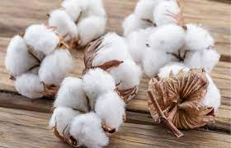
Cotton
Scientific name: Gossypium hirsutum L.
Family: Malvaceae
Parts used: Seeds
Cottonseed oil is commonly used in soaps and cosmetic products, while cotton fiber can also be used in the cosmetic field. The importance of the oil is linked to the high content in linoleic acid.
This fatty acid is essential for the structure of cellular membranes and ensures the integrity of the skin water barrier. Linoleic acid reduces skin dehydration, but it also has protective effects against external irritating agents

Slide 11
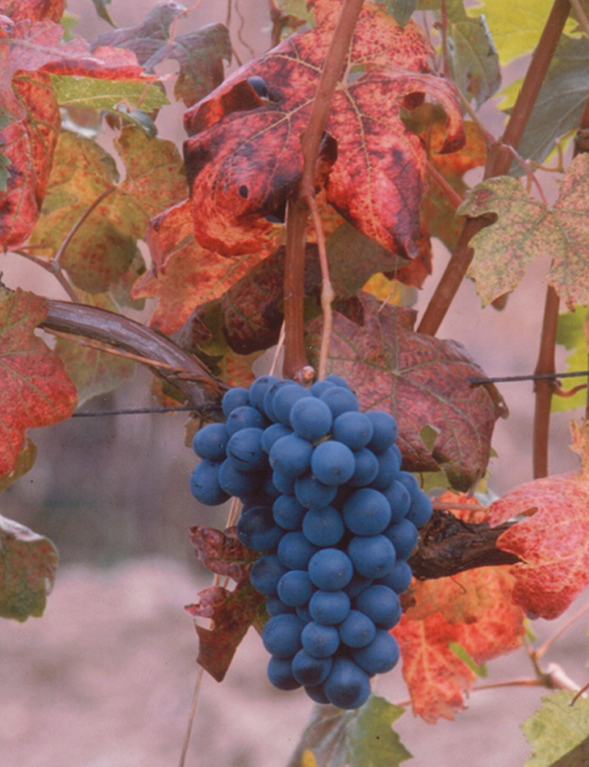
Herbal Skin Care Products
Grape
Scientific name: Vitis vinifera L.
Family: Vitaceae
Parts used: Fruits, seeds, leaves

Slide 12
Red grape extracts and active principles are widely used in cosmetic products.
The importance of grape in skin care is evidenced by wine therapy, which originally developed in the region of Bordeaux, France, and then diffused to other countries.
Wine therapy basically consists of baths or applications of wine and grape extracts rich in polyphenols in order to stimulate microcirculation and strengthen blood vessels.
The stabilizing action of proanthocyanidins on capillary vessels gives a contribution to the maintenance of skin elasticity and improves disorders linked to skin circulation, such as couperose, or to an insufficient draining of subdermal tissue, like cellulite.

Slide 13
Grape
The antioxidant power of flavonoids and polyphenols contrasts aging processes induced by UV radiations and free radicals.
A main change involved in skin aging is the degradation of glycosaminoglycans and collagen, with a consequent reduction in skin thickness.
Resveratrol has a tightening and firming action on the skin and favors tissue renewal, thus acting similarly to retinol.
A grapeseed extract has promoted the expression of vascular endothelial growth factor (VEGF) in keratinocytes, thus favoring skin angiogenesis and wound healing

Slide 14
Grapeseed oil is easily absorbed by the skin, on which it exerts emollient, mildly astringent, and hydrating effects.
It is particularly suitable for stress-induced skin damage, particularly in the periocular region, because of its high regenerative properties.
The oil forms a thin film on the skin and is therefore used as a vehicle of
essential oils in aromatherapy. It is also useful in the treatment of acne

Slide 15
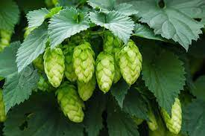
Herbal Skin Care Products
Hops
Scientific name: Humulus lupulus L.
Family: Cannabaceae
Parts used: Female flowers
The active principles of hops can stimulate the cells of the connective tissue. Herbal preparations of the plant are used in wound healing and in the manufacturing of creams and lotions having emollient, hydrating, and regenerative effects

Slide 16
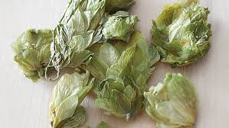
Herbal Skin Care Products
Hop extracts are also useful in the prevention of skin aging and in the treatment of loose skin, stretch marks, and sagging.
They are also used in breast tightening, for the presence of the phytoestrogen 8-prenylnaringenin, even though clinical trials do not allow a reliable evaluation of this treatment and cannot exclude the insurgence of noxious effects.
A hexan extract containing humulones and lupulones, mixed to an oily or creamy vehicle, has been patented as a solar screen due to its ability to absorb UV light.62,63 This product has also been claimed to prevent erythema and sunburning by the stimulation of cutaneous melanization.

Slide 17
References
Peter Elsner, (2000). Cosmeceuticals , Drugs vs Cosmetics, Marcel Dekker, Inc. New York • Basel TM
Bruno Burlando, Luisella Verotta, Laura Cornara, Elisa Bottini-Massa, Herbal Principles in Cosmetics: Properties and Mechanisms of Action, 2010, CRC Press.

