Slide 1
SALIVARY GLAND DISEASES

Slide 2
- There are three paired major salivary glands in humans (the parotid gland, the submandibular gland, and the sublingual gland)
As well as about 800-1000 minor salivary glands in the oral mucosa of the mouth.
The function of the salivary glands is to secrete saliva, which has a lubricating function, which protects the oral mucosa of the mouth during eating and speaking.
Saliva also contains digestive enzymes (e.g. salivary amylase) and has antimicrobial action and acts as a buffer.

Slide 3
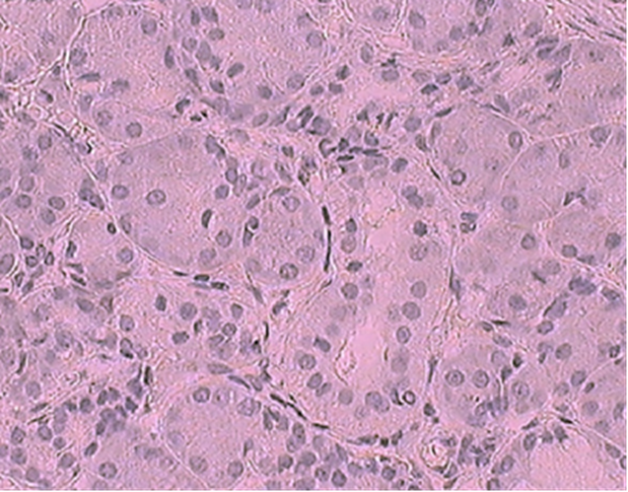

Slide 4
Salivary gland diseases are multiple and varied in etiology:
CONGENITAL:
These disorders of the salivary glands are rare, but may include:
Aplasia, atresia, and ectopic salivary gland tissue.

Slide 5
SALIVARY CALCULI (sialolith):
-Salivary calculi or a stone can form in a salivary gland or duct.
At least 80% of calculi form in the submandibular gland.
Several possibly coexisting factors have been suggested to be involved in the formation of salivary stones, including altered acidity of saliva, reduced salivary flow rate, abnormal calcium metabolism and abnormalities in the sphincter mechanism of the duct opening,
The exact cause in many cases is unknown.

Slide 6
-It usually forms by deposition of calcium salts around a nidus of organic material, and have a layered structure.
Adults are mainly affected.
Calculi are usually unilateral.
The classical symptom is pain when the smell or taste of food stimulates salivary secretion.
Duct obstruction can lead to infection, pain and swelling of the gland.

Slide 7
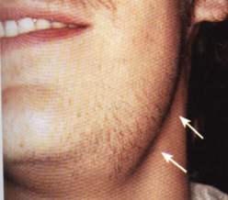
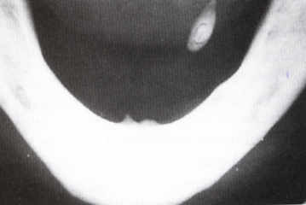
The stone may be seen in a radiograph. However, some stones are not radiopaque, and sialography may be needed to locate them.
(A,B)Submandibular sialolithiasis with swelling bellow the mandible. Occlusal radiograph shows a stone in Warthin duct

Slide 9
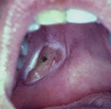
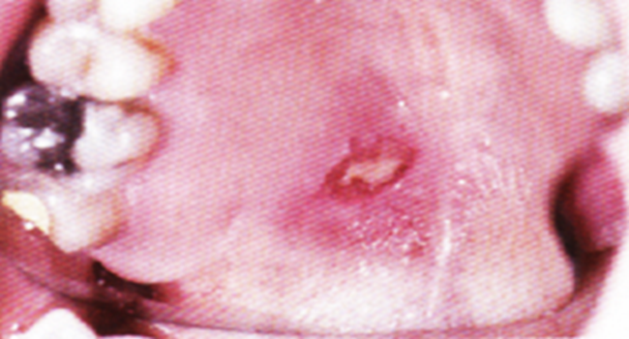
VASCULAR DISEASE:
Necrotizing sialometaplasia
-Is ulcerative lesion; the ulcer is deep well-circumscribed, usually located towards the back of the hard palate.
It is thought to be caused by ischemic necrosis (death of tissue due to lack of blood supply) of minor salivary glands in response to trauma.
- Often painless, the condition is self-limiting and should heal in
6–10 weeks.

Slide 10
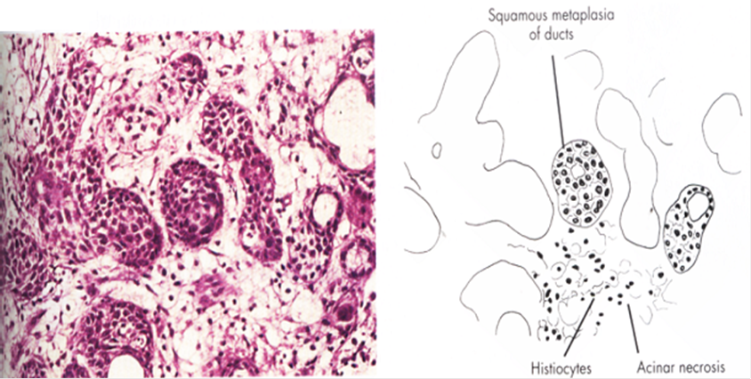
Although entirely benign and requiring no treatment, due to its similar appearance to oral cancer, it is sometimes misdiagnosed as malignant. Therefore, it is considered an important condition, despite its rarity. Differentiation between this and squamous cell carcinoma ulcer would be based on a history of recent trauma or dental treatment in the area like local anesthetic injections
Ductal structures undergo transformation from cuboidal to squamous cells (squamous metaplasia)

Slide 11
CYSTS OF SALIVARY GLANDS:
Mucoceles and ranula
INFECTION DISEASES:
Infections can be viral or
bacterial (or rarely fungal).

Slide 12
Viral sialadenitis:
Mumps
-Is caused by paramyxovirus which causes painful swelling of the parotids and sometimes other glands.
- It is highly infectious and is the most common cause of acute parotid swelling.
Children are mainly affected
The virus is transmitted by direct contact with infected saliva and by droplet spread.

Slide 13
CLINICAL FEATURES
-An incubation period of about 21days is followed by headache, malaise, fever and tense, painful and tender swelling of the parotids.
-The salivary glands enlargement gradually subsides over a period of about seven days.
-In adults other organs are involved such as testes, ovaries, central nervous system and pancreas, and orchitis is the most common complication.
-Mumps may be mistaken for a dental infection or bacterial sialadenitis, if unilateral.

Slide 14
B. Bacterial sialadenitis:
Present as an acute or chronic condition
Acute bacterial sialadenitis particularly involves the parotid glands and traditionally affected debilitated patients, particularly postoperatively, as a result of xerostomia secondary to dehydration.
It is more commonly seen in patients with severe xerostomia, particularly Sjogren's syndrome, and as an uncommon complication of drugs that cause xerostomia.
It is usually caused by ascending organisms from the oral cavity. Important bacterial causes include Staphylococcus aureus and streptococcus pyogenes.

Slide 15
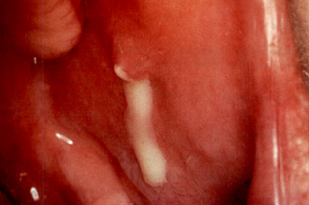
clinical features
-Typical clinical features are pain in one or both parotids with swelling, redness and tenderness and often increasing malaise and fever.
- The regional lymph nodes are enlarged and tender, and pus exudes or can be expressed from the parotid duct.

Slide 16
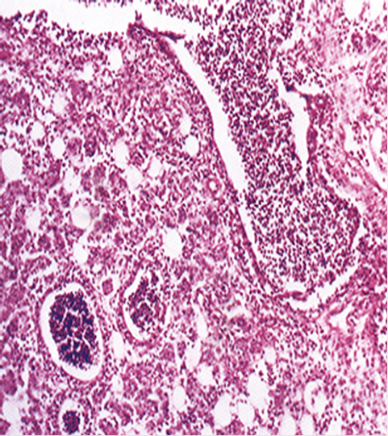
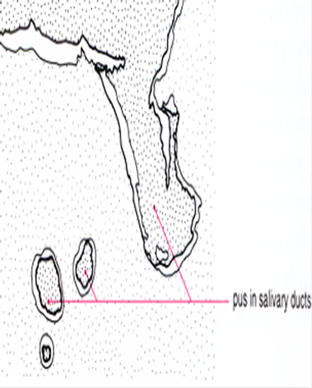
Microscopically
An intense acute inflammatory infiltrate extends into the periductal tissues is seen.

Slide 17
Chronic bacterial sialadenitis
Is usually a complication of duct obstruction, or due to decreased salivary flow with low grade ascending infection.
Mostly unilateral and associated with recurrent painful swelling of the gland.
The submandibular gland is much more commonly affected, and the duct orifice may appear inflamed and red.
Sialography may show dilatation of ducts (sialectasia) behind the obstruction.

Slide 18
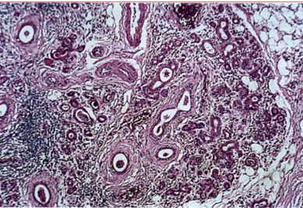
. Microscopically
- Varying degrees of destruction of acini, duct dilatation and a scattered chronic inflammatory cellular infiltrate, and interstitial fibrosis are seen.
Chronic bacterial sialadenitis, severe acinar atrophy with infiltrate of lymphocytes and plasma cells.

Slide 19
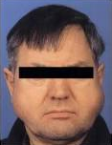
SIALADENOSIS (sialosis):
Chronic, bilateral, diffuse, non-inflammatory, non-neoplastic enlargement of a salivary gland, usually the parotid gland ,but occasionally affects the submandibular glands.
This can be painless or in some instances tender.
Sialosis may be idiopathic or may be associated with the chronic malnutrition, obesity, diabetes mellitus, alcoholism, liver disease, or drugs (like antihypertensives)

Slide 20
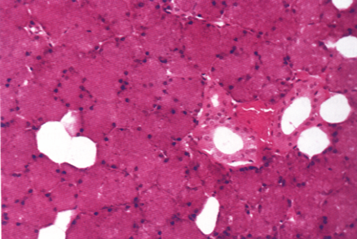
Microscopically
- Fatty infiltration in the glandular stroma is seen.
Salivary gland enlargement usually resolves with treatment of the underlying condition.

Slide 21
IRRADIATION DAMAGE:
Salivary tissue is highly sensitive to ionizing radiation.
Irreversible destruction of acini and fibrous replacement can result from therapeutic radiation of the head and neck.
Xerostomia with its attendant complications, such as rampant dental caries, is the typical result.

Slide 22
AUTOIMMUNE DISEASE:
Sjögren's syndrome is autoimmune disease and divided into:
Primary Sjogren's syndrome (Sicca syndrome) which comprises dry mouth and dry eyes and not associated with any connective tissue disease.
Secondary Sjogren's syndrome comprises dry mouth and dry eyes and associated with rheumatoid arthritis or other connective tissue disease.

Slide 23
CLINICAL FEATURES
-Females are affected nearly 10 times as frequently as males.
Salivary glands enlargement is variable.
About half of the cases shows bilateral enlargement which predominantly affect the parotid glands, and seldom painful.
In established cases the oral mucosa is obviously dry, often red, and shiny.
The tongue is typically red and the papillae show atrophy.

Slide 24
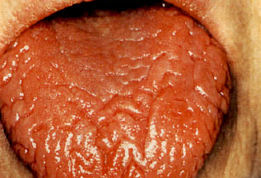
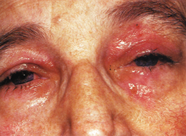
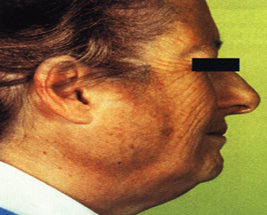
- With diminished salivary secretion the oral flora shows changes, candidal infections, bacterial sialadenitis, and dental caries can be seen

Slide 25
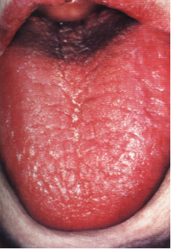
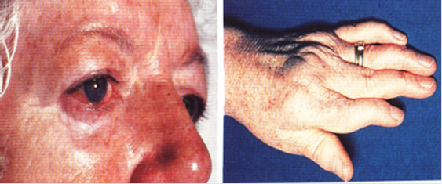

Slide 26
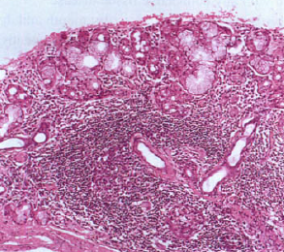
Microscopically
- Histopathological examination of involved major glands shows acinar atrophy and lymphocytic infiltration which eventually replaced the whole affected lobules
Dense, well-defined foci of lymphocytes surround the larger ducts in the centre of the lobules with complete acinar atrophy and a rim of residual salivary parenchyma remains around the periphery of the lobule.

Slide 27
SALIVARY GLAND TUMORS

Slide 28
-Tumors of the salivary glands comprise a significant proportion of oral tumors, and are the next most common neoplasms of the mouth after squamous cell carcinoma.
-However, tumors of the minor intraoral salivary glands are less common than in the major salivary glands
About 70% of salivary gland tumors develop in the parotid
Over 75% of salivary gland tumors are benign.

Slide 29
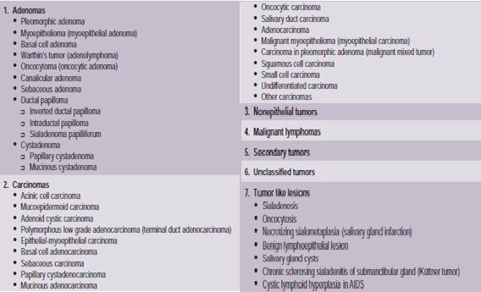
The WHO histological classification of tumors of the salivary glands and the typical clinical features of salivary gland tumors are seen in Table-1and Table-2.

Slide 30
The typical clinical features of salivary gland tumors.

Slide 31
BENIGN TUMORS OF SALIVARY GLANDS
PLEOMORPHIC ADENOMA (Mixed tumor)
- It is the most common benign neoplasm.
- The term ‘pleomorphic adenoma’ is due to the unusual histologic pattern.
- Ductal and myoepithelial cells in possibly either or both may play active roles in the histogenesis of the tumor.

Slide 32
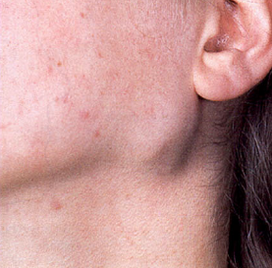
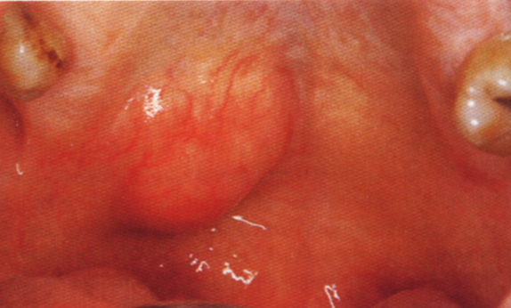
.
Clinical features:
Pleomorphic adenoma is the most common tumor of salivary glands.
The parotid gland is the most common site of the pleomorphic adenoma .
Approximately about 8% of pleomorphic adenomas involve the minor salivary glands and the palate is the most common site of minor salivary gland involvement and glands of the lip and occasionally other sites.

Slide 33
It occurs more frequently in females than in males.
The majority of the lesions are found in patients in the fourth to sixth decades, but they are also relatively common in young adults and have been known to occur in children.
The history presented by the patient is usually that of a small, painless nodule which slowly begins to increase in size, sometimes showing intermittent growth.

Slide 34
The pleomorphic adenoma, particularly of the parotid gland, is typically a lesion that does not show fixation either to the deeper tissues or to the overlying skin
Rubbery in consistency.
The skin seldom ulcerates
pain is not a common symptom
facial nerve involvement manifested by facial paralysis is rare.

Slide 35
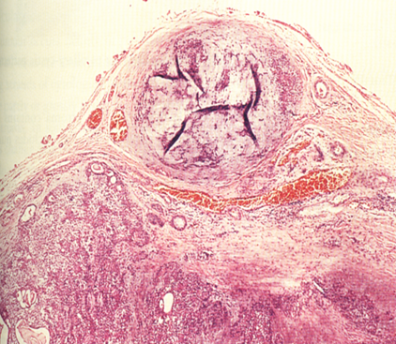
Histopathological features :
The tumor is usually surrounded by capsule which varies in thickness and presence,
The tumor sometimes bulges through the capsule, and this may cause recurrence after its surgical removal.
For this reason the tumor must excised with a margin of surrounding normal tissue.
Tumor nodule within the capsulate

Slide 36
The epithelium usually forms sheets or duct-like structures.
The ducts show cuboidal luminal cells, and often contain eosinophilic secretory material.
Squamous metaplasia and sometimes with the formation of keratin pearls can be seen.
Myoepithelial cells may form a fine reticular pattern or sheets of spindle-shaped cells.

Slide 37
The mesenchymal-like component is myxoid or cartilaginous and sometimes this tissue forms the bulk of the tumor.
Bone may form within this cartilage or form directly by osseous metaplasia of the stroma.
Malignant transformation may occur, usually in tumors that have been present for many years.

Slide 38
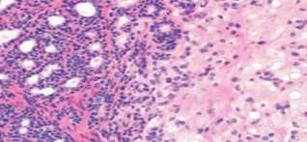
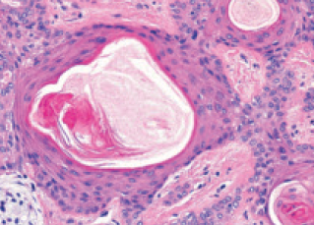
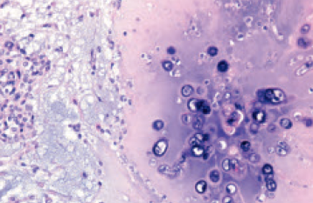
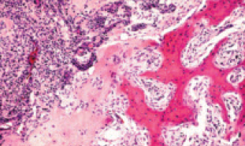
Epithelial component with ductal structures (left) and a mesenchymal myxoid component (right
Squamous differentiation
Chondroid differentiation.
Osseous differentiation.

Slide 39
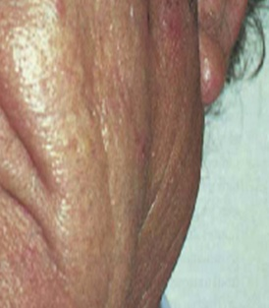
WARTHIN TUMOR (adenolymphoma)
Clinical features:
Warthin tumor is the second commonest tumor of the salivary glands,
- It is rare before 40 years, and is almost exclusively restricted to the parotid glands.
Most patients present with a painless mass.
Facial paralysis is very rare.

Slide 40
Histopathological features:
The lesion is essentially an adenoma exhibiting cyst formation.
It contains papillary projections into the cystic spaces.
The papillae have fibrovascular cores often with a lymphoid matrix showing germinal centers.
The epithelium comprises two layers of cells: the columnar and deep to this layer is the cuboidal basal cells.
The cystic spaces contain eosinophilic secretions.
The tumor is surrounded by sharply demarcated thin capsule.

Slide 41
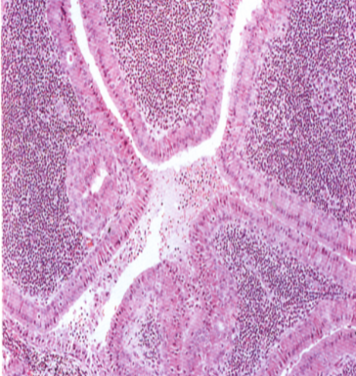
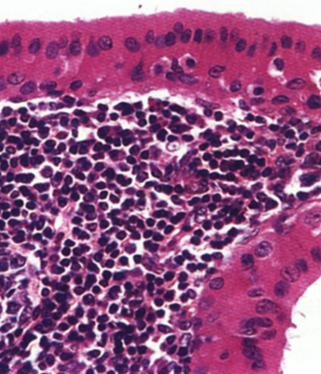
Papillary projection and cystic space. The epithelial cells and lymphoid tissue.

Slide 42
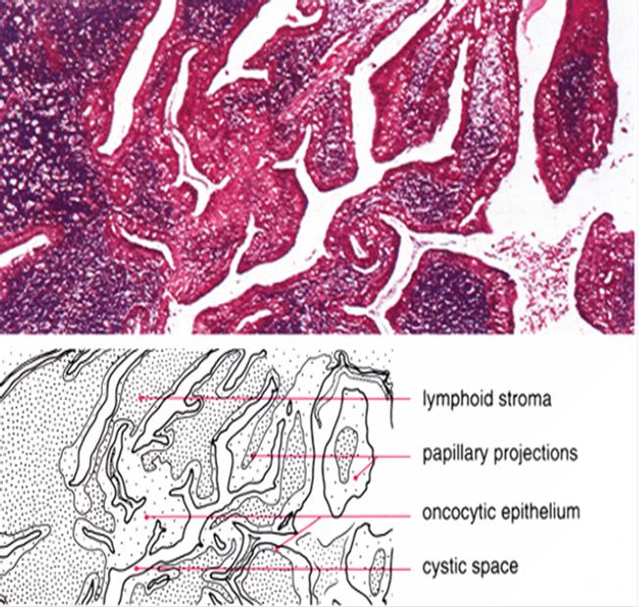

Slide 43
CANALICULAR ADENOMA
Clinical features:
Canalicular adenoma is an uncommon neoplasm originates mainly in the intraoral accessory salivary glands, and in the vast majority of cases, it occurs in the upper lip (about 80% of cases). However, cases are known in which the lesion occurred in the palate, buccal mucosa and lower lip.
The tumor occurs in old patients
Seen more commonly in females.

Slide 44
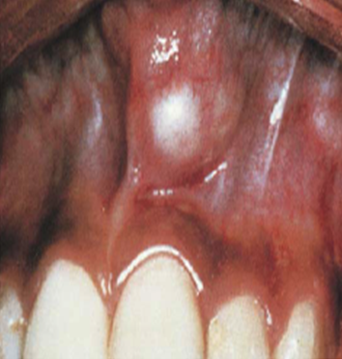
The tumor generally presents as a slowly growing, well-circumscribed, firm nodule which is not fixed and may be moved through the tissue.
No pain or paralysis in the area affected seen.
Multiple canalicular adenomas may be seen.
Canalicular adenoma in the lip

Slide 45
Histopathological features:
It is composed of long columns or cords of cuboidal or columnar cells in a single layer.
These single layers of cells are parallel, forming long canals.
In some instances, cystic spaces of varying sizes are enclosed by these cords.
The cystic spaces are usually filled with an eosinophilic coagulum. - The supporting stroma is loose with delicate vascularity.
Some canalicular adenomas have a fibrous capsule.

Slide 46
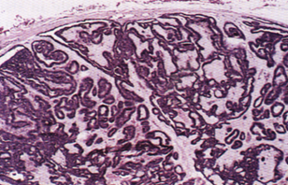
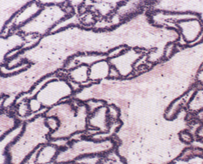
capsule and cord arrangement of epithelial components. Anastomosing cords and delicate stroma.

Slide 47
MALIGNANT TUMORS OF SALIVARY GLANDS

Slide 48
MUCOEPIDERMOID CARCINOMA
Mucoepidermoid carcinoma is the most common epithelial malignant neoplasm observed in the major and minor salivary glands.
Clinical features.
The parotid gland is the most common site of occurrence.
Intraorally, it shows a strong predilection for the palate.
It occurs with a slight female predilection
Mostly old age patients affected, but can occur in any age.
It is the most common malignant salivary gland tumor of children.

Slide 49
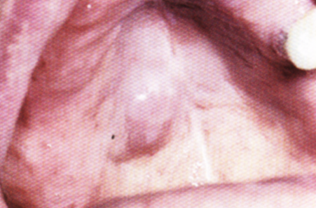
The tumor grows rapidly and facial nerve paralysis is frequent in parotid tumors.
The patient may also complain of trismus, dysphagia, numbness of the adjacent areas, ulcerations and pain.
The mucoepidermoid carcinoma is not encapsulated, and tends to infiltrate the surrounding tissue, and in a large percentage of cases, it metastasizes to regional lymph nodes.
Distant metastases to lung, bone, brain
and subcutaneous tissues are also common.

Slide 50
Histopathological features:
The mucoepidermoid carcinoma is composed of epidermoid type (squamous) cells, mucous secreting cells, and intermediate cells.
The mucous cells are of various shapes and have abundant, pale, foamy cytoplasm.
A population of cells is referred to as the intermediate cells are larger than basal cells and smaller than the squamous cells are believed to be the progenitor of epidermoid and mucous cells.

Slide 51
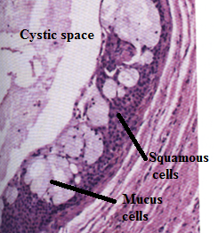
The epidermoid cells, together with intermediate and mucous cells line cystic spaces or form solid masses or cords.

Slide 53
G/ 1
Q A. A 26-year-old male patient reported with swelling below the tongue, which was associated with pain for 1 week .
Clinical examination revealed a superficial, 5 mm hard swelling situated near the lingual frenum, which was extremely tender on palpation.
There was no associated discharge or bleeding reported from the area
- What is your diagnosis, and what is the needed treatment ?
Q B .define Necrotizing sialometaplasia

Slide 56
Tmj
The forward dislocated disc is an obstacle for the condyle movement when the mouth is opening. In order to fully open the jaw, the condyle has to jump over the back end of the disc and onto its center. This produces a clicking or popping sound. Upon closing, the condyle slides back out of the disc hence another “click” or “pop”. This condition is called disc displacement with reduction.
In later stage of disc dislocation, the condyle stays behind the disc all the time, unable to get back onto the disc. The clicking sound disappeared but mouth opening is limited. This is usually the most symptomatic stage – the jaw is said to be “locked” as it is unable to open wide. At this stage the condition is called disc displacement without reduction.

Slide 57
G/2
QA. 45-year-old female patient with a complaint of painful swelling on left side of her face since four days.
History of swelling which was initially small in size and gradually progressed to present size .
Patient also gave a history of similar recurrent swelling since 5 years. intraoral examination, revealed inflamed parotid duct orifice, pus discharge evident on milking of duct orifice
What is your diagnosis, and what is the needed treatment ?
QB .Define warthine tumor

