Slide 1
Tishk International University
Nursing department
Central Processing Unit
Third Lecture
1st Grade- Fall Semester 2023-2024 Goran N. Saleh

Slide 2
The purposes and the objectives CPU:
The purpose & objective of the Central Processing Unit (CPU) is to carry out program instructions.
Each CPU is designed to execute a specific group of instructions, the instruction set.

Slide 3
A central processing unit (CPU), also called a central processor or main processor, is the electronic circuitry within a computer that executes instructions that make up a computer program.
The CPU performs basic arithmetic, logic, controlling, and input/output (I/O) operations specified by the instructions in the program.
The computer industry used the term "central processing unit" as early as 1955.Traditionally, the term "CPU" refers to a processor, more specifically to its processing unit and control unit (CU), distinguishing these core elements of a computer from external components such as main memory and I/O circuitry.

Slide 4
The form, design, and implementation of CPUs have changed over the course of their history, but their fundamental operation remains almost unchanged.
Principal components of a CPU include the arithmetic logic unit (ALU) that performs arithmetic and logic operations, processor registers that supply operands to the ALU and store the results of ALU operations, and a control unit that orchestrates the fetching (from memory) and execution of instructions by directing the coordinated operations of the ALU, registers and other components.

Slide 5
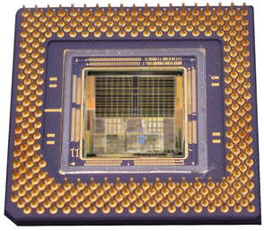
The CPU
The CPU (Central Processing Unit) is the ‘brains’ of the computer.
The purpose of the CPU is to carry out program instructions (each CPU type is designed to understand a specific group of instructions, the instruction set).
On personal computers and small workstations, the CPU is housed in a single chip called a microprocessor.
A typical modern CPU
design showing the
pins that connect it
to the motherboard

Slide 6
What are the components of a typical CPU?
There are huge variations in CPU designs but most will share the following key components:
An electronic clock
The control unit
An instruction unit which consists of:
The arithmetic logic unit (ALU)
The floating point unit (FPU
Various registers such as the accumulator.
Various buses
The bus management unit

Slide 7
Typical CPU components – the clock
An electronic clock regulates the rate at which the CPU runs and synchronizes all the various computer components.
The higher the clock frequency, the more instructions the CPU can execute per second.
The speed of the clock (and therefore the speed of the CPU) is measured in Megahertz (MHz).

Slide 8
Typical CPU components – the control unit
The control unit performs the tasks of:
Fetching instructions from memory
Decoding the instructions
Managing the execution of instructions and the storing of the results
It does this mainly by controlling the links between the other components of the CPU.
It also contains various registers such as:
the Program Counter which stores the memory address of the next instruction.
the Current Instruction register which stores the instruction currently being executed.

Slide 9
Typical CPU components – the INSTRUCTION unit
An instruction unit consists of:
The arithmetic logic unit (ALU) which executes basic arithmetic and logical operations on integer data that it is linked to. Examples of such operations include:
Integer arithmetic operations (addition, subtraction)
Logic operations (AND, NOT, OR, XOR)
The floating point unit (FPU) which performs math functions on floating point numbers (non-integer numbers).
Various registers such as the accumulator that are used while instructions are being executed.

Slide 10
Typical CPU components – Buses
Buses are sets of tiny parallel wires that carry data between CPU components and between the CPU and external devices and RAM. The three main bus types are:
address buses - used to set which memory address a CPU component is linked to for a read/write operation.
data buses - used to exchange the data between a memory address and the CPU when a read/write operation is carried out.
control buses - used to transfer command codes and return status signals between components of the CPU and external devices.
The bus management unit manages the transfer of data along the external bus connections, including the links to RAM.

Slide 11
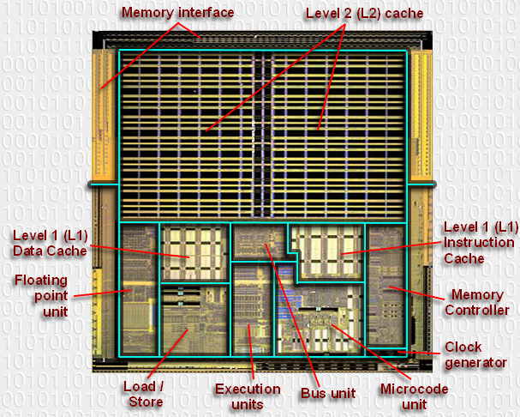
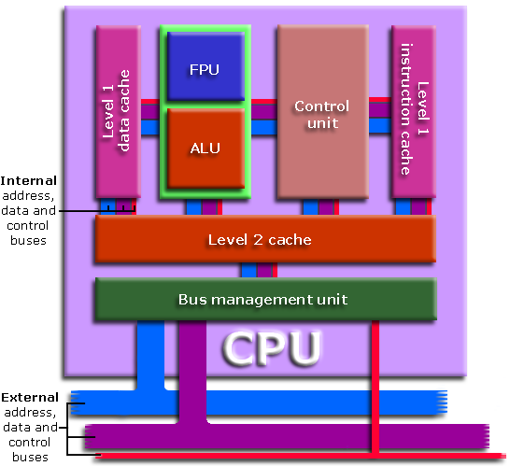

Slide 12
The functions of the CPU
1 - The Fetch step:
This involves retrieving a binary instruction from a memory address and storing it in the Current Instruction register.
The memory address of the instruction is stored in a register called the Program Counter (PC) so the CPU can keep track of which instruction is next.
After an instruction is fetched, the PC is updated so the CPU knows the address of the next instruction it has to fetch.
MEMORY ADDRESS |  |  |  |  |  | MEMORY CONTENTS
1 | 0 | 0 | 1 | 1 |  | 1 | 1 | 0 | 0 | 0 | 1 | 1 | 0
Notes:
Prior learning: Students will need to know about memory addresses and memory contents.

Slide 13
The functions of the CPU
2 - The Decode step:
This involves the CPU identifying the operation code (op-code) part of the instruction which tells it which operation to perform.
If the op-code requires the CPU to act on some data then the second part of the instruction will contain either the data or the memory address where the data is stored.
MEMORY CONTENTS
1 | 1 | 0 | 0 | 0 | 1 | 1 | 0
OP-CODE |  |  |  | ADDRESS OF DATA
1 | 1 | 0 |  | 0 | 0 | 1 | 1 | 0
Notes:
Prior learning: Students will need to know about memory addresses and memory contents.

Slide 14
The functions of the CPU
3 - The Execute step:
In this step the control unit links together the parts of the CPU that are needed to execute the instruction.
If the instruction involved integer arithmetic or logical operations then the arithmetic logic unit (ALU) would be connected to the relevant memory locations
Some types of instructions alter the program counter rather than produce result data. This allows programs to carry out iteration loops and conditional program execution rather than stepping through instructions in sequence.
Some instructions involve an additional write-back step if data is written back to RAM.
Notes:
Prior learning: Students will need to know about memory addresses and memory contents.

Slide 15
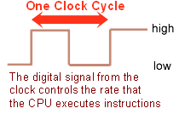
CPU characteristics vs. performance
Clock speed:
Although it might seem that a computer is carrying out many tasks simultaneously, the CPU is actually only ever processing one instruction at a time and is constantly switching between programs (sets of instructions).
The speed that the processor executes instructions is controlled by the clock speed and is measured in MHz (megahertz).
The CPU requires a fixed number of clock cycles to perform each instruction.
Summary:
The higher the clock speed, the more instructions the CPU can execute per second, resulting in a faster running computer system.

Slide 16
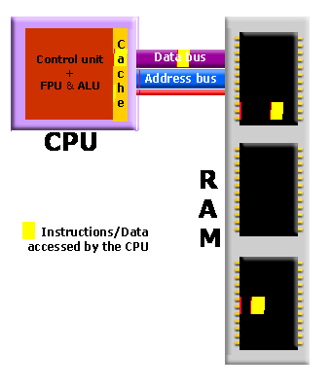
CPU characteristics vs. performance
Cache size:
Cache memory is a small amount of very fast memory that is built into the CPU. Blocks of instructions and data that are in use by the CPU are copied from RAM into cache memory, along with the associated memory addresses.
If the CPU needs to access a memory address it first checks the cache memory to see if there is a match. If there is then it access the contents of the cache version.
Summary:
A CPU with a larger cache memory and more levels of cache memory will have a higher performance than one without cache memory.
Notes:
Cache memory is covered in more detail in the memory presentations

Slide 17
CPU characteristics vs. performance
Number of Cores:
A multi-core processor is a single computing component with two or more independent actual processors (called "cores").
A dual-core processor contains two cores and a quad-core processor contains four cores. Each core can process instructions independently of the other cores.
The biggest performance gain when using a multi-core processor is when the software has been specifically written to run on multiple cores.
Summary:
A multi-core CPU will have a higher performance than a single-core CPU with the same clock speed.

Slide 18
Thank You

