Slide 1
Chronic renal diseases
By
Dr. Muhammad Abdullah Shwani
Assistant professor/Consultant urologist
Kurdistan Higher Council of Medical Specialties (KHCMS)
drmalshwani@mail.com

Slide 2
Chronic Renal Failure
Progressive, irreversible damage to the nephrons and glomeruli results in a progressive deterioration in renal function .
When ESRD(End Stage Renal Disease) is reached the patient becomes dependent on renal replacement therapy to avoid life-threatening uremia.

Slide 3
Chronic Renal Failure -End Stage Renal Disease (ESRD)
Protein and waste metabolism accumulates in the blood (azotemia- uremia)
When 90% of kidney function is lost, kidneys begin to lose the ability to concentrate the urine adequately

Slide 4
Stages of Chronic Renal Failure
Diminished Renal Reserve Normal BUN, and serum creatinine absence of symptoms
Renal Insufficiency GFR is about 25% of normal, BUN and serum Creatinine levels increased
Renal Failure GFR <25% of normal .
ESRD or Uremia GFR < 15% of normal, creatinine clearance <15ml/min .

Slide 5
Uremia
Uremia is a clinical and laboratory syndrome reflecting dysfunction of all organ system as a result of untreated or under treated acute or chronic renal failure.

Slide 6
Causes of chronic failure
Congenital & inherited diseases
Polycystic kidney disease
Congenital Obstructive uropathies
Glomerular Diseases
Primary glomerulo -nephropathies
Secondary glomerular diseases
SLE, DM, HTN, etc
Vascular disease
Atherosclerotic renal vascular disease
Tubulointerstitial disease
Tubulointerstitial nephritis
Idiopathic
Drugs
Reflux nephropathy(VUR).
Urinary Tract obstruction
calculus
Tumor
Prostate problems (CA, BPH)

Slide 7
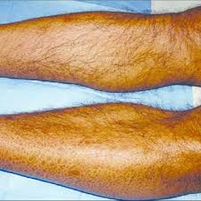
Symptoms
Common symptoms:
malaise, loss of energy
loss of appetite
Insomnia
nocturia and polyuria
itching
nausea, vomiting, diarrhea
Paresthesia
Bone pain
tetany
Symptoms due to salt & water retention(Edema, SOB)
Symptoms due to anemia
Sexual dysfunction
mental slowing, clouding of consciousness, seizures, Coma

Slide 8
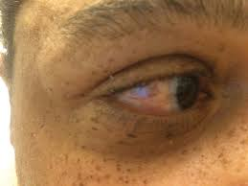
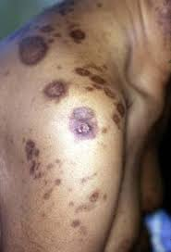
Signs of Uremia.
Short stature if renal failure starts in childhood.
Pallor.
Pigmentation
Scratch marks.
Signs of fluid overload
Pericardial Friction rub
Flow murmurs
Peripheral neuropathy
Kidneys – impalpable except in polycystic disease, obstruction, or tumor
Physical signs of underlying disease
Cutaneous vasculitis
Retinopathy
Evidence of neurogenic bladder

Slide 9
Investigations
Urine analysis (macroscopic) looking for :
Hematuria.
Proteinuria.
Glycosuria.
Urine microscopic exam:
WBC
Red blood cell (RBC)
Granular casts - active renal disorder
Red cell casts – Glomerulonephritis
Urine biochemistry (24 hrs)
Urinary electrolytes
Urine osmolality
Creatinine clearance to estimate the severity of renal failure
Serum biochemistry
Urea and creatinine
Electrolytes >>>>Hyperkaliemia

Slide 10
Imaging
USG (Ultrasonography)Renal size and texture
IVU (Intravenous urography)
CT may shaw cortical scarring, retroperitoneal fibrosis, urinary obstruction
Renal biopsy In unexplained CRF with normal-sized kidneys

Slide 11
Complications of CRF
Anaemia due
Erythropoietin deficiency
Bone marrow toxins
Bone marrow fibrosis
Hematinic deficiency (iron, B6, B12 )
RBC destruction
Blood loss.
Renal osteodystrophy
Skin disorders
Pruritus because of :
Retention of nitrogenous waste
Hypercalcemia
Hyperphosphatemia
Iron deficiency

Slide 12
Complications
G.I.T Complications
Impaired gastric emptying
Reflux esophagitis
Peptic ulceration
Acute pancreatitis
Constipation

Slide 13
Complications
Metabolic
Gout ( Hyperuricemia)
Lipids- hypercholesterolemia
Endocrine
Hyperprolactinemia
Decreased LH
Decreased testosterone
Abnormalities of GH
Abnormal thyroid function

Slide 14
Complications
CNS
Cerebral function impairment
Seizure
Dementia
Peripheral neuropathy
Autonomic disturbances
Myopathy
CVS
HTN
Cardiac Hypertrophy
Myocardial fibrosis
Pericarditis

Slide 15
Management-Principles
Identify and treat the underlying disease.
Attempt to prevent further renal damage
Look for reversible factors which are causing failure
Attempt to limit the adverse effect of loss of renal functions
Institute RRT(Renal Replacement Therapy) (Dialysis, transplantation)

Slide 16
Specific Therapy Treatment should be started well before the measurable decrease in the GFR
Dietary proteins restriction( approx. 60 gm/d)
Pharmacological management of intraglomerular HTN by ACE Inhibitors, Diuretics, Diltiazem, Verapamil

Slide 17
Treatment modalities
Decrease fluid 1000ml/day
Decrease protein (0.5-1 kg /body weight)
Decrease sodium (1-4gm )
Decrease potassium
Decrease phosphorous (<1000mg/day )
Dialysis (peritoneal, hemodialysis)
Treatment of anemia (Erythropoietin S.C injection ).
Vitamin D (calcitriol ) replacement .

Slide 18
RRT
Should not be initiated when totally asymptomatic
Clear indication for initiation
Pericarditis
Progressive neuropathy
Encephalopathy
Muscle irritability
Fluid & electrolytes imbalance refractory to conservative management
High S. creatinine >8 mg/dl ???? .
Creatinine clearance <10 ml/min.

Slide 19
Dialysis
Hemodialysis
Usually for 3 - 5 hrs. for 3 times a week
Peritoneal dialysis -Catheter placement - anterior abdominal wall
Continuous Ambulatory Peritoneal Dialysis (CAPD)
A permanent silastic catheter is placed in the peritoneal cavity
Dialysis fluid is left and drained after approx. 6 hrs.
Renal Transplantation
Cadaver Donor
Live donor
HLA matching
Immunosuppressive therapy

Slide 20
Peritoneal Dialysis

Slide 21
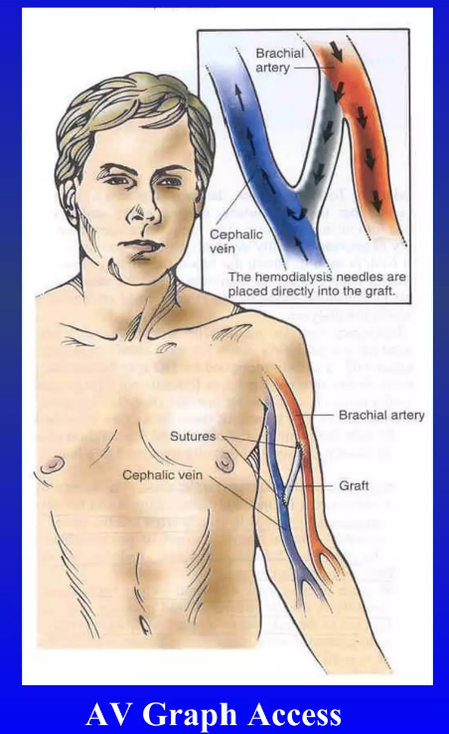
Hemodialysis

Slide 23
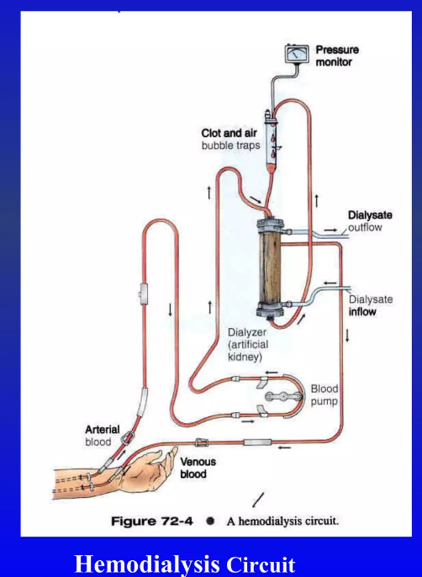
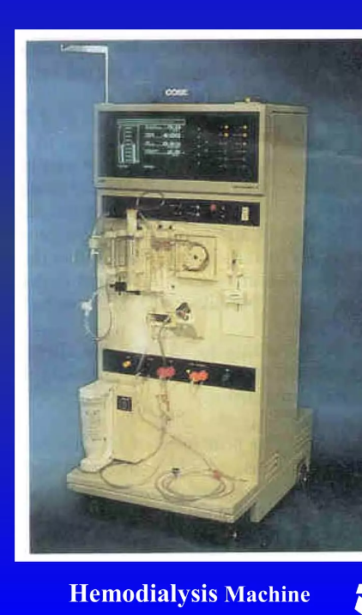
Hemodialysis

Slide 24
Complications of renal transplantation
Graft rejection:
Hyperacute rejection
Acute rejection
Chronic rejection
Infection
Hypertension
Malignancies
Recurrence of original renal disease
Retroperitoneal bleeding
Arterial stenosis
Urine leakage

Slide 25
THANK YOU

