Slide 1
Diabetes Miletus
Dr. Muhammad Abdullah Shwani
Assistant professor/Consultant urologist
Kurdistan Higher Council of Medical Specialties (KHCMS)
drmalshwani@mail.com

Slide 3
DM
chronic metabolic disorder of multiple etiology in which the body can't metabolize carbohydrates, fats, and proteins
because of defects in insulin secretion and/or action characterized by elevated blood glucose levels.

Slide 5
Classification of DM
Type 1 DM
It is due to insulin deficiency and is formerly known as:
Insulin Dependent DM (IDDM)
Juvenile onset DM
Type 2 DM
It is a combined insulin resistance and a relative deficiency in insulin secretion and is frequently known as
Noninsulin Dependent DM (NIDDM)
Adult onset DM

Slide 6
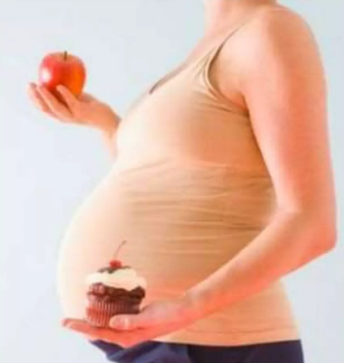
Classification of DM
Gestational Diabetes Mellitus (GDM):
Gestational Diabetes Mellitus (GDM) develops during some cases of pregnancy but usually disappears after delivery.
Secondary DM:
Results from another medical condition or due to the treatment of a medical condition that causes abnormal blood glucose levels like:
Cushing syndrome
Hyperthyroidism

Slide 7
Etiology
Type 1 Diabetes:
Autoimmune disease
Selective destruction of B-cells by T cells
Several circulating antibodies against B-cells
Cause of autoimmune attack: unknown
Both genetic & environmental factors are important

Slide 8
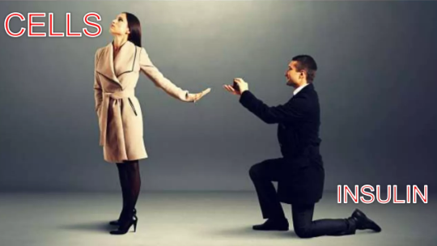
Etiology of Type 2 Diabetes
Insulin resistance (response is decreased).
The mechanism of insulin resistance is unclear
Insulin receptor defects.
Both genetic & and environmental factors are involved

Slide 9
Epidemiology
Type 1 DM
Usually develops in childhood or early adulthood
accounts for up to 10% of all DM cases
Develops as a result of the exposure of a genetically susceptible individual to an environmental agent

Slide 10
Epidemiology
Type 2 DM:
It results from insulin resistance with a defect in compensatory insulin secretion.
Insulin may be low, normal, or high!
About 30% of Type 2 DM patients are undiagnosed (they do not know that they have the disease) because symptoms are mild.
Accounts for up to 90% of all DM cases

Slide 11
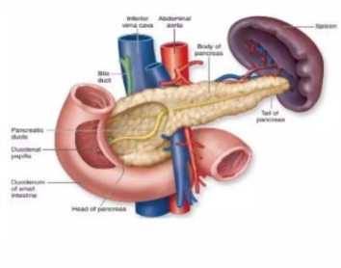

Slide 12
Risk Factors
For Type 1 DM
Genetic predisposition
In an individual with a genetic predisposition, an event such as a virus or toxin triggers autoimmune destruction of B-cells probably over a period of several years.

Slide 13
Risk Factors
For Type 2 DM
Family History
Obesity
Habitual physical inactivity
Previously identified impaired glucose tolerance (IGT) or impaired fasting glucose (IFG)
Hypertension
Hyperlipidemia

Slide 15
Clinical manifestations
Type 1 DM
Polyuria
Polydipsia
Polyphagia
Weight loss
Weakness
Dry skin
Ketoacidosis
Type 2 DM
Patients in Type 2DM can be asymptomatic
Most patients with Type 2 DM are discovered while performing urine glucose screening

Slide 16
Complications
Acute Complications
Hypoglycemia
Diabetic ketoacidosis
Hyperosmolar hyperglycemic nonketotic syndrome

Slide 17
Chronic complications
Macrovascular complications:
Coronary Heart Disease
Stroke (CVA)
Peripheral Vascular Disease
Microvascular Complications:
Retinopathy
Nephropathy
Neuropathy

Slide 18
Complications

Slide 19
Investigations
Fasting blood glucose(FBG)
Glucose blood concentration in samples obtained after at least 8 hours of the last meal
Random Blood glucose
Glucose blood concentration in samples obtained at any time regardless of the time of the last meal

Slide 20
Investigations
Oral glucose tolerance test(OGTT)
75 gm of glucose is given to the patient with 300 ml of water after an overnight fast
Blood samples are drawn 1, 2, and 3 hours after taking the glucose
This is a more accurate test for glucose utilization if the fasting glucose is borderline

Slide 21
Investigations
Glycosylated hemoglobin (HbA1C)
Normally it comprises 4-6% of the total hemoglobin.
Increase in the glucose blood concentration increases the glycated hemoglobin fraction.
HbAIC reflects the glycemic state during the preceding 8-12 weeks

Slide 22
Investigations
Glucosuria
To detect glucose in urine by a paper strip
Semi-quantitative
Ketonuria
To detect ketone bodies in urine by a paper strip
Semi-quantitative

Slide 23
Diagnostic criteria

Slide 25
DM management
Goals of therapy:
Reduce symptoms
Promote well-being
Prevent acute complications
Delay onset and progression of long-term complications

Slide 26
DM management
Lines of therapy:
Non-pharmacological treatment
Pharmacological treatment

Slide 27
Non-pharmacological treatment
Nutritional therapy:
Diet
Exercise
Stop smoking
Avoid precipitating factors

Slide 28
Nutritional Therapy/Exercise
Essential part of diabetes management
Increases insulin sensitivity
Lowers blood glucose levels
Decreases insulin resistance
Take small carbohydrate snacks during exercise to prevent hypoglycemia
Exercise after meals
Monitor blood glucose levels before, during, and after exercise

Slide 29
Pharmacological treatment
Insulin (Type I and Type 2 DM).
Oral hypoglycemic drugs for Type 2DM like :
SGLT2(Sodium-glucose cotransporter) Inhibitors(Type 2 DM)
Amylin analogs(Type 1 and Type 2 DM)
Sulfonylurea (Type 2 DM)
Biguanides (Type 2 DM)
Meglitinides (Type 2 DM)
Thiazolidinediones Glitazones (Type 2 DM
a-Glucosidase inhibitors (Type 2 DM)
Incretin mimetic (Type 2 DM)
DPP4 inhibitors (Type 2 DM)

Slide 30
Insulin
Exogenous insulin needed :
For all patients with type 1 DM
For the patient with type 2 DM who cannot control blood glucose by other means

Slide 31
Insulin
Source of insulin
Human insulin(Recombinant DND by genetic engineering )
Most widely used type of insulin
Cost-effective & less allergic reaction
Animal insulin(Cow, pigs)
Insulins differ regarding:
onset of action
peak action
duration
Different types of insulin may be used for combination therapy

Slide 32
Insulin
Available types of insulin
Regular insulins
Insulin analogs
Pre-mixed insulin
Types of insulin according to onset:
Rapid-acting insulin e.g. Insulin lispro and insulin aspart
Short-acting insulin e.g. Regular insulin
Intermediate-acting insulin e.g. NPH and Lente insulin
Long-acting insulin e.g. Insulin Glargine

Slide 33
Insulin
Insulin delivery methods(routes):
Ordinary SC injection with:
Syringes
Insulin pen
Infusion by wearing an insulin pump.
Intravenous infusion.
Cannot be taken orally

Slide 35
Insulin
Sites of administration of insulin
Fastest absorption from the abdomen, followed by arm, thigh, buttock
Rotate injections within one particular site

Slide 36
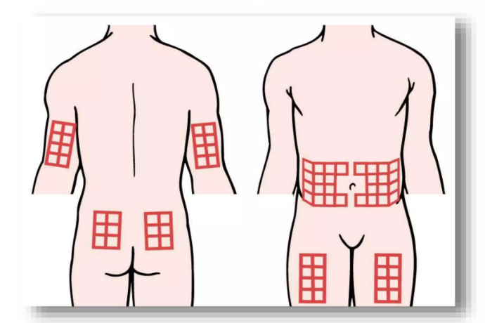

Slide 37
Complications of insulin therapy
Hypoglycemia:
Due to too much insulin use.
Allergic reactions
Local inflammatory reaction
Lipodystrophy
Hypertrophy or atrophy of SC tissue due to frequent use of the same injection site.

Slide 38
Oral agents
Effects of oral agents :
Increase insulin production by the pancreas
Reduce glucose production by the liver
Enhance insulin sensitivity and glucose transport into the cell
Slow absorption of carbohydrates in intestine

Slide 39
Oral agents
Sulfonylureas e . g : glimepiride, glipizide, and glyburide
Meglitinides e . g repaglinide ,Nateglinide
Biguanides metformin
Glitazones (ppary agonists) e.g rosiglitazone – pioglitazone
alpha-glucosidase inhibitors e.g acarbose – miglitol
Amylin analog :Pramlintide (Symlin)
Incretin mimetic :exenatide – liraglutide
DPP4-Inhibitors : Sitagliptin - Linagliptin
SGLT-2 Inhibitors

Slide 40
Self-monitoring of blood glucose(SMBG)
Extremely useful for outpatient monitoring especially for patients who need tight control of their glycemic state.
A portable battery-operated device that measures the color intensity produced by adding a drop of blood to a glucose oxidase paper strip.
E.g. One Touch, Accu-Chek, DEX, Prestige, and Precision.

Slide 41
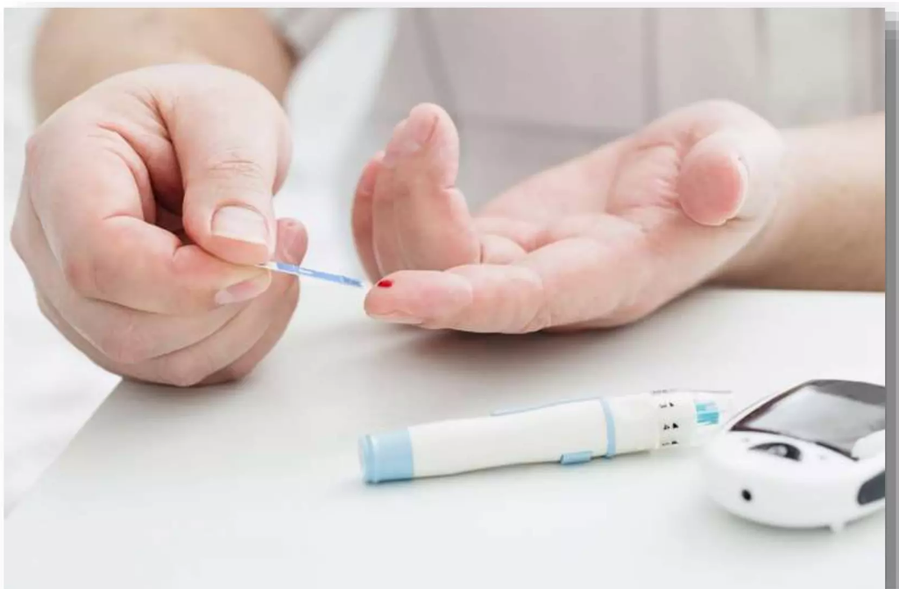
Self Monitoring Test

Slide 43
Acute Complication:
Hypoglycemia : Hypoglycemia occurs due to too much insulin (or oral agents) in relation to glucose availability
Brain requires constant glucose supply thus hypoglycemia affects mental function

Slide 44
Clinical manifestations
Confusion, irritability
Anxiety, tachycardia, tremors
Diaphoresis, hunger, weakness, visual disturbances
If untreated> loss of consciousness, seizures, coma, death

Slide 45
Treatment for hypoglycemia
Ingest simple CHO (fruit juice, soft drink), or commercial gel or tablet
Avoid sweets with fat (slows sugar absorption)
Then eat usual meal snack or meal and recheck
if not alert enough to swallow
Glucagon 1 m IM or SC
Then complex CHO when alert

Slide 46
THANK YOU

