Slide 1
Introduction Sequences
Name of teacher :Dr. Mazin R Khalil
Advanced Mathematics2 –ME212
Semester 4
Week 1
Date :30/1/2024

Slide 2
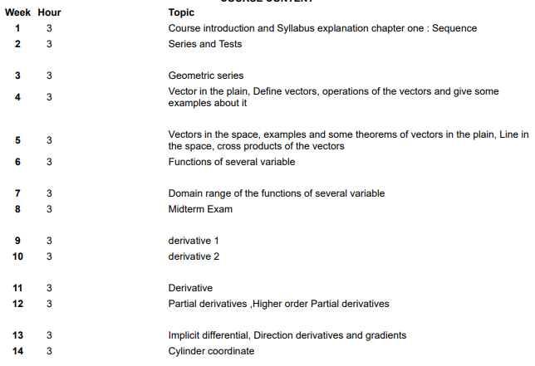
Syllabus

Slide 4
Objectives
To teach students the following opinions through out the course

Slide 5
Sequences

Slide 6
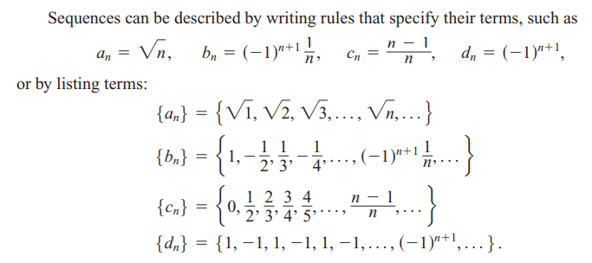

Slide 7
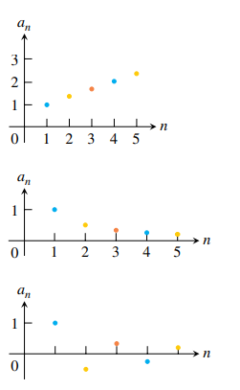

Slide 8
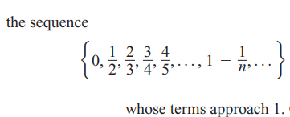
As n get larger

Slide 10
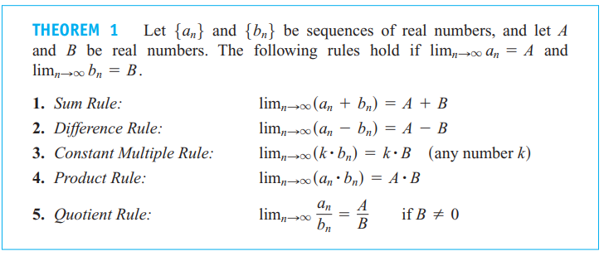

Slide 11
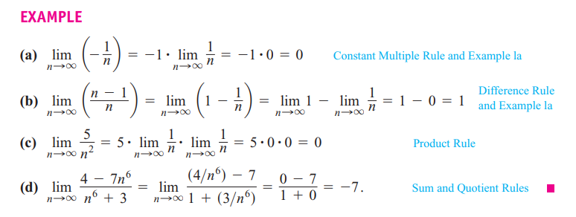

Slide 12
References
1. Thomas' Calculus" 11th edition
2. Calculus Early Transcendental Functions" by Ron Larson and Bruce Edwards

