Slide 1

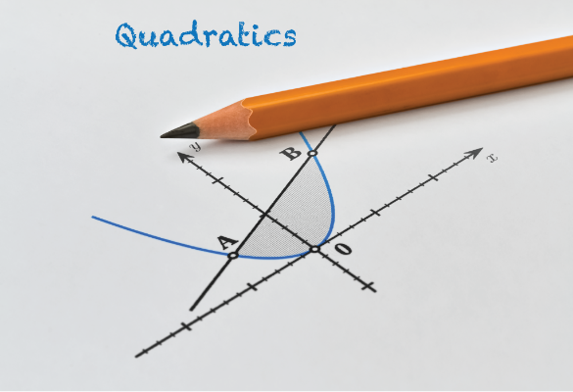
Lecture 4:
Quadratics and Circles
Quadratics and Parabolas
Methods of solving quadratic equations
  Graphing
  Completing the square
  Quadratic Formula
Circles
Ms. Togzhan Nurtayeva
Course Code: IT 161/A
Semester 1
Week 6-8
Date: 16.01.2024

Slide 2
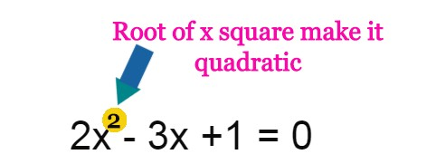
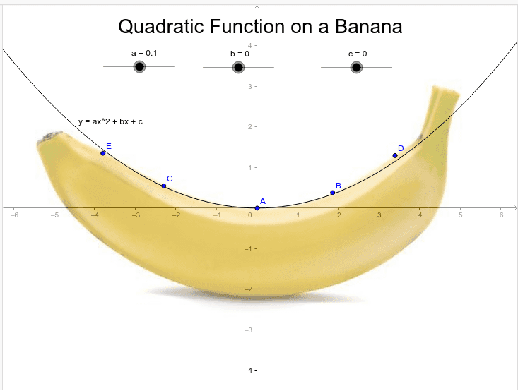
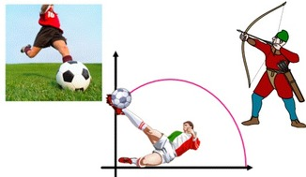
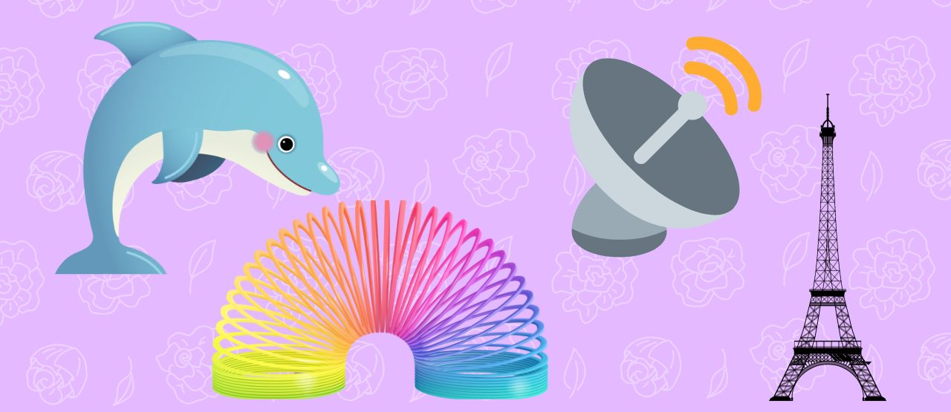



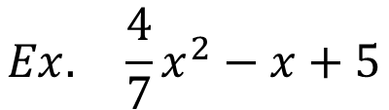
Quadratics
Quadratic expressions: A quadratic expression (in $x$) has general form:
${ax}^{2}+bx+c$
$$Ex. 3x^{2}−16x+36$$
$$Ex. \frac{4}{7}x^{2}−x+5$$
$$………………$$

Slide 3
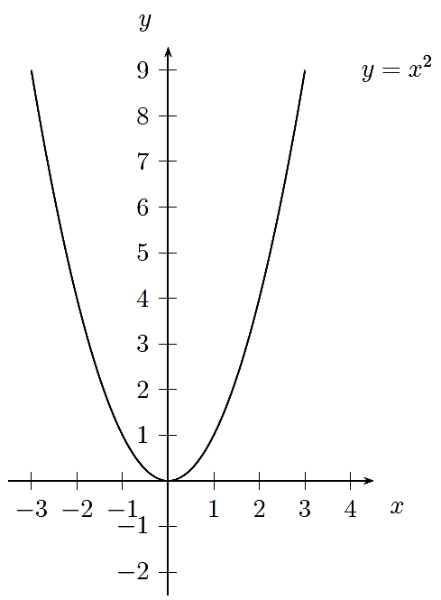
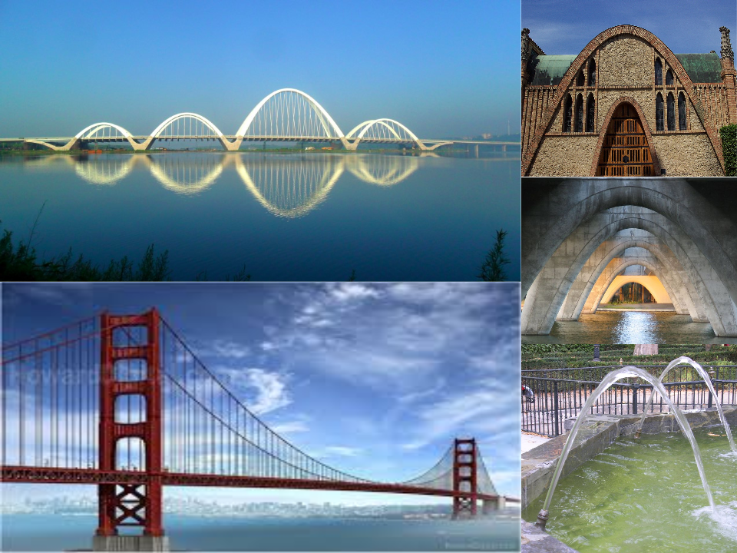

Parabolas
is a curve in the plane that is result of any combinations of (positive or negative) dilations, rotations or translations of the curve
$$y=x^{2}$$
Parent function
Facing upwards, a>0
Facing downwards, a<0

Slide 4
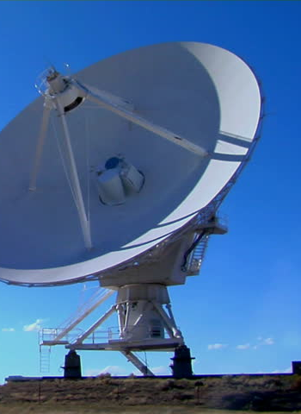
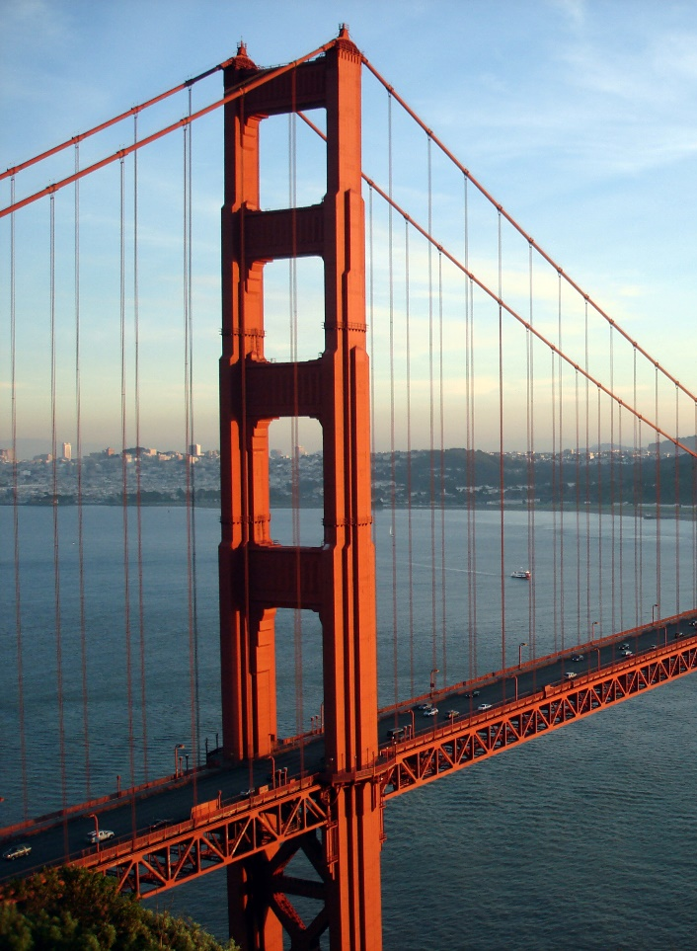
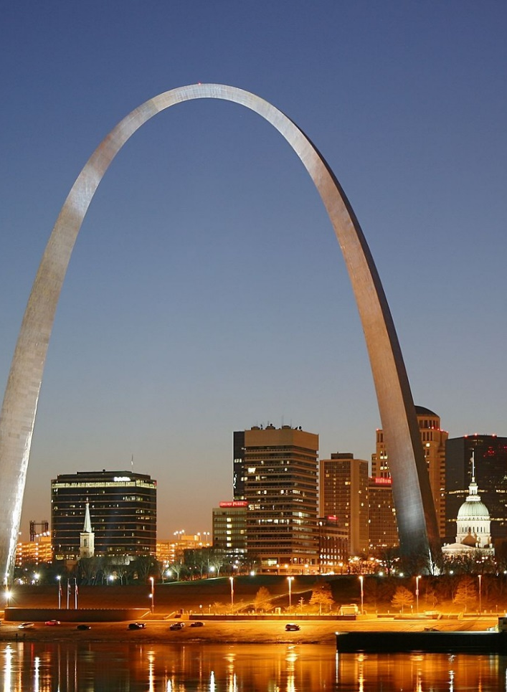
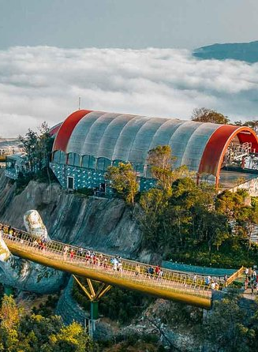
Parabola
Consider the satellite dish. These structures have a parabolic shape, allowing the reflection and focus of radio waves (parabolic shape helps receive and transmit signals).
Parabolas in Spaceflight

Slide 5
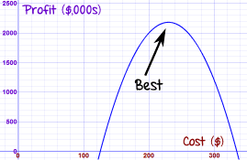
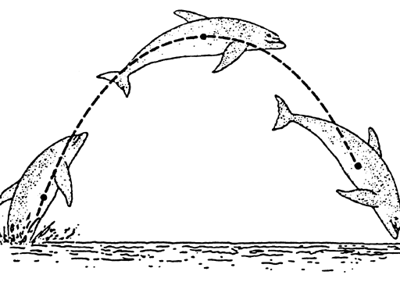
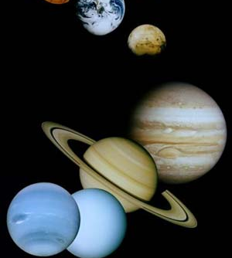
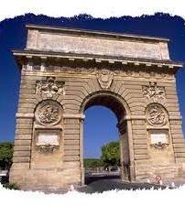
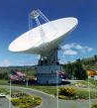
Quadratics and Parabolas in Real Life
Calculating Room Areas
Figuring a Profit (Business Profit)
Quadratics in Athletics
Finding a Speed
River Cruise
Resistors In Parallel (In Physics)
For a parabolic mirror, a reflecting telescope or a satellite dish, the shape is defined by a quadratic equation.
Quadratic equations are also needed when studying lenses and curved mirrors.
And many questions involving time, distance and speed need quadratic equations.

Slide 6
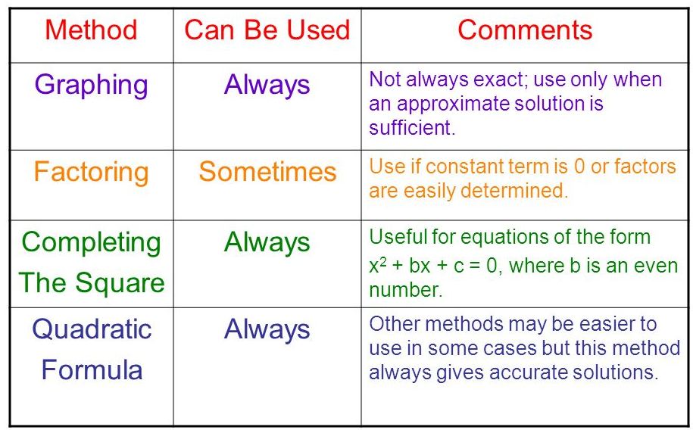
Methods to solve quadratic equations

Slide 7
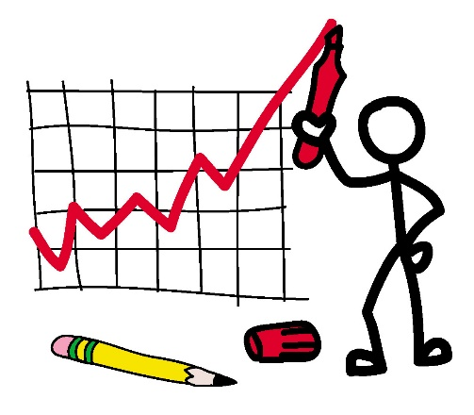
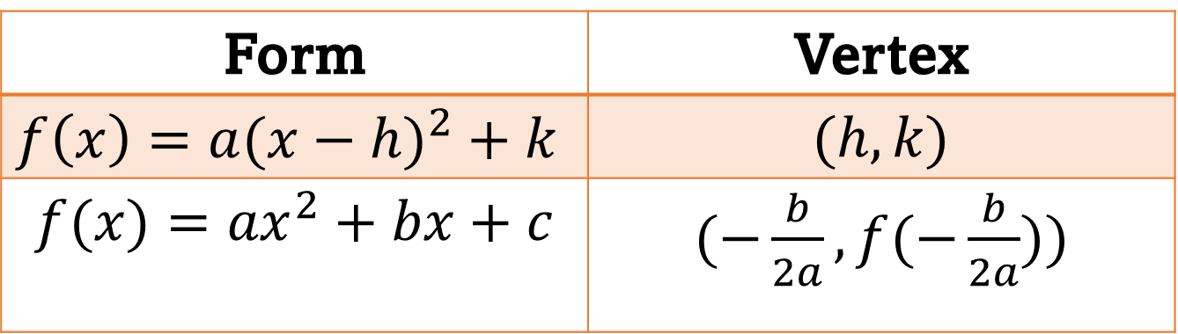

Graphing
Form | Vertex
$$f\left(x\right)=a(x−h)^{2}+k$$ | $(h, k)$
$$f(x)={ax}^{2}+bx+c$$ | $(−\frac{b}{2a}, f(−\frac{b}{2a}))$

Slide 8
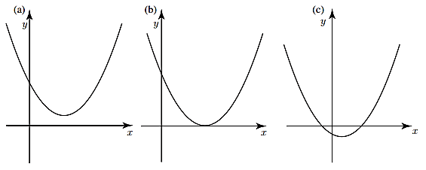
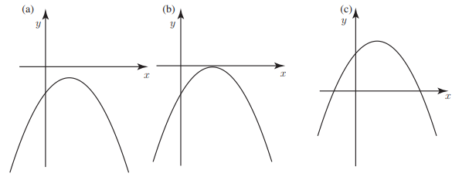
Graphs of $y = ax^{2} + bx + c$ when $a$ is positive
Graphs of $y = ax^{2}+ bx + c$ when $a$is negative

Slide 9
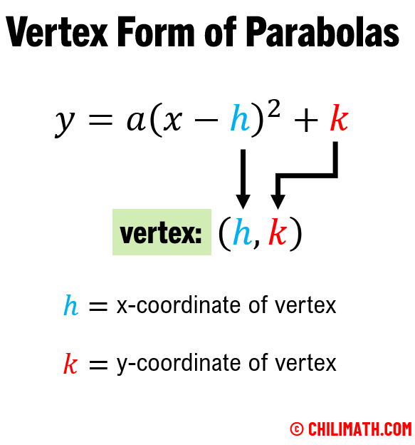

Slide 10
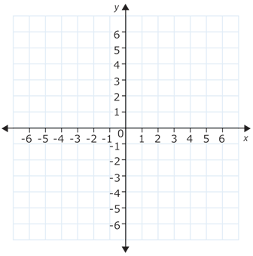

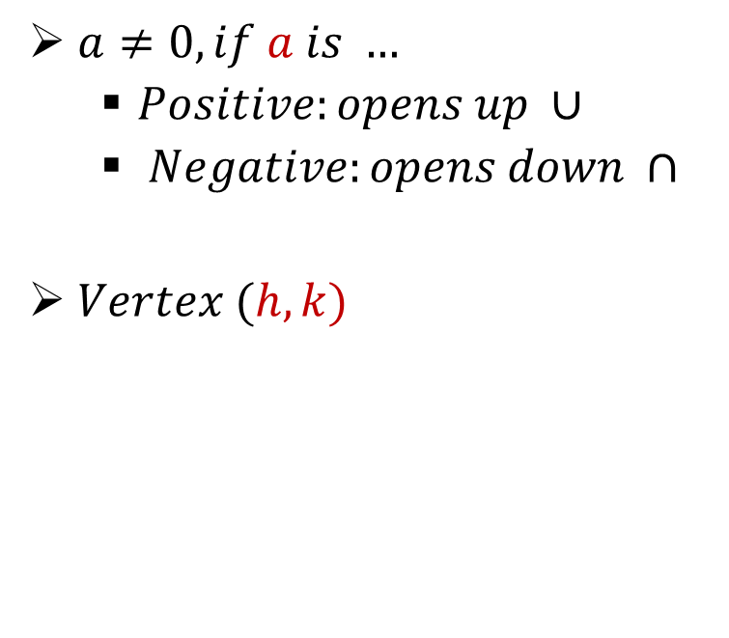

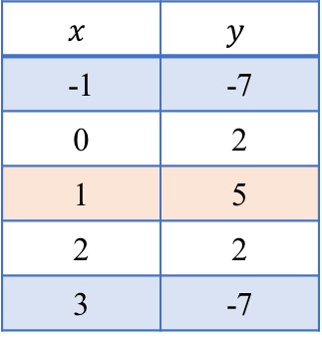


$$f\left(x\right)=a(x−h)^{2}+k$$
$$y=−3(x−1)^{2}+5$$
$a=−3−opens down$
$h=1$
$k=5$
So, $vertex is at point (1,5)$
$a≠0, if a is …$
  $Positive:opens up ∪$
  $Negative:opens down ∩$
$Vertex (h, k)$
$$Vertex$$
$$x$$ | $$y$$
-1 | -7
0 | 2
1 | 5
2 | 2
3 | -7
$$Vertex$$

Slide 11
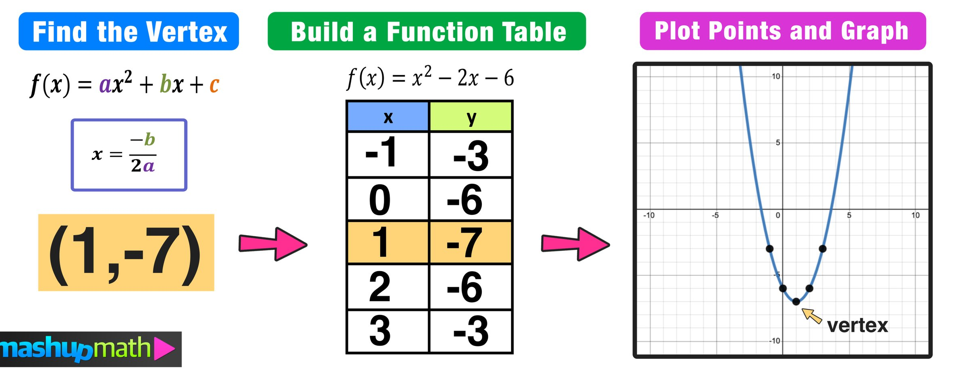

$$f(x)={ax}^{2}+bx+c$$

Slide 12
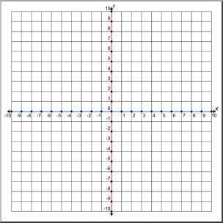



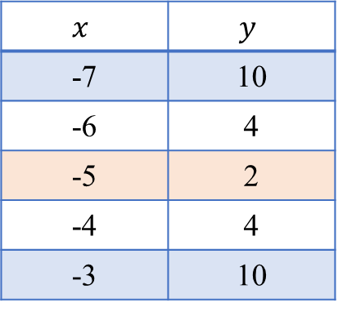

$$f(x)={ax}^{2}+bx+c$$
$$Vertex:(−\frac{b}{2a}, f(−\frac{b}{2a}))$$
$$y=\text{2}x^{2}+20x+52$$
$−\frac{b}{2a}=−\frac{20}{4}=−5$
$f\left(−\frac{b}{2a}\right)=(2×\left(−5)^{2}\right)+20×\left(−5\right)+52=2$
$$x$$ | $$y$$
-7 | 10
-6 | 4
-5 | 2
-4 | 4
-3 | 10
$$Vertex$$

Slide 13
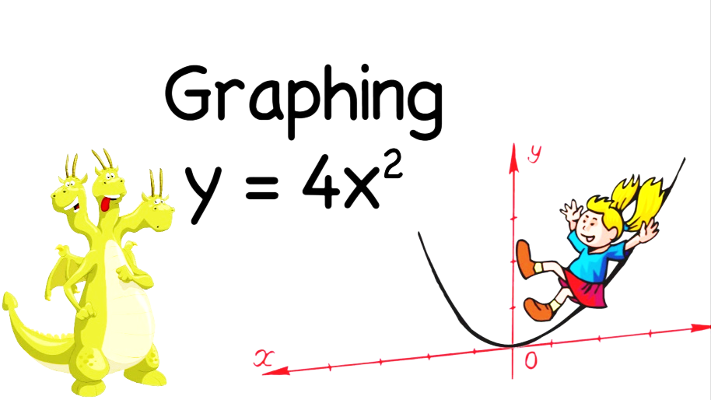
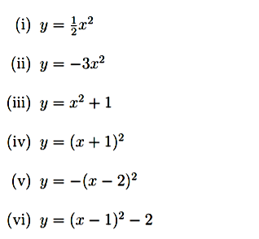
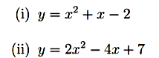
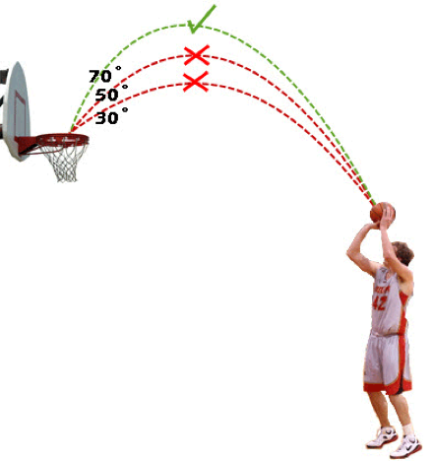





Problems
$$y=x^{2}+12x+38$$
$$y={2x}^{2}−16x+30$$
$$y=2x^{2}+6x$$
$$y=−x^{2}−10x−26$$
$$y=−\frac{1}{2}x^{2}+4x−6$$

Slide 14
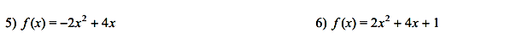
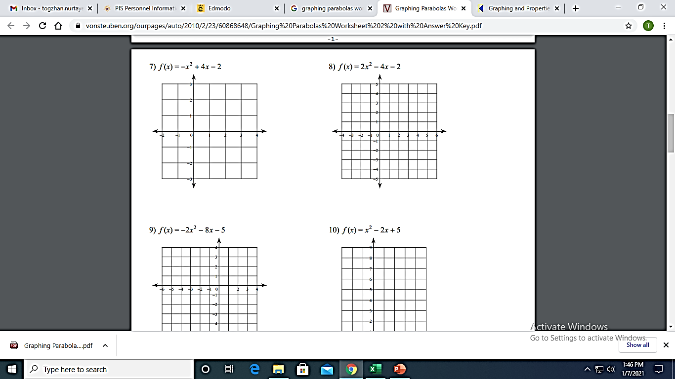

Graphing Parabola Practice

Slide 15
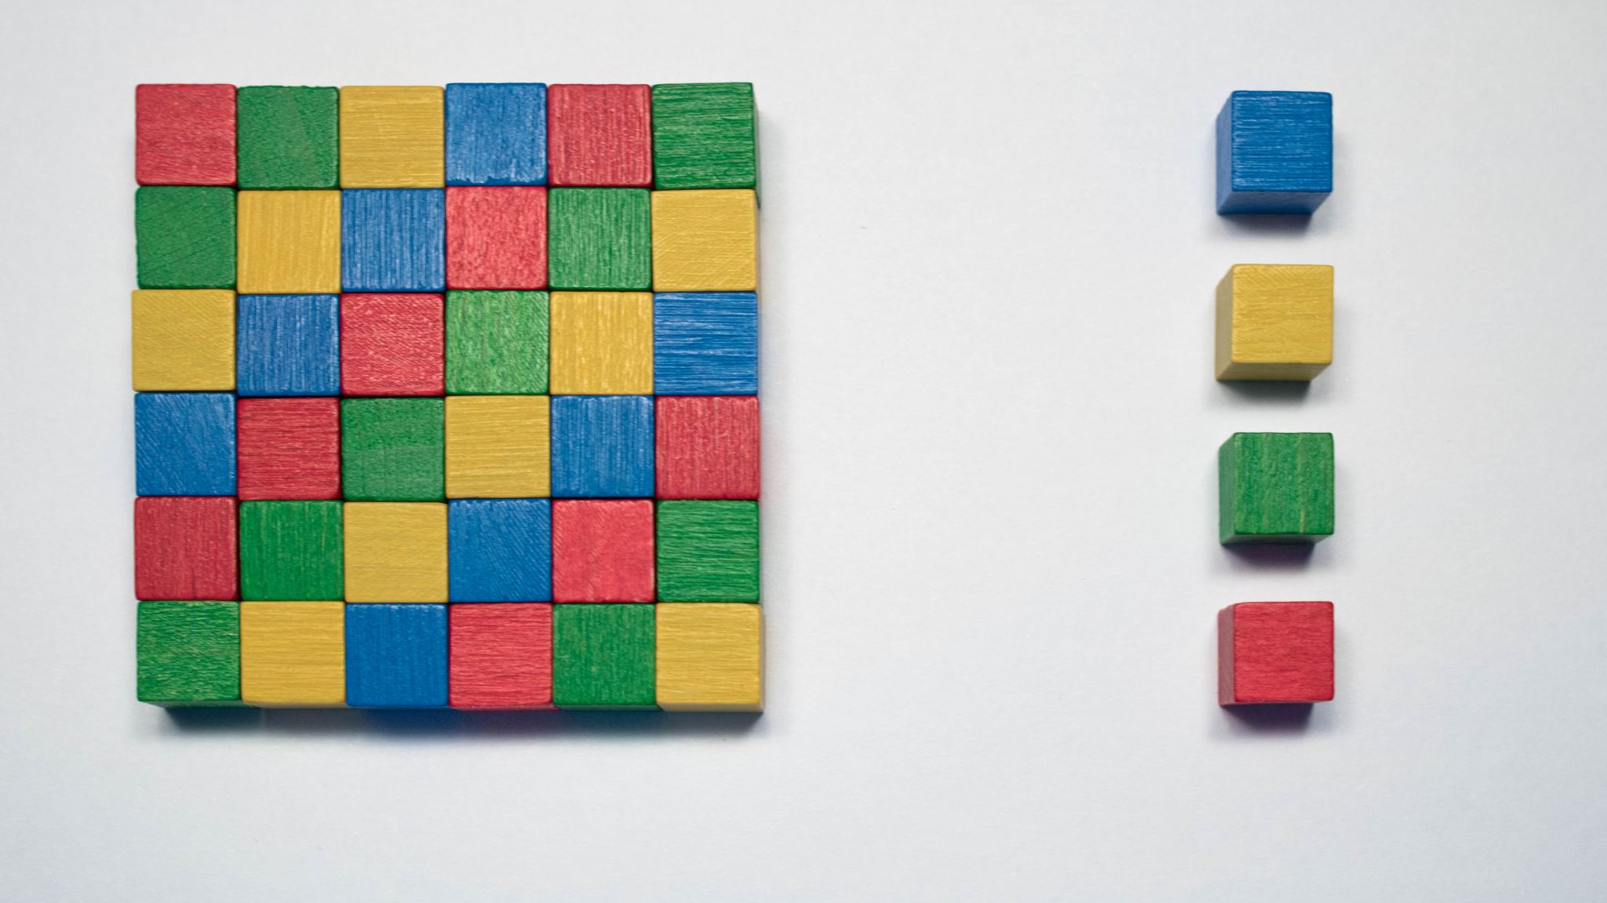
Completing the square (square root method)

Slide 16
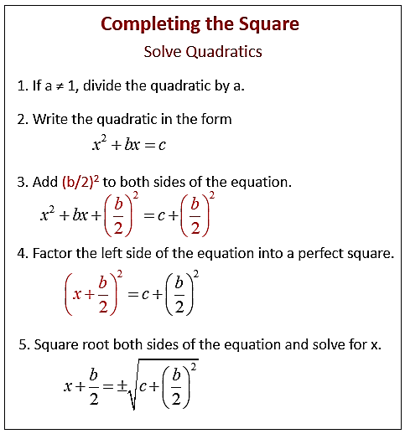
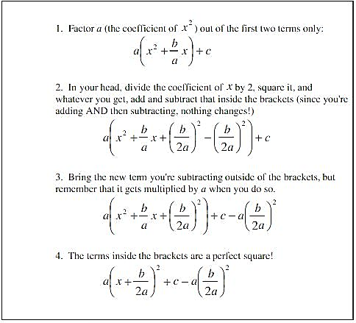


$$x^{2}+bx+c$$
$$ax^{2}+bx+c$$

Slide 17
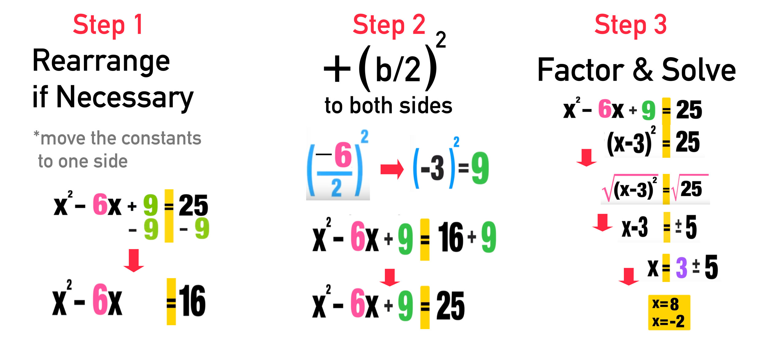

Slide 18
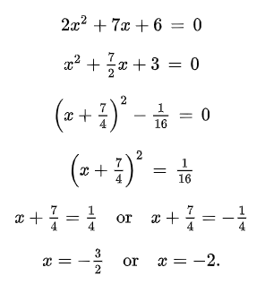


$$2x^{2}+7x+6=0$$
$$| ÷2$$

Slide 19



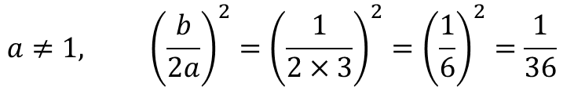













Example
$$a≠1, {\left(\frac{b}{2a}\right)}^{2}={\left(\frac{1}{2×3}\right)}^{2}={\left(\frac{1}{6}\right)}^{2}=\frac{1}{36}$$
${3x}^{2}+x−10=0$ – completing square
$Step 1. 3\left(x^{2}+\frac{x}{3}\right)−10$
$$Step 2.$$
$$3{(x+\frac{1}{6})}^{2}−10\frac{1}{12}=0$$
$$10\frac{1}{12}=\frac{121}{12}$$
$$3\left(x^{2}+\frac{x}{3}+\frac{1}{36}−\frac{1}{36}\right)−10$$
$$3{(x+\frac{1}{6})}^{2}=10\frac{1}{12}$$
$$3{(x+\frac{1}{6})}^{2}=\frac{121}{12}$$
$$3{(x+\frac{1}{6})}^{2}−3×\frac{1}{36}−10$$
$$x+\frac{1}{6}=±\frac{11}{6}$$
$${(x+\frac{1}{6})}^{2}=\frac{121}{36}$$
$$3{(x+\frac{1}{6})}^{2}−\frac{1}{12}−10$$
$$\sqrt{{(x+\frac{1}{6})}^{2}}=\sqrt{\frac{121}{36}}$$
$$x_{1}=−2$$
$$3{(x+\frac{1}{6})}^{2}−10\frac{1}{12}$$
$$x_{2}=\frac{5}{3}$$

Slide 20










Example
$y=x^{2}+4x+4$ - graph
$$Completing square method:$$
$${ a=1, (\frac{b}{2})}^{2}={(\frac{4}{2})}^{2}=2^{2}=4$$
$$perfect square$$
$x^{2}+4x+4=x^{2}+4x+4+4−4={(x+2)}^{2}$
$$\left(2 values for line\right) but$$
$$y={(x+2)}^{2}$$
$$5 values for parabola:$$
$$x$$ | $$y$$
0 | 4
-1 | 1
-2 | 0
-3 | 1
-4 | 4
$$−2 units left by x−axis$$
-2

Slide 21


Slide 22

Example
$y=x^{2}+2$
$y=x^{2}+4x+4$
$y={2x−x}^{2}$
$2x^{2}+3x=0$
$x^{2}+2x+8=0$
${3x}^{2}+x−10=0$

Slide 23


Slide 24



Slide 25


Slide 26


Quadratic Formula
$${ax}^{2}+bx+c=0$$
$$x=\frac{−b±\sqrt{b^{2}−4ac}}{2a}$$
$16x^{2}−56x+49=0$
$\frac{2}{x+1}−\frac{2}{x+2}=7$

Slide 27











Example
$\frac{2}{x+1}−\frac{2}{x+2}=7$
$check for the denominator, should be the same$
$\frac{2×(x+2)}{(x+1)(x+2)}−\frac{2×\left(x+1\right)}{\left(x+1\right)\left(x+2\right)}=7$
$\frac{2x+4−2x−2}{(x+1)(x+2)}=7$
$$In order to solve this type of questions, we have to$$
$$get the form of quadratic equation:ax^{2}+bx+c$$
$$Quadratic Formula:$$
$$2=7(x+1)(x+2)$$
$$2=7(x^{2}+3x+2)$$
$$x=\frac{−21±\sqrt{{21}^{2}−4×7×12}}{2×7}$$
$$7x^{2}+21x+14=2$$
$$7x^{2}+21x+12=0$$
$$x=\frac{−21±\sqrt{105}}{14}$$
$$Denominator cannot be zero, so x≠−1, x≠−2$$
$$b=21$$
$$c=12$$
$$a=7$$

Slide 28

Write each quadratic equation in standard form then solve them.

Slide 29


Slide 30

A right triangle has one leg that is 3 m shorter than the other leg. The triangle has area of 54 $m^{2}$. Find the lengths of the legs.
The hypotenuse of a right triangle is 3 in. longer than the longer leg. The shorter leg is 3 in. shorter than the longer leg. Find the lengths of the sides of the triangle.
The hypotenuse of right-angled triangle is 2 more than twice of one of the other side while the third side is 13 more than half of the hypotenuse. Find the length of the median to the hypotenuse.
The difference between the squares of the two numbers is 72. Eight times the numerically smaller number is 1 more than 5 times the other number. Find the numerically greater number.
Notes:
1.
54 = $\frac{1}{2}\left(x+3\right)x$
2.
${(x+3)}^{2}={(x−3)}^{2}+x^{2}$
3.
x² + (x+14)² = (2x+2)²
4.
x² –y² =72 ……..(1)
8y= 5x +1…(2)

Slide 31



Slide 32


Problems to practice (try to use all methods)

Slide 33

Write Linear if the given equation is a Linear equation or Quadratic and solve them.

Slide 34


Circle
r - radius
Q (x, y)
r
By Pythagoras:
$$r^{2}={(x−a)}^{2}+{(y−b)}^{2}$$
P (a, b)
Equation of the circle

Slide 35


Circle C centered at P (3, 4) with radius 5 units. Equation?
Crossing $x$ and $y$ axes:
$x = 0$, touches y-axis
$y = 0$, touches x-axis

Slide 36

Circle-Line Intersection

Slide 37
















Example
$$x, y = ?$$
$$Step 2. {(x−2)}^{2}+{(y+3)}^{2}=4$$
$$y⟺x$$
$${(x−2)}^{2}+{(−x−\frac{1}{2}+3)}^{2}=4$$
${(x − 2)}^{2}+ {(y + 3)}^{2}= 4$
$2x + 2y = −1$
$${(x−2)}^{2}+(−x+\frac{5}{2})^{2}=4$$
$$x^{2}−2×x×2+2^{2}+x^{2}−2×x×\frac{5}{2}+{(\frac{5}{2})}^{2}=4$$
$$Step 1. 2x+2y=−1$$
2$x^{2}−9x+\frac{25}{4}=0$
$$2y=−2x−1$$
$$y=−x−\frac{1}{2}$$
$$Step 3. Any method of solving quadratic equations:$$
$$x=\frac{9±\sqrt{81 −50}}{4}=\frac{9±\sqrt{31}}{4} (quadratic formula)$$
$$y_{1}=−\frac{9+\sqrt{31}}{4}−\frac{1}{2}=\frac{−11−\sqrt{31}}{4}$$
$$x_{1}=\frac{9+\sqrt{31}}{4}$$
$$x_{2}=\frac{9−\sqrt{31}}{4}$$
$$y_{2}=−\frac{9−\sqrt{31}}{4}−\frac{1}{2}=\frac{−11+\sqrt{31}}{4}$$

Slide 38




At what points given equations’ graphs intersect?
$x+y=1$
${(x−2)}^{2}+{(y+1)}^{2}=8$
$$x^{2}+y^{2}=9$$
$\left(x−1\right)+y=2$
At what points does the line with equation $y=2x+5$ intersect a circle with radius 2 and center (0, 5)?

Slide 39

More problems

Slide 40





Solve for 3 lines below:
$(x+9)^{2}+(y+10)^{2}=100$
_____________
$y=x+1$
$x=1$
$y=−x+3$

Slide 41




$−4y−3x−2=0$ meets the circle $x^{2}+y^{2}+6x+4y=0$ in points A and B. Find the coordinates of A and B.
${(x−2)}^{2}+{(y+3)}^{2}=4$
$2x+2y=−1$

Slide 42



