Slide 1
Introduction to Biology
Peshraw S. Hamadamin
Biology
First Semester
Week 2
Date 1/10/2023

Slide 2
Outline
Define biology
Characteristics of living organisms
Level of organization of organism
Levels of organization beyond organism:

Slide 3
Objectives
Introducing the characteristics of living organism
Understanding different levels of organization of organisms
Defining different fields of Biology

Slide 4
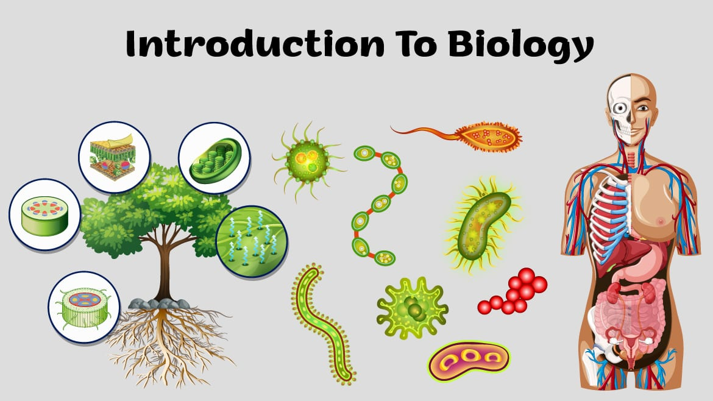
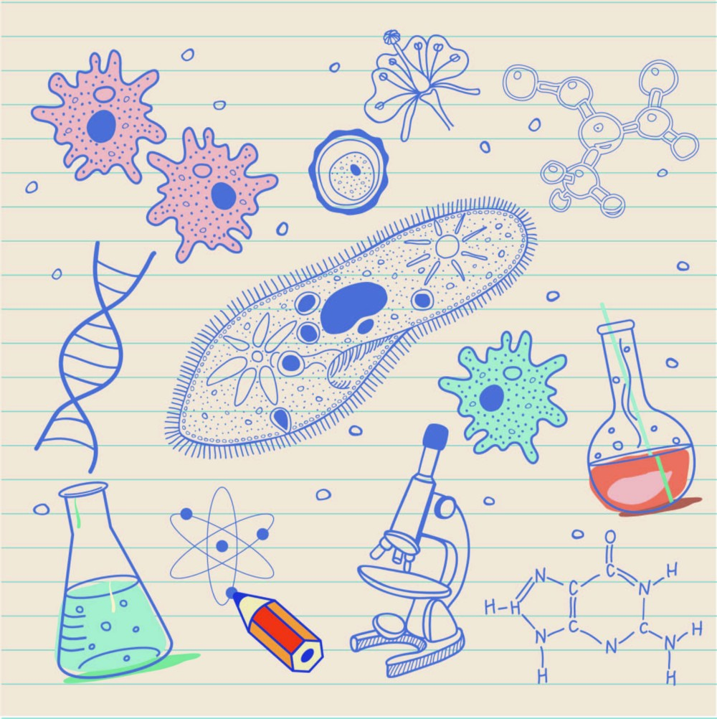
What is biology?
Biology (Greek or Latin origin)
Bios = life
Logos = study of
Biology is the branch of science which deals with the study of living organisms.
The study of living organisms, divided into many specialized fields that cover their morphology, physiology, anatomy, behavior, origin, interaction with environment and distribution.

Slide 5
Characteristics of Life
Cellular composition
Growth
Movement
Reproduction
Adaptation
Metabolism
Specific organization
Homeostasis
Responsiveness

Slide 6
1-Cellular Composition
Made up of at least one cell
Unicellular - made of one cell (bacteria, amoeba, paramecium)
Multicellular - made up of two or more cells (plants, fungi, animals)

Slide 7
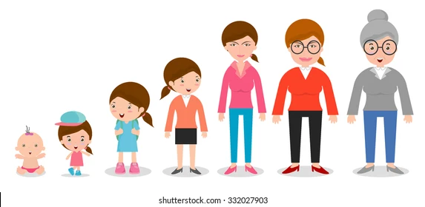
2-Growth and development
Growth in means increase in the mass of an organism.
Increase in cell size (unicellular) and/or an increase in cell number (multicellular)

Slide 8
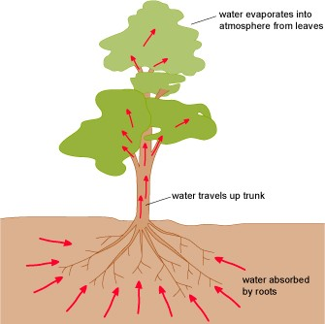
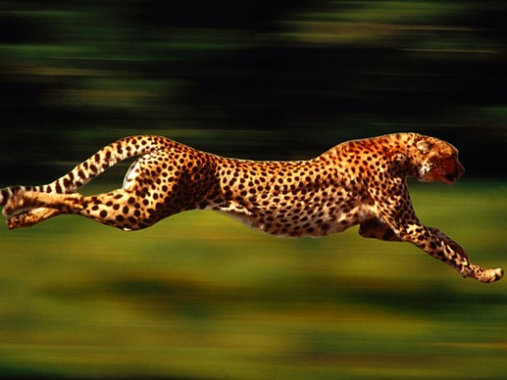
3- Movement:
Internal movement: Characteristic of all life.
Locomotion: Self-propelled movement from point A to point B. Not observed in all life forms

Slide 9
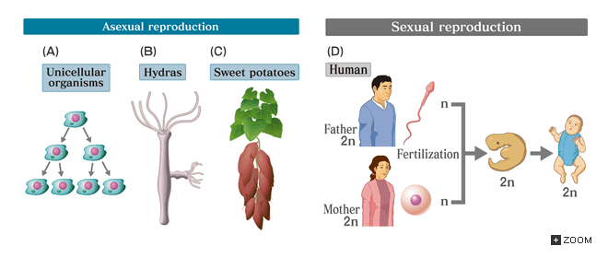
4- Reproduction
Asexual- cell division (mitosis)—one cell becomes two Ex: bacteria
Sexual- union of sex cells (sperm and egg) Ex: plants and animals

Slide 10
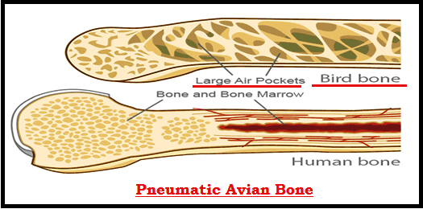
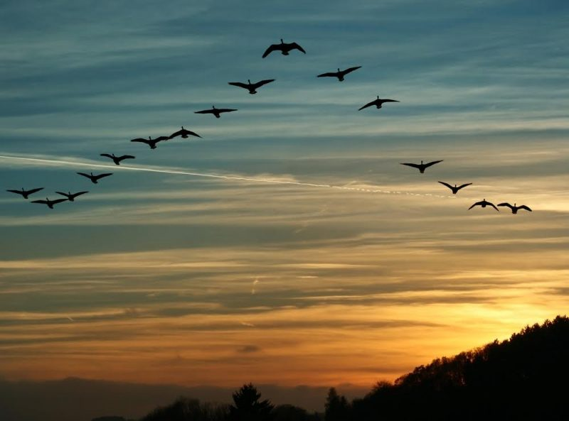
5- Adaptation
Adaptation refers to the process of adjusting in behavior, physiology, or structure of organisms to become more suited to an environment. in order to improve their chances at survival in that environment.
e.g. The light bones of flying birds and mammals, and the long daggerlike canine teeth of carnivores.

Slide 11
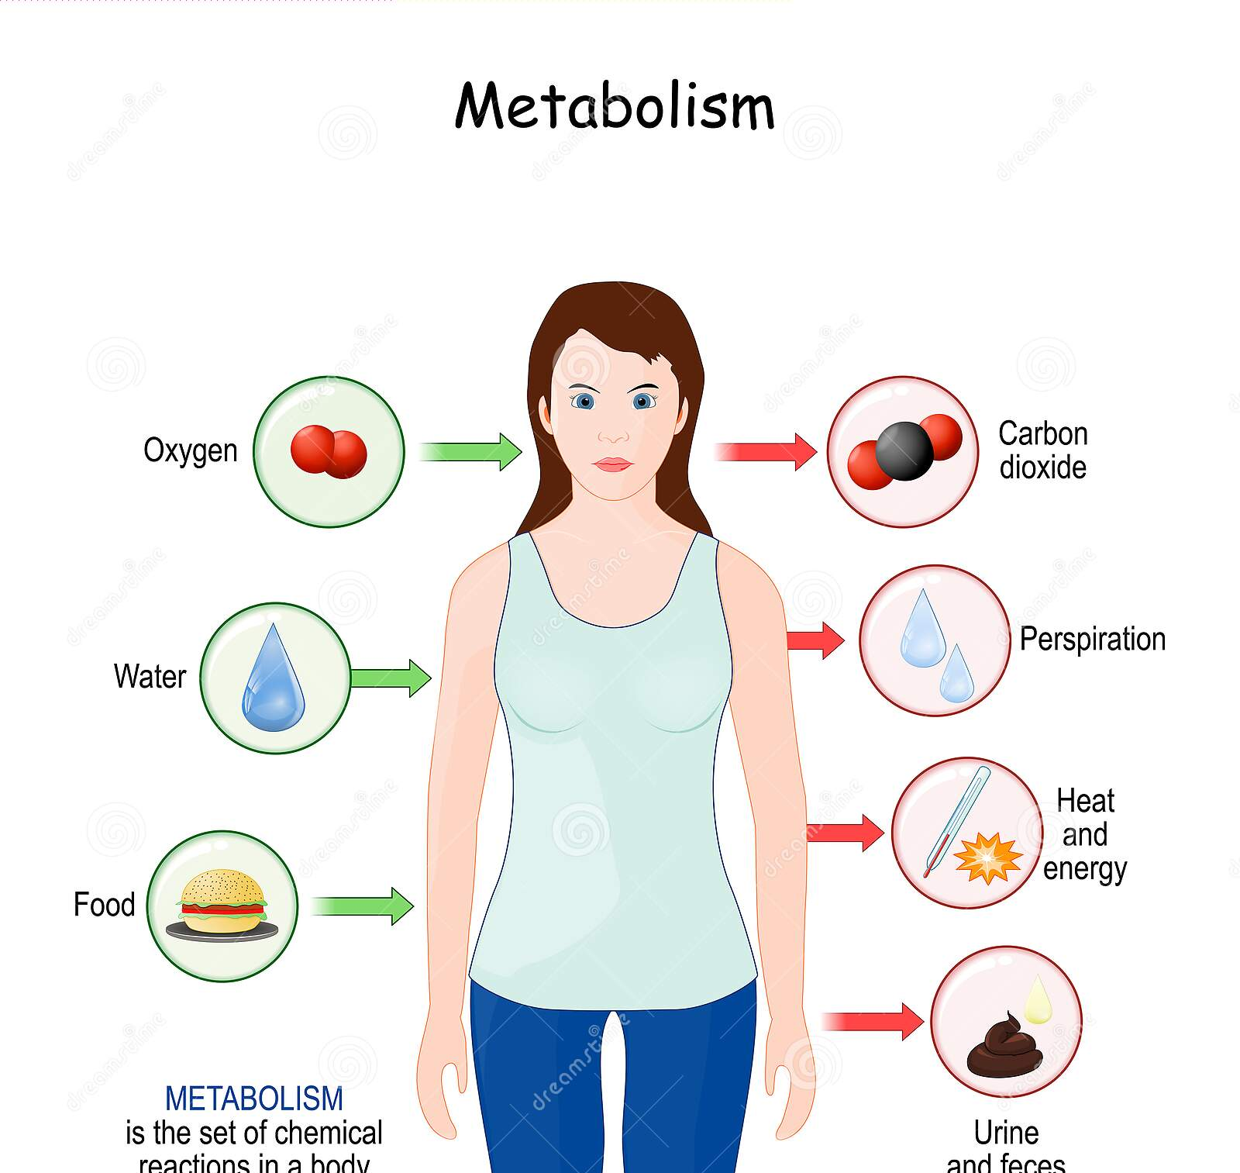
6- Energy use and metabolism:
All organisms must take in and transform energy to do work, to live.
Living things get their energy from food
Most plants and some unicellular organisms use light energy from the Sun to make their own food and fuel their activities.
Organisms that cannot make their own food get energy by consuming other organisms.
Metabolism: All chemical reactions and energy transformations, essential for growth, maintenance, and reproduction.

Slide 12
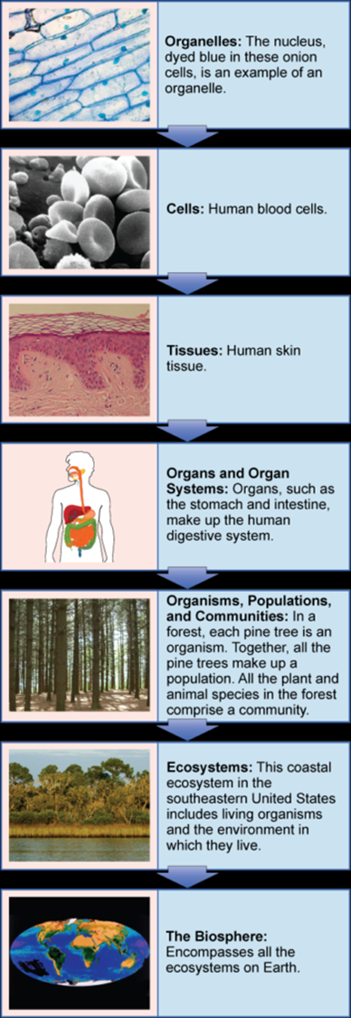
7- Specific organization
All living things are both complex and highly ordered. Your body is composed of many different kinds of cells, each containing many complex molecular structures.
Many nonliving things may also be complex, but they do not exhibit this degree of ordered complexity

Slide 13
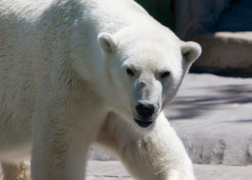
8- Regulation (Homeostasis)
External environment may change, but internal environment remains fairly constant. All organisms maintain relatively constant internal conditions that are different from their environment, a process called homeostasis

Slide 14
9- Responsiveness
Reaction(s) to various stimuli
Examples of stimuli: light, heat, pH, vibration, smell.

Slide 15
Some Branches of Biology
Branch | Studies
Paleontology | history of life using fossils
Molecular biology and Biochemistry | biological processes at the molecular and chemical level.
Microbiology | structure and function of single-celled organisms.
Neurobiology | the nervous system
Zoology | animals
Botany | plants
Genetics | heredity and genes
Ecology | how organisms interact with other organisms and with their environment
Biotechnology | how to use biological processes, for example manipulating micro-organisms to produce medicines
Forensic Biology | applications of biology to law
Physiology | functions of organisms and their parts
And many more!

Slide 16
Levels of Organization of living things
The organization of the biological world is hierarchical—that is, each level builds on the level below it.
Levels of biological organization:
Atoms
Molecules
Subcellular organelles
Cells

Slide 17
Tissues*
Organs*
Organ systems*
Organism: May consist of a single cell or a complex multicellular organism.
* Level of organization not found in all organisms

Slide 18
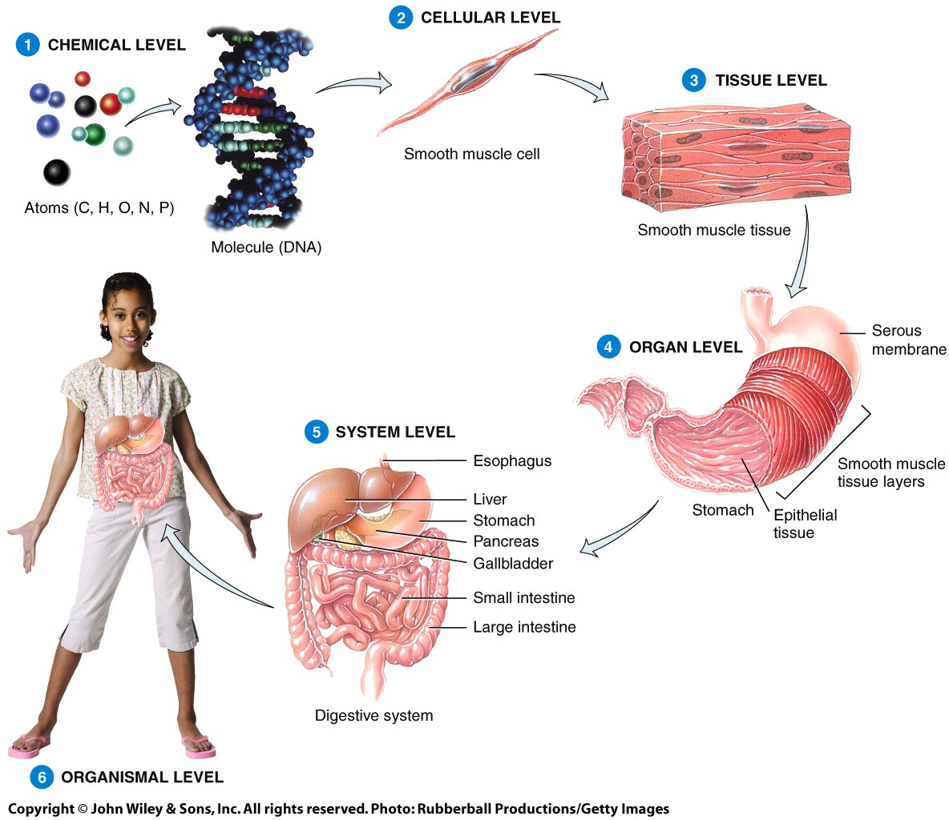

Slide 19
The Population level: refers to a group of individuals of the same species that live in a specific geographic area and are capable of interbreeding.
All populations of a particular kind of organism together form a species, its members similar in appearance and able to interbreed.
e.g. Humans, regardless of differences in skin color, hair type, or other features, belong to the same species. Humans can interbreed and produce fertile offspring, which is a key criterion for being classified as members of the same species.
A species is fundamental concept to the field of biology and is defined as a group of organisms that are capable of interbreeding and producing fertile offspring in nature.
The Community : Several different populations living together in same area (e.g.: lake, forest, jungle).

Slide 20
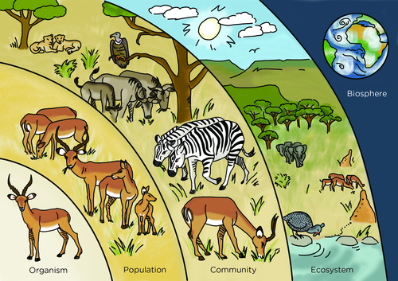

Slide 21
The ecosystem level : Interactions of community with non-living environment (air, water, soil).
An ecosystem is a biological community of interacting organisms (including plants, animals, and microorganisms) and their physical environment. This concept encompasses both living organisms and their non-living surroundings
Biosphere(Ecosphere): All ecosystems on planet earth: It is made up of the parts of earth where life exists and it include lithosphere, atmosphere and hydrosphere.

Slide 22
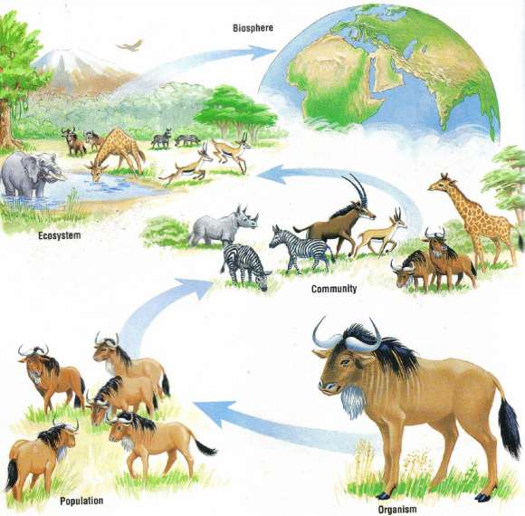

Slide 23
References
Urry, L. A., Cain, M. L. 1., Wasserman, S. A., Minorsky, P. V., Reece, J. B., & Campbell, N. A. (2017). Campbell biology. Eleventh edition. New York, NY, Pearson Education, Inc.
Mader, Sylvia S. and Michael Windelspecht. 2022. Biology. New York, NY: McGraw-Hill Education.

